Slide 1
Public Image

Slide 2
AWARENESS OF ROTARY
Have you heard of an organization called Rotary?
Source: 15 Country Omnibus Research, Leger (Dec 2022)

Slide 3
UNDERSTANDING OF ROTARY
How familiar are you with the work that Rotary does?
73%
52%
57%
54%
41%
26%
20%
24%
18%
18%
18%
13%
Source: 15 Country Omnibus Research, Leger (Dec 2022)

Slide 4
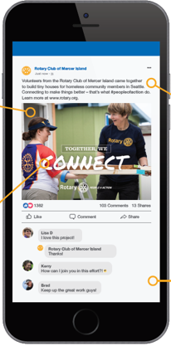
Objective:
Enhancing Rotary’s public image relies on our 1.4 million members
sharing their stories with the public.
Increase public awareness of Rotary – our impact, our benefits, and our relevance

Slide 5
Benefits of a strong public image
Engagement
Members and participants
Partners and donors
Relevance
Advocacy and impact

Slide 6
5 ACTIONS TO GET STARTED

Slide 7
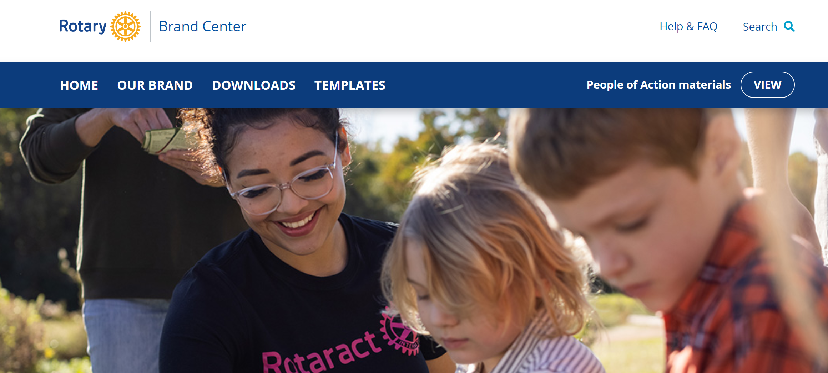
Action #1: USE THE BRAND CENTER
Notes:
Tip 1 is to have your club members familiarize themselves with Rotary’s brand portal, Brand Center (available at brandcenter.rotary.org or rotary.org/brandcenter). It is not password protected anymore! Use Brand Center instead of Googling logos and images or recreating a logo using an alternative design tool. Make sure any friends, designers, or members use the Brand Center for guidelines and materials.
You can also access Brand Center from My Rotary through the Manage pull-down tab. Brand Center is the one-stop shop where you can find materials to bring your club’s public image to life through a consistent message and Rotary look and feel.
Brand Center has a variety of content, including:
Guidelines
Logos
Templates and other customizable materials
Flyers and brochures
And press releases, ads, and videos
If you need a topic or speaker for your club meetings, Share the Rotary videos on Brand Center with your members.
If you are not familiar with Brand Center, I recommend that you access it and explore it to familiarize yourself with all of its materials. You’ll be amazed at what you can do.

Slide 8
Action #1: USE THE BRAND CENTER
https://brandcenter.rotary.org/en-us/

Slide 9
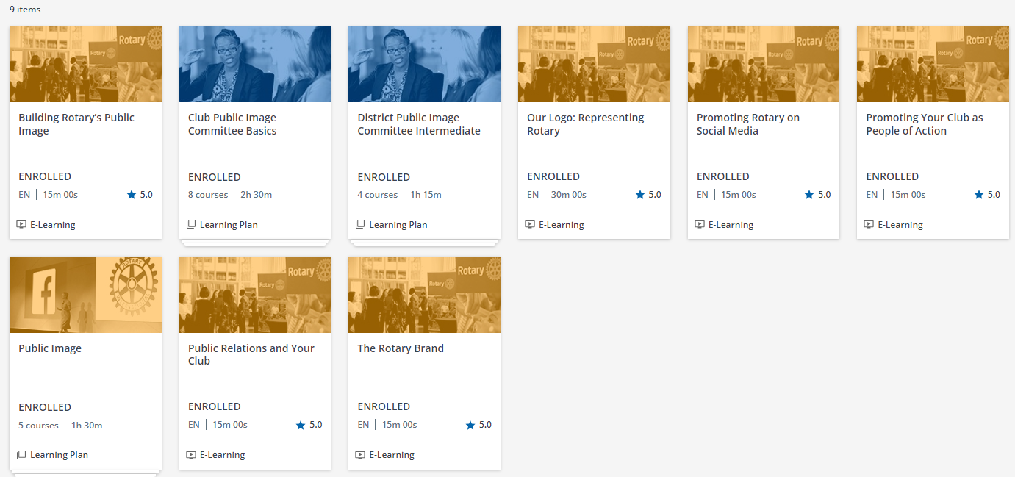
Action #2: VISIT THE LEARNING CENTER

Slide 10
ACTION 3: USE CORRECT LOGOS
10

Slide 11
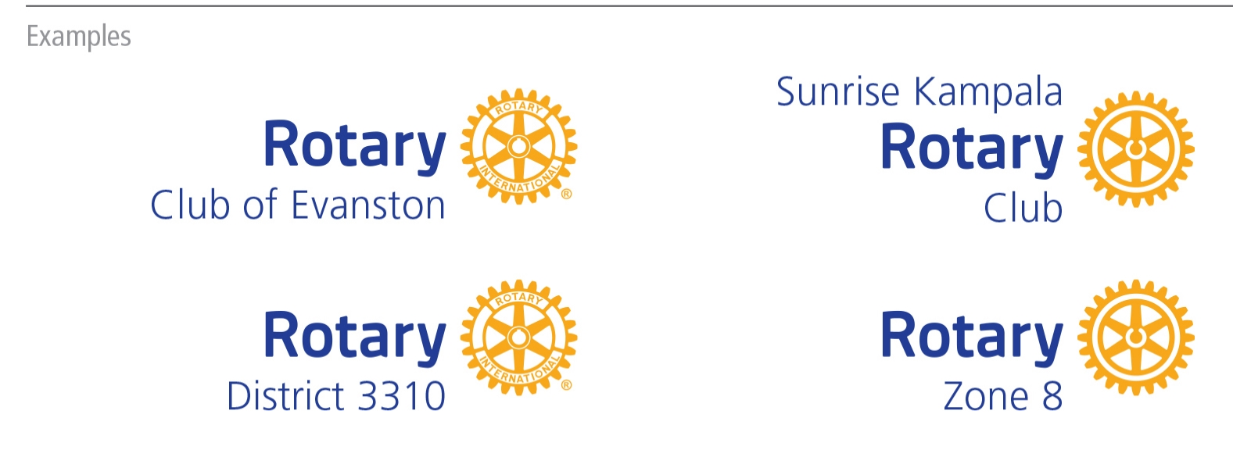
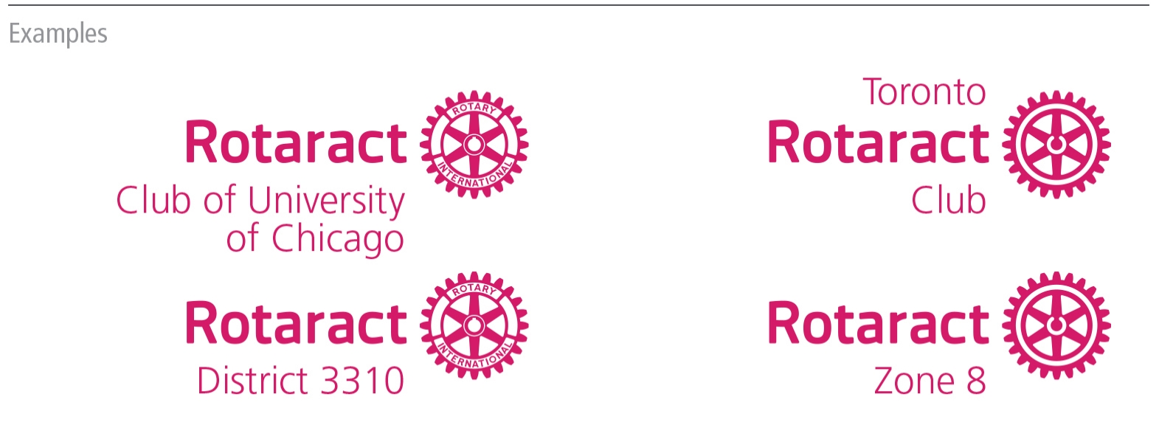
ACTION #3: USE CORRECT LOGOS

Slide 12
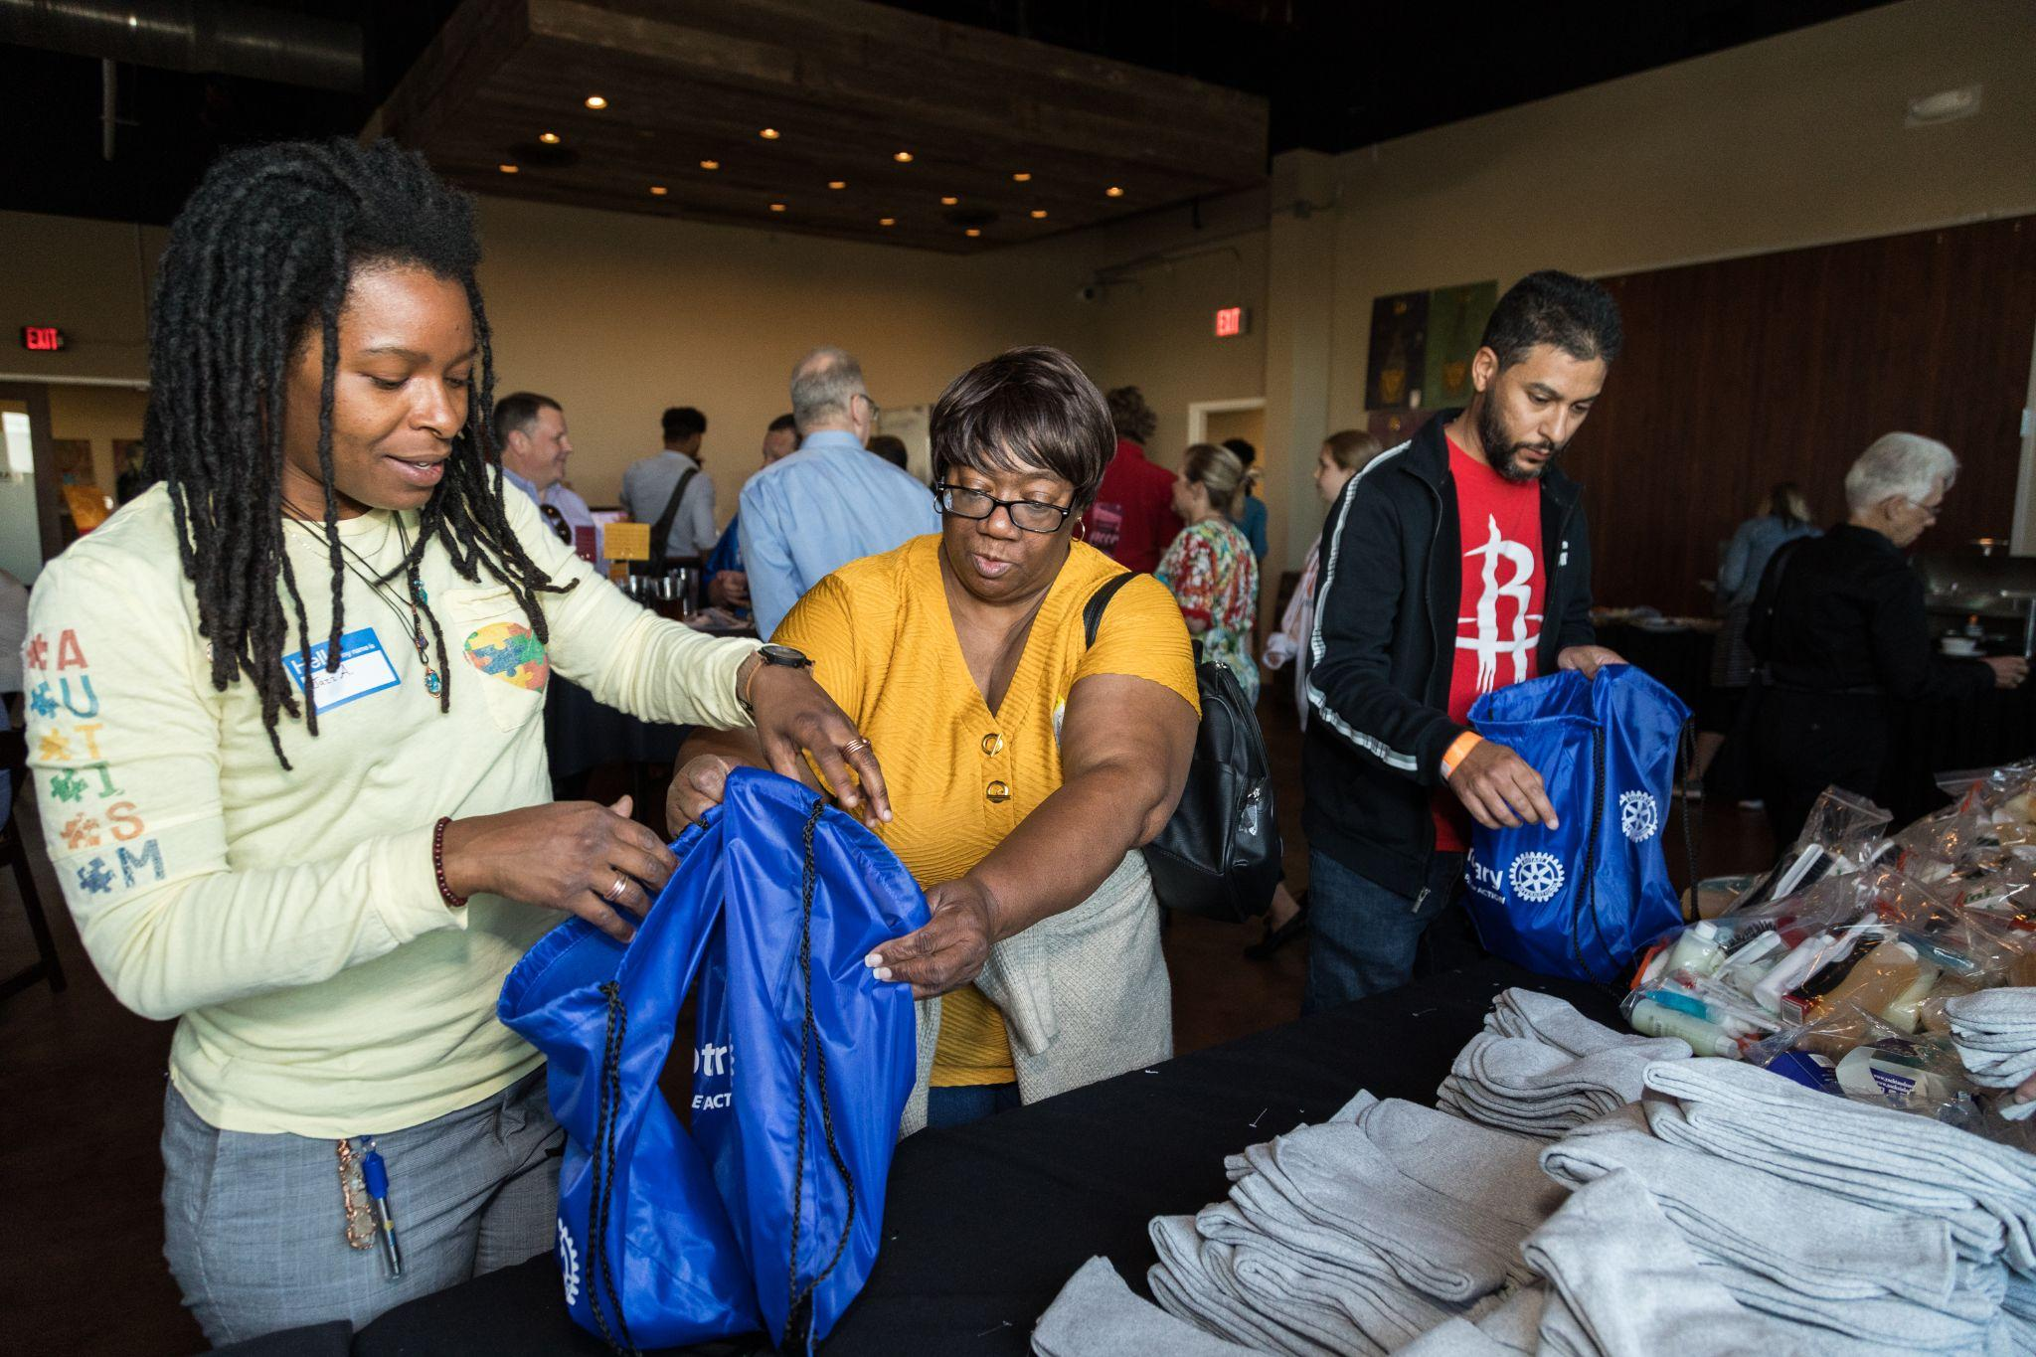
ACTION #4: SHARE YOUR IMPACT AS

Slide 13
People of action
More than just messaging
Portrays Rotary members as people who address community needs
Narrows the gap between awareness and understanding
Allows others to imagine themselves as part of Rotary

Slide 14
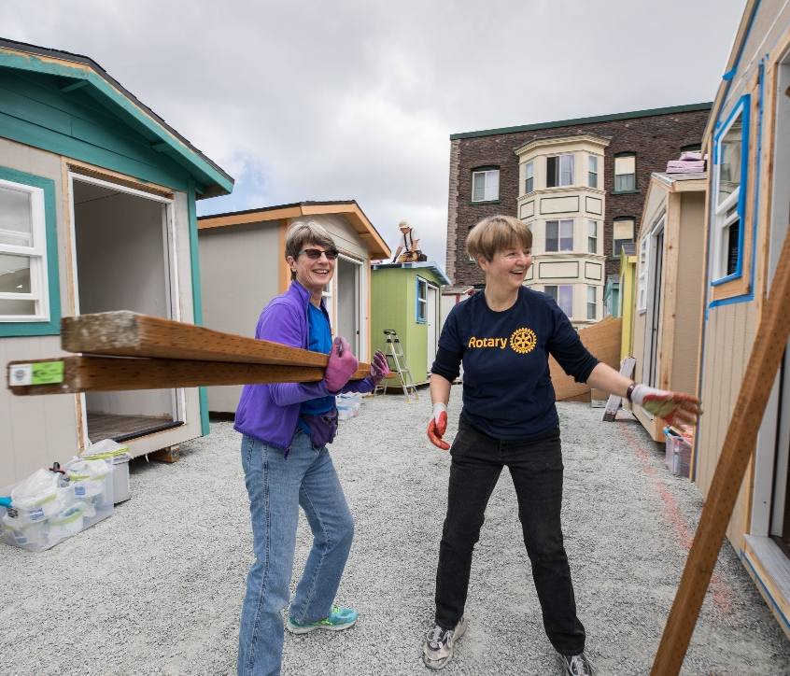
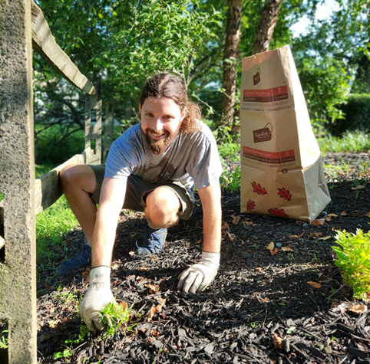
Telling Your Club’s Story
What were we trying to accomplish?
Who is our audience?
How we took action?
Impact/Support to the claim?
Call to Action for the viewer/reader!
Notes:
By using a People of Action framework we can represent our brand & show the impact we create in our communities & around the world

Slide 16
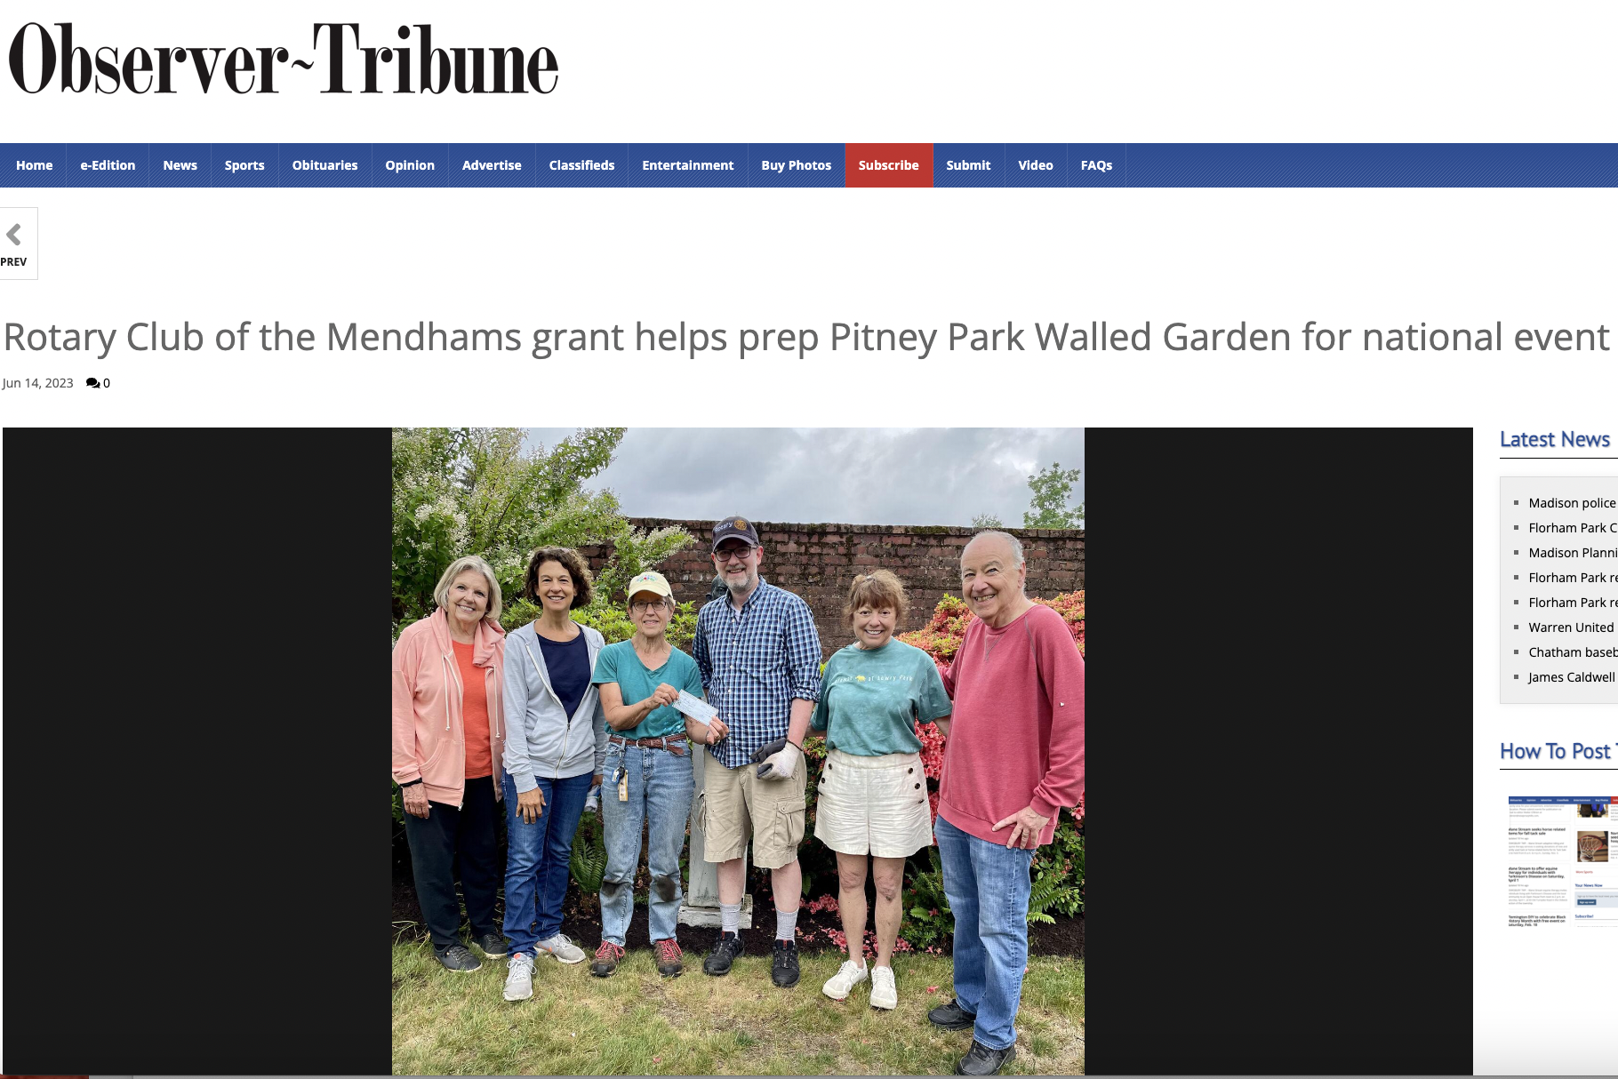
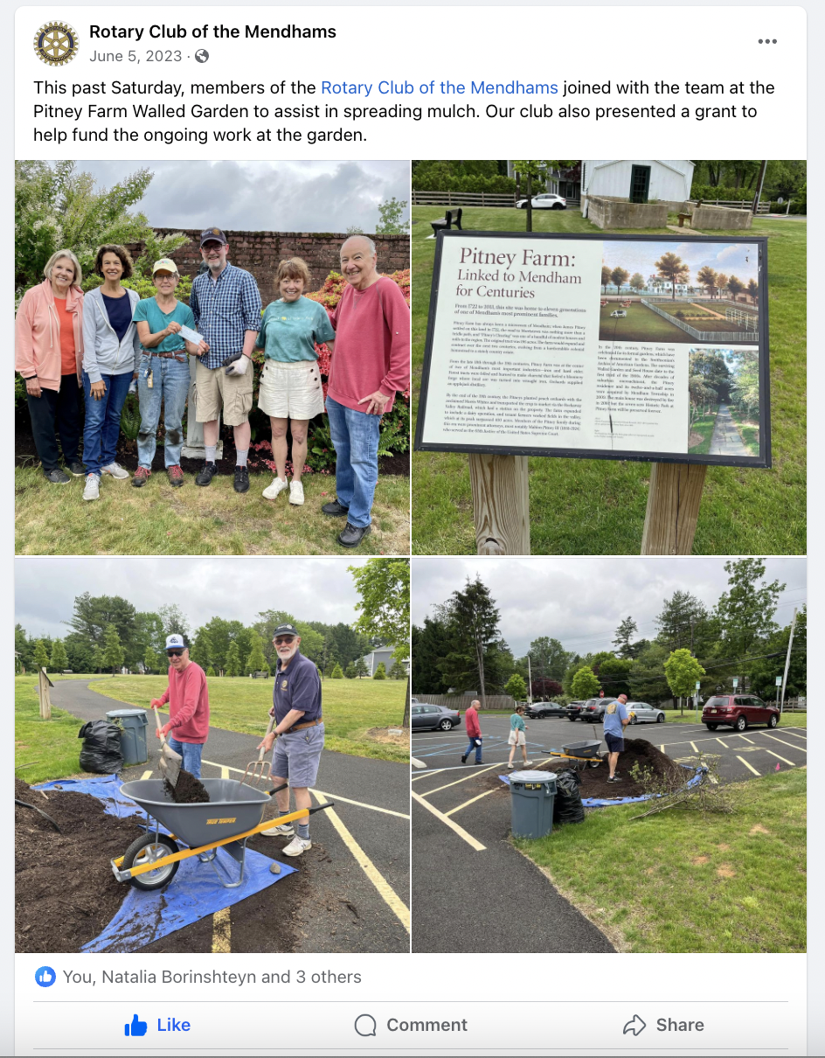
District public image chair amalia’S Story
Together, We Transform!
As People of Action, we immersed ourselves in the revitalization of a cherished historic Walled Garden. Our contribution of $1,000 served as the initial seed to purchase mulch and new plants, fostering the garden's growth. Together, we dedicated a morning to volunteerism, nurturing the garden with our own hands.
Our impact extended beyond the physical realm as the Walled Garden now proudly showcases a permanent sign acknowledging The Rotary Club of the Mendhams’ support. Through this endeavor, we exemplified the essence of Rotary: community engagement, public recognition, and the spirit of service.
By actively participating in this project, we not only supported our community but also showcased the core values of our club. We didn't just talk the talk; we walked the walk, proving that Rotary is more than a club—it's a force for meaningful change.
Come Join Us!

Slide 17
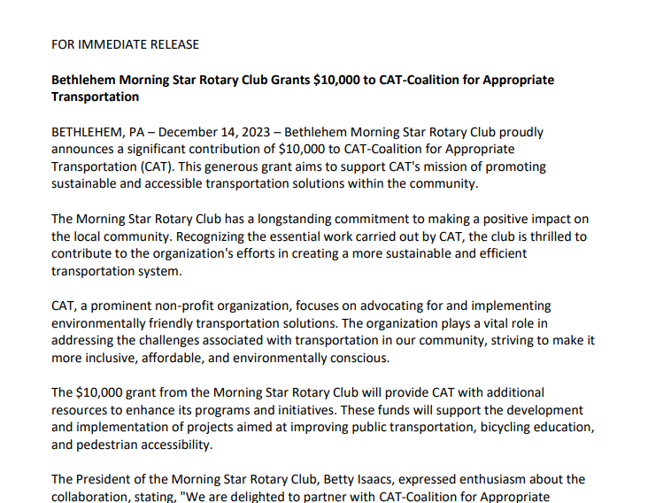
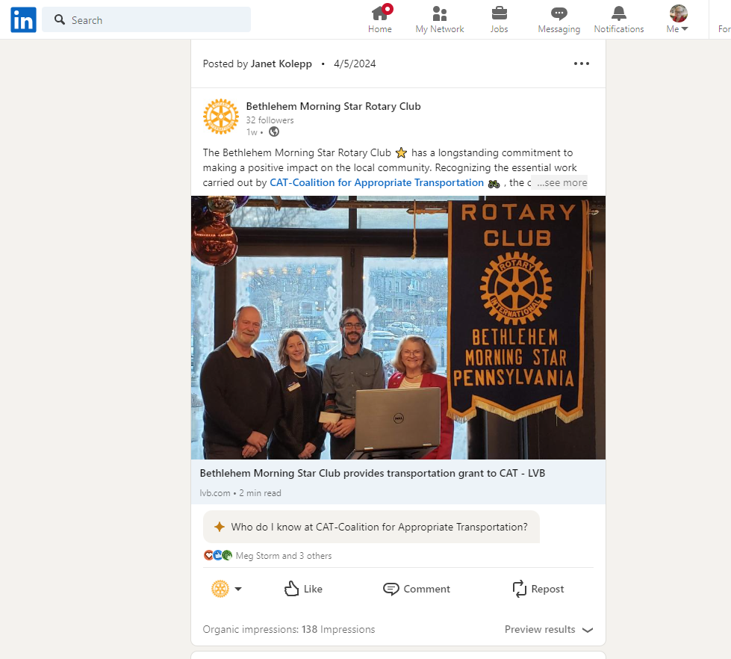
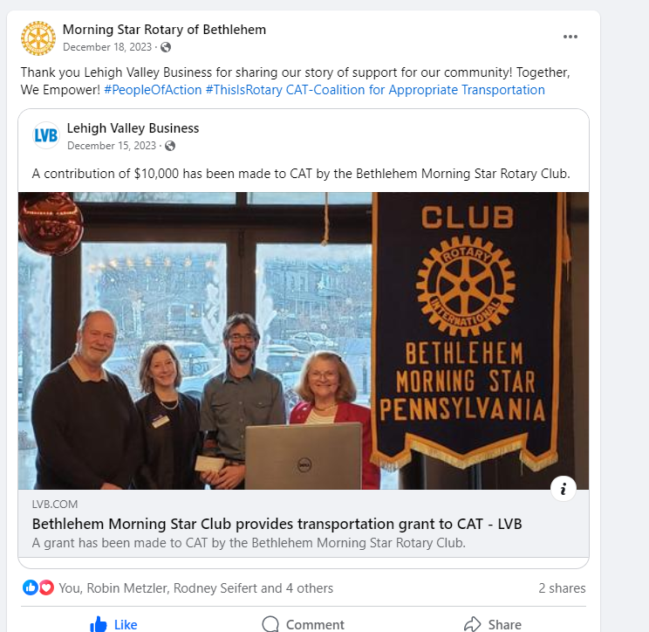
ACTION #5: SHARE YOUR EXPERIENCE IN MULTIPLE MEDIA OULETS

Slide 18
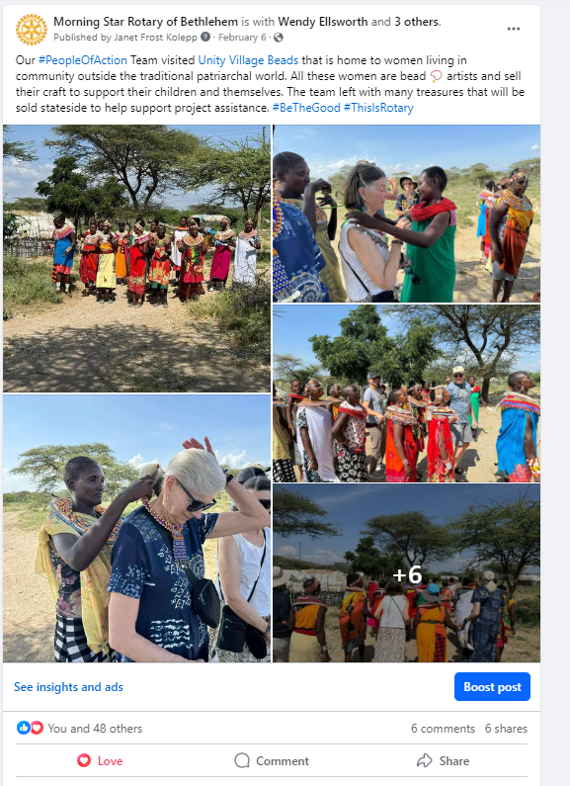
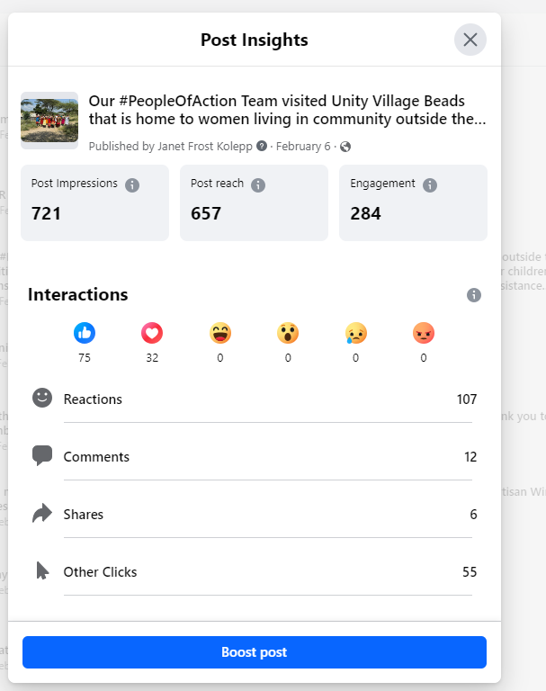

Slide 19
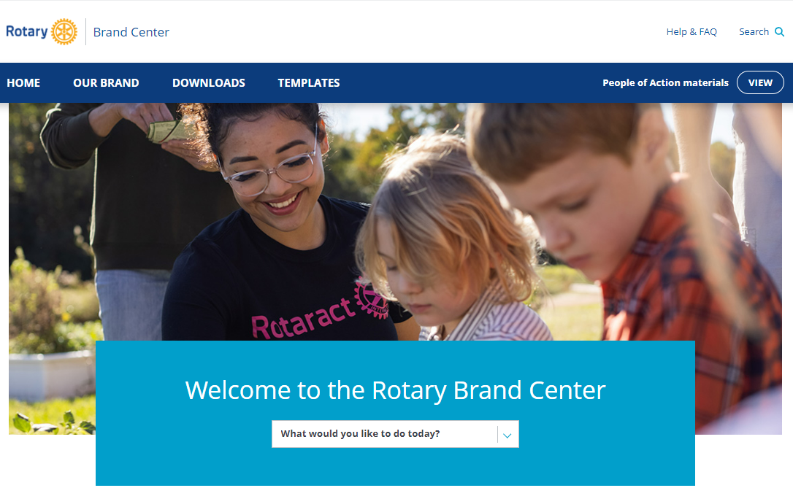
WHAT you can do today
Use the Brand Center resources
Always use the correct branding
Showcase your club as vibrant & your members as People of Action
Invite public engagement
Use content from Rotary International
Appoint a public image chair
Show people outside Rotary that we are people of action.

Slide 20
Public Image
is every Rotary member’s
responsibility!!

