Slide 1
RISK MANAGEMENT
District 7475
May 6, 2024

Slide 2
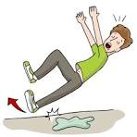
Four Ways to
Manage Risk

Slide 3
Insurance

Slide 4
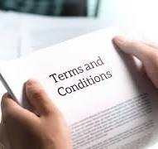
Pass Risk To Others
(Contract terms/Indemnity/waivers)

Slide 5
Loss Prevention Strategies

Slide 6
Common Sense

Slide 7
Insurance
Pass to others
(Contract terms/Indemnity)
Loss Prevention Strategies
Common Sense

Slide 8
Insurance Policy
The U.S. Rotary Club and District Liability Insurance Program (“Program”) provides general liability insurance coverage to all active U.S. Rotary and Rotaract clubs and districts for their liability arising out of bodily injury and property damage to a third party.

Slide 9
Insurance Policy
LIMITS
$2,000,000 Per occurrence, primary insurance
$2,000,000 Non-owned and rented auto liability (excess of personal)
$2,000,000 Sexual misconduct liability
$5,000,000 Per occurrence, excess insurance

Slide 10
Insurance Policy
COVERAGES
General Liability
Liquor Liability
Medical Payments
Non-owned/Rented Auto
Sexual Misconduct

Slide 11
Insurance Policy
Online Resources:
U.S. Rotary Insurance Portal: rotary.hylant.com
* Summary of Coverages
* Loss Prevention Strategies

Slide 12
Insurance Policy
Construction projects Information. Where the value of materials (donated or purchased) is $50,000 or more, your Club must purchase a primary liability insurance policy with minimum limits of $1M per occurrence up to the project cost including products liability and completed operations for five years. The Program will provide excess insurance over a club’s primary insurance policy in the case of a catastrophic loss.

Slide 13
Insurance Policy
Fireworks Information. When your club signs an agreement with a pyrotechnic firm, your club must purchase a primary general liability policy with a minimum limit of $2M per occurrence/aggregate. In addition, your club must require the pyrotechnic firm to carry a limit of $5M per occurrence/aggregate. The Program will provide excess insurance over a club’s primary insurance policy in the case of a catastrophic loss.

Slide 14
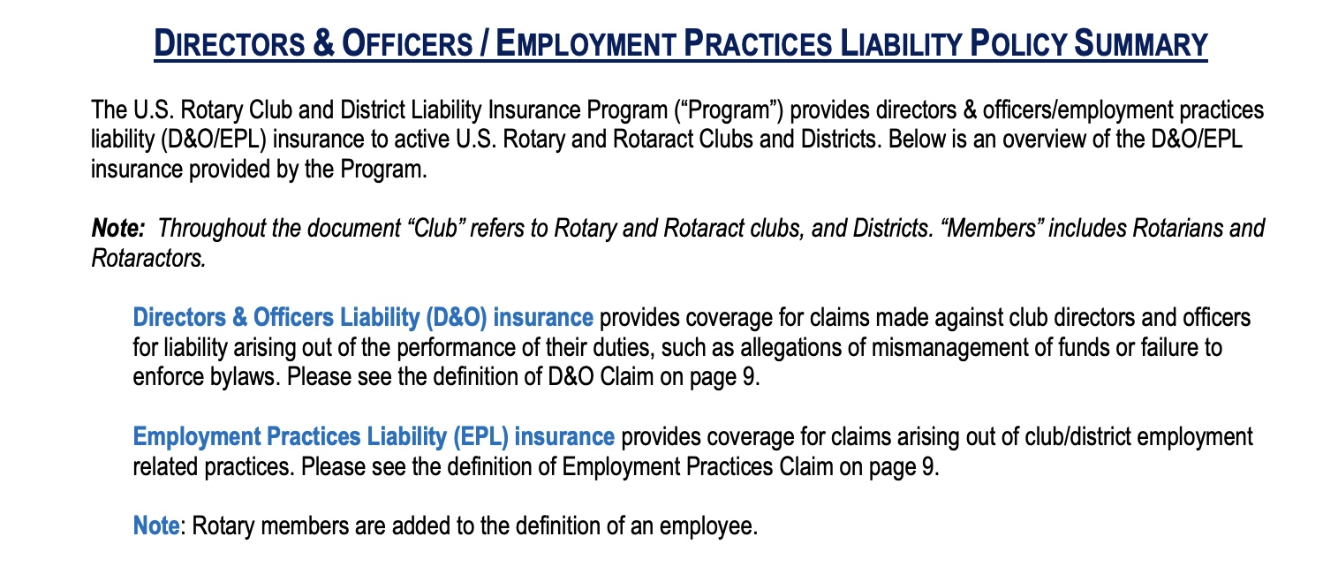
Insurance Policy

Slide 15
Insurance Policy
INSURANCE QUESTIONS:Hylant Insurance Broker
Phone: 419-259-2710
Email: rotary@hylant.com
U.S. Rotary Insurance Portal: rotary.hylant.com

Slide 16
Pass to others
(Contract terms/Indemnity/Waiver)
Use a written agreement
Indemnity language
Specific activities allowed/prohibited
Insurance certificates

Slide 17
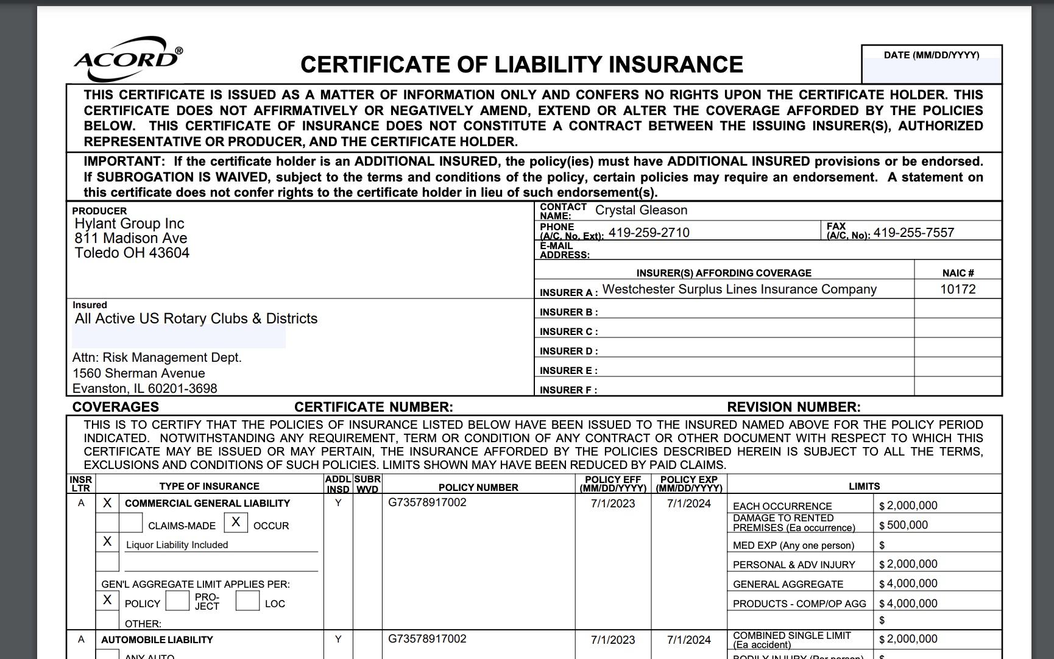

Slide 18
Insurance Policy
Insurance Certificates
Website: rotary.hylant.com
USER: rotary@hylant.com
PW: Rotary1905
Phone: (419) 259-2710

Slide 19
Loss Prevention Strategies
See Online PDF resource
at rotary.hylant.com
Loss Prevention Strategies

Slide 20
Alcohol Liability
Follow state laws
Be sure the venue allows
Train servers
If a third-party vendor, get a certificate
Avoid open bars
Control the area, ID, underage, intoxicated individuals

Slide 21
Youth Activities
Insurance includes coverage for Certified Youth Exchange organizations, RYLA, and Interact, activities, as well as other youth programs and activities

Slide 22
SEXUAL MISCONDUCT LIABILITY COVERAGE
The Policy provides separate sexual misconduct liability coverage on a claims-made basis. Sexual misconduct means sexual molestation, including but not limited to, any unwanted sexual involvement, sexual conduct, or sexual contact. Upon request, Certificates of Insurance will reflect a separate coverage limit for sexual misconduct liability coverage.

Slide 23
ROTARY INTERNATIONAL STATEMENT OF CONDUCT FOR WORKING WITH YOUTH
Rotary International strives to create and maintain a safe environment for all youth who participate in Rotary activities. To the best of their ability, Rotarians, Rotarians’ spouses and partners, and other volunteers must safeguard the children and young people with whom they come into contact and protect them from physical, sexual, and psychological abuse.

Slide 24
Youth Activities
Use common sense
Minors should never be alone or alone with just one other person (adult or minors)
Consider having a safety committee
Always have an eye toward safeguarding minors

Slide 25
Motor Vehicles
Rotary policy only provides excess coverage
Rotarians and volunteers using their personal autos in the course and scope of insured activities must carry appropriate auto liability insurance limits.
The auto owner’s auto liability would provide primary insurance coverage should an accident occur. The Program does not provide any insurance coverage to the auto owner.
At a parade or car show, participants should sign a waiver indicating their understanding that there is no coverage under the Program for damage to their vehicles; the vehicle owner’s personal or commercial automobile insurance is primary. No coverage is provided for damage to the participant’s vehicle.

Slide 26
Construction Projects
Club to purchase separate liability insurance/provide certificate to RI
Hire qualified professionals
Use a written contract
Get certificates of insurance
Train volunteers
Use waivers

Slide 27
Waivers
A waiver and release form can be used to reduce the likelihood of a claim or lawsuit being brought against your club/district. It can also increase communication and understanding between your club and participants/volunteers of the activities you organize or sponsor. A waiver and release form (also known as a liability release or liability waiver) is a promise not to pursue legal action for injury or damage.

Slide 28
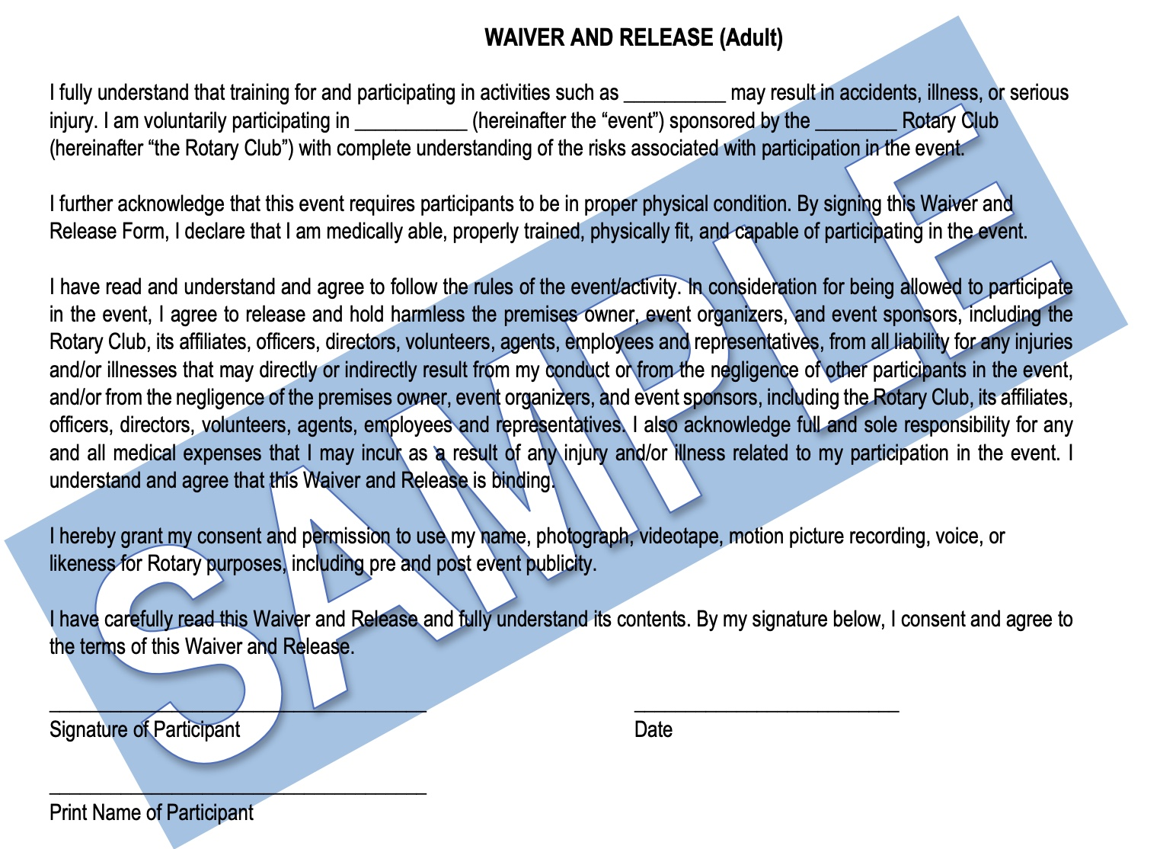

Slide 29
Common Sense

