Slide 1



Called to higher service

Slide 2
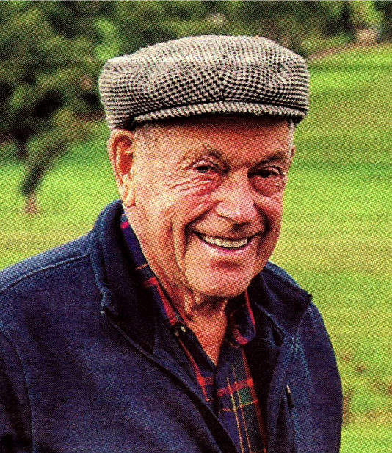
PP JOHN KINRADE 1 MAY 1933 – 15 MAY 2023 ROTARY CLUB OF DROUIN

Slide 3
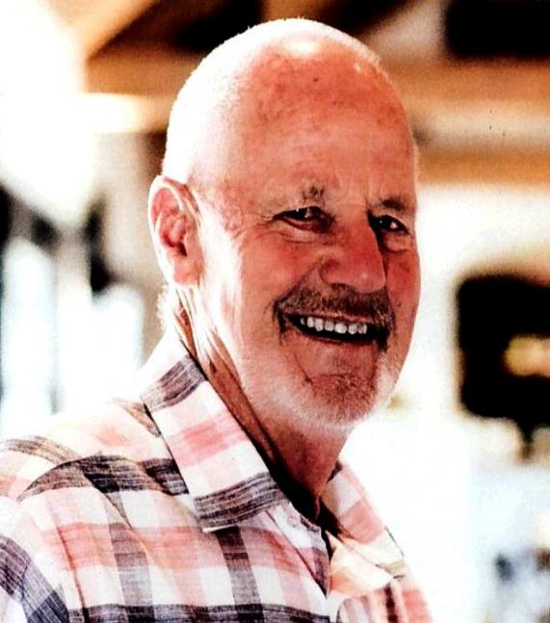
PP MAXWELL HINE 25 AUGUST 1935 – 6 NOVEMBER 2023 ROTARY CLUB OF DROUIN

Slide 4
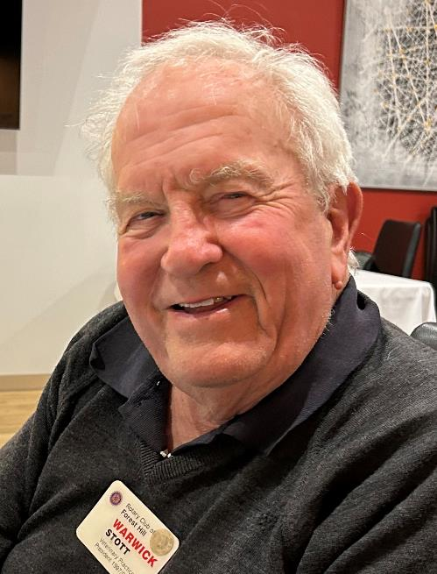
pp WARWICK STOTT 30 JANUARY 1938 -12 MARCH 2024 ROTARY CLUB OF forest hill

Slide 5
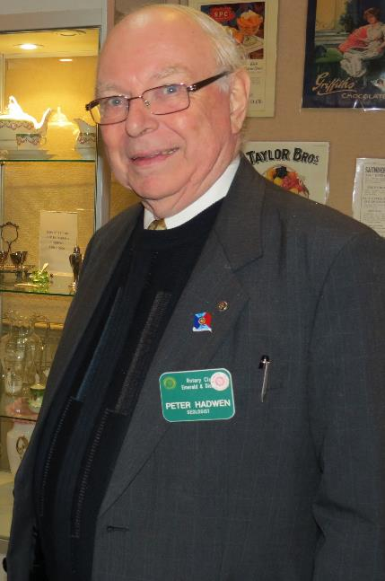
DR PETER HADWEN 30 JULY 1936 – 26 MARCH 2024 ROTARY CLUB OF EMERALD

Slide 6
JOHN MORGAN 25 APRIL 2024 ROTARY CLUB OF WARRAGUL

Slide 7
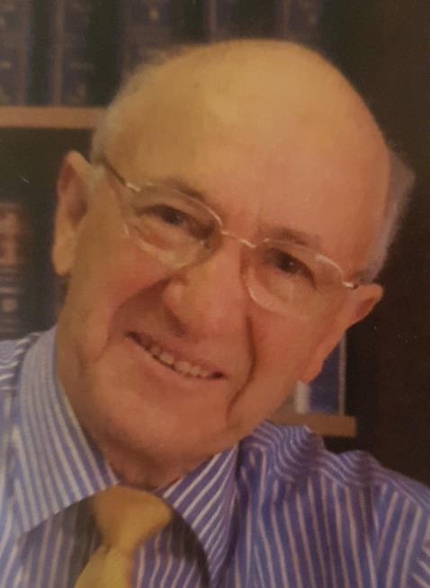
PP FRANK BORCHARD 26 JUNE 1935 – 26 APRIL 2024 ROTARY CLUB OF NOBLE PARK DINGLEY

Slide 8
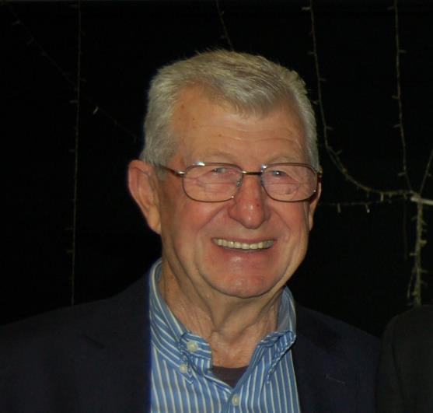
PP GARRY COOPER 26 APRIL 1945 – 28 APRIL 2024 ROTARY CLUB OF BERWICK

Slide 9
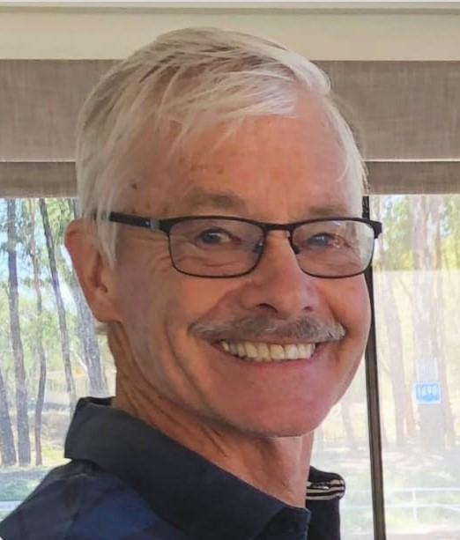
PP Richard jones 4 may 2024 ROTARY CLUB OF Beaumaris

Slide 10

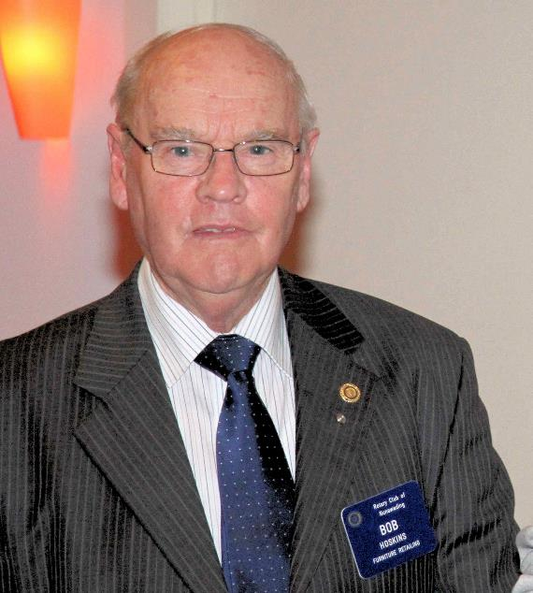
PP ROBERT (BOB) HOSKINS OAM 8 MAY 2024 ROTARY CLUB OF NUNAWADING

Slide 11
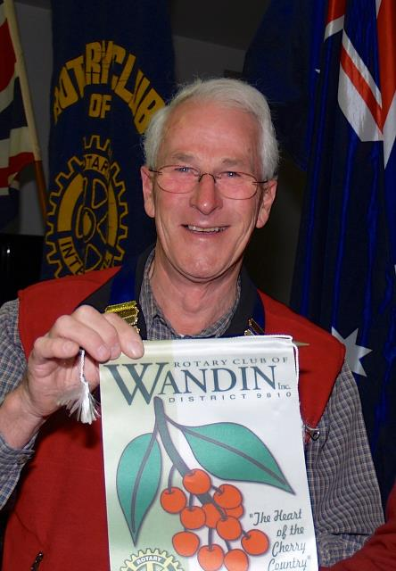
PP PETER MANDERS 3 JUNE 2024 ROTARY CLUB OF WANDIN

Slide 12
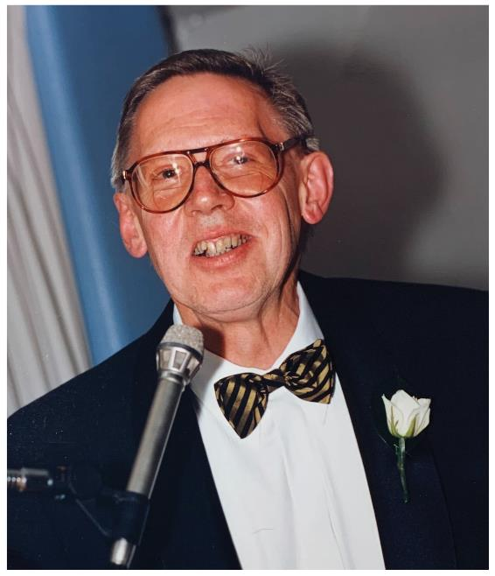
PP Victor Sullivan 17 JANUARY 1941 - 7 June 2024 ROTARY CLUB OF MORNINGTON

Slide 13
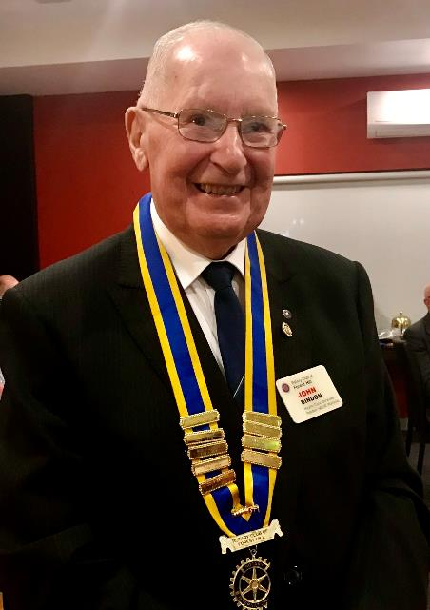
pp JOHN binden 9 MARCH 1937 – 20 JUNE 2024 ROTARY CLUB OF forest hill

Slide 14
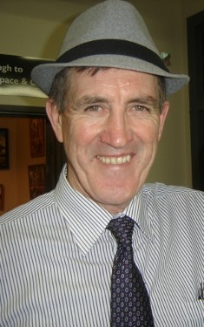
RAY DONOVAN 3 JULY 2024 ROTARY CLUB OF LILYDALE

Slide 15
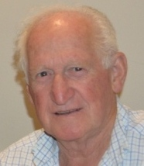
PP ROBERT (BOB) McKenzie 2 FEBRUARY 1939 – 8 JULY 2024 ROTARY CLUB OF WARRANDYTE DONVALE

Slide 16
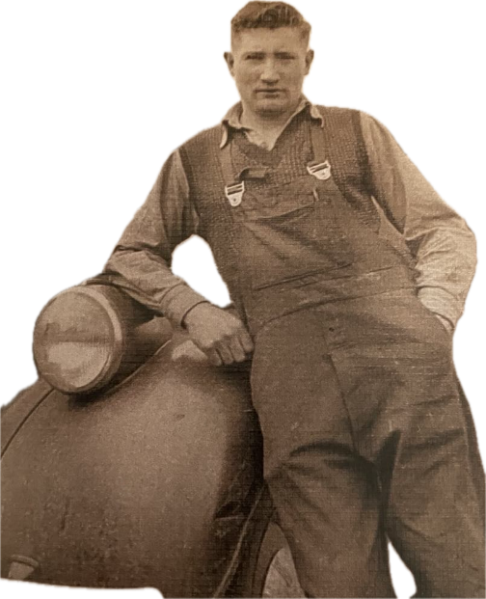
RON ANSON 24 September 1929 – 10 AUGUST 2024 ROTARY CLUB OF GREATER DANDENONG & ENDEAVOUR HILLS

Slide 17
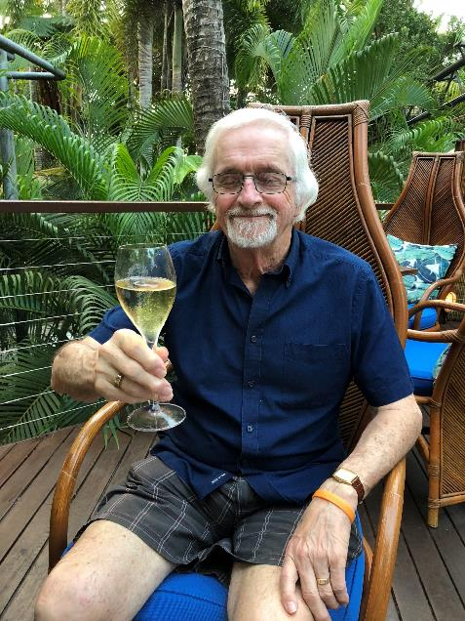
JIM GILCHRIST 11 AUGUST 2024 ROTARY CLUB OF BORONIA

Slide 18
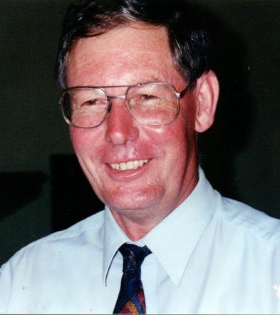
PDG IAN PICKERING 27 JANUARY 1944 – 13 AUGUST 2024 ROTARY CLUB OF NARRE WARREN

Slide 19
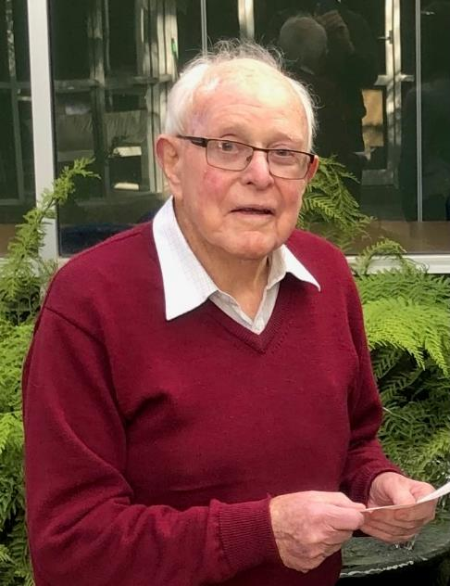
Pp KEITH BROWNBILL 25 AUGUST 2024 ROTARY CLUB OF MORWELL

Slide 20
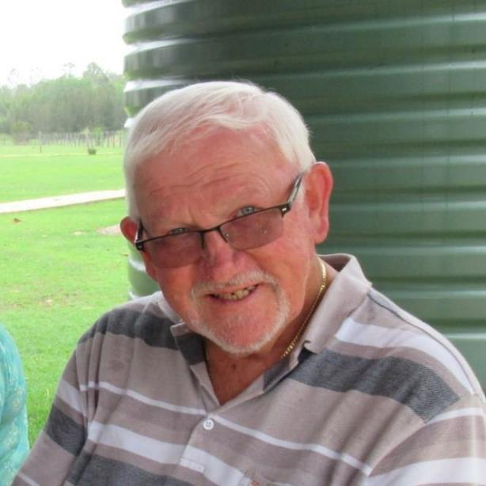
MERVYN McCONCHIE 27 OCTOBER 1941 – 26 AUGUST 2024 ROTARY CLUB OF MORWELL

Slide 21
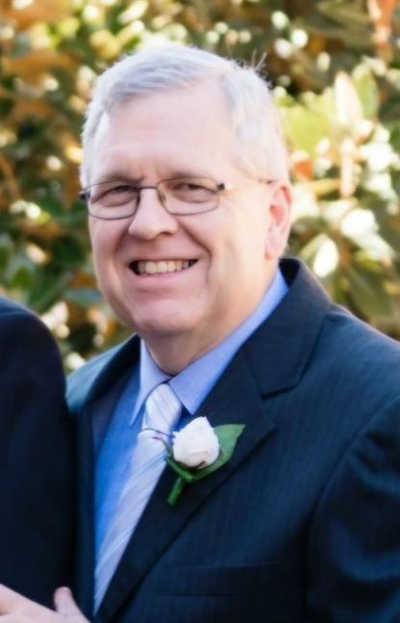
ADRIAN CLEP 9 SEPTEMBER 2024 ROTARY CLUB OF ROWVILLE LYSTERFIELD

Slide 22
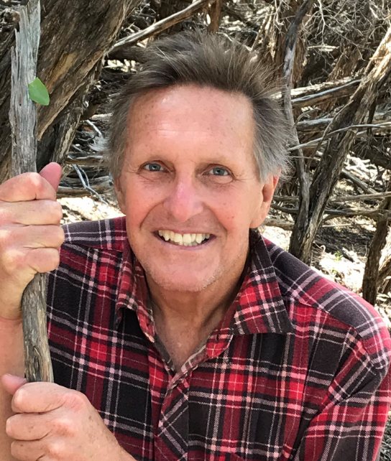
RICHARD PARKER 1 OCTOBER 2023 ROTARY CLUB OF FRANKSTON

Slide 23
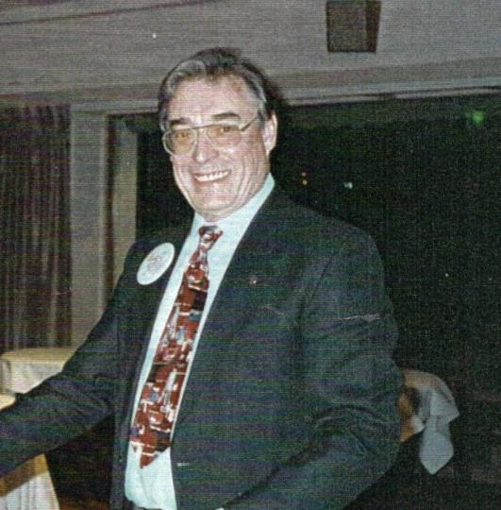
ROBERT (BOB) TYE 6 OCTOBER 2024 ROTARY CLUB OF MORDIALLOC MENTONE

Slide 24
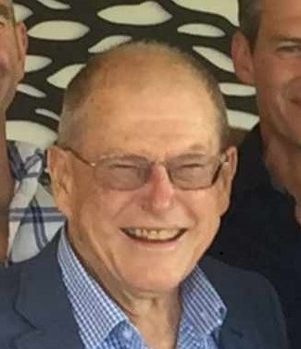
PP IAN GRAHAM 4 MAY 1947 – 28 OCTOBER 2024 ROTARY CLUB OF MORWELL

Slide 25
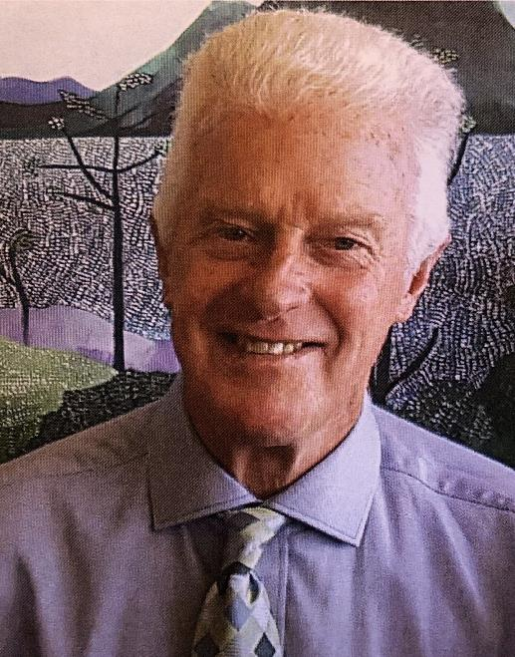
PP DON NICOLL 6 NOVEMBER 2024 ROTARY CLUB OF FOSTER

Slide 26
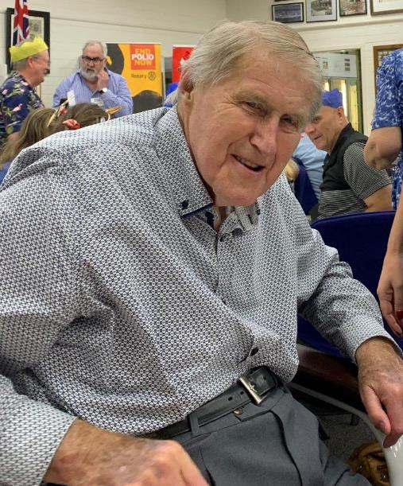
PP GEORGE FARNHAM 12 DECEMBER 1935 – 10 NOVEMBER 2024 ROTARY CLUB OF WARRAGUL

Slide 27
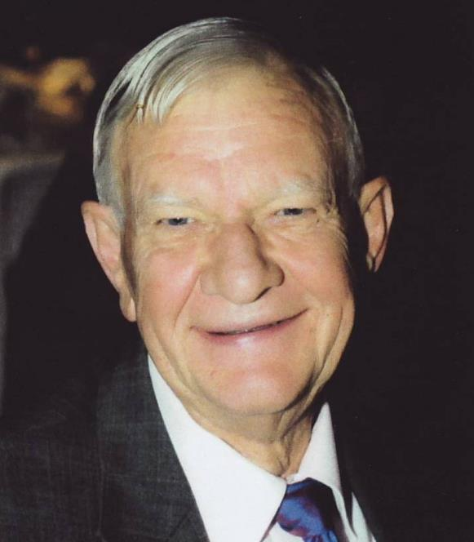
PP ROBERT STEWART 2 JULY 1940 – 27 NOVEMBER 2024 ROTARY CLUB OF DROUIN

Slide 28
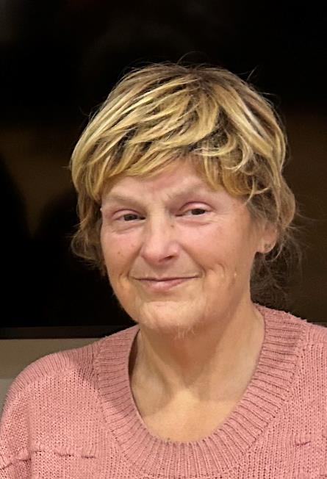
PP SUZANNE BALLARD 5 DECEMBER 2024 ROTARY CLUB OF FOREST HILL

Slide 29
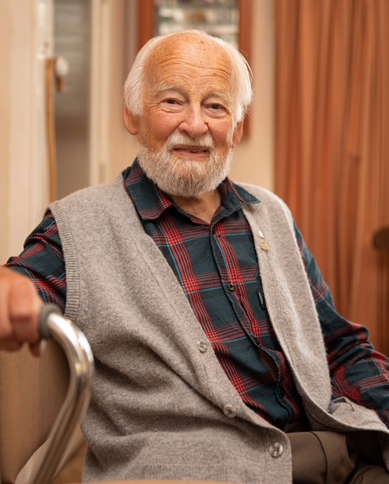
GEOFFREY WEEKS 17 DECEMBER 2024 ROTARY CLUB OF BOX HILL BURWOOD

Slide 30
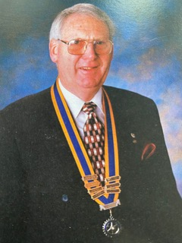
PP RALSTON WOOD 3 JULY 1934 – 30 DECEMBER 2024 ROTARY CLUB OF BOX HILL CENTRAL

Slide 31
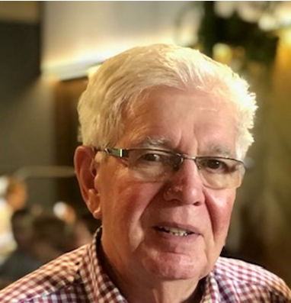
PP ROBERT (BOB) TANNER 1945 - 2024 ROTARY CLUB OF FRANKSTON

Slide 32
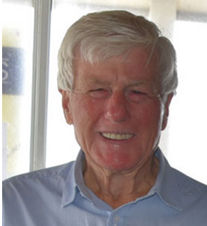
PP Barrie peel 1941 - 2024 ROTARY CLUB OF LAKES ENTRANCE

Slide 33
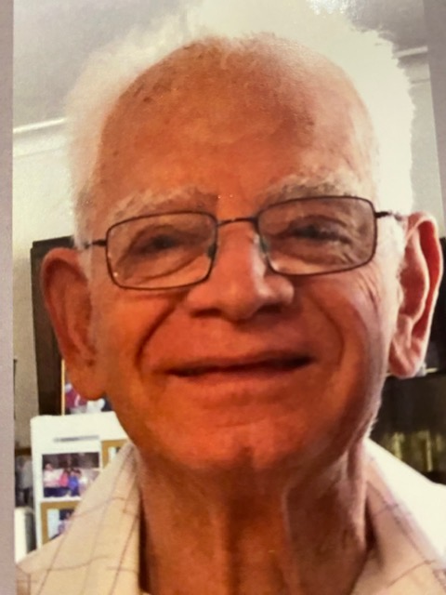
PETER GIASOUMI 8 September 1938 - 13 January 2025 ROTARY CLUB OF MANNINGHAM CITY

Slide 34
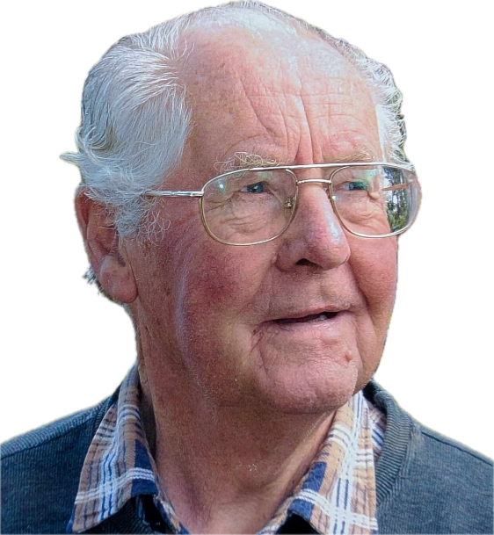
JAMES BUCHANAN BLAIR ROTARY CLUB OF MAROONDAH

Slide 35
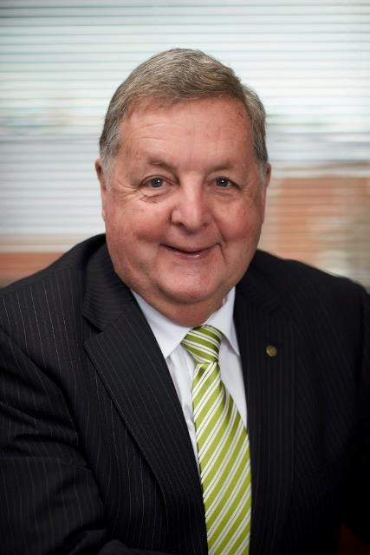
PP JOHN ANDERSON ROTARY CLUB OF MAROONDAH

Slide 36
Called to higher service DISTRICT 9815 2025 This presentation will be available on the conference WEB site 31/03/2025

