Slide 1
SOCIAL MEDIA: WHAT CAN WE DO?
Website and Social Media
Jenny Kendrick, Midland Rotary Club, jakendrick@outlook.com
May 20, 2016

Slide 2
WEBSITES

Slide 3
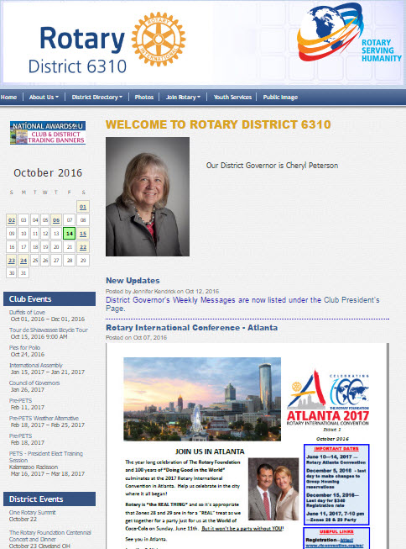
DISTRICT WEBSITE
I have updated this website to . . .
Streamline
Remove duplication
Add some club resources
Add District Club information and events

Slide 4
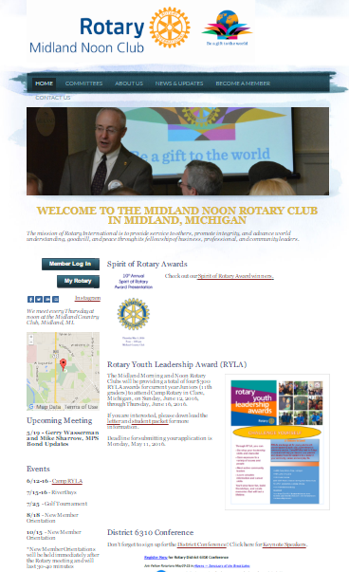
CLUB WEBSITES
This is what Midland Rotary include:
Lots of photos
Club information and meeting days/times
Upcoming speakers
Upcoming events
Links to social media accounts
Links to Rotary International and District websites
International and District news
Club newsletters
Local news involving Rotary
Birthdays and anniversaries
Discussion

Slide 5
NEWSLETTERS

Slide 6
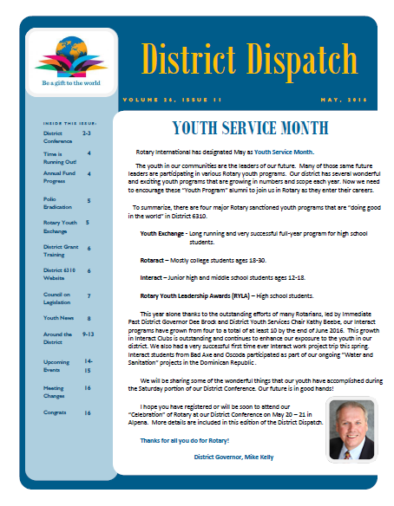
DISTRICT NEWSLETTER
Wonderful Resource
International News
District News
Club News and Upcoming Events
Polio News
Youth News
Club Anniversaries
Please submit your Club information

Slide 7
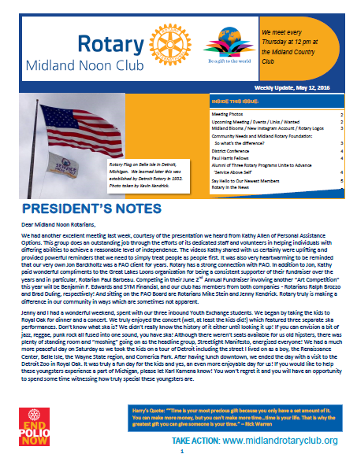
CLUB NEWSLETTER
This is what Midland Rotary includes
Club meeting details
President’s Notes
Meeting photos
Upcoming meetings and events
Links to social media accounts
Informational articles
District news
International news
Paul Harris Fellows
New members, photos and info
Shorts on Local, District, and International news
Discussion

Slide 8
FACEBOOK

Slide 9
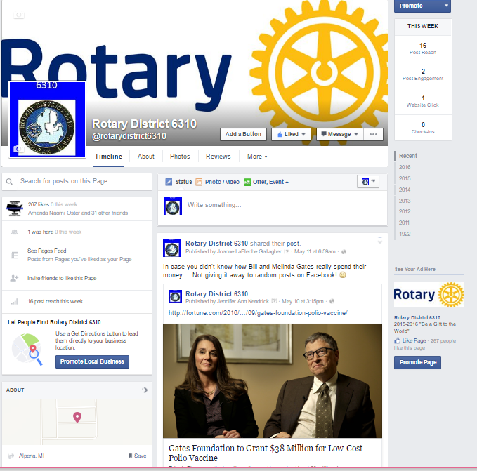
DISTRICT FACEBOOK PAGE
What to Post
Share posts from Rotary International page
District news
Videos
Polio Plus news
Rotary Peace Center news
RYE news
Rotaract news
Interact news
Discussion

Slide 10
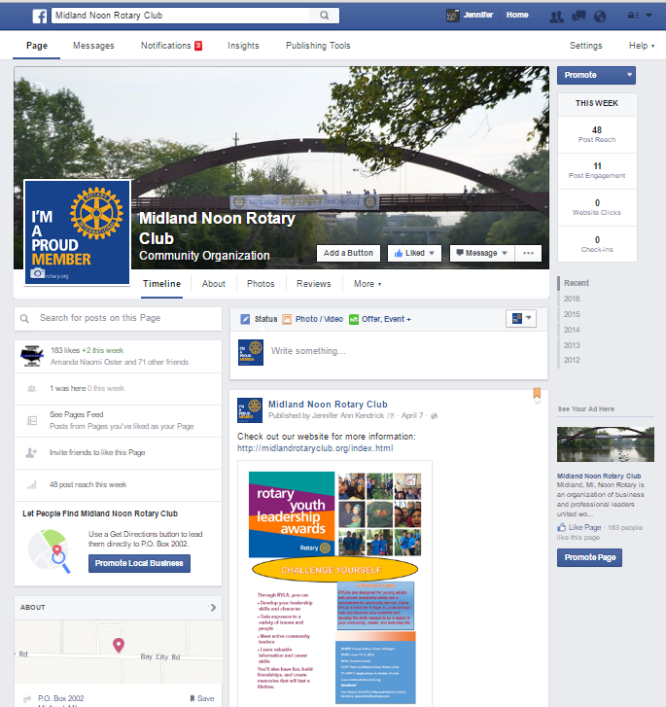
CLUB FACEBOOK PAGE
Midland Rotary posts
Local Rotary news
Meeting photos and information
Upcoming events
Shares posts from RI, District, etc.
Share posts regarding city happenings, weather, businesses your Rotarians participate in
Discussion

Slide 11
FACEBOOK PAGE DIMENSIONS
Facebook Cover Photo
Dimensions are 399 x 150
Loads faster as a JPG file that is 851 315 and less than 180 kilobytes
Facebook Profile
Dimensions are 160 x 160
Loads best at 180 x 180
Located 16 pixels from leftand 176 pixels from top of Cover Photo

Slide 12
TWITTER, INSTAGRAM, PINTEREST?

Slide 13
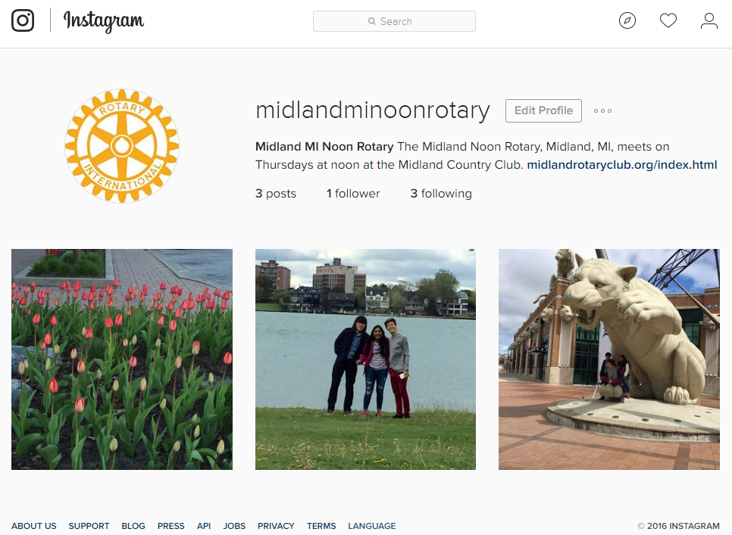
CLUB TWITTER, INSTAGRAM, PINTEREST PAGE
Twitter Header Photo
1500 x 500 pixels
Twitter Profile Photo
1500 x 500 pixels
Photos can be JPG, GIF, or PNG
Instagram Photo
Square: 1080 x 1080 pixels
GIF, or PNG

Slide 14
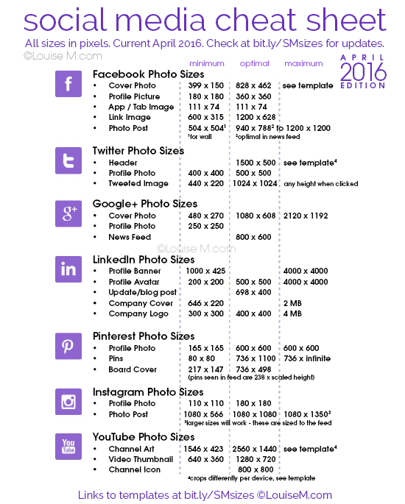
SOCIAL MEDIA CHEAT SHEET

Slide 15
RESOURCES

Slide 16
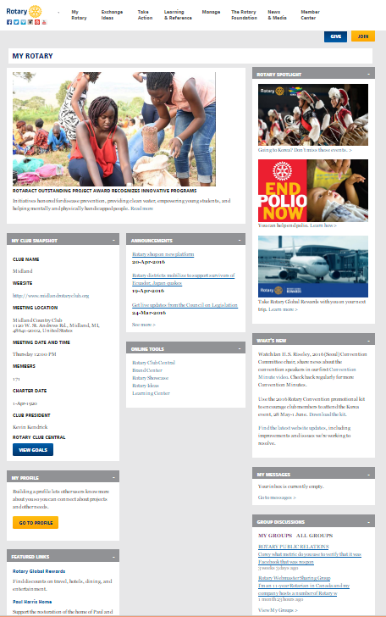
“MY ROTARY”
Offers Numerous Resources for
Websites, Social Media, Newsletters
Stories
Story Spotlights
Announcements
What’s New
Brand Central

Slide 17
SIGNING UP FOR “MY ROTARY”
Go to www.rotary.org and click on “My Rotary”.
Click on “Sign In/Register”.
If you are a first time user, click on “Create an Account”.
Fill in the account registration information (your name and e-mail) and click “Continue”.
You will be informed that an e-mail has been sent to you.
Check your e-mail for the address you provided in the step above. You will receive this message. “Click on the blue link (Activiate my account) to finalize the process.”
Fill in all the mandatory information and click on “Create Account”.
Click on “Continue”.
Congratulations! You have created your “My Rotary” account.

Slide 18
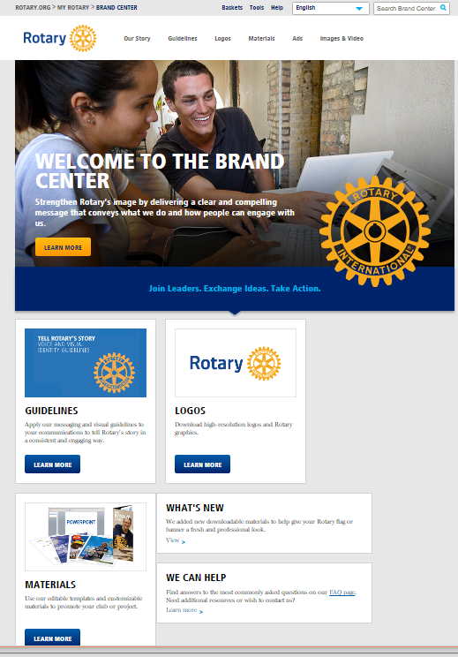
BRAND CENTER
Offers
Logos
Foundation Logos
President’s Theme Logos
Club Logos
Program Logos
Photos to display for each area of service
Templates for letters, newsletters, PowerPoint presentations

Slide 19
BRAND CENTRAL

Slide 20
BRAND CENTRAL

Slide 21
MEDIA LINKS - WEBSITES
Rotary International: https://www.rotary.org/myrotary/en
Brand Center: https://brandcenter.rotary.org/en-GB
Official Graphics: http://www.graphics-for-rotarians.org/
My Rotary: https://www.rotary.org/myrotary/en
Rotary Peace Center: http://rotarypeacecenternc.org/
Rotary International YouTube Videos: https://www.youtube.com/user/RotaryInternational
The Rotarian Magazine: https://www.rotary.org/myrotary/en/news-media/magazines/rotarian
District 6310: http://portal.clubrunner.ca/60077/
Central States RYE: http://csrye.org/
End polio: http://www.endpolio.org/

Slide 22
MEDIA LINKS – FACEBOOK
Rotary International: https://www.facebook.com/rotary/?fref=nf
Rotary District 6310: https://www.facebook.com/rotarydistrict6310/?fref=ts
RYE District 6310: https://www.facebook.com/groups/178107885592985/
Rotaract: https://www.facebook.com/rotaractor/?fref=ts
Interact: https://www.facebook.com/interactofficial/?fref=ts
Rotary Resources - Graphics & Images: https://www.facebook.com/groups/1595163847383932/
Rotarians on Social Networks Fellowship: https://www.facebook.com/groups/rosnf/
http://www.facebook.com/rosnf
Rotary International President: https://www.facebook.com/RotaryPresident/?fref=ts
John Hewko, General Secretary/CEO, Rotary International: https://www.facebook.com/JohnHewko/?fref=photo
Evan Burrell, Rotarian: https://www.facebook.com/RotarianEvanBurrell/?fref=nf
Mark Huddleston: https://www.facebook.com/mark.huddleston.980?fref=nf
Being Rotarian: https://www.facebook.com/BeingRotarian?hc_location=ufi
End Polio Now: https://www.facebook.com/EndPolioNow/?fref=nf

