Slide 1



Celebration of Life
Title Page Option

Slide 2
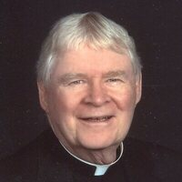
James Doyle
June 14, 1931 – May 24, 2021
41 years of Rotary Service
Club of Downtown Sioux Falls
Title Page Option
Notes:
https://www.georgeboom.com/obituary/msgr-james-doyle

Slide 3
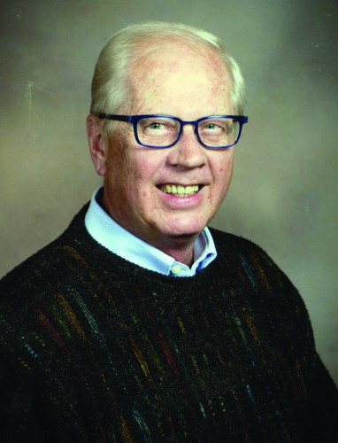
Jerome French
January 31, 1947 – February 9, 2021
44 years of Rotary Service
Club of Rapid City
Title Page Option
Notes:
https://www.legacy.com/us/obituaries/rapidcity/name/jerome-french-obituary?pid=197753513

Slide 4
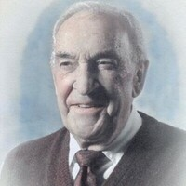
Richard Furnish
January 8, 1927 – July 31, 2021
18 years of Rotary Service
Club of Spearfish
Title Page Option
Notes:
https://www.fidler-isburgfuneralchapels.com/obituary/richard-furnish

Slide 5
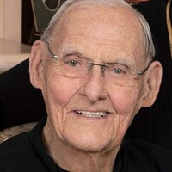
Glenn Jorgenson
January 26, 1930 – July 23, 2021
32 years of Rotary Service
Club of Downtown Sioux Falls
Title Page Option
Notes:
https://www.heritagesfsd.com/obituary/glenn-jorgenson

Slide 6

Tom Kelley
February 14, 1958 – October 15, 2020
12 years of Rotary Service
Club of Downtown Sioux Falls
Title Page Option
Notes:
https://www.millerfh.com/obituary/tom-kelley

Slide 7

Jill Kettle
June 23, 1963 – November 16, 2020
7 years of Rotary Service
Club of Custer
Title Page Option
Notes:
https://www.chamberlainmccolleys.com/obituary/jill-kettle

Slide 8
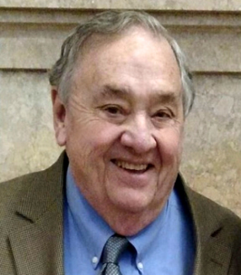
Patrick Mahowald
March 17, 1939 – October 18, 2020
41 years of Rotary Service
Club of Watertown
Title Page Option
Notes:
https://www.wightandcomes.com/memorials/patrick-mahowald/4361987/

Slide 9
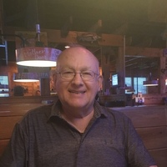
Kent Musegades
December 16, 1942 – September 21, 2021
20 years of Rotary Service
Club of Rapid City Rushmore
Title Page Option
Notes:
https://www.behrenswilson.com/obituaries/roy-eldon-roadifer/1778/

Slide 10
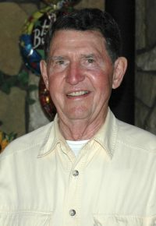
Roy Roadifer
October 18, 1926 – December 8, 2020
27 years of Rotary Service
Club of Custer
Title Page Option
Notes:
https://www.behrenswilson.com/obituaries/roy-eldon-roadifer/1778/

Slide 11
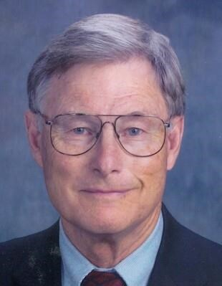
Murray Rowe
September 2, 1932 – November 5, 2020
Club of Canton
Title Page Option
Notes:
https://www.legacy.com/us/obituaries/argusleader/name/murray-rowe-obituary?pid=197051652
83 years of service on record not correct must contact club secretary for correction

Slide 12

Lee Van De Walle
November 1, 1962 – February 19, 2021
14 years of Rotary Service
Club of Sioux Falls West
Title Page Option
Notes:
https://www.georgeboom.com/obituary/lee-van-de-walle

Slide 13
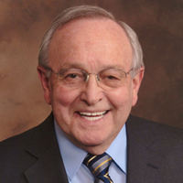
James Walter
June 2, 1943 – January 17, 2021
41 years of Rotary Service
Club of Rapid City
Title Page Option
Notes:
https://www.kirkfuneralhome.com/obituary/james-walter
Obituary indicates Rushmore Rotary but Clubrunner Rapid City on record

Slide 14
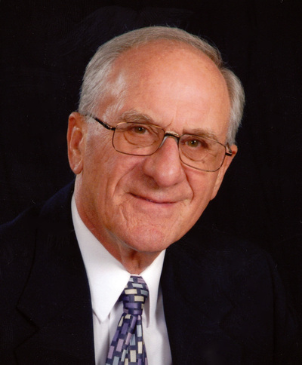
Ronald Waltz
July 25, 1941 – November 6, 2020
8 years of Rotary Service
Club of Brookings
Title Page Option
Notes:
https://www.rudesfuneralhome.com/obituary/ronald-waltz

Slide 15
Music Selection Wistful Harp - Andrew Huang
Title Page Option

