Slide 1
Rotarians of Distinction
Title Page Option

Slide 2
Area 1
Assistant Governor Jean Cline
Title Page Option

Slide 3
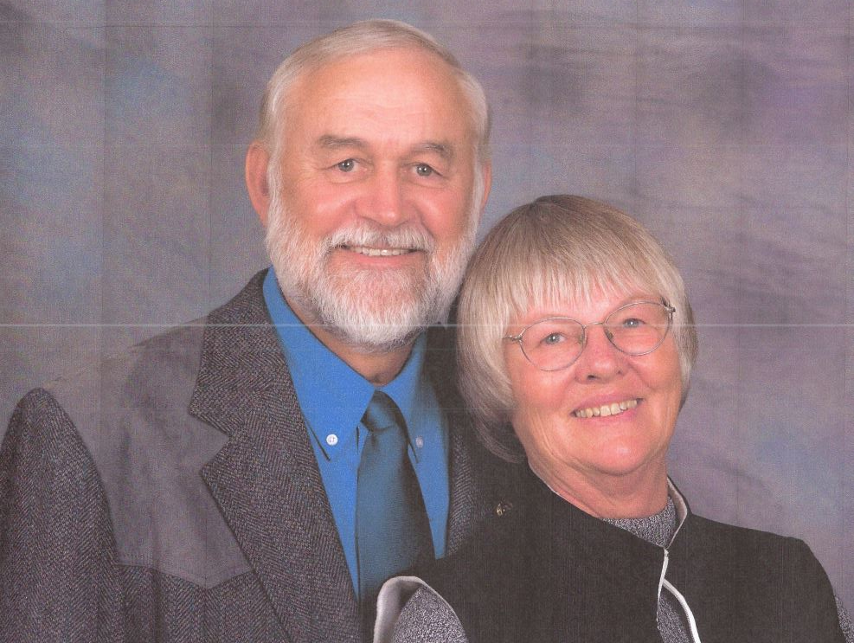
Verl Scheibe
Club of Custer
Area 1
Notes:
Verl Scheibe was raised on a dairy farm in eastern South Dakota. His years growing up were filled with the typical activities a school sports, 4H, and church youth group. After graduation from high school he joined the Navy, during which time he met his wife Kathy. Upon discharge for the Navy, they moved back to the farm near Wolsey, South Dakota. They farmed for the next 8 years, during which Verl was on the board of many of the farm organizations, the local school board and an officer in the local JC‘s. In 1979 Verl and Kathy and their four-year-old daughter Tanya moved to Kathy’s native Oregon, where Verl all started out working at a John Deere dealership in St. Paul, Oregon. There, Verl became a partner in the growing business in 1990. His partner and mentor Bill Dolan, suggested he join Rotary. He joined the Newberg, Oregon Rotary Club in 1993, and became involved with many of the different humanitarian projects. In 1994 he received his first Paul Harris Fellowship from International president Bill Huntley on stage with 5 other first time Paul Harris recipients at the International Convention in Portland, Oregon. During the years from 1990 to his retirement he served on the Newberg Rotary board six years, on the Newberg Providence hospital board, Newberg Chamber of Commerce board was selected as Newberg Oregon‘s Business person of the Year. He was involved with several other volunteer organizations such as the St. Paul fire department in St. Paul Oregon (25 years as a volunteer EMT and fire fighter). He is past president and secretary of the Custer club and past Assistant District Governor. He and his wife Kathy are Paul Harris Society and Bequest members, and Benefactors. Verls’ upbringing in a family that had values like Rotary has led to his continued involvement and commitment to Rotary and the many worthwhile projects they have, particularly the involvement with wheelchair distributions with Hope Haven. Verl and Kathy retired in April 2009 and settled in Custer, where they enjoy living in the mountains. His hobbies are woodworking, traveling, and diving.

Slide 4
Area 2
Assistant Governor Peg Wunder
Title Page Option

Slide 5
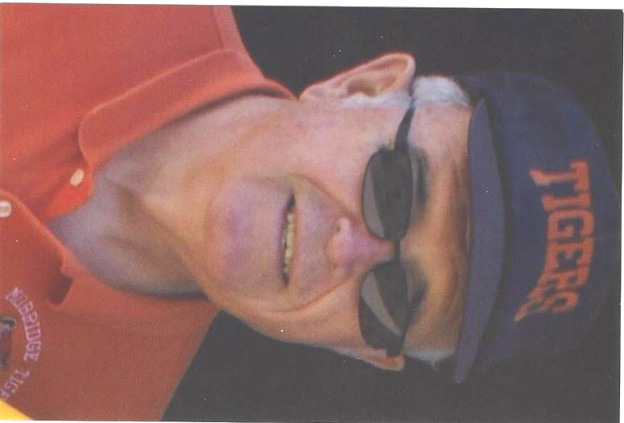
Herb McClellan Jr.
Club of Mobridge
Area 2
Notes:
Herb McClellan, Jr. graduated from Mobridge High School in 1952, going to Dental School and returning to practice dentistry with his father in 1960. Herb’s father was very active in the community and was a Rotarian and Herb followed in his father’s footsteps. In 1961 Herb, Jr. joined Rotary. At that time each member had to be a different profession and the profession of dentist was already taken by Herb’s father so Herb joined Rotary as a pediatric dentist.
It is impossible to name all the activities Herb has been involved in over the years. Starting in 1960 he took charge of the boy scouts and held that position for years. He served as mayor for 5 years in 1970 and 1980. He was president of the Jaycess and president of Mobridge Rotary in 1977. He was very active in the sportsmen’s club and he has always been very active in Trinity Lutheran Church. He also served for years as secretary to Mobridge Rotary. As a Rotarian, Herb has been in charge of the Halloween Party, the Track Meet and has organized people to help serve the county 4H Achievement meal each year. With the competition of the new school, Herb and his wife Joyce purchased white boards and electronic equipment for all the classrooms plus one for the community library.
Though Herb is retired at the present time, during the years he practiced dentistry he had patients that came from over 100 miles. Herb consistently attends Rotary meetings and all of us in the Mobridge Rotary look to him for advice. He is one of our senior Rotarians. (His son, Marc, is also a dentist and a Rotarian who has served as president and heads a number of events we sponsor.)

Slide 6
Area 4
Assistant Governor Steve Carnes
Title Page Option

Slide 7
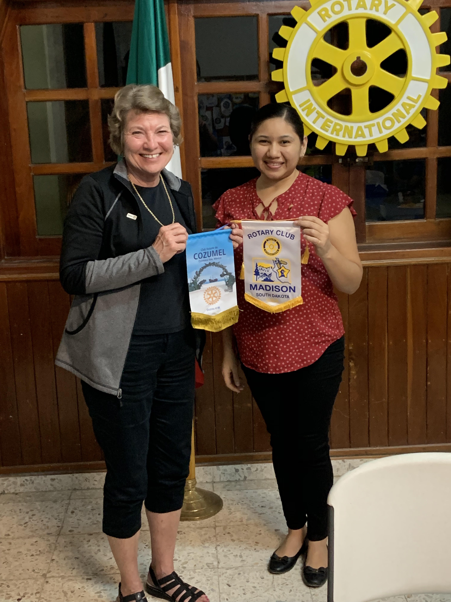
Nancy Moose
Club of Madison
Area 4
Notes:
Active with youth exchange, served on club exchange committee and also served on the District 5610 exchange committee
Club president - Madison
Club secretary
Club foundation chair
A G for our area of Dist 5610
Past District Governor
District Trainoe for several years
Served as a trainer at the Rotary Zone level
Part of two wheelchair trips to Romania with Hope haven and Rotary
Participated in and hosted Friendship Exchanges with Australia and Sweden

Slide 8
Area 5
Assistant Governor Richard Bot
Title Page Option

Slide 9
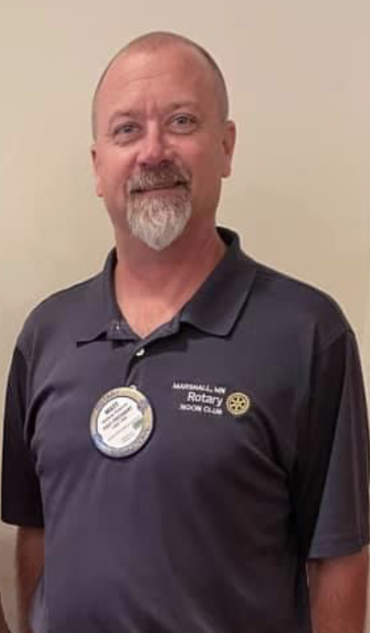
Matt Pedersen
Club of Marshall Noon
Area 5
Notes:
Matt Pedersen joined the Rotary of Marshall Noon Club June 1st, 1995. He has served twice as Club President (1998-99 and 2019-20). He is a Paul Harris Fellow Plus 2. In his 26 years as a Rotarian he has served many roles in his club. In 2004, he traveled with the Solar Oven Partners to Haiti with the connections he made at the Rotary District 5610 conference.
In early 2020, Matt is proud to have helped the Rotary of Marshall Noon Club and the Rotary Sunrise of Marshall Club join together to purchase and distribute 11 iPads to help patients and individuals connect with their loved ones and medical providers in a quick response to the isolation caused by the coronavirus (Covid-19) pandemic. Rotary District 5610 contributed $500 as part of the “Covid-19 Pop-Up Grant”.

Slide 10
Area 6
Assistant Governor Bill Frei
Title Page Option

Slide 11
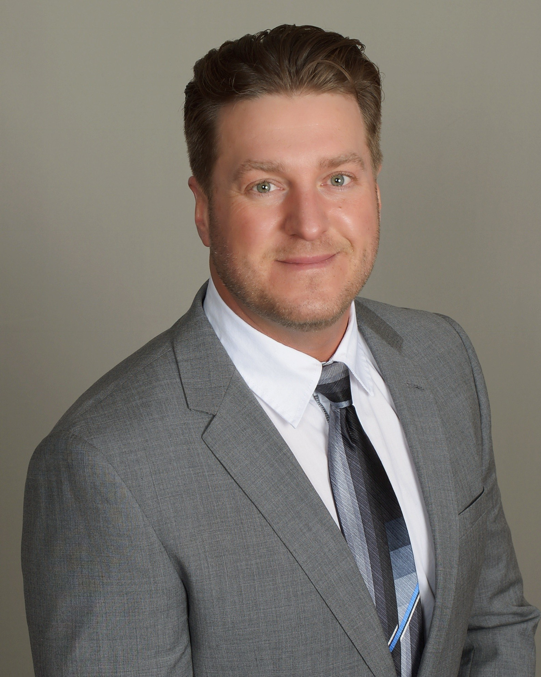
Casey Berndt
Club of Winner
Area 6
Notes:
Casey Berndt grew up in Tyndall South Dakota. Graduated in 1997. He headed off to Laramie Wyoming and attended trade school to be a diesel technician. Immediately after graduating from Wyoming Technical Institute Casey moved to Winner South Dakota and spent six years working for Grossenburg Implement a John Deer Dealership. After meeting his wife Erin they moved to Sturgis and spent another three years in the diesel technology field. In that time Casey started doing some career shopping and that led me to an opportunity to become a financial advisor with Edward Jones. After the training process and passing the regulatory required exams Casey moved back to Winner South Dakota and started my career with Edward Jones in 2007. This opportunity led Casey to meeting quite a few business people in the area. Thru an invite from another Rotarian Casey joined the club in 2011. Shortly after that was installed as a board member and then club president in 2014 - 2015. Shortly after Caseey was asked by district Rotarians that he had met through the district conferences and experiences that being the club president exposed him to consider moving into the AG ( assistant district governor) position. Casey served in this role from 2016 to 2021. Casey feels this made him a better Rotarian as being involved at the district level really exposes one to the true purpose of rotary. Casey is a sustaining member since 2012 and has become a Paul Harris fellow +4 at this time. Over the years he also tried to contribute to my local community as much as possible. Casey has served in multiple board positions and moved to the president positions of the Chamber of Commerce and Winner country club. Although Casey stepped down and moved on from the AG position he remains very involved in his local club to benefit the community as much as possible. Casey is an avid golfer and enjoys some fishing from time to time. His wife Erin is a musician and has played piano for many restaurants and events over the years including three years for Jake’s fine dining at the Midnight Star in Deadwood. They have one daughter Autumn who is attending college at Lincoln Nebraska University.

Slide 12
Area 7
Assistant Governor Rich Burns
Title Page Option

Slide 13
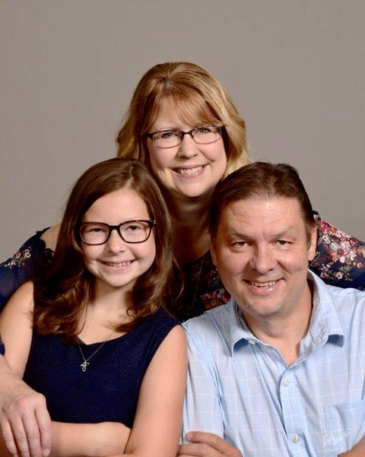
Brad Preheim
Club of Centerville
Area 7
Notes:
August 12, 2021
To: District 5610 DGE John Schneider
From: District 5610 AG Area 7 Rich Burns
Subject: Area 7 Rotarian of Distinction Selection - Brad Preheim
2021 Rotarian of Distinction
Name: Brad Preheim
Club(s)/Tenure: Centerville Rotary Club; Joined October 1, 2013
Why they are Distinguished: Brad truly lives the Rotary motto of “Service Above Self”. While holding a two year term as Centerville Club President, Brad went above and beyond to keep the Centerville Rotary Club together, informed, and engaged throughout the pandemic. During the meetings I attended, Brad with Centerville Rotary coordinated how best to provide food donations to those in need through Centerville Rotary’s Food Pantry Project, provided fundraisers to support local high school sports and academic programs, created strategies to keep local businesses afloat, and checked in with those of the community on how they were coping during these difficult times. In addition to all of this, Brad was instrumental to me by providing his time and direction on how to best organize and operate the District 5610 Raffle Event.
Though not an extensive list, Brad’s involvement and leadership responsibilities include:
Oversees the Food Pantry Board along with ordering the food, supplies, and scheduling the volunteer workforce.
Served as Centerville Rotary Club President 2019-2021.
Served as Centerville Rotary Club Treasurer 2015-2018.
Served as Rotary District 5610 Fundraising Subcommittee and District Raffle Chair 2018-2019.
Recognition within the Rotary Foundation, Sustaining Member, and “Every Rotarian Every Year Campaigns 2014-2021”.
Instrumental in helping save the Centerville Nursing Home from closing and through that effort, was able to vitalize the Town into a welcoming place to live.
Serves on the Centerville Economic Development and Centerville School Advisory Boards.
Serves on the Centerville City Council and recently served as Mayor of Centerville.
Has been the Announcer for Centerville High School Football and Track Meet events for over 20 years.
Volunteers as Junior Achievement Teacher for Centerville Schools grades 6th and 12th.
Brad and his wife Kim have been married over 18 years. They have 4 kids and 5 grandkids
Brad is truly an inspiration for Rotarians to follow. He is one of my heroes inside and outside of Rotary and highly deserving of District 5610 Rotarians of Distinction for 2021. If you have any questions, feel free to direct them to me.
Sincerely,
Rich Burns
District 5610
AG Area 7

Slide 14
Area 8
Assistant Governor Gregg Brown
Title Page Option

Slide 15
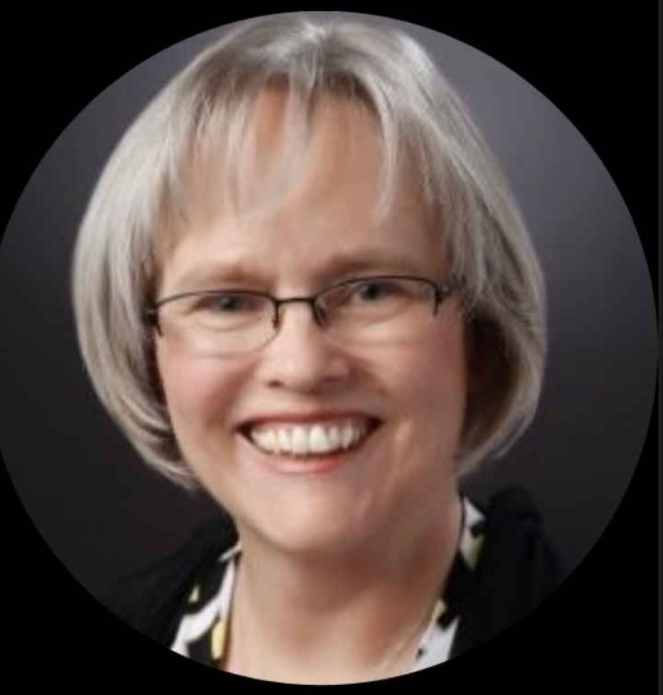
Mary DeVany
Club of Sioux Falls South
Area 8
Notes:
Our nominee for our area Rotarian of Distinction is our Past President-Mary DeVany. Mary is a second generation Rotarian who often attended Rotary meetings and functions in Vermillion with her father. She graciously agreed to serve a second term as president when the scheduled incoming president was unable to serve.
Our club lost our regular meeting location and Mary led our nomadic club in trying multiple venues before deciding on a permanent location fitting our club members. This business recently decided to close on our regular meeting night so Mary led the club in moving to a different night. When Covid hit last year, Mary transitioned us seamlessly to virtual meetings and established our ability to meet either in person or remotely. She has been a resource person for several other District clubs facing the same challenges.
She helped us establish a regular schedule of monthly events for our club- 1 social and 1 service event and 2-3 regular presentations by speakers. Several of our speakers were from outside Sioux Falls and presented remotely, including the incoming Rotary International Director for our Zone, who lives in Illinois. This schedule has been a great recruiting tool for new members in our club. She is a constant reminder that new members are not only good for our club, but good for the new member and our community. She had led the outreach of our club to Harrisburg, SD for potential new members. Her organization and presentation skills impress our club members and speakers.
Mary and her family also hosted a Rotary Youth Exchange student-Awan for six months. Mary and her husband-Rex have one son, Adam who attends South Dakota State University. She is a graduate of Leadership South Dakota, member of Gloria Dei Lutheran Church, sings in the choir and is a champion for Lutheran Outdoors. She has been a member of the Lennox Band for over 25 years and plays in the USD Alumni Band.
Mary’s professional career for over 30 years has centered around telehealth. She is the Associate Director at gpTrac for the University of of Minnesota as a TeleHealth Enthusiast and Rural Health Advocate helping people visualize how they might use telehealth.
Her educational background includes a Master of Science degree in Organizational Leadership from the University of South Dakota and a Bachelor of Science degree in Mass Communications/PR-Advertising at USD as well.
Our 8 year old honorary member Caylee M. says, “Mary is very smart, a good past president and super nice.”

Slide 16
Area 9
Assistant Governor Joe Lundsgaard
Title Page Option

Slide 17
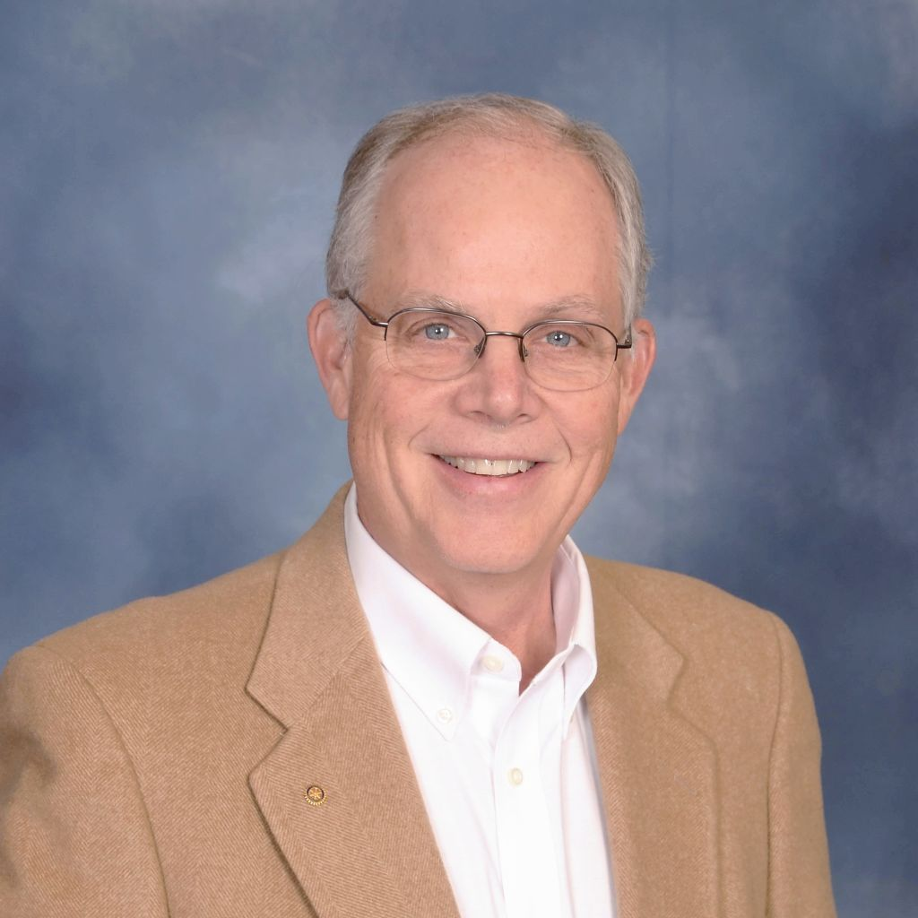
Bruce Young
Club of Le Mars
Area 9
Notes:
The Rotarian of Distinction from Area 9 is Bruce Young of the Rotary Club of Le Mars, Iowa. Bruce is a graduate of Iowa State University with a degree in Computer Engineering and a Master’s degree in Electrical Engineering from Stanford. He worked as an engineer and engineering manager at HP, Pixar and Intel before moving to Le Mars in 1996 to lead the engineering effort for consumer electronics products at Gateway 2000. He became interested in Intellectual Property during his career and has been named as an inventor on more than 50 patents. He has now been a Patent Agent in solo practice for over a decade, helping inventors, entrepreneurs and industrialists patent their products and procedures. This lead to Bruce spending much more time in Le Mars and allowing him to join Rotary.
Bruce joined Rotary in 2013 and immediately immersed himself in the activities and leadership of the club. He was club treasurer where he updated the accounting system and was valuable in analyzing the clubs financials and forecasting cash flows. In 2016 Bruce became club president and provided valuable leadership to the club including strategic planning. He is a multiple Paul Harris Fellow, member of the Paul Harris Society and a Sustaining Member. Bruce is the club’s Foundation Chairman. The previous 4 years he has been District 5610’s Grants Sub-Committee Chairman where he created on-line grants training.

Slide 18
Area 10
Assistant Governor Tammy Lee
Title Page Option

Slide 19
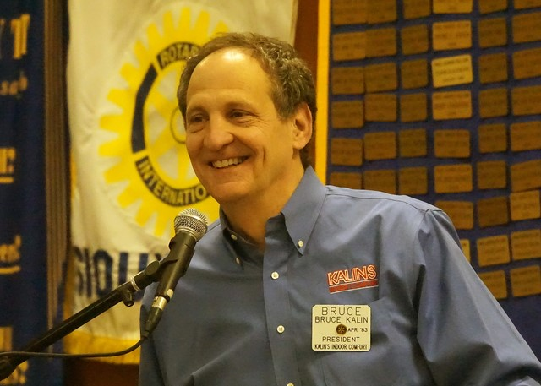
Bruce Kalin
Club of Sioux City
Area 10
Notes:
Rotarian of Distinction 2021-22
Area 10 – Bruce Kalin
Bruce is being recognized as a Rotarian of Distinction for his significant contribution to the Rotary Club of Sioux City. Bruce joined Rotary in 1999 and after nearly 20 years as a member accepted the position of Sgt at Arms, ultimately serving as club president 2020-21. His creativity and wit as Sgt at Arms raised the bar for his successors.
Bruce brought to Rotary the same dedication to success that he demonstrated as a business leader. He led by example, was strategic and focused on building a solid team. COVID-19 could have limited club membership, yet even in a year where many meetings were not possible in-person there was membership growth. After a period with Zoom meetings, hybrid meetings were established and continue today, offering an ongoing opportunity for anyone to access Rotary Club meetings in Sioux City. He furthered the trajectory of his predecessors with pursuit of District funds to establish Rotary branded projects in community. His easy going style is welcoming and his impact will be felt for years to come.
Bruce and his wife Linda, also a Rotarian, are Paul Harris Fellows.

Slide 20
Area 1 – Tahiry Razafimanjato, Rotary Club of Spearfish
Area 2 – Gary Steuck, Rotary Club of Mobridge
Area 3 – Willie Gruenwald, Rotary Club of Clark
Area 4 – Reva Johnson, Rotary Club of Brookings
Area 5 – Darold (Dar) Snortum, Rotary Club of Canby
Area 6 – Dan Bechtold, Rotary Club of Winner
Area 7 – Milton Haar, Rotary Club of Yankton
Area 8 – Duane Waack, Rotary Club of Sioux Falls West
Area 9 – Arlene Kuehl, Rotary Club of Sibley
Area 10 – Colin Tague, Rotary Club of Sioux City
2018 - 2019
Title Page Option

Slide 21
Area 1 – Bruce Nearhood, Rotary Club of Rapid City Rushmore
Area 2 – Larry Lyngstad, Rotary Club of Pierre – Fort Pierre
Area 3 – Wendy Fransen, Rotary Club of Watertown
Area 4 – Gregg Jongeling, Rotary Club of Brookings
Area 5 – Eric Luther, Rotary Club of Marshall Sunrise
Area 7 – Kelsey Collier-Wise, Rotary Club of Vermillion
Area 8 – Michelle Lavallee, Rotary Club of Downtown Sioux Falls
Area 9 – George Wittgraf, Rotary Club of Cherokee
Area 10 – Heather Hennings, Rotary Club of Sioux City
2019 - 2020
Title Page Option

Slide 22
The Rotarians of Distinction Award is presented to individuals who through service to their Rotary club and community have distinguished themselves, even among all Rotarians who strive to place service above self. The recipients have traveled different paths in their Rotary service, but those paths have all resulted in a record of service that identifies them as ROTARIANS OF DISTINCTION.
Title Page Option

