Slide 1
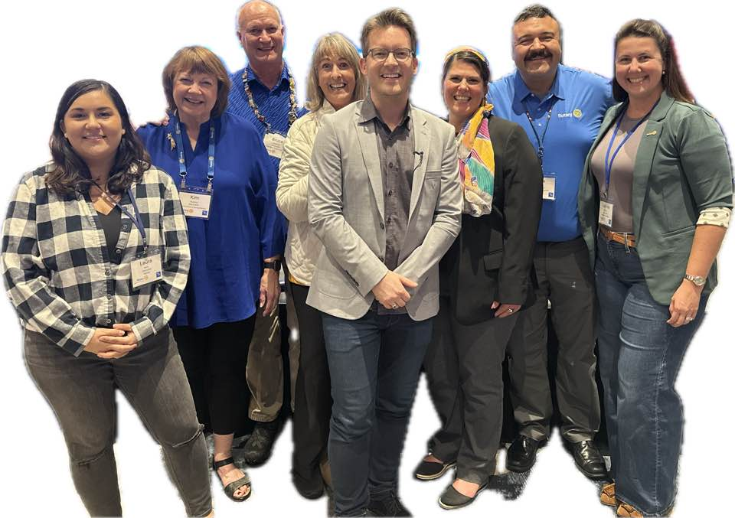
PRESIDENT-ELECT LEARNING SEMINAR (PELS)
District 5610 – The Rotary Foundation

Slide 2


Slide 3

Are Rotary International and The Rotary Foundation one in the same?

Slide 4
No, they are not. - Differences Between Rotary International and the Rotary Foundation
Rotary International
The Rotary Foundation
Is a member organization and administrative body that supports clubs worldwide.
Focuses on governance, programs, leadership, and networking.
Is a 501(c)(4) social welfare organization.
Tax-exempt donations to RI or local clubs generally are NOT tax-deducible.
Is a public charity that funds humanitarian projects.
Transforms donations into service projects and grants to support world peace.
Contributions count towards Paul Harris Fellow points; one of Rotary’s highest honors.
Is a separate 501(c)(3) entity and donations to TRF are tax-deducible.

Slide 5


From the Perspective of the Rotary Foundation, Your Role as Club President is to spend money! In Fact, You’re a Rock Star if You
Spend More Money Than You Bring In!

Slide 6
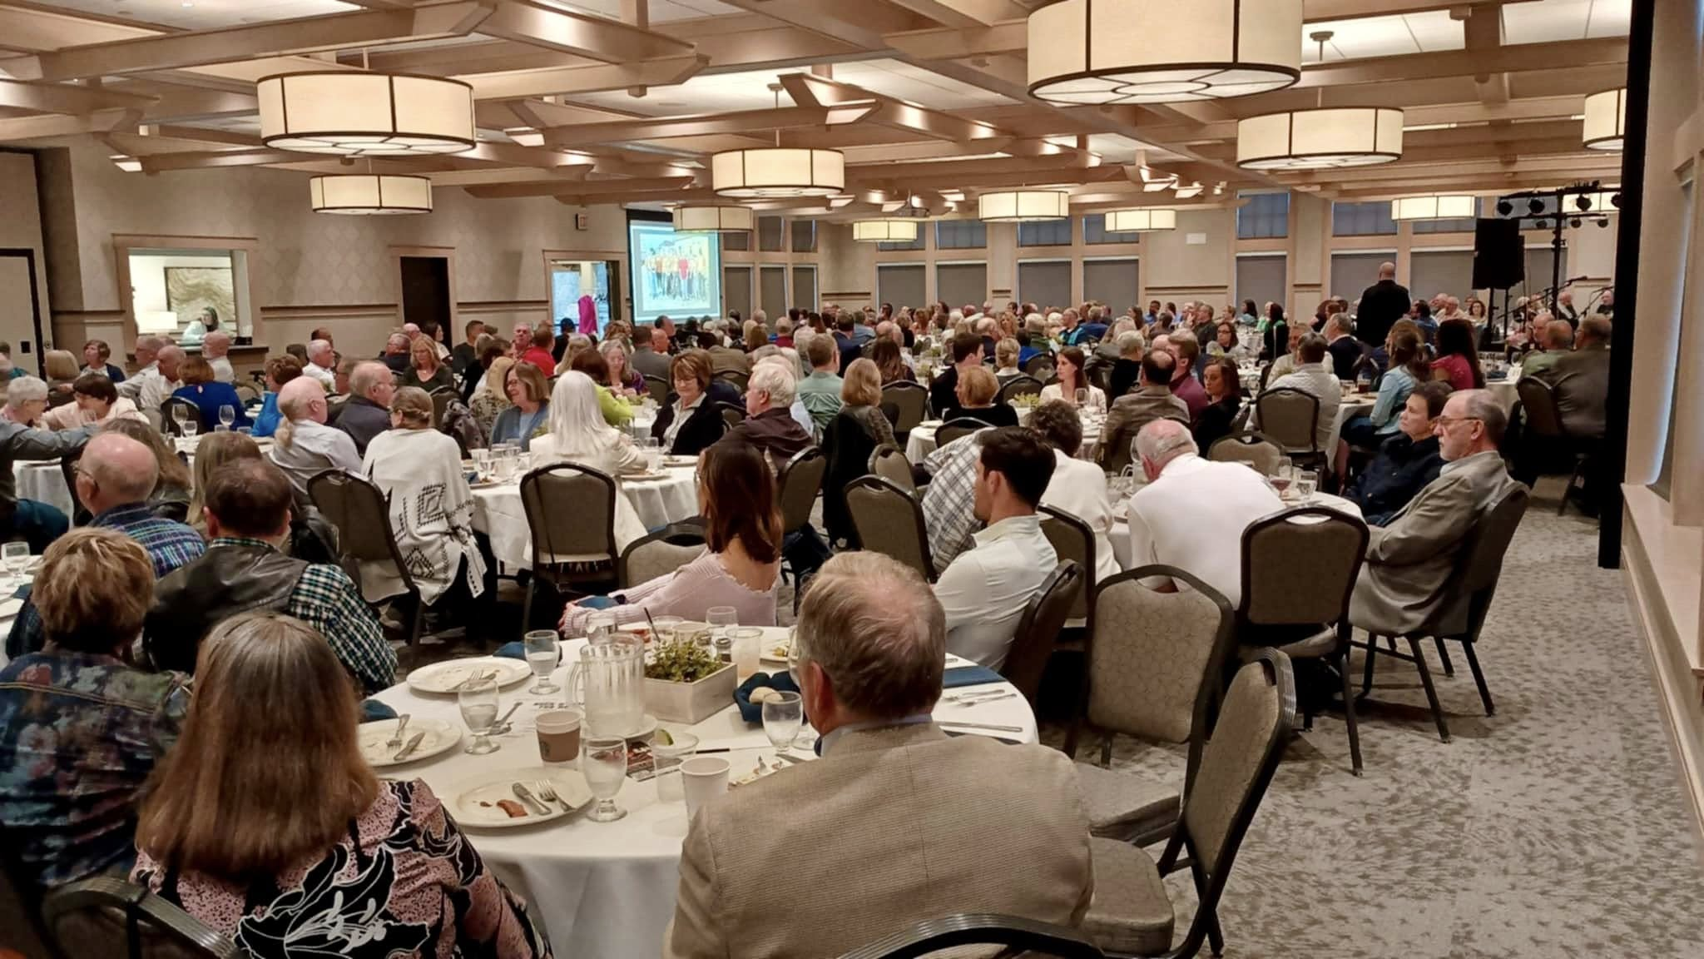
Giving to the Annual Fund – Contributions to the Annual Fund from Year A are returned to the District in the form of District Designated Funds (DDF) in Year C

Slide 7
Yearly District Contributions to the Annual Fund and Polio Plus 07/01/2020 to 03/31/2026
Annual Fund
Polio Plus
07/01/20 – 06/30/21 $262,818
07/01/21 – 06/30/22 $187,412
07/01/22 – 06/30/23 $156,805
07/01/23 – 06/30/24 $155,510
07/01/24 – 06/30/25 $139,706
*07/01/25 – 04/15/26 $74,307
*23 Clubs have donated to the Annual Fund
$72,079
$52,587
$31,271
$48,140
$45,349
*$34,362
*23 Clubs have donated to Polio Plus

Slide 8
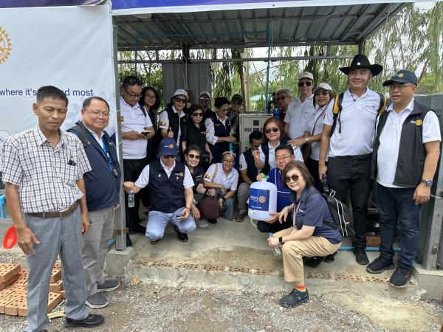
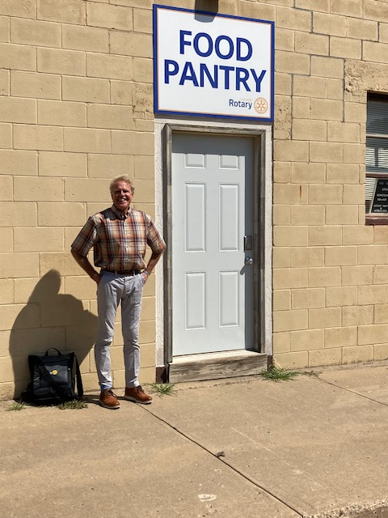
Of Annual Fund contributions, about 50% goes to the World Fund and about 50% comes back to the District as DDF.
World Fund Disaster Relief; Myanmar 7.7 magnitude Earthquake
DDF Funded Club Projects: Centerville Rotary Club

Slide 9
Annual Fund/Available DDF By Rotary Year
DATE AF DDF to Clubs
2023-2024 $160,400 $80,200
2024-2025 $108,200 $54,100
2025-2026 $94,600 $47,300
2026-2027 $71,400 $35,800
2027-2028 $64,500 $32,300 (Estimated)
2028-2029 $70,300 $35,150 (Estimated if no further donations are made to the Annual Fund This Rotary Year)

Slide 10
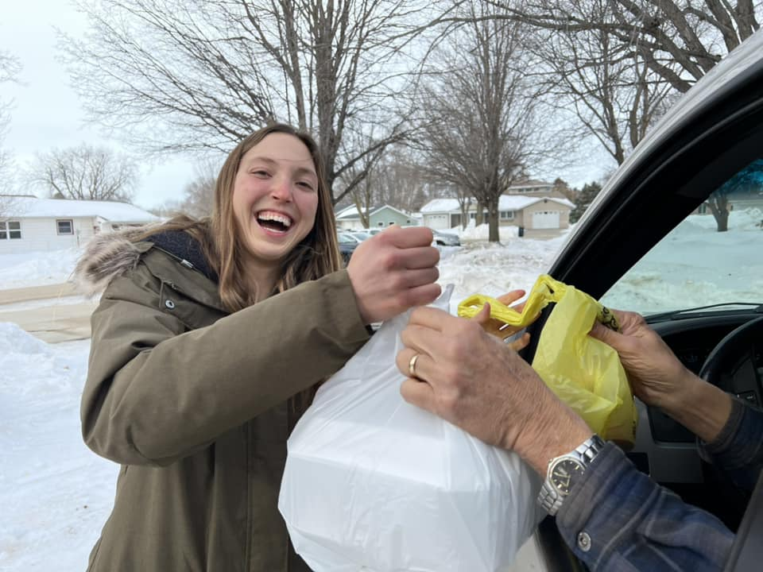
Grants Available to Clubs
District led grants
Global Grants
Disaster Grants
Scholarship Grants
Directed Endowed Gifts
Programs of Scale
Pop-Up Grants

Slide 11
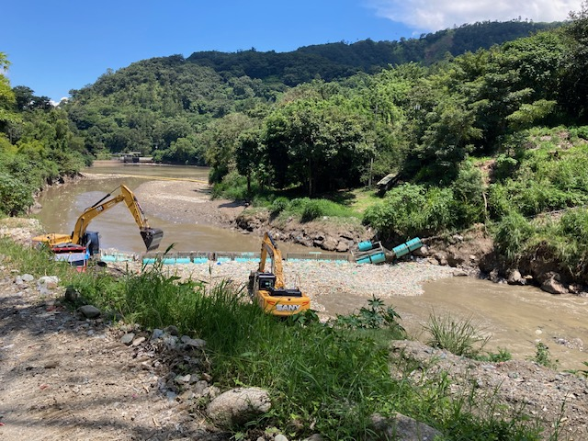
Approximately Half of the DDF Coming Back to the District Supports Global Grants (GG) and Half Supports District Grants (DG)
District 5610 Global Grants
School of St Jude; Arusha, Tanzania
Raising Awareness; Human Trafficking of School Aged Children Pine Ridge, SD
Providing Wheelchairs and Disease Treatment Odessa Oblast, Ukraine
Cleaning Contamination from the Motagua River Puerto Cortes, Honduras

Slide 12
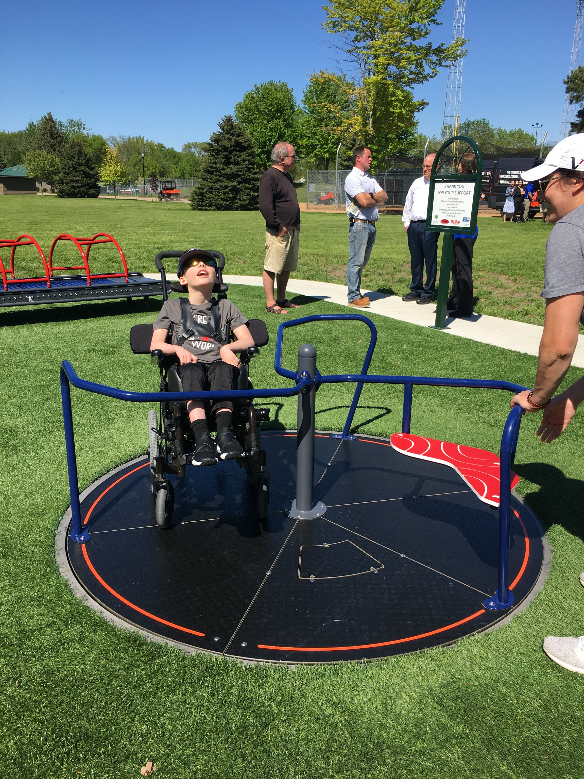
Approximately Half of the DDF Coming Back to the District Supports Global Grants (GG) and Half Supports District Grants (DG)
District 5610 Grants Awarded in 2025 – 14 Grants for a Total of $34,084
Parks/Recreation – 5 grants
Education/Literacy – 2 grants
Economic Development – 2 grants
Food Insecurities – 3 grants
Sanitation/Hygiene – 1 grant
Environment – 1 grant

Slide 13
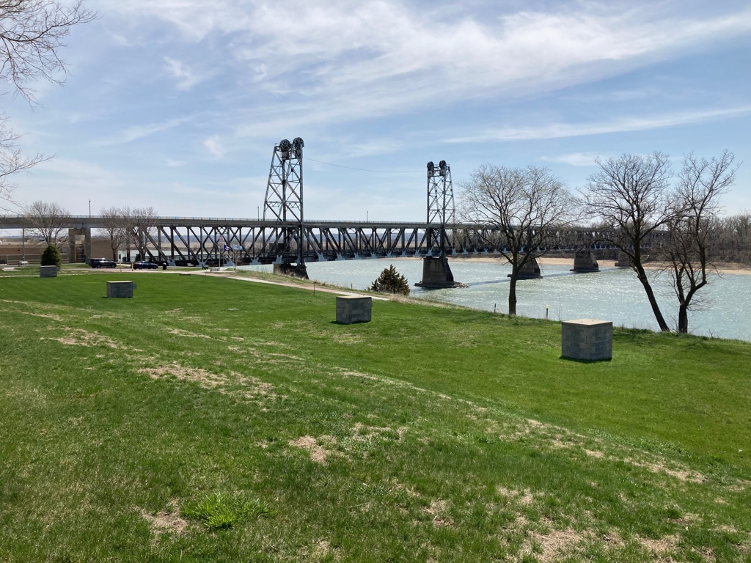
QUESTIONS?
The Rotary Foundation Contribution form ca be accessed from our District 5610 Website.
THANK YOU!
Have an Amazing Rotary Year!

