Slide 1
PRESIDENT ELECT
TRAINING
APRIL 18, 2026

Slide 2
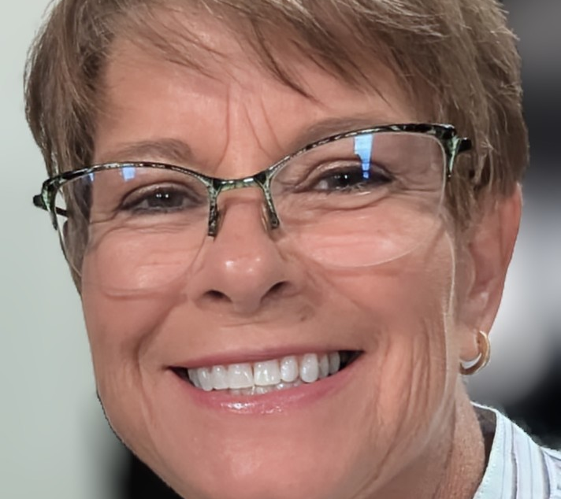
Introduction
Marsha Whetham
Winner Rotary Club
Rotarian for 14 years
Past President, Past Assistant Governor
Paul Harris Fellow
Various District Roles
District Membership Chair since fall of 2025

Slide 3
Thank you for accepting this leadership role in your local club. You are going to have a lot going on!
Enlist the assistance of a
Club Membership Chair

Slide 4
Current Membership Data
July 1, 2025: All Rotary Clubs 1,124,681
March 31, 2026: 1,165,097
Increase of 40,416
July 1, 2025: District 5610 1493
March 31, 2026: 1503
Increase of 10
The Board of Directors of RI has set a membership goal of 1.25 million Rotarians and 125,000 Rotaractors by our 125th anniversary in 2030.
Achieving this goal starts with all of us.

Slide 5

Strategies for Growth
Attract New Members: New Members Bring Fresh Energy
Engage & Retain Current Members: Consider Adaption and Flexibility. Rotary International is Encouraging New Club Models Which Suit Different Lifestyles and Schedules.
Expand Our Reach: Collaborate with Other Organizations to Enhance Service Impact and Visibility.

Slide 6

New Prospective Member Management System
First contact for prospective member when an interest form is submitted to Rotary International.

Slide 7
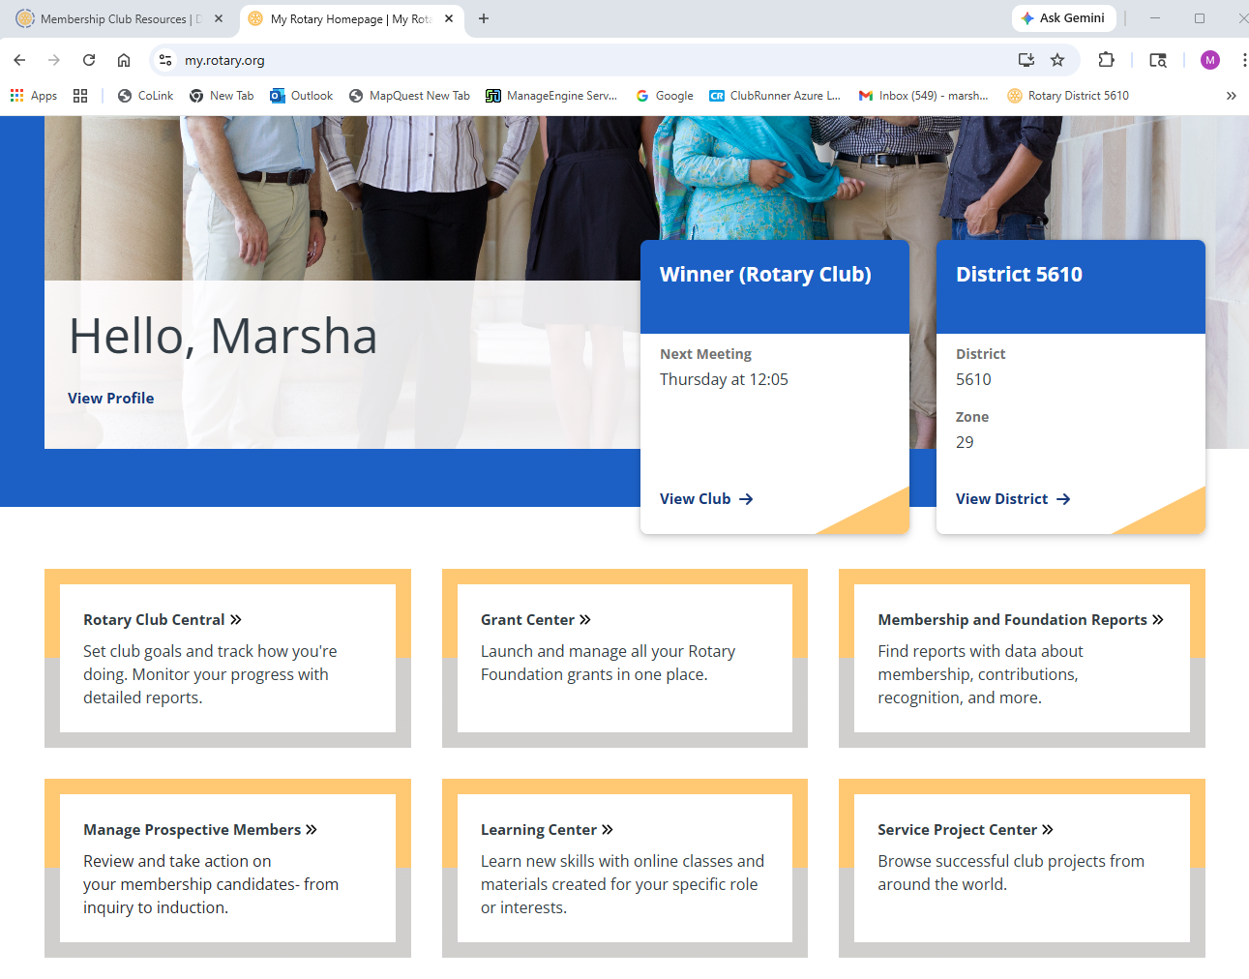

Slide 8
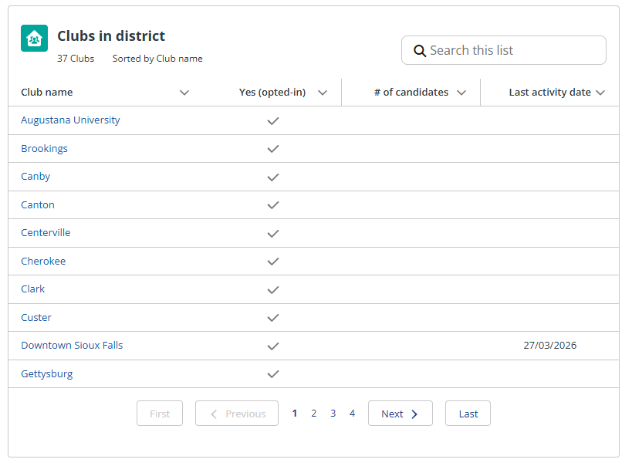

Slide 9
Plans are useless, but planning is indispensable.
Dwight D. Eisenhower
Q4
Membership
Chairperson
Q1
Set Membership
Goals
Q2
Plan How To Meet Your Goals
Q3
Reflect: How Are You Doing?
Currently gearing up for
an exciting new year
Engage your members
Your membership campaign will generate more members

Slide 10
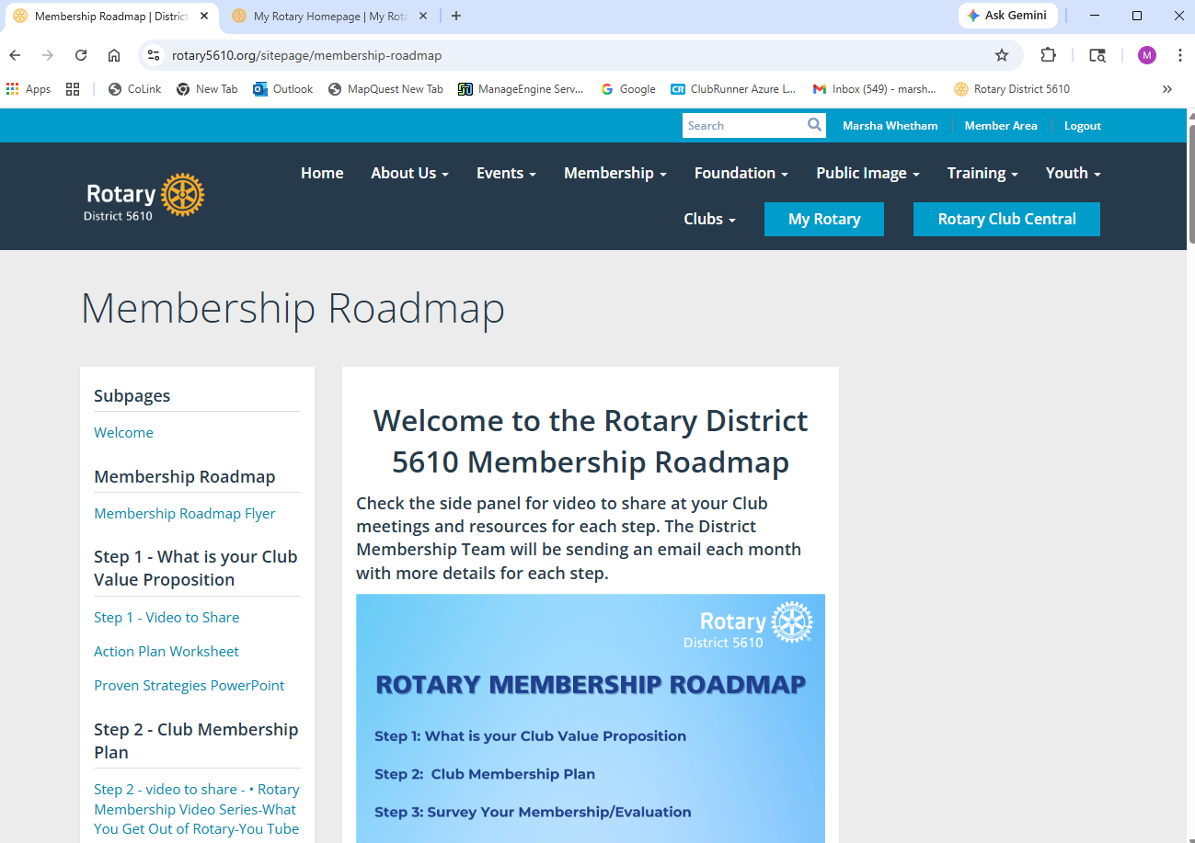
Rotary District 5610.org
Membership Tab

Slide 11
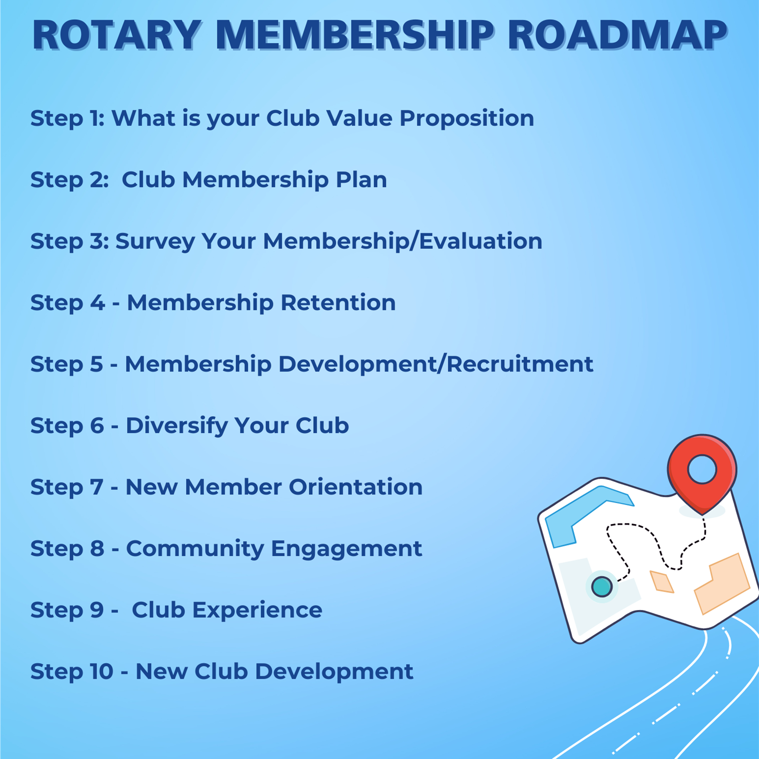
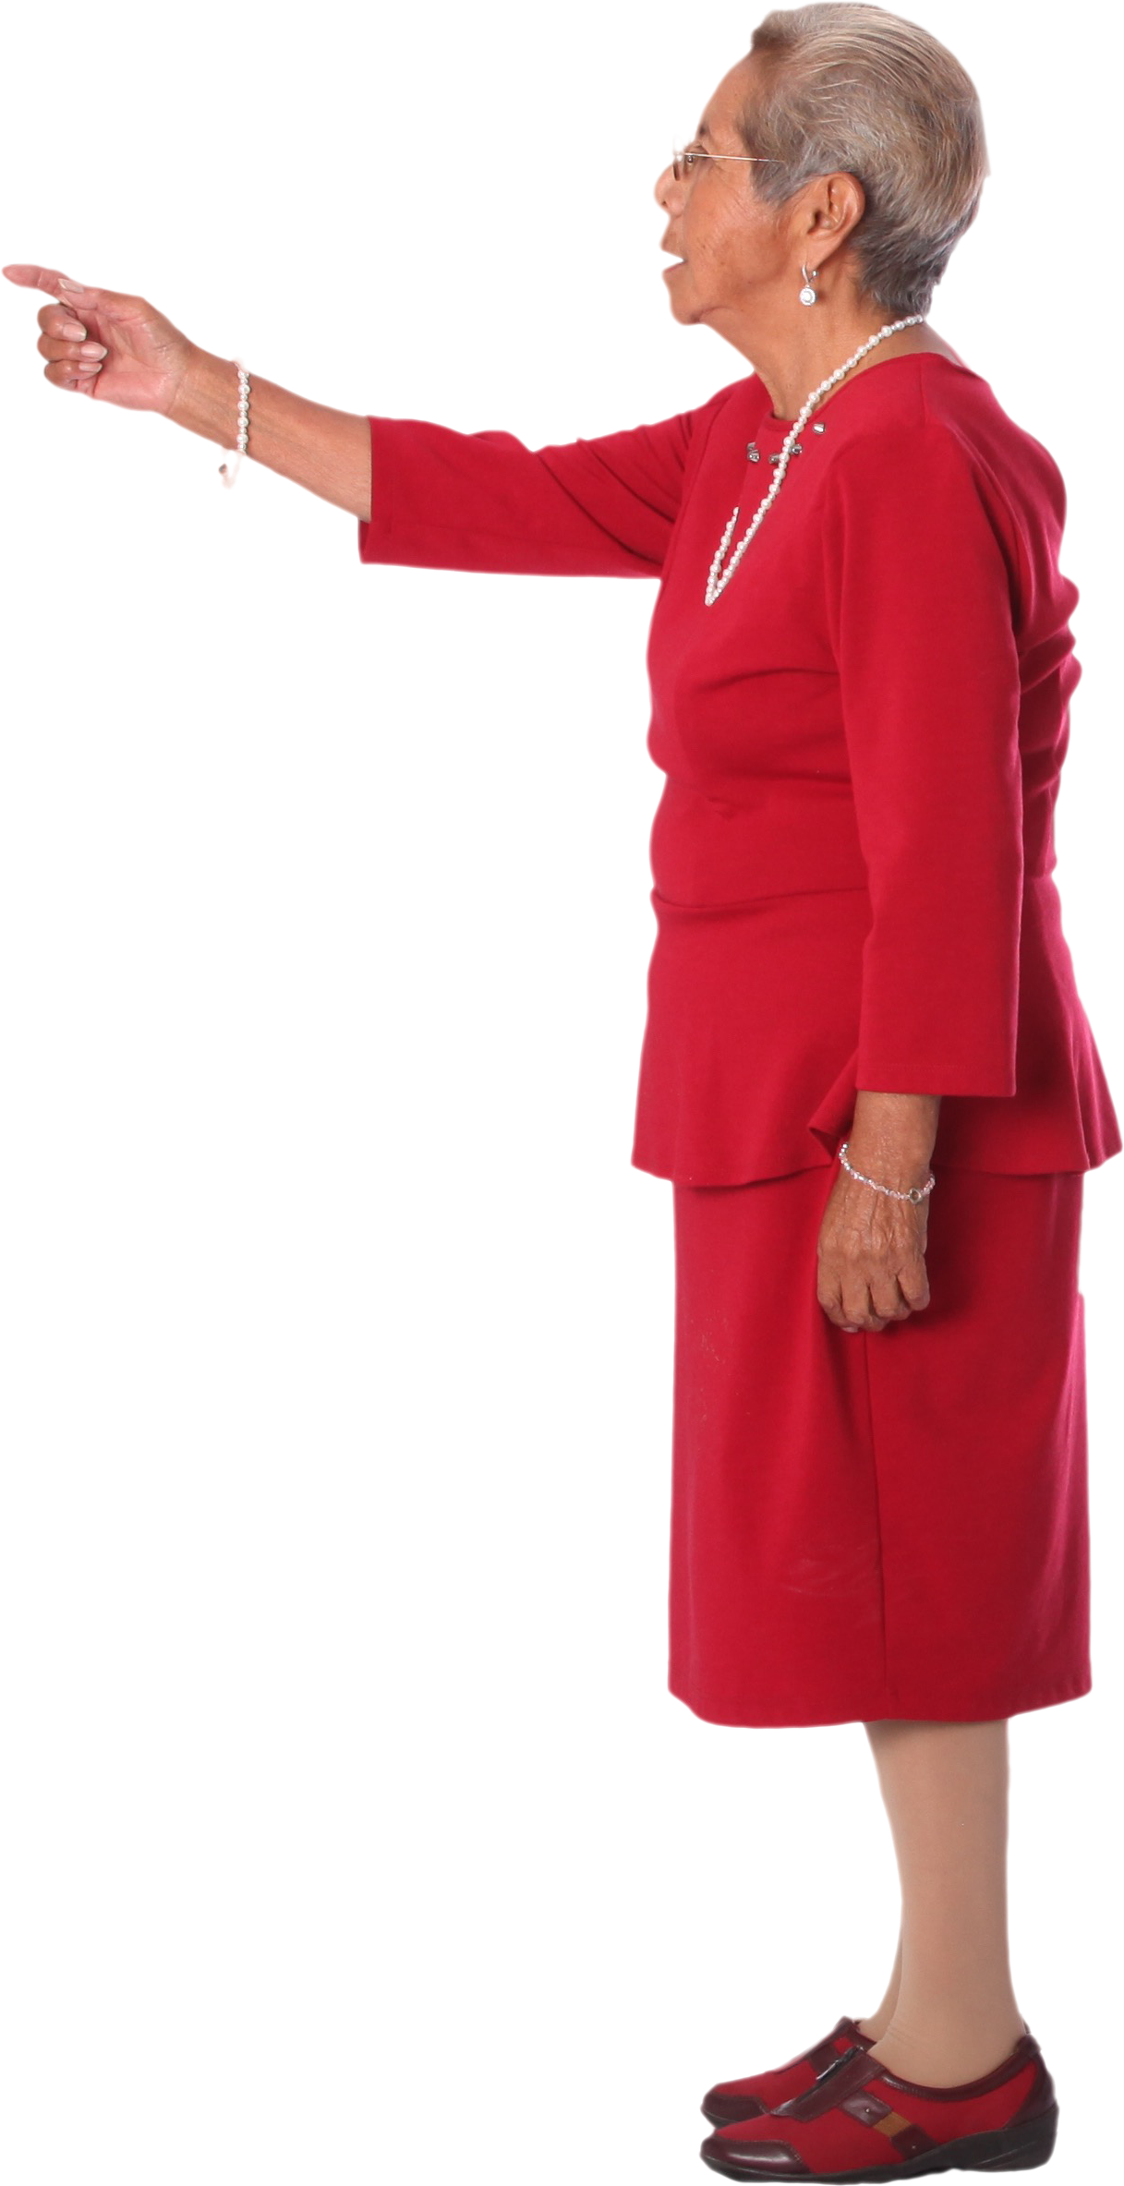

Slide 12
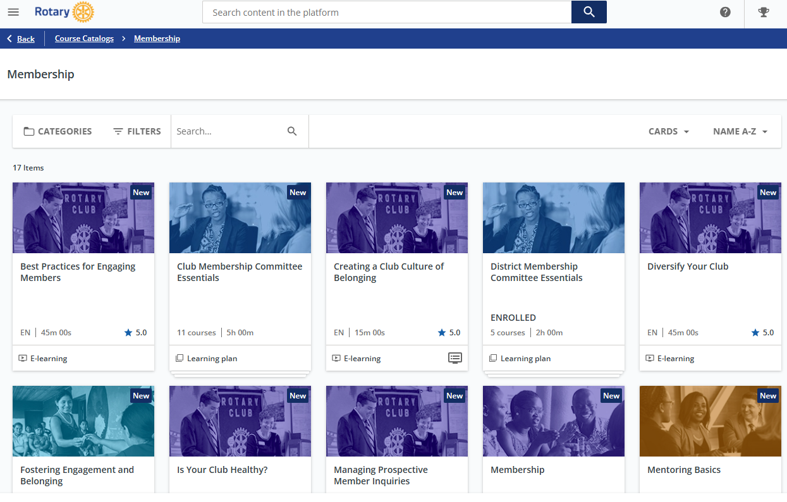
https://learn.rotary.org/members/learn/catalog/view/70

Slide 13

Improvise. Adapt. Overcome!

Slide 14

You are not alone. Share your responsibilities with others.
Use the tools provided on the District 5610 website.
Check out all the information provided by Rotary International.
Ask for help! Feel free to contact me and we will navigate this together.

Slide 15
Thank You
Marsha Whetham
marshawhetham@gmail.com
605-840-6246

