Slide 1
RYLA: ROTARY YOUTH LEADERSHIP AWARD-
LEADERSHIP BEYOND LIMITS
Inspire a Student.
Change a Life.
A message to new club presidents
from your District RYLA Chair, Rene Sorenson
District RYLA Chair | Rene Sorenson | GREATPLAINS RYLA.ORG

Slide 2
WHY ARE WE HERE?
Your club has the power to unlock a student's potential
★
♦
✔
The Problem
The Solution
The Goal Today
Most sophomores & juniors never hear about RYLA. They simply don't know it exists — until a Rotarian tells them.
You. Your club. A single conversation with a teacher or student can change the entire trajectory of a young person's life.
Leave this session with a clear, simple plan to recruit at least one RYLA candidate from your community for the 2027 RYLA camp year.
RYLA | Rotary Youth Leadership Awards

Slide 3
WHAT IS RYLA CAMP?
I've been there — twice. Here's what actually happens.
“
Team Challenges
Outdoor and indoor exercises that build trust, communication, and problem-solving under pressure.
RYLA isn't just a camp. It's the moment a teenager realizes they're capable of leading something bigger than themselves.
Leadership Workshops
Sessions on public speaking, goal-setting, conflict resolution, servant leadership and the 4-Way Test.
Lifelong Friendships
Students bond across towns and schools — many keep in touch for years.
Rotary Connection
— Your District RYLA Chair, 2-time attendee
Young people see Rotary values in action and start Interact Clubs, Rotaract Clubs, apply for Rotary Youth Exchange, and become future club members.
RYLA | Rotary Youth Leadership Awards

Slide 4
WHO SHOULD YOU SPONSOR?
Sophomores & juniors with a spark — they don't need to be the obvious leaders yet.
1
Natural curiosity
GRADES
10 & 11
Students who ask questions, get involved in activities, or care about their community.
2
Not just the star student
RYLA transforms the quiet kid, the athlete, the artist — not just the class president.
The sweet spot.
Old enough to lead,
young enough to
grow into it.
3
Recommended by teachers
Your best source. Ask a school counselor or teacher: 'Who has untapped potential?'
4
Willing to step outside comfort
Students open to new experiences and meeting people from other schools.
RYLA | Rotary Youth Leadership Awards

Slide 5
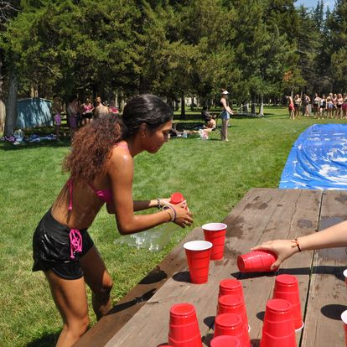
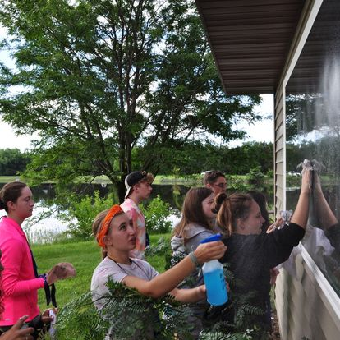
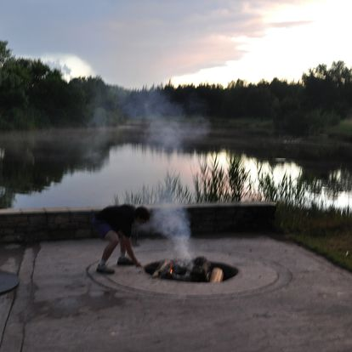
RYLA IN ACTION
Real students. Real transformation.
📷 INSERT PHOTO 1
📷 INSERT PHOTO 2
📷 INSERT PHOTO 3
Teambuilding Games at RYLA Camp
Reflection Time and Friendship Building
at RYLA Camp
Service Above Self
at RYLA Camp

Slide 6
HOW YOUR CLUB RECRUITS
A simple 4-step process any club can follow
1
2
3
4
Connect
Nominate
Invite
Sponsor
→
→
→
Contact your local high school counselor or a teacher you know
Ask them to recommend 2-3 sophomores or juniors with leadership potential
Meet the student (and parents). Share what RYLA is and why you chose them
Cover camp costs, submit the application, and stay in touch throughout
💡 Pro tip: The school counselor is your best ally. One email or phone call is often all it takes to find your candidate.

Slide 7
WHAT IT COSTS & WHAT IT'S WORTH
Small investment. Extraordinary return.
The Investment
The Return
Camp registration fee: $500/per student. Once a student attends camp, our District 5610 reimburses your club 50% ($250).
A young person discovers their leadership voice and your club witnesses the transformation of a youth
Your club is seen as a pillar of community investment
Transportation to/from camp. Our District 5610 reimburses drivers A $100 stipend to and from camp.
The Service Above Self motto and 4 Way Test are now a part of this youth’s experience and life
A few hours of a member's time to nominate & mentor
Your community's next generation of leaders is stronger
Optional: small send-off celebration from your club
A potential future Rotarian is born
RYLA | Rotary Youth Leadership Awards

Slide 8
YOUR ACTION PLAN
Three things to do during your presidency in February, 2027!
1
Talk to Your Club
This week
Spend 5 minutes at a meeting sharing what RYLA is. Use your own words — your passion is the best pitch.
2
Call a School
Within 2 weeks
Contact a counselor or teacher at your local high school. Ask: 'Do you have a student with leadership potential who could benefit from a free camp experience?'
3
Submit a Candidate
By [deadline]
Help your club sponsor at least one sophomore or junior for RYLA next year. I'm here to support you every step of the way.
RYLA | Rotary Youth Leadership Awards

Slide 9
One student.
One decision.
One Rotarian.
That's all it takes to change a young person's life through RYLA.
I'm your District RYLA Chair. I've lived this experience — twice.
Reach out any time and I will help your club find the right candidate.
Questions? Let's talk. Rene Sorenson / reneinak@gmail.com
GREATPLAINSRYLA.ORG

