Slide 1

Title Page Option

Slide 2


Slide 3
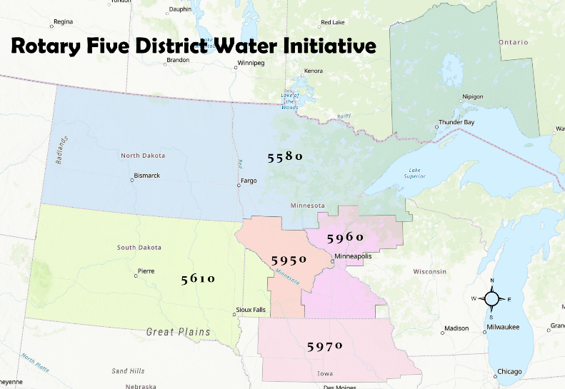
Who is involved?
District | # Clubs | # Rotarians
5580 | 56 | 1925
5610 | 35 | 1508
5950 | 65 | 2330
5960 | 59 | 2140
5970 | 49 | 1782
Totals | 264 | 9,685

Slide 4
What are 5610 clubs doing for unite for water?
      Brookings – Highway storm sewer clean-up; awareness of water pollutants
      *Centerville – Showing of Dragonfly Pond at Water Festival Sioux Falls West
      *Le Mars – Education on actions to improve water quality
      Mitchell – Install drinking foundation at City park
      *Madison – Water quality testing
      Marshall Noon – Trash pick-up and water test the Redwood River
      Mobridge – Plant Flower Garden and Tree
      *Rapid City – Creek clean-up, trash pick up, & water testing @ expo
      *Rapid City Rushmore – Creek Clean-up, trash pick up, & water testing @ expo
      *Rock Valley – Installed drinking station at City park
      Sioux City – Adopt-a-Drain
      Sioux Falls Downtown – Garbage pick-up at Big Sioux River
      Sioux Falls South – Litter pick up
      Sioux Falls West - Garbage pick-up at Big Sioux River
      Watertown – Trash pick-up at city beach
      *Winner – Installed a water dripline for trees
      Yankton - River watershed/river clean-up * indicates complete/started at time of this presentation

Slide 5
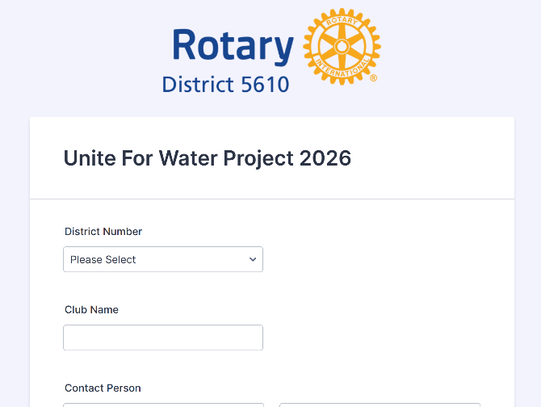
Submit your project
https://form.jotform.com/252576772728067

Slide 6
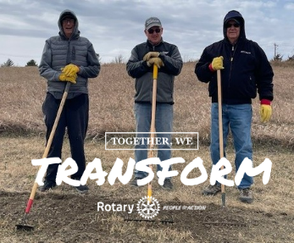
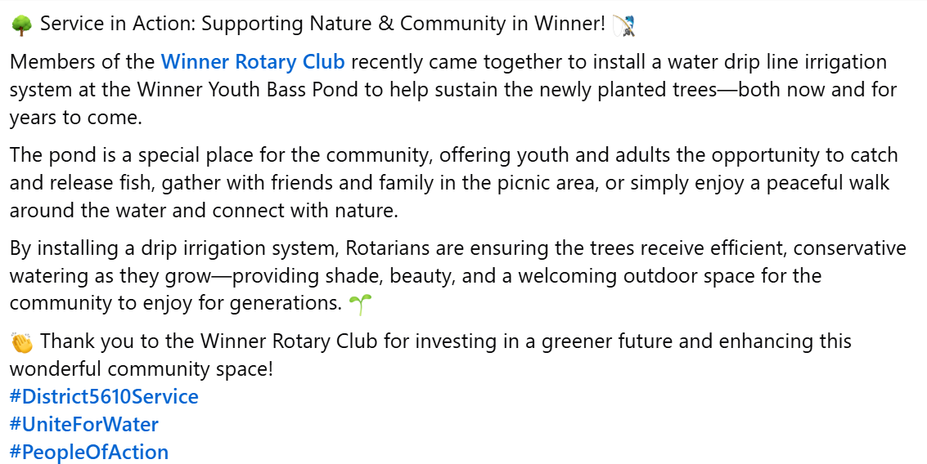
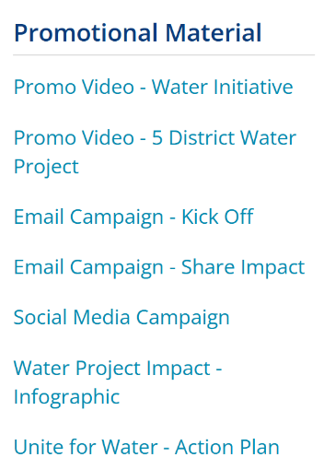

Promote your project (before)
Share your impact (after)
Welcome | Zones 25B & 29

Slide 7
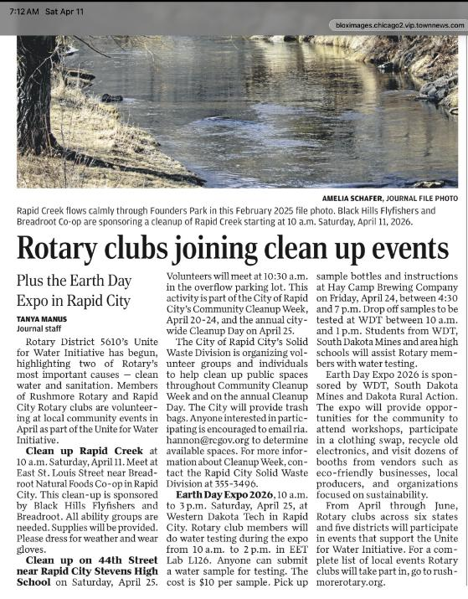
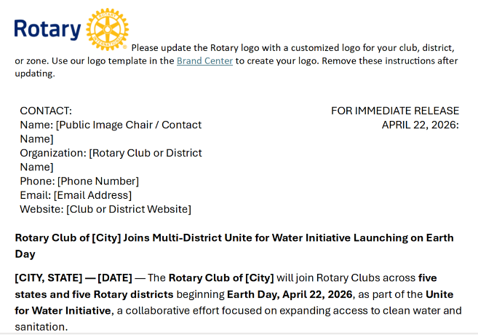
Public release
https://clubrunner.blob.core.windows.net/00000050186/en-us/files/sitepage/unite-for-water/club-version---unite-for-water-press-release/Club-Version---Unite-for-Water-Press-Release.docx

Slide 8
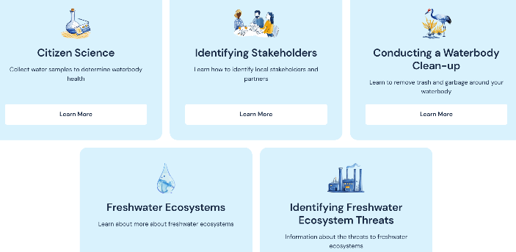

resources
      Welcome | Zones 25B & 29
        Public Image, Unite for Water
      Welcome | District 5610
        Events, Unite for Water
      Map your project! (Rotary and UN Environment Program partnership)
        https://www.communityactionforfreshwater.org/
      Environmental Sustainability Rotary Action Group
        https://esrag.org/

Slide 9
Projects still available!
        MacroBlitz! · iNaturalist
        South Dakota Association of Rural Water Systems - South Dakota Association of Rural Water Systems
        We Are Water MN - Minnesota Humanities Center
        Adopt-a-Drain – Minnesota
        WaterSense | US EPA
        Western Dakota Regional Water System

Slide 10


Slide 11
UNITE FOR WATER
WHY?
ACT TODAY FOR WATER TOMORROW
Title Page Option

