Slide 1


District 5610 2025 Raffle
May 13, 2025
DGND Jennifer Rollins
Title Page Option

Slide 2
Thank you
Club raffle representatives!
Club | Raffle rep
Brookings | Brad Blaha Jennifer Olson
Canby | James Hiedeman
 | (also from Canby)
Canton | Bryan Launderville
Centerville | Jan Stevens
Cherokee | Jennifer Griffin
Clark | Dala Albright
Custer | Patrick Argabright
Gettysburg | Kim Sheehan
Gregory | Scott Anchutz
Hot Springs | Morris Nelson
Le Mars | Robin Willer
Luverne | Tammy Loosbrock
Madison | Nancy Moose
Mapleton | Jeanie Theobold
Marshall Noon | Dave Shelkoph
Marshall Sunrise | David Haen
Mitchell | Patrick Clark
Mobridge | Janice Sayler
Pierre-Fort Pierre | Tom LeFaive Jay Vogt Doug Evanstad
Rapid City | Darrell Sawyer
Rapid City Rushmore | Terri Davis
Rock Valley | Kyle Spaans
Sibley | Scott Schroeder
Sioux City | Brenda Bradley
Rotary Club of Sioux Falls Downtown | Shelly Johnson Pam Hanneman
Sioux Falls North | Shelli Masek
Sioux Falls South | Rachel Chase
Sioux Fall West | Henry Evans and Jeanelle Lust
Spearfish-Northern Black Hills | Tom Willnard
Tyndall | Ernie Bures
Vermillion | Kathy Chandler
Wagner | Becky Brunsig
Watertown | Carla Roby
Winner | Lana Stickland
Yankton | Rich Burns

Slide 3
Why wAS this year’s Raffle so important
District Designated Funds (DDF) Fund District Grants!
DDF is transferred to us each year from RI based on the amount that is contributed by clubs in the District to Rotary Annual-Fund SHARE 3 years earlier.
  50% of DDF is used to fund 50% of every approved District Grant.
  30% of DDF is designated to assist in District approved Global Grants
  20% of DDF is redirected to Polio Plus
Over next two years, RI has directed all DDF is spent. In other words, no rollover starting in July 2026.
Donations this year are vital to support any District Grants in 2027-2028 Rotary year.

Slide 4

This Year’s Raffle
What’s new
  Ability to electronically pay via online platform
  $2000 savings in raffle ticket printing
What’s old
  Ability to still utilize a paper tickets
  Ability to still pay directly via https://my.rotary.org/en/donate
What’s different
  No raffle tickets snail mailed, completed hard copy raffle tickets may be emailed
  Individual raffle “numbers” assigned automatically via online platform or by hand (by District Raffle staff for hard copy tickets or self-initiated donations

Slide 5
How did we do?

Slide 6
GRAND TOTAL:
$45,695
Club | Total $ Raised | % of Club Members who participated in the Raffle
Rotary Club of Sioux Falls Downtown | 4559 | 29%
Mitchell | 3570 | 52%
Watertown | 3300 | 37%
Pierre-Fort Pierre | 2980 | 27%
Rapid City Rushmore | 2760 | 38%
Winner | 2430 | 60%
Rapid City | 2300 | 33%
Madison | 2250 | 74%
Wagner | 1900 | 224%
Brookings | 1841 | 28%
Luverne | 1730 | 43%
Vermillion | 1700 | 35%
Sioux City | 1580 | 28%
Centerville | 1400 | 314%
Sibley | 1100 | 55%
Yankton | 1100 | 100%
Rock Valley | 1100 | 73%
Sioux Fall West | 990 | 20%
Tyndall | 850 | 156%
Marshall Noon | 820 | 40%
Sioux Falls South | 770 | 74%
Spearfish-Northern Black Hills | 760 | 29%
Le Mars | 700 | 35%
Sioux Falls North | 600 | 62%
Clark | 540 | 40%
Canton | 510 | 50%
Mobridge | 460 | 147%
Custer | 425 | 19%
Mapleton | 400 | 68%
Hot Springs | 150 | 7%
Cherokee | 100 | 2%
Marshall Sunrise | 20 | 4%
Canby | 0 | 0%
Gettysburg | 0 | 0%
Gregory | 0 | 0%
Rock Valley | 0 | 0%
TOTAL | 45695
AVERAGE |  | 54%
Bragging rights for Top Sales
  #1 Rotary Club of Sioux Falls Downtown
  #2 Mitchell
  #3 Watertown
Bragging rights for 100% (or over!) club participation:
  Wagner
  Tyndall
  Mobridge
  Yankton
Honorable mention for 50%-75% club participation
  Winner
  Madison
  Sibley
  Sioux Falls South
  Sioux Falls North
  Canton
  Mapleton
  Rock Valley

Slide 7


Grand Prize
LG 4K TV on Legends Fireplace Stand
($6500 value)
Donated by:
Quarterly Dakota style boxes worth 50$ each total $200
$100 Visa Card and a SD State Park Pass
$150 DeWalt Corded/Cordless Air Inflator
$150 Visa Card
$150 Amazon Gift Card
Amazon Echo $100 Gift Card Show 5 + children’s book collection from Storybook Island (total value $150)
$100 Gift Card + Brau Beer & Specialty Fudge ($200 Value)
Games and Snack Basket
$100 Dairy Queen Gift Card
$100 Runnings Gift Card
$100 Runnings Gift Card
$100 Visa Card
$100 Visa Card
$100 Visa Card
$100 Visa Card
$200 Cabela’s gift card
$100 Visa Card
$50 Gift Card
$50 Cheyenne Crossing Gift Card
$50 Cheyenne Crossing Gift Card
$500 Gift Card
$500 Gift Card
Geometry towel set, gourmet coffees, candle, lotion, magnetic page markers, lemon diffuser, and home décor
A pair of maple accent tables created by Rotarian Tony L. Berg. One of kind to add to rustic warmth to your space
Gift Basket with an estimated value of $250
$250 gift card to Landscape Color Gardens
$250 Gift Card
$250 Walmart Gift Card
$200 Runnings Gift Card
$200 Visa Card
$200 Visa Card
$200 Visa Card
Rotary Cutting Board
List current as of April 13, 2025

Slide 8

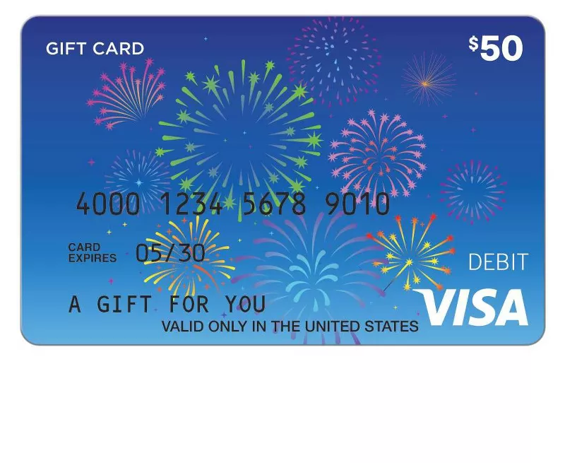

Prizes and winners!
CLUB that donated the prize | VALUE OF PRIZE | PRIZE | WINNING NUMBER | WINNER'S NAME | WINNER's CLUB
Sibley | 50 | $50 Gift Card | 3134 | Jeff Logan | Brookings
Spearfish-Northern Black Hills | 50 | $50 Cheyenne Crossing Gift Card | 3156 | Robert Plastow | Mitchell
Spearfish-Northern Black Hills 2 | 50 | $50 Cheyenne Crossing Gift Card | 4029 | Larry Keyes | Watertown

Slide 9
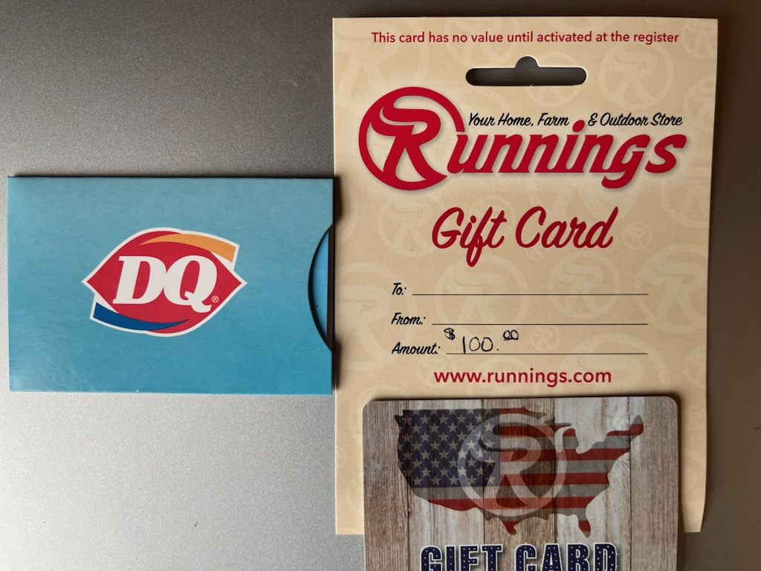
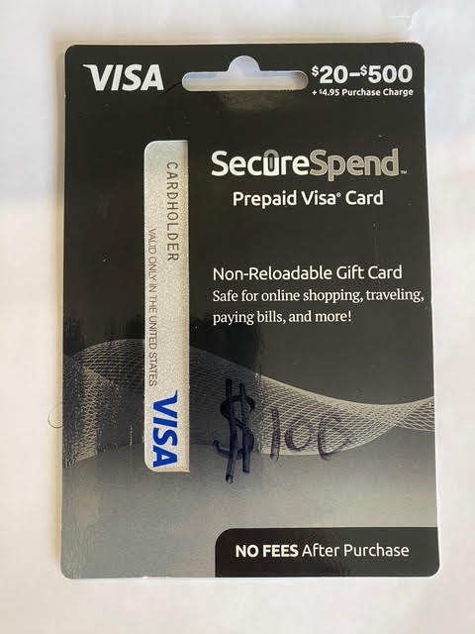
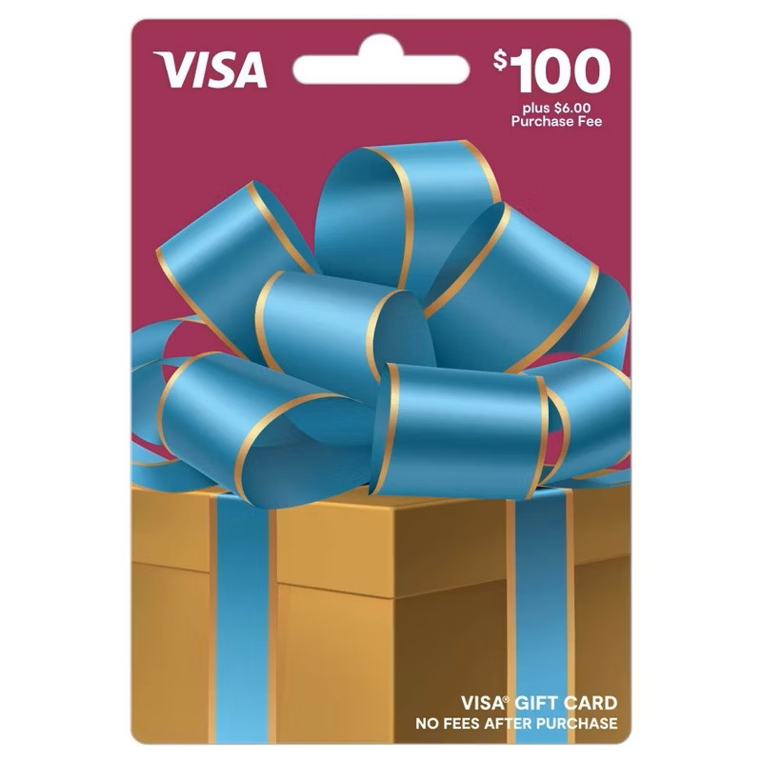

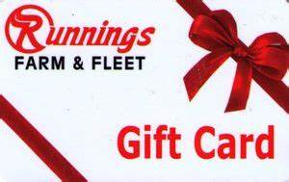
CLUB that donated the prize | VALUE OF PRIZE | PRIZE | WINNING NUMBER | WINNER'S NAME | WINNER's CLUB
Canby | 100 | $100 Dairy Queen Gift Card | 1161 | Jill Ruhd | Madison
Canby 2 | 100 | $100 Running's Gift Card | 2416 | Brian Gatzhe | Brookings
Canton | 100 | $100 Visa Card and a SD State Park Pass | 4049 | Carla Roby | Watertown
Cherokee | 100 | $100 Visa Card | 3259 | Sheila Moser-Davis | Mobridge
Luverne | 100 | $100 Visa Card | 790 | Arin Gonseth | Rotary Club of Sioux Falls Downtown
Marshall Sunrise | 100 | $100 Running's Gift Card | 45 | Mary Kenner | Rapid City Rushmore
Mitchell | 200 | $200 Cabela’s gift card | 2304 | Kirk Henderson | Canton
Mobridge | 100 | $100 Gift Card | 1301 | Ruth Schmidt | Centerville
Rapid City Rushmore | 100 | $100 Visa Card | 628 | John Carson | Custer
Sioux Falls South | 100 | $100 Gift Card | 1065 | Sherri Meyers | Rotary Club of Sioux Falls Downtown

Slide 10
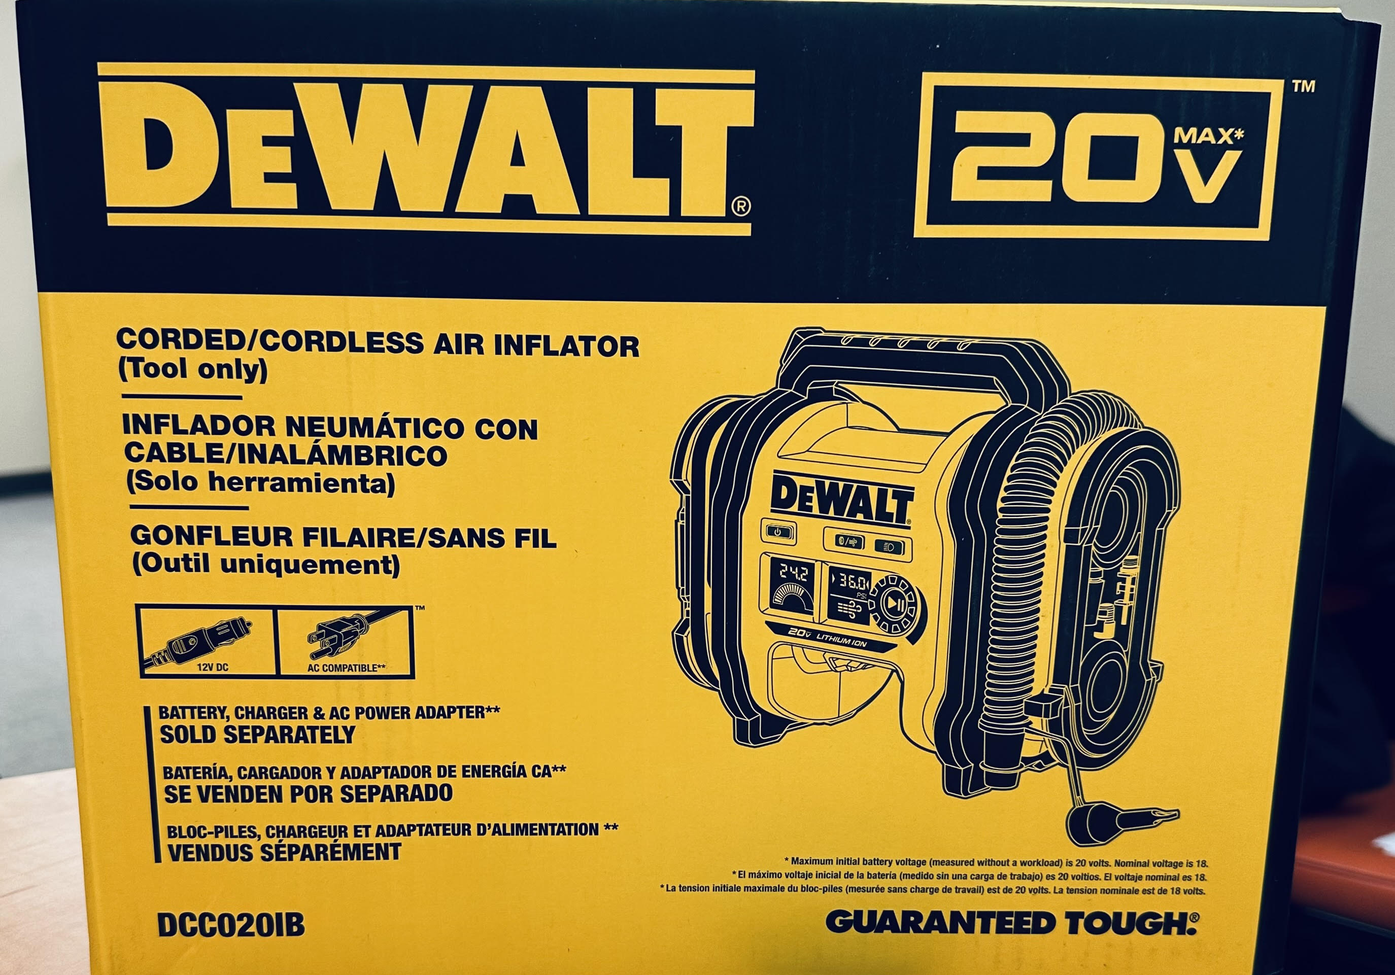
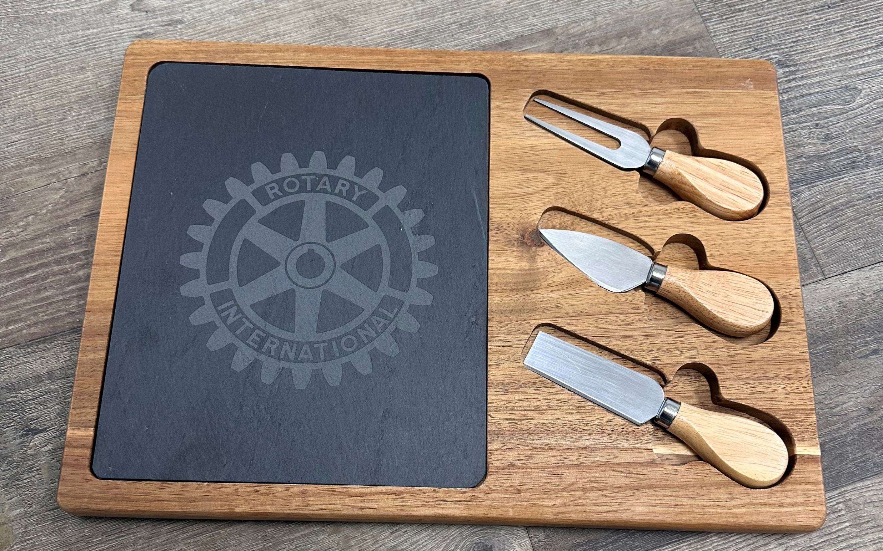

CLUB that donated the prize | VALUE OF PRIZE | PRIZE | WINNING NUMBER | WINNER'S NAME | WINNER's CLUB
Rapid City | 150 | $100 Amazon gift card to buy an Alexa; 5 + children’s book collection from Storybook Island (total value $150) | 3645 | George Lapp | Sioux Falls North
Sioux City | 150 | $150 Visa Card | 3276 | Mark Dady | Mobridge
Tyndall | 150 | $150 DeWalt Corded/Cordless Air Inflator | 4061 | Shane Conger | Watertown
Wagner | UNKNOWN AMOUNT | Rotary Cutting Board | 4322 | Tony Burg | Winner
Watertown | 150 | $150 Gift Card | 585 | Mindi Miller | Winner

Slide 11
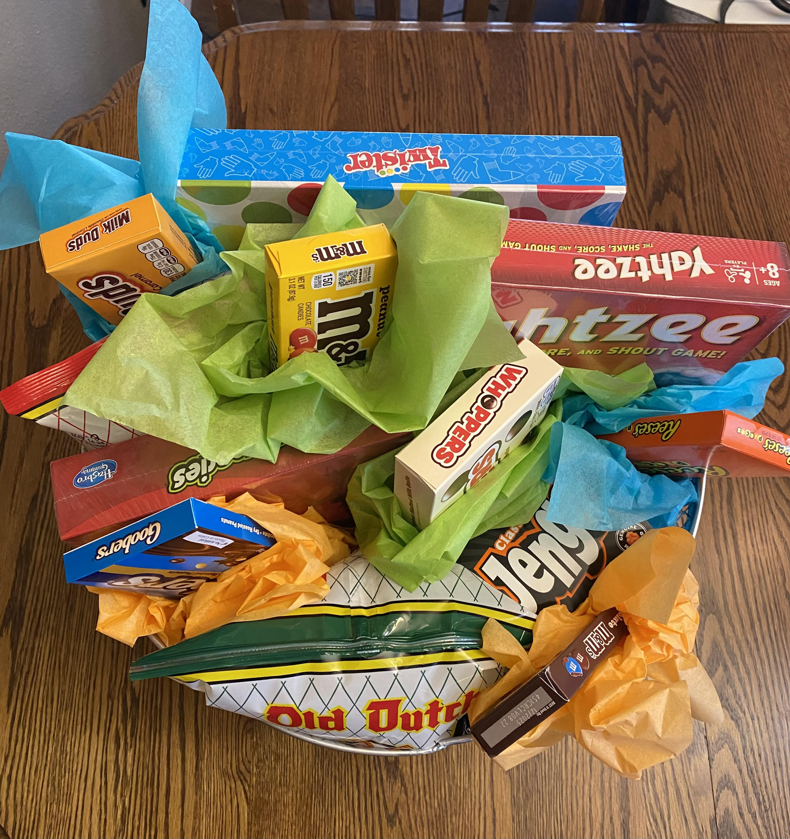
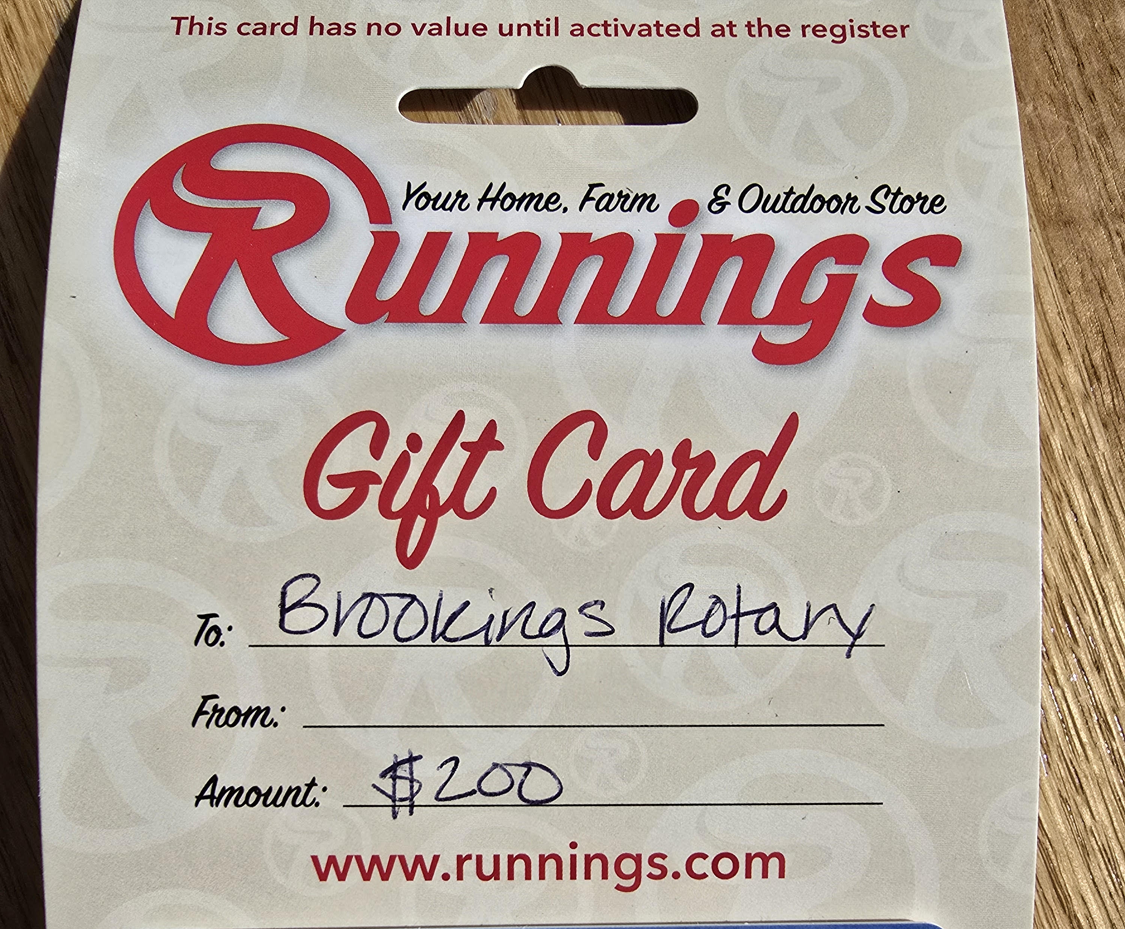
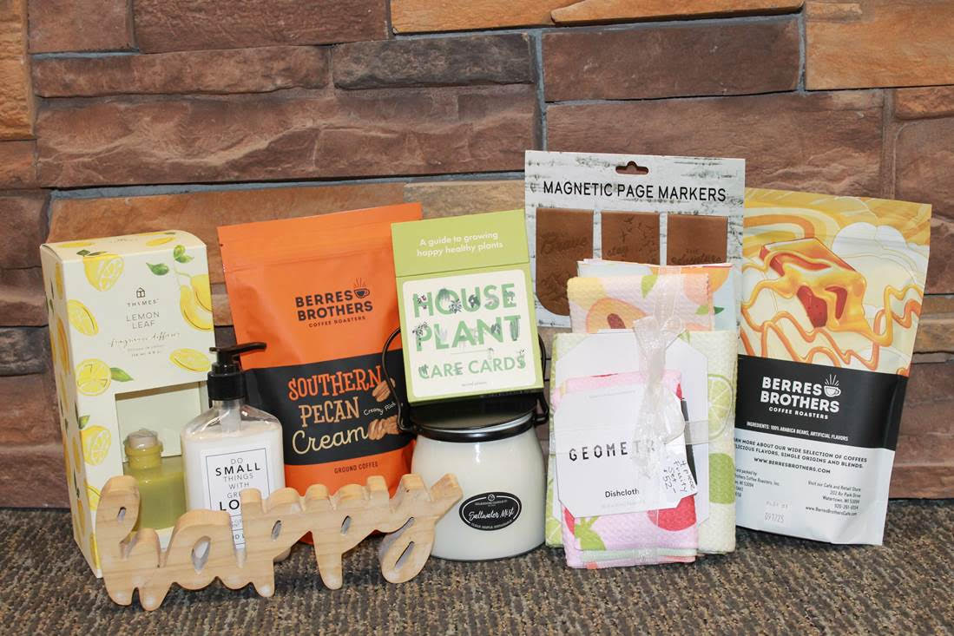
CLUB that donated the prize | VALUE OF PRIZE | PRIZE | WINNING NUMBER | WINNER'S NAME | WINNER's CLUB
Brookings | 200 | $200 Runnings Gift Card | 3246 | D'Orsay Winthers | Mitchell
Centerville | 200 | $200 Visa Card | 2309 | Kirk Henderson | Canton
Clark | 200 | Quarterly Dakota style boxes worth 50$ each total $200 | 2055 | Qadir Aware | Rotary Club of Sioux Falls Downtown
Le Mars | 200 | $200 Visa Card | 3141 | Todd Loomer | Mitchell
Mapleton | UNKNOWN AMOUNT | Games and Snacks Basket. | 3678 | Ashli Danilko | Tyndall
Marshall Noon | 200 | $100 Gift Card plus Brau Brothers Customary Beer, and Speciality Fudge ($200 total value) | 3331 | Roger Novontny | Pierre/Ft Pierre
Rock Valley | UNKNOWN AMOUNT | Geometry towel set, gourmet coffees, candle, lotion, magnetic page markers, lemon diffuser, and home décor | 3110 | Virginia Lambert | Mitchell
Sioux Falls North | 200 | $200 Visa Card | 2685 | Paul Hankenson | Luverne

Slide 12
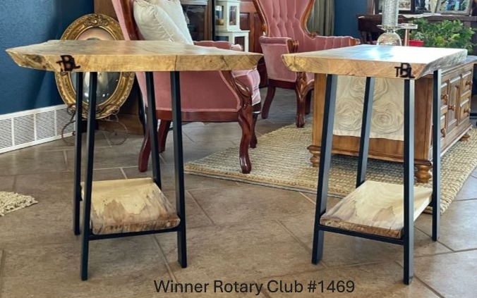
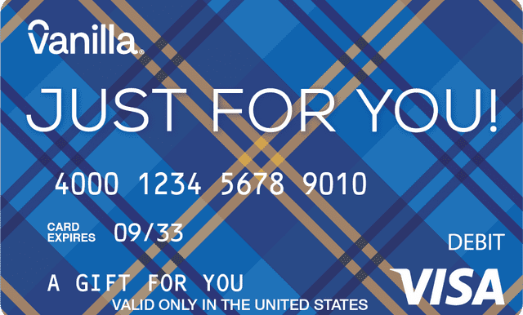
CLUB that donated the prize | VALUE OF PRIZE | PRIZE | WINNING NUMBER | WINNER'S NAME | WINNER's CLUB
Winner | UNKNOWN AMOUNT | A pair of maple accent tables created by Rotarian Tony L. Berg. One of kind to add to rustic warmth to your space | 1695 | Morris Nelson | Hot Springs
Madison | 250 | Gift Basket with an estimated value of $250 | 2598 | Jeff Johnson | Gregory
Sioux Fall West | 250 | $250 gift card to Landscape Color Gardens. | 3938 | Jerry Henke | Wagner
Vermillion | 250 | $250 Gift Card | 69 | Darrel Kaiser | Winner
Yankton | 250 | $250 Walmart Gift Card | 539 | Bryan Slaba | Wagner
Pierre-Fort Pierre | 500 | $500 Gift Card | 2319 | Patricia Frei | Wagner
Rotary Club of Sioux Falls Downtown | 500 | $500 Visa Gift Card | 4143 | Don Goldhorn | Watertown

Slide 13
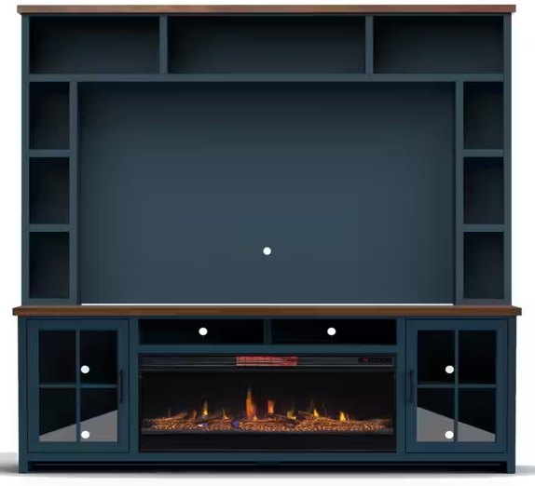
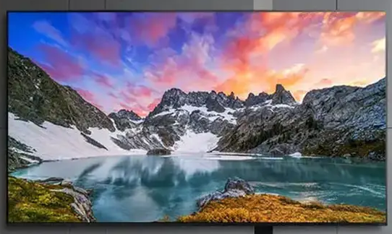
GRAND PRIZE !!!
CLUB that donated the prize | VALUE OF PRIZE | PRIZE | WINNING NUMBER | WINNER'S NAME | WINNER's CLUB
Gregory | 6500 | Grand Prize | 1421 | Rich Widman | Brookings
Grand prize (donated by Gregory)
98” LG 4K TV on a
Legends Fireplace Stand,
$6500 value!
  Donated by

Slide 14
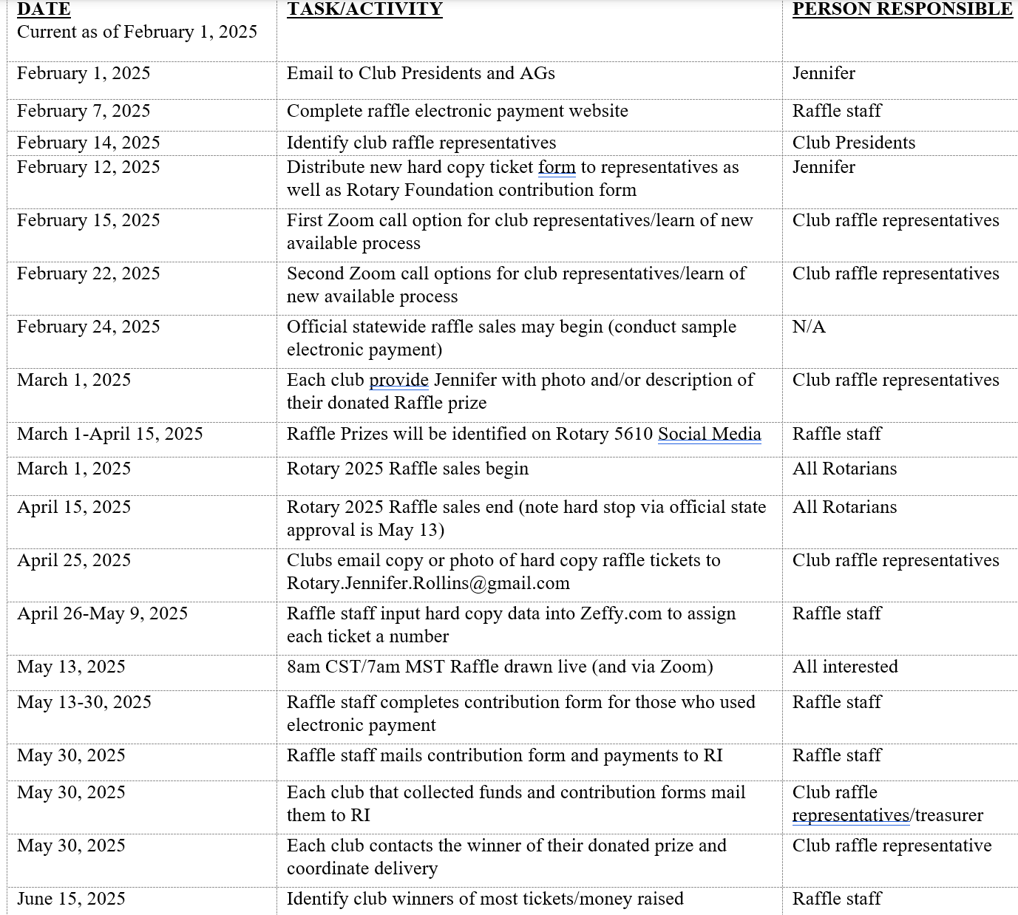

What’s next?

Slide 15

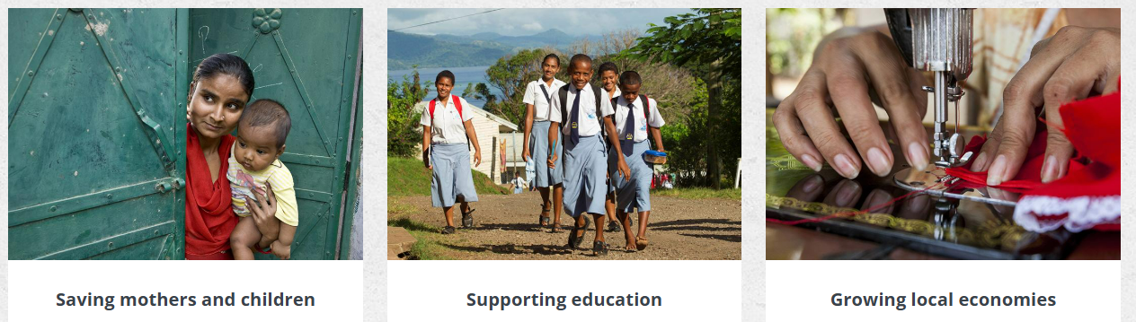

STARt thinking about your next club project!
For ideas, training, application form, visit:
https://www.rotary5610.org/sitepage/district-grants
Contact our District Grants Committee Chair, Brad Blahah

Slide 16

Congratulations
Winners!

Slide 17
Winners will be posted
https://www.Rotary5610.org/sitepage/district-raffle
Rotary District 5610 | Facebook
Feedback
Rotary.Jennifer.Rollins@gmail.com

