Slide 1
Embracing New Opportunities for Club Growth
Dave Cook
District 6000 DGE
April 27, 2024

Slide 2
Overview of Our Discussion Today
Each of us is being challenged to help grow our clubs.
Club Extensions are a proven way to help clubs grow by providing an alternate meeting time that allows more people to join.

Slide 3
Many of District 6000’s faster growing clubs have started Club Extensions
1. Winterset | +47% |  | 7. Perry | +14%
2. Bettendorf | +23% |  | 8. Mt. Pleasant | +13%
3. North Scott | +18% |  | 9. Boone | +13%
4. Iowa City Dntwn | +17% |  | 10. Marengo | +10%
5. Nevada | +17% |  | 11. Ankeny | +10%
6. Keosauqua | +15% |  | 12. Marshalltown | +9%
Membership Growth 7/1/20 to 1/1/24
Have Club Extension

Slide 4
Two fundamental truths will grow and strengthen clubs into the future.
Striving for greater membership parity among men and women is key to our future. Growth among adults 25 to 49 is especially important.
Clubs offering more than one meeting time are more likely to grow these key demographics because it helps them accommodate differing work schedules and family responsibilities.

Slide 5
Membership Among Men & Women
 | Women | Men
Worldwide | 26% | 74%
United States | 37% | 63%
District 5610 | 34% | 66%
Data as of 4/24

Slide 6
Membership Among Younger Adults
Rotary Region | Under 50 | 50+
Worldwide | 30% | 70%
U.S. Zone 29 | 24% | 76%
District 5610 | 27% | 73%
Data among those reporting.

Slide 7
Definition of a Satellite has Changed
In the past, a satellite was a short-term, transitional club the sponsor believed would charter to become a independent Rotary club within 3 years.
Today, a satellite or club extension is simply an alternate meeting time for a club. Members are full Rotarians in the sponsor club and many extensions have no future plan to charter.

Slide 8
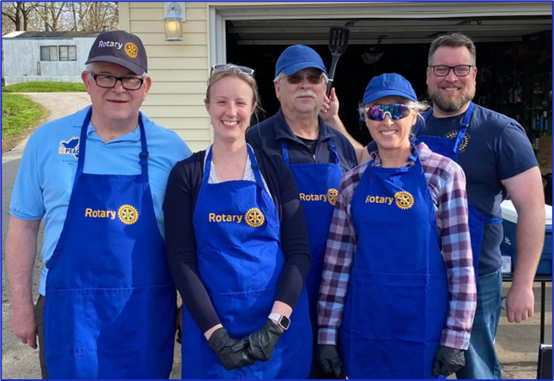
What’s the difference between a Satellite Club and Club Extension?
Satellites and club extensions are the same; an alternate meeting time that allows more people to join your club.

Slide 9
Popular extension strategy quickly gaining momentum in the U.S.
One club that meets at two different times.

Slide 10
5:30 to 6:30 is the Golden Hour for Club Extensions
Members come to Rotary after work and are still home for dinner & evening activities.
It’s preferred meeting time for parents of school-aged children, working moms, teachers, retailers and younger professionals.
No meal is served so membership costs less.

Slide 11
Other Factors Driving Extension Growth
Because it’s a club extension, members are included in sponsor club membership numbers.
Having two meeting time options is a big advantage for prospective members.
Snacks are usually provided and beer & wine are often available for purchase.
Younger professional couples often attend together.
Spouses of current members are among first to join.

Slide 12
Other Factors Driving Extension Growth
Most club extensions meet twice a month (1st & 3rd Thursday, 2nd & 4th Tuesday, etc.)
Common for members to attend both meetings.
RI recognizes one President per club. Leader of extension is often referred to as The Chair.
Most clubs maintain one board that includes club extension representation.
Decision to start a club extension does not require approval by RI.

Slide 13
Typical Member Quarterly Billing Comparison
 | Sponsor Club Quarterly Billing | Club Extension Quarterly Billing
RI & District Dues | $40.00 | $40.00
Meals @ $11.00 ea. | $132.00 | $0.00
Total | $172.00 | $40.00
For most clubs, only difference between quarterly billing for traditional members and extension members is cost of meals.

