Slide 1


Slide 2
Why
Raise Awareness of Rotary’s role in eradicating Polio
Create unified District visibility
Contribute to Zone-Wide Impact
Provide a flexible way for every club to participate
Create Lasting Impact

Slide 3
At 10:00 AM on October 24….
Rotary Clubs across Central Texas will walk simultaneously - demonstrating our unified commitment to ending Polio.

Slide 4
Goals of Walk
Increase Awareness of Rotary’s Efforts to eradicate Polio
Share consistent talking points on polio eradication and current efforts
Raise $1 million Zone Wide to support efforts to end Polio
Raise $113,585 in the District for PolioPlus ($58.70/member)

Slide 5
Ways to Participate
Host your own Club Walk (Strongly Encouraged)
Partner with another club(s)
Attend the District Central Walk
Host locally and attend the District Central Walk
All Walks begin at 10:00 AM on October 24
Clubs are encouraged to host a walk in your community to maximize district-wide visibility

Slide 6
Club Designed Walk – Supported & Flexible
District Provides
Official Branding & Logos
Approved Polio messaging and templates
Reporting tools & club recognition
Club Responsibilities
Secure location & obtain local permits (if required)
Coordinate local media outreach
Manage event logistics & on-site details
Your club leads locally – the District equips & supports you

Slide 7
Club Designed Walks
All Walks begin at 10 am, October 24
Clubs design their own walk
Distance determined by the Club
5K, 1 mile, through a park, 0.5K
Walk for a specific amount of time (i.e., 1 hour)
Combine with current PolioPlus fundraising events

Slide 8
Common Concerns
This complements existing PolioPlus efforts
  Clubs may combine traditional PolioPlus efforts with the walk
Flexible participation options reduce planning burden
District support available

Slide 9
Fund raising ($1 Million Goal)
$1 Million is Achievable - Together
  11 States, 23 Districts, 1,145 Clubs, 43,000+ Rotarians
  35% clubs (400) or 35% Rotarians (15,050) Participate
    Or any combination
  400 Clubs averaging $2,500 = $1 Million
  15,050 members donate $66.45 = $1 Million

Slide 10
Event Recognition
Participating Clubs receive:
World’s Largest Polio Walk Certificate
Thank you letter
Awards
District raising the most $/capita
District engaging the most people in the event

Slide 11

What is Needed From Participating Clubs
Designate
Designate Club Walk Champion
Attend coordination meetings via zoom
Keep Club informed of events
Monitor and respond to emails from District Walk Champions (that’s us)
Promote
Promote the walk
To your members
To the community
Use provided materials
Track
Track fundraising & participation
Info for reporting provided before walk
Submit
Submit post-event results
Reporting Form Provided
Due 1 week post walk

Slide 12
Key Dates
Summer – Promotional Push
October 24 – Walks Begin at 10:00 AM
1 week post walk – reporting deadline

Slide 13

New Logo
Do not use the original brand/logo
  If printed anything with old logo, can still use.
  All new printing must use the brand compliant logo
Club Walks – Pam B. can help create a logo for your club

Slide 14
Club Walks
Who is planning local walk?
Combining with other clubs?
Combining with PolioPlus events?

Slide 15
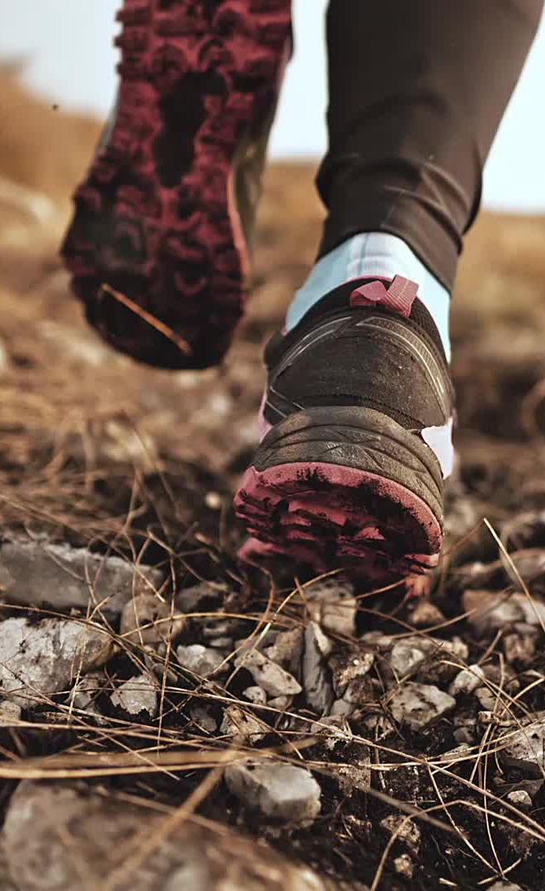
Fundraising Ideas
Walkers get pledges:
  For the walk
  By the step
  $X Miles logged by the club
Sponsorships of the Walk
This is optional
Club Fundraising Page via Club Runner
  QR code link to page

Slide 16
Polio Fact Sheet
(Consistent Messaging)
More than 20 million people are walking or alive today because of the polio eradication efforts of Rotary and our partners.
Since 1988, when the Global Polio Eradication Initiative was launched, more than three billion children have been immunized against polio.
Since 1988 only two countries, Afghanistan and Pakistan, have never stopped the transmission of the wild poliovirus, down from 125.
Up to 370 million children are vaccinated each year in polio-affected and high-risk countries to sustain high population immunity because as long as the poliovirus circulates anywhere in the world it is a threat everywhere.
During four-day polio immunization campaigns, over 45 million children under the age of five are immunized in Pakistan and over 11 million in Afghanistan.
There are 146 specialized polio laboratories around the world. Collectively they test over 200,000 stool samples every year.
It costs on average US$0.73 to immunize a child against polio in Afghanistan and US$0.52 in Pakistan, including the cost of the vaccine and activities required to deliver the vaccine to children. A child must receive multiple doses of polio vaccine to be fully protected and therefore must be reached multiple times.
In Pakistan, there are over 300,000 frontline health workers, mostly women, who provide vaccinations to children during immunization campaigns.
Through the PolioPlus program, Rotary provides US$150 million/year for the polio eradication efforts carried out by WHO and UNICEF.
If polio is not fully eradicated, we could see a global resurgence of the disease with as many as 200,000 new cases each year within the next 10 years.

Slide 17
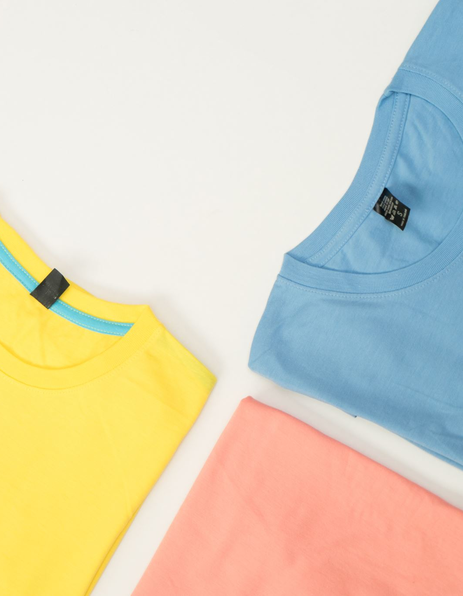
World’s Largest Polio Walk T-shirts
Designing District branded shirt
Goal is individuals able to order, pay and ship to them
Will have the District logo on it
  Most likely on the sleeve
Clubs may create on shirt, just be sure to use
  Official logo
  District Tag line –
  Creating Impact. Ending Polio.

Slide 18
District Walk
  District:
  Coordinates media outreach
  PI Team leads the social media campaign
  Manage site logistics & participant communications
  Provides a central gathering location for clubs preferring to join a district site
Lake Pflugerville Park
  18216 Weiss Ln
  Pflugerville, TX 78660
Gather at 9 am
Walk begins 10 am
5K loop
  Walk all or as little as you want

Slide 19
Media
Zone PI planning to provide media
Press release – fill in the blank
Social media
District PI
modifying for our district
Create own
Share with clubs to modify for local walks

Slide 20
Materials
All materials - logo, fact sheet, etc. post to District website
Available July 1st
Need before – send us email

Slide 21
Contact Info
  Russell Sander
  Russell.sander.rotary@gmail.com
  512-755-6729
  Tammie Sander
  davidsmommie@gmail.com
  832-236-5951
Questions ?

