Slide 1



The Vision Statement
Notes:
Asks audience to sit with someone they do not know.
Have them sit by club size.
If you club is 80 people or more, sit at these tables
If your club has 15 or fewer sit at these tables.
If your club is on the cusp, you're welcome to choose to sit where you feel you'll get the most value.

Slide 2


Slide 3

Develop service projects that reflect the needs of your community and are more effective.

Slide 4

Work with groups, organizations, and community leaders that you haven’t partnered with before. Show that we’re inclusive, engaging, compassionate, and ambitious about making change.

Slide 5

Make all members feel like they have a role in the club and make sure that anyone who engages with your club feels empowered to share their ideas and get involved.

Slide 6

Ask members what your club should continue, start, or even stop doing to ensure that the club reflects the needs of its members and potential members

Slide 7


Make decisions grounded in evidence.
Be inclusive, engaging, compassionate, and ambitious on behalf of the world.
Create meaningful relationships across decades and continents.
Seek new perspectives and new ideas that can strengthen Rotary and create lasting change.
Notes:
NO MORE THAN 5 Minutes!
The action plan isn't just something Rotary International created that doesn't pertain to you. Everything you'll be learning about this weekend has its place within the action plan and our goal is that by the end of this session you'll see how everything you do to improve your club has it's roots in the action plan.
That's why on the sheet you have in front of you it says Personal Action Plan.
So lets take a look at the 4 parts to the action plan:
First we have:
Increase our Impact:
We want to build practices and infrastructure to define, measure, track, and analyze data from our service projects.
Next, we have
Expand our Reach:
We want to share our values with new audiences and creating new ways to bring people together to experience the power of Rotary.
Third, we have:
Enhance Participant Engagement:
We want to use every encounter as an opportunity to show people what Rotary can do for them as individuals and as members of our communities.
Last but not least, and possibly the hardest depending on your club, we have:
Increase our Ability to Adapt:
We need to work to create a culture of research, innovation, and willingness to take risks in your club to better serve your community.

Slide 8

Notes:
Introduce yourself

Slide 9

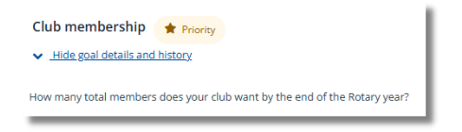

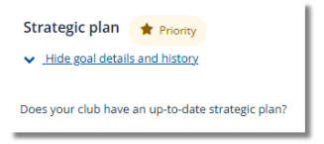
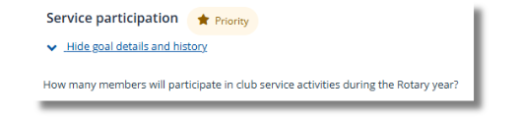
Three-year Rolling Goals: 6 Priority Goals
Club Membership
This goal is the number of members you want to have at the end of the year.
Strategic Plan
Even sitting down with your board of directors to set your 3 year rolling goals will complete this for you.
Service Participation
This is the number of members you want to participate in club service activities.

Slide 10
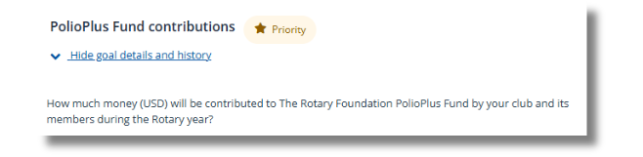
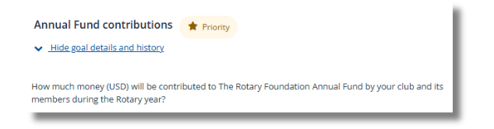
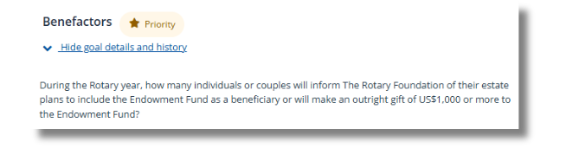
Three-year Rolling Goals: 6 Priority Goals
PolioPlus Fund contributions
How much would you like to see your club members donate to the PolioPlus Fund?
Annual Fund contributions
How much would you like to see your club members donate to the Annual Fund?
Benefactors
This one may seem daunting! Make a goal that makes sense for your club.

Slide 11
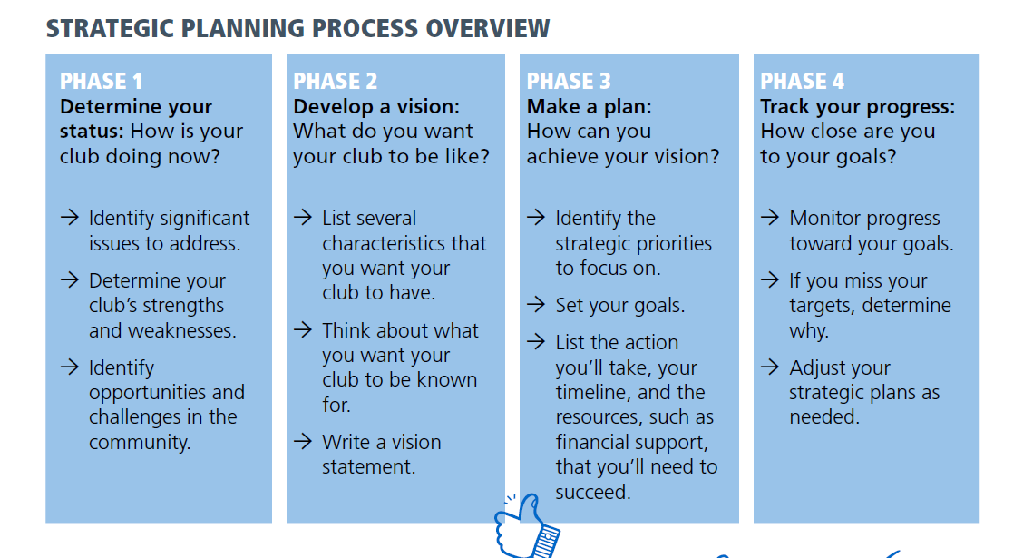

Slide 12
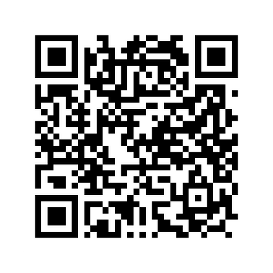
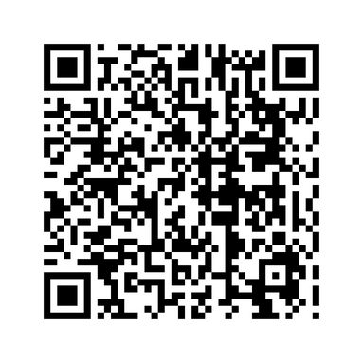


What Clubs Can Do:
Action Plan
Strengthening Your
Membership:
Notes:
Before we leave today, I want to make sure you know that there are so many resources available to you. On the Southwest PETS Website, links are up to some of our favorites.

Slide 13


Slide 14
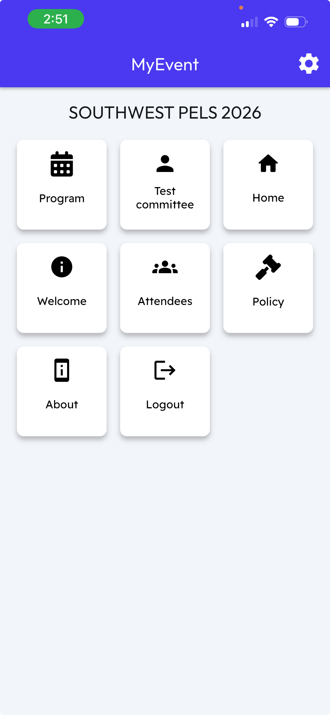
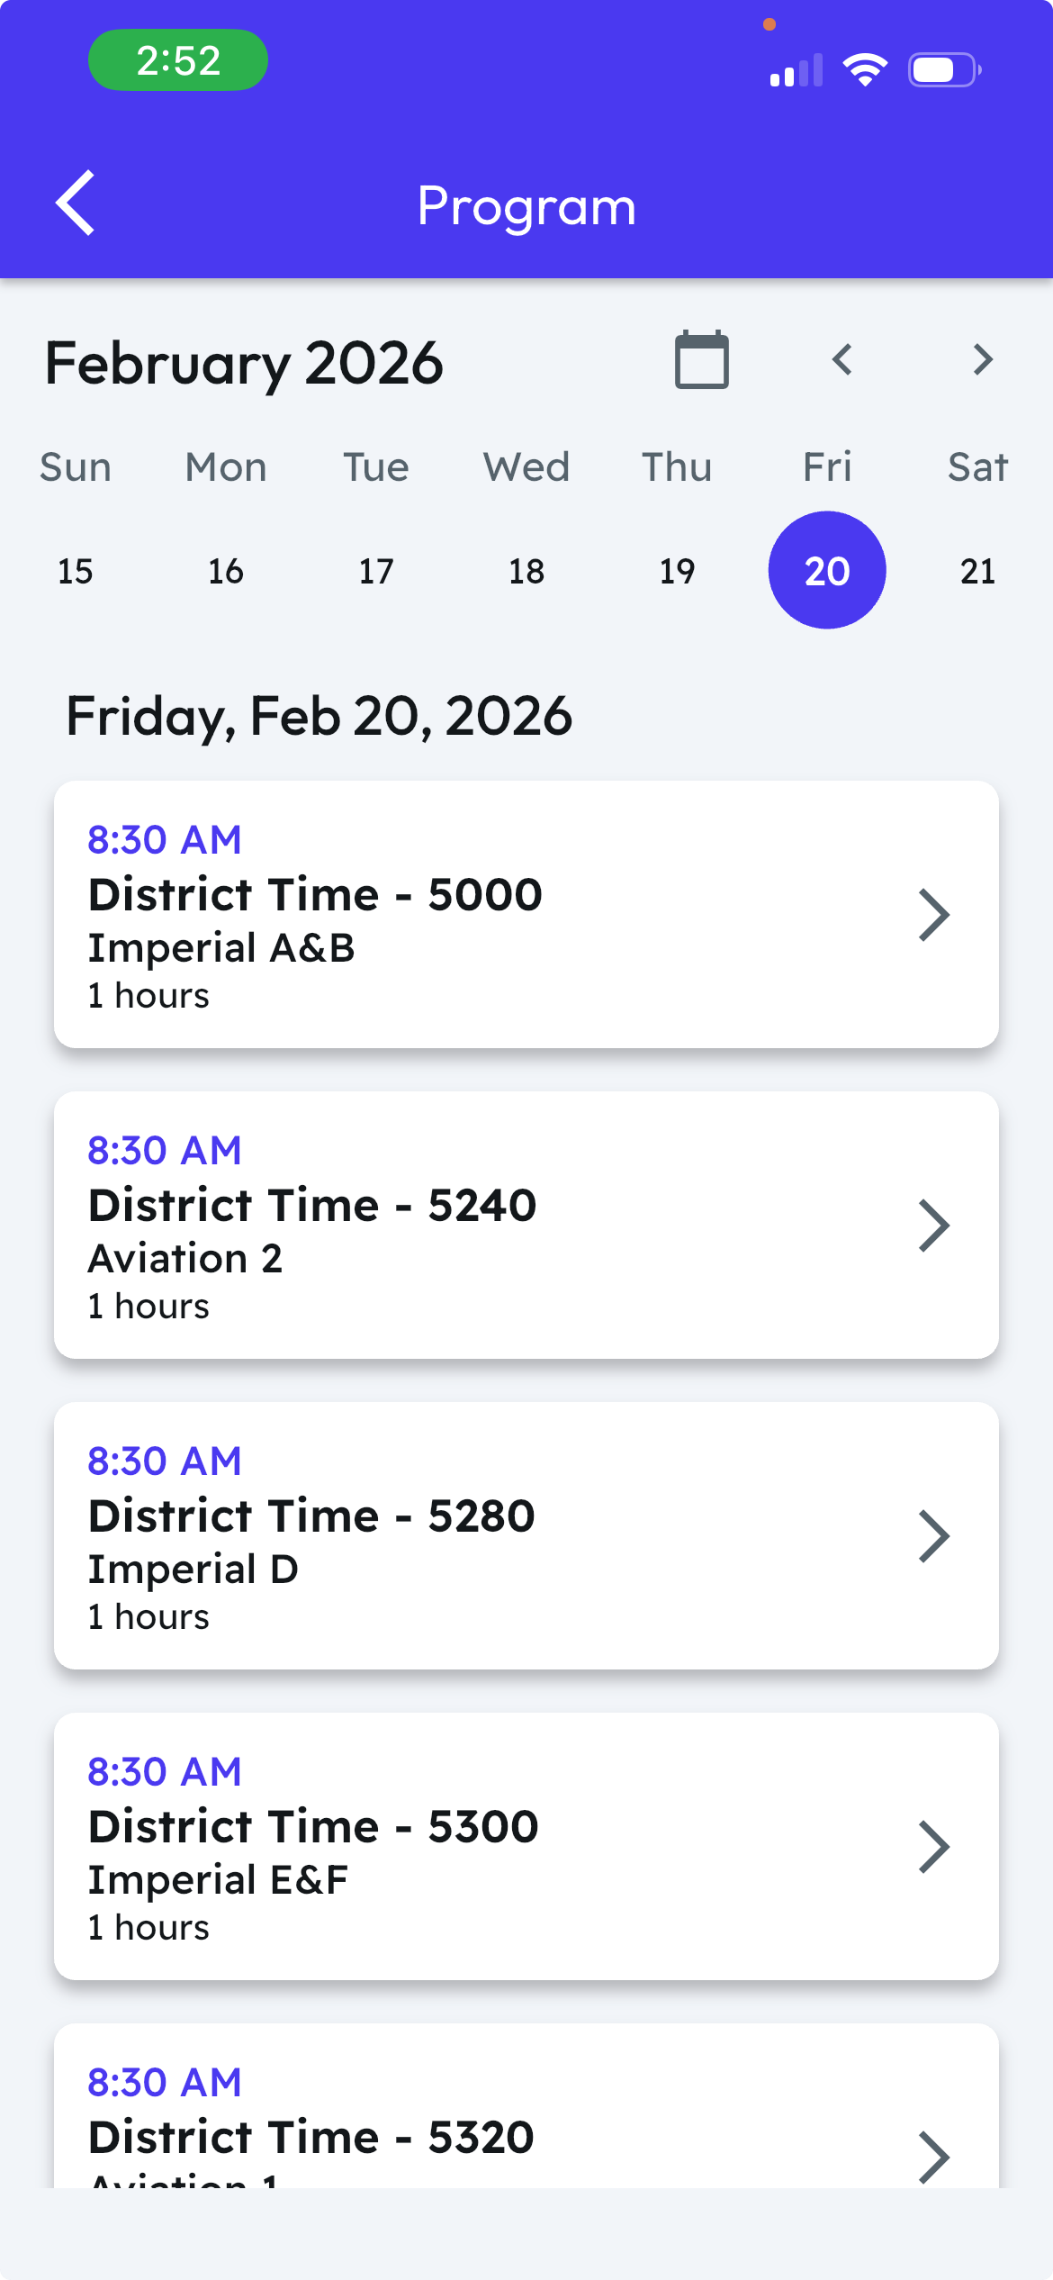
Before you go: download
MyEvent app
Use your email address
Password: ROTARY2026
Event is SWPELS2026

Slide 15
Thursday, Feb 20:
Airport Shuttle Free 24-hour shuttle bus to the hotel, proceed to the red designated curbside waiting area. Blue/Black LAX Marriott Hotel shuttles arrive every 20-25 minutes. Shuttle Phone: +1 310 338-9466
All get room keys from the front desk. PELS registration booth on the Ballroom level is open Noon-5pm on Thursday. If arriving after 5pm, go to the District’s Suite # 104. All go to the District’s Suite #104 to get your bag, portfolio and kukui nut lei.

Slide 16
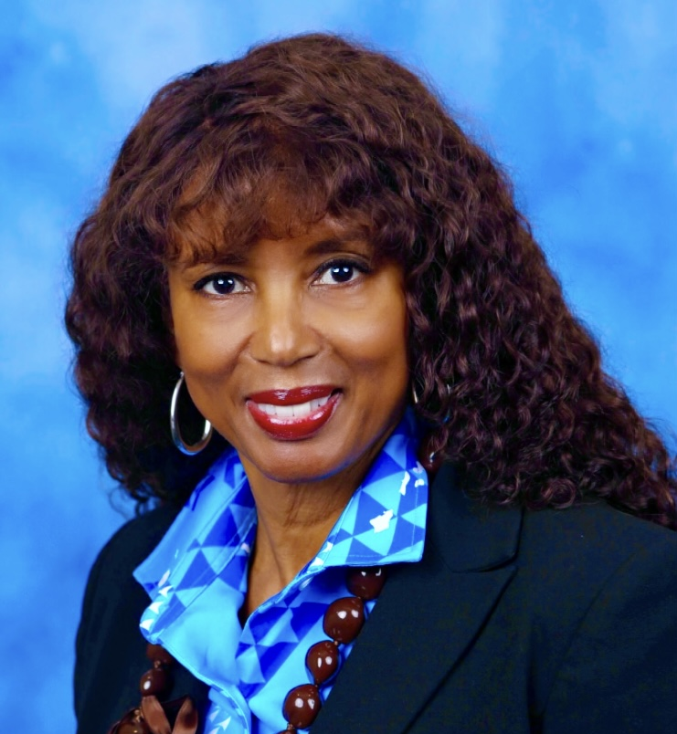
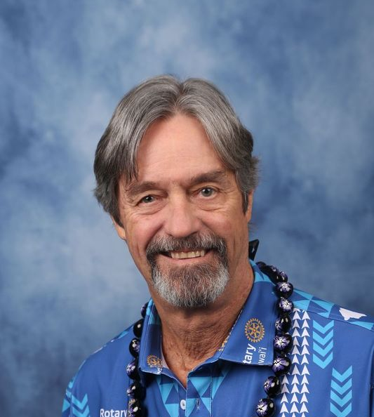
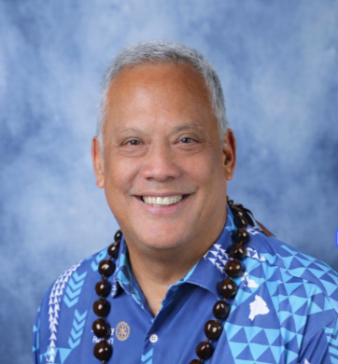
Don’t forget to take Individual photos
Wear District shirt with kukui nut lei.
Fri 8am-5pm, Sat 7:30am-6:30pm, Sun 8:30am-11am
Los Angeles Room 1

Slide 17
Friday, Feb 21: Remember to wear name badges to all sessions
Breakfast on your own
8:30-9:30am District meeting, Imperial A&B
Elective breakout session at 9:45am and 10:45am. Schedule on your badge
11:40am Be prompt. Assemble inside Marquis Ballroom. Scan badge, find seat Wear District 5000 shirt/ kukui lei. Get silk lei to pass out. Group picture in front of stage, with silk lei on arms.
Noon General Session 1 & lunch (11:45am doors open) D5000 marches in, distribute lei
Core Sessions 1:45pm, 2:55pm, 4:05pm
6:30pm General Session 2-dinner (Reception 5:40pm, 6:15pm doors open)
8-10pm D5000 Hospitality Room in Suite 104. Clean up crew. Aloha attire. District Members only.

Slide 18
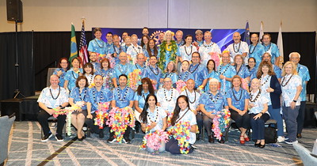

Slide 19
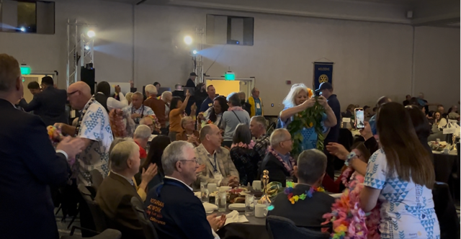

Slide 20
Saturday: Remember to wear name badges to all sessions
7:00-8:30 General Session 3 and breakfast (Doors open 6:45am)
8:45am, 9:50am and 10:55am Core Sessions
Noon-1:30pm General Session 4-lunch (Doors open 11:45am)
2-5pm District Training in Imperial A&B
5:30pm reception – Saturday night attire is semi-formal.
  Dress for the ladies and tie and jacket for the men.
6-7:30pm General Session 5-Dinner (Doors open 5:45pm)
7:30-10pm Hospitality in Suite 104.
  Aloha attire. Open to everyone
  AGs to clean up. Pack up room.

Slide 21
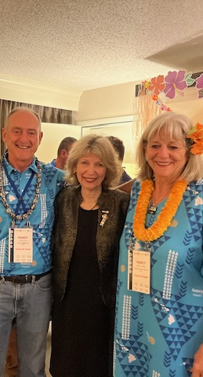
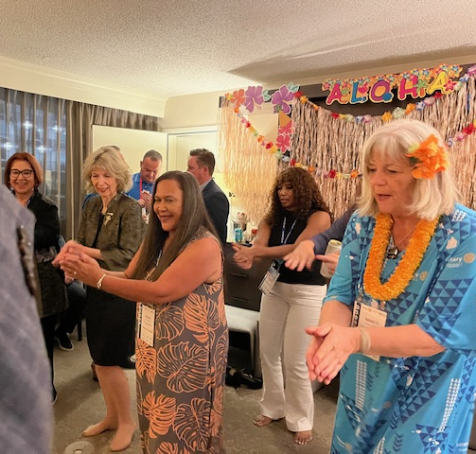
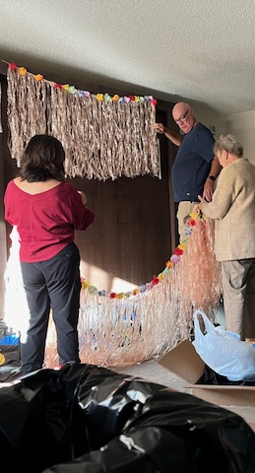

Slide 22
Sunday: Remember to wear name badges to all sessions
Hotel check out time is 11am.
  Check out and leave your bag with the Bell desk.
8:00-10:00am District session in Imperial A&B
10:30am-Noon General Session 6- brunch, Marquis Ballroom
  Give your kukui nut lei to someone special

Slide 23
Reminders:
Wear badges at all times,
Emergencies: see Sergeants with vest,
Bring jackets (may be cold in rooms),
Attire: business casual with kukui nut lei, bring business cards. Visit the vendors on Friday and Saturday to purchase all the Rotary paraphernalia you want.
Attire is business casual. Saturday night is semi-formal.
Don’t forget to see the photographer for your photo.

