Slide 1

Welcome AGs!
Focus on Our Rotary Foundation
WHY?

Slide 2


OUR ROTARY FOUNDATION
– POWERED BY ROTARY MEMBERS

Slide 3
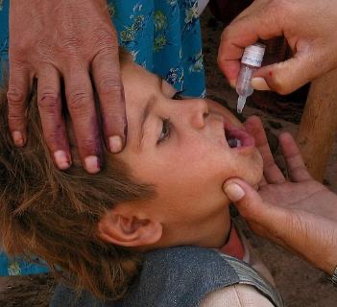
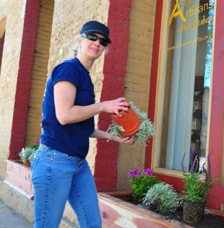
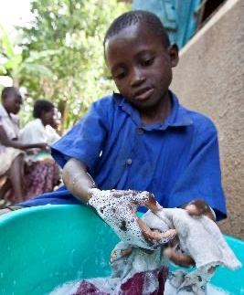
We give to Our Rotary Foundation because
PolioPlus Fund
End Polio Now
Annual Fund
District Grants &
Global Grants
Endowment Fund
To Secure Tomorrow
Disaster Response
A specific Area of Focus

Slide 4
When you give to Our Rotary Foundation,
it gives back to you,
transforming your gifts into programs and projects
that change lives and build peace,
both close to home and around the world.

Slide 5
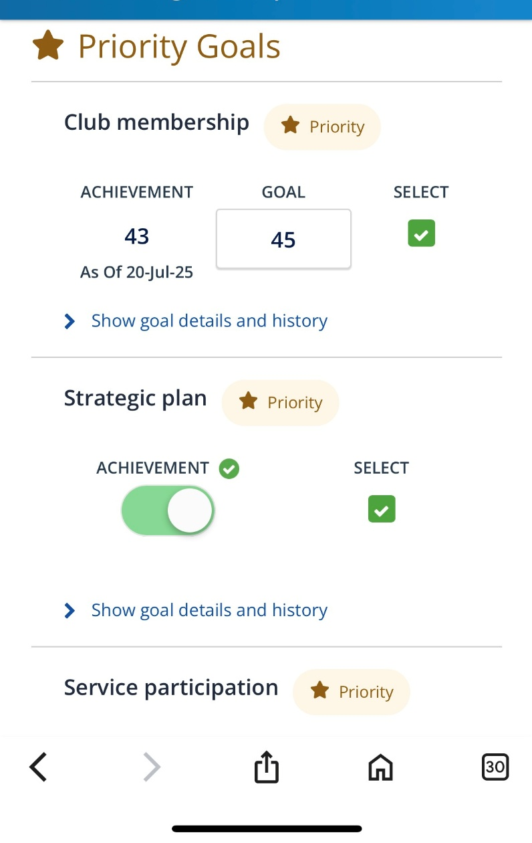
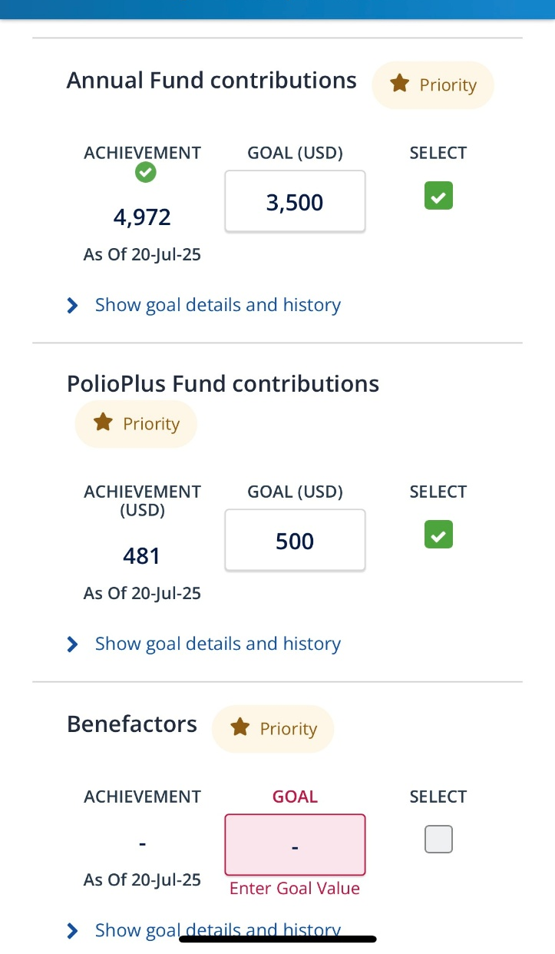
Six priority goals

Slide 6
HOW OUR ROTARY FOUNDATION ‘FUNDRAISING’ WORKS
PolioPlus
Annual Fund
Endowment Fund
Funds Spent
only on Polio
Funds are matched 2:1 by Gates Foundation

Slide 7


Together, we end polio.

Slide 8
HOW OUR ROTARY FOUNDATION WORKS
PolioPlus
Annual Fund
Endowment Fund
3 – Year SHARE
Gifts come in Y1, Y2 and Y3
Year 4:
Y1 Gifts released to Projects
Interest Income helps pay Operating costs

Slide 9
HOW OUR ROTARY FOUNDATION WORKS
PolioPlus
Annual Fund
Endowment Fund
Cash and Bequests
Principal Never Spent
Earnings to Projects and Expenses

Slide 10

The true meaning of life
is to plant trees under which
you do not expect to sit.
Nelson Henderson

Slide 11

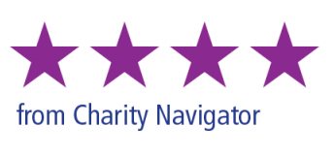

Slide 12
How does a focus on Our Rotary Foundation
help a club be successful and thrive?
Consider how this focus will:
Engage members?
Attract new members and expand our reach?
Create a positive club experience?
Increase our impact?
Increase our ability to adapt?

Slide 13

Together, we see a world where people unite and take action
to create lasting change –
across the globe,
in our communities,
and in ourselves.

Slide 14


