Slide 1

CLUB SECRETARY
Spring Learning Seminar - April 2026

Slide 2
As club secretary, you have an important role in helping your club run smoothly and effectively
Notes:
The session is being record so you can refer to this later and this powerpoint will be in on the District website in the webinar recordings page

Slide 3
DUTIES
Maintain Records and Reporting:
1. Membership – new, terminating, updates
2. Calendar of club and District activities
3. Meetings
Meeting notices
Agendas
Minutes (written minutes provided to members within 60 days of meeting)
4. Club Records (keep a folder and retain for 5 years)
Constitution, By-Laws
Correspondence
Preserve historical records
Reporting – rotaryd5000.org
Membership Changes - within 2 weeks
Officers and Chairs – by January 31 for incoming officers
Club Info – Changes in meeting days/time/location

Slide 4
Tasks
Learning – District training, Learning Center (MyRotary>Knowledge & Resources>Learning Center)
Transition - Meet with the outgoing secretary and receive club records
Meet with the incoming club officers or board of directors to plan the year
Create a My Rotary account on Rotary.org, if you don’t have one
Update your club’s records and member list on My Rotary, or through your club management system
Make sure the club treasurer has the club invoices, due in July and January
Take minutes at club and board meetings and club assemblies
Update club and officer information
Manage club correspondence, including responding to emails and sending official notices and invitations
Keep promotional items, name badges, and other materials used at meetings and events
Preserve your club’s historical records
Write an annual report for the club at the end of the Rotary year
Assist the club president, treasurer, and committees as needed
Meet with your successor and hand over club records
And anything else as assigned

Slide 5
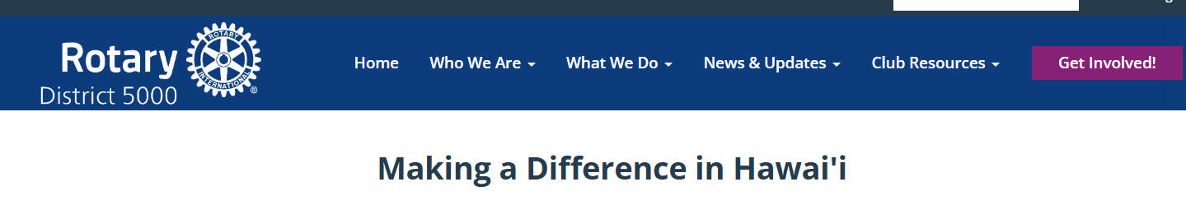
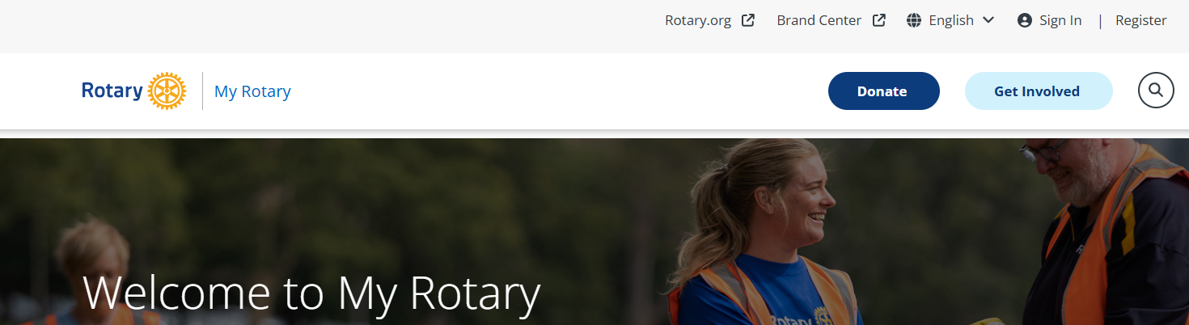
Websites
District – rotaryd5000.org
Rotary International – rotary.org

Slide 6
District Uses ClubRunner
District 5000 uses ClubRunner’s program for the website.
Clubs do not need to use ClubRunner for their own websites, however, if clubs are using ClubRunner, the club’s information uploads to the District’s website when integrated.
If your club does not have a website or uses another web designer, input the member information and officer list on the District’s website.
Download the “Clubrunner” app from the Apple App Store or Google Play

Slide 7
rotaryd5000.org
What you can find on the district website:
Membership rosters
District dues invoice template
District Chairs and Org Chart
Information on the Avenues of Service
Club Presidents and Meeting Locations
Events in the Calendar
Register for Events
Look for Rotarians in the Doing Business Directory or Yellow Pages
Notes:
Who we are – find a club – secretaries need to keep meeting locations and other info updated.
Recommend going to the breakout on club resources for where to find these. Will be April 5 11:30

Slide 8
District Website: rotaryd5000.org (ClubRunner)
Membership Information:
Add or terminate members
Update Member Profiles
Identify Officers and Club Chairs
Membership information uploads to Rotary International automatically (sometimes there is a time delay.)
Important to have the correct address and email address.
Notes:
User Name for the RI website is the original email address on record and the address is where the Rotary magazine is mailed

Slide 9
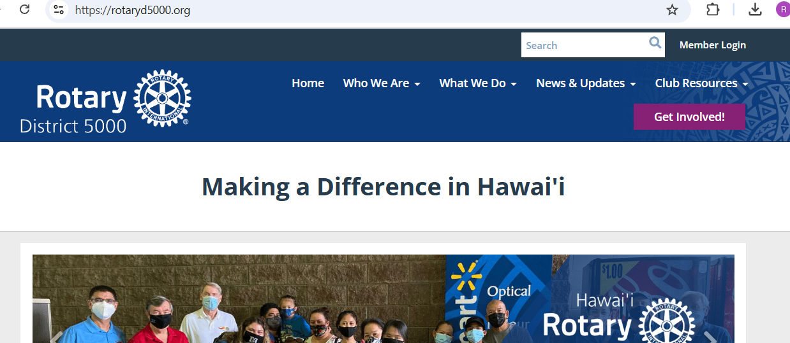
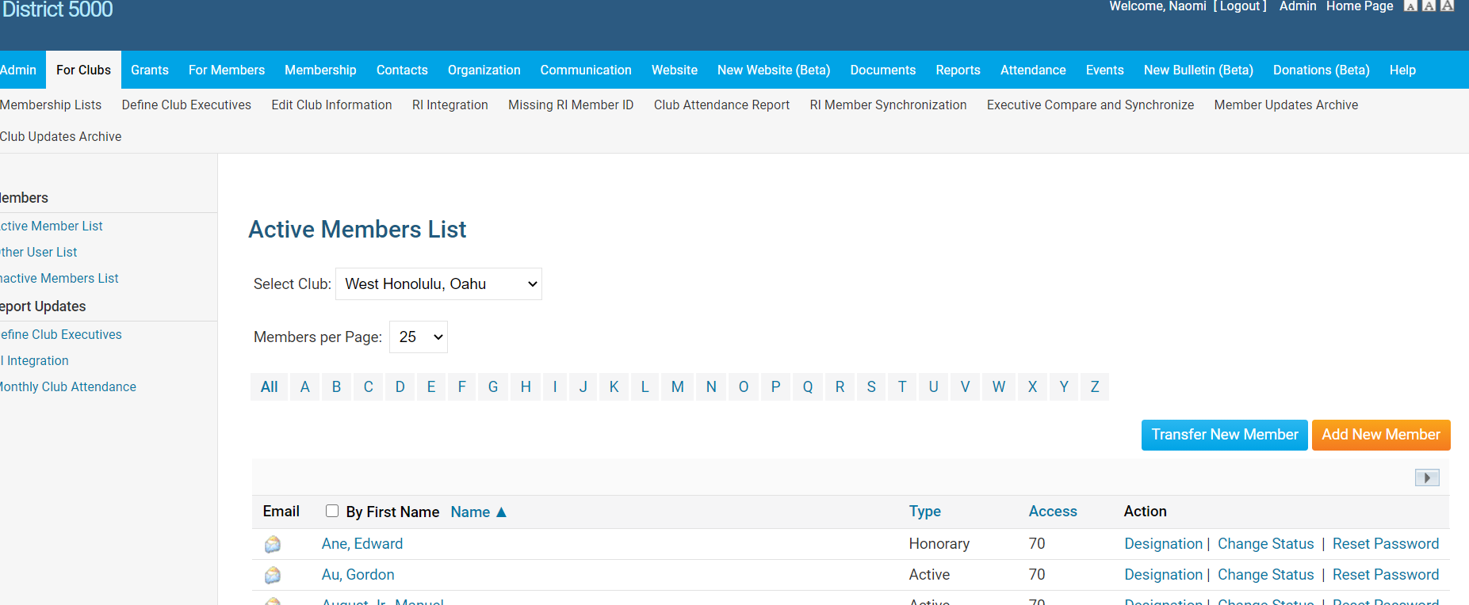

Log In, click on ”Member Area” to get to Admin Sitepages
To Add a Member:
Click on “For Clubs” , “Membership Lists”, “Add New Member”

Slide 10
Tips - Membership Rosters
Keep your roster up to date. RI will prepare invoices as of July 1 and January 1 and New members added after the RI invoice date will be prorated for dues at the RI next billing.
If adding a Rotarian, make sure you keep their same Rotary ID number to preserve their Paul Harris point history. You can add them to your roster from the RI website by doing a search from the MyRotary-Club Resources-Club & Member Data area. Click on “Add, edit or remove members” and then: Search for an existing member. Or, from ClubRunner, click on Transfer New Member.
3) Ensure that the name on the RI records is exactly the same as ClubRunner’s records.
Notes:
you are not able to adjust that number. If terminating any membership, best to do it by June 15 and Dec 15. Suggest sending the club invoices out no later than June 1 and December 1, with payment due dates of July 1 and January 1.
Sometimes the RI membership list and club or district membership list doesn’t match. Eg; gets put in clubrunner but not RI.

Slide 11
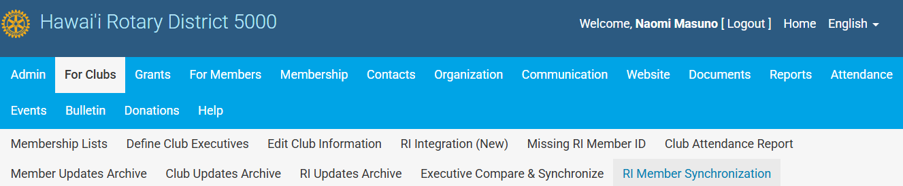

Synchronization
Periodically, perform a synchronization from ClubRunner by clicking on “RI Member Synchronization”. This action compares the ClubRunner roster with the RI roster and lists those who are not on the RI website and also those on the RI website, but not in ClubRunner. Click on the link to add them to the site that is missing the listing. If you find a member with 2 RI numbers, they need to call RI to consolidate the profiles. 1 866-976-8279 (toll free)

Slide 12
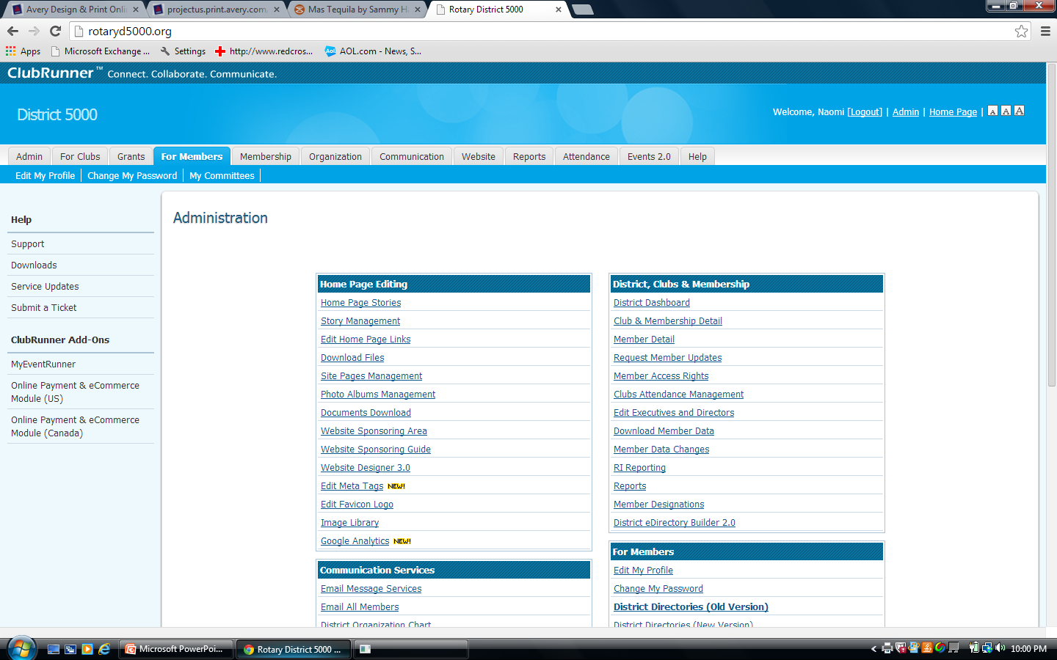
To Update Member Information
Click on “For Members”, then “Edit My Profile”
Notes:
Each member can update their own record
RI website uses email address as user name. Important to have correct email address.

Slide 13
Member Profile
Click “Edit” and enter information
To download a picture, click on “Update” under the silhouette
The primary email address will be used for emails.
Check other tabs for other categories to edit.
Change passwords in the “Settings” tab.
Opt in or out in the “Privacy” tab
Don’t forget to click on “Save” at the bottom.

Slide 14
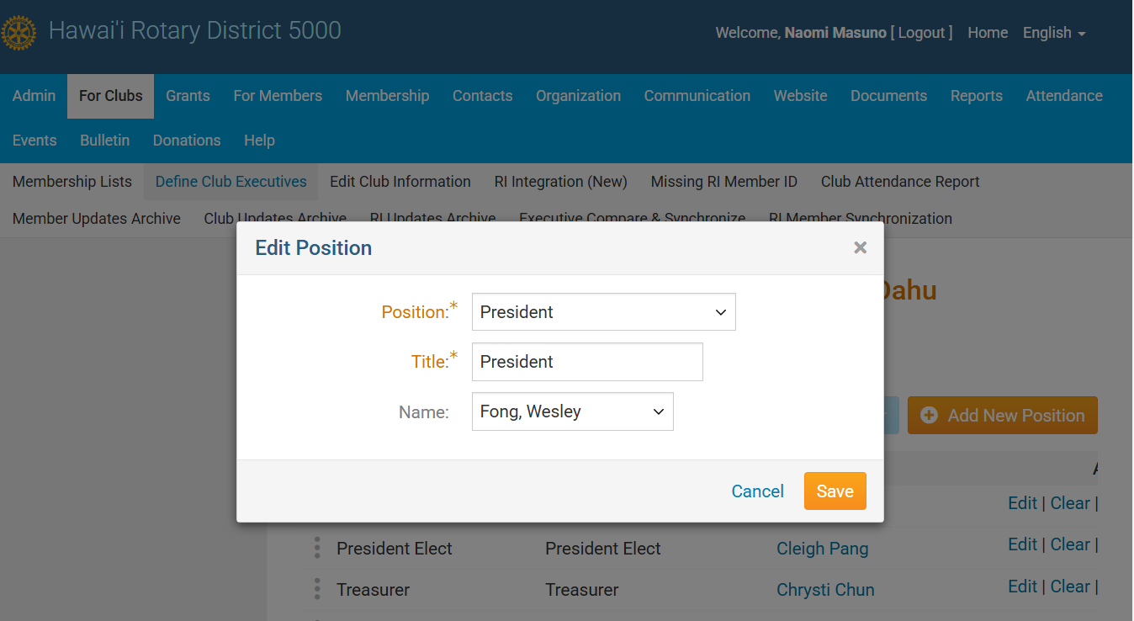

Click on “For Clubs”, then “Define Club Executives”
Click on “Next Year” to list your officers. Use the “Edit” button to add names or “Add New Positions” to add lines.
Tip: If “Carry over Next Year” is highlighted, click on it and all the positions will carry to the next year!

Slide 15
New Officers: Elected by December 31. Nominations 30 days Before
ELECTIONS. Review your Constitution and By-Laws
The annual meeting for the election of officers should be held no later than December 31st. Elect officers, including the President-Elect and Club Trainer. The President for 2026-2027 was elected last year and is the current P.E.
Input the elected officer names on the district website by January 31. Information uploads to the RI website.
Notes:
This coming December, the club would be electing the President for the 2025-2026 Rotary year. The 2024-2025 President was elected this past December and becomes the PE July 1
The Club Trainer title is changing to Club Learning Facilitator beginning July 1.

Slide 16
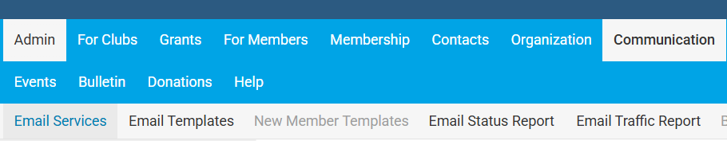
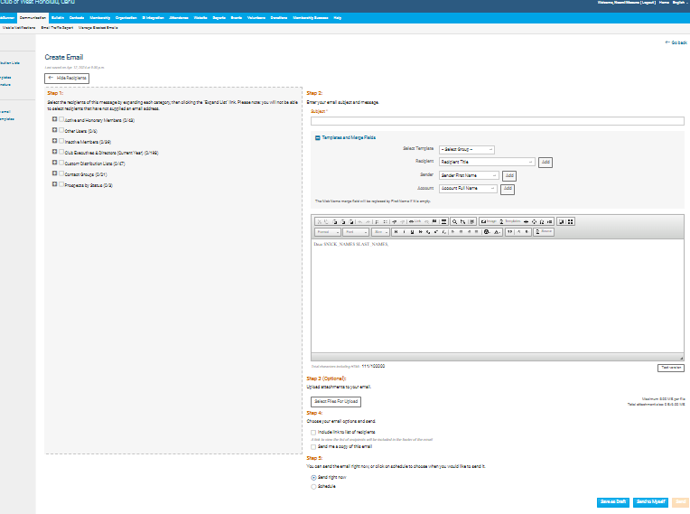
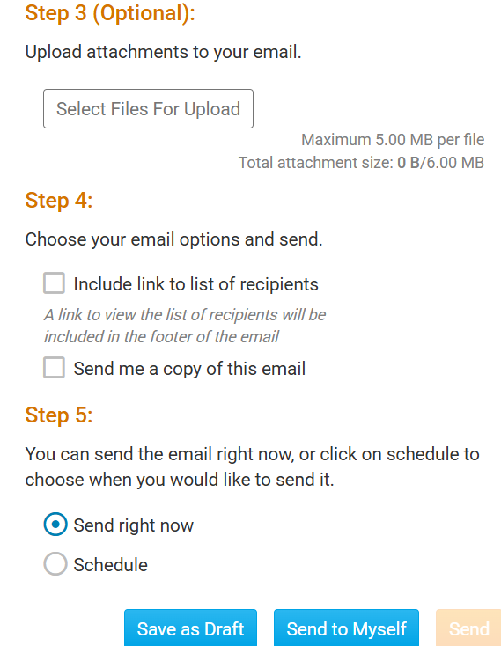
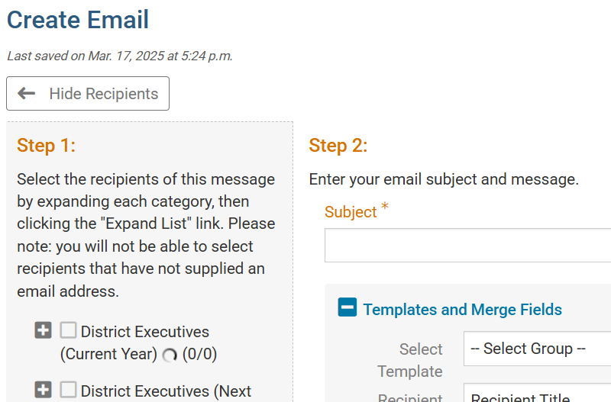
ClubRunner Email
Log in – Member Area – Communication - Email Services
Compose new message:
Step 1 – Who is the email going to?
Step 2 – What is the message
Step 3 – Upload attachments, if applicable
Step 4 – email options
Step 5 – When to send it?
Notes:
This is why positions need to be updated.

Slide 17
RI Website: rotary.org/myrotary

Slide 18
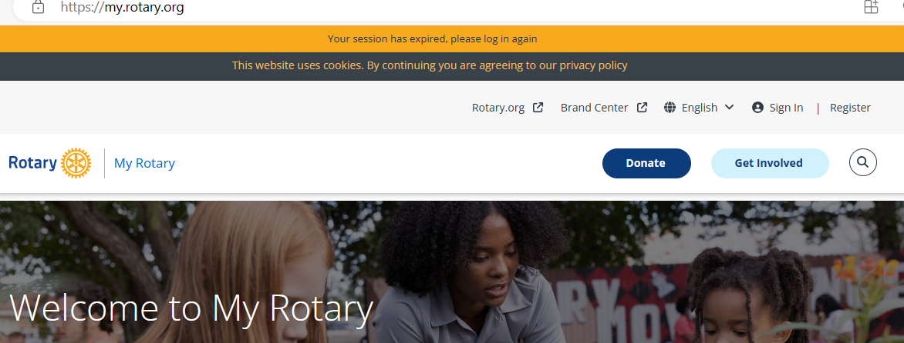
rotary.org - Sign In
Sign in with your email address and password. “Register for an Account”, if you have never signed in or if you have entered the wrong sign-in info too many times. The User Name or Login password may be different from District’s website password. Email address is from the District’s website, unless you change it for RI. If your email address changes, RI’s website needs to be updated separately.

Slide 19
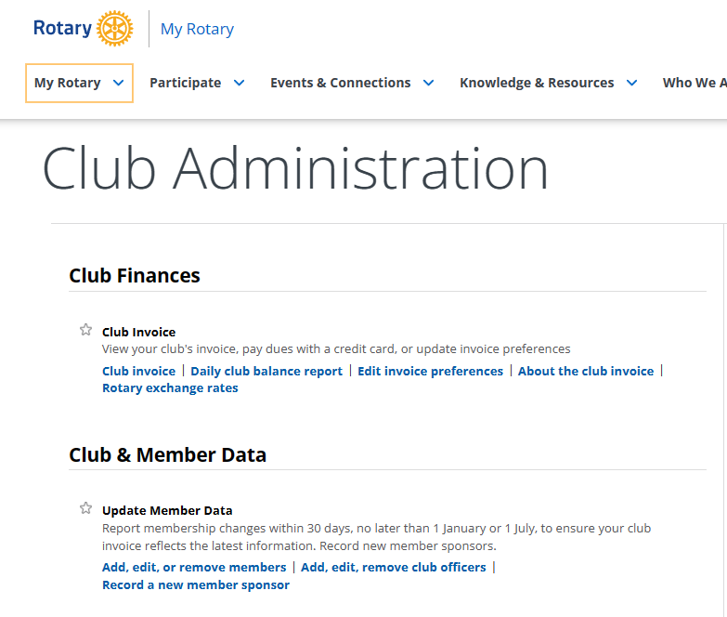
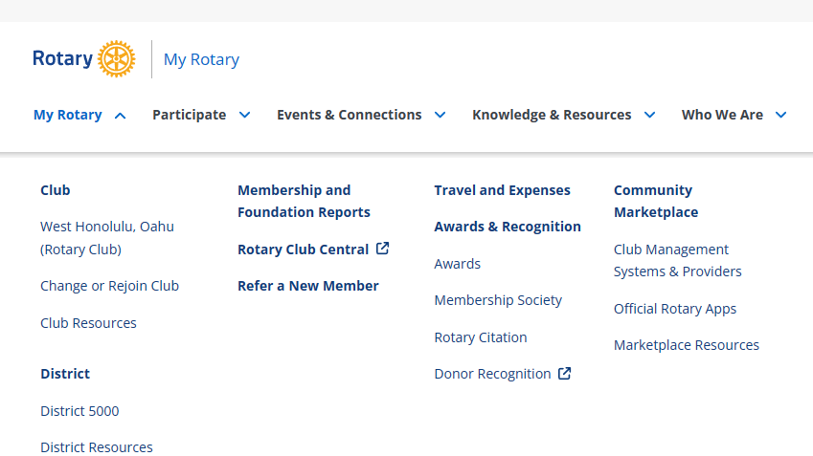

Click on “Manage”
Go to My Rotary and then “Club Resources” for Dues Invoice or Member Data.
Notes:
From My Rotary, click club Resources to get to dues invoice.

Slide 20

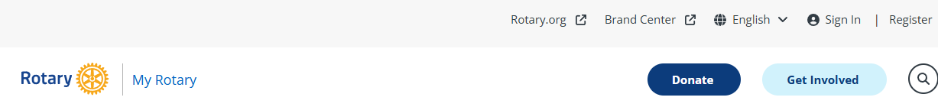
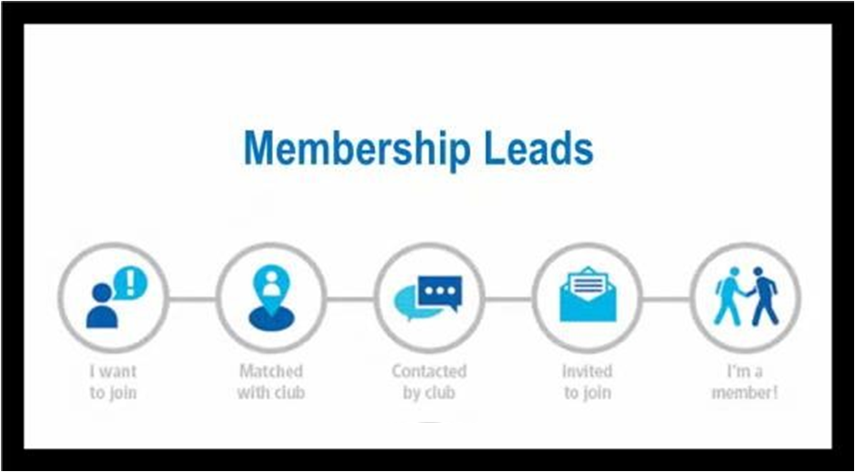
Rotary Member Leads Program
Rotary International has an innovative process for connecting prospective members and referrals with clubs by empowering candidates with the knowledge they need to find their home in Rotary and connect them to a club right away.
The membership leads management system on My Rotary is powered by Salesforce, which will both streamline the process for prospective members and reduce the number of administrative tasks for club and district leaders.
Prospect clicks here on rotary.org and completes form

Slide 21
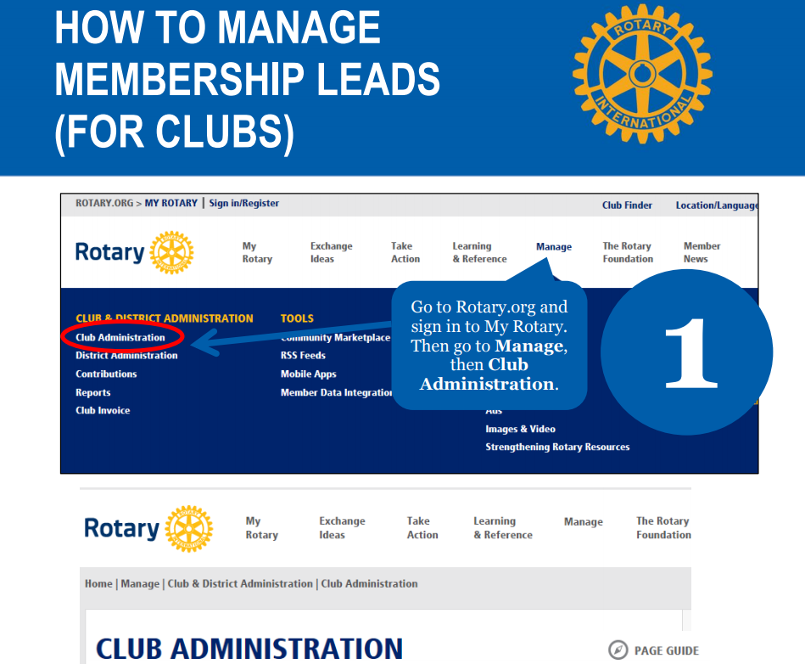
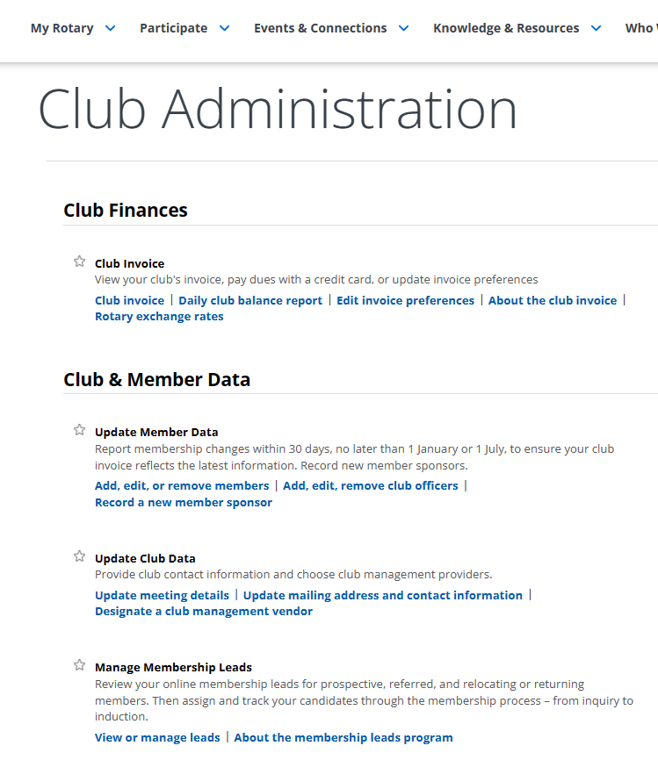
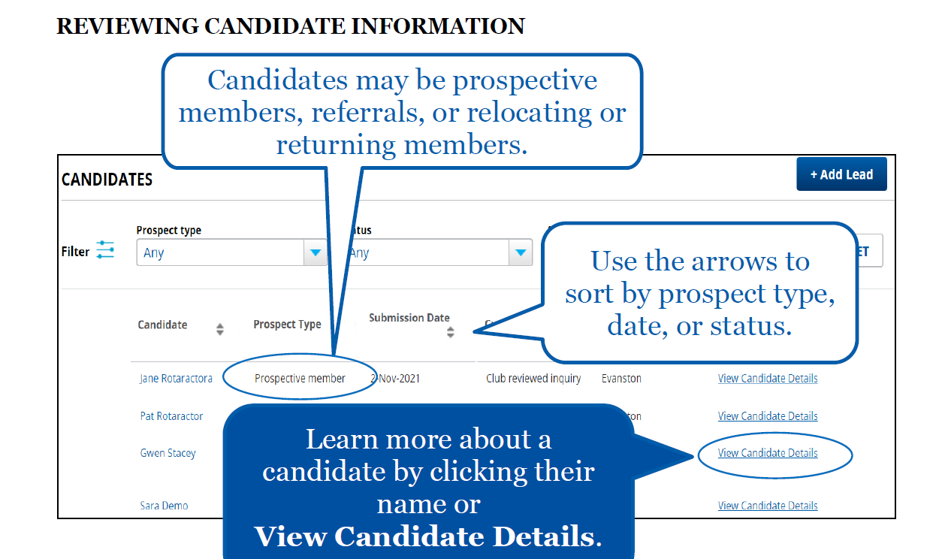


Slide 22
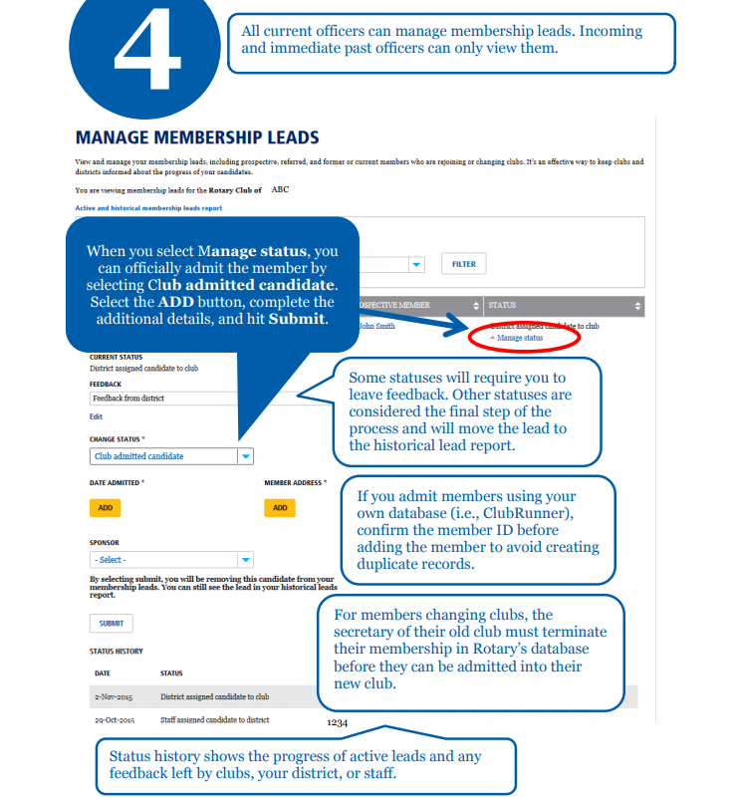

Add the new members in the Membership Leads page
Use the Manage Membership Leads page of My Rotary to store information about all of your prospective members. Some things to note:
Choose Club proposed candidate for membership if the candidate was proposed for membership and still needs board approval.
Choose Club admitted candidate if the candidate is now a member of your club.
Notes:
Use this if a lead comes to your club. If the lead turns into a member, add through this site.

Slide 23
Where to go for help and information
You are not alone! You have multiple resources to help you.
>The District has an extensive training program, with zoom sessions and webinars every week.
>This presentation and all of the other training presentations can be viewed on the District website.
>From the ClubRunner Home page, scroll down to see all of District 5000’s recorded webinars.
>Be aware of the District calendar and all of the opportunities for learning about Rotary and specific roles and events. Work with your club President to encourage new members to attend the once a month “Welcome To Rotary” session on Saturdays on zoom. There are monthly service area sessions that are valuable to your Board chairs.
>RI has a Learning Center with training videos for club officers and chairs. Go to MyRotary, Knowledge and Resources, Learning Center. You will find a 9 module course on Club Secretary Essentials under “Club Leadership Courses”.

Slide 24

Mahalo!

