Slide 1

CLUB TREASURER BASICS
2026 District Leadership Learning Seminars

Slide 2
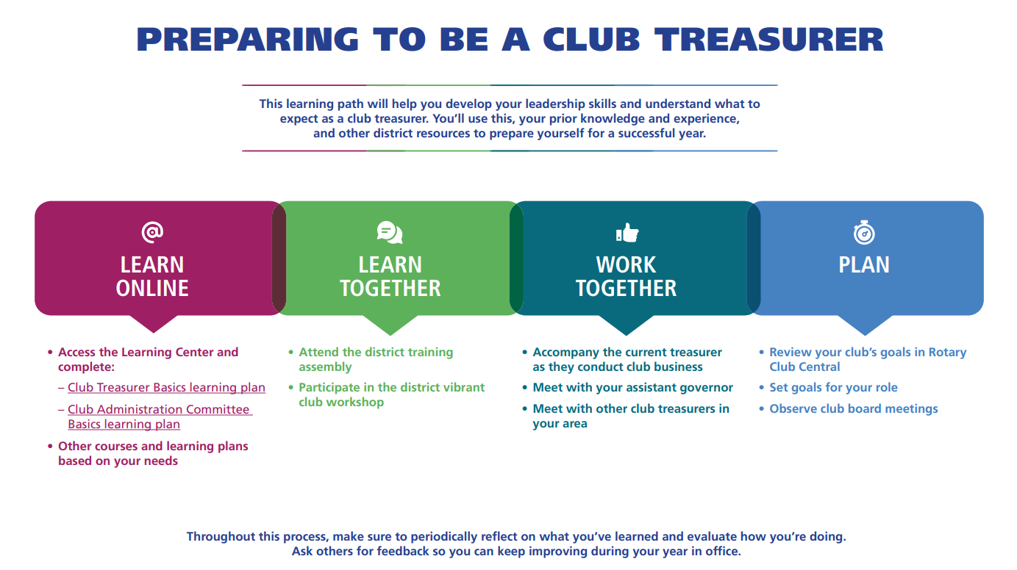

Slide 3
What you do
Manage club funds:
1. Collect club funds
2. Collect dues and fees
3. Keep Board informed of the finances
4. Remit payments, may include Rotary Foundation & HRYF donations
Maintain Records:
1. Bank statements and reconciliations (5-year retention)
2. Grant finances
3. Include Satellite club financial numbers
Reporting:
1. Keep the Board informed
2.Taxes: Federal, State, General Excise
3. Keep Board informed of the finances and budget comparisons

Slide 4
Governance
Recommended Bylaws:
Article 9 Finances
Section 1 — Before each fiscal year starts, the board prepares an annual budget of estimated income and expenditures.
Section 2 — The treasurer deposits club funds in a financial institution or institutions designated by the board, divided into two accounts: one for club operations and one for service projects.
Section 3 — Bills are paid by the treasurer or another authorized officer and approved by two other officers or directors.
Section 4 — A qualified person conducts a thorough annual review of all financial transactions.
Section 5 — Club members will receive an annual financial statement of the club. A mid-year financial report, with current and previous year income and expenses, is presented at the annual meeting.
Section 6 — The fiscal year is from 1 July to 30 June.

Slide 5
Annual Requirements
Budget – approved by Board (ideally before 7/1)
IRS 990 – due by 11/15 MANDATORY
Due 15th day of the 5th month after June 30 (Nov 15)
Send a copy to Grants Chair at Email: grants@rotaryd5000.org for grant qualification purposes
General Excise Tax (GET) filings as required by State Tax Department

Slide 6
Reporting
Present a financial report on the previous Rotary year at the annual meeting to elect officers before 31 December, and a midyear financial report for the first six months of the Rotary year at a meeting before 31 January.
Write a detailed annual report at the end of the Rotary year.

Slide 7
Financial Controls
Financial controls are highly suggested to help ensure that funds are managed properly and preclude misuse.
Require more than 1 signature on checks or have a disbursement authorization form approved by an officerfor payment
Review bank statements by the president
Reconcile bank statements monthly
Update bank signature cards for new officers
Close accounting records in a timely fashion
Submit tax forms on time
Have an audit committee for oversight and continuity

Slide 8

Budget Template
INCOME | Budgeted income last year | Actual income last year | Amount under/over last year | Estimated income this year
OPERATIONS
Membership dues
Admission fees
Income from visitors
Other income
SUBTOTAL | 0 | 0 | 0 | 0
CHARITABLE
Donations to club for projects
Club fundraisers
Other income
SUBTOTAL | 0 | 0 | 0 | 0
TOTAL INCOME | 0 | 0 | 0 | 0
EXPENSES | Budgeted income last year | Actual income last year | Amount under/over last year | Estimated income this year
OPERATIONS
Secretary's Office
Badges/engraving
Postage and post box
Printing
Stationary
Phone/fax
Annual report
Web site hosting charges
Rent
Miscellaneous supplies
Other
SUBTOTAL | 0 | 0 | 0 | 0
District Dues
SUBTOTAL | 0 | 0 | 0 | 0
(https://my.rotary.org/en/learning-reference/learn-role/treasurer)

Slide 9
Budget Items 2026-2027
RI Invoice - $109.62
District Dues – $65.00
HRYF Club Dues - $200.00
PELS (Los Angeles airfare, registration, extra nights) - $1,500 approx.
PELS Hospitality Room (about $100)
Unpaid Global Grant pledges
District Workshops (Foundation, Membership Seminars)
RYLA
District Conference
Virtual meetings:
Pre-PELS
Training Assemblies

Slide 10
Rotary Dues
RI Invoice: $109.62 for 2026-27
$85.50 Dues + $1.00 COL + $6.12 Insurance + $18 for magazine.
Due July 31 ($57.87) and Jan 31 ($51.75) to RI. New members prorated. Honorary magazine $18. (RI dues will be $89.25 for 2027-2028, $93 for 2028-2029) Mail to Chicago
District Dues: $65.00 per active member annually) due July 1 ($32.50) and Jan 31($32.50) to District Treasurer, PO Box 3325, Honolulu, HI 96801.
Suggest that you send out the club invoice by June 1 and Dec 1 and have a due date of July 1 and January 1. You may want to include an “Optional” line for Rotary Foundation giving and HRYF ($20).

Slide 11
Rotary International Dues
RI dues are based on the members count as of 7/1 and 1/1 and cannot be adjusted. Very important to have the correct roster before those dates.
RI invoices are emailed to Club President, Secretary and Treasurer. Please ensure that the email addresses are correct. The invoice can also be found on the rotary.org/myrotary website in the Club Administration section. A detailed listing of members is available. Payments can be made online with a credit card.

Slide 12
RI Dues – Where Does It Go?
Annual RI dues for:
HR, Legal, Audit
Finance
Governance and Executive
International Operations
Messaging and Communications
IT, Operations, Administration
Programs and Member Services
$1.00 per member annually for Council on Legislation *
$1.25 per member annually for D&O/EPL insurance *
$4.27 per member annually for General Liability insurance *
$18 annually for the Rotarian magazine
* Annual payments on only the July 1 invoice, may be subject to change

Slide 13

District Dues Invoice– Input number of members
 |  | Rotary International District 5000
 |  | District Dues Invoice
 | Rotary Club of
 | Contact Name
 | Phone/Email:
 | DESCRIPTION |  | AMOUNT
 | Semi-annually | Semi-Annual Dues Per Active Member: | $32.50
 | (July 1, Jan 1)
 |  | Input number of members --->
 |  | Sub-total | $0.00
 |  | Total District Dues: | $0.00
 |  | Payment due by: | Upon Receipt
 | Please make check payable to Rotary International District 5000 for the total.

Slide 14

Common Mistakes to Avoid
Failing to track restricted vs. unrestricted funds.
Ignoring cash flow issues.
Under-estimating fundraising or administrative costs.
Not reviewing statements regularly
with the board.

Slide 15

Penalties
A. Late filing of Form 990EZ or Form 990 results in penalty of $20/day not to exceed the lesser of $10,500 or 5% of gross receipts for the year.
B. If the appropriate version of Form 990 is not filed for three consecutive years, the tax exemption is automatically revoked.

Slide 16

Rotary Insurance
Rotary’s general liability and directors & officer’s insurance is paid by members to R. I. via the dues invoice
The broker is The Hylant Group
Website: rotary.hylant.com
Username: rotary@hylant.com
Password: Rotary1905
Email: rotary@hylant.com
Telephone: 419-259-2710
Rotary International Risk Management
Email: insurance@rotary.org
Manager: Julita Brzozowska
Telephone: 847-424-5394
To obtain a certificate of insurance, insurance policies and summaries, loss prevention strategies, and more, please visit the insurance broker’s website, U.S. Rotary Insurance Portal.

Slide 17
District Website: rotaryd5000.org
What you can find on the district website:
Membership rosters
District dues invoice
District Chairs and Org Chart
Information on the Avenues of Service
Club Presidents and Meeting Locations
Events in the Calendar
Register for Events
Look for Rotarians in the Yellow Pages

Slide 18
District Grants

Slide 19
District Grant Key Dates
May 31 - Final Grant report
June 15 – Grant application for 2026-2027 grant due
July 31 – Deposit club cash portion in grant account
A copy of the bank statement showing the club cash is required to receive the grant funds. The President will be notified when the funds are available, hopefully sometime in August.

Slide 20
Foundation Grant Financial Requirements
Disbursement Requirements:
Do not disburse funds until your grant application is approved
Maintain separate grant bank accounts
Two (2) signatures required for disbursements.
Invoices and proof of payment required for all disbursements.
Proof of Expenditures:
Promptly deliver receipts for all expenditures to the Club Treasurer.
If there is a difference between the receipt and invoice amounts, provide documentation to the Treasurer
Retain account records in physical form and electronic form for five (5) years from the date of Approval of the Final Report.
Monthly Reconciliation:
The District Grant Account and each Global Grant Account will be reconciled on a monthly basis by the Club Treasurer and a report of this shall be made to the Club President and President-elect

Slide 21
District Audit of Grant Records
If your club is selected to be audited, the following documents will be requested for the review by a member of the audit committee:
1. The grant qualification documents and application
2. Bank statements
3. Cancelled checks
4. Bank signature cards
5. Check registers or ledger showing revenue and disbursements for each project
6. Invoices and receipts to support disbursements
7. Bank reconciliations
8. List of physical assets acquired for the grant projects, if any
9. Report to district of misuse of funds, if any
The review is limited only to the transactions regarding the grant, and does not include the other operations and bank accounts of the club.

Slide 22
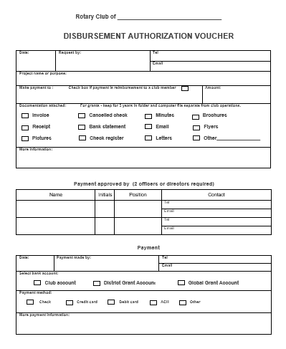
New Requirement: Use this Voucher to authorize disbursements from the grant account.
Form posted on the district website in the District Grants page.

Slide 23
RI Website: rotary.org/myrotary

Slide 24
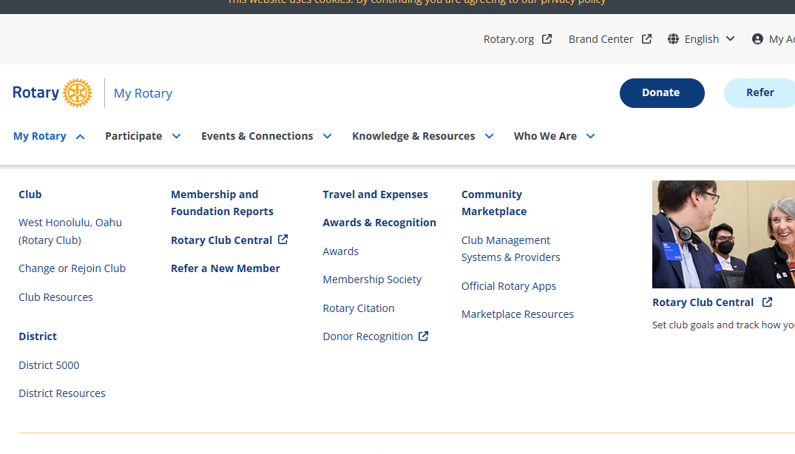
rotary.org - Sign In (User name is email address)
Sign in with your email address and password. “Register for an Account”, if you have never signed in or if you have entered the wrong sign-in info too many times. The User Name or Login password may be different from District’s website password. Email address is from the District’s website, unless you change it for RI. If your email address changes, RI’s website needs to be updated separately.

Slide 25
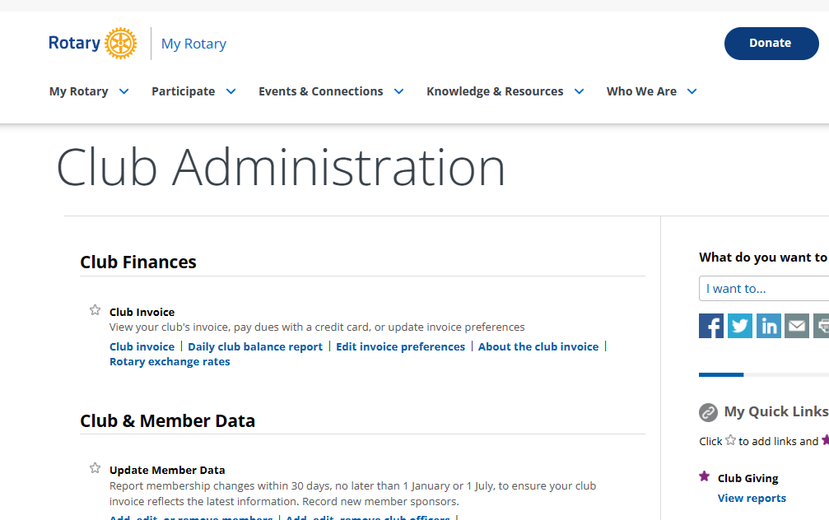
RI Club Invoice in the “Club Resources” site page

Slide 26
Rotary Foundation Contributions
Forms and Foundation Reports can be fund on the rotary.org website, under “Who We Are” tab –then “Get Involved” – then “Ways to Give”. Forms are on the bottom of the site page.
Submitted using The Rotary Foundation Contribution Form
Members can donate online.
Multiple Donor Form
Memorial or Tribute Gift form
Rotary Direct enrollment form
Indicate gift designations (such as Polio Plus or Annual Fund- SHARE).
In addition to monetary gifts, contributions can include stock, appreciated securities, life insurance policies, property, and bequests. Contact Planned Giving staff at Rotary headquarters or your international office for assistance in sending these types of contributions. See the Foundation’s Gift Acceptance Policy for more information.

Slide 27
What is State general excise tax revenue ?

Slide 28
Not GE Taxable
Tax facts 98-3, “Tax Issues for Hawaii Nonprofit Organizations”
The organization is exempt from paying the general excise tax on income that is (a) derived from its activities that fulfill its exempt function and (b) that do not have as a primary purpose the production of income. (TF99-04).
Not taxable (Q8):
Dues, donations or gifts
Interest income from bank deposits, including CDs, for safekeeping of cash (Q16).
Logo merchandise sales (shirts, hats, tote bags) sold at or near cost (TF99-04, Q52)
However, such sales sold with intent to make a profit are taxable.
Dividend income (HRS 237-3(b)).

Slide 29
GE Taxable
Taxable
“Gross receipts derived from any activity the primary purpose of which is to produce income are subject to the GET”. (Q8)
Fundraising activities (Q9): white elephant sales, fairs, bazaars, bake sales.
Also: gala dinners, concerts, chili sales, etc. (Q12).
Rental income (Q11)
Gross proceeds from benefit dinner, even if some of it is a donation (Q13).
Silent auction and other sales of donated items (Q14).
Interest income, rents, royalties etc from investment portfolio (ie earned from the “investment of the capital of the business) (TIR 42-74)
Advertising in newsletters (TF99-04, Q34).

Slide 30
General Excise Tax Filings
Evidence of Annual GE Tax filings is required for grant qualifications.
If no revenues subject to GET, you should still need to file the return.

Slide 31
Exemption
Use form G-6 to obtain GET exemption (ref HRS 237-23(a)).
Exemption letters may have been issued by tax office prior to 1990.
Typically needed for organizations that earn income from “exempt” activities such as school tuition, museum admission income, hospital patient revenue, etc. (“exempt function income”).
Tax exempt for income tax purposes is not the same as tax exempt for GET.

Slide 32

Mahalo!

