Slide 1
DEVELOPING AND EFFECTIVE CLUB TRAINING PROGRAM

Slide 2
WHAT DOES A CLUB TRAINER DO?
Club Trainers work with club leaders to create training programs that support your club and are essential in developing leaders. They share their experience and provide the skills that help Rotarians excel.
To keep up to date on the latest training information, sign up for the Rotary Training Talk newsletter: (https://my.rotary.org/en/news-features/newsletters)rams that support your club and are essential in developing leaders. They share their experience and provide the skills that help Rotarians excel.
To keep up to date on the latest training information, sign up for the Rotary Training Talk newsletter: (https://my.rotary.org/en/news-features/newsletters)

Slide 3
What Do Rotary Trainers Train On?
Rotary Foundation- what it does, how to support, promote it.
Membership activities- attracting and engaging members.
Grant management- how to successfully manage Rotary grants.
Leadership opportunities in Rotary- for club leaders.
Public image- strategies to improve Rotary’s public image.
Whatever else members want training on.

Slide 4
District Training
President-Elect Training (PETS)
President-Elect Readiness Education Program (PREP)
District Training Assembly
Grant Management Seminar
District Membership Seminar
District Rotary Foundation Seminar
Leadership Development Program
Periodic Webinars

Slide 5
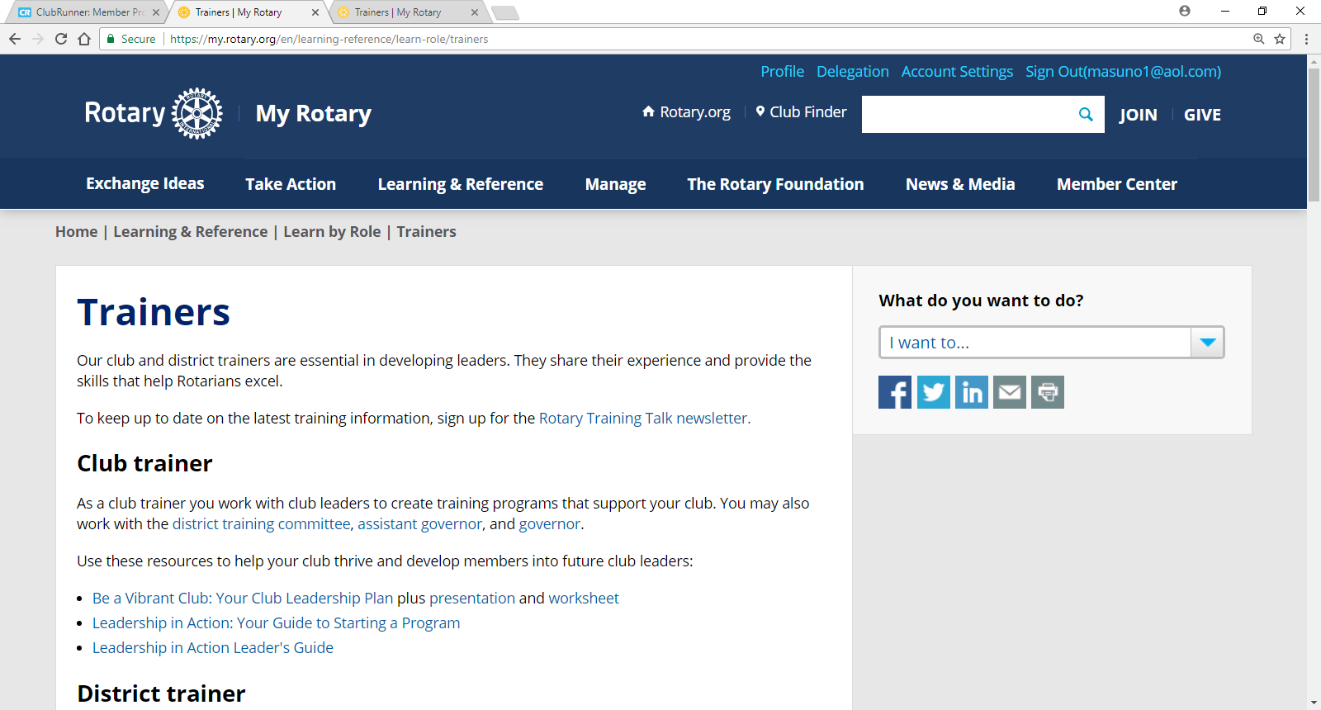
Resources on the rotary.org website

Slide 6
PLANNING
Did a needs assessment?
What are you training on?
What outcome do you want?
How much time do you have?
How will you deliver the curriculum?
What about logistics?
Who will help you?
Who is qualified to train?
What’s the budget?
Evaluations?

Slide 7
Logistics
Space and seating
Podiums, tables for speakers
Microphones
Screens
AV equipment
Flip charts, whiteboards, markers, erasers
Internet access
Materials, handouts, workbooks
Session Formats: General sessions, Breakout sessions, Interactive, Group discussions

Slide 8
FACILITATOR PREPARATION
Facilitation techniques, appropriate pace
Focus on the topic
Use appropriate nonverbal skills
Speak clearly
Make eye contact
Appear relaxed, pleasant, confident
Encourage everyone to share ideas
Use encouraging body language
Provide reinforcement for participation
Exhibit nonjudgmental behavior, maintain composure
Demonstrate understanding of and comfort with the content

Slide 9
FACILITATOR
LEARNING ENVIRONMENT
Make learning interesting
Use relevant examples
Address disruptive behaviors
Handle incorrect answers
Reinforce positive behavior

Slide 10
THE DELIVERY
CONTENT AND PROCESS
Organize the presentation effectively
Summarize key learning points clearly
Listen well
Check for understanding
Made smooth transitions
Manage group effectively
Explain why the topic is important
UNEXPECTED CHALLENGES
Handle unexpected events effectively
Manage difficult participants
Display flexibility
Manage time and topics

Slide 11
Timeline
6 months
-select dates and secure venue
-needs assessment, evaluation reviews
-agenda
-qualifies facilitators
-budget
-promotional schedule
3 months
-finalize agenda
-arrange food service
-materials (handouts, name badges, evaluations)
5 weeks
-trainer ready
-participant list
-supplies

Slide 12
MAHALO
YOU CAN DO IT!

