Slide 1
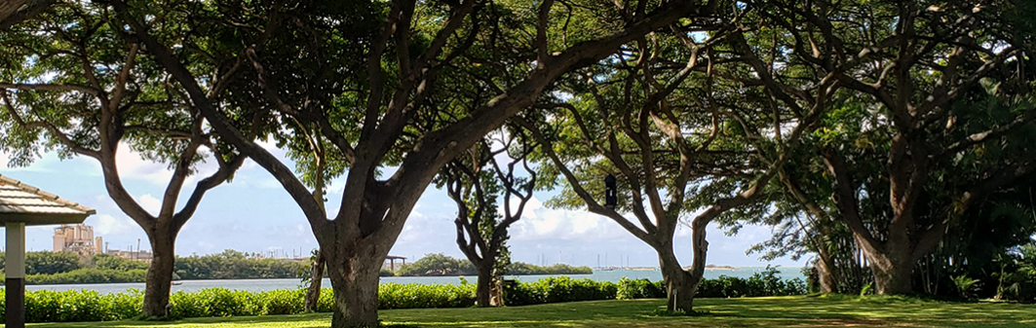
2026 Rotary International District 5000 Conference August 21-23, 2026

Slide 2
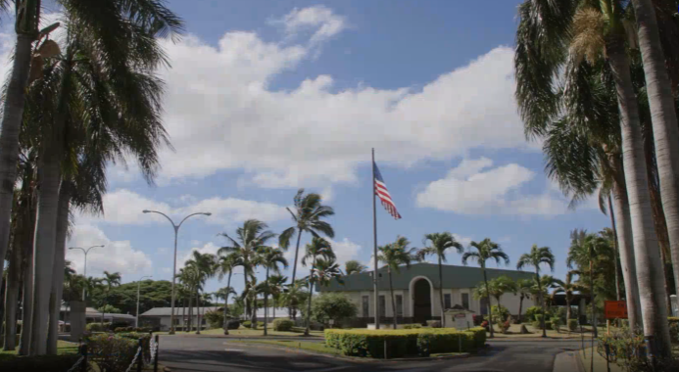

Keehi Lagoon Memorial
2685 N. Nimitz Hwy
Honolulu, Hawaii

Slide 3

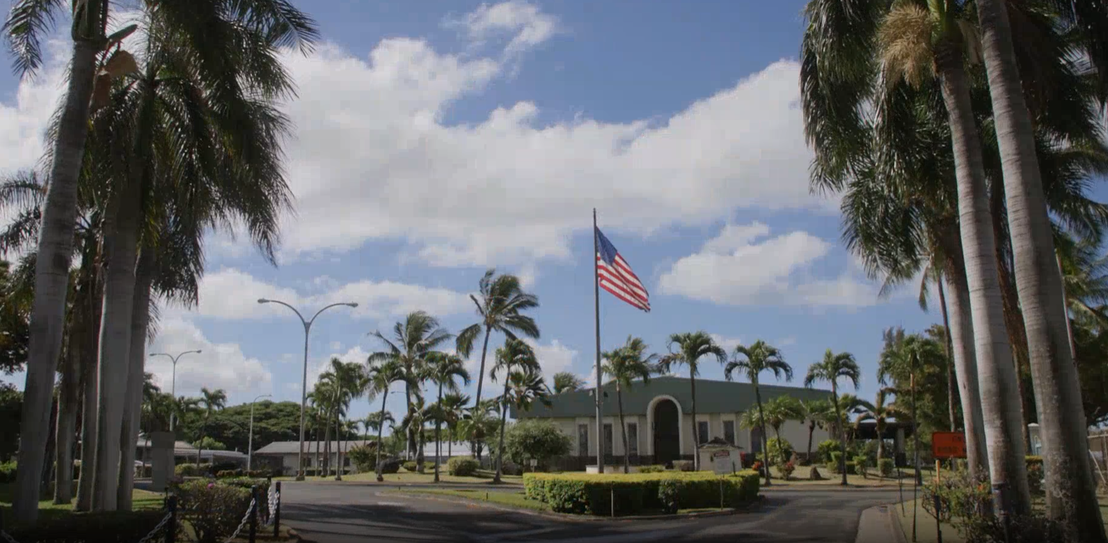
Company overview
Notes:
Video

Slide 4


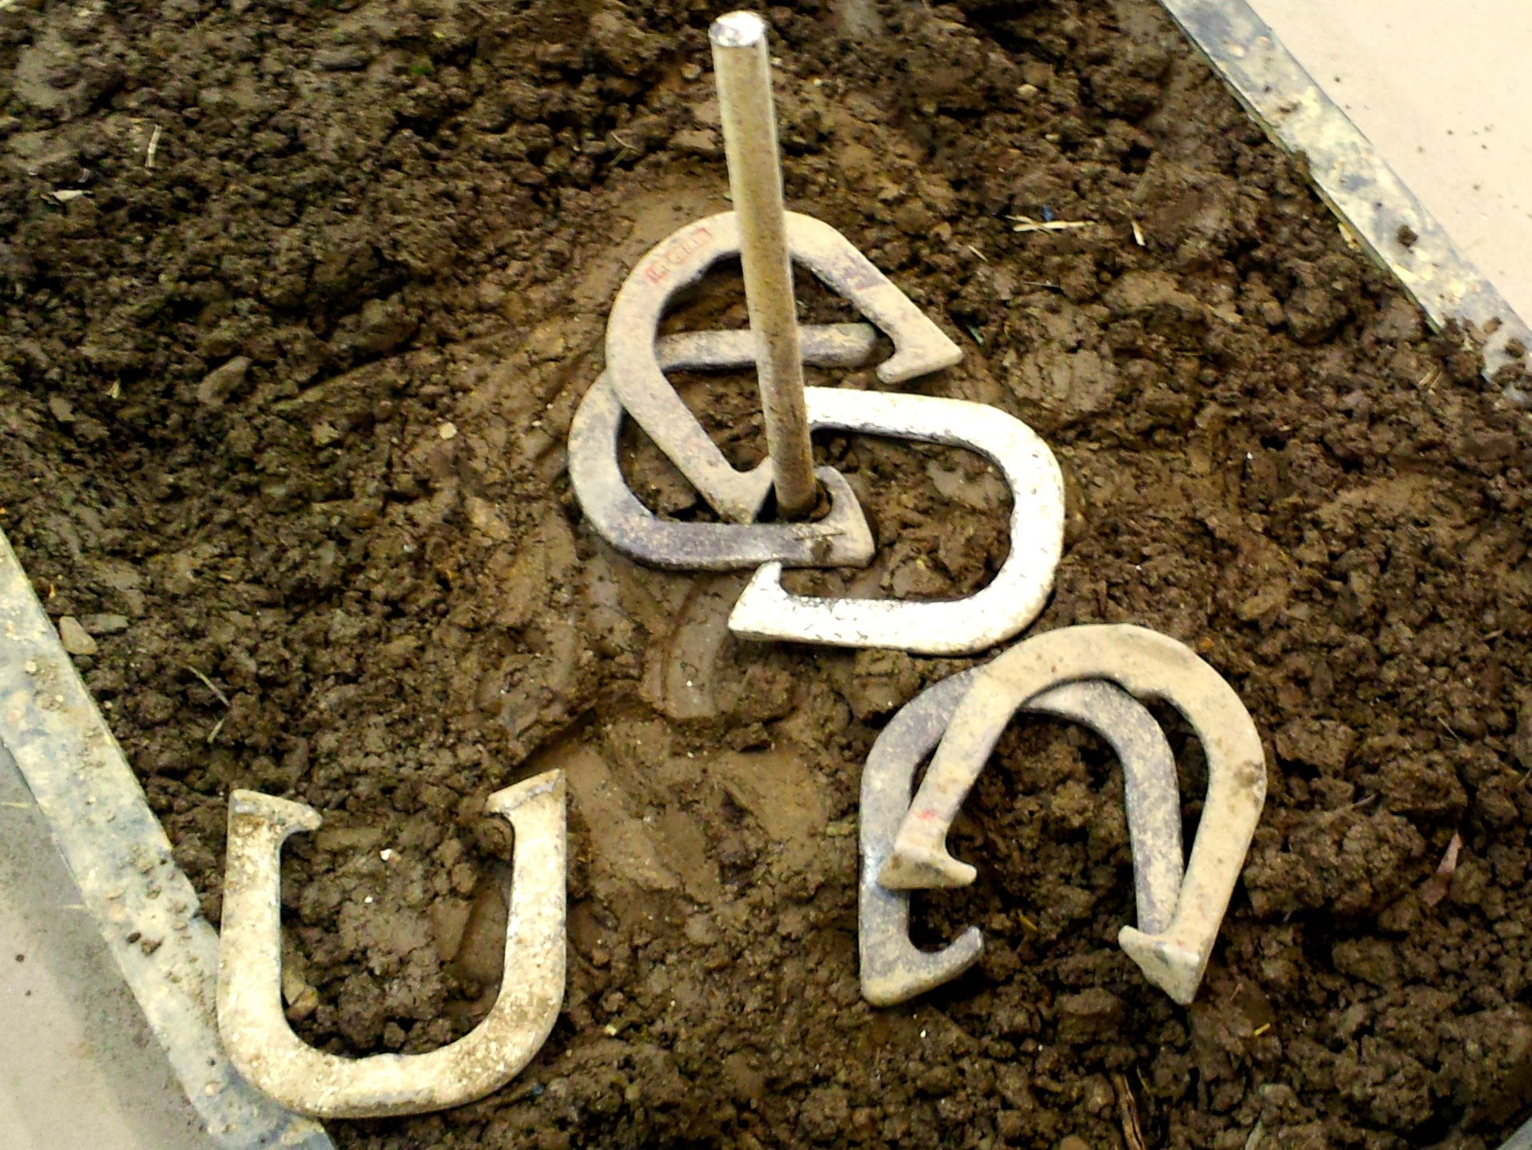
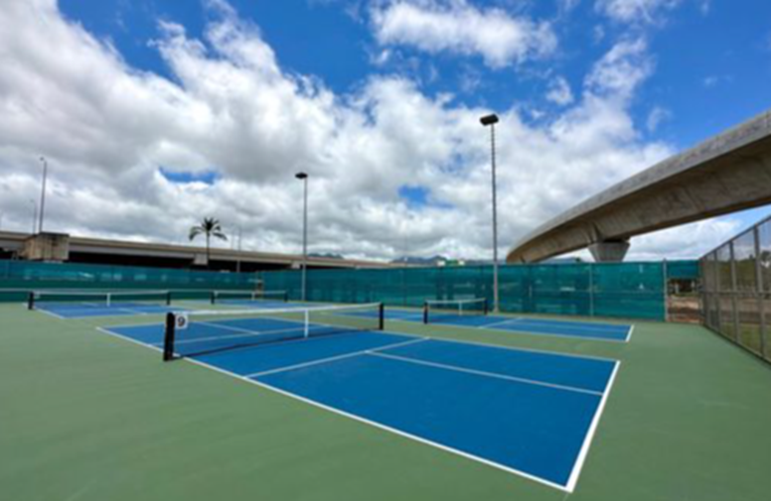
Friday Tournaments

Slide 5

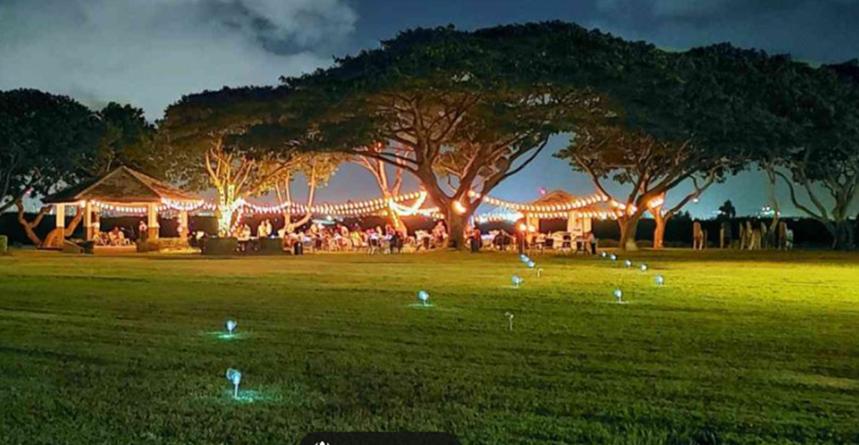
Friday Night Hoolaulea

Slide 6
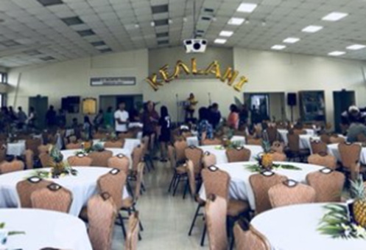
Saturday Speakers
Be inspired
Hear from beneficiaries of our projects
Learn about our peace focus
Celebrate club successes
Recognize extraordinary club efforts

Slide 7

Sunday
Celebration of Life
Meet the 2026-2027 Team, under DG Benson Medina
Collaborate and form strategic partners
Hear from community stakeholders
Raise your Rotary I. Q.

Slide 8

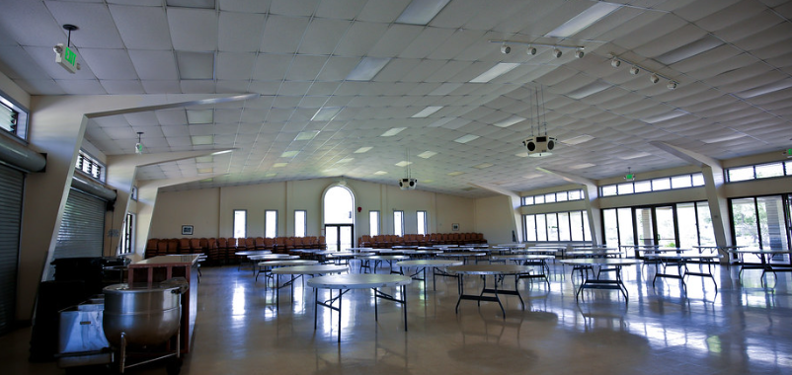
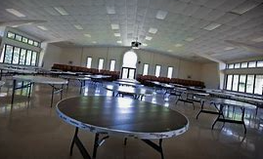
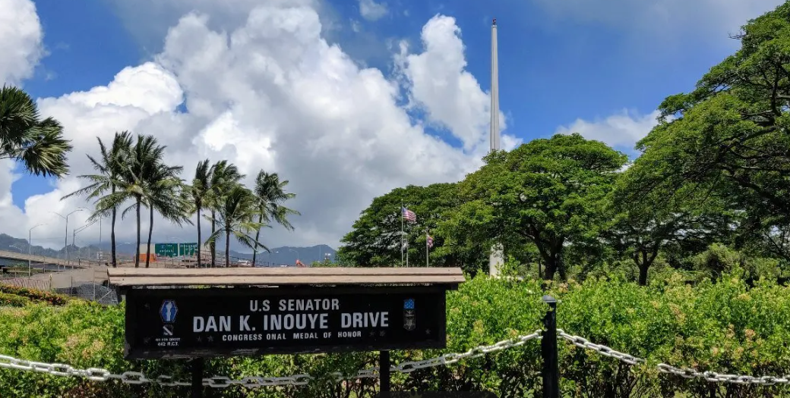

Slide 9
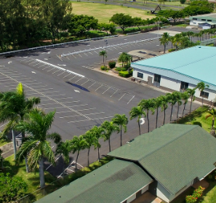
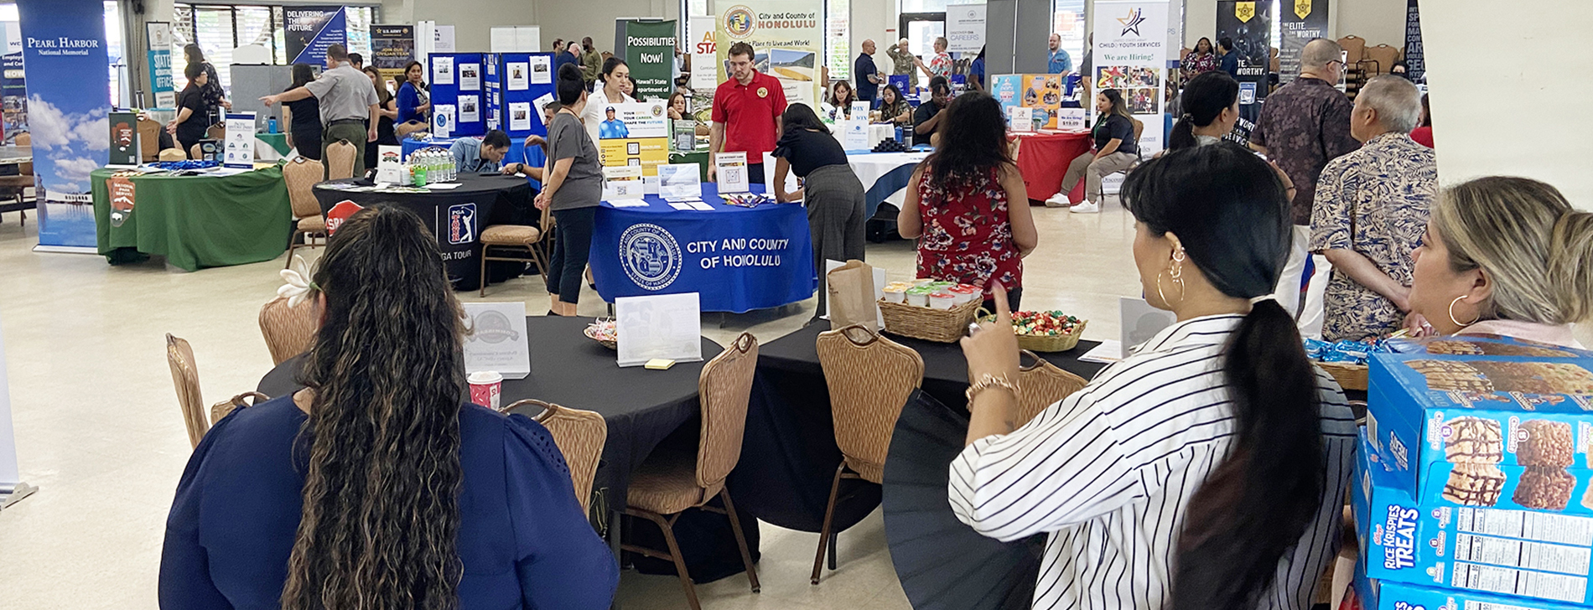
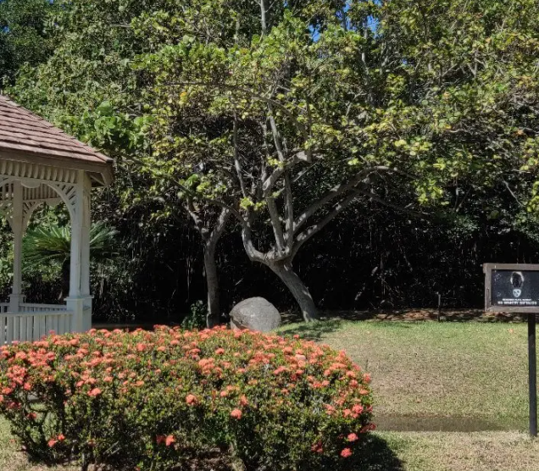
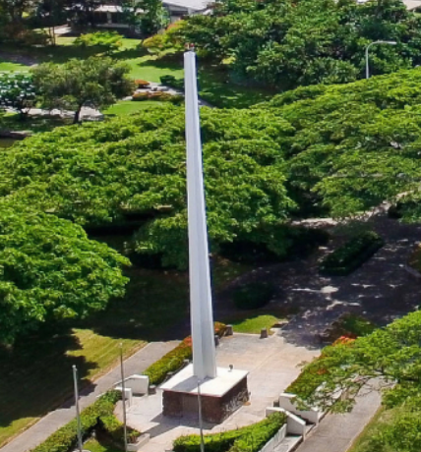
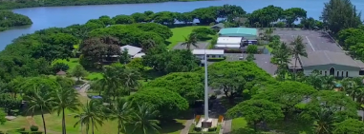

Slide 10
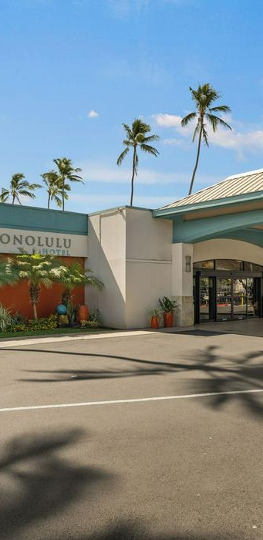
Hotel
Free airport shuttle
Close to conference site
Swimming pool
Fitness Center

Slide 11
2026 Conference Chair Laurie Yoshida

