Slide 1


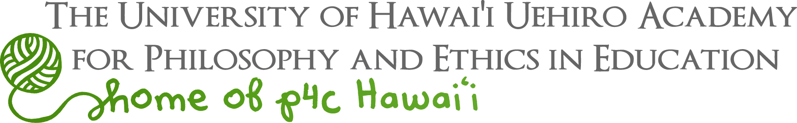
Educating Peace Leaders:
The Transformative Power of Social and Emotional Learning
Notes:
I am going to take a few minutes to explain what we mean by social and emotional learning or SEL, and why we feel it can help to grow ethical and compassionate leaders.
After I am done, Dr. Yos – and more importantly, some of his wonderful students – will illustrate how this can all work in our schools.

Slide 2
Kekoa has 3 pineapples.
If Lani takes 2 pineapples,
Notes:
So I borrowed and modified this from our Roots of Empathy partners.
Here’s a typical word problem a young student might be faced with.
Kekoa has 3 pineapples. If Lani takes 2…
I bet many of your minds went straight to the answer – 1.
But social and emotional learning would take you to this additional question to ponder…

Slide 3
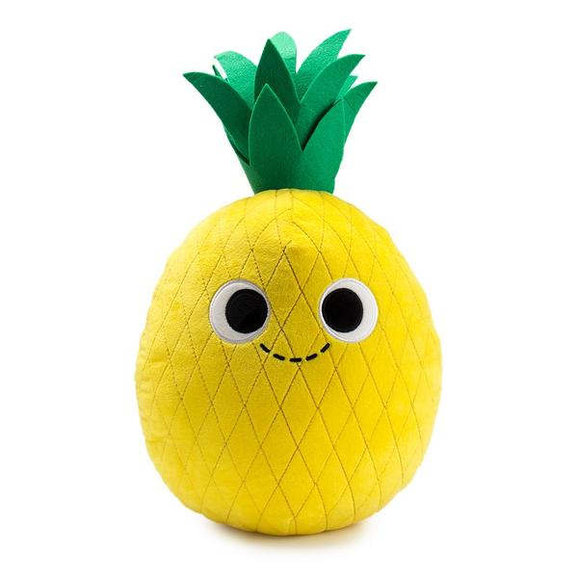
Kekoa has 3 pineapples.
If Lani takes 2 pineapples,
How will Kekoa feel?
Notes:
How does Kekoa feel?

Slide 4
SEL … SEEL … SEAD … SEED…
Self Awareness – Recognizing and understanding one’s emotions and values as well as one’s strengths and challenges
Self Management (or Regulation) – Managing emotions and behaviors to achieve one’s goals; demonstrating resilience and grit
Social Awareness – Showing understanding, empathy and compassion for others
Relationship Skills – Forming positive relationships; working in teams; dealing effectively with conflict
Responsible Decision Making – Making ethical, constructive choices about personal and social behavior
Notes:
Along with SEL, you may have heard the terms SEEL – which adds “ethical” to the equation - or SEAD – which includes Academic Development - or some other variation –
but basically we are talking about the knowledge and skills to understand and manage emotions,
to set and achieve positive goals,
to feel and show empathy for others,
to establish and maintain positive relationships, and
to make responsible decisions.
Let me illustrate what this looks like.

Slide 5
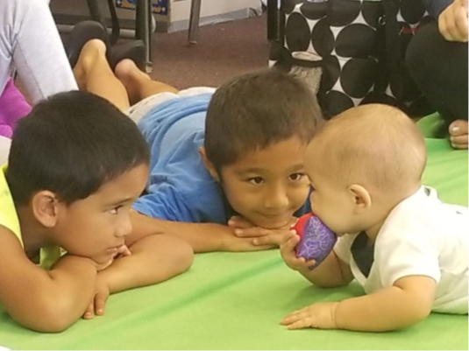
Notes:
The Roots of Empathy program I just mentioned is one of the SEL programs being used in some of our Hawai‘i schools.
They began over 20 years ago in Canada with a goal to break the intergenerational cycle of violence and poor parenting.
Their mission is to build caring, peaceful and civil societies through the development of empathy in children and adults.
With Roots of Empathy, there is a trained instructor who goes into an individual classroom of students. The classroom teacher is also present. But the real teacher is a baby with their parent, sitting on a green blanket.
The program happens once a week for 27 weeks – about 40 minutes a visit. It’s very intensive. They go through 9 themes or cycles beginning with an instructor-only visit to prepare and discuss what’s coming up, then the baby and parent visit with the instructor, followed by a reflective conversation with the instructor alone.
Students participate in writing and art and other activities to follow-through on discussions and observations that happen with the baby teacher.

Slide 6
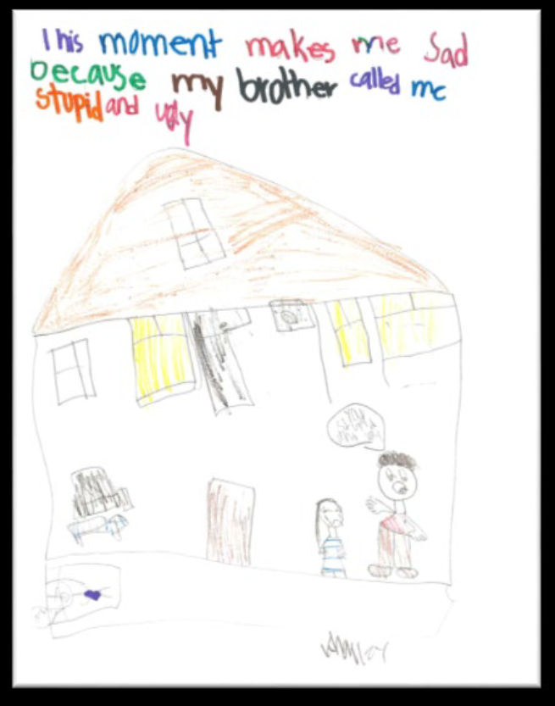
Notes:
And here is an example of student artwork from a class here in Hawai‘i.
Feeling safe in her classroom, this child shared that it makes her feel sad when her brother calls her mean names. She was able to identify her feelings and had the courage to talk about them.
Of course, the instructor has more conversation with the students about this and other drawings – How does this make them feel? What could they do to manage these feelings or make positive changes in their lives?
When children learn to challenge cruelty at a young age it gives them a voice not only to protect themselves but to protect others in the future.
You know the children of today are the citizens of tomorrow. Will they stand up for injustice in the future?

Slide 7
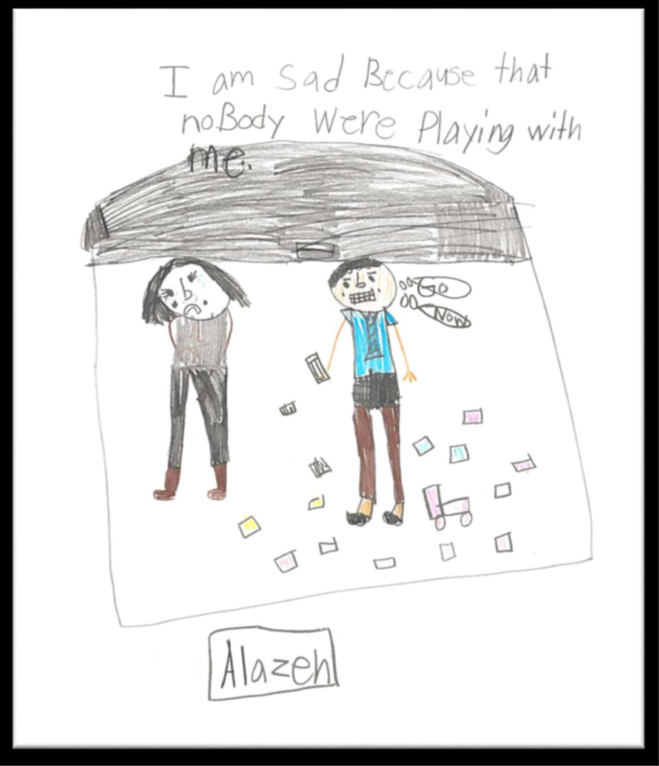
Notes:
Another child drew a picture of pain that is universal. Not only does exclusion make children feel sad, but over time it negatively impacts their mental health and well-being.
Through SEL, children are learning to understand how other people feel when they are excluded. The discussions they have shines a light on both negative and positive feelings.
They are not given any answers but their universal, and brilliant, solution to helping sad, lonely or frightened children is to ask “do you want to play?”
If we had more children who could recognize the pain of their classmates and positively intervene, we would have less need for targeted and clinical services. We would see more positive social behaviors and relationships, and less bullying, isolation and aggression.

Slide 8
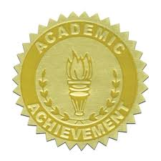
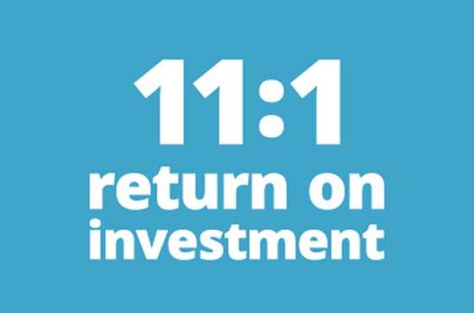
SEL Impacts Academic Outcomes
(2011 meta-analysis of 213 studies involving more than 270,000 students)
With evidence-based SEL programs (vs. those who did not participate with SEL):
11 percentile-point gain in academic achievement
Improved classroom behavior
Increased ability to manage stress & depression
Better attitudes about themselves, others & school
SEL Benefit-Cost Analysis
(2015 study by researchers at Columbia University)
Average benefit-cost ratio of about 11 to 1 among the six evidence-based SEL interventions studied i.e., for every $1 invested in SEL programming, there is a return of $11.
From https://casel.org/impact/
Notes:
And the research backs this up.
While not the primary goal of SEL programs, research shows an 11% gain in academic achievement.
More importantly, it also shows more positive social behaviors and peer relationships,
Fewer conduct problems, and
Reduced emotional distress.
It’s really a preventative tool for future challenges with an 11 to 1 return on investment.

Slide 9
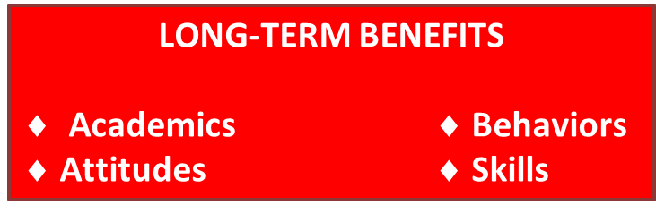
SEL Impact is Long-Term and Global
Up to 18 years later, students exposed to SEL in school continue to do better than their peers on a number of indicators:
        More positive social behaviors & attitudes
        Better skills such as empathy & teamwork
        Improved academics
        Fewer conduct problems
        Less emotional distress
        Lower drug use
The analysis looked at 82 research studies involving about 100,000 students here and abroad. according to a 2017 meta-analysis from CASEL, the University of Illinois at Chicago, Loyola University, and the University of British Columbia involving 82 research studies involving 100,000 students in U.S. and other countries. From https://casel.org/impact/
Notes:
The impact is long-term and has been seen around the world.

Slide 10
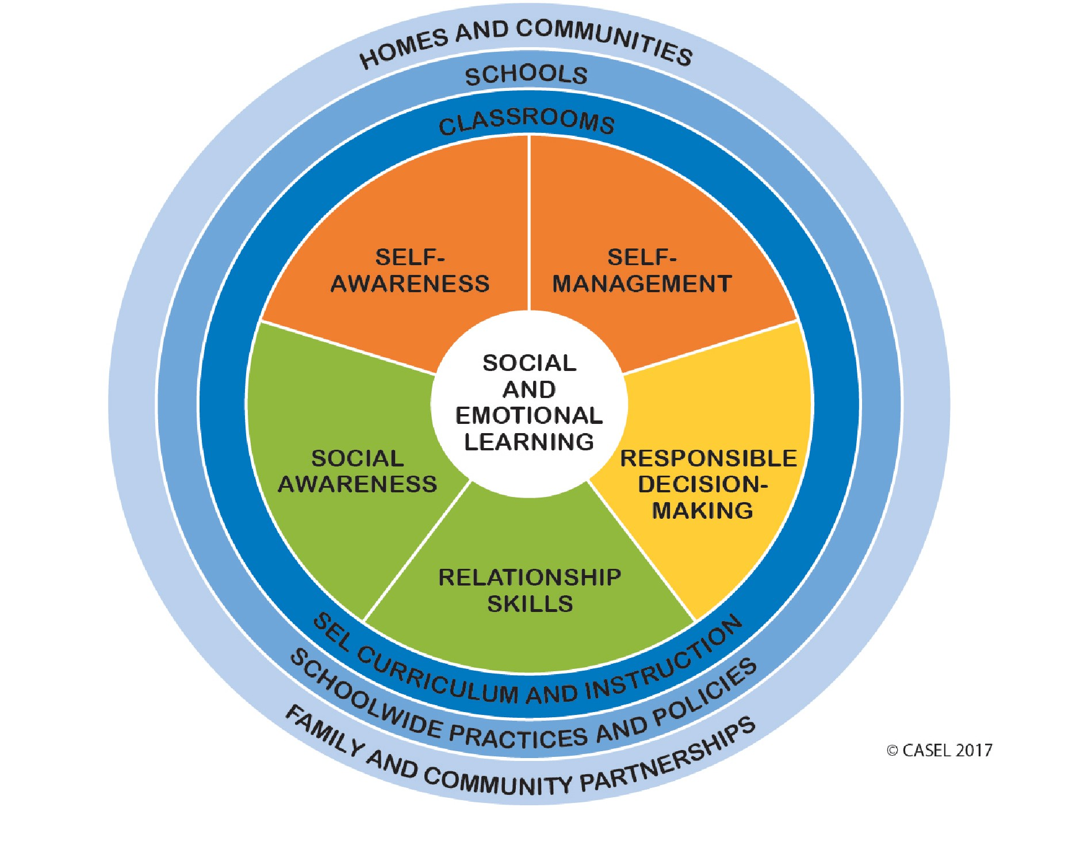
“Just as important as the SEL competencies are the contexts for teaching them, the overall educational environment. SEL is not a single program or teaching method. It involves coordinated strategies across classrooms, schools, homes and communities, and districts.”
Source: Collaborative for Academic, Social, and Emotional Learning (CASEL), “Social and Emotional Learning” (SEL)
Notes:
So you have a sense of what SEL is.
Good programs address 5 inter-related core competencies – self awareness and management, social awareness and relationship skills, and responsible decision making.
But just as important are the contexts for teaching these skills. SEL is not a single program or teaching method.
It works best when done in a systemic way – not just in a classroom but throughout a school and school district, in the home and with the community.
So here to illustrate some of these best practices is Dr. Toby Yos and his students.

Slide 11
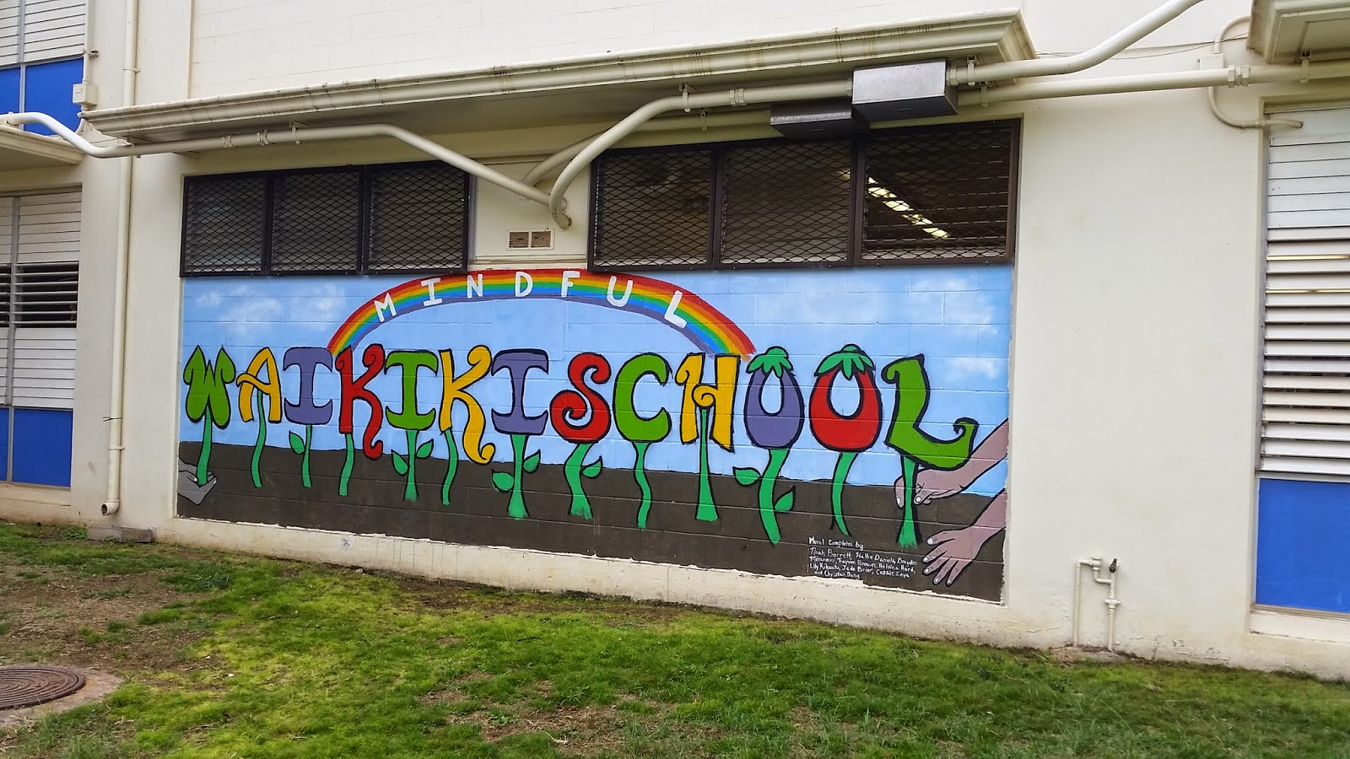
Waikiki Elementary School
One of the DOE’s “Bright Spots”

Slide 12
2016-2017 Test Scores
State DOE Average Compared to Waikiki School
Language Arts/Literacy
Math & Science

Slide 13
Enrollment Increase of 71% over the past 14 years

Slide 14
20 Years of SEL
at Waikiki School
(Explicit) SEL
Teach it
(Implicit) SEL
Live it
(and others will) Catch it

Slide 15
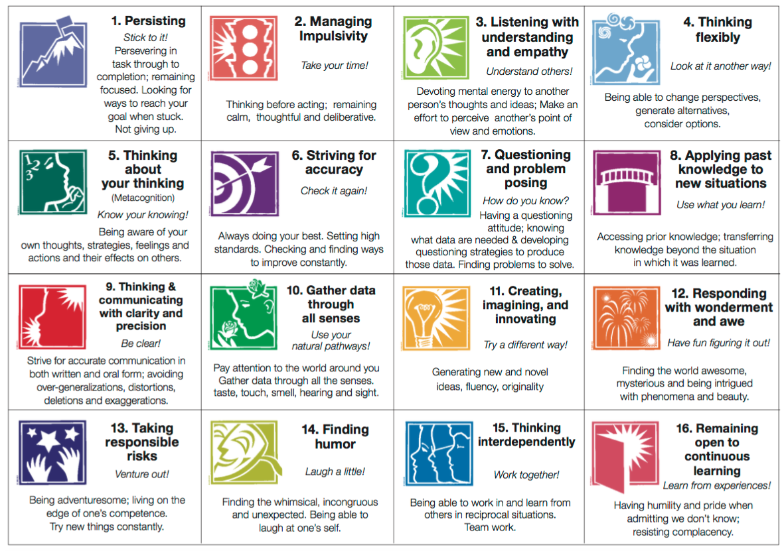
Teach it: Habits of Mind
Image from: https://sites.google.com/a/wesvt.net/library/habits-of-mind

Slide 16

Philosophy for Children Hawai‘i:
Creating aloha-laden communities where SEL and good thinking
are lived, practiced, and internalized
Live it
Catch it
Today’s p4c question:
Is Social Emotional Learning important?
or
Why should schools focus on relationships and emotions as well as academics?

Slide 17
How can I support SEL?
Live it (and others will follow)
  “Be the change you wish to see in the world.” Mahatma Gandhi
Support organizations that teach and live SEL.
Thank you for coming and listening to us today!

