Slide 1
INTRODUCTION TO THE GRANT CENTER
Notes:
Welcome to today’s webinar, ‘Introduction to the Grant Center.’

Slide 2
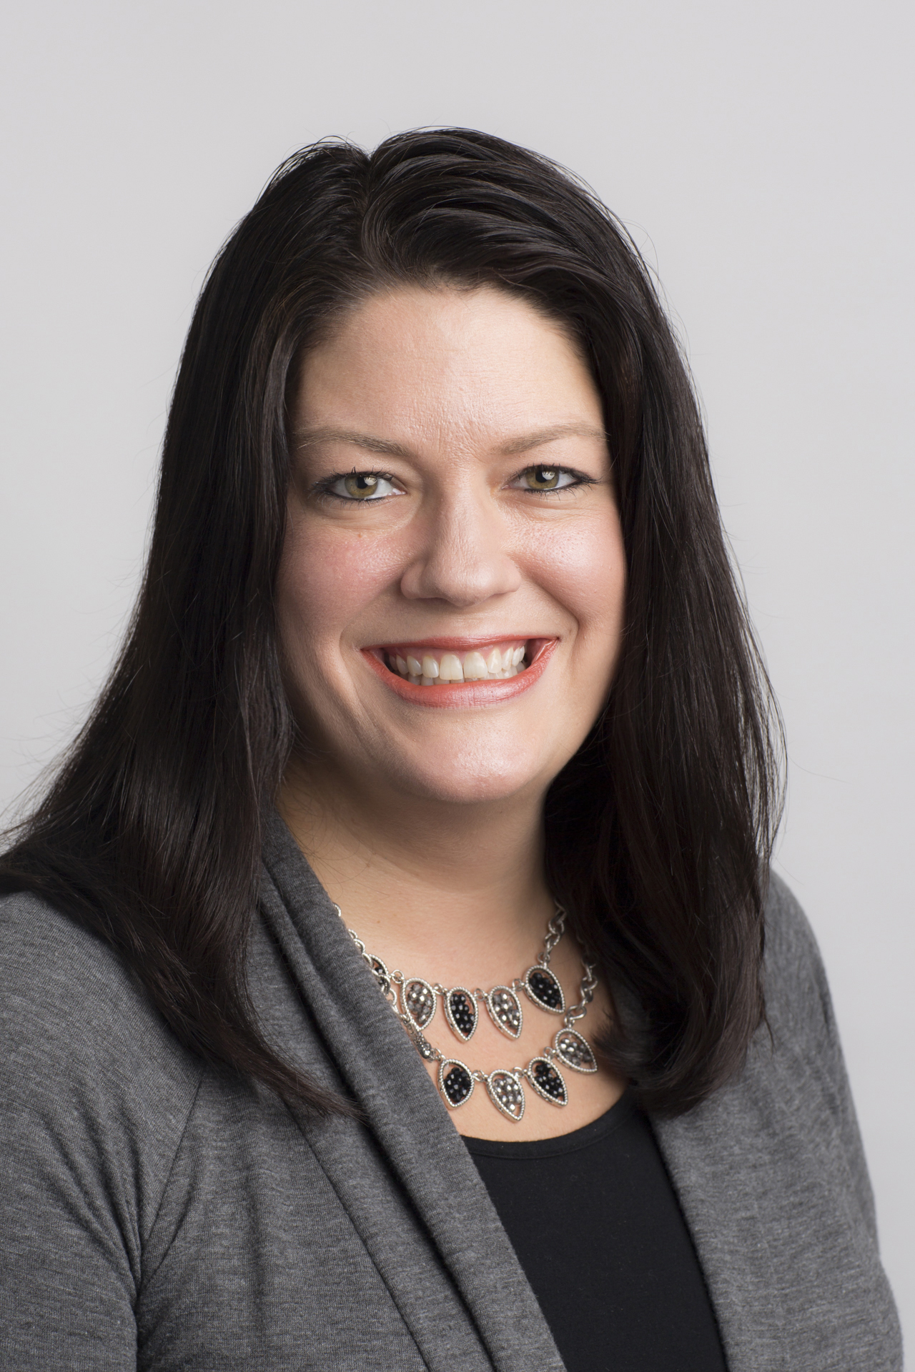
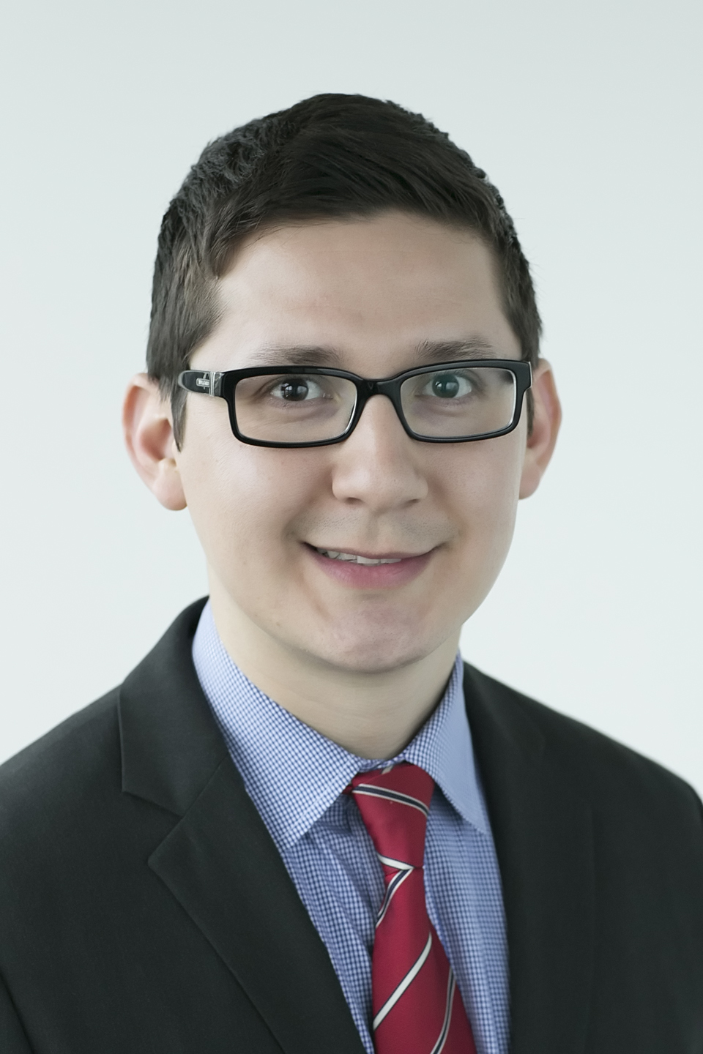
Welcome to the webinar
Renee Reiling
Regional Grant Officer
Jorge Aguilar
Grants Module Administrator
Notes:
My name is Renee Reiling from the grants area at Rotary International, and I will be moderating today’s session. For the next 60 minutes we will discuss Rotary’s Grant Center.
Our presenter will be Jorge Aguilar, our grants module administrator.

Slide 3
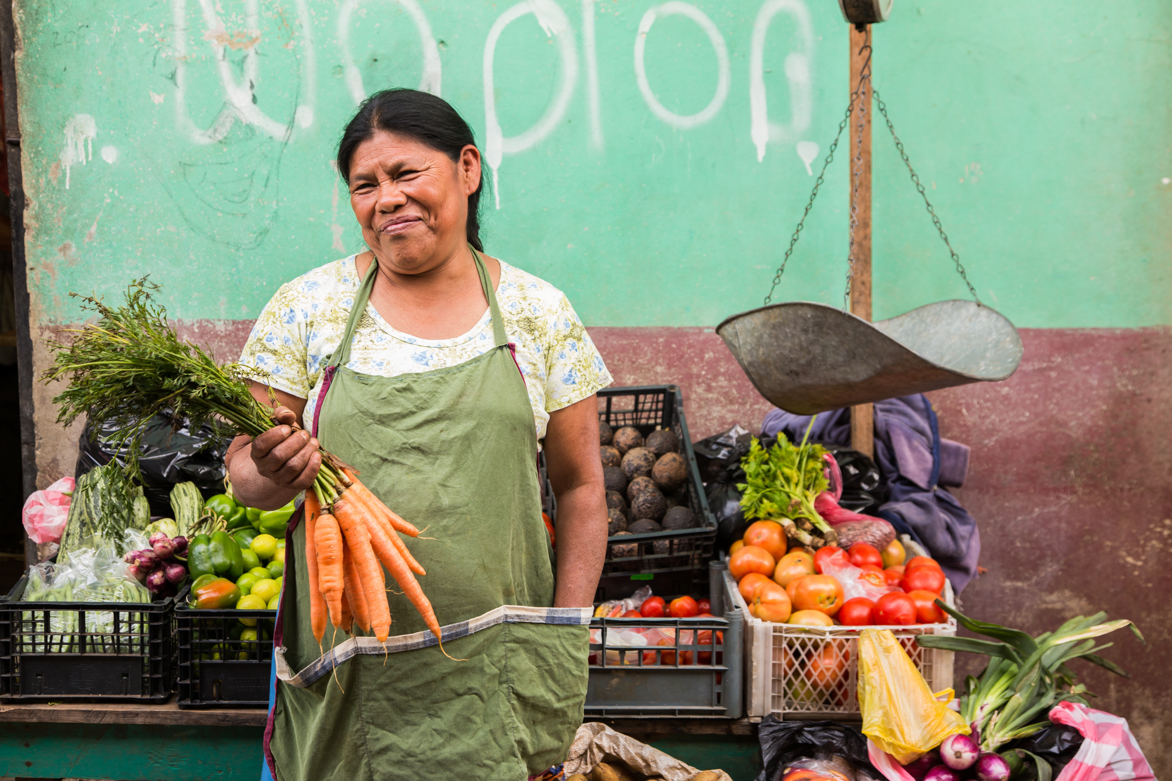
You will learn:
How to use the new Grant Center
Notes:
During today’s webinar, you will become acquainted with the new Grant Center. Rotary members contribute their skills, expertise, and resources to help solve some of the world’s toughest problems. Using Rotary grants, members can expand the reach of their efforts, creating positive change for communities in need around the world. So stay tuned for the next 60 minutes for this important information.

Slide 4
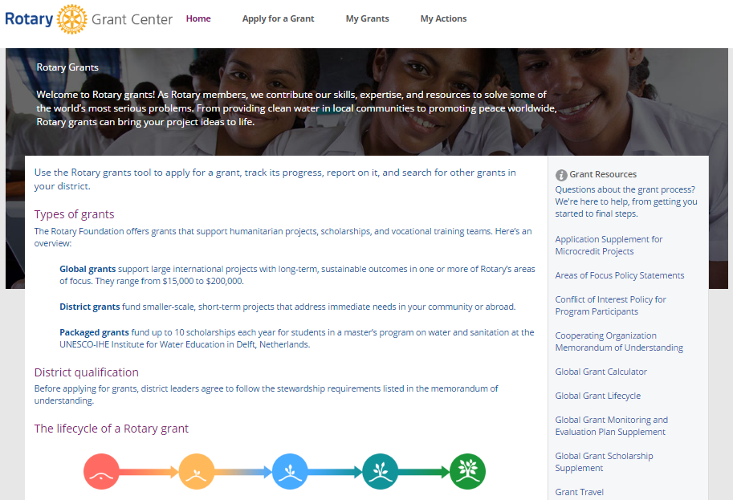
NEW GRANT CENTER
Notes:
The Grant Center, which launched last December, features both a new look and a streamlined application. The Grant Center’s landing page gives an overview of Rotary grants and links to helpful resources.

Slide 5
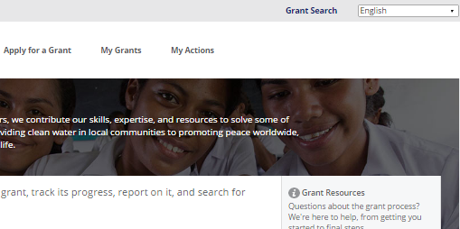
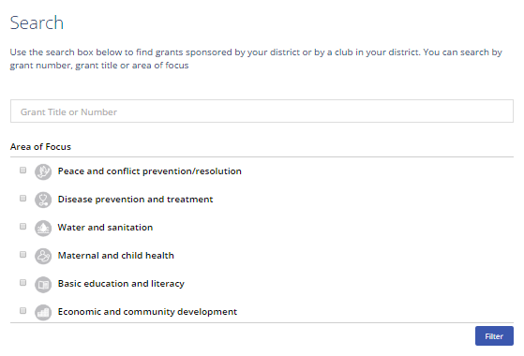
SEARCH
Notes:
Use Grant Search to find all of the global and district grants sponsored by your district, whether or not your club is involved. You can search for grants by number, title, or area of focus. After entering search criteria, use the Filter button.

Slide 6
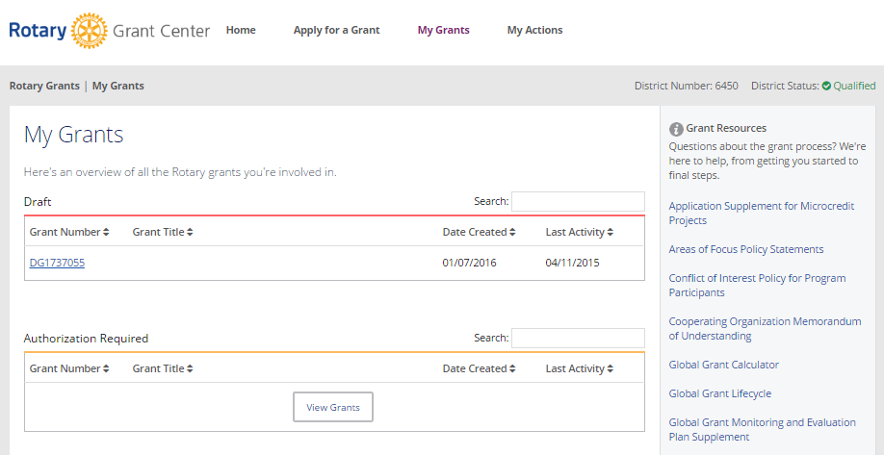
MY GRANTS
Notes:
Use the menus at the top to navigate the Grant Center. Choose My Grants to see all of the grants you’re involved in. On the My Grants page, grants are grouped by status. Use View Grants to see all of the grants that have each status.

Slide 7
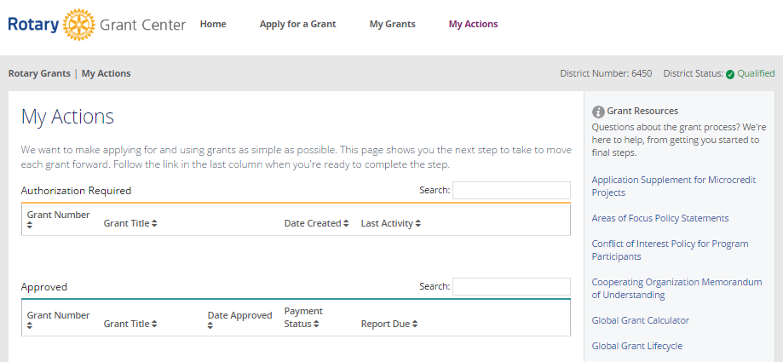
MY ACTIONS
Notes:
Go to My Actions to see the grants you’re involved in that require action from you.

Slide 8
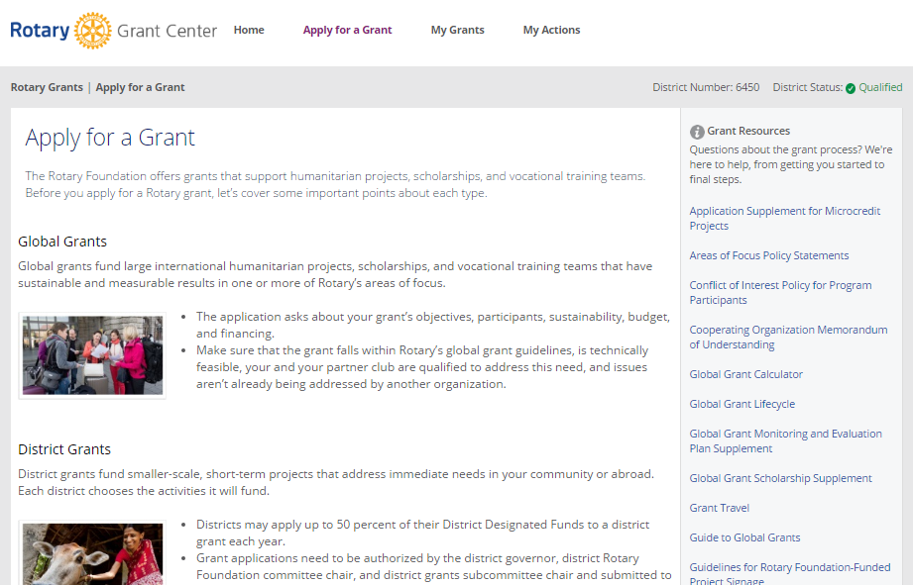
APPLY FOR A GRANT
Notes:
To start a grant application, go to Apply for a Grant. At the bottom of the page, select the grant type for which you want to apply.
We will now walk through how to apply for a global grant.

Slide 9
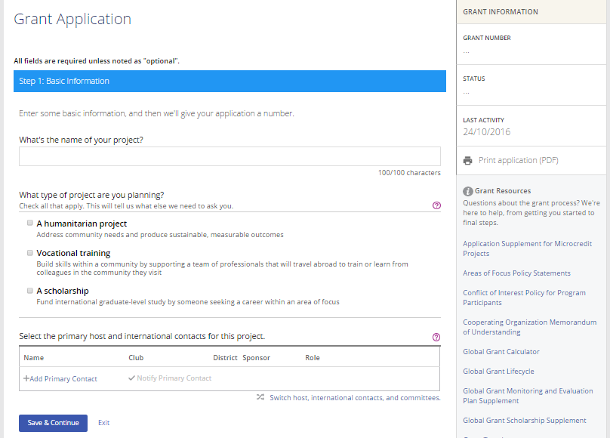
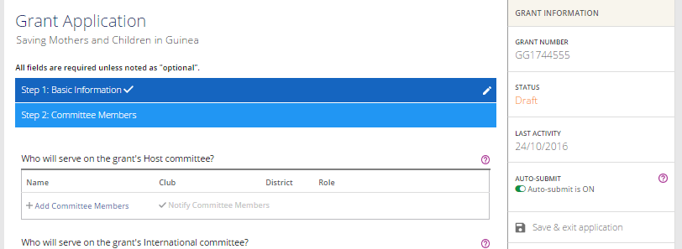
GLOBAL GRANT APPLICATION
Notes:
As part of designing the Grant Center, we streamlined the global grant application and refined the application questions. The application now includes 12 steps. In step 1, Basic Information, start by telling us your project’s name, what type of project it is, and the primary host and international contacts. Click on the question mark icons throughout the application for important information. Use the Save & Continue button to move to the next step. The Grant Center now assigns your project a grant number.

Slide 10
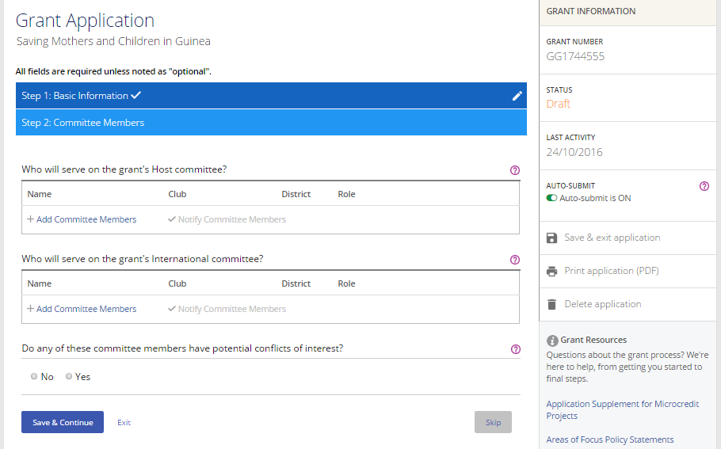
GLOBAL GRANT APPLICATION
Notes:
Now you’re at step 2, Committee Members. Add at least two members of the host committee, made up of Rotarians who live in the country where the project activities will be carried out (or where the scholar will study, in the case of a scholarship), and at least two members of the international committee. Answer the question about conflicts of interest. After each step, you’ll use the Save & Continue button to move to the next step.

Slide 11
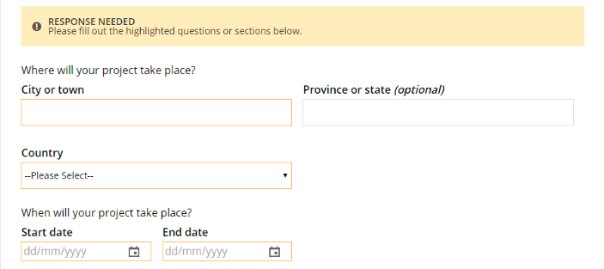
GLOBAL GRANT APPLICATION
Notes:
As you complete the steps, you’ll notice that check marks appear next to their labels. You can click the pencil to edit steps you’ve completed. You can also Skip a step and return to it later, but any changes you’ve made within that step will not be saved.
If you save a step when you haven’t supplied all of the necessary information, a banner will tell you that more information is needed. The incomplete sections will be highlighted. The banner will remain until all information for the step has been provided.

Slide 12
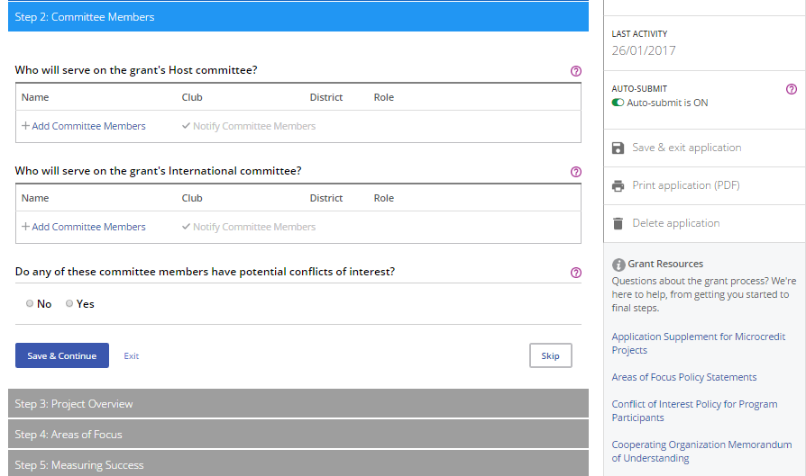
GLOBAL GRANT APPLICATION
Notes:
Throughout the process, you can click Save & exit application. You can also create a PDF of the grant application at any time using Print application (PDF), or you can delete an application that is still in “Draft” status by clicking on Delete application. Helpful Grant Resources are listed at the bottom of the right-hand column.

Slide 13
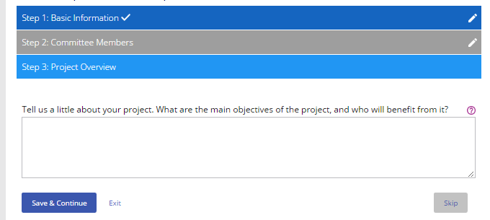
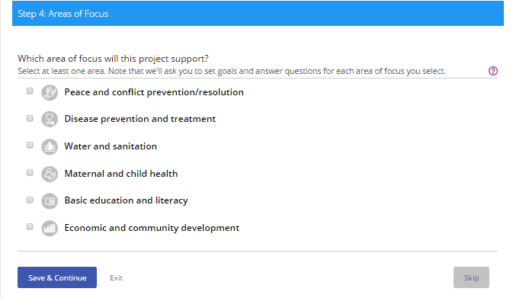
GLOBAL GRANT APPLICATION
Notes:
In step 3, briefly describe your project in a Project Overview.
Step 4 is where you indicate the Areas of Focus that your project will support.

Slide 14
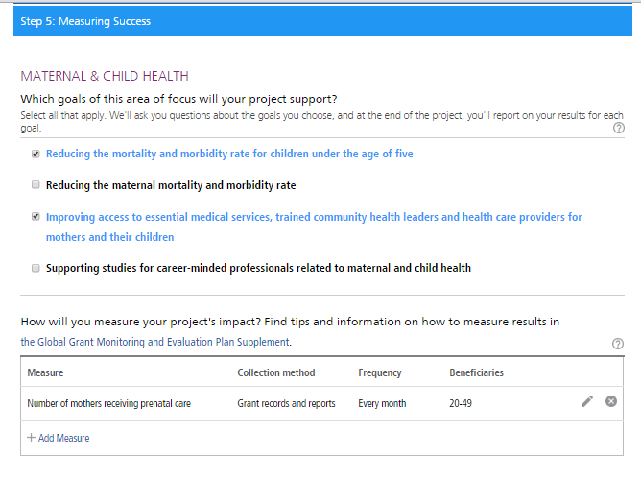
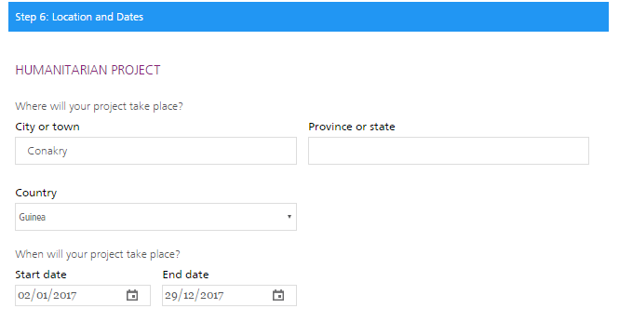
GLOBAL GRANT APPLICATION
Notes:
In step 5, outline your plan for Measuring Success, by checking one or more goals for each area of focus and adding measures for each goal.
In step 6, add the Location and Dates of the project. For scholarships and vocational training teams, add the estimated travel dates.

Slide 15
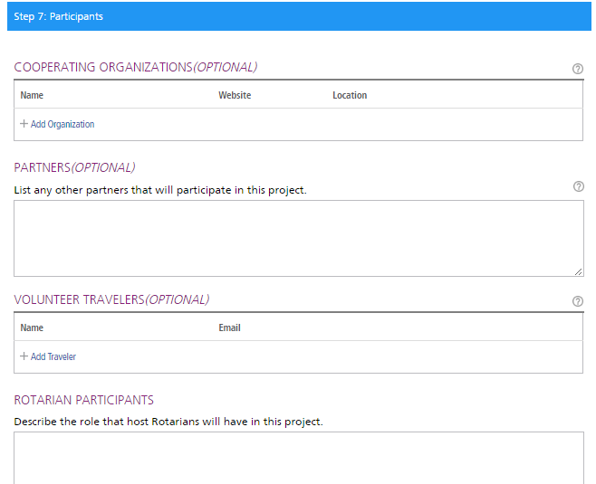
GLOBAL GRANT APPLICATION
Notes:
In step 7, list other project Participants, including cooperating organizations, scholarship candidates, vocational training team leaders, additional partners, volunteer travelers, and participating clubs or districts.
For vocational training teams, the team leader is now responsible for entering all team information into the online application. Previously each individual team member had to upload his or her information individually. We hope that this change will improve the application process for vocational training team members.

Slide 16
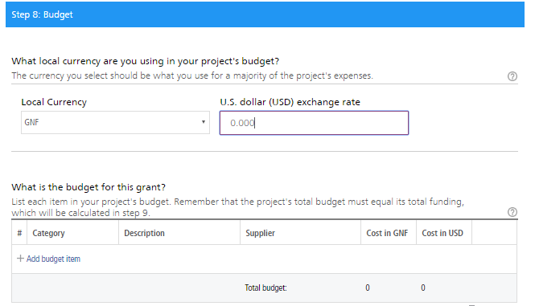
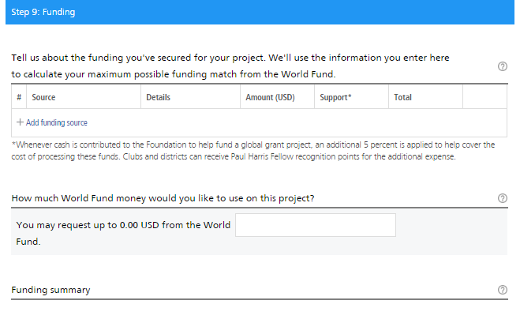
GLOBAL GRANT APPLICATION
Notes:
Step 8 asks about your project Budget. Enter the local currency and exchange rate, list budget items, and upload supporting documents.
In step 9, list your sources of project Funding.

Slide 17
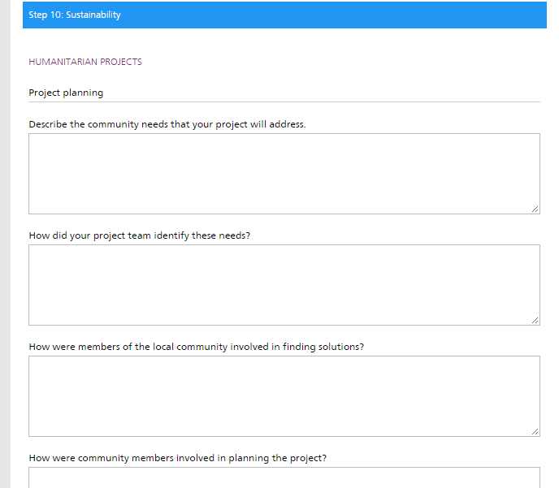
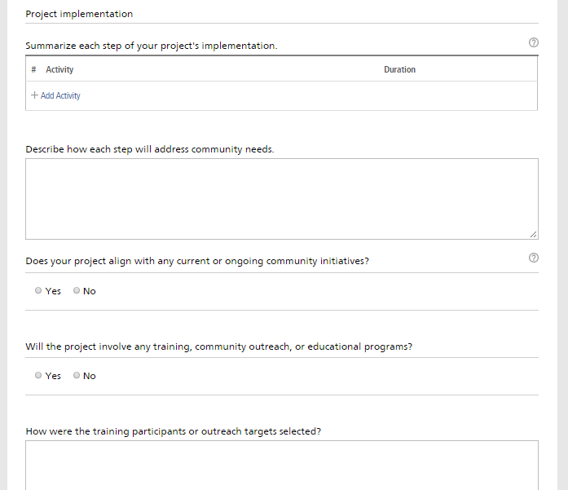
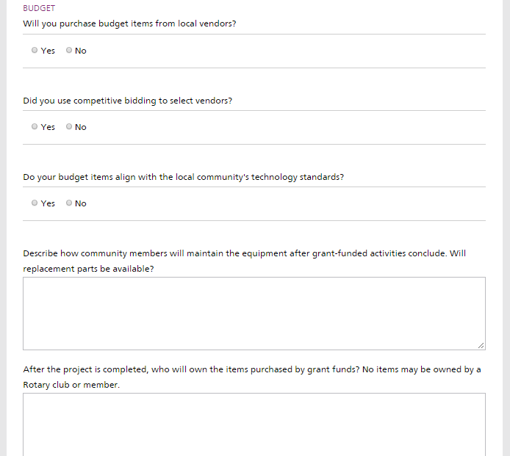
GLOBAL GRANT APPLICATION
Notes:
In step 10, Sustainability, you explain each step of the project, how the project responds to community needs, and what makes the project activities sustainable. You also answer a few questions about how the budget affects the sustainability of the project.

Slide 18
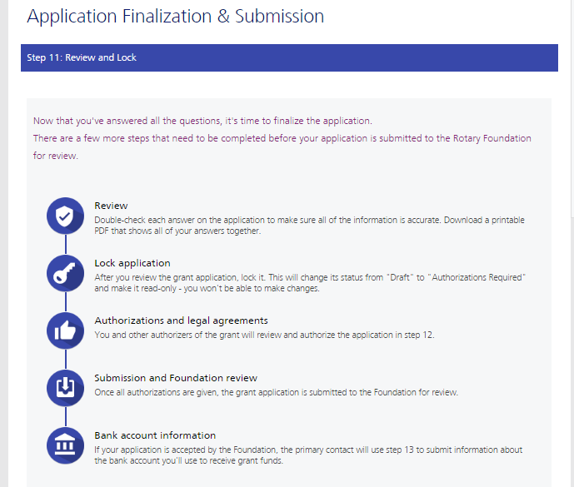
GLOBAL GRANT APPLICATION
Notes:
Once you’ve completed steps 1-10, you’re ready to finalize and submit your application. In step 11 you Review and Lock your application. Check each answer you’ve given to make sure all of the information is accurate and complete. You may find it helpful to print the full application. After you review the grant application, lock it. This will change its status from “Draft” to “Authorizations Required” and make it read-only — you won’t be able to make changes. Only the primary contact can lock the application.

Slide 19
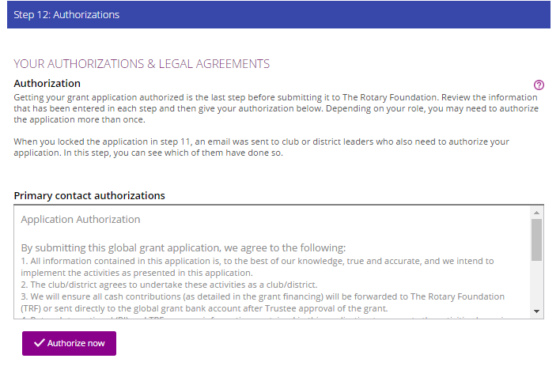
GLOBAL GRANT APPLICATION
Notes:
In step 12, Authorizations, the primary contacts and district and club leaders will authorize the application. Review the information, then click Authorize now. As soon as everyone who needs to authorize the application does so, the application is submitted to The Rotary Foundation for review. After your application is submitted, you cannot change it without contacting Rotary staff.

Slide 20
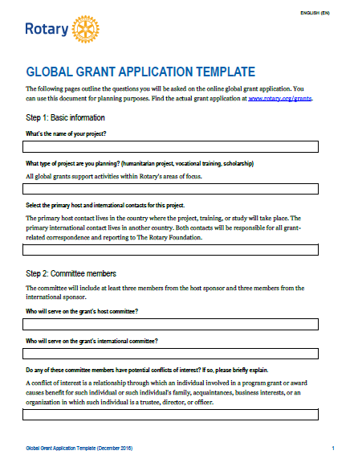
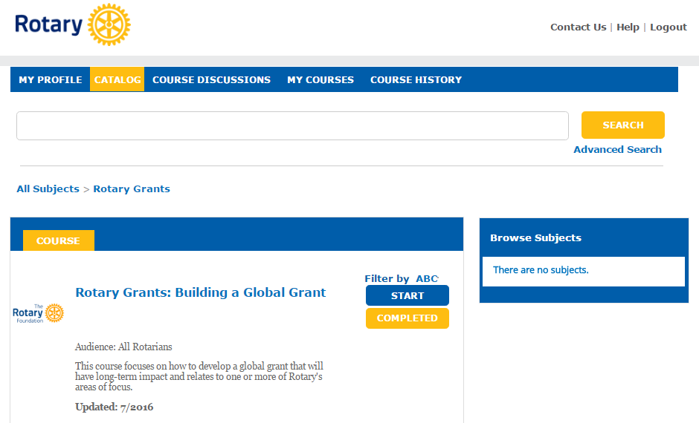
GLOBAL GRANT APPLICATION
Notes:
To help you in the planning process, we have a global grant application template available on rotary.org. Also, I would encourage anyone interested in applying for a global grant to take the Building a Global Grant course in Rotary’s Learning Center and read the Guide to Global Grants before getting started.

Slide 21
Thank you!
Questions? Email us at rotarysupportcenter@rotary.org.
Register for upcoming webinars and access recordings of past webinars at www.rotary.org/webinars
Notes:
Thank you all for participating today. As a follow up to the webinar, you will receive a link to view a recording of today’s webinar. If you have any follow-up questions from today’s webinar, please email us at rotarysupportcenter@rotary.org.
You will also receive a survey after this webinar. Your feedback is important to us, as your survey responses will be used to improve future webinars offered by Rotary International. Please take a moment to complete the survey and give us your input.
Thank you for attending today’s webinar.
Remember – if you enjoyed today’s webinar, you can register for upcoming webinars and check out the recordings of past webinars on the Rotary website at www.rotary.org/webinars.

