Slide 1
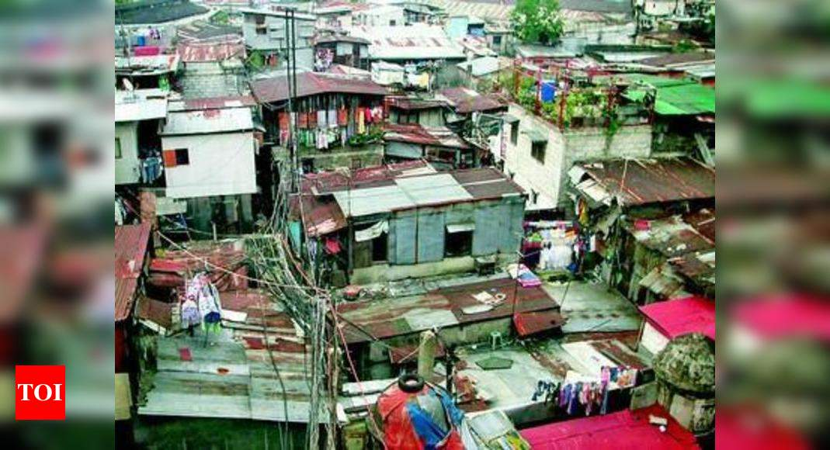
Global Grant 2120603 Building Livelihoods in in Post-Covid-19 Kusumpur Pahari: The Challenge of Inclusion in a Delhi Slum

Slide 4
Global Grant 2120603 Building Livelihoods in in Post-Covid-19 Kusumpur Pahari: The Challenge of Inclusion in a Delhi Slum
Leverage Rotary Club of Delhi South Metropolitan (RCDSM) experience in navigating among community members, community leaders (pradhan, Self Help Groups (SHGs), All India Democratic Women’s Association (AIDWA), Kusumpur Ekta Manch), lower-level bureaucracy workers (Delhi Development Authority (DDA), Delhi Urban Shelter Improvement Board (DUSIB) to establish formal interface between slum residents and Government agencies and Skills Enhancement Centers.
Establish Centers of Excellence for vocational training based on skills assessment matched with priority skills established through community surveys and aligned with the Skill India Mission (Ministry of Skill Development and Entrepreneurship (KSDE)) model training centers (Pradhan Mantri Kaushal Kendra (PMKK)) and India International Skill Centers (IISC).
Identify livelihood disruptions resulting from Covid 19 that need urgent attention and intervention
Establish channels of access to Government of India (GoI) programs through awareness building, Rotarian advocacy and intermediation, and active involvement of NGO partners. Provide training on digital platforms for access to government services.

Slide 5
Global Grant 2120603 Building New Livelihoods in in Post-Covid-19 Kusumpur Pahari: The Challenge of Inclusion in a Delhi Slum
Area of Focus: Peace and Conflict Resolution
Group activities including workshops, training, and other programs that support peace leadership and education, Positive Peace, community integration of vulnerable populations.
Legal, psychological, social, and rehabilitative services that help integrate vulnerable populations into society.
Area of Focus: Community Economic Development
Offering training related to community economic development, including entrepreneurship, community leadership, vocational skills, and financial literacy.

Slide 6
Community Needs Assessment Kusumpur Pahari: Assessing the Impact of Covid-19
The impact of Covid and the lockdown on the lives of migrant workers, through the lenses of
Income
Expenditure
Migration pattern
Health and nutrition indicators
Skill mapping of the community
Evaluation of the existing skill enhancement programmes
To asses the demand for skill promotion

Slide 7
Community Needs Assessment Kusumpur Pahari: Survey Methodology 1
Identification of Survey Informants—52 community members of Kusumpur Pahari (including local Pradhan, 11 key informants, and 5 alternates).
Survey Data collection (Computer Assisted Personal Interviews).
In Managed Focus Group Discussion with Key Informants—4 Focus Groups of 3 people each, one women only, and one seniors only.
In Depth Interviews—16 IDIs with stakeholders– first 12 social influencers + political leaders, NGO activists, front line health workers, government workers. 4 interviews with RCDSM members.
Secondary Data—government housing and infrastructure survey data, household surveys, NGO reports, available government and NGO skills development programs.

Slide 8
Community Needs Assessment Kusumpur Pahari: Survey Methodology
Age Groups
Gender
The low level of female representation reflect cultural factors—separate separate interventions are envisioned

Slide 9
Community Needs Assessment Kusumpur Pahari: Survey Methodology—Skill Mapping
Employment Profile
Actual Occupations (52 respondents
Daily Casual Wage Earner: 5
Driver: 3
Gardener: 13
Guard: 8
Housekeeping/ Sweeper: 12
Office Helper: 6
Other: 5

Slide 10
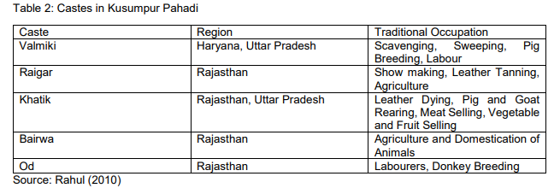
Global Grant 2120603 Kusumpur Pahari: The IEP Eight Pillars in the Global Grant context—Caste and “Hometown” Barriers to Good Relations Between Neighbors
Note: In-migration patterns largely established in 1960s—Pradhan(s) leadership may reflect caste, region of origin, occupational status

Slide 11
Community Needs Assessment Kusumpur Pahari: Survey Results—Covid 19 Effect on Employment
37 of the respondents (71%) suffered a reduction in income during lockdown.
40 of the 52 respondents reported they had lost jobs, at least for some period
12 were able to continue working at reduced wages and working hours
47 of the respondents (89%) reportedly reduced their expenditure during the lockdown; Of those 47 However, nobody had taken loan to sustain livelihood
13 of the 52 respondents (25%) reported to have reduced their remittances to their hometowns

Slide 12
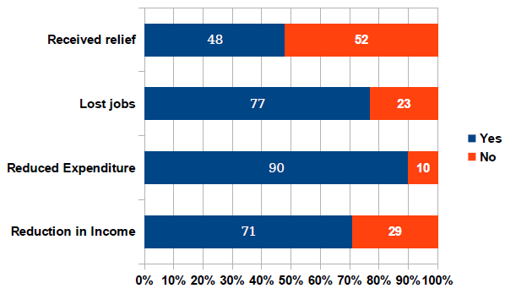
Community Needs Assessment Kusumpur Pahari: Survey Results—Covid-19 Effect on Employment
*25 respondents received some unemployment relief from government agencies. None had received extended help from NGOs.

Slide 13
Community Needs Assessment Kusumpur Pahari: Survey Results—Dramatic Covid-19 Effect on Migration
11 respondents had returned to home village, only to return to Kusumpur Pihari:
It’s really bad. Especially after corona, a lot of people have left for their villages. So many people have lost their jobs. There is almost no income. (IDI)
Income was affected massively. 90% of people didn’t even get salary. The government policy itself got changed. It said in the circular that it’s entirely up to the employer if they would like to give salaries or not and no one can sue them in court. So, most of the people didn’t get salaries. (IDI)
Covid-19 and the subsequent lockdown have caused one of the biggest reverse migrations of recent times. Informal workers lost their employment or face impossible conditions in their workplaces. In order to avoid starvation and other uncertainties, they traversed all the way back to their home villages, only to find that conditions were worse there. With public transportation in disarray, they often had to walk back hundreds of kilometers to return to Kusumpur Pahari (IGPP secondary research).

Slide 14
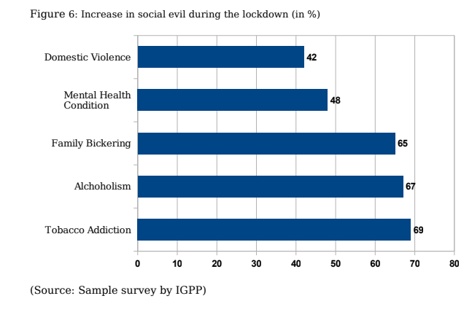
Community Needs Assessment Kusumpur Pahari: Survey Results—Deterioration in Family Life in Lockdown, Lack of Work

Slide 15
Community Needs Assessment Kusumpur Pahari: Survey Results—Survey Results: Most Desired Skills, Skills Enhancement

Slide 16
Community Needs Assessment Kusumpur Pahari: Survey Results—Survey Results: No Awareness of Government Skills Enhancement Programs
Do you know about government or NGO sponsored Skills Enhancement Programs?
Sample Survey by IGPP

Slide 17
Global Grant 2120603 Kusumpur Pahari: Livelihoods After Covid-19
Key Outcome: Kusumpur Pahari residents gain access to sustainable employment through appropriate skill development and market linkage provisions.
Participation of Pradhan(s), Civil Society Organizations, NGOs, Rotary, community leaders in awareness building and providing links to Government of India and NGO skill development training opportunities.
Cooperating Organization: Research Triangle Institute Global India (RTI)
Staffs pilot Center of Excellence
Video based training material—introduction to training portals, qualification requirements
Logistics training and direct assistance in meeting qualification requirements for entry

Slide 18
Global Grant 2120603 Kusumpur Pahari: Livelihoods After Covid-19
Staffs pilot Center of Excellence
Video based training material—introduction to training portals, qualification requirements
Logistics training and direct assistance in meeting qualification requirements for entry, including transportation, day care translation/interpretation services, interview assistance
Explores replication and scaling opportunities/feasibility in Delhi
Compile data on three types of unplanned settlements in Delhi (3 of 7 types comprise almost half of Delhi’s population)
Jhuggi Jhopri Clusters (JJCs)—Kusumpur Pahari is largest in Delhi
Unauthorized Colonies (UACs)
Resettlement Colonies (RCs) (permanent resettlement) and Temporary Resettlement Camps—(related to “in-situ redevelopment”)

Slide 19
Global Grant 2120603 Kusumpur Pahari: Livelihoods After Covid-19
Make contact with relevant officials across agencies
Delhi Development Authority and other Landowning Agencies (LOAs)
Delhi Urban Shelter Improvement Board (DUSIB)
Ministry of Skill Development and Entrepreneurship
Skill India Mission: state of the art, aspirational model training centers in every district of India—Pradhan Mantri Kaushal Kendra (PMKK)
Pradhan Mantri Kaushal Vikas Yojana (PMKVY) standardization of Certification process, recognition of existing skills, registry of skills
National Apprenticeship Promotion Scheme (NAPS)—provides financial incentives, technology, and advocacy support
India International Skill Centers (IISCs) skill training to international standards, Pre-Departure Orientation Training (recognizing out migration (Dubai, Malaysia, etc.) as viable strategy)

Slide 20
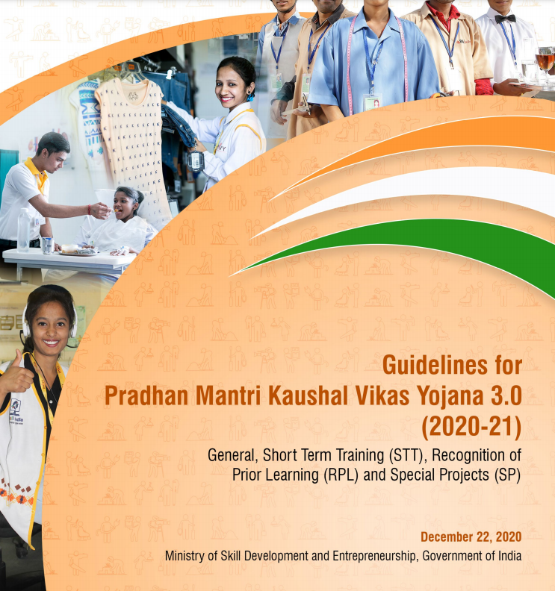
Global Grant 2120603 Kusumpur Pahari: Government Training IS Available
The Pradhan Mantri Kaushal Vikas Yoyana—India Skills Centers for Youth

Slide 21
Global Grant 2120603 Kusumpur Pahari: Why Kusumpur Pahari and Why Rotary?
The Rotary Club of Delhi South Metropolitan has been active in the area for more than 25 years—beginning with polio eradication drives
Training residents to repair hand pumps for government-run tube wells—1980s
Day-care centers for working women
Pre-schools
Remedial classes, individual tutoring, counseling for high school students
Computer and mobile device training for boys and girls
OTC drug store and homeopathic clinic
Specialty “beauty culture” classes for women
Design, embroidery, stitching, and machine sewing
Gift of sewing machines to girls and women completing sewing classes

Slide 22
Community Needs Assessment Kusumpur Pahari: Survey Results—No Awareness of Government Skills Enhancement Programs
Do you know about government or NGO sponsored Skills Enhancement Programs?
Sample Survey by IGPP

Slide 23
Global Grant 2120603 Kusumpur Pahari: Barriers to Access for Slum Dwellers--DOCUMENTATION
Requirements for Application to Government Programs
Unique Identification Numbers (UID) of the applicant and spouse.
Voter ID Card: These must be submitted for three different years (a date prior to June 4, 2009, 2013, year of application.
Proof of Residence: One of eleven document proofs dated before 2009.
Additional certificates and affidavits for Scheduled Caste or Physically Handicapped applications
Note: While copies of these documents may be submitted on-line, applicants must appear in person with original documents at the offices of each of the agencies involved.

Slide 24
Global Grant 2120603 Kusumpur Pahari: Why Kusumpur Pahari and Why Rotary?
The Rotary Club of Delhi South Metropolitan is trusted and has a long track record in Kusumpur Pahari
The Rotary Club of Delhi South Metropolitan member Dr. Rajiv Tandon is the Executive Director of Research Triangle Institute, India, a leading US-based NGO with connections to the Government of India. RTI has been involved in developing this project

Slide 25
Global Grant 2120603 Kusumpur Pahari: Why Kusumpur Pahari and Why Rotary?
Other Important Civil Society Organizations, NGOs
All India Democratic Women’s Association (AIDWA)—leads a community of women within the JJC that meets regularly to discuss livelihood issues, runs education programs, and programs on maternal health
Kusumpur Ekta Manch—a group of residents in opposing government redevelopment plans for the JJC
Center for Advocacy and Research (CFAR)
Action India
Bharat Foundation
Azad Foundation
Center for Urban and Regional Excellence
Cities of Delhi Project—Centre for Policy Research

Slide 26
Global Grant 2120603 Kusumpur Pahari: Three Tracks to Opening Doors to Better Livelihoods
Track 1: Preparing for Success
Training for Success in application and enrollment—basic training in on-line access to government and NGO skills enhancement programs, interview styles, CV writing
Specialized courses in computer and mobile device applications
Business English and Hindi practice, refresher
Special courses for women in beauty culture, retail and hospitality special skills (Note: these are in addition to the training above, and only for women who want them).

Slide 27
Global Grant 2120603 Kusumpur Pahari: Three Tracks to Opening Doors to Better Livelihoods
Track 2: Opening Doors to Opportunity
Mass Recruitment and screening of candidates—target 1,000 applicants (400 men, 600 women, 30% youth
Targeted Recruitment of community leaders (Pradhan(s), CSO and community Self-Help Groups, NGOs active and trusted in the community
Securing Cooperation of lower-level officials in documentation offices, relevant agencies
Removing Logistical Obstacles including day care, transportation, accompanying candidates to interviews

Slide 28
Global Grant 2120603 Kusumpur Pahari: Three Tracks to Opening Doors to Better Livelihoods
Track 3: Keeping the Doors Open
Ongoing Training while candidates are working through skills enhancement programs to reinforce livelihood skills
Ongoing Support to ensure that logistics or livelihood concerns do interrupt training
Connecting with employment opportunities beyond those provided by government training programs
Introducing training for foreign employment as an option with introductions to India International Skills Center (IISCs) where appropriate

Slide 29
Global Grant 2120603 Kusumpur Pahari: The Three Tracks to Opening Opportunity—Systems Design
While the Three Tracks are Conceptually Distinct, after the initial recruitment, they should all be running simultaneously—primary training occurs while candidates receive assistance with applications to government training centers, while Rotary and Cooperating Partner assist with logistics and work on coopting and briefing Pradhan(s), CSOs, NGOs, government agencies responsible for ID and Residence certification documentation.

Slide 30
Global Grant 2120603 Kusumpur Pahari: Global Grant Training Plan—Track 1 (Incubation) Track 2 (Consolidation)

Slide 31
Global Grant 2120603 Kusumpur Pahari: Global Grant Training Plan—Track 1 (Incubation) Track 2 (Consolidation)

Slide 32
Global Grant 2120603 Kusumpur Pahari: Replication and Scaling up
Two large budget items in the Grant are for two staff members to organize units to:
Explore replication and scaling opportunities/feasibility in Delhi
Explore scaling up to National Center of Excellence—a model for coordination and systemization of a Government of India portal for inclusion of marginalized communities in the national training program.

Slide 33
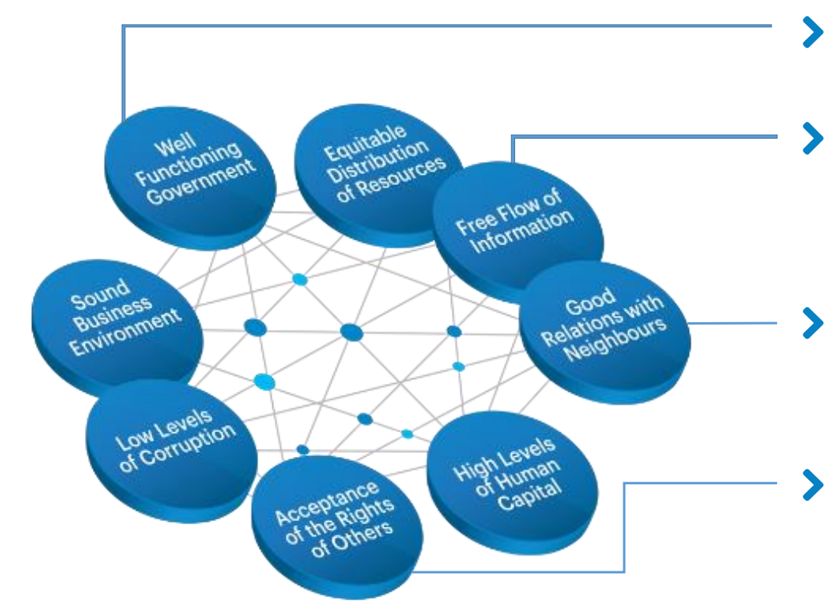
Global Grant 2120603 Kusumpur Pahari: The IEP Eight Pillars in the Global Grant context—Well Functioning Government
Well Functioning Government:
Inclusion of slum residents in Government documentation programs (UID biometric), Residence registry, Scheduled Caste certification
Inclusion of slum residents in Government and NGO skills enhancement and job placement programs
Reduction of “patronage politics” and predatory corruption (Chatterjee 2004)—formalization of access to skills enhancement a job placement programs
Restoration of interface between slum residents and the State during implementation

Slide 34
Global Grant 2120603 Kusumpur Pahari: The IEP Eight Pillars in the Global Grant context—Free Flow of Information
Free Flow of Information:
Participatory Awareness Campaign and “Preparing for Success” courses introducing Skills Enhancement/Job Placement programs
Increase in reliable data on JJCs, UACs, and Resettlement Colonies/ Temporary Transit Camps—there are over a thousand excluded settlements in Delhi but no reliable data on service delivery (Heller, et. al. 2015)
Restoration of formal and informal interfaces between slum residents and the State during implementation—demonstration that slum dwellers, with CBOs and NGOs, can access rights to services.

Slide 35
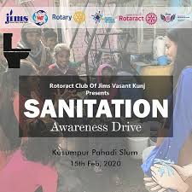

Slide 36
Global Grant 2120603 Kusumpur Pahari: The IEP Eight Pillars in the Global Grant context—Good Relation with Neighbors
Good Relations with Neighbors:
Implementation requires participation across caste, home province, gender, political, and CBO and NGO lines.
Personal interventions by Rotary and Cooperating Organization in logistical support, negotiating with Skills Enhancement providers, engaging with government agencies
Rotary’s Long-standing relationships with Pradhan(s), Kusumpur Ekta Manch, AIDWA, NGO ensures respect for their roles in awareness building and advocacy
600 of 1,000 participants women, with classes on family roles after women go to work or establish businesses

Slide 37
Global Grant 2120603 Kusumpur Pahari: The IEP Eight Pillars in the Global Grant context– Acceptance of the Rights of Others
Acceptance of the Rights of Others:
Implementation requires participation across caste, home province, gender, political, and CBO and NGO lines.
Project, based on Rotary DEI principles, advocates “right to services,” “right to city” discourse—challenges “slums as nuisance” mindset of courts and DDA, DUSIB
Rotary’s Long-standing relationships with Pradhan(s), Kusumpur Ekta Manch, AIDWA, NGO ensures respect for their roles in awareness building and advocacy
600 of 1,000 participants women, with classes on family roles for working women

Slide 38
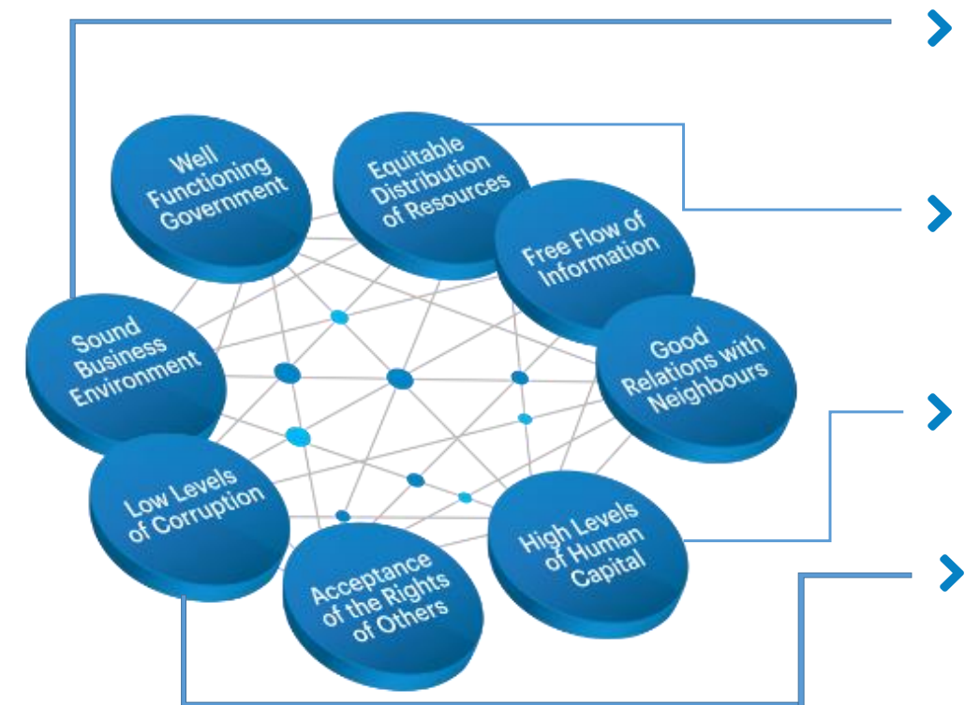
Global Grant 2120603 Kusumpur Pahari: The IEP Eight Pillars in the Global Grant context—Sound Business Environment
Sound Business Environment:
Project, based on Rotary DEI principles, advocates “right to services,” “right to city” discourse—challenges “slums as nuisance” mindset of courts and DDA, DUSIB
Project opens opportunities to marginalized slum dwellers to participate in skills training to meet national (and international) standards
600 of 1,000 participants women, with classes on women’s roles in service industries (hospitality, retail, in-home businesses)
India International Skill Centers (IISCs) will offer skills training to certification benchmarked to international standards

Slide 39
Global Grant 2120603 Kusumpur Pahari: The IEP Eight Pillars in the Global Grant context—Equitable Distribution of Resources
Equitable Distribution of Resources:
Project, based on Rotary DEI principles, advocates “right to services,” “right to city” discourse—challenges “slums as nuisance” mindset of courts and DDA, DUSIB
While project will not eliminate “patronage politics,” it will create awareness among slum residents of rights to Skills Enhancement Programs and Job Placement Services
Rotary intervention, with Pradhan(s), Kusumpur Ekta Manch, AIDWA, NGO will challenge predatory clientism that demands “payments” for services
600 of 1,000 participants women, with classes on women’s roles in industry and home life.

Slide 40
Global Grant 2120603 Kusumpur Pahari: The IEP Eight Pillars in the Global Grant context—High Levels of Human Capital
Project opens opportunities to marginalized slum dwellers to participate in skills training to meet national (and international) standards
600 of 1,000 participants women, with classes on women’s roles in service industries (hospitality, retail, in-home businesses) and in family life
India International Skill Centers (IISCs) will offer skills training to certification benchmarked to international standards

Slide 41
Global Grant 2120603 Kusumpur Pahari: The IEP Eight Pillars in the Global Grant context—Low Levels of Corruption
One major project goal is to establish “clean” window/interface between slum residents and documentation agencies, skills enhancement providers
Skills certification to industry (or even international) standards will reduce exposure to corrupt practices in access to menial jobs
India International Skill Centers (IISCs) certification to international standards will reduce corruption in access to legal immigration and foreign employment
Global Grants stewardship requirement will demonstrate international standards at all levels of interaction—agencies, Community Based Organizations, NGOs.

Slide 43
Global Grant 2120603 Kusumpur Pahari: The IEP Eight Pillars in the Global Grant context—How Systems Thinking Works in this Grant
Inclusion of slum residents in Government and NGO skills enhancement and job placement programs (Good Government) will also improve slum residents’ access to better jobs (Equitable Distribution)
Increase in reliable data on JJCs, UACs, and Resettlement Colonies/ Temporary Transit Camps (Free Flow of Information) will also contribute to better survey information ahead of in-situ redevelopment (Good Governance) and more inclusion (Equitable Distribution)
Skills certification to industry (or even international) standards will reduce exposure to corrupt practices in access to menial jobs (Low Corruption) and lead to better jobs (Equity) and Higher Level of Human Capital

