Slide 1
Rohingya Refugee Crisis
: A joint Rotarian response

Slide 2
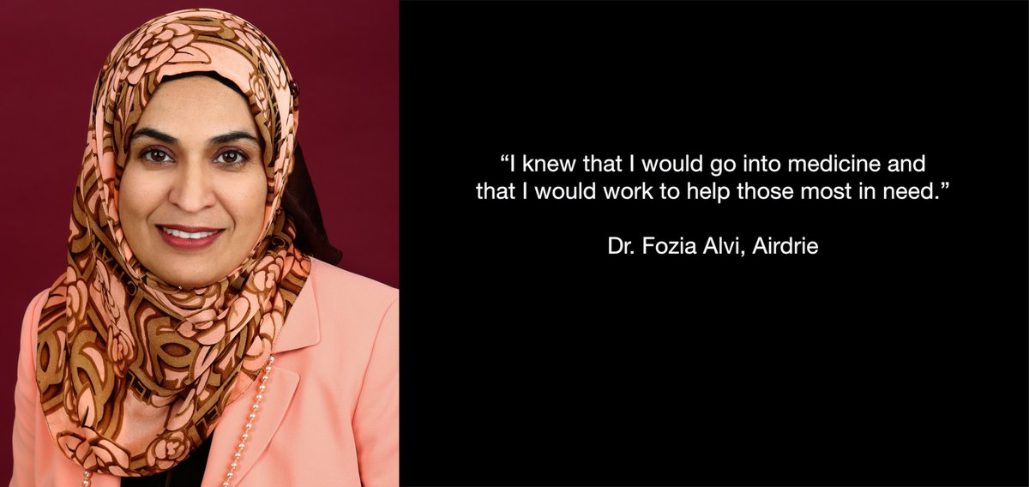

Slide 3
2020 Rotary World Peace Conference Presentation
Dr. Fozia Alvi -Inspirational Speaker on the plight of the Rohingya
Dr. Alvi Fozia is a Rotarian with her Medical partner Dr. Mohsina Chaklader RC of Airdrie,
Practices medicine in Calgary, Canada
After Dr. Alvi’s visit to the Rohingya refuge camps in 2017 she and Dr. Chaklader started the Humanity Auxilium Foundation to provide for the medical needs of refugees.
Visit (humanityauxilium.com)

Slide 4
History of the Rohingya Crisis
Myanmar (Burma) has had a Rohingya population in it’s borders for hundreds of years. The Rohingya consider Myanmar their homeland.
The Rohingya as Muslim are a minority in a mostly Buddhist country.
The Myanmar government has systematically reduced the Rohingya’s rights including since the 1970’s including taking away their citizenship.
In 2017 a campaign of mass violence including murder, torture, rape and burning of villages began.
724,000 Rohingya fled across the border to Bangladesh where were 200,000 Rohingya refugees has already fled in previous years.

Slide 5
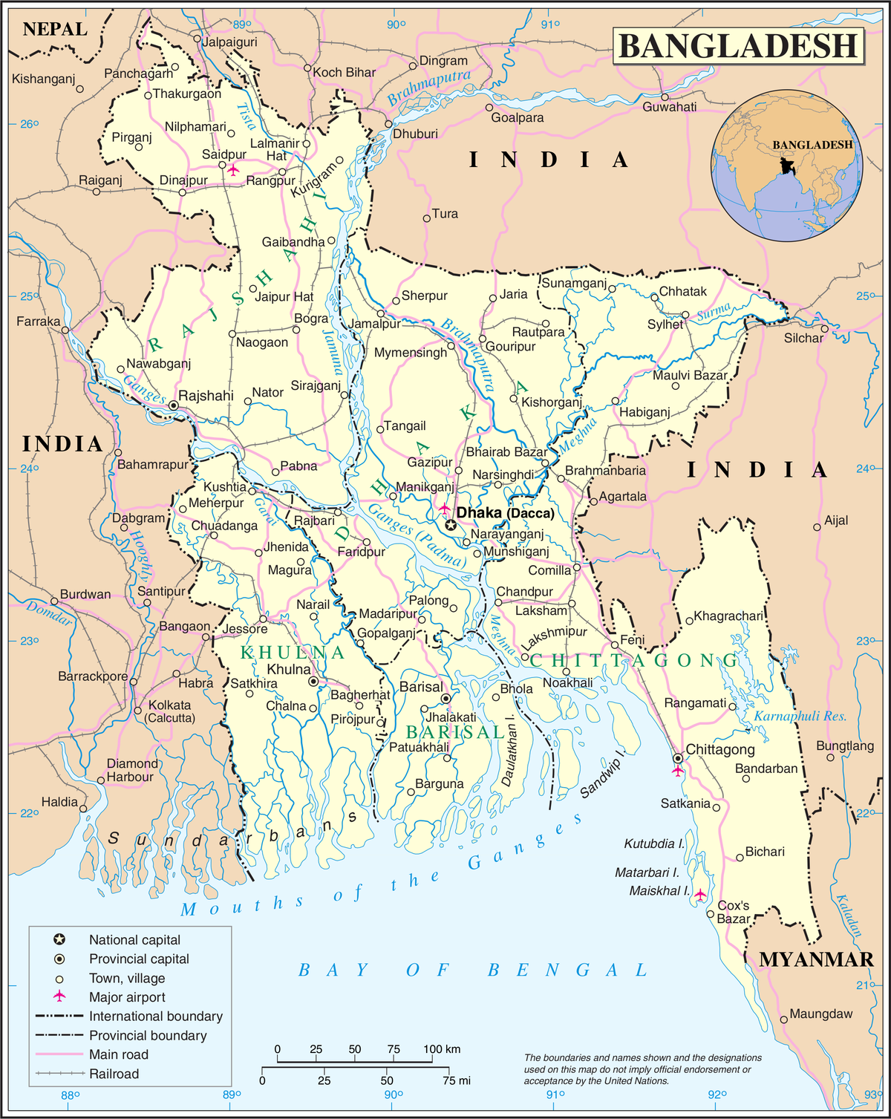
This Photo by Unknown Author is licensed under CC BY-SA

Slide 6
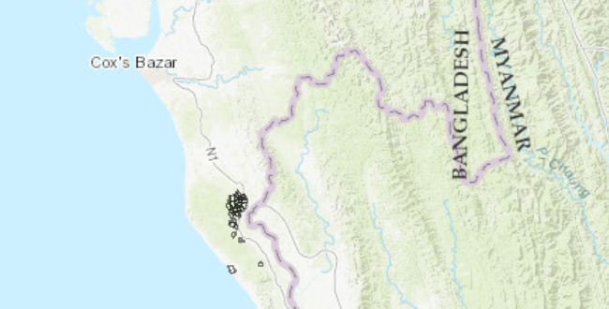
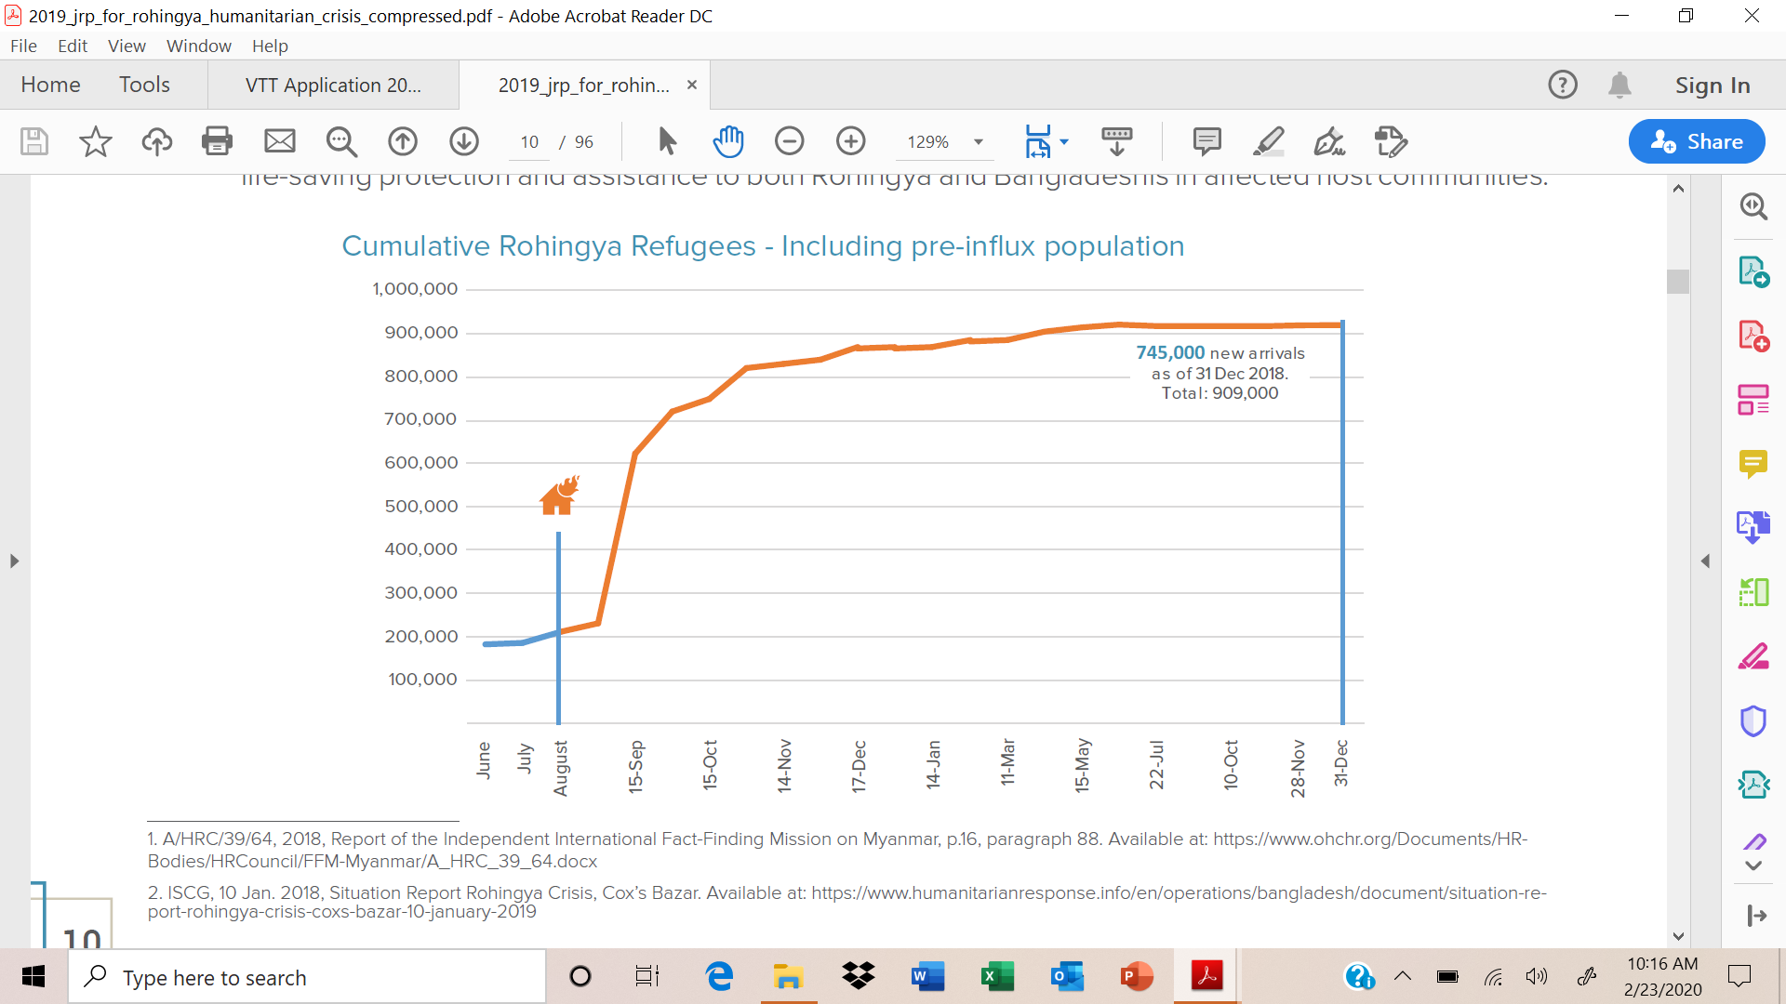
Rohingya Camps (in black)
Over 1,000,000 refugees in approximately sq. miles
Land is mostly muddy, proned to flooding during the monsoon season

Slide 7
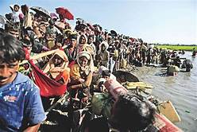
Myanmar Rohingya fleeing to Bangladesh

Slide 8
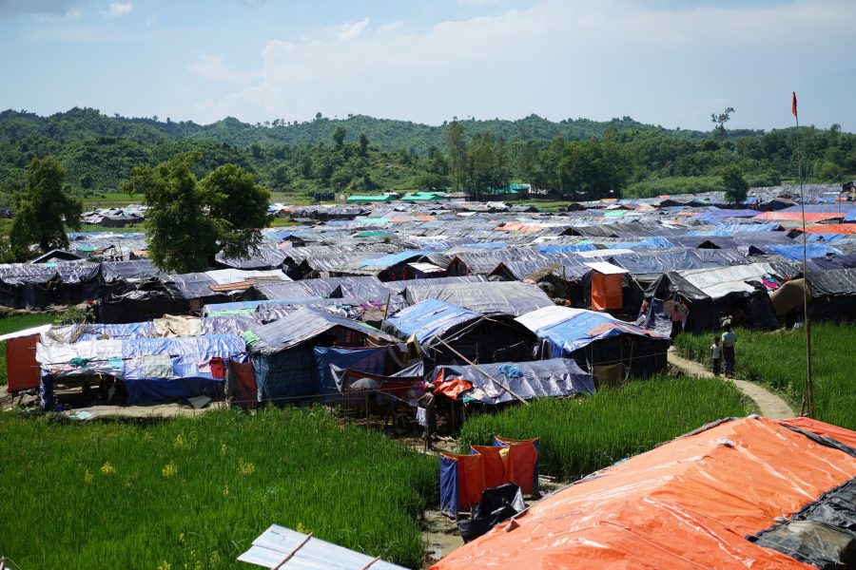
Housing crisis

Slide 9
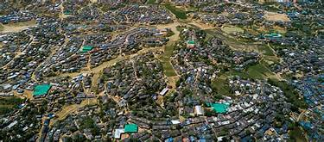
Extreme conditions 600,000 in one camp – 100,000 per square mile

Slide 10
Location of the Rohingya Camps in Bangladesh
This Photo by Unknown Author is licensed under CC BY

Slide 11
Needs assessed (UNHRC/NGO’s)
RI GG is working within two of the largest camps approximately (100,000) total
Children 0-17 years old = 55%
Many men, heads of households were killed
The camps lack clean water, stable housing, sanitation, power
The refugees are completely reliant on the outside for everything- food, medical care. This population before the virus was already food insecure.
Since Covid-19 the foreign NGO’S, Red Crescent, removed most if not all of their workers. This leaves the refugees already weak extremely vulnerable to the virus.
Because of the extreme density of the population the virus will spread like wild-fire.
Extreme PTSD resulting from trauma .

Slide 12
RI GLOBAL GRANT (Airdrie, Calgary) #2099637
Phase I ( the GG goals below were modified due to Covid -19 to include only medical supplies and equipment in Phase 1)
Medical supplies, clean water, power to operate the clinics and community
Survival and medical kits and training to parents, and older siblings
Provide 6 MediGcal Vocational Training Teams (VTT) to train local doctors in best practices and to supervise the running of the 2 clinics currently in operation. Each team will be assigned for one month and consist of 5 medical personnel.
In addition to the VTT’s working in the clinics with the local medical teams the VTT’s will develop curriculum on maternity basics and basic nutrition for the refugees
The grant will provide transportation, housing and meals for the VTT teams while in service.
The GG will provide for translators for written and verbal communication
Phase II will include mental health assessment and a leveled plan to service the needs specifically to children.
Notes:
Show Now This Video of Dr. Alvi

Slide 13
Emergency Rotary Covid-19 GG Proposal
Provide immediate virtual training to existing local medical, social work, teacher teams on science-based safety measures to prevent the spread of Covid-19 in the camps .
Provide protective supplies to local medical teams and refugees such as masks, testing and ventilators.
This currently is being organized by the Humanity Auxilium Foundation but funds are needed to provide the training and medical supplies. A proposed Rotary Covid-19 grant may be written for this purpose.

