Slide 1
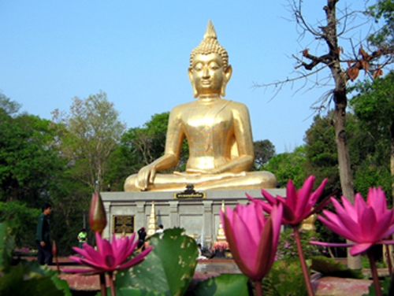

Slide 2
Thailand Global Grant
GG# 2093771
Disease Awareness, Prevention &
Gaining improved entry into needed healthcare system

Slide 3
Prime Hosts & International Contacts

Slide 4
Project Overview
Expanding improved entry into more comprehensive healthcare services in rural communities through enhancement of health infrastructure.
Supporting ongoing preventive services & health educational programs, and providing training to transfer technical knowhow to local healthcare professionals.

Slide 5
Area of Focus
Disease Prevention and Treatment

Slide 6
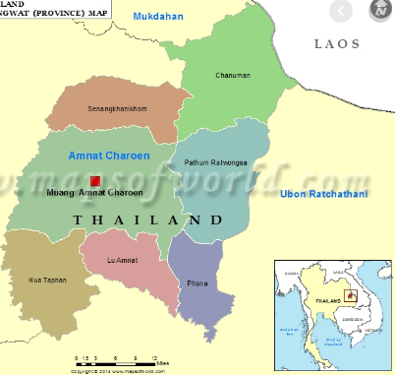
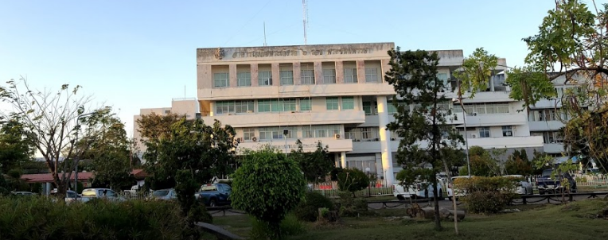
Project Site:
Amnat Charoen Hospital

Slide 7
Amnat Charoen Hospital a secondary referral hospital
Serves a population of 380,000 in 653 communes
Receive referral cases from 6 district hospitals
Medical team of 72 doctors + 323 professional nurses
350 IPD beds
400,000 OPD case visits/year

Slide 8
Funding:
RC Honolulu Sunrise
RC Ala Moana
RC Mililani Sunrise
RC Pearl Harbor
RC Windward Oahu Sunrise
RC Waianae Coast
RC Amnat Charoen
World Fund Contributions $32,150.00
DDF Contributions $18,049.00
Cash Contributions $28,201.00
TOTAL FUNDING $78,400.00

Slide 9
Hamilton Mobile Ventilator: dual-purpose, compact & convenient for transport

Slide 10
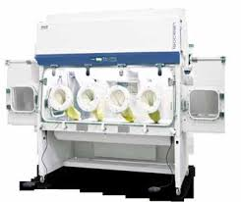
ESCO Negative Pressure Containment Isolator
To compound personalized oncology drugs for chemotherapy service

Slide 11
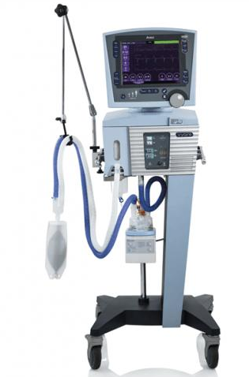
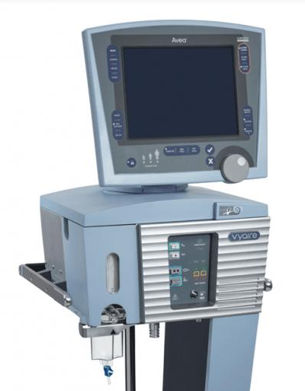
AVEA Standard Ventilator

Slide 12
Thank You
QUESTIONS?

