Slide 1
Grants for Rotary Year 2021-22: The Grants and Things to Keep in Mind
Mark Harbison, District Rotary Foundation Committee Vice Chair & Grants Subcommittee Chair,
PDG Laura Steelquist, Grant Stewardship Subcommittee Chair, Arjun Aryal, Grants Subcommittee Global Grants Chair, Dave Hamil, Grants Subcommittee District Grants Chair

Slide 2
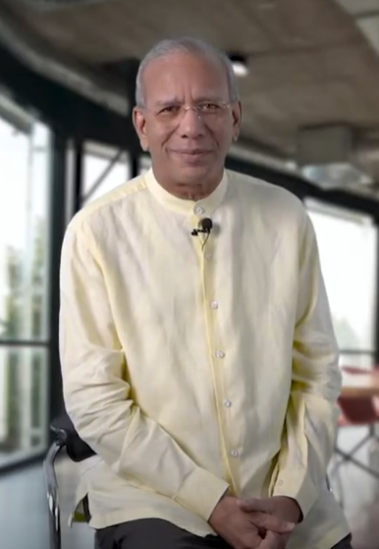
Our Foundation Funded more than 2,000 Global Grants in 2020-2021
K.R. (Ravi) Ravindran
@KRRavindran105
Together, we funded more than 2,000 global grants that empowered Rotary members around the world to take on projects they care about and make a difference in their communities. Your generosity helped us raise more than $440 million! Unbelievable! Highest ever!

Slide 4
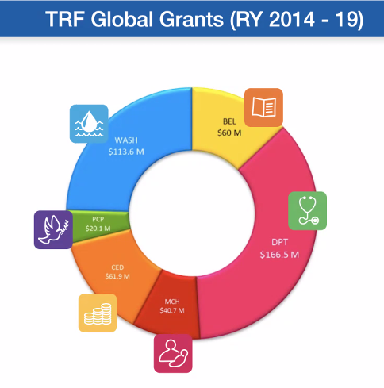
Areas of Focus shares of total global grants

Slide 5
Our New Area of Focus
Global Grants in the new Area of Focus begin July 1 2021

Slide 6
Decision 2: Reduce the World Fund match of DDF from 100% to 80% for global grants
DDF contribution to Global Grant
Example scenario:
80% World Fund Match
Advocacy
+
$36,000
for global grant
$20,000
$16,000

Slide 7
Decision 2: Reduce the World Fund match of DDF from 100% to 80% for global grants—Effect in district 5000
Example scenario:
DDF contribution to Global Grant
+
80% World Fund Match
$36,000
for global grant
Advocacy
$16,000
$20,000
Cash contribution to Global Grant
+
$50,000
for global grant
$20,000

Slide 8
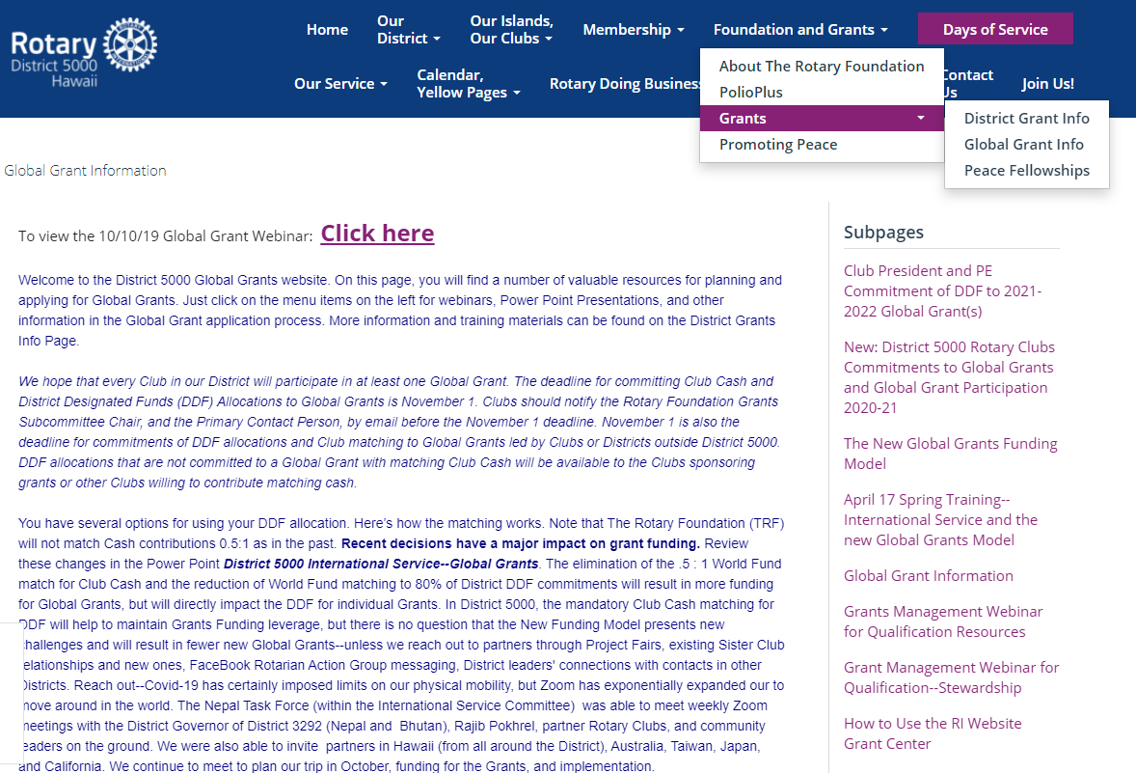
global Grant Management Resources on the D5000.org Website

Slide 9
Global Grant GG2230470 WASH in 9 schools of Jwalamukhi, Nepal
Rotary Clubs of Honolulu Sunset and Narayangarh (District 3292)
$TBD
Area of Focus: WASH
Ahead of our trip to Nepal and Bhutan (postponed again due to the Delta outbreak), we are working on another project in the Jwalamukhi District. Part of Rotary’s WASH in Schools campaign, this grant will provide clean drinking water, gender sensitive sanitation and hygiene facilities, with training in the importance of toilet use and maintenance for school staffs and students following Rotary Action Group for Menstrual Health and Hygiene training guides for girls adapted for Nepal. We hope to implement the project in 9 schools in the District.
Contact Arjun Aryal aryala@gmail.com and Andy Chamberlain AlaskanAndy@gmail.com

Slide 10
Global Grant 2230297 Avoidable Blindness in Delhi Slums
Rotary Clubs of Kihei-Wailea and Delhi South Metropolitan (District 3011) with Nara East and District 2650
$134,589
Area of Focus: Disease Prevention and Treatment
Building on our work in the Delhi slums and the extensive network of eye care clinics connected to the Rotary Eye Care Hospital in Karol Bagh, we will train health workers involved in door-to-door polio and Covid-19 vaccination campaigns to also screen for vision problems, especially children needing glasses and candidates for cataract or glaucoma surgery. The grant will pay for eyeglasses and for patients referred to the Rotary Eye Care Hospital for major surgeries.
Contact Mark Harbison markaharbison@gmail.com 808-283-3785

Slide 11
Global Grant GG2229939 Supporting Pediatric Emergency Resuscitation (SUPER) Project
Rotary Clubs of Honolulu Sunset and Palau, Pohnpei, and Chuuk (District 2750)
$TBD
Area of Focus: Disease Prevention and Treatment
The SUPER Project aims to assist with Emergency Medical Services (EMS) equipment to raise the overall standard of EMS care for children in the Pacific Basin region. Up to 1/3 of the population in the Pacific Basin is under the age of 15 years, yet funding, equipment and training for pediatric emergency care is deficient in many islands throughout the Pacific. The grant will fund basic pediatric EMS resuscitation “crash carts” and resuscitation training equipment for hospital emergency rooms.
Contact Dr. Paul Moroz pjmoroz@gmail.com

Slide 12
Global Grant 2231243 Ultrasound Equipment and Training in Papua New Guinea
Rotary Clubs of Honolulu Sunset and Port Moresby Papua New Guinea (District 9620)
$TBD
Area of Focus: Disease Prevention and Treatment
According to WHO, Papual new Guinea has the lowest physician per capital in the world. Point of Care Ultrasound (POCUS) is a bedside diagonostic imaging modality to help physicians and other health professionals get immediate results and diagnoses, reducing mobidity and mortality, especially in trauma and pregnant mothers. POCUS is inexpensive, durable, noninvasive, safe, and avoids exposure to radiation. Its flexibility makes it a high impact, low cost imaging mode in emerging and complex conditions even in resource limited environments. The grant will provide handheld POCUS devises to four regional hospitals serving four districts.
Contact Dr. James Ham: james.ham@gmail.com

Slide 13
GG GG2231364 Reducing risk factors for Noncommunicable Disease
Rotary Clubs of Honolulu Sunrise and Silom Thailand (District 3350)
Area of Focus: Disease Prevention and Treatment
Another Hospital Equipment and community outreach grant in rural Thailand from Kasemchai Nitiwanakun of the RC of Silom in District 3350 and David Mozdren of the RC of Honolulu Sunrise. The grant leaders have not yet set a budget, but many of you are familiar with these life saving projects in Thailand. These are great global grants and our district and usually receive wide support from Sister Clubs in Thailand, Korea, and Japan, as well as District 5000.
Contact Dave Mozdren David.Mozdren@hawaiiantel.com 808-294-3283

Slide 14
GG 2229588 Ventilator, ICU Bed, and PARP for Lampang
Rotary Clubs of E-Club Francophone and Bangkok Pattanakarn Thailand (District 3350)
Area of Focus: Disease Prevention and Treatment
The grant will provide equipment and training for Fort Surasak Montri Hospital in Lampang Province in Northern Thailand.
Contact Del Green del.Rotary5000@gmail.com and Jean Louis NGUYEN QUI
jl.nguyen1@orange.fr

Slide 15
GG 2125558 You Can Kid! Training center for kids with cerebral palsy in 5 areas of russia
Rotary Clubs of Moscow East (District 2223) and Yerevan Panarmenian (District 2452)
Area of Focus: Disease Prevention and Treatment
The grant will provide verticalizers and training in their use in therapy for staff in 5 training centers for children with cerebral palsy in 5 areas of Russia. This therapy is extremely effective in training patients to stand within 6 months, and enabling them to walk on their own with only the aid of cane within a year. This grant was facilitated by members of the US-Russia Intercountry Committee.
Contact Aryuna Radnaeva radnaevaaryuna@gmail.com

