Slide 1
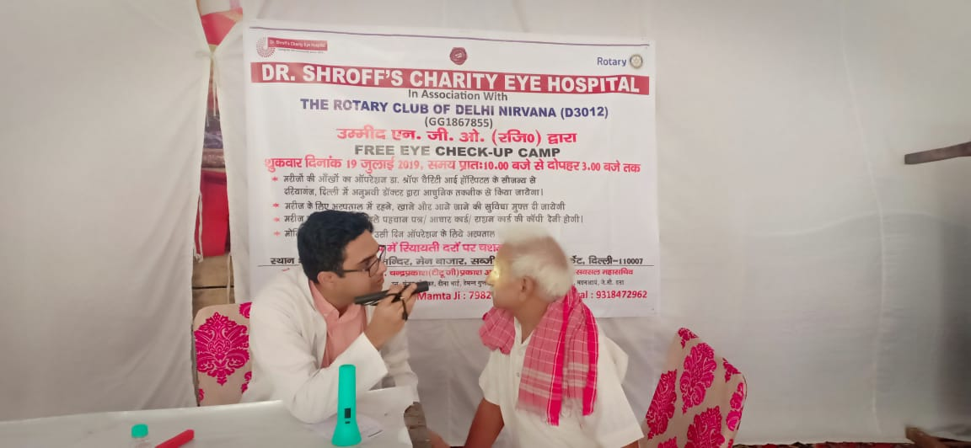
DISTRICT 5000 INTERNATIONAL SERVICE—GLOBAL GRANTS
Mark Harbison, District Rotary Foundation Committee Vice Chair—Grants Subcommittee Chair
April 17, 2021 Webinar

Slide 2
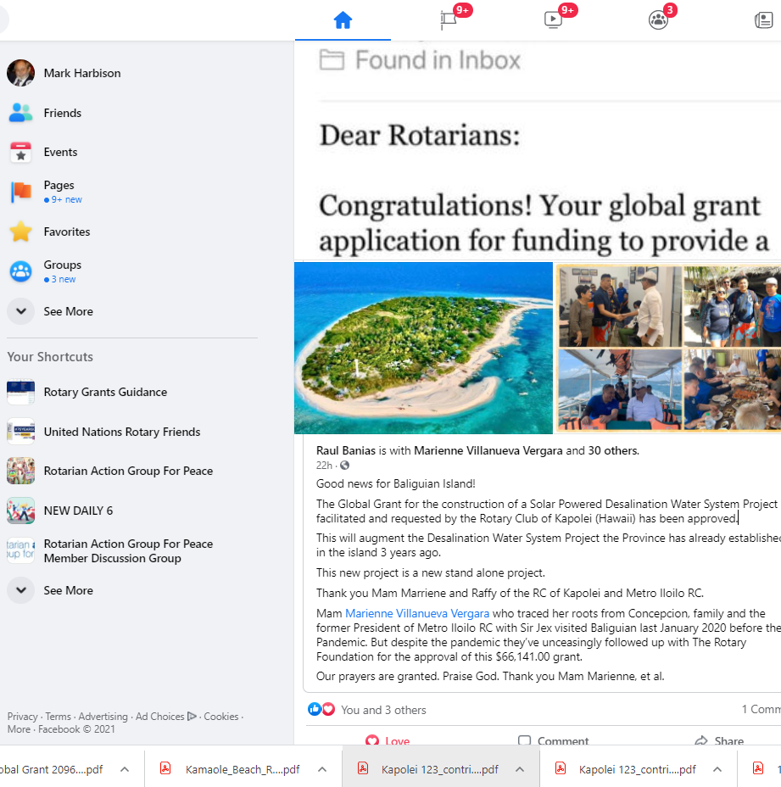
Global Grants Matching—Let’s Begin on with a SHOUT OUT
Thank you Mam Marriene and Raffy of the RC of Kapolei and Metro Iloilo RC.
Mam Marienne Villanueva Vergara
who traced her roots from Concepcion, visited Baliguian last January 2020 before the Pandemic. But despite the pandemic they’ve unceasingly followed up with The Rotary Foundation for the approval of this $66,141.00 grant.

Slide 3
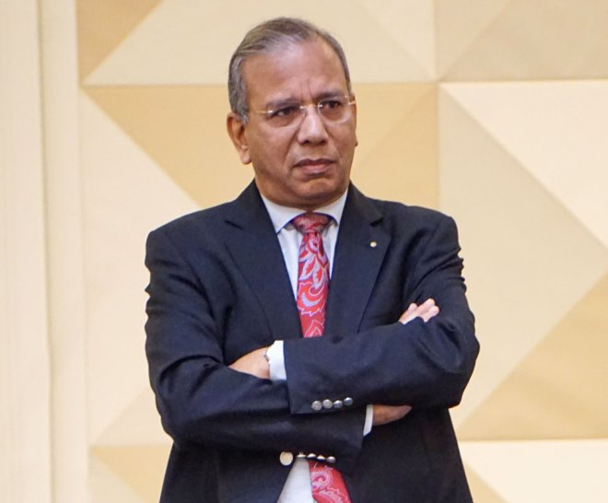
New Policy on Global Grant Matching—No TRF Club Match
KR (Ravi) Ravindran, Rotary Foundation Trustee Chair:
“The global grant (GG) program, the flagship program of our Foundation, has been an enormous success. In 2013–14, when GGs were introduced, TRF had awarded 868 of them worth $47.3 million. By 2018–19, this number had risen to 1,403 grants worth $86.6 million.” But while this demand shot up by 80 per cent, the corresponding Annual Fund contributions showed only a 7 per cent increase. ”
“This year, unfortunately, TRF had almost $12 million less in its World Fund for GGs; 25 per cent less compared to Rotary year 2020. This was not related to Covid; and resulted from the Annual Fund contribution decreasing significantly two years ago. Given this $12 million shortfall, the Trustees have initiated a new policy that has “eliminated the match, on cash contributions to global grants.”
MORE FUNDING IS CRITICAL

Slide 4
New Policy on Global Grant Matching—No TRF Club Match
KR (Ravi) Ravindran, Rotary Foundation Trustee Chair:
At the January 2021 meeting of the Trustees, Trustees approved:
Transfer of US$7.5 million from TRF’s operating reserve to the World Fund to fund global grants in 2020–21, of which $3 million would be allocated for global grant scholarships;
Request to the RI Board to match the transfer of
$7.5 million from RI funds (approved);
To Provide a 100 percent World Fund match on DDF for applications that are in “submitted status” by 31 May 2021, or on the date the World Fund runs out, whichever date is earlier;
To provide a 100 percent World Fund match on DDF for approved global grant scholarship applications that are in “submitted status” by 30 June2021, even if the World Fund budget is exhausted prior to 30 June.
MORE FUNDING IS CRITICAL

Slide 5
New Policy on Global Grant Matching

Slide 6
New World Fund Policy Effects on Global Grant Funding
Earlier Decisions:
Eliminate 50% match for Club Cash contributions
Eliminate requirement for minimum $15,000 World Fund Match

Slide 7
New Policy on Global Grant Matching—DDF Match Reduced to 80%
MORE CASH FUNDING IS CRITICAL

Slide 8
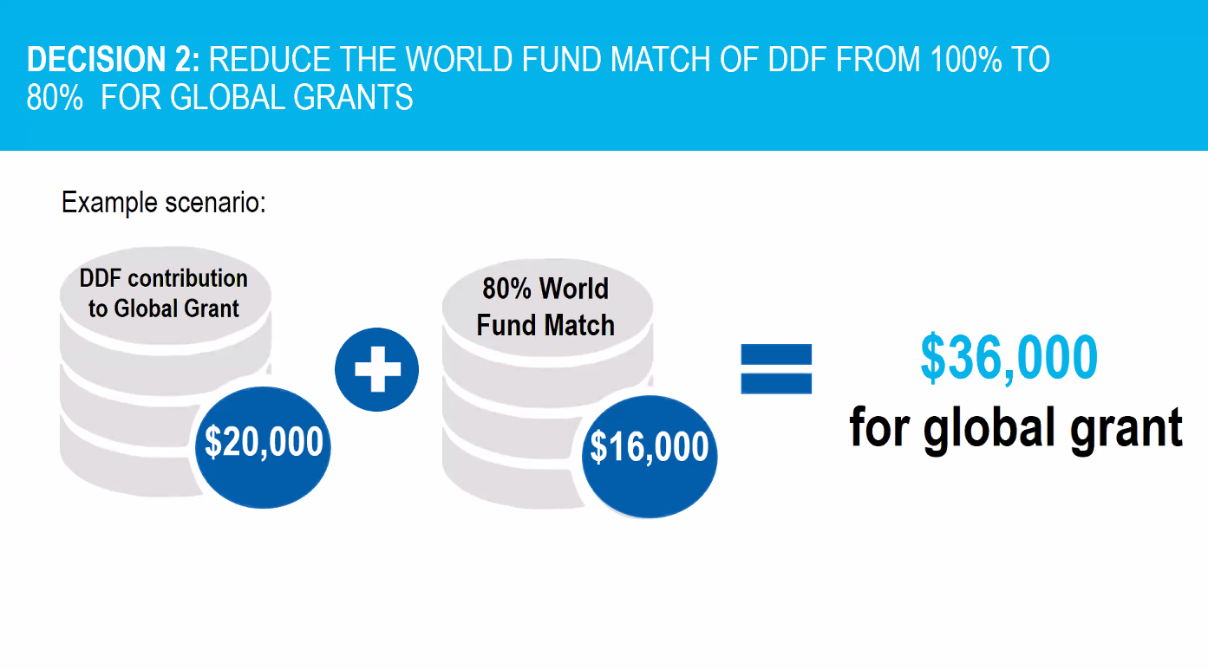
New Policy on Global Grant Matching—DDF Match Reduced to 80%

Slide 9
New Policy on Global Grant Matching—Changes in Expense Share
MORE FUNDING IS CRITICAL

Slide 10
New Policy on World Fund Match—5-Year limit on Rollover DDF--$48 Million to the World Fund Over 5 Years
KR (Ravi) Ravindran, Rotary Foundation Trustee Chair:
“The ability to roll over unused DDF will be limited to five years. Districts are encouraged to fully use their DDF to make a positive impact through our programs, but the amount of DDF rollover remains high — on 1 July 2020, $48.8 million was carried into the current Rotary year. At the end of each Rotary year, starting 1 July 2026, DDF that has been held for more than five years will be applied at the district’s discretion to PolioPlus, areas of focus Endowment funds, Rotary Peace Centers, the Endowment Fund, the Disaster Response Fund, or the World Fund.”

Slide 11
New Policy on Global Grant Matching—What is the Payoff?

Slide 12
New Policy on the World Fund—Endowment Fund to the Rescue?

Slide 13
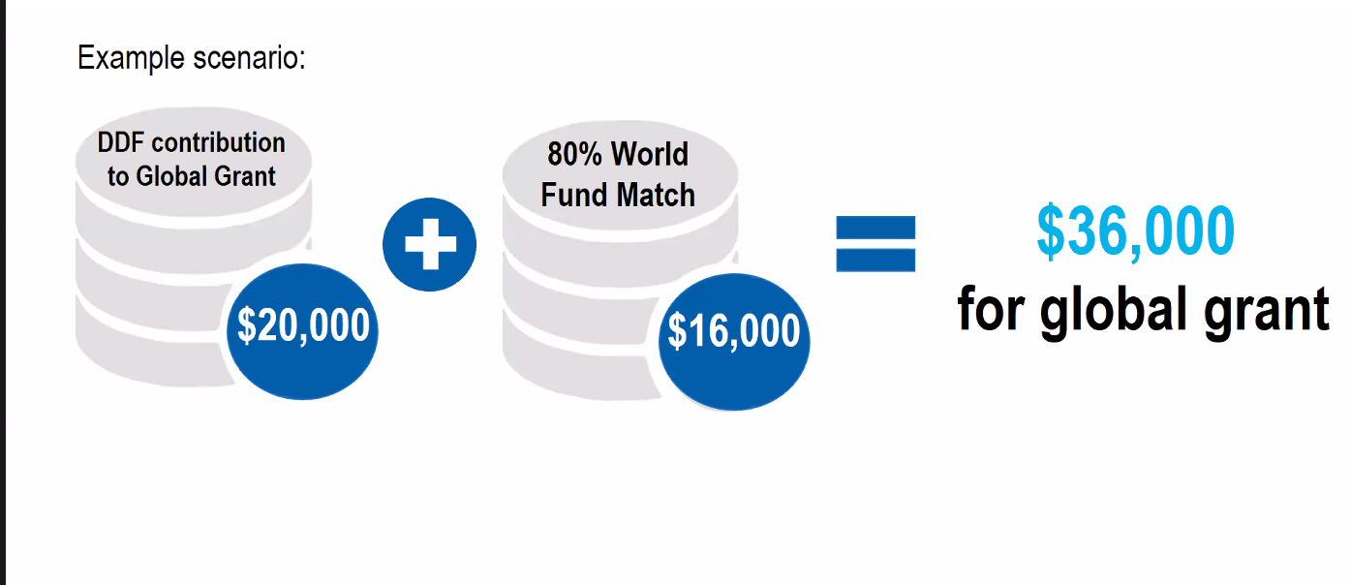
New Global Grant Funding Model—Getting to $100,000 in District 5000
+ $20,000 in Club Cash Matching
+ $24,000 DDF Cooperating District
+ $19,200 in World Fund Matching
+ $800 Club Cash from Host Partner Club or District, or Intl. Partner Club in Cooperating District

Slide 14
New Global Grant Funding Model—Getting to $300,000 in District 5000
+ $20,000 in Club Cash Matching
+ $24,000 DDF Cooperating District
+ $19,200 in World Fund Matching
+ $800 Club Cash from Host Partner Club or District, or Intl. Partner Club in Cooperating District
+ $200,000 2 FOR 1 MATCH FROM UNICEF/USAID/WORLD VISION/IAPB/WHO

Slide 15
Our New Area of Focus—Global Grants Begin July 1, 2021
Global Grants in the new Area of Focus begin July 1 2021

Slide 16
The Rotary Foundation SEVEN Areas of Focus

Slide 17
Our New Area of Focus—Global Grants Begin July 1, 2021

Slide 18
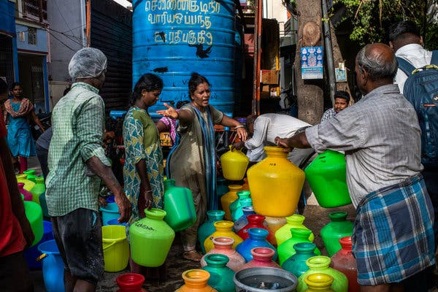
Programs of Scale Grants
District 5000 2020-2021 Global Grants
Multi-year programs that benefit large number of people
Alignment with areas of focus
World Fund award of $2 million; no additional Rotarian funding required
Require implementation with partner organization(s)
Competitive two-step application process

Slide 19
Programs of Scale Grant 2020-21—Zambia Malaria Program
“Our first Programs of Scale award was Initiated by the Rotary Club of Federal Way in Seattle, Washington, USA Rotary clubs in Zambia . The program has an ambitious goal of helping reduce the incidence of malaria by 90% in ten target districts in Zambia.
The Rotary Foundation, World Vision USA and the Bill & Melinda Gates Foundation will each contribute $2 m to add 2,500 community health workers to the national health system in Zambia, allowing for more effective malaria diagnosis &treatment for more than 1.3 million people.
The project will save lives, ease the pressure on the health system and increase productivity of people. It enhances the scope, impact and sustainability of successful Rotary projects by providing longer-term resources.”

Slide 20
Rotary USAID Hearts of Europe Global Grants--$2M in 3 Years
Project: “DRONES FOR ICT CLASSROOMS”
Area of focus: Basic education and literacy
Host club: Rotary Club Sremska Mitrovica, District 2483
Partner: Ministry of Education of the Republic of Serbia
Beneficiary: Elementary schools (1300 schools)
Type of donation: Drones and programming languages
Scratch and Python
Budget: 184,800 $

Slide 21
New Policy on World Fund Match—No $15,000 Minimum Word Fund Match or 15% International Partner Contribution
K.R. Ravindran
@KRRavindran105
·
Mar 6
As of 31 Dec ‘20, 1,186 global grants have been approved by TRF this fiscal year. Together with the 1,614 grant applications in the pipeline, it makes a total of 2,800, already representing an unprecedented level of activity beating the record set last year at 1,717 applications.

Slide 22
New Policy on Global Grant Matching—No TRF Club Match
KR (Ravi) Ravindran, Rotary Foundation Trustee Chair, April 2021:
When the coronavirus hit about a year ago, The Rotary Foundation quickly mobilized and awarded 319 COVID-19-specific disaster response grants for $7.9 million. To date, we have further awarded 317 COVID-19 global grants for about $24.1 million, which, combined with previously approved global grants that grant sponsors repurposed to support coronavirus response, has made for a total outflow of more than $32.7 million.

Slide 23
Rotary District 5000 Global Grants(s) Travel Opportunity in Nepal and Bhutan—Stay tuned for more information
District International Service Project in Nepal sponsored by DG Naomi Masuno and Nepal District 3292 Governor Rajib Pokhrel
Three Global Grants you can support:
Global Grant 2118290 Improving Basic Education at two schools in Damauli (site of our Chunder WASH project GG1988399), with “hands on” participation by District 5000 Rotarians
Global Grant 2117300 Medical Equipment and Telemedicine at Dhading Region Hospital—”on tour”
Global Grant 1752052 Medical Equipment and Telemedicine at Kumari District Hospital—”on tour for the adventurer
+Possible tour of projects in Bhutan

Slide 24
Rotary District 5000 Global Grants(s) Heads up: Rotaractors Are Part of Global Grants Now

Slide 25
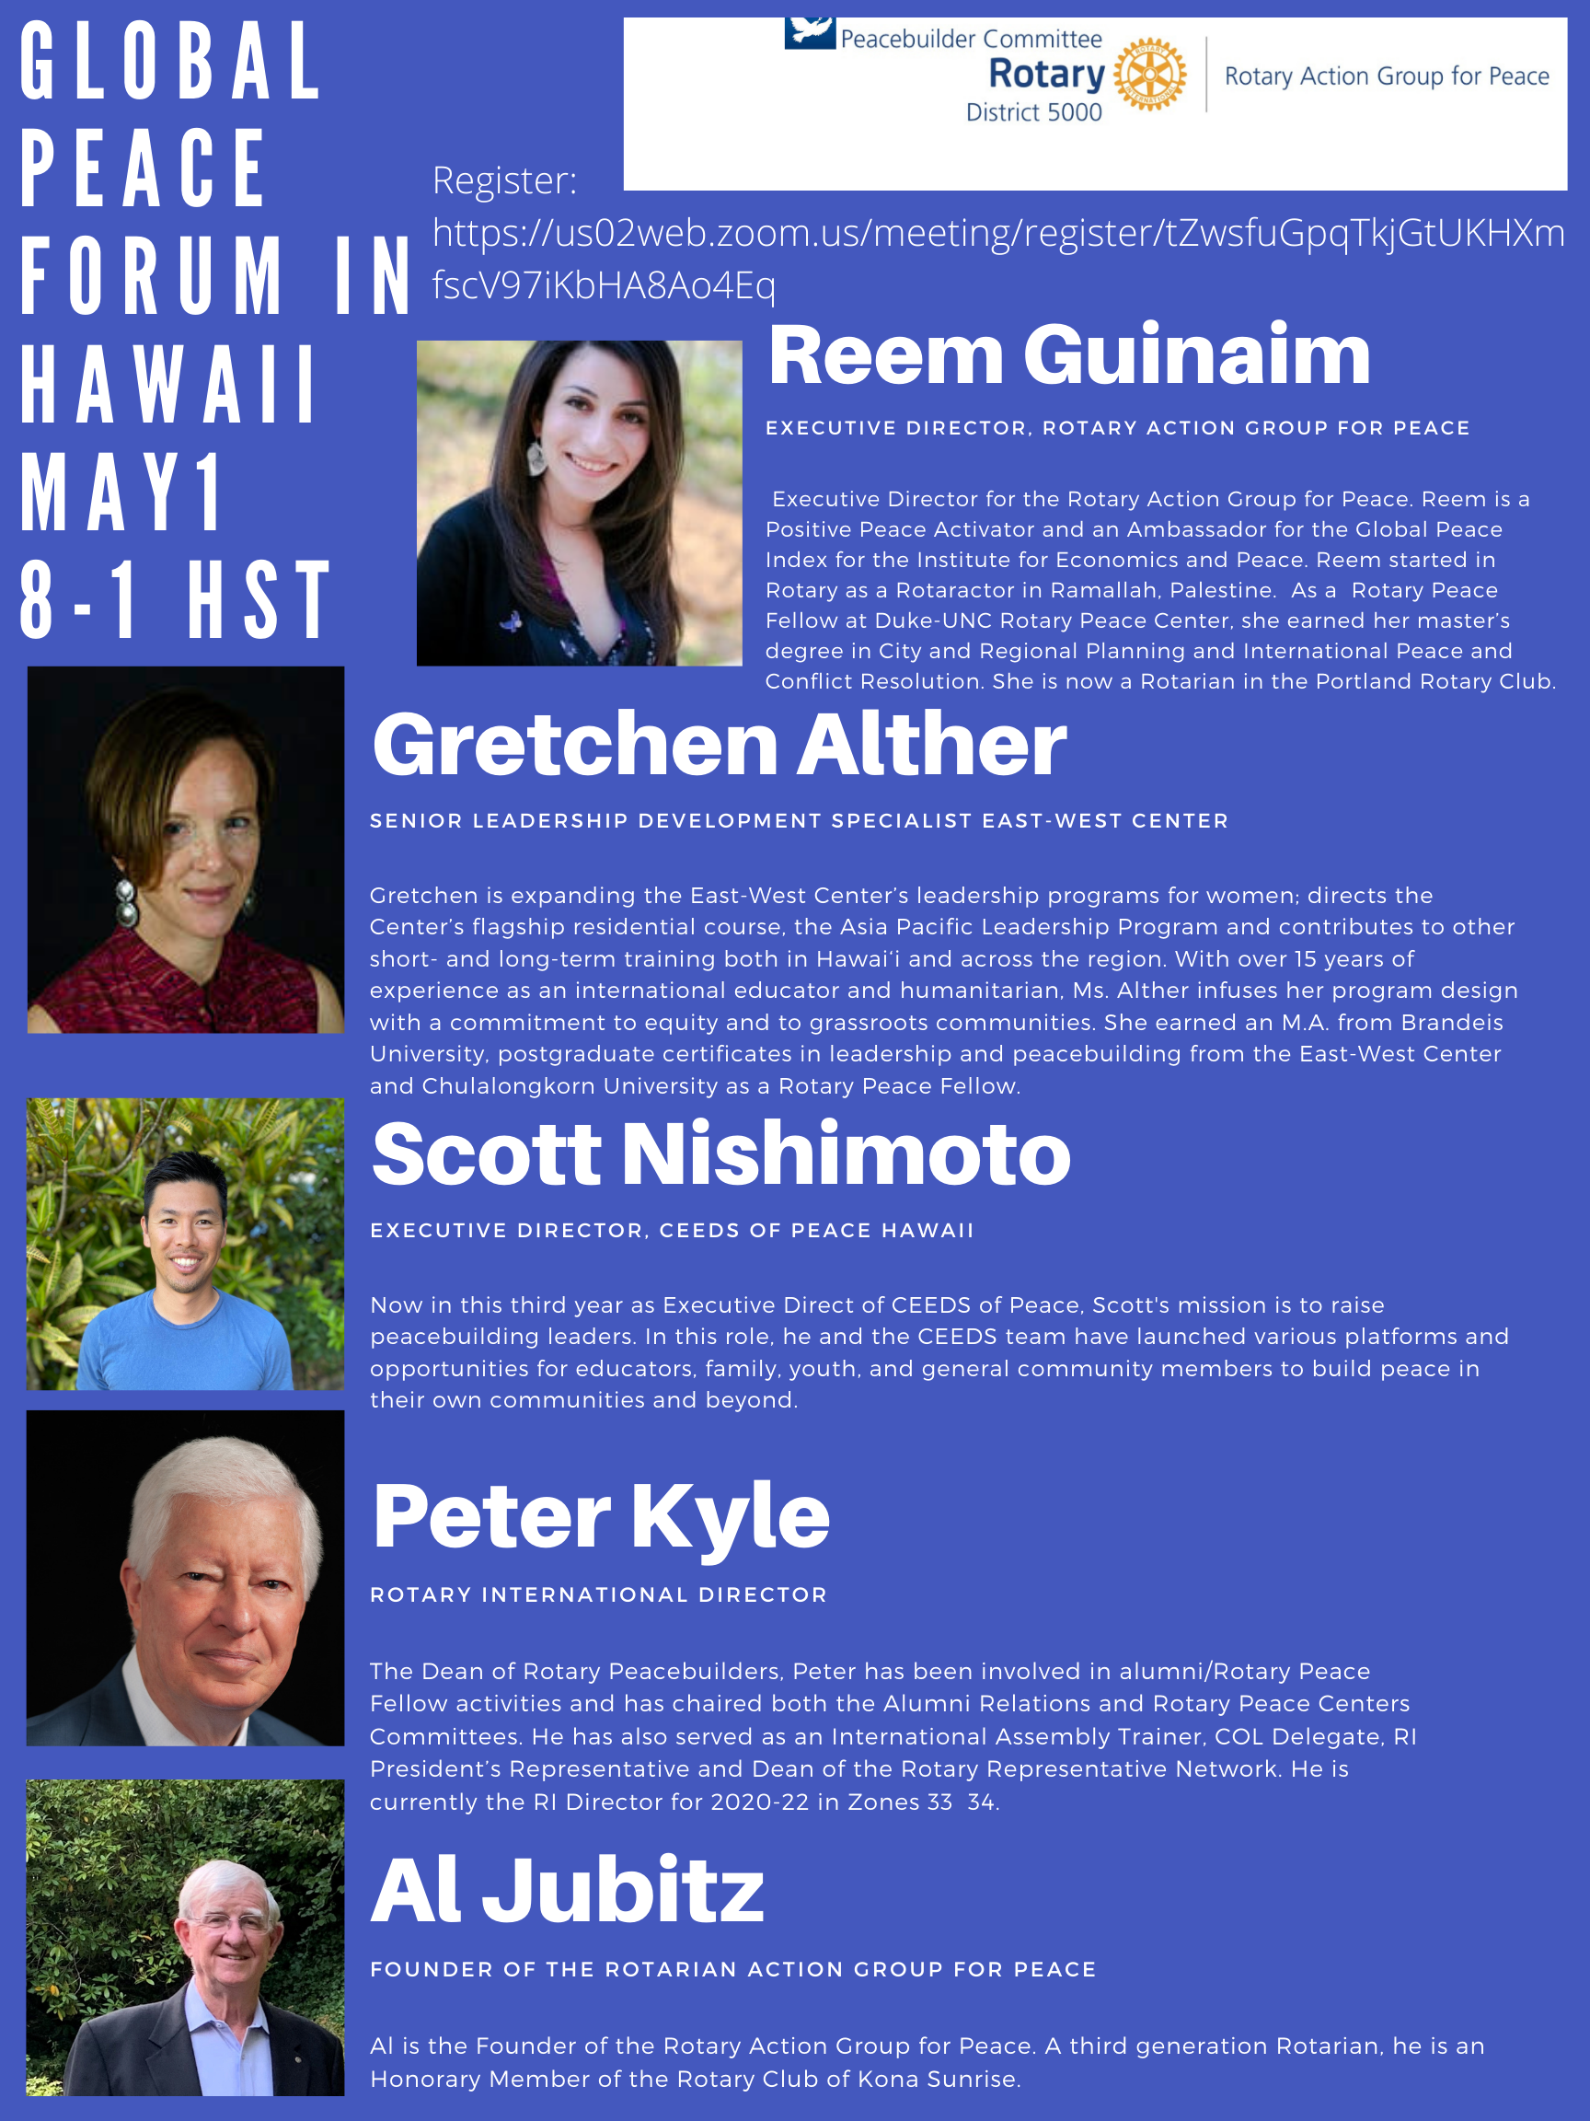
Rotary District 5000 Global Grants: Global Peace Forum in Hawaii May 1—The Future of Global Peace is Global Grants

Slide 26
JUN 10 at 3 AM UTC-10 – June 11 AT 2 PM UTC-10 2021 Virtual ROTARACT PreConvention Online Event

Slide 27
JUN 12 AT 1 AM UTC-10 – JUN 16 AT 1 PM UTC-10 2021 Virtual Rotary International Convention Online Event

Slide 28
Rotary District 5000 Conference—June 19, 2021

Slide 29
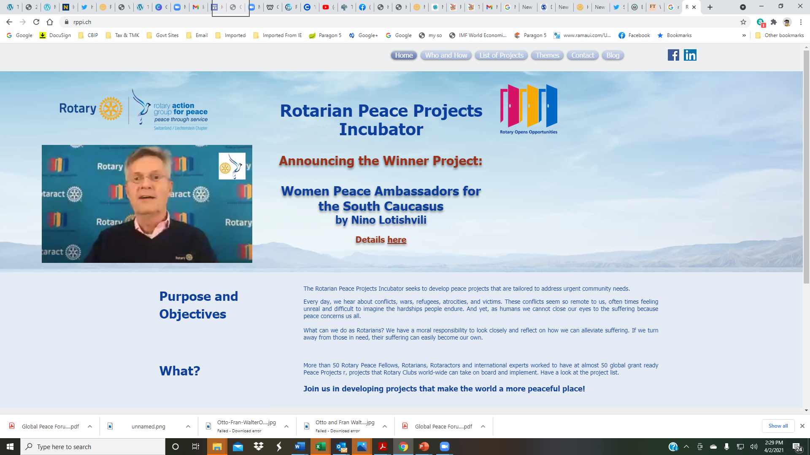
Rotary District 5000 Global Grants: The Rotary Peace Projects Incubator—Watch for the Date in 2021-22

Slide 30
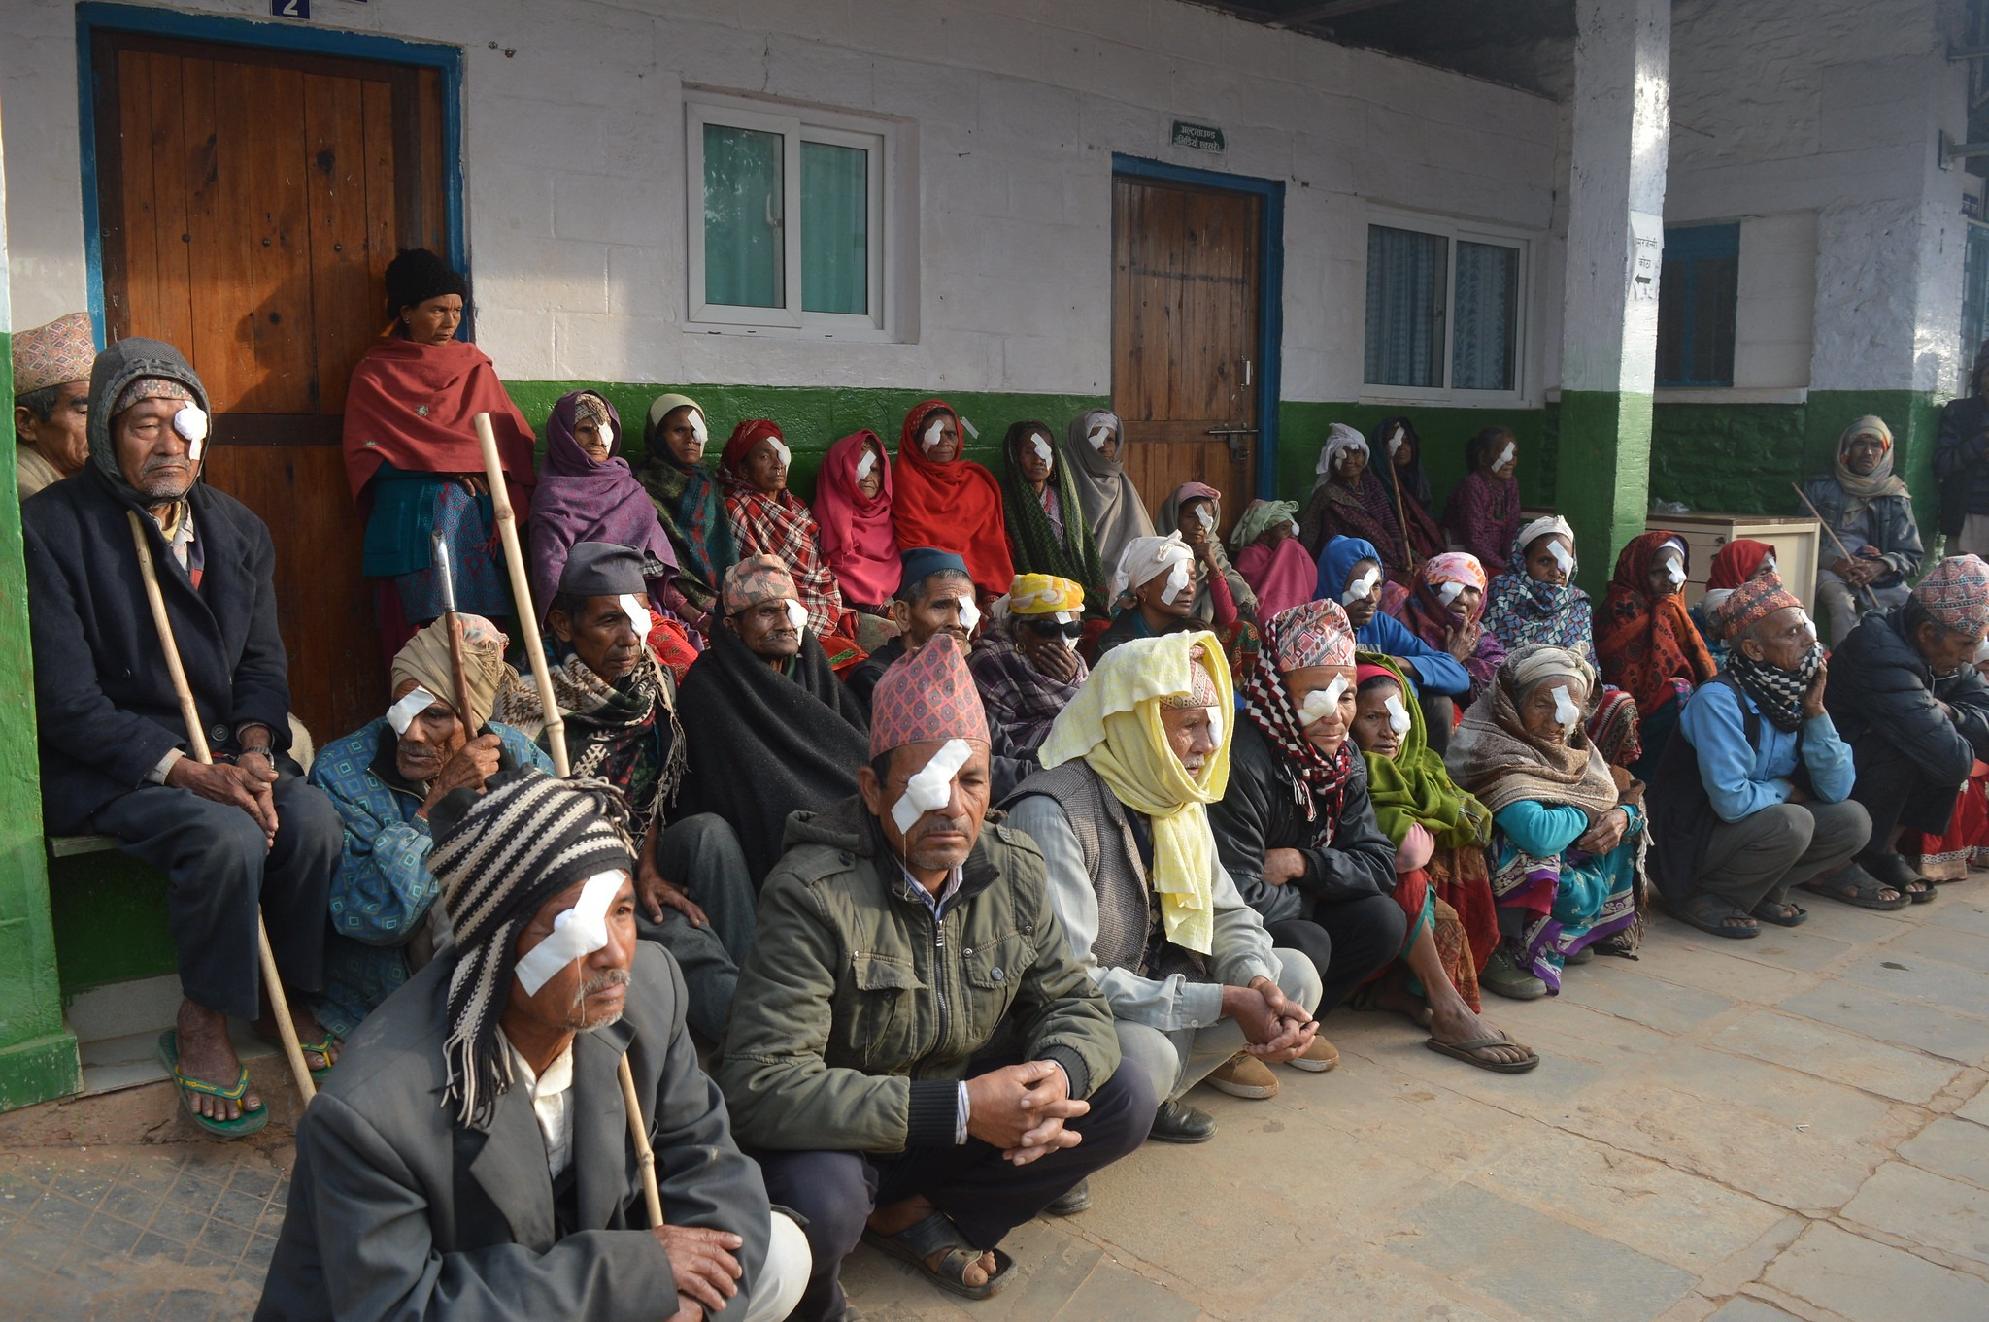
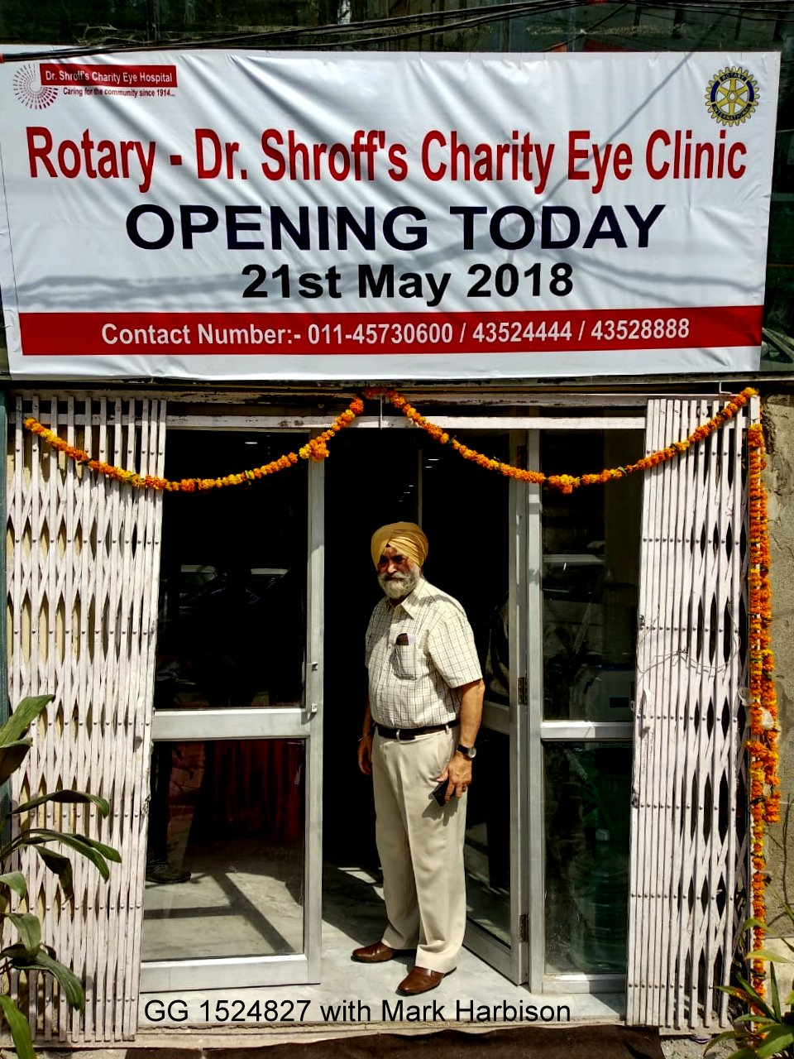
QUESTIONS???

