Slide 1

DISTRICT 5000
GLOBAL GRANT
SERVICE PROJECT
ROTARY YEAR 2027-28
Central Vietnam
Bathrooms and hygiene training in two rural schools

Slide 2
Basic Information
Global Grant #: | Name: Vietnam School Bathrooms – Toilets for 2 Rural Schools in Quang Tri
Project location and country: | Hieu Giang Commune, Quang Tri Province, Vietnam
Local host primary club and contact: | Rotary Club of Quang Tri, Uyen Le
International host primary club and contact: | District 5000, 2027-28 DG Rich Proctor
Budget and funding: estimated $50,000 | Already committed: $0. Still need: $50,000
Needs assessment: Completed, September 2026 | Application status: In progress

Slide 3
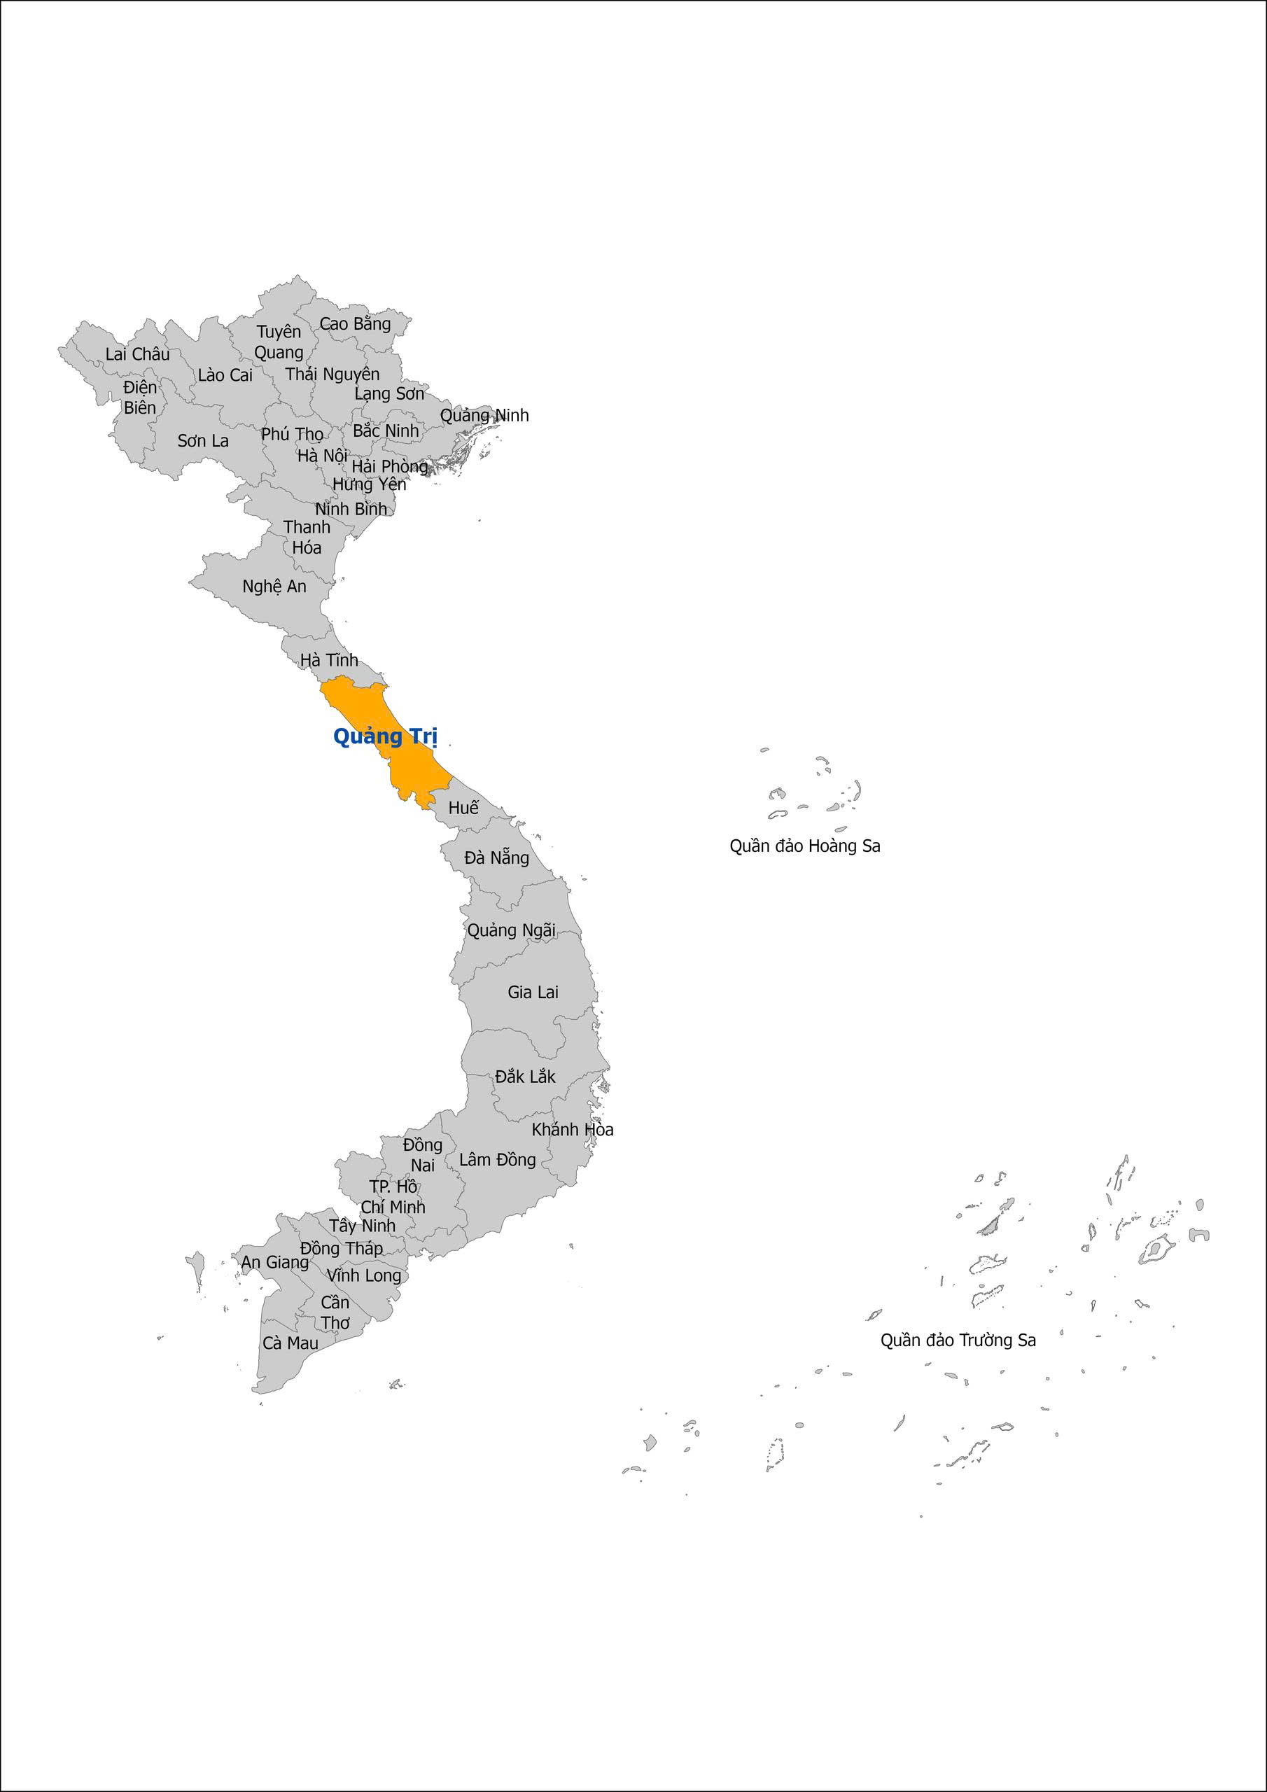
Map of Vietnam

Slide 4
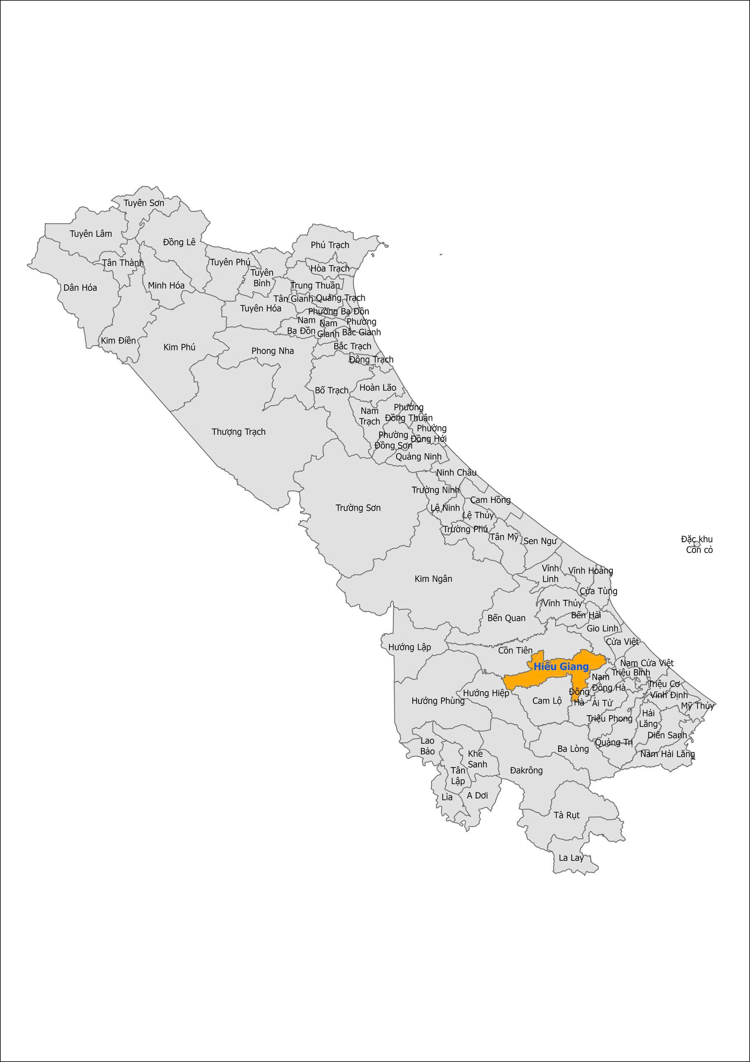
Map of Quang Tri Province and Hieu Giang Commune

Slide 5
People and Society – Quang Tri
Quảng Trị is a central coastal province of Viet Nam. It has a population of about 1.8 million people from different ethnic groups. The area has a predominantly rural character and a diverse socio-economic landscape. Many rural and mountainous communities face challenges associated with difficult terrain, extreme weather, limited infrastructure and unequal access to essential services. Quang Tri is regularly exposed to heavy rainfall, flooding, storms and other natural hazards. These events can damage roads, public facilities and agricultural production and can temporarily restrict access to schools and other essential services.
Education is an important component of Quang Tri's long-term development strategy. However, despite progress, some educational institutions continue to face shortages of teachers and limitations in physical infrastructure. For rural schools in particular, investment in essential sanitation infrastructure—including toilets, handwashing facilities, water supply and drainage—has often received less attention compared with more immediate educational infrastructure needs.
Through the proposed bathroom construction project, our support can help ensure that primary and secondary students in rural areas of Hiếu Giang Commune have access to safe, hygienic and appropriate sanitation facilities while at school.

Slide 6
Project overview
This Global Grant was developed by RC Quang Tri to address urgent community-driven sanitation needs by constructing toilet blocks at two rural schools serving 624 children. The schools are Tan Tuyen elementary school currently serving 210 students (107 male/102 female students) and Lam Lang Secondary School with 414 students (193 male and 221 female students).
The Grant is modeled after a successful Global Grant project completed by RC Quang Tri and RC Cupertino in 2025, in the same province. Schools, teachers and parents call sanitation a top priority and have committed to donating labor and funding. The community is motivated to ensure its long-term success.
Latrines will feature a durable septic tank system for waste management, reducing soil and water contamination. Students, teachers and custodial staff will receive training in hygiene, facility maintenance and menstrual hygiene management. Baseline attendance metrics are in place and we hope to see a reduction in hygiene-related absenteeism after the new bathrooms come online.
The project aligns with the United Nations Sustainable Development Goal #6 – “Safe Toilets for All by 2030”- and reinforces Rotary’s commitment to WASH as a foundation for public health and community development.

Slide 7
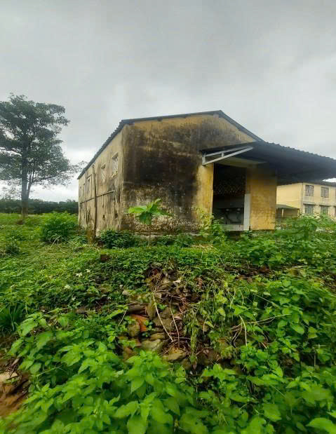
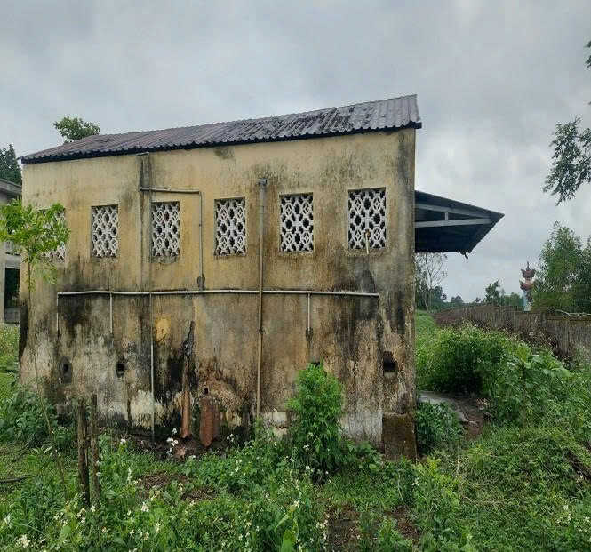
Current conditions

Slide 8
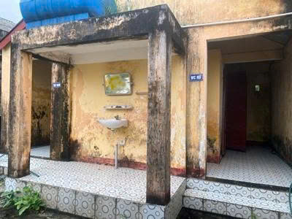
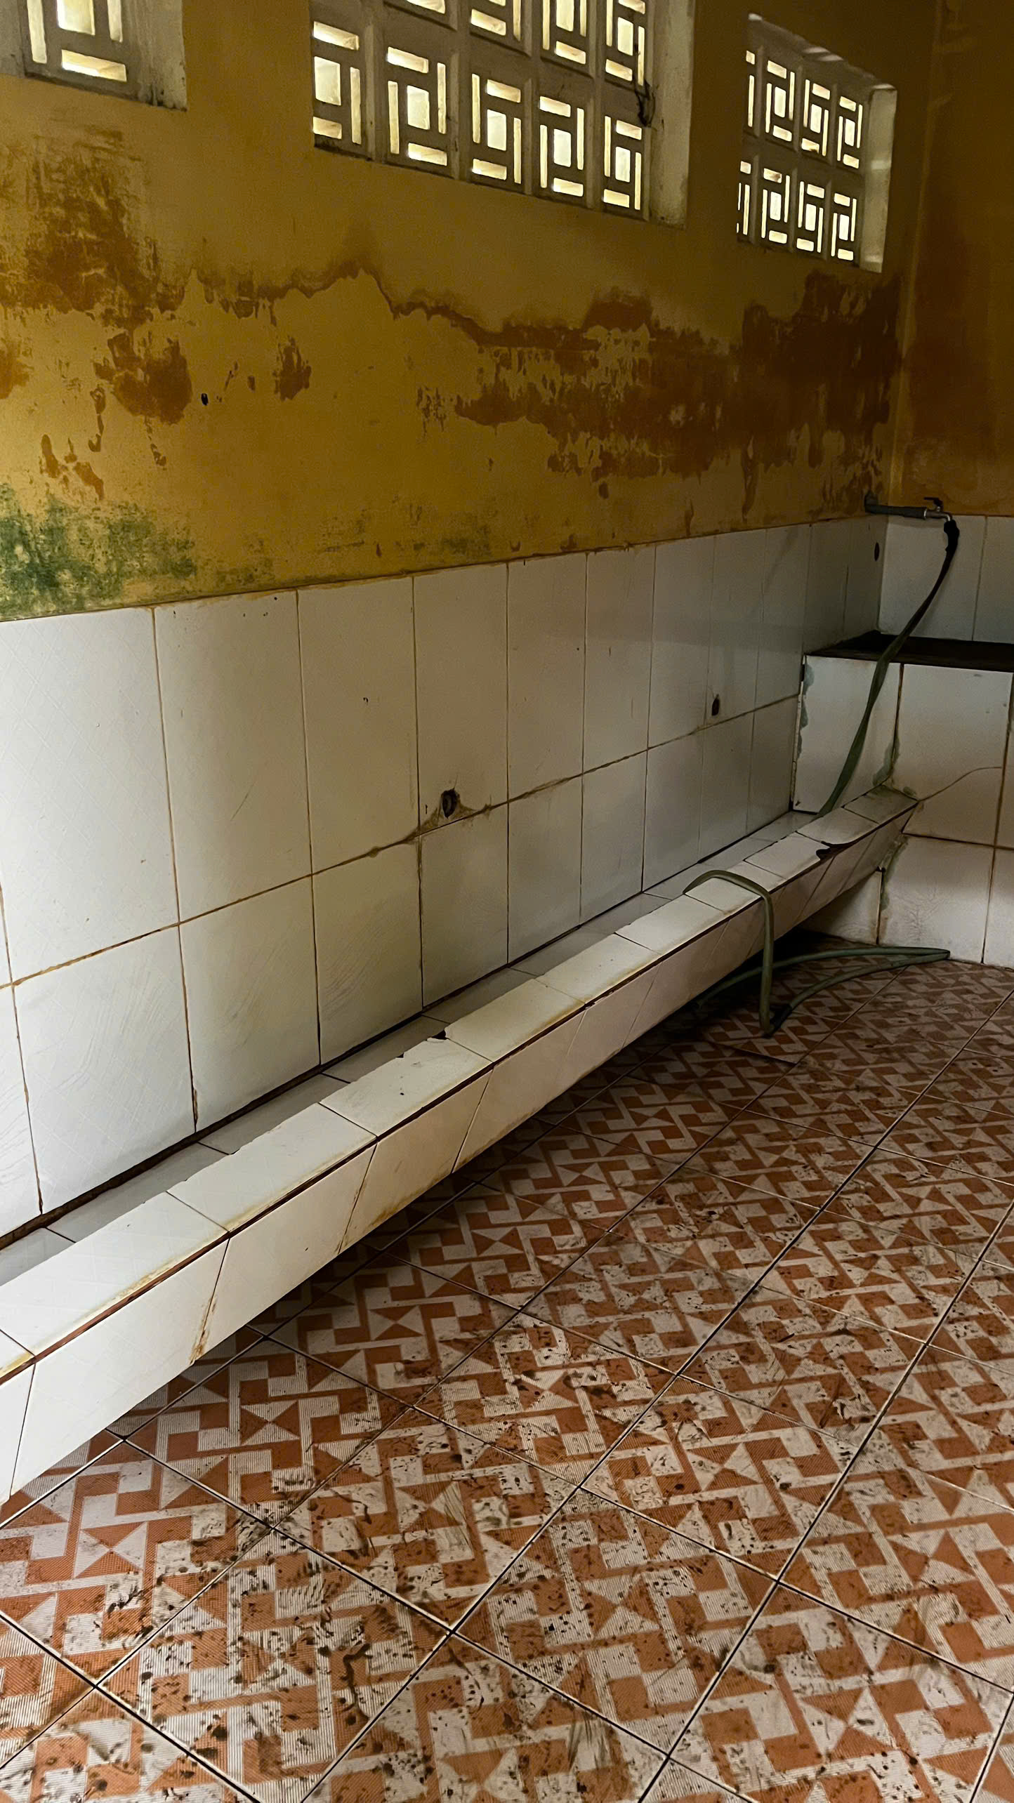
Current conditions –Boys’ bathrooms

Slide 9
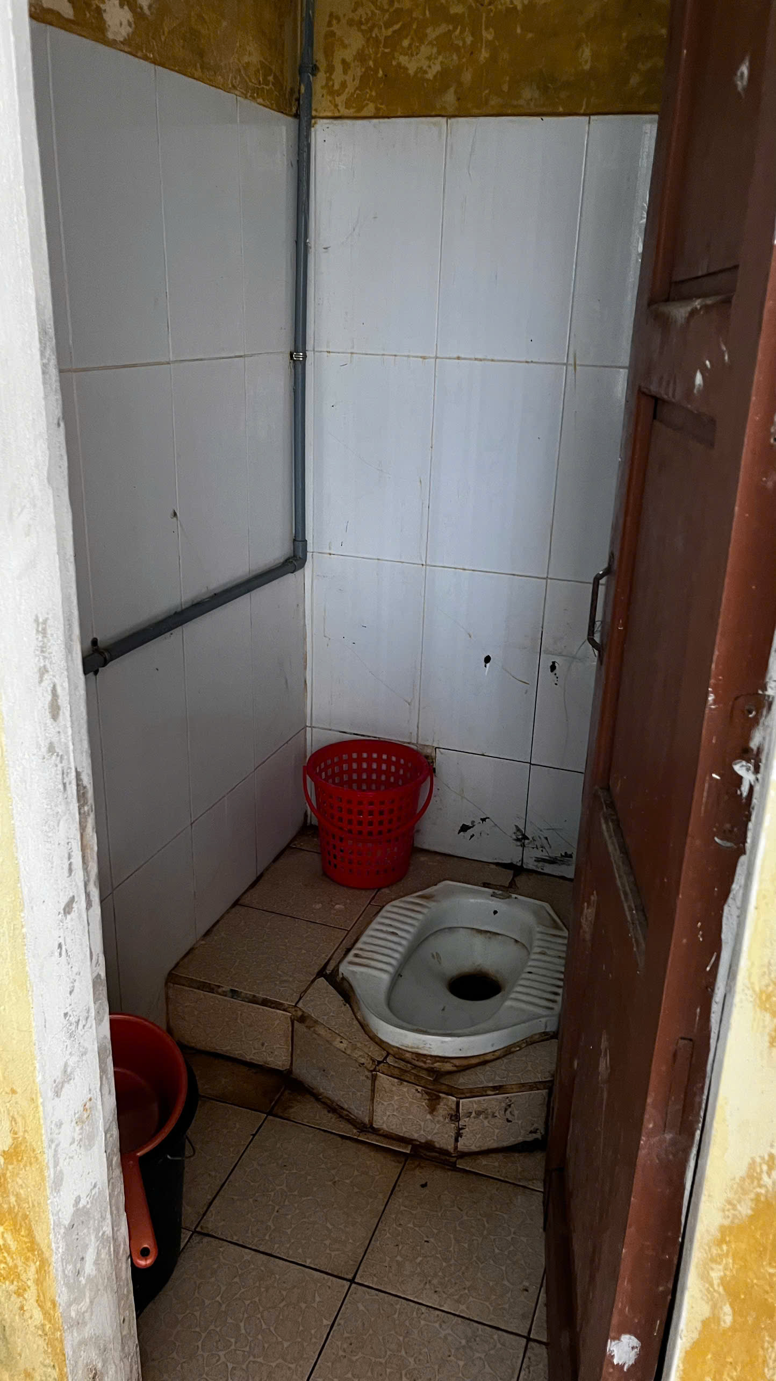
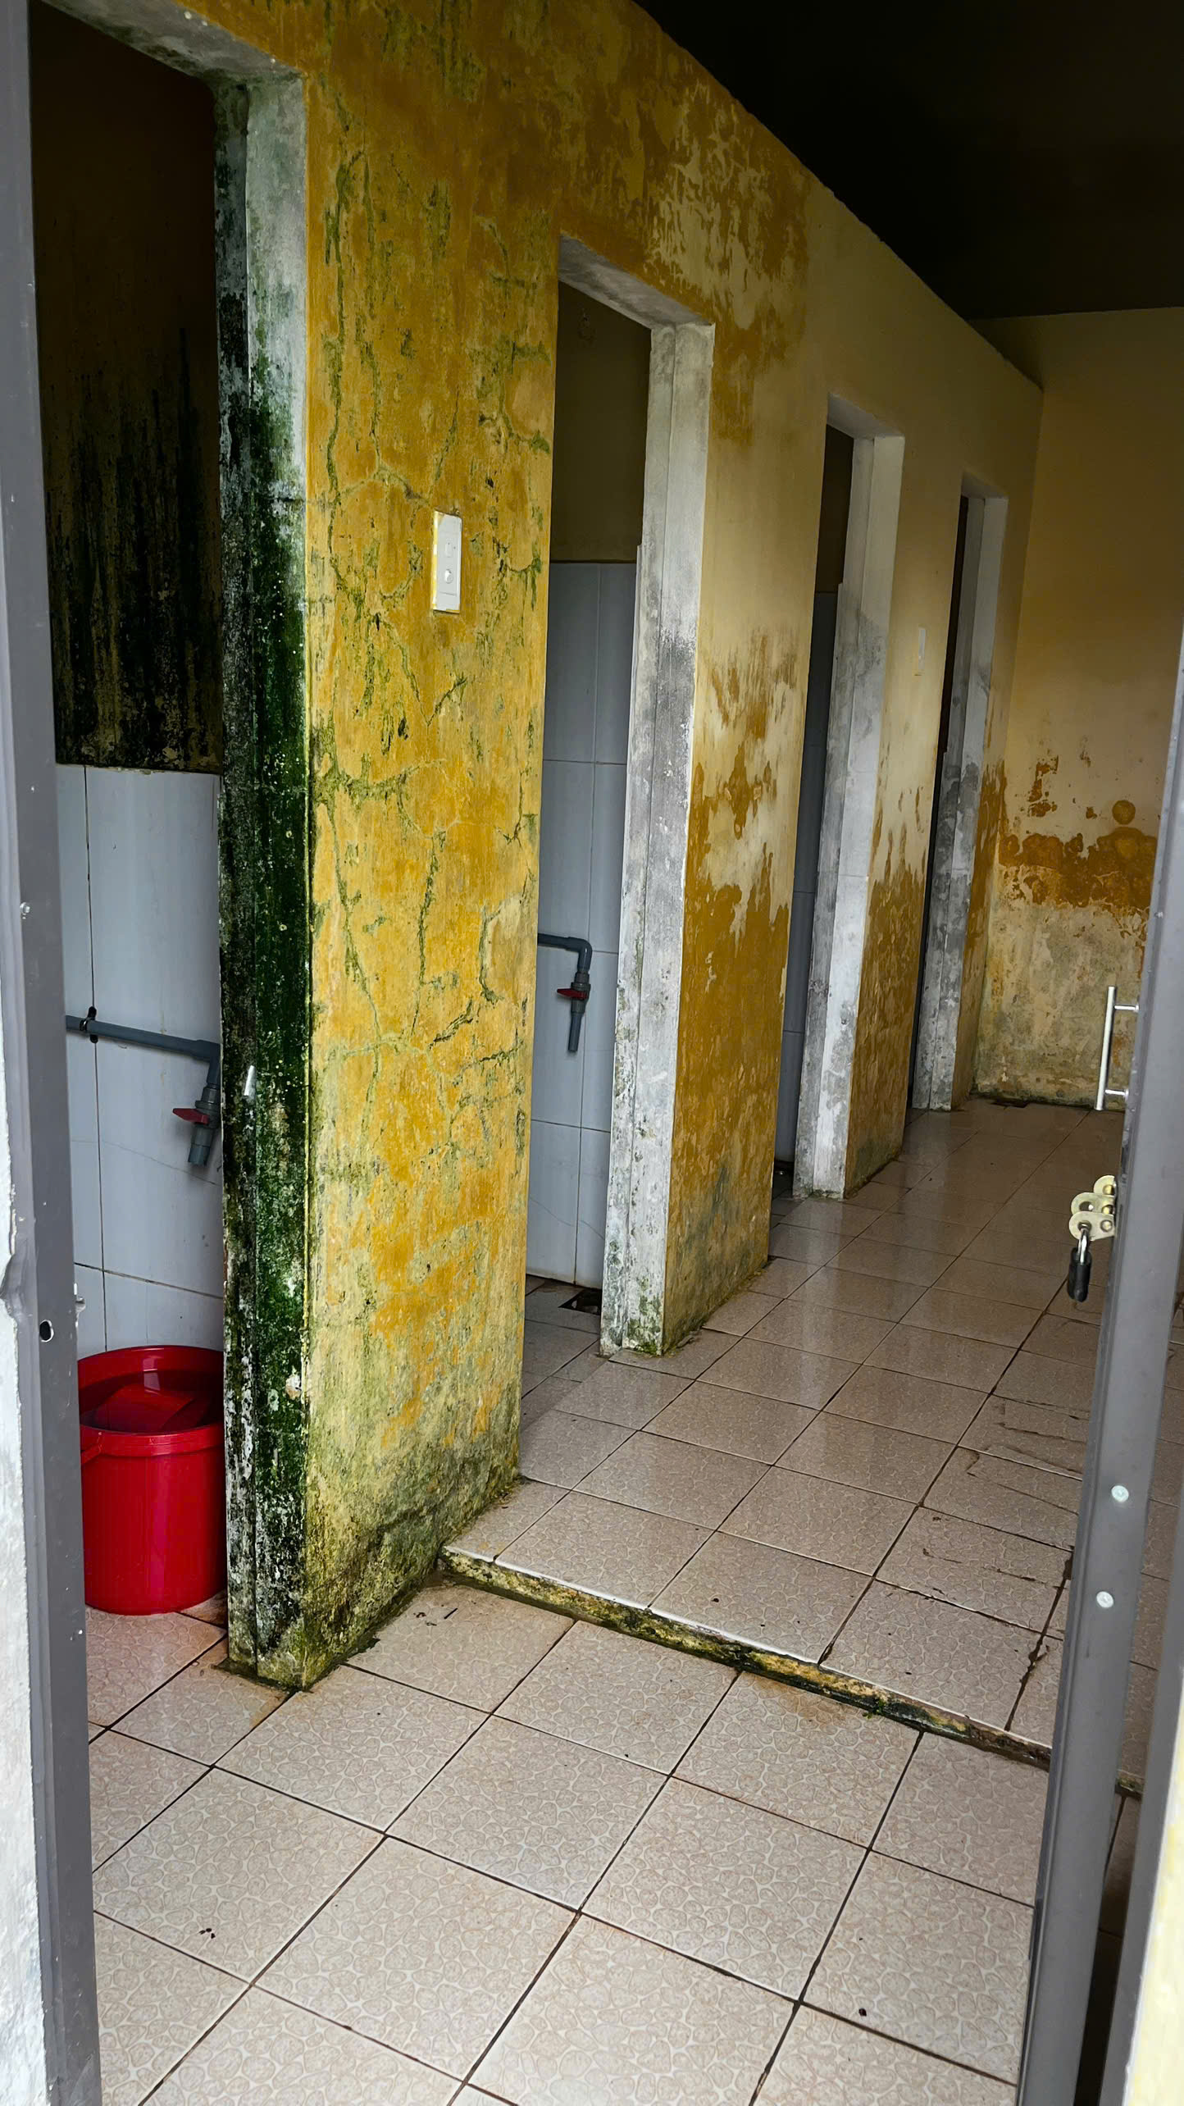
Current conditions – Girls’ bathrooms

Slide 10
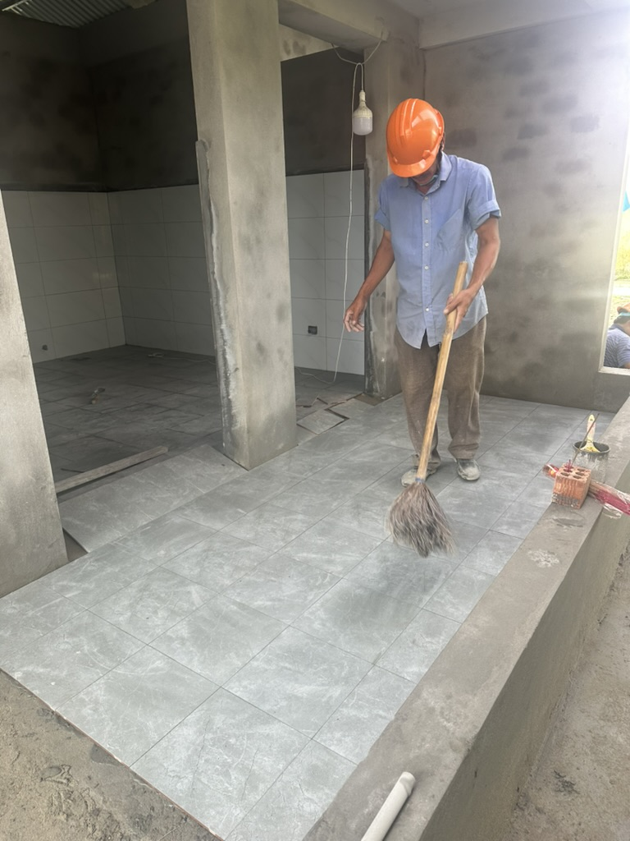
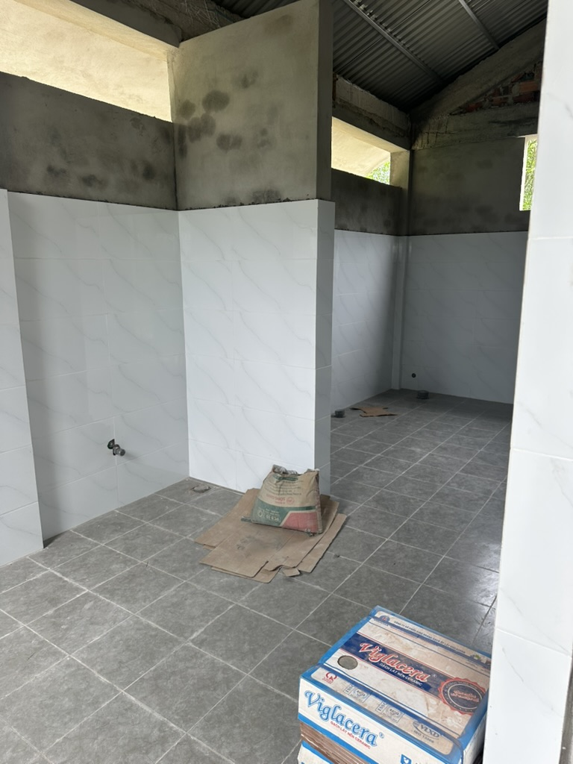
New bathrooms under construction (RC Cupertino project, Sept. 2025)

Slide 11
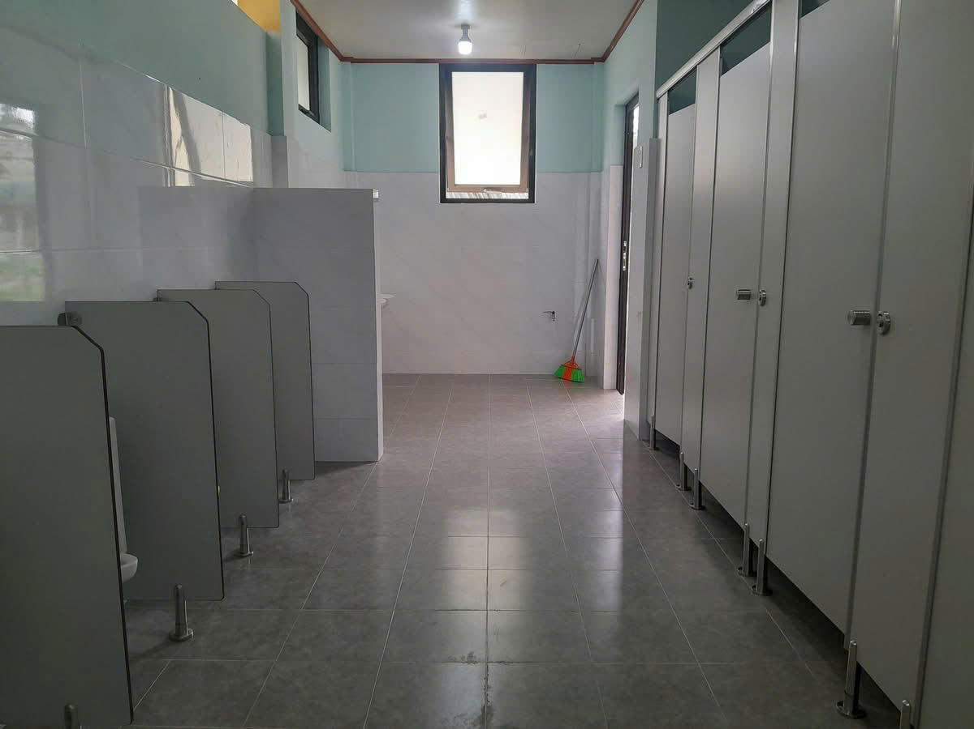
New boys’ bathrooms

Slide 12
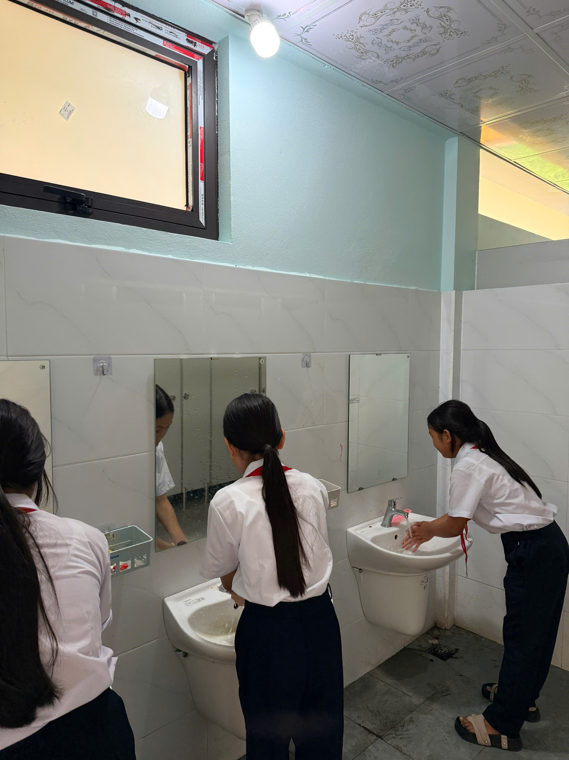
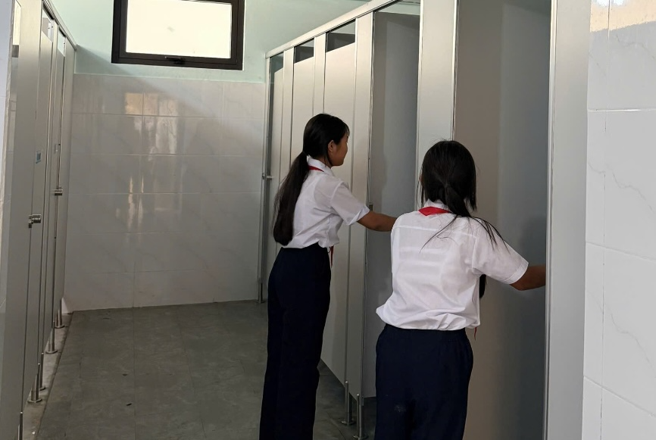
New girls’ bathrooms

Slide 13
Next steps
This Global Grant project is planned as a District service project during DGE Rich Proctor’s District Governor year beginning July 1, 2027. We are seeking funding in advance of his Rotary year because we would like construction to begin in July 2027, during the school summer break, and money needs to be secured to fund the construction. Subject to the timing of completion of construction and the weather, a site visit by a limited number of 5000 Rotarians is planned to perform finish work such as painting and landscaping, and/or provide hygiene training. The rainy season extends from mid October through December. Therefore we expect a working project visit might be possible some time between January and April, 2028.
Key to a successful Global Grant is finding the right partner club to take the reins. Our partner host club, RC Quang Tri, has the expertise and experience to administer this Global Grant. They are currently seeking bids from contractors in order to complete the actual budget. We expect that to be done in November. We have an estimated budget based on the 2025-2026 Global Grant project completed by RC Cupertino.
The needs assessment is completed. We will submit the Grant application for approval as soon as the budget is competed by RC Quang Tri and funding commitments by clubs are secured.

