Slide 1
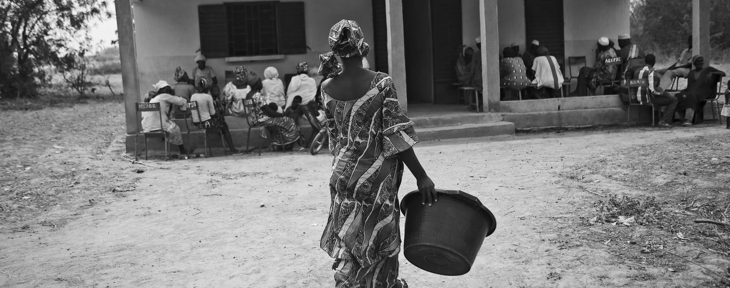
Getting Advocacy Right:
Tools and Resources for WASH in HCF
Rotary WASH-RAG Advocacy Meeting – November 2021

Slide 2
Advocacy
Advocacy is the deliberate process, based on demonstrated evidence, to directly and indirectly influence decision makers, stakeholders and relevant audiences to support and implement actions that contribute to your cause. (UNICEF, 2010)
There are two distinct types of advocacy:
Operational Advocacy to achieve discrete aims (i.e. Individual project objectives)
Governance Advocacy to improve or change institutional and accountability arrangements

Slide 3
Advocacy is…
Educating
Influencing
Encouraging
Championing
…with a goal of bringing in others to help us make change that we cannot affect ourselves.

Slide 4
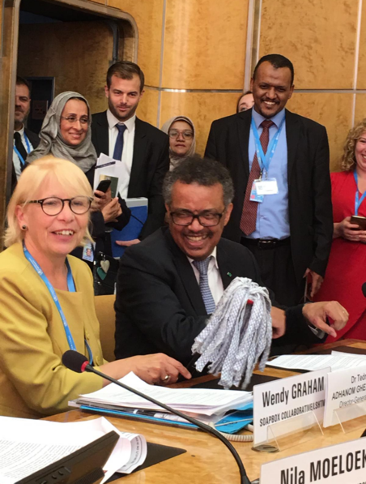
WASH in HCF Advocacy Toolkit
The WASH in HCF Advocacy Toolkit offers a simple framework to advocate for WASH in HCF to a variety of stakeholders
It can be useful to raise awareness, advocate for policy change, allocate funding, drive demand, or increase prioritization of WASH in HCF.
While many will be advocating to governments, you may find reason to advocate to other parties including local communities, clinicians, or specific sectors (global health, WASH).

Slide 5
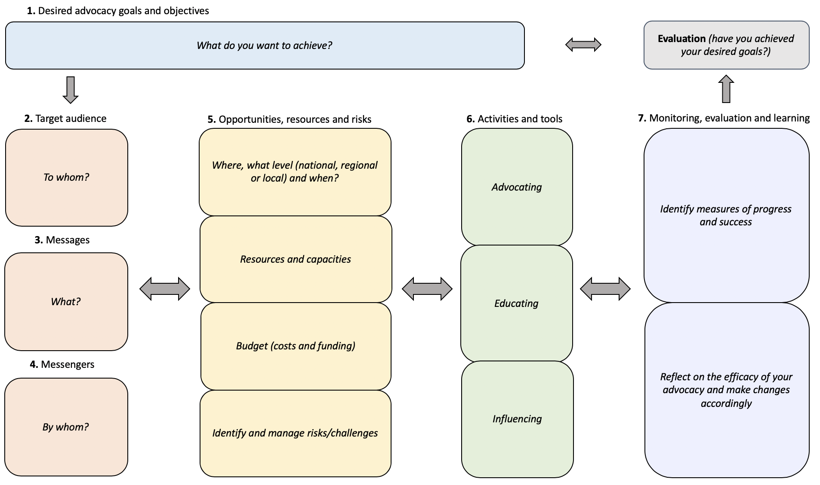
Advocacy Roadmap
1. Goals/Objectives
2. Target Audience
3. Messages
4. Messengers
5. Opportunities, Resources and Risks
6. Activities/Tools
7. Monitoring, Evaluation
and Learning

Slide 6
1. Desired advocacy goals and objectives
“What do you want to achieve?”
Goal: Overall vision for WASH in HCF
Global goal: 100% WASH in HCF coverage by 2030
Specific goal may vary based on context/country
Objective: Measurable action needed to achieve your goal. You likely will require multiple advocacy objectives to achieve your goal.
Why is WASH in HCF a problem?
What is needed to fill that gap?
What are the objectives needed to fill that gap?

Slide 7
Advocating Throughout the System
You can direct your advocacy efforts toward any level within the system.
National Level
Ex: Ministry of Health or Ministry of Water
Activities: Developing guidelines, monitoring, setting national budget
Subnational Level
Ex: District Health Office
Activities: Implementing guidelines, requesting budget
Local Level
Ex: Healthcare Facility
Activities: creating hygiene culture, reinforcing behaviors, ensuring operations and maintenance

Slide 8
Example advocacy goals and objectives
PROBLEM: WASH infrastructure is not maintained at the health center
GAP: There is no budget for operations and maintenance and to address repairs
OBJECTIVE: To add line item(s) in the annual facility budget that is specific to maintaining WASH services

Slide 9
2. Target audience
“To whom?” Target audience: the decision-maker who has the power to make your change happen
Who must you reach in order to achieve your goal?
Who has the power to make change happen?
This audience may be at the global, national, subnational, or community level and may be a specific person, entity, or a grassroots audience, depending on your objective
Example Target Audience: Government, communities of practice, faith-based organizations, private sector, local community

Slide 10
3. Messages
“What?”
Message: Messages are the core of your advocacy and include both the importance of WASH in HCF and your specific “ask” of the target audience.

Slide 11
4. Messengers
“By whom?”
Messenger: the person or group who will carry your message to the target audience
Messengers do not necessarily have to be within the decision-maker’s immediate circle nor a specific person
There may be overlap between target audiences and messengers
Example Messengers: Those who are particularly compelling for WASH in HCF, such as: clinicians (doctors, nurses, and midwives), mothers, health and WASH organizations, etc.

Slide 12
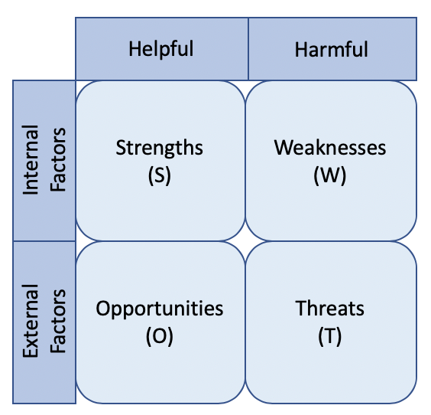
5. Opportunities, resources and risks
Opportunities
Are there opportunities to elevate your issue? (e.g. global awareness days)
Is now a good time to advocate?
Are there messages you can use to leverage your advocacy?
Are there groups doing similar work?
Resources/Capacity/Budget
What resources are at your disposal? (e.g. social media)
What is your current capacity?
What is your budget?
Risks
Are there potential challengers to your issue?
Why?
SWOT Analysis

Slide 13
6. Activities and tools
“Advocating, influencing, educating”
 | Governments/Institutions/Experts | Engaged Partners | General Public
Written | Policy studies Research papers Working papers Policy reports Policy-oriented journals | Policy briefs, memos and fact sheets Newsletters Policy reports | Op-ed articles in newspapers Letters to newspapers Ads, banners, posters, t-shirts, stickers
Oral | Conference presentations Less formal presentations at one-on-one meetings or lobbying Presentations to working groups or public hearings |  | Radio and TV programs Public meetings and hearings Speeches to the public
Visual |  | Documentary videos Advocacy-based advertising Photos
Digital | Dedicated advocacy websites | Email campaigns Dedicated advocacy websites or pages Social Networking platforms Texts/messaging apps

Slide 14
7. Monitoring, evaluation and learning
“Is it working?”
To continue to be effective, advocacy must also be adapted. Be sure to reflect on your strategy and adjust accordingly.
Example Measures of Progress:
Health facility identifies a WASH focal point
District health office allocates funding for WASH
Integration of WASH indicators into Health Management Information Systems (HMIS)

Slide 15
Advocating at the Local Level
Target audiences AND messengers may include:
District health officials (health, WASH)
Healthcare workers (doctors, nurses, midwives)
Healthcare facility IPC/WASH focal point
Healthcare administrators
Community leaders
Community WASH and/or health boards
Community members

Slide 16
Advocating at the Local Level
Examples of Advocacy Objectives:
Raise awareness of WASH expectations at the healthcare facility and increase patient demand for good WASH services
Increase budget for WASH (facility and/or district level)
Train staff on WASH/IPC guidelines and protocols
Identify a WASH/IPC focal point (facility and/or district level)
Monitor availability of WASH as well as staff and patient satisfaction with WASH services
Encourage engagement with the community WASH/health board
Use funds for COVID on WASH improvements
Hire cleaners

Slide 18
What Now?
Work with your fellow Rotarians, partners, and community members to identify root causes for the lack of sustainability of WASH services in the healthcare facilities where you work.
Determine which of those challenges you have the ability to address.
Use the advocacy toolkit to develop a strategy.
Reflect on your progress and adjust as needed.
Advocacy is not easy! But it is the most important tool we have in ensuring sustainable solutions. Be patient, be creative, and be persistent.

Slide 19
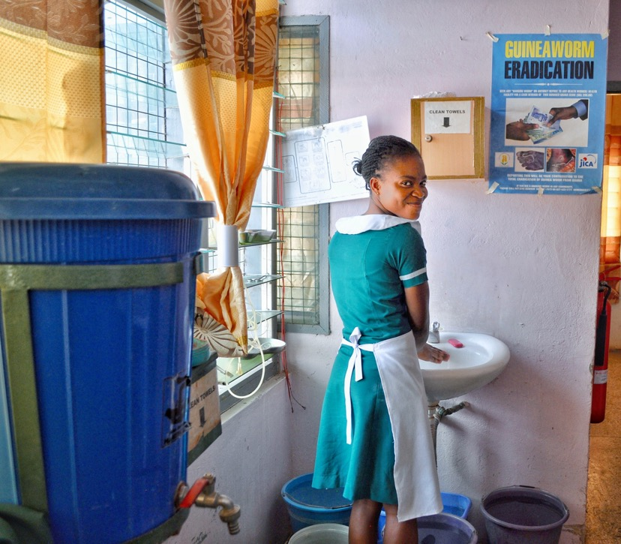
Thank you!
For more information on WASH in HCF:
www.WASHinHCF.org
For Questions/Comments/Feedback:
Lindsay Denny
ldenny@emory.edu

