Slide 1
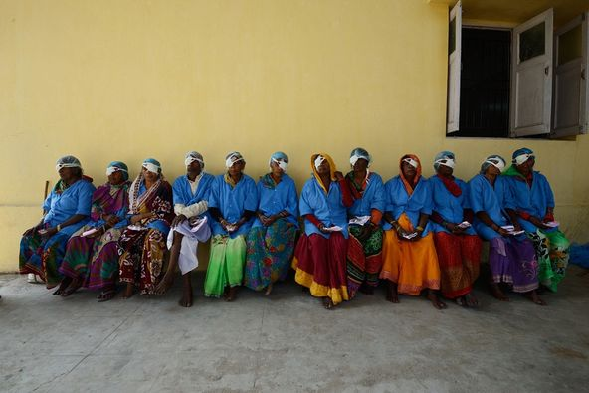
District 5000 Rotary Foundation Training—Grants
Mark Harbison,
District Rotary Foundation Committee Vice Chair—Grants Subcommittee Chair
October 17, 2020
via ZOOM

Slide 2
District 5000 2020-2021 Grant Management Webinar Global Grant Resources on Rotary.org
District grants
494 grants
$27.7 million
Global grants
1,403 grants
$97.9 million
Polio Plus
63 Grants
$157 million
Disaster response grants
7 grants
$134,178 (Covid-19 Response in 2020, $2,000,000)
Rotary Peace Centers
94 Fellows Approved
$4.1 million

Slide 3
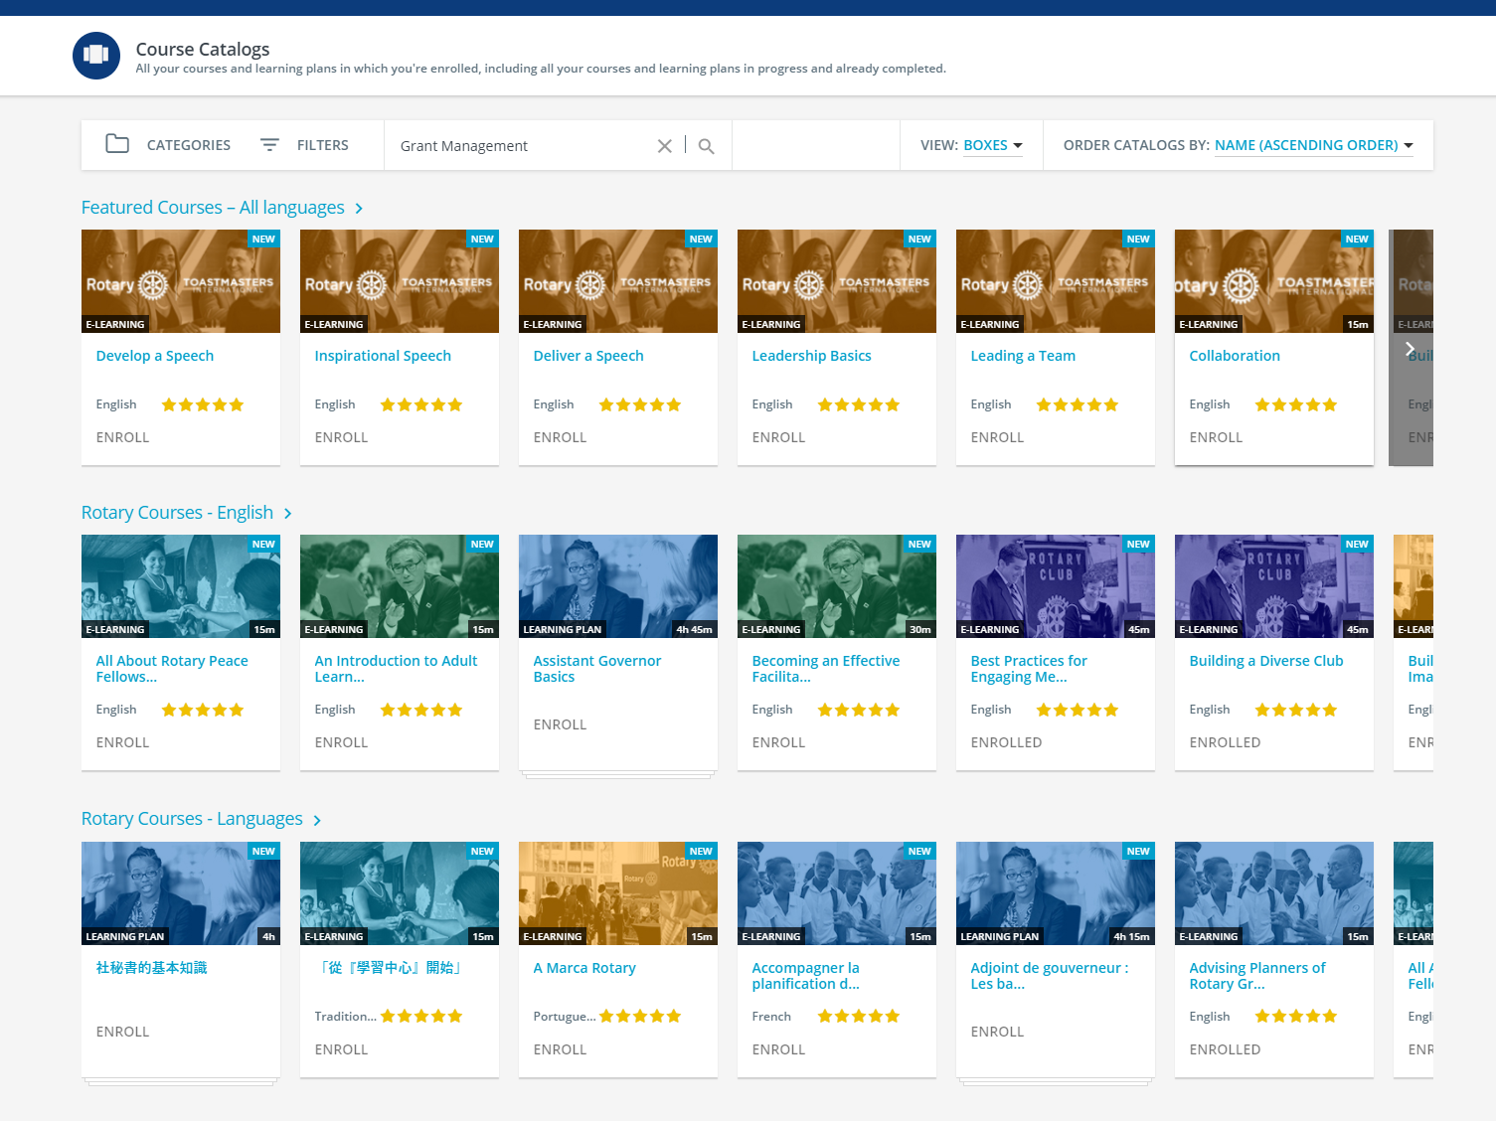
Grant Management Seminars on the Rotary.org Learning Center

Slide 4
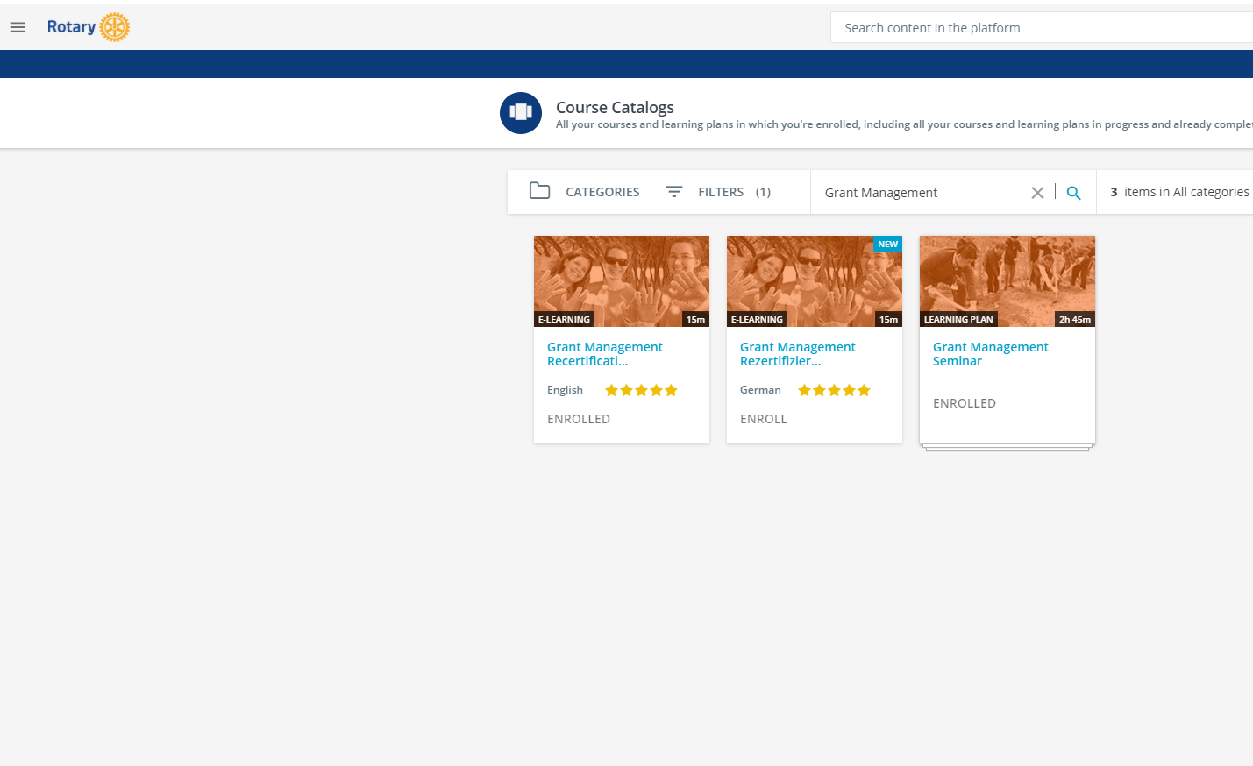
Grant Management Seminars on the Rotary.org Learning Center

Slide 5
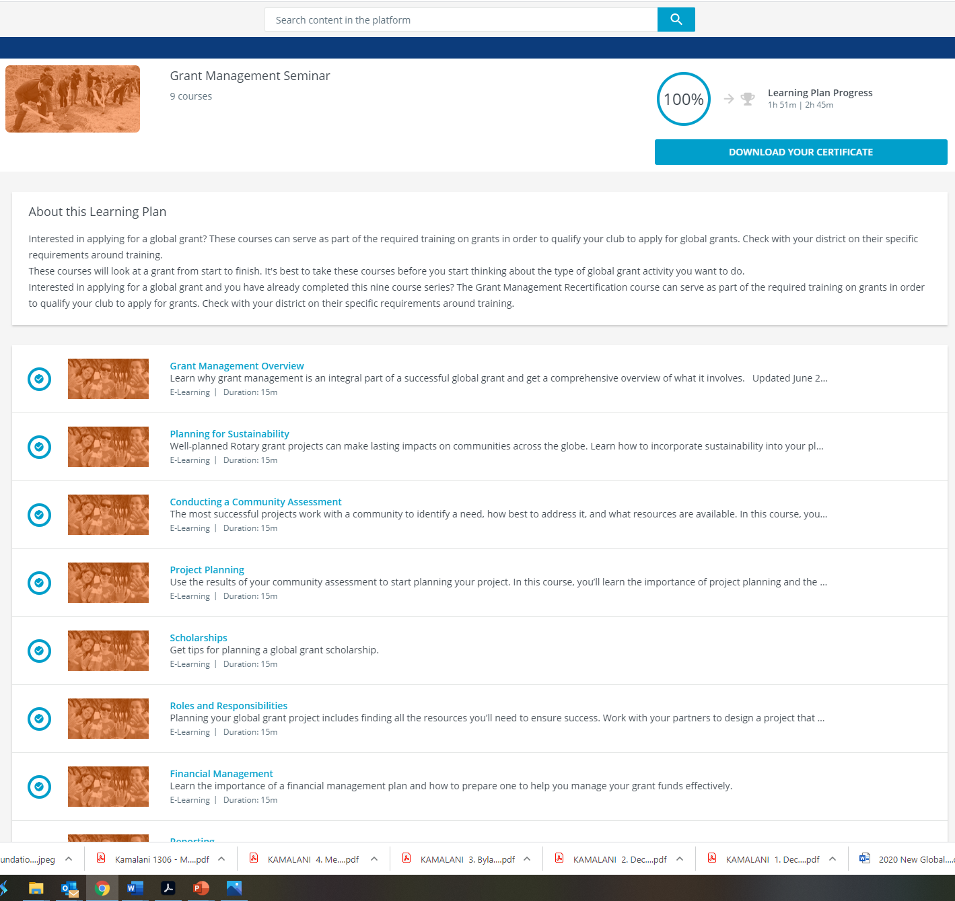
Grant Management Seminars on the Rotary.org Learning Center

Slide 6
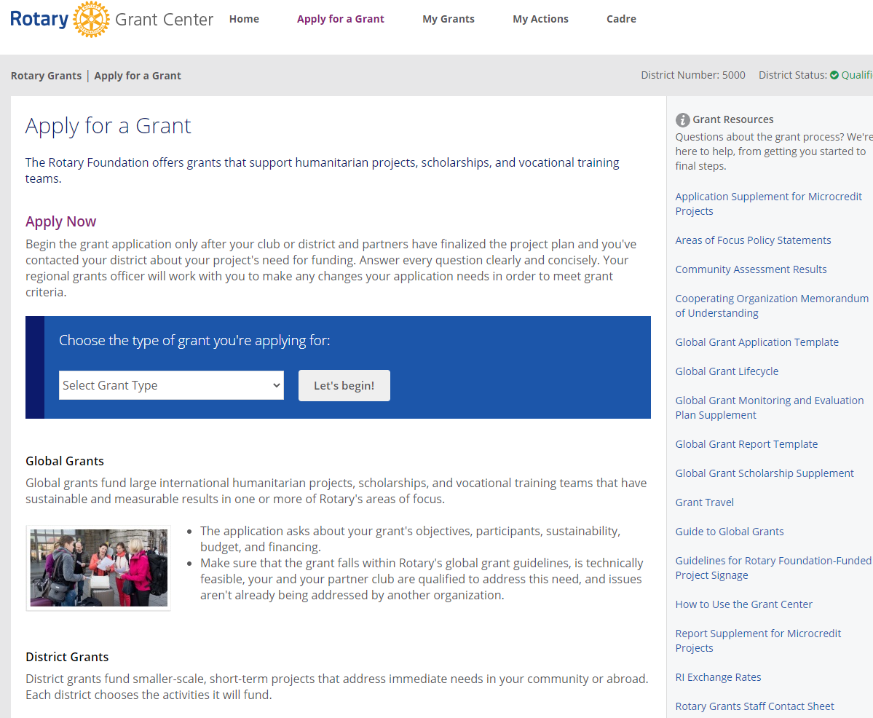
District 5000 2020-2021 Grant Management Webinar Global Grant Resources on Rotary.org

Slide 7
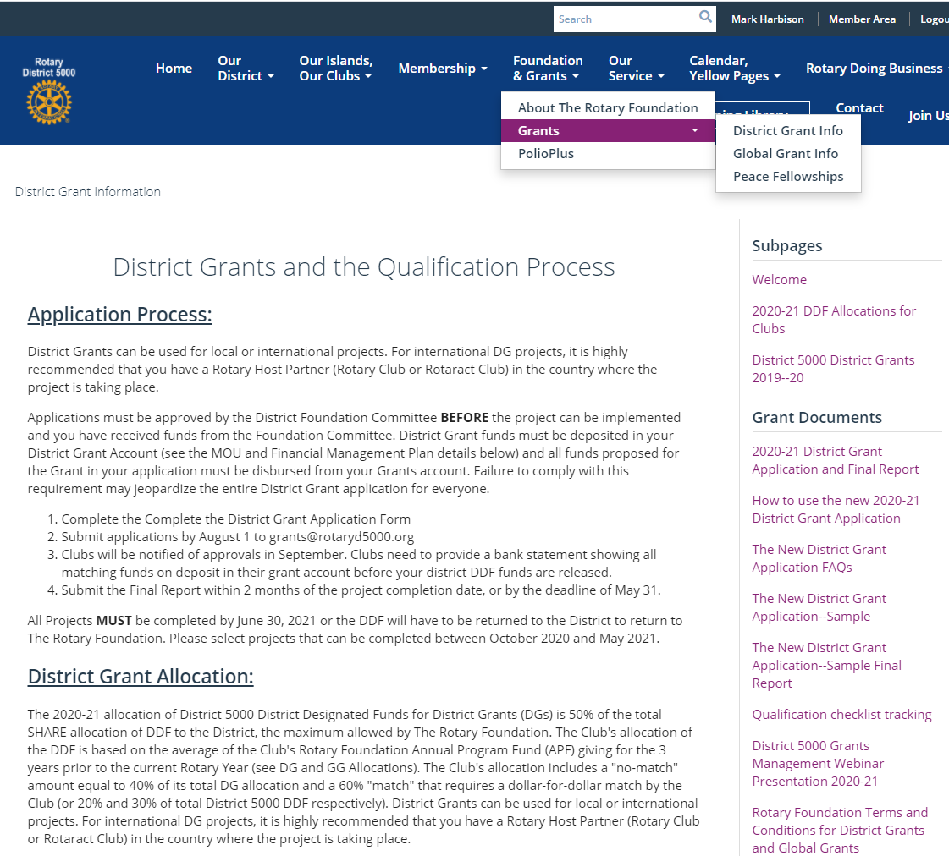
Grant Management Resources on the D5000.org Website

Slide 8
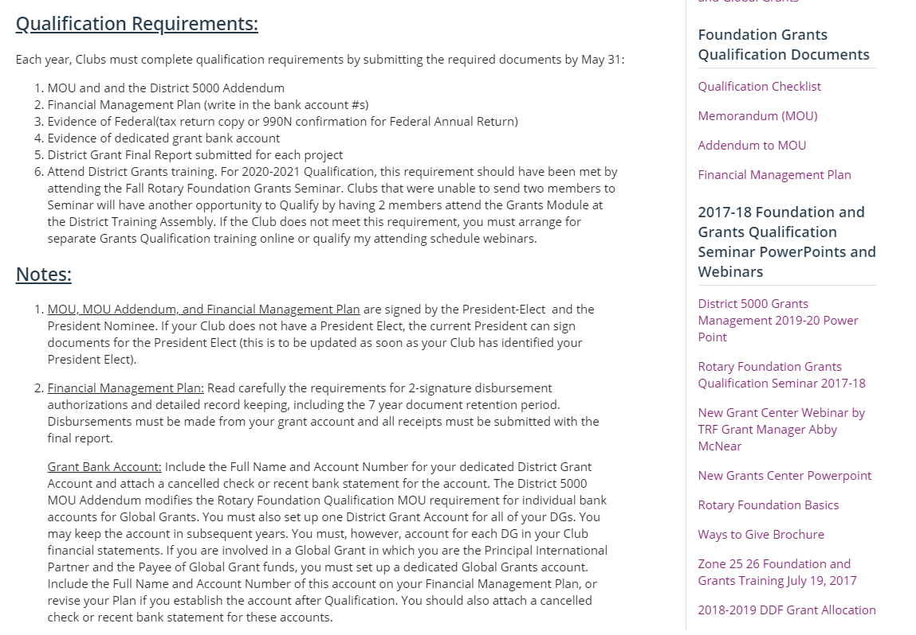
Qualification Resources on the D5000.org Website

Slide 9
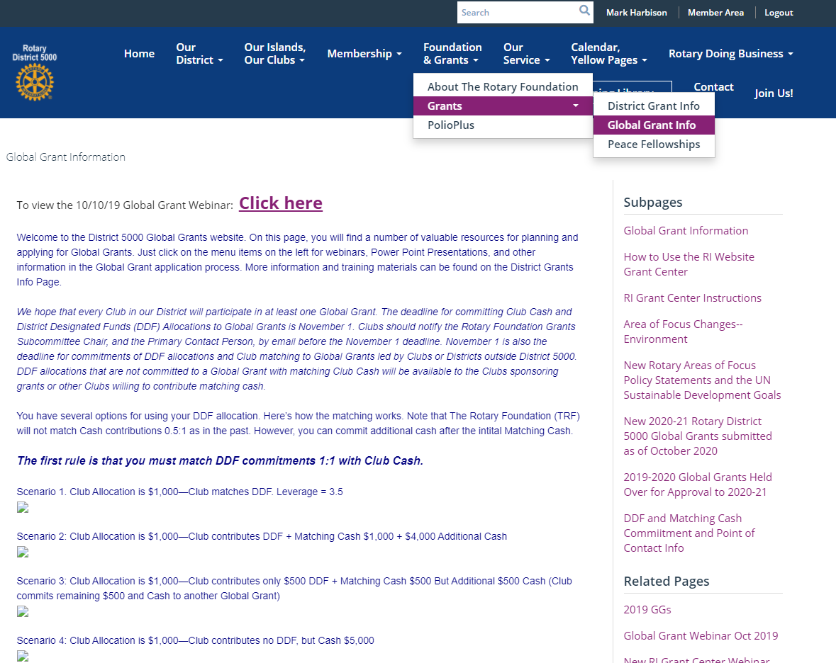
Global Grant Management Resources on the D5000.org Website

Slide 10
District 5000 2020-2021 Grant Management Webinar District 5000 Available District Designated Funds (DDF)
Rotary YEAR BASE YEAR AVAILABLE DDF WORLD FUND Allocation D5000 SHARE
2017-18 | 2014-15 | $183,789 50% of D5000 SHARE | $183,789 | $367,578 D5000 SHARE IN BASE YEAR
2018-19 | 2015-16 | $235,404 | $235,404 | $470,808
2019-20 | 2016-17 | $176,457 | $176,457 | $352,914
2020-21 | 2017-18 | $144,649 | $144,649 | $289,298
2021-22 | 2018-19 | $144,174 | $144,174 | $288,348

Slide 11
District 5000 2020-2021 Grant Management Webinar How District 5000 is Different: DDF Allocations to Our Clubs
TOTAL DDF $144,649
50% ALLOCATED TO DISTRICT GRANTS $72,325
NO-MATCH ALLOCATION FOR DGs (20%) $28,930
MATCHING ALLOCATION FOR DGs (30%) $43,395
ALLOCATED TO GLOBAL GRANTS $67,000
20% ALLOCATED TO POLIOPLUS $28,930
ALLOCATED TO PEACE CENTERS $5,000

