Slide 1


2024 Grant Qualification Webinar
Notes:
The slide will be on the screen when PEs enter the room.
Introduce yourself. Put forth that we’ve attempted to change the Foundation presentation to hopefully give a better understanding of how TRF is different and why Rotarians should choose to give to the Foundation first over other charitable organizations

Slide 2
Agenda – Learning Plan
Overview of grant program
Grant funding (where does the money come from)
How to qualify for grant funds
Grant agreements
  Memorandum of Understanding (MOU)
  Addendum to MOU
  Financial Management Plan
Resources
Notes:
Benson

Slide 3
Key takeaways
Use of grant funds
  Used for the purpose described on the application that was approved
  Do not spend project funds until after the grant funds are in the account
  Use funds by May 31, return funds to D5000 asap if not used
  Disbursements authorized by 2 people via the voucher or on the grant check
  Grant funds cannot be carried over to another year
Complete qualification checklist by January 31
Maintain separate club grant account – all disbursements from this account
Keep documents for 5 years
Notes:
Benson

Slide 4
Grant Timeline
For 2025-2026 Grants:
Fall 2024 – 2 members attend grant management training
Jan 31, 2025- upload 3 documents (MOU, Addendum, Financial Plan) and the IRS filing confirmation of tax return and GET for year ended 6/30/24. The president for 2025-2026 and 2026-2027 sign the documents. If no President Nominee (PN), the current president can sign.
May 31, 2025-Final grant report submitted by this year’s team.
June 15, 2025-Grant application for Rotary year 2025-2026 submitted
July 15, 2025 – Submit District grant to RI for approval
August - distribute grant funds to clubs
All documents are emailed to grants@rotaryd5000.org
Forms can be found on the District website at: https://rotaryd5000.org/sitepage/district-grant-info-documents
Notes:
Benson

Slide 5
Types of grants
The Rotary Foundation offers grants that support humanitarian projects, scholarships, and vocational training teams. Here’s an overview:
Global grants support large international projects with long-term, sustainable outcomes in one or more of Rotary’s areas of focus. They range from $30,000 to $400,000.
District grants fund smaller-scale, short-term projects that address immediate needs in your community or abroad. 50% of DDF
Disaster response grants support disaster relief and recovery efforts through grants from the Rotary Disaster Response Fund. Max Is $25k
Programs of scale grants support Rotary member-led, evidence-based, programs that have already demonstrated success. $2million over 3-5 years
Notes:
Benson

Slide 6

2023-24 GRANT STATISTICS
District grants
485 grants
$30 million
Global grants
1,285 grants
$ 82 million
Disaster response grants
105 grants
$ 4 million
Programs of scale grants
$ 2 million
Notes:
Benson

Slide 7
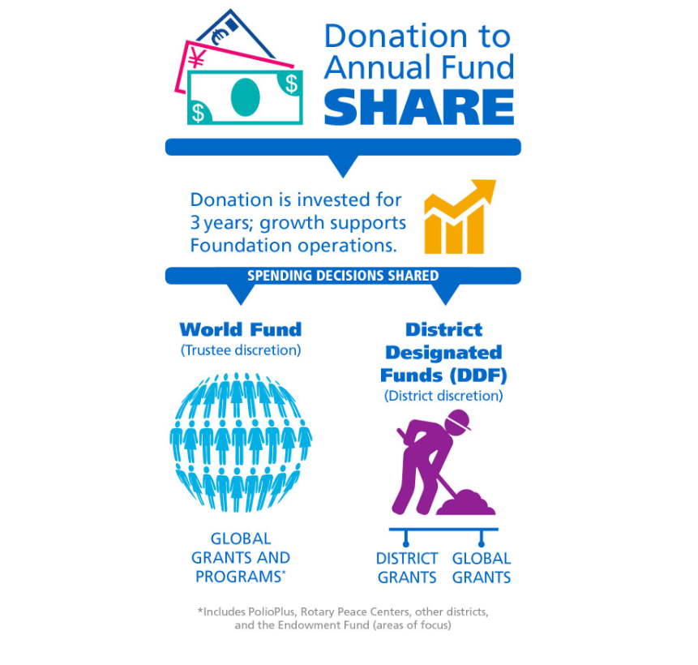
Notes:
Patti: Annual Fund contributions are transformed into grants and programs that support Rotary's humanitarian service using the SHARE system.
SHARE uses a three-year funding cycle. It allows the Foundation to invest donations and use the earnings for administrative and fund development costs.
After the investment period, the donation is divided. Annual Fund-SHARE contributions now have the first 5% of the total directed to operating expenses, with the remainder split equally between the World Fund and District Designated Funds.
The Foundation uses the portion credited to the World Fund to pay for grants and programs that are available to all Rotarians. Your district can use the portion that becomes DDF to participate in grants and the programs you choose.

Slide 8
Grant Funds to Rotary Projects
2021-2022 donations of SHARE $263,969 from District 5000
5% Admin Fee $ 13,198 to Rotary International
47.5% to World Fund $125,385 to The Rotary Foundation
47.5% to District Designated Fund (DDF) $125,385 to District 5000
Funds returned in 3 years to the District as grants. Available this year for projects:
$ 24,324 No match (20% of DDF)
$ 36,487 Match (30% of DDF)
$ 62,692 Match for Global Grants (50% of DDF)
$123,503 From District Designated Funds (DDF), net of Admin fee
$ 36,487 Matching Club Cash for matching District Grants
$ 62,692 Matching Club Cash for Global Grants
$ 50,153 From World Fund to match Global Grants
$272,835 Total for Global and local projects
.
Notes:
Patti: This year, we have $125k in DDF –District Designated Funds for District and Global Grants. With the club matching cash and the World Fund for Global grants, there is potentially $273k for projects and this is because of the donations to The Rotary Foundation and club funds. The District’s process is to take 20% of the DDF for no matched funds. Meaning the club does not need to match this amount with club cash. Then 30% is to be matched with cash from the club. 50% of the DDF is for global grants and the club needs to match this amount and is able to pledge the total to a global grant.

Slide 9
District 5000 Program Allocations
2024-2025
SHARE ALLOCATION
$125,385
Polio Plus $12,538
RCIS (Peace Centers) $ 2,000
District Grants $59,761 + $1,050 (small clubs & Rotaract)
Global Grants $62,693
Admin fee $1,881
Notes:
Patti: RCIS=Rotary Centers for International Studies

Slide 10
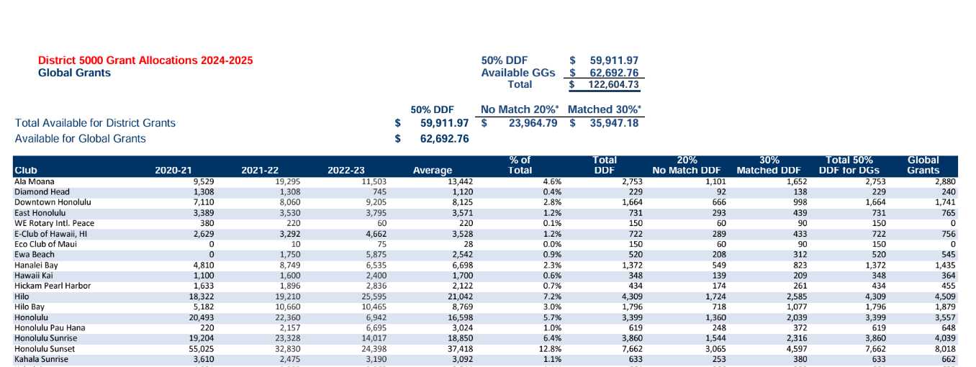
Grant allocation
Notes:
Patti

Slide 11
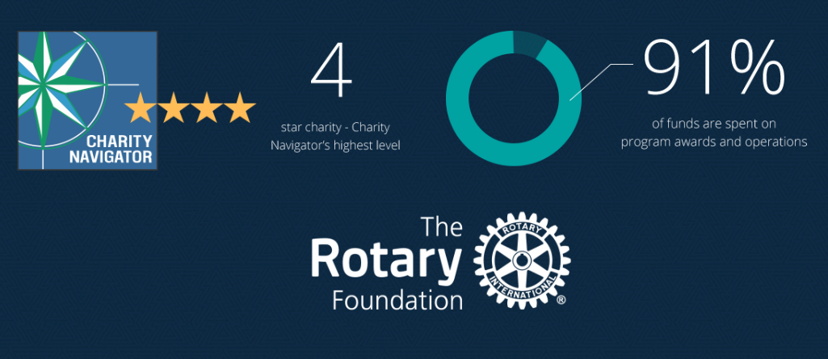
The Rotary Foundation of Rotary International has received 15 consecutive 4-star ratings from Charity Navigator.
The rating reflects Charity Navigator's assessment of how the Foundation uses donations, sustains its programs and services, and practices good governance and openness. (aka Stewardship)
Notes:
Laura: The Foundation earned the recognition for adhering to sector best practices and executing its mission in a financially efficient way, demonstrating both strong financial health and commitment to accountability and transparency. Only one percent of the organizations Charity Navigator evaluates have received 15 consecutive 4-star evaluations. The rating reflects Charity Navigator's assessment of how the Foundation uses donations, sustains its programs and services, and practices good governance and openness. This is also known as Stewardship. The District signs an MOU and must oversee the process and adhere to Rotary’s rules.

Slide 12
What is Stewardship?
Stewardship is the responsible management and oversight of grant funds, which ensures that funds are used properly and truly benefit the populations in need:
Supervise projects—MOU Guidelines
Implement projects as approved
Report irregularities
Submit reports
Retain documents- 5 years of soft (electronic) and hard copy
Notes:
Laura

Slide 13
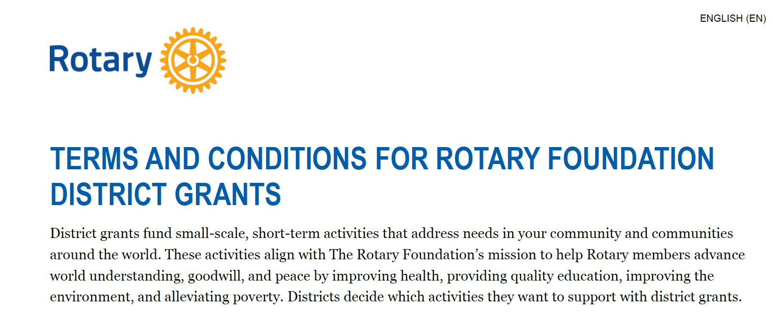
Notes:
Laura

Slide 14
Grants cannot fund:
Unrestricted cash donations to a beneficiary or cooperating organization
Continuous or excessive support of any one beneficiary, entity, or community
The purchase of land or buildings
A Rotary Club cannot own assets purchased with grant funds
Fundraising activities
Expenses related to Rotary events such as district conferences, conventions, institutes, anniversary celebrations, entertainment activities, or project ceremonies
Public relations initiatives, unless they are essential to carrying out the project
Project signs that cost more than $1,000
The operating, administrative, or indirect program expenses of another organization
Activities for which the cost has already been incurred
Notes:
Laura

Slide 15
Grant eligibility guidelines
Relate to the Foundation’s mission
Can’t use grants to reimburse clubs or districts for activities and expenses that are in progress or already completed.
If you want to alter a project after a grant is approved, the Foundation also needs to approve those changes before they are carried out.
Comply with the Conflict of Interest Policy for Program Participant
Follow Rotary’s Privacy Statement (personal data, images, etc)
Include signs on/near projects that identify Rotary Foundation
Notes:
Laura

Slide 16
Qualification checklist
By January 31:
1) Review, Sign and Submit
Memorandum Of Understanding (MOU)
District 5000 Addendum to the MOU
Financial Management Plan
2) Evidence of tax filing (tax return copy or 990N confirmation, proof of GE return)
3) Evidence of grant bank account (bank statement or check copy)
4) Attended District Grants training by 2 members, preferably the PE and person handling grant funds
By May 31: Final grant report for the current year
Notes:
Laura: So, how does the club qualify?

Slide 17
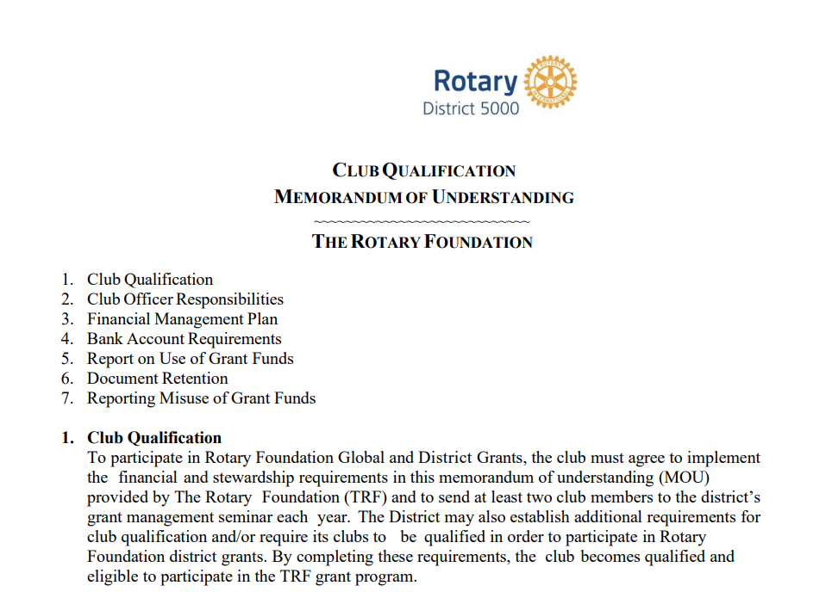
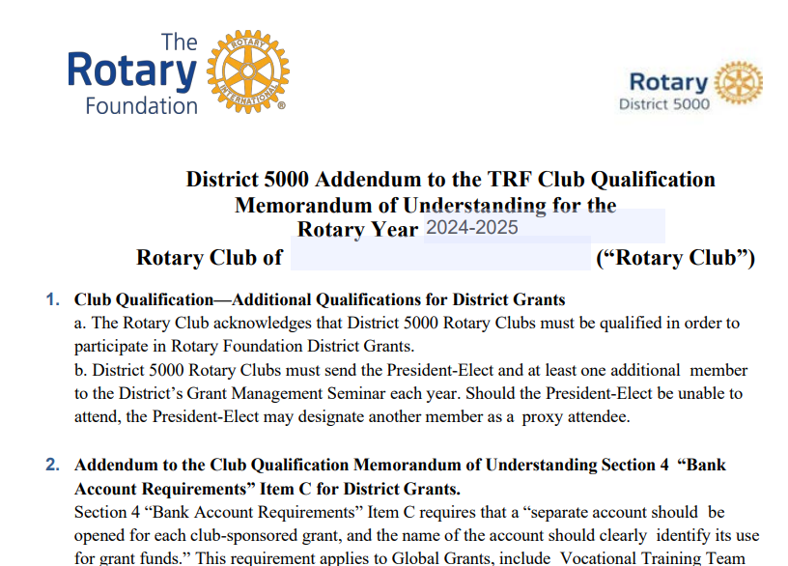
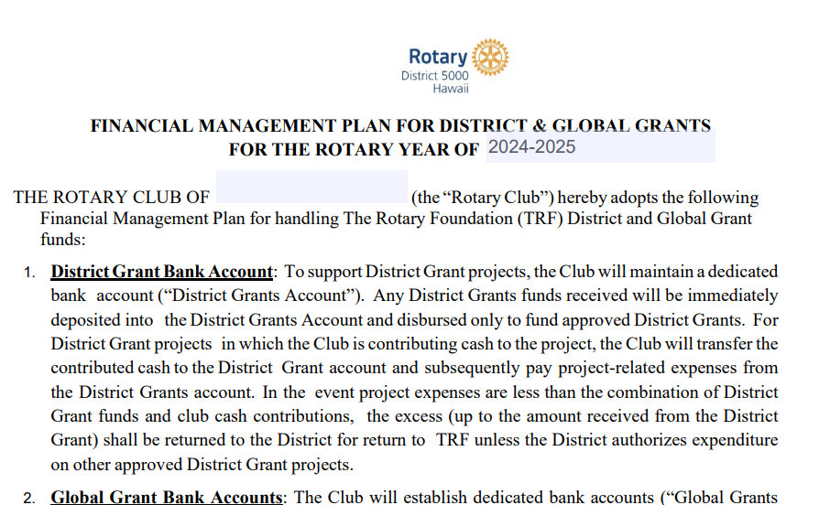
Three forms signed by PE and PN
Notes:
Laura

Slide 18
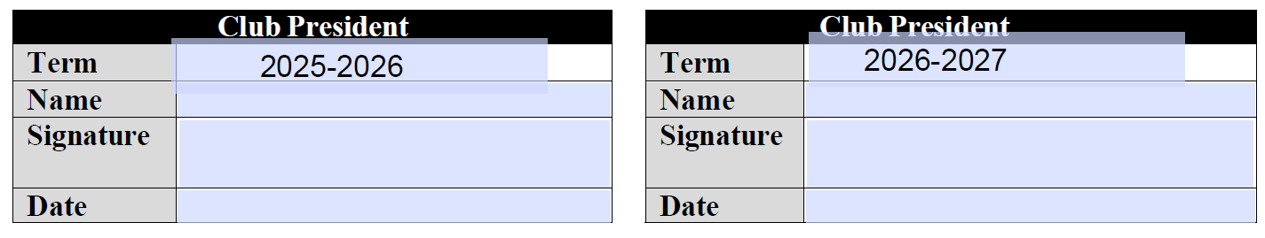
MEMORANDUM OF UNDERSTANDING
1. Club Qualification
2. Club Officer Responsibilities (adhere to stewardship measures)
3. Financial Management Plan (handling funds)
4. Bank Account Requirements (2 authorizing disbursements)
5. Report on Use of Grant Funds (how funds were spent)
6. Document Retention (5 years)
7. Reporting Misuse of Grant Funds (no tolerance)
Notes:
Laura

Slide 19
District 5000 Addendum to the TRF Club Qualification
Section 4 “Bank Account Requirements” Item C requires that a “separate account should be opened for each club-sponsored grant, and the name of the account should clearly identify its use for grant funds.” This requirement applies to Global Grants, include Vocational Training Team and Global Scholar Global Grants.
Notes:
Laura

Slide 20
FINANCIAL MANAGEMENT PLAN FOR DISTRICT & GLOBAL GRANTS
Maintain a dedicated bank account.
  Grant funds deposited and disbursed to fund approved District Grants.
  Club cash is transferred to the District Grant account and subsequently pay project-related expenses from the District Grants account
Title of the account: Rotary Club of xxxx TRF District Grants Account
Disbursements require two (2) signatures on a Disbursement authorization form or checks written from the Club District Grants Account or Global Grants Accounts. Authorized signatories may be: The Club President, the Immediate Past President, the Club Treasurer, or the Rotary Foundation Chair. An invoice or receipt, retained by the Club Treasurer, shall be required for all disbursements.
The Club will retain receipts and other documentation of disbursement of Funds in physical form and electronic form for five (5) years from the date of Approval of the Final Report
Notes:
Laura

Slide 21
FINANCIAL MANAGEMENT of District Grants
Important
Any DDF received will be immediately deposited in the District Grants Account and disbursed only to fund approved District Grants.
For DG projects in which the Club is contributing cash to the project, the Club will transfer the contributed cash to the District Grant Account
Pay project-related expenses only from the District Grants Account.
Do not disburse any funds until your application is approved and all DDF from District 5000 and Club contributions for matching are deposited in the District Grant Account.
Notes:
Laura

Slide 22
FINANCIAL MANAGEMENT of District Grants—the District Audit
About 15-20% of District Grants audited each Rotary Year
Documents you will need:
The DG Application and Final Report with explanation of any changes
Current Bank Signature Cards
Bank Statements showing incoming funds (Club cash and DDF) and disbursements
Cancelled checks
Check registers
Paid invoices, receipts, D5000 Disbursement Authorizations/Payment Vouchers
Bank Reconciliation
Notes:
Laura

Slide 23
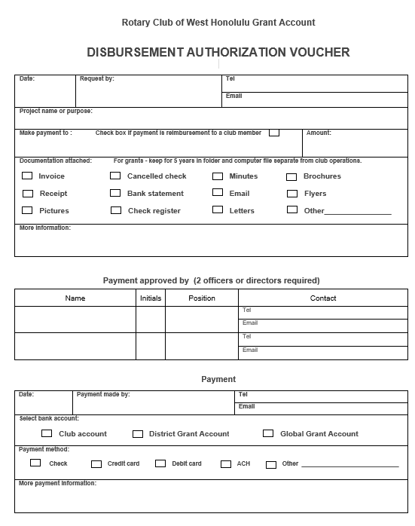
Disbursement Authorization Voucher
Notes:
Patti

Slide 24
New process
Starting this Rotary year, we will be using the Grant Module on ClubRunner. Qualification documents will be uploaded to ClubRunner. The grant application will be online and inputting, submission and reporting will all be online
Notes:
Patti

Slide 25
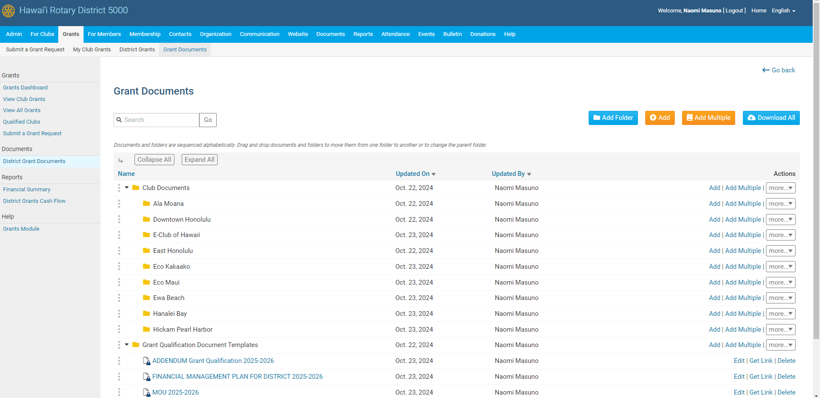
Grant Module in ClubRunner
Notes:
Patti

Slide 26
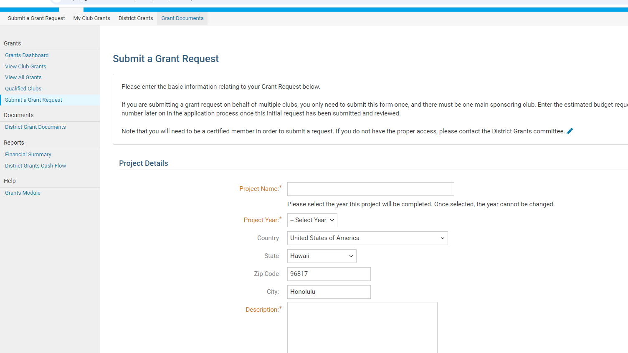
Page 2
Only those attending training can input a grant
Notes:
Patti

Slide 27
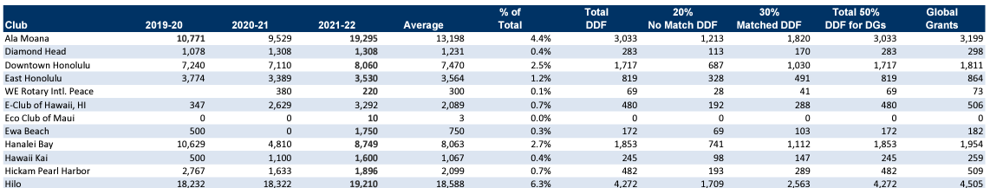
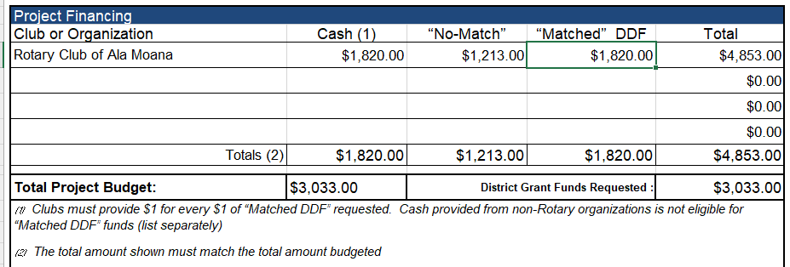



DDF Allocated to the Clubs for district grants and global grants 2025-26 https://rotaryd5000.org/sitepage/district-grant-info-documents
Notes:
Patti

Slide 28
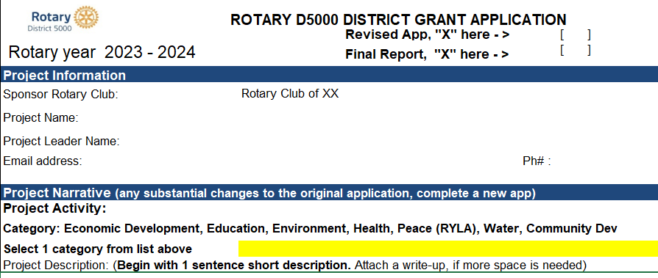

Final Reports
Final Reports are due 2 months after the completion of the project, but no later than May 31. Send the receipts along with the report to grants@rotaryd5000.org
Notes:
Naomi

Slide 29
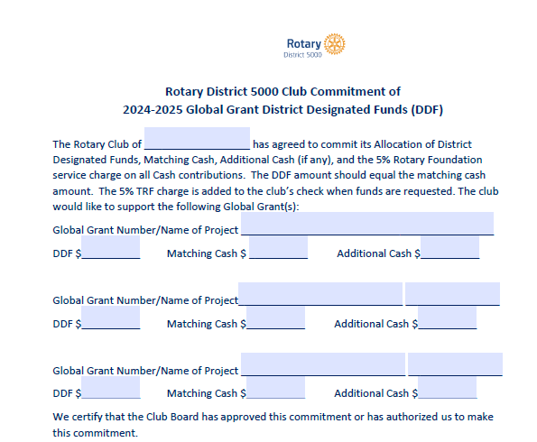
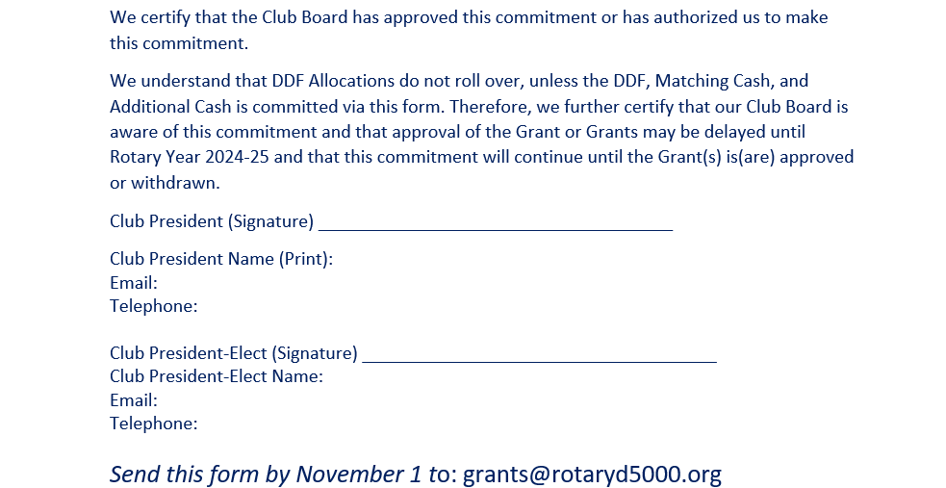
FINANCIAL MANAGEMENT for
Global Grants – Pledge form
Important
Retain copies of Global Grants Commitment Letter
Make sure PE and incoming Board have copies and understand commitment
COMMITMENT EXISTS UNTIL GRANT IS APPROVED/FUNDED OR CANCELLED
Notes:
Naomi

Slide 30
District Grants vs Global Grants
Global Grant District Grant
Cost - $30,000 minimum No maximum
Funding - World Fund, DDF, Cash DDF and Mandatory Club Match
Application -Online District Application
Area of Focus No area of Focus requirement One of seven areas of Focus
Partnerships – Host Club required No partnership required
Sustainability - Required Not Required
Measurability - Required Required
Scholarships Sponsor Club Determines Graduate- Post Graduate
Notes:
Naomi: What’s the difference between a District Grant and a Global Grant?

Slide 31

Rotary Foundation Areas of Focus
Notes:
Naomi

Slide 32
requirements for Global grants
Districts must be qualified in order to receive grant funding from The Rotary Foundation. Clubs that want to apply for global grants must also be qualified.
The qualification process helps ensure that your district or club understands your financial responsibilities, including stewardship, and is prepared to take them on. Qualification must be completed each year.
Club qualifies for global grants by someone taking the Grant Management Seminar in the Rotary Learning Center. New requirement starting this year.
Notes:
Naomi

Slide 33
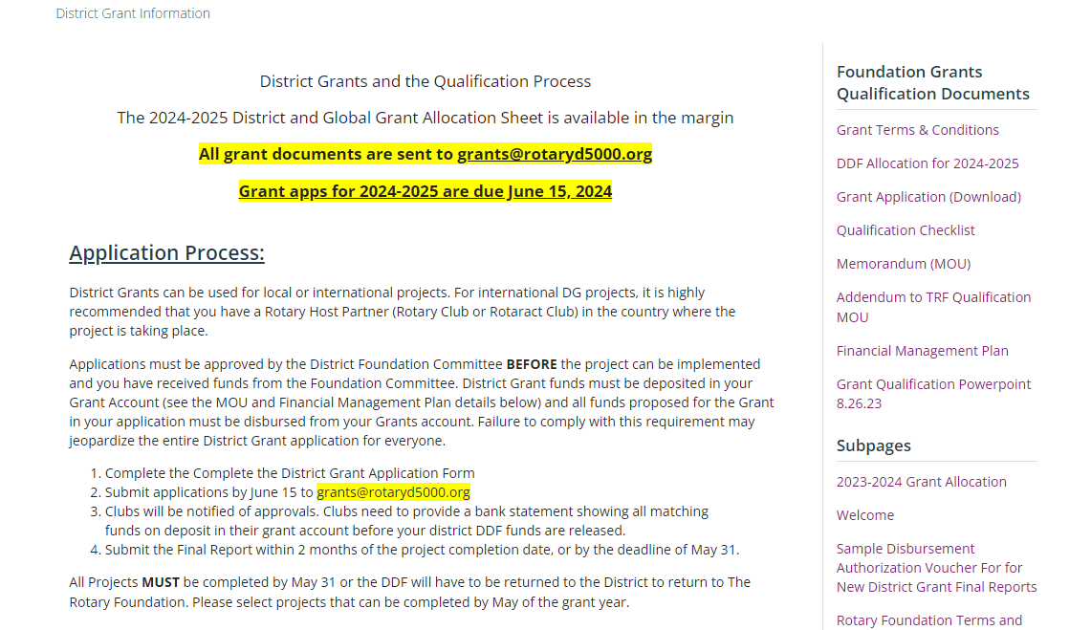
District Sitepage
https://rotaryd5000.org/sitepage/district-grant-info-documents
Notes:
Naomi

Slide 34
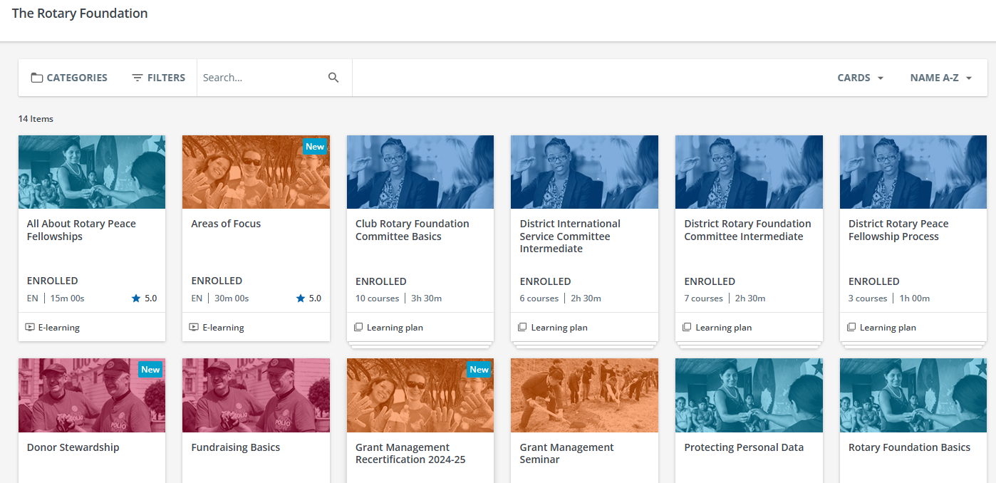

Learn.rotary.org
Notes:
Naomi

Slide 35
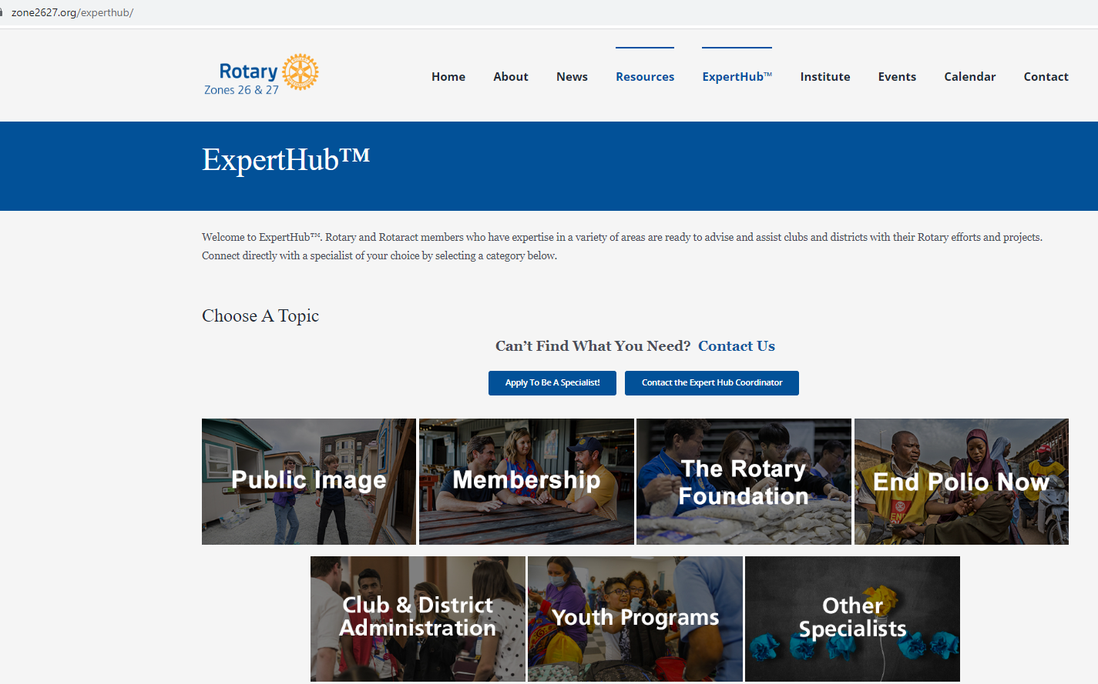
Notes:
Naomi

Slide 36
Upcoming webinars
Recording of Zooms are in the webinar tab under Quick Links on the rotaryd5000.org website.
Nov 2, 9-10:30am – The Rotary Foundation, the engine that powers Rotary. Want to know all about The Rotary Foundation programs? Join us to get an in-depth view of TRF programs, such as the Endowment Fund, Legacy Society, and donor recognitions.
Notes:
Naomi

Slide 37
Key takeaways
Use of grant funds
  Used for the purpose described on the application that was approved
  Do not spend project funds until after the grant funds are in the account
  Use funds by May 31, return funds to D5000 asap if not used
  Disbursements authorized by 2 people via the voucher or on the grant check
  Grant funds cannot be carried over to another year
Complete qualification checklist by January 31
Maintain separate club grant account – all disbursements from this account
Keep documents for 5 years
Notes:
Naomi

Slide 38

Notes:
Naomi

Slide 39


