Slide 1
Grants Stewardship and Qualification 2021-2023
Mark Harbison, District Rotary Foundation Committee Vice Chair & Grants Subcommittee Chair,
PDG Laura Steelquist, Grant Stewardship Subcommittee Chair, Arjun Aryal, Grants Subcommittee Global Grants Chair, Dave Hamil, Grants Subcommittee District Grants Chair

Slide 2
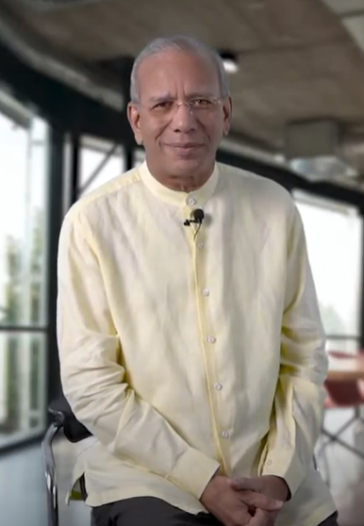
Our Foundation Funded more than 2,000 Global Grants in 2020-2021
K.R. (Ravi) Ravindran
@KRRavindran105
Together, we funded more than 2,000 global grants that empowered Rotary members around the world to take on projects they care about and make a difference in their communities. Your generosity helped us raise more than $440 million! Unbelievable! Highest ever!

Slide 3
Why Are We Here?

Slide 4
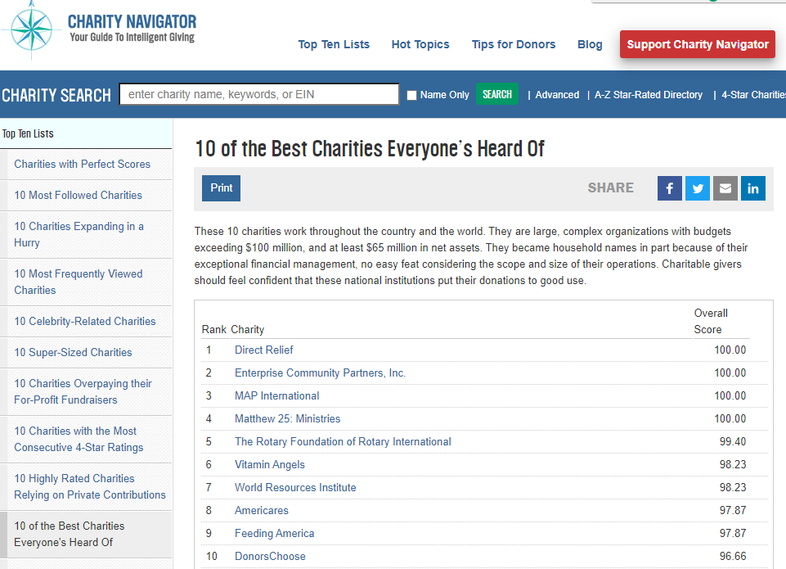
Why Grants Stewardship? Why Qualification?

Slide 5
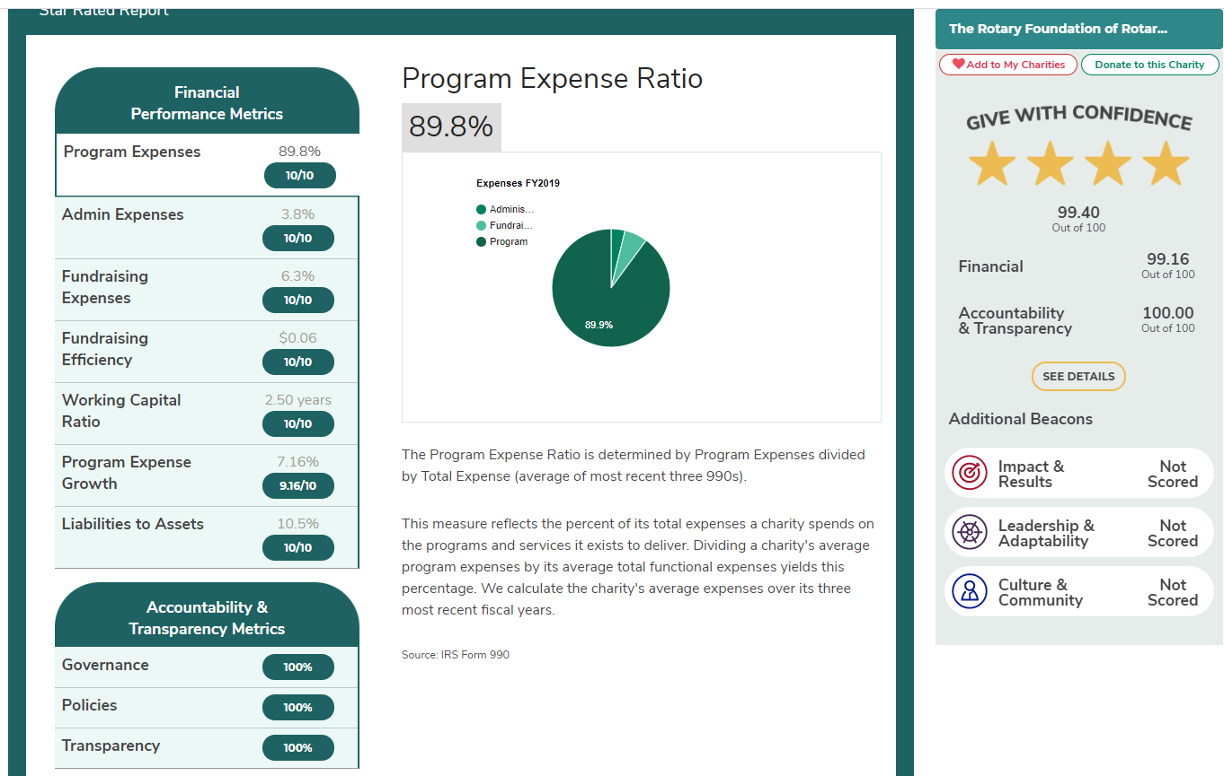
Why Grants Stewardship? Why Qualification?

Slide 6
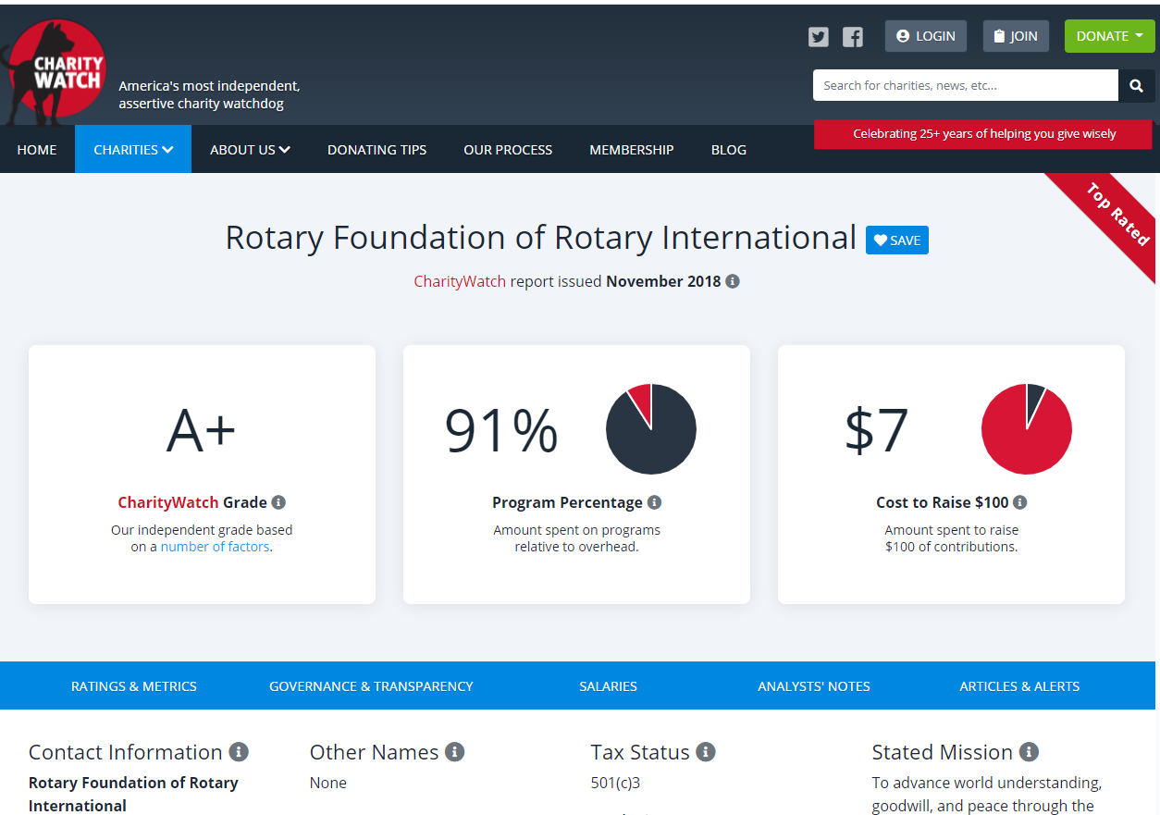
Why Grants Stewardship? Why Qualification?

Slide 7
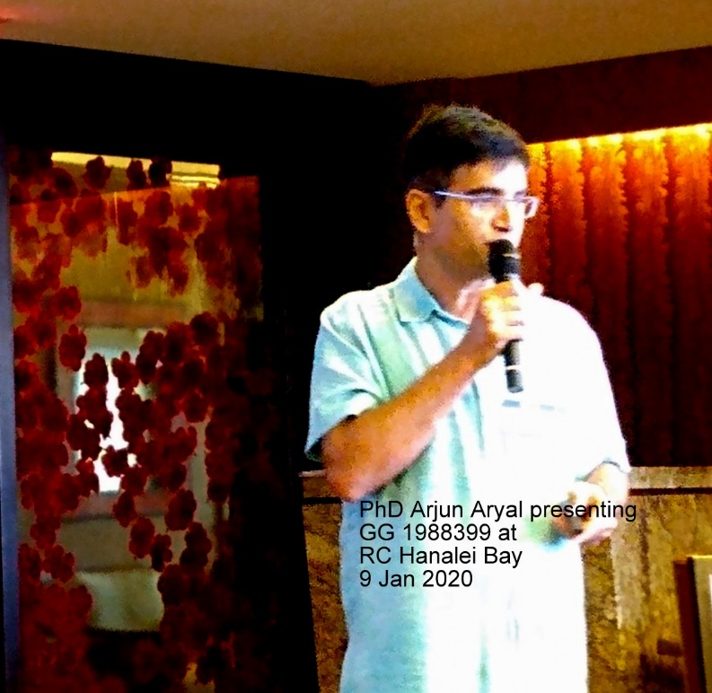
What is Stewardship? Why Qualification?
Stewardship is the responsible management and oversight of grant funds, which ensures that funds are used properly and truly benefit the populations in need:
Supervise projects—MOU Guidelines
Implement projects as approved
Report irregularities
Submit reports
Retain documents (7 years electronic/cloud and hard copy)

Slide 8
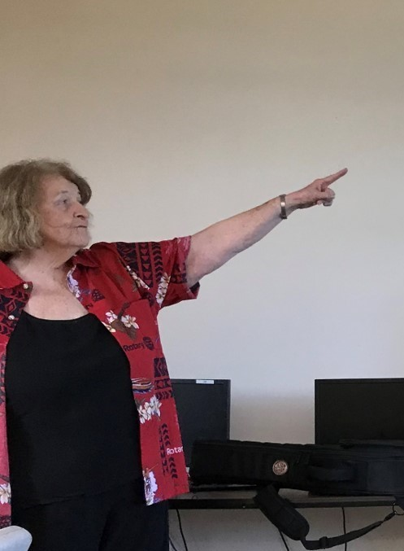
Grants Stewardship and Qualification 2021-22
Attend a Grant Management Seminar (Zoom or on-line Webinar + Learning Center Module) PE + 1 member
2022-23 President and PE sign Qualification Documents
Memorandum of Understanding (MOU)
District 5000 Addendum to the MOU
Provide name and account number of dedicated DG account
2021 IRS 999 and GE Annual 2021-22
Current on GG Contributions
Qualification Checklist
Financial Management Plan
DG Final Report Submitted

Slide 9
District 5000 Qualification Documents
Rotary Foundation Club Memorandum of Understanding (MOU)—Global Grants
District 5000 Addendum to the Club MOU—extends MOU requirements to District Grants, simplifies bank account requirements
District 5000 Club Financial Management Plan—meets Foundation MOU and District 5000 requirements

Slide 10
The Rotary Foundation MOU
Club Qualification for Global Grants
Club Officers Responsibilities
Financial Management Plan
Dedicated Bank Account Requirements
Report on Use of Grant Funds
Document Retention
Reporting Misuse of Grant Funds

Slide 11
Implementing the Qualification documents
MAINTAIN A SEPARATE BANK ACCOUNT FOR DISTRICT GRANTS—D5000 Addendum allows for ONE DG ACCOUNT
SEPARATE BANK ACCOUNTS FOR EACH GLOBAL GRANT YOU MANAGE
TWO AUTHORIZED SIGNATURES ON CHECKS OR PAYMENT AUTHORIZATION FORMS
PAID INVOICES FOR DG FINAL REPORTS, PAID RECEIPTS FOR FINAL REPORTS, USE D5000 PAYMENT VOUCHER
REPORT ON DISTRICT GRANTS BY MAY 31
DOCUMENT RETENTION—5 YEARS
DO NOT SPEND GRANT FUNDS UNTIL APPLICATION APPROVED

Slide 12
FINANCIAL MANAGEMENT of District Grants
Do not disburse funds until District DDF received
Dedicated District Grant Account separate from Club Account or Club Foundation Account
All Club Cash and Club Foundation Cash for DDF match on DG projects deposited in DG Account BEFORE you receive District 5000 DDF check
Two signature on all checks from DG Account or on Check Request/Payment Voucher
Paid Invoices or receipts for DG Final Reports and Payment Vouchers for all expenditures

Slide 13
FINANCIAL MANAGEMENT of District Grants
Important
Any DDF received will be immediately deposited in the District Grants Account and disbursed only to fund approved District Grants.
For DG projects in which the Club is contributing cash to the project, the Club will transfer the contributed cash to the District Grant Account
Pay project-related expenses only from the District Grants Account.
Do not disburse any funds until your application is approved and all DDF from District 5000 and Club contributions for matching are deposited in the District Grant Account.

Slide 14
FINANCIAL MANAGEMENT of District Grants—the District Audit
About 15% of District Grants audited each Rotary Year
Documents you will need:
The DG Application and the Final Report with explanation of any changes
Current Bank Signature Cards
Bank Statements showing incoming funds (Club, Club Foundation, DDF) and disbursements
Cancelled checks
Check registers and
Paid invoices, receipts, D5000 Disbursement Authorizations/payment vouchers
Bank Reconciliation

Slide 15
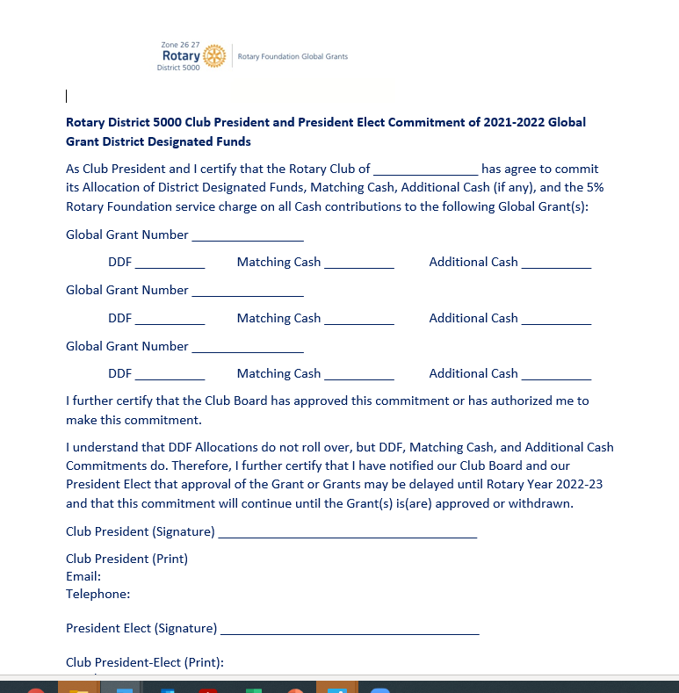
FINANCIAL MANAGEMENT of global Grants
Important
Retain copies of Global Grants Commitment Letter
Make sure PE and her Board have copies and understand commitment
COMMITMENT EXISTS UNTIL GRANT IS APPROVED OR CANCELLED

Slide 16
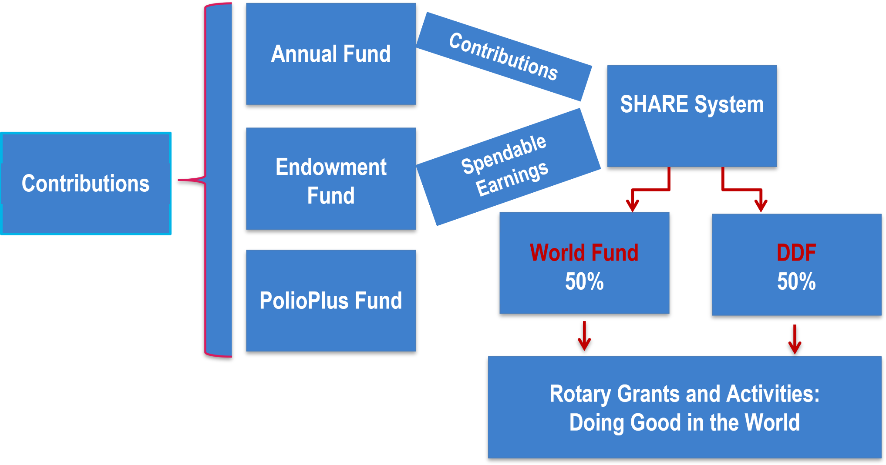
The Rotary Foundation Funding Model

Slide 17
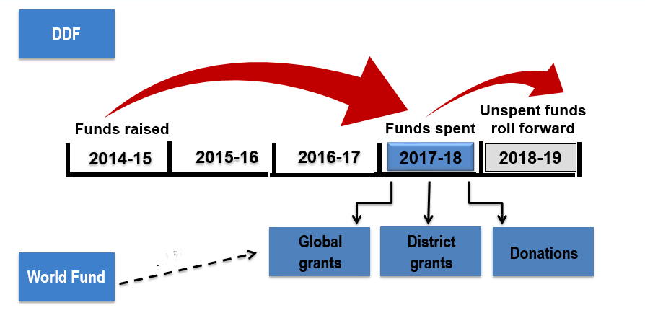
The Rotary Foundation Funding Model Three-Year Investment and Spending cycle

Slide 18
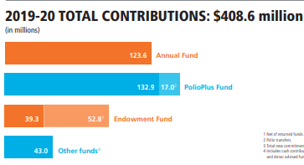
Rotary Foundation Programs Budget 2021-22

Slide 19
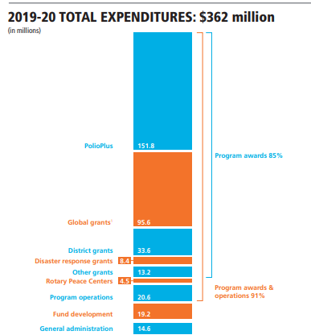
Rotary Foundation Programs Budget 2021-22

Slide 20
Rotary Foundation Programs Budget 2021-22
2021-22 Contributions
SHARE +Polio $338,486,000
Investments $ 40,288,000
Endowment $ 27,324,817
2021-22 Allocation
Annual Fund $168,544,000
PolioPlus $135,500,000
Program Awards
District Designated Funds $ 83,165,000
World Fund $ 41,969,000
PolioPlus $135,500,000

Slide 21
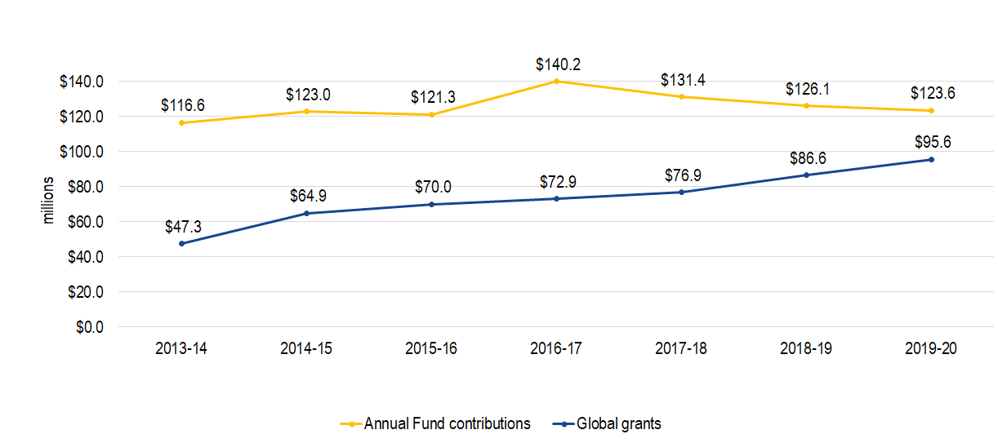
Challenge to the TRF Funding Model

Slide 22
Endowment fund role in rotary’s future

Slide 23
District 5000 Program Allocations 2021-22
SHARE ALLOCATION $144,173.64
Polio Plus $28,834.73
RCIS (Peace Centers $ 5,000.00
District Governor Global Grant $30,000.00
District Grants $72,086.82
(50% of SHARE)
Global Grants $61,748.24

Slide 24
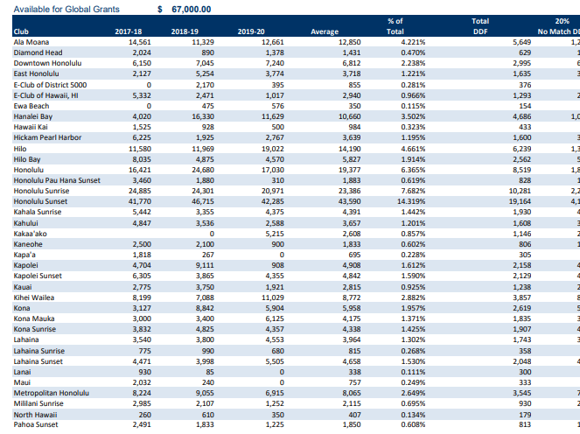
DDF Allocated to the Clubs for district grants and global grants 2021-22
SHARE ALLOCATION $144,173.64
Polio Plus $28,834.73
RCIS (Peace Centers $ 5,000.00
District Governor Global Grant $30,000.00
District Grants $72,086.82 (50% of SHARE)
Global Grants $61,748.24

Slide 26
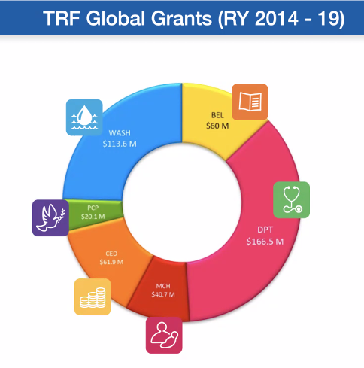
Areas of Focus shares of total global grants

Slide 27
Our New Area of Focus
Global Grants in the new Area of Focus begin July 1 2021

Slide 28
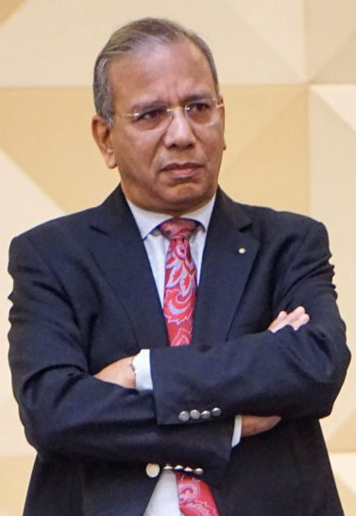
New Policy on Global Grant Matching—No TRF Club Match
KR (Ravi) Ravindran, Rotary Foundation Trustee Chair:
“The global grant (GG) programme, the flagship programme of our Foundation, has been an enormous success. In 2013–14, when GGs were introduced, TRF had awarded 868 of them worth $47.3 million. By 2018–19, this number had risen to 1,403 grants worth $86.6 million.” But while this demand shot up by 80 per cent, the corresponding Annual Fund contributions showed only a 7 per cent increase.”
“This year, unfortunately, TRF had almost $12 million less in its World Fund for GGs; 25 per cent less compared to Rotary year 2020. This was not related to Covid; and resulted from the Annual Fund contribution decreasing significantly two years ago. Given this $12 million shortfall, the Trustees have initiated a new policy that has “eliminated the match, on cash contributions to global grants.”

Slide 29
Decision 2: Reduce the World Fund match of DDF from 100% to 80% for global grants
DDF contribution to Global Grant
Example scenario:
80% World Fund Match
Advocacy
+
$36,000
for global grant
$20,000
$16,000

Slide 30
Decision 2: Reduce the World Fund match of DDF from 100% to 80% for global grants—Effect in district 5000
Example scenario:
DDF contribution to Global Grant
+
80% World Fund Match
$36,000
for global grant
Advocacy
$16,000
$20,000
Cash contribution to Global Grant
+
$50,000
for global grant
$20,000

Slide 31
District Grants vs global grants
Global Grant District Grant
Cost $30,000 minimum No maximum or minimum
Funding World Fund, DDF, Cash DDF, Club Cash
Application Online District Application
Area of Focus One of seven areas of Focus No area of Focus requirement
Partnership Host and International Clubs No partnership required
Sustainability Required Not required
Measurability Required Required
Scholarships Graduate & Post-Graduate Sponsor Club Determines
Vocational Programs OK

Slide 32
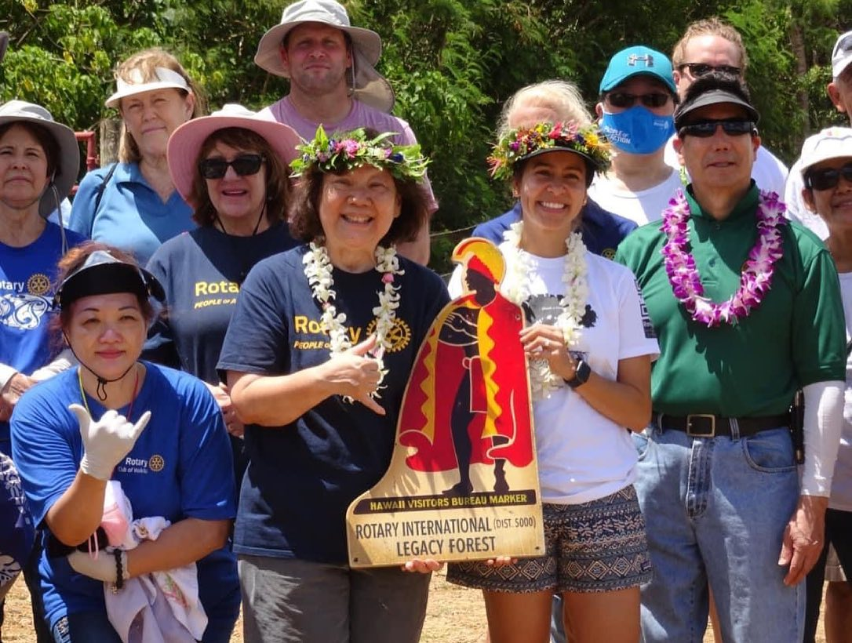
District Grants: 95 District Grants in District 5000--$125,000
Small-scale, short-term
Local or international activities
Alignment with the Foundation’s mission
Single grant awarded annually to District
$78,000 in DDF in D5000 for 95 projects worth $125,000
Rotary International (D5000) Legacy Forest
Rescue Tubes and Ocean Safety on Maui

Slide 33
District 5000 Impact Grants Funded by the Foundation Endowment Fund $2,500 Each for 3 Clubs

Slide 34
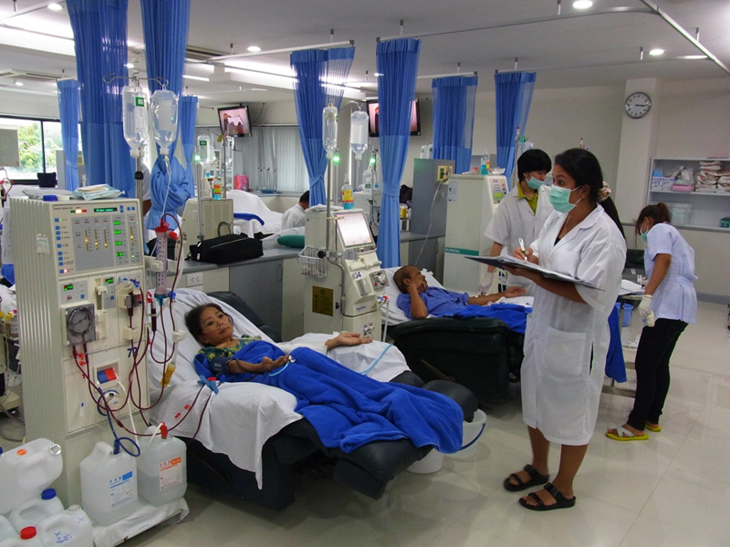
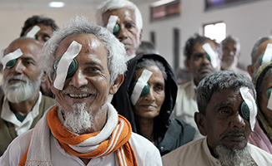
Global Grants Humanitarian projects in the Areas of Focus
Saving Lives with Hemodialysis Machines
to rural areas within Thailand
…A gift of Vision with a Rotary Eye Hospital in
New Delhi

Slide 35
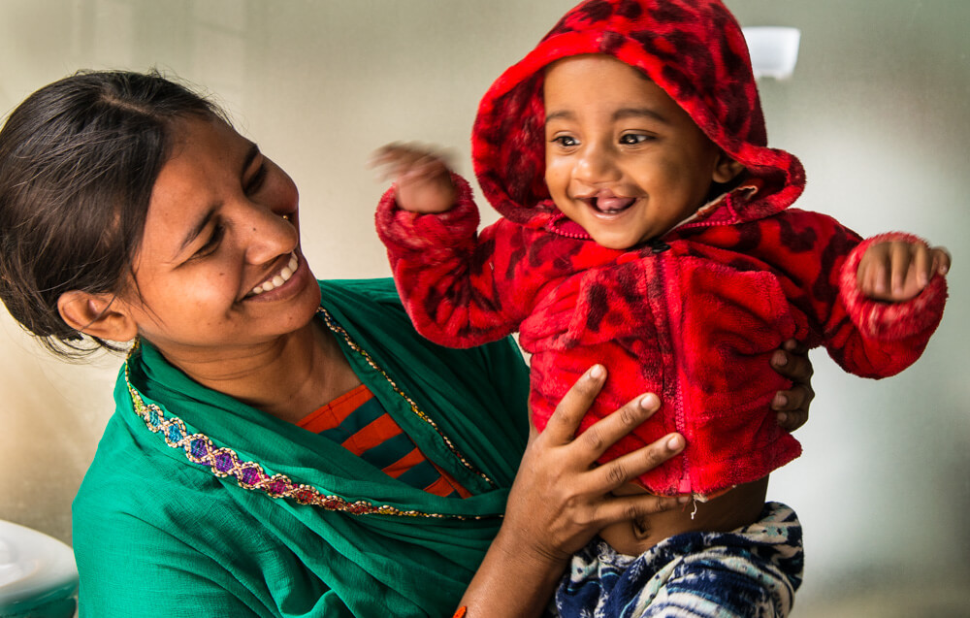
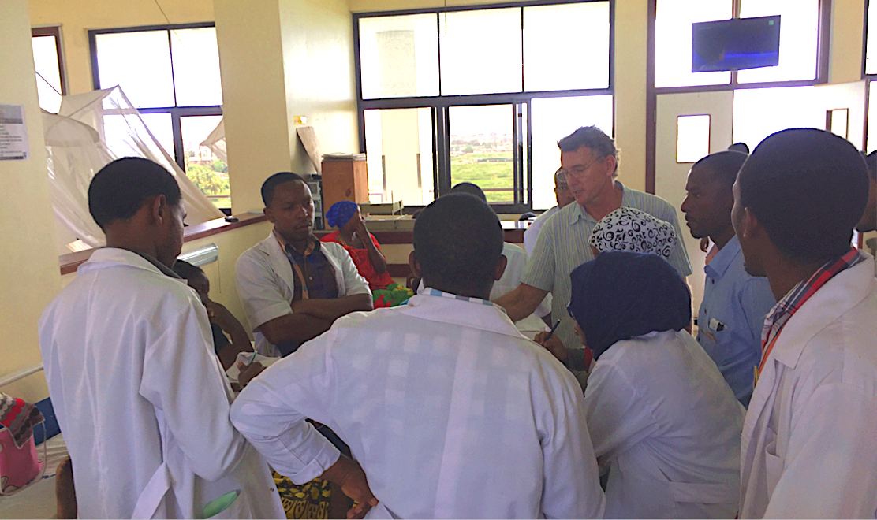
Global Grants Vocational Training Teams (VTTs)
A VTT Rotaplast Project in Iasi Romania
VTTs for Pediatric Surgeons in Tanzania
and Uganda

Slide 36
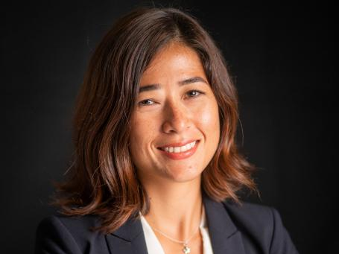
Rotary Global Scholars Global Grants Outgoing
Global Scholar ARIEL STENEK
With the assistance of Rotary, Ariel received her Masters in International Relations at the University of Paris in London. She is now employed in Honolulu, by a non-profit Indo-Pacific THINK TANK, which has been in business for 44 years and is a research institute on Foreign Policy.

Slide 37
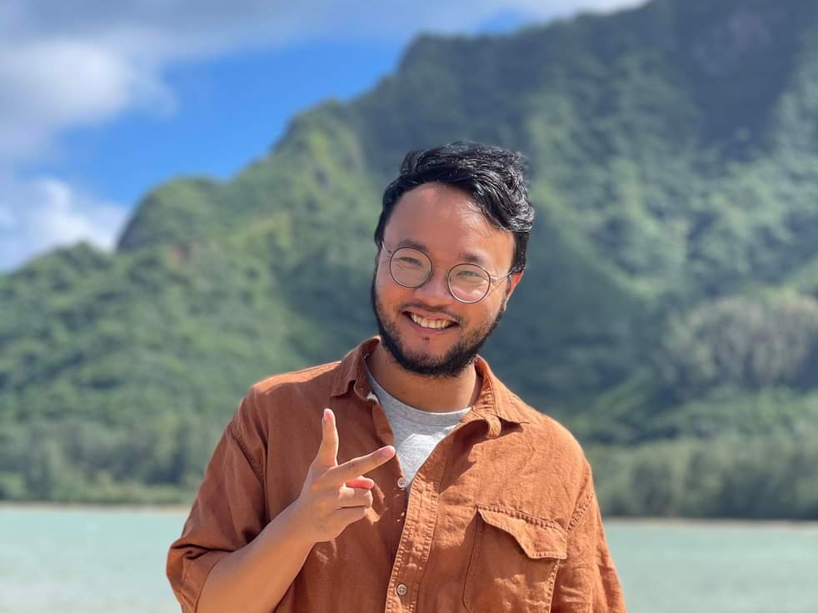
Rotary Global Scholars Global Grants to UH Graduate Schools
Global Scholar Yi-yu Lai
Hosted by the Rotary Club of Honolulu Sunset and sponsored by the Rotary Club of Lengfung (D3523), Yi-Yu, has been working on his PhD at UH Manoa since 2019. He is working on Peace and Conflict Resolution models among indigenous tribes in the Philippines in the Department of Anthropology. Arjun Aryala is the Primary Contact.

Slide 38
Programs of Scale Grants
Multi-year programs that benefit large number of people
Alignment with areas of focus
World Fund award of $2 million; no additional Rotarian funding required
Require implementation partner organization(s)
Competitive two-step application process

Slide 39
Programs of Scale Grants
2020-21 Project to eliminate Malaria in Zambia
Alignment with areas of focus—Disease Prevention and Treatment
World Fund award of $2 million; no additional Rotarian funding required
Require implementation partner organization(s): Gates Foundation and World Vision USA co-fund the program with $2 million each, bringing total funding to $6 million.
Increase access to malaria diagnosis and treatment for the more than 1.3 million people

Slide 40
Rotaractors in Global Grants from July 2021
To be eligible to sponsor a global grant, a Rotaract club needs to have previously partnered with a Rotary club or district on a global grant-funded project and must be qualified to participate in global grants. For global grants, if one sponsor is a Rotaract club, the other needs to be a Rotary club.

Slide 41
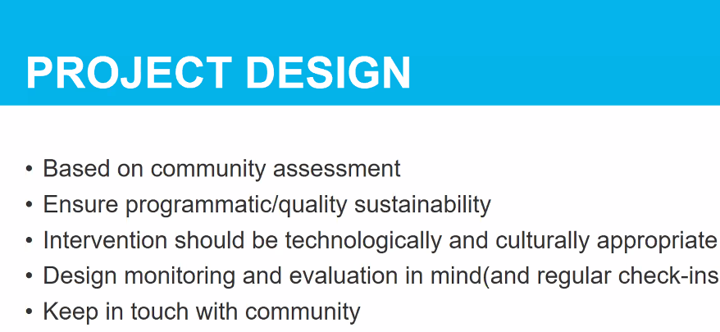
Community Assessment and sustainability—monitoring and evaluation

Slide 42
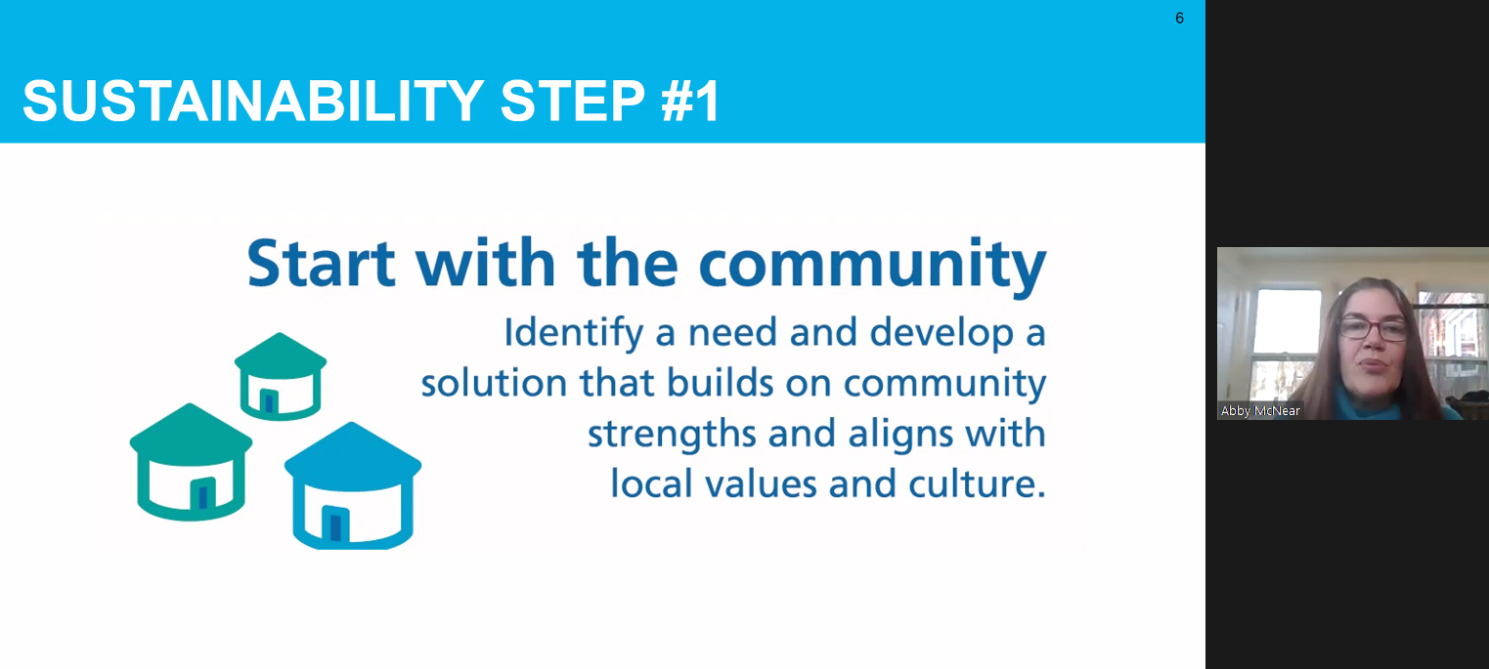
Community Assessment and sustainability—monitoring and evaluation

Slide 43
Community Assessment and sustainability—monitoring and evaluation

Slide 44
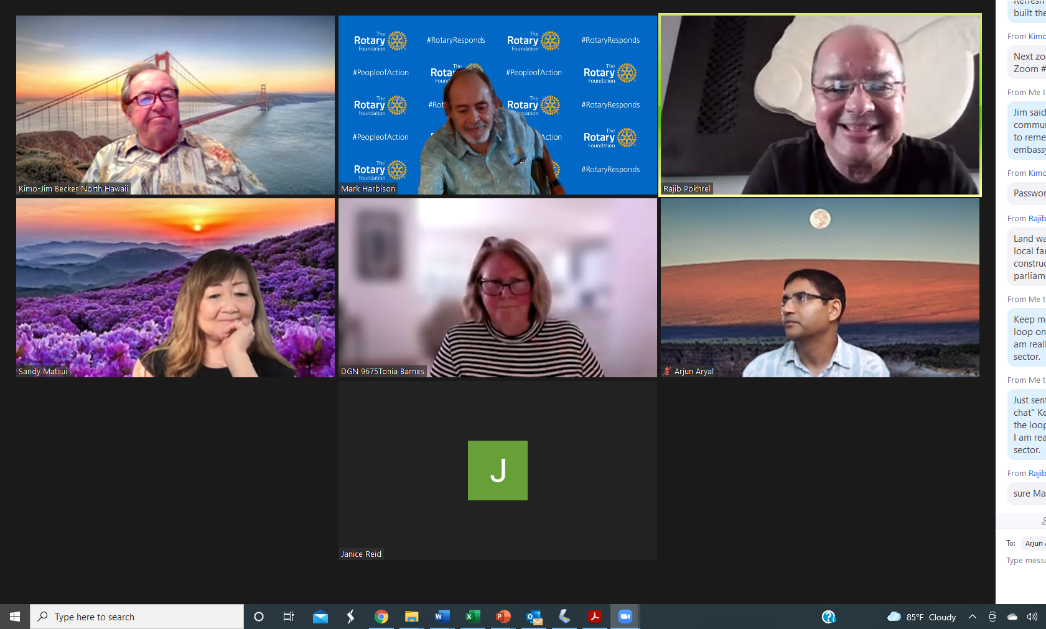
Community Assessment and sustainability—monitoring and evaluation

Slide 45
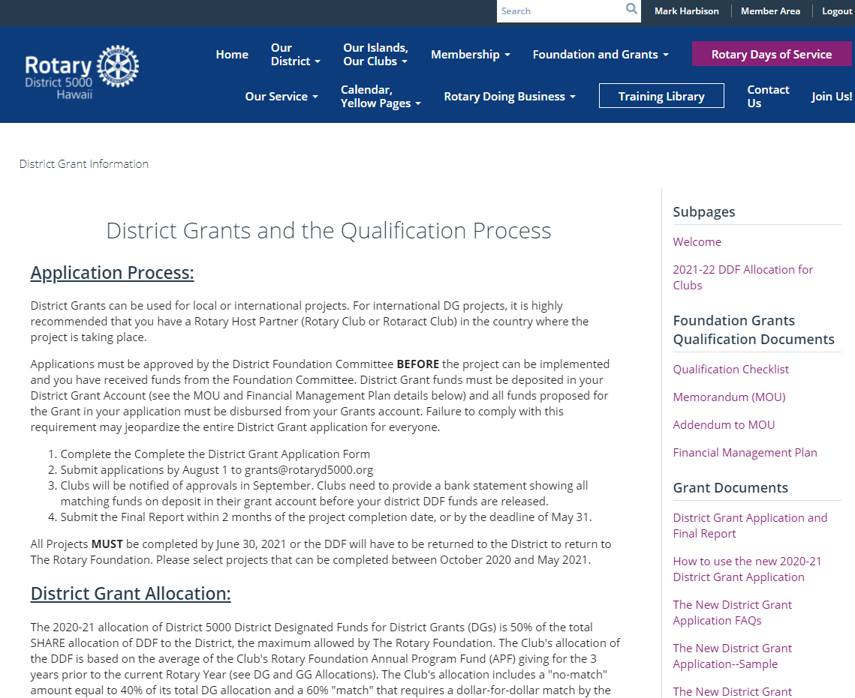
District Grant Management Resources on the D5000.org Website

Slide 46
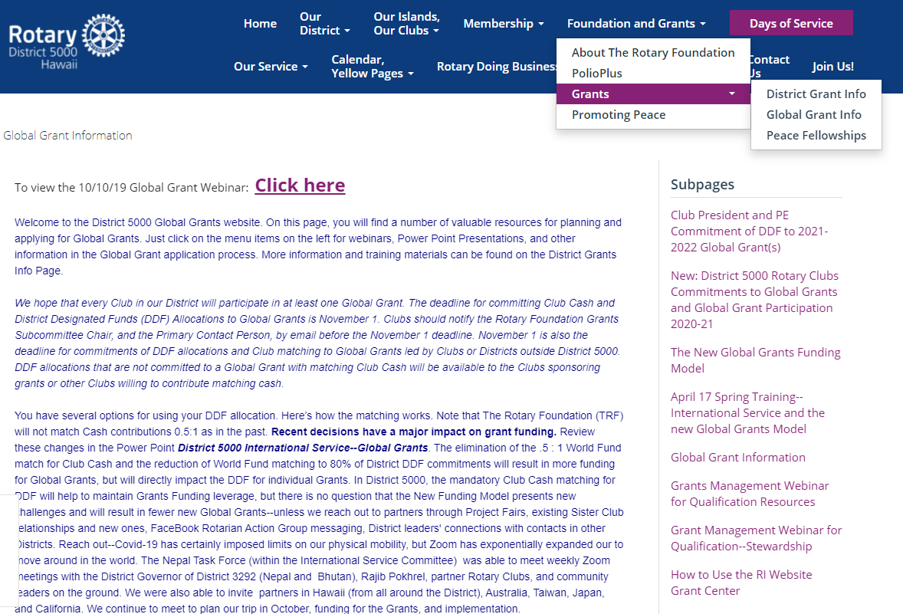
global Grant Management Resources on the D5000.org Website

Slide 47
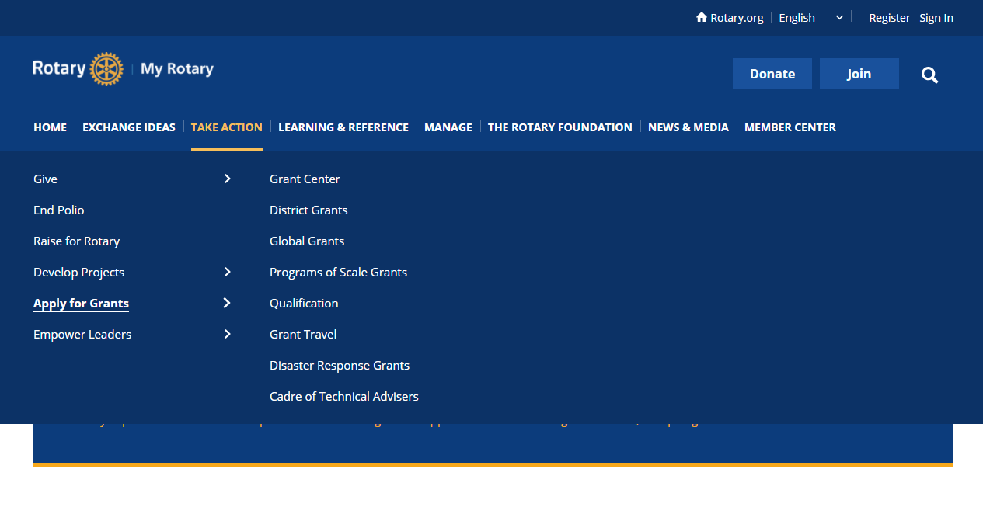
Getting into the Grant Center on Rotary.org

Slide 48
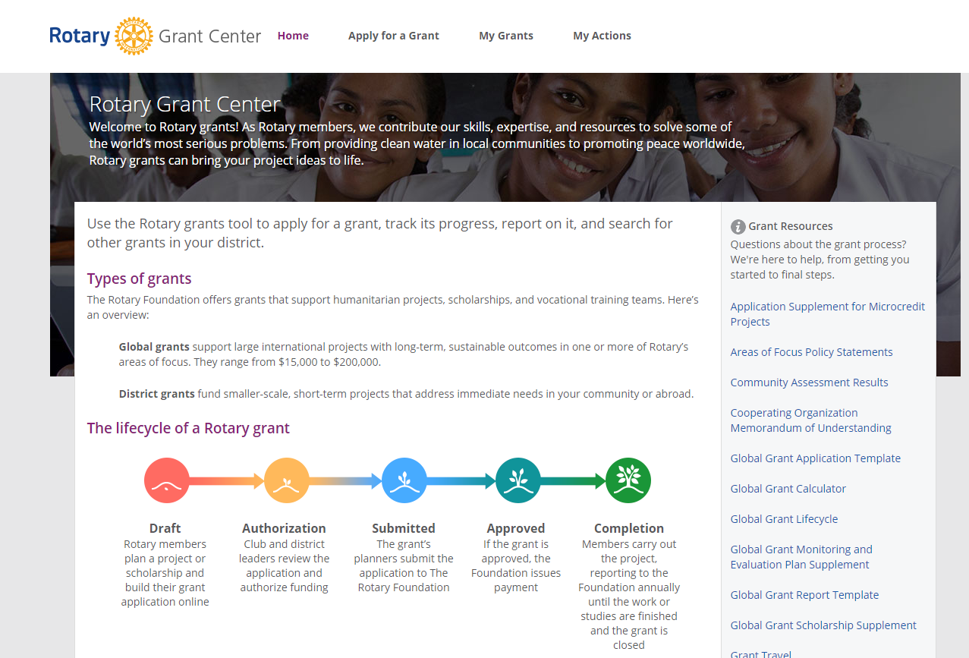
The Grants Center Landing Page

Slide 49
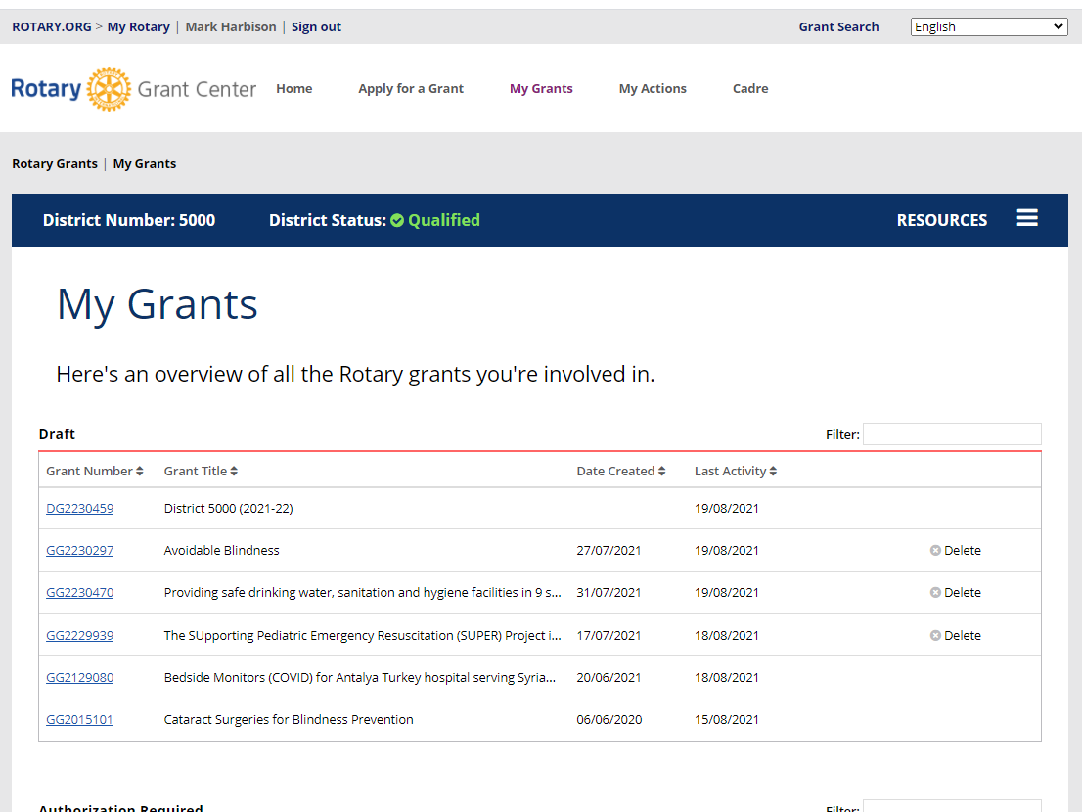
New Global Grants for 2021-22
District 5000 2019-2020 Global Grants Webinar

Slide 50
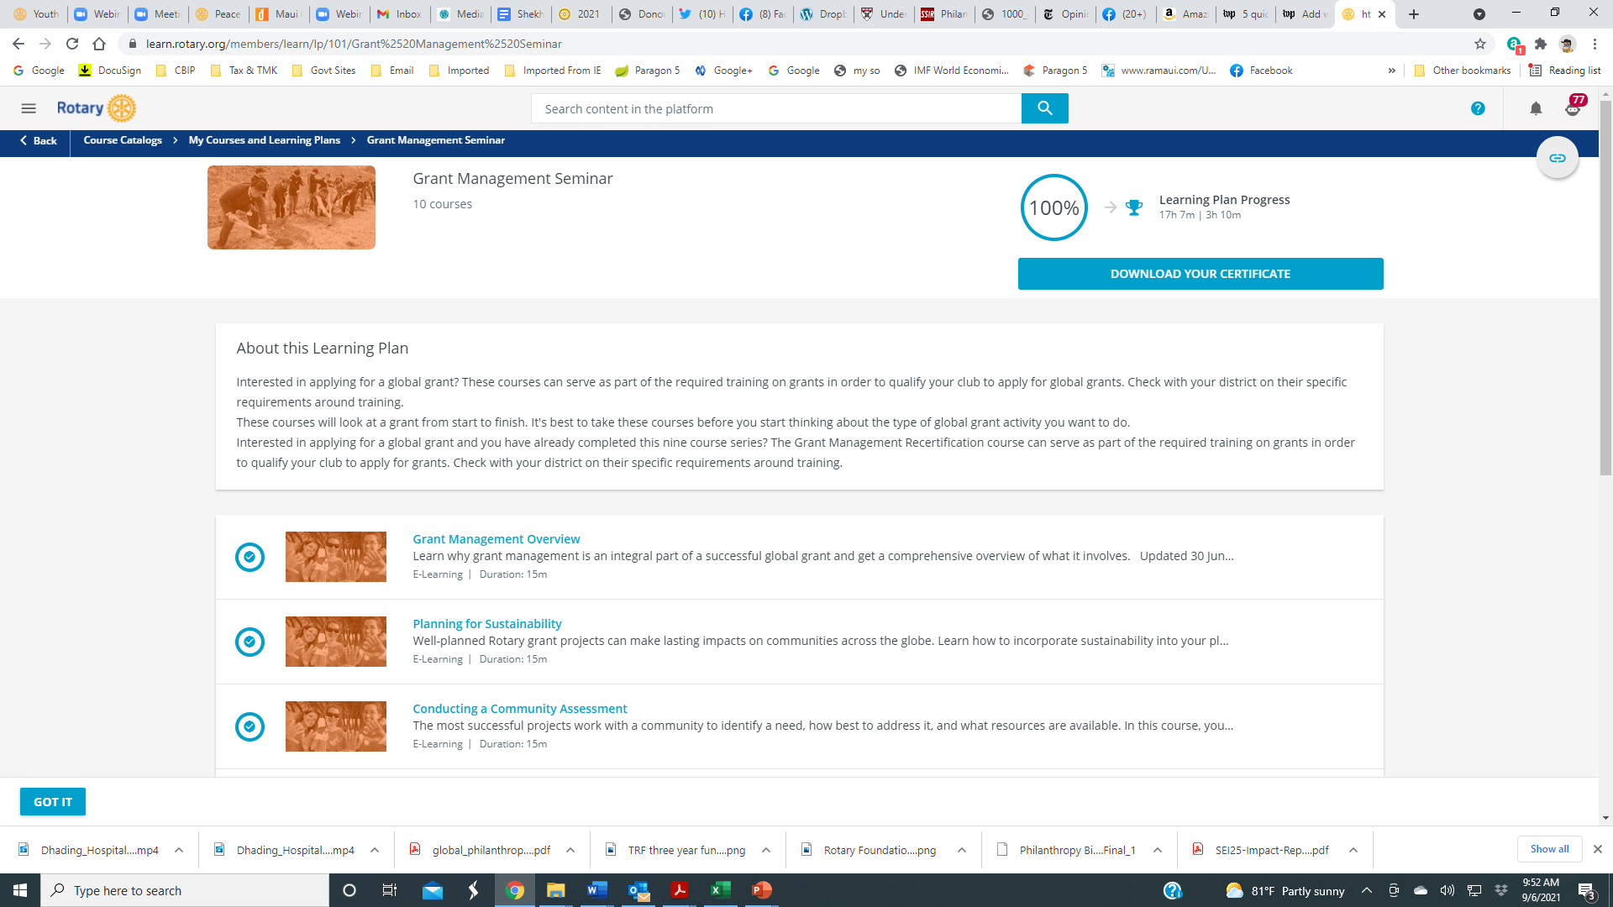
Rotary Foundation Resources: ROTARY LEARNING CENTER Grant Management seminar

Slide 51
Rotary Foundation Resources: Foundation resource guide

Slide 52
Rotary Foundation Resources: ROTARY action groups

Slide 53
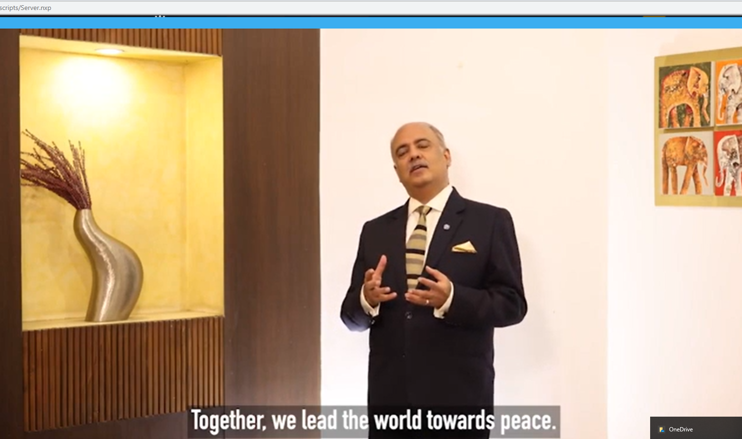
Questions?
Comments?

Slide 54
Global Grant GG2230470 WASH in 9 schools of Jwalamukhi, Nepal
Rotary Clubs of Honolulu Sunset and Narayangarh (District 3292)
$TBD
Area of Focus: WASH
Ahead of our trip to Nepal and Bhutan (postponed again due to the Delta outbreak), we are working on another project in the Jwalamukhi District. Part of Rotary’s WASH in Schools campaign, this grant will provide clean drinking water, gender sensitive sanitation and hygiene facilities, with training in the importance of toilet use and maintenance for school staffs and students following Rotary Action Group for Menstrual Health and Hygiene training guides for girls adapted for Nepal. We hope to implement the project in 9 schools in the District.
Contact Arjun Aryal aryala@gmail.com and Andy Chamberlain AlaskanAndy@gmail.com

Slide 55
Global Grant 2230297 Avoidable Blindness in Delhi Slums
Rotary Clubs of Kihei-Wailea and Delhi South Metropolitan (District 3011) with Nara East and District 2650
$134,589
Area of Focus: Disease Prevention and Treatment
Building on our work in the Delhi slums and the extensive network of eye care clinics connected to the Rotary Eye Care Hospital in Karol Bagh, we will train health workers involved in door-to-door polio and Covid-19 vaccination campaigns to also screen for vision problems, especially children needing glasses and candidates for cataract or glaucoma surgery. The grant will pay for eyeglasses and for patients referred to the Rotary Eye Care Hospital for major surgeries.
Contact Mark Harbison markaharbison@gmail.com 808-283-3785

Slide 56
Global Grant GG2229939 Supporting Pediatric Emergency Resuscitation (SUPER) Project
Rotary Clubs of Honolulu Sunset and Palau, Pohnpei, and Chuuk (District 2750)
$TBD
Area of Focus: Disease Prevention and Treatment
The SUPER Project aims to assist with Emergency Medical Services (EMS) equipment to raise the overall standard of EMS care for children in the Pacific Basin region. Up to 1/3 of the population in the Pacific Basin is under the age of 15 years, yet funding, equipment and training for pediatric emergency care is deficient in many islands throughout the Pacific. The grant will fund basic pediatric EMS resuscitation “crash carts” and resuscitation training equipment for hospital emergency rooms.
Contact Dr. Paul Moroz pjmoroz@gmail.com

Slide 57
Global Grant 2231243 Ultrasound Equipment and Training in Papua New Guinea
Rotary Clubs of Honolulu Sunset and Port Moresby Papua New Guinea (District 9620)
$TBD
Area of Focus: Disease Prevention and Treatment
According to WHO, Papual new Guinea has the lowest physician per capital in the world. Point of Care Ultrasound (POCUS) is a bedside diagonostic imaging modality to help physicians and other health professionals get immediate results and diagnoses, reducing mobidity and mortality, especially in trauma and pregnant mothers. POCUS is inexpensive, durable, noninvasive, safe, and avoids exposure to radiation. Its flexibility makes it a high impact, low cost imaging mode in emerging and complex conditions even in resource limited environments. The grant will provide handheld POCUS devises to four regional hospitals serving four districts.
Contact Dr. James Ham: james.ham@gmail.com

Slide 58
GG GG2231364 Reducing risk factors for Noncommunicable Disease
Rotary Clubs of Honolulu Sunrise and Silom Thailand (District 3350)
Area of Focus: Disease Prevention and Treatment
Another Hospital Equipment and community outreach grant in rural Thailand from Kasemchai Nitiwanakun of the RC of Silom in District 3350 and David Mozdren of the RC of Honolulu Sunrise. The grant leaders have not yet set a budget, but many of you are familiar with these life saving projects in Thailand. These are great global grants and our district and usually receive wide support from Sister Clubs in Thailand, Korea, and Japan, as well as District 5000.
Contact Dave Mozdren David.Mozdren@hawaiiantel.com 808-294-3283

Slide 59
GG 2229588 Ventilator, ICU Bed, and PARP for Lampang
Rotary Clubs of E-Club Francophone and Bangkok Pattanakarn Thailand (District 3350)
Area of Focus: Disease Prevention and Treatment
The grant will provide equipment and training for Fort Surasak Montri Hospital in Lampang Province in Northern Thailand.
Contact Del Green del.Rotary5000@gmail.com and Jean Louis NGUYEN QUI
jl.nguyen1@orange.fr

Slide 60
GG 2125558 You Can Kid! Training center for kids with cerebral palsy in 5 areas of russia
Rotary Clubs of Moscow East (District 2223) and Yerevan Panarmenian (District 2452)
Area of Focus: Disease Prevention and Treatment
The grant will provide verticalizers and training in their use in therapy for staff in 5 training centers for children with cerebral palsy in 5 areas of Russia. This therapy is extremely effective in training patients to stand within 6 months, and enabling them to walk on their own with only the aid of cane within a year. This grant was facilitated by members of the US-Russia Intercountry Committee.
Contact Aryuna Radnaeva radnaevaaryuna@gmail.com

