Slide 1

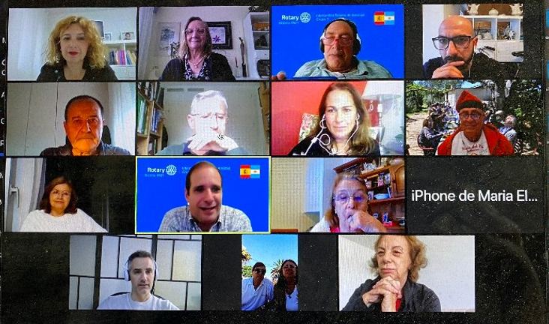
Rotary Friendship Exchange

Slide 2
Agenda
Rotary Friendship Exchanges
Exchange Guidelines
Virtual Exchanges
Rotary Friendship Exchange Themes
Culture-oriented Exchanges
Service-oriented Exchanges
Vocation-oriented Exchanges
District [Your # District] RFE
Resources and Support
Notes:
Exchange participants work together to determine all aspects of an exchange. Participants:
- Determine all details, including exchange location and dates, travel & housing, and the schedule itself
- Assume all financial responsibilities associated with program participation. Check with your club or district if funding is available to help offset expenses.
Secure travel insurance
After an exchange, participants are encouraged to submit a report to Rotary with program reactions, suggestions for improving relationships between the two countries , and what was learned about Rotary’s work in a different part of the world to inspire other Rotary districts to plan their own exchanges.

Slide 3
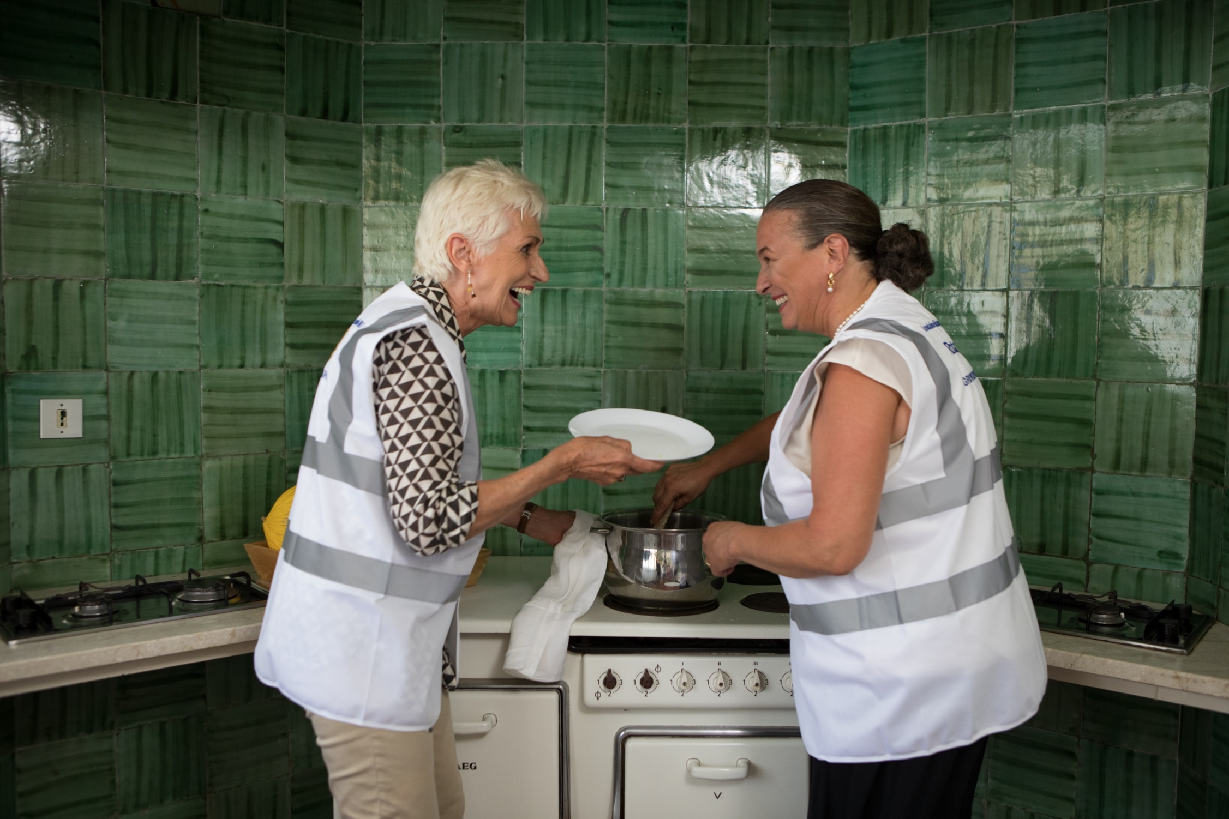
Rotary Friendship Exchanges
Rotary Friendship Exchanges: build goodwill, foster peace, strengthen international friendships, expand international understanding and create a more global community
Notes:
Rotary Friendship Exchange is an international program for Rotary members and friends that allows participants to take turns hosting one another in their homes and clubs. Exchanges allow Rotarians and non-Rotarians alike to
experience different cultures
broaden their international understanding
foster good will
explore their professions in a different context
build longstanding friendships
establish a foundation for peace and service

Slide 4
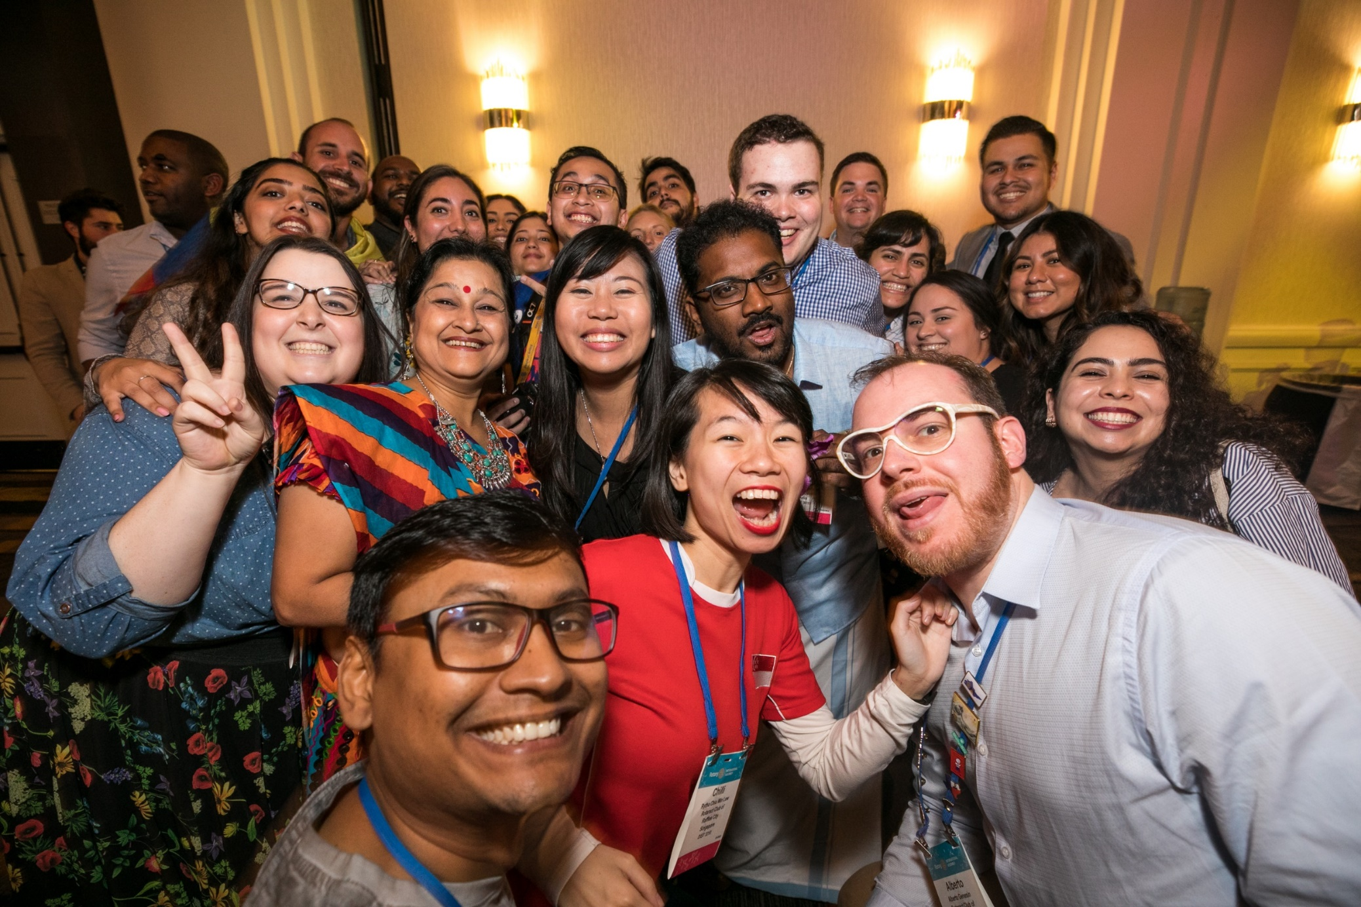
Exchange Guidelines
Exchanges are coordinated at the district level and reflect the interests and preferences of participants
Notes:
Exchange participants work together to determine all aspects of an exchange. Participants:
- Determine all details, including exchange location and dates, travel & housing, and the schedule itself
- Assume all financial responsibilities associated with program participation. Check with your club or district if funding is available to help offset expenses.
- Secure travel insurance
After an exchange, participants are encouraged to submit a report to Rotary with program reactions, suggestions for improving relationships between the two countries , and what was learned about Rotary’s work in a different part of the world to inspire other Rotary districts to plan their own exchanges.

Slide 5
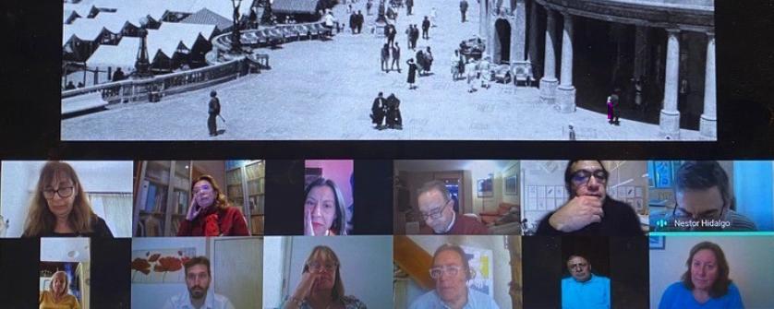
Virtual Exchanges
Share cultural traditions. Organize a virtual cooking class to introduce national dishes or take a virtual museum or landmark tour.
Introduce each other to local industries or how a specific profession is practiced in each community.
Collaborate on a digital service project, like offering online language classes.
Build relationships that can transition seamlessly to future in-person exchanges.

Slide 6
Rotary Friendship Exchange Themes
Culture: Experiences that highlight a region’s ethnicity, food, language, history, landmarks, hobbies through Rotary Fellowships, and more
Service: Opportunities for hands-on project involvement and support
Vocation: Exploring specific professions or jobs in a different cultural context
Notes:
Districts should structure exchanges around one (or more) of the following themes:
Cultural Exchanges: Experiences that highlight a regions ethnicity, food, language, history, and more
Service Exchanges: Opportunities for hands-on project involvement and support
Vocational Exchanges: Exploring specific professions or jobs in a different cultural contest
Trips often lead to long-term relationships between the two partnering districts, and clubs often form twin club relationships or find partners for global grants with clubs participating on exchanges.

Slide 7
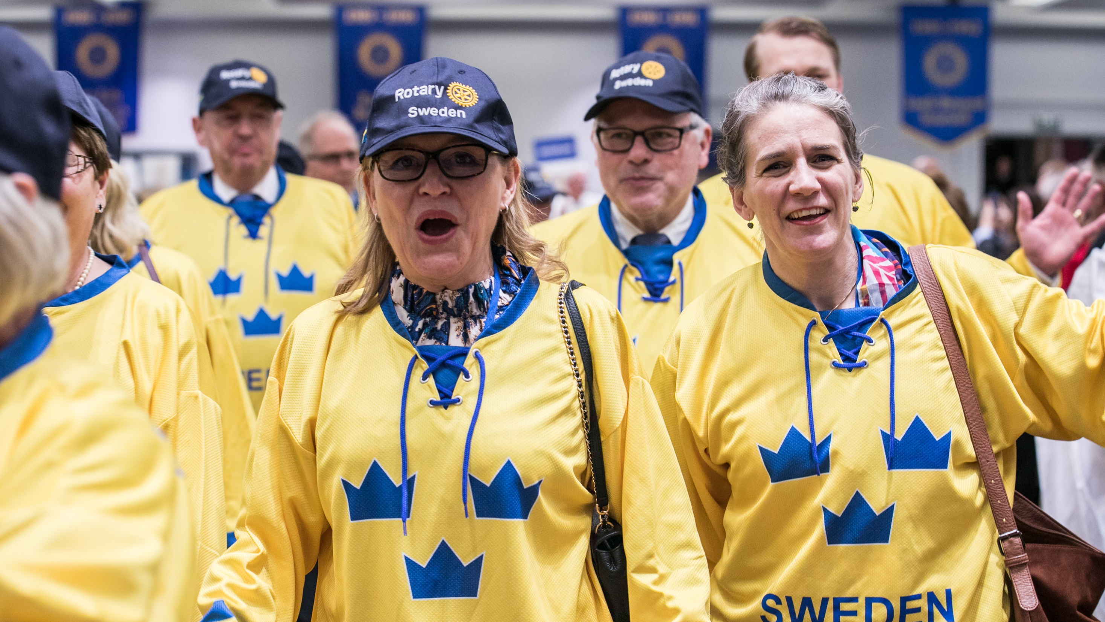
Group cultural exchanges

Slide 8
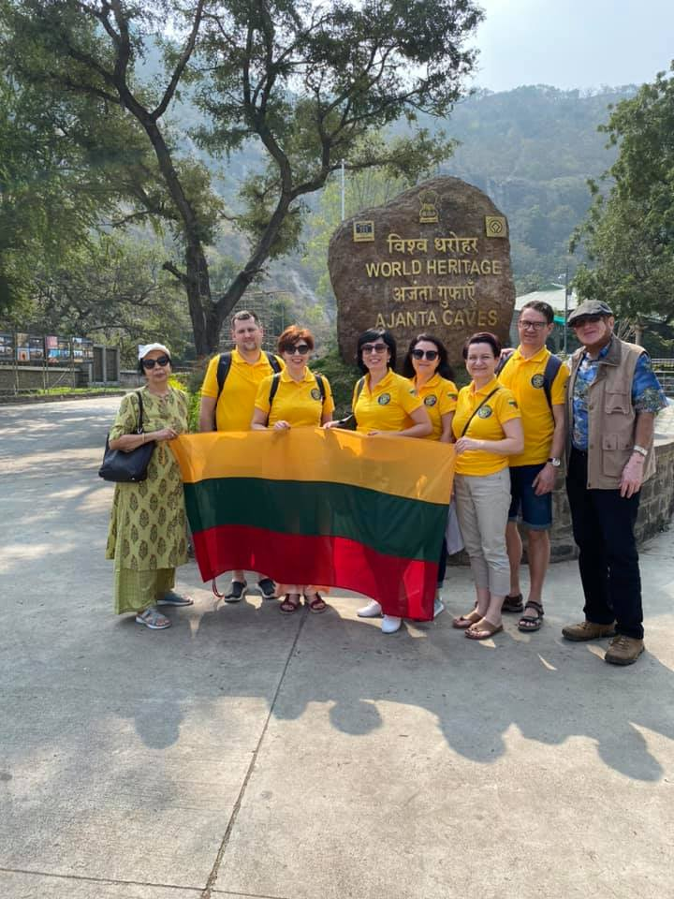
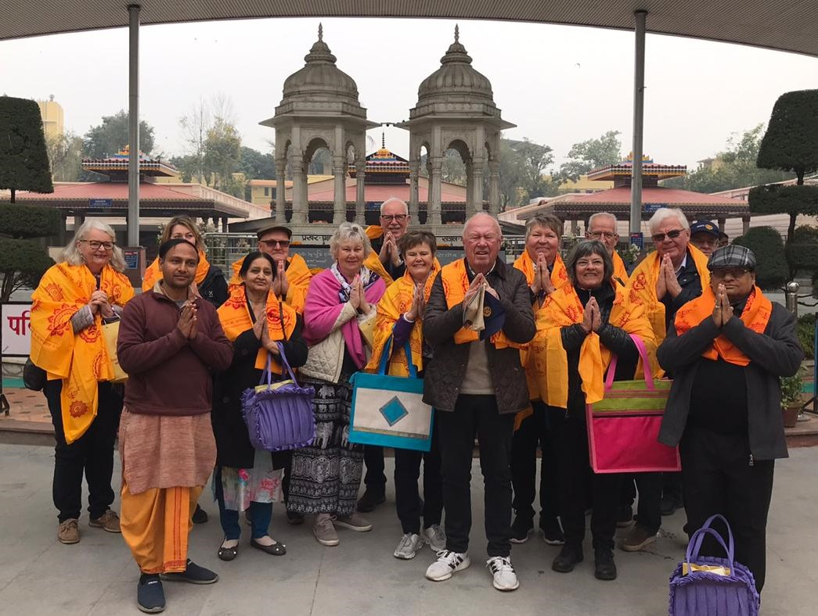

Group Cultural Exchanges
Notes:
As of July 2017, districts are encouraged to plan group cultural exchanges, a subset of RFEs. These types of exchanges place a particular emphasis on cultural immersion and ideally incorporate non-Rotarian young professionals, or those in the transitional stages of their career to help foster greater awareness, intercultural understanding, deeper connections, and a broader global mindset.

Slide 9
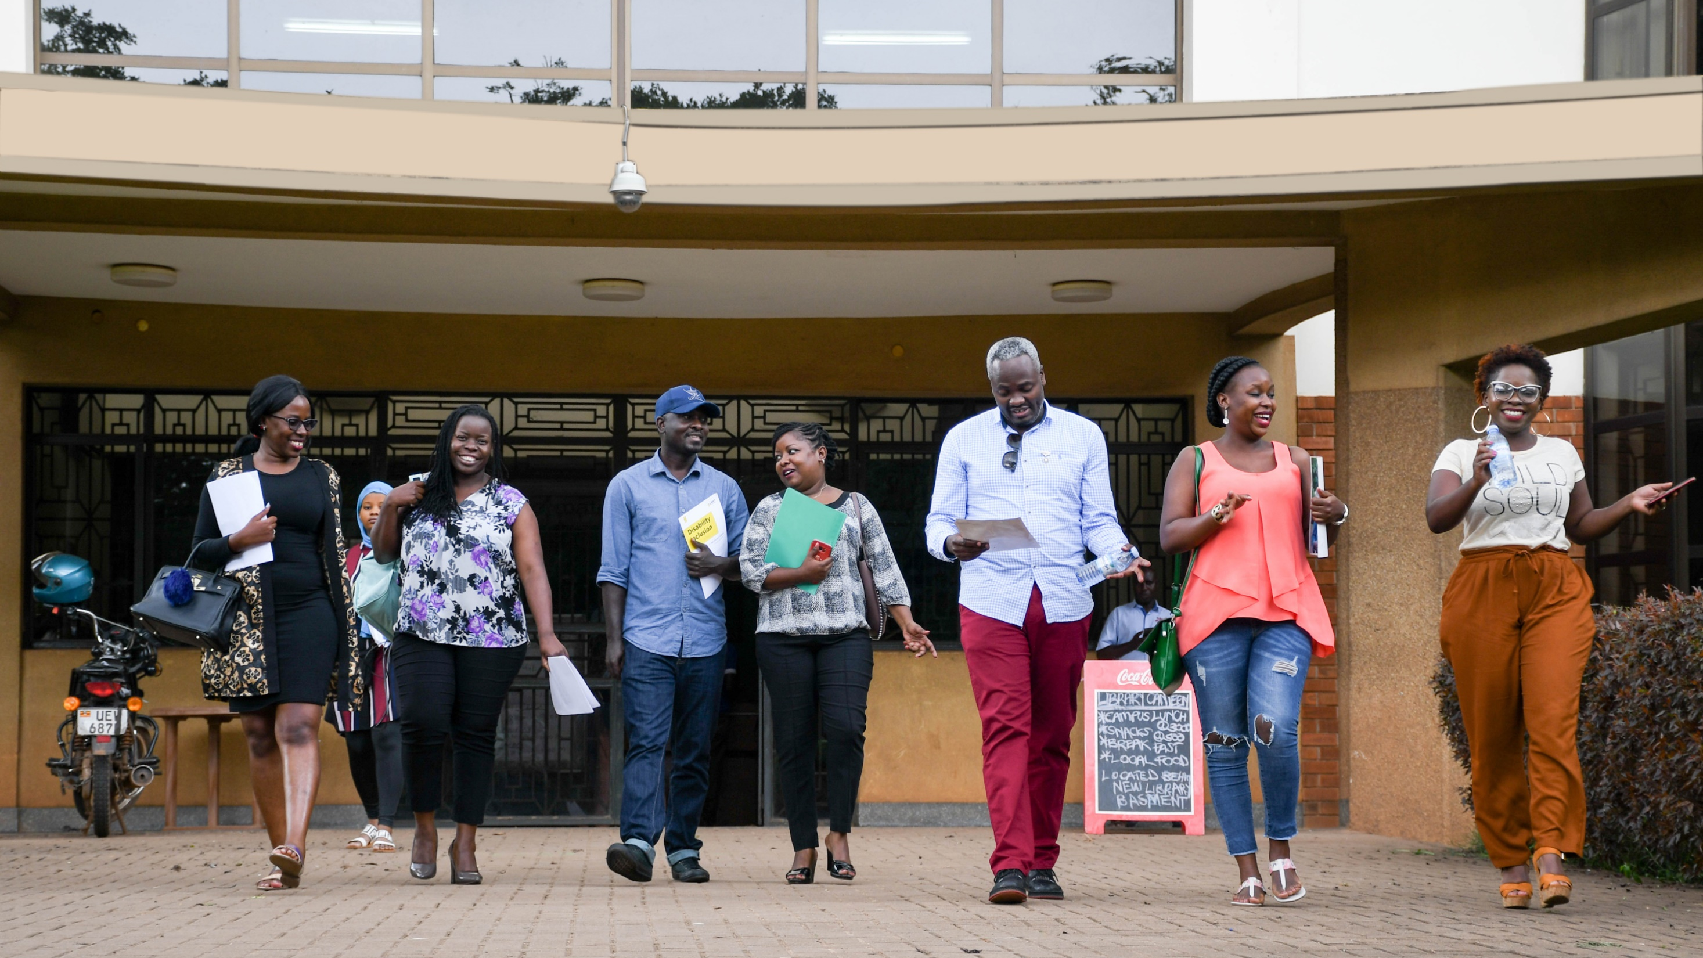
Rotary friendship exchange in action

Slide 10
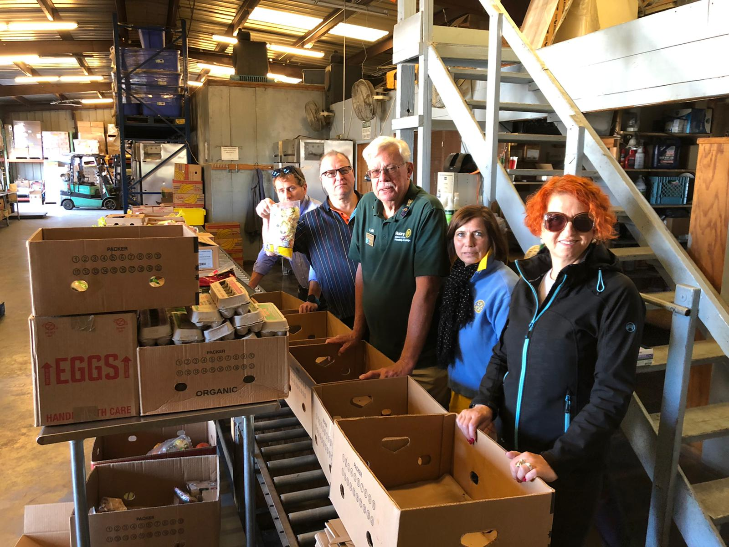
Service-oriented Exchanges
Teams from USA (District 5330) and India (District 3141) were warmly welcomed in Lithuania (District 1462) for an exchange in May of 2020.

Slide 11
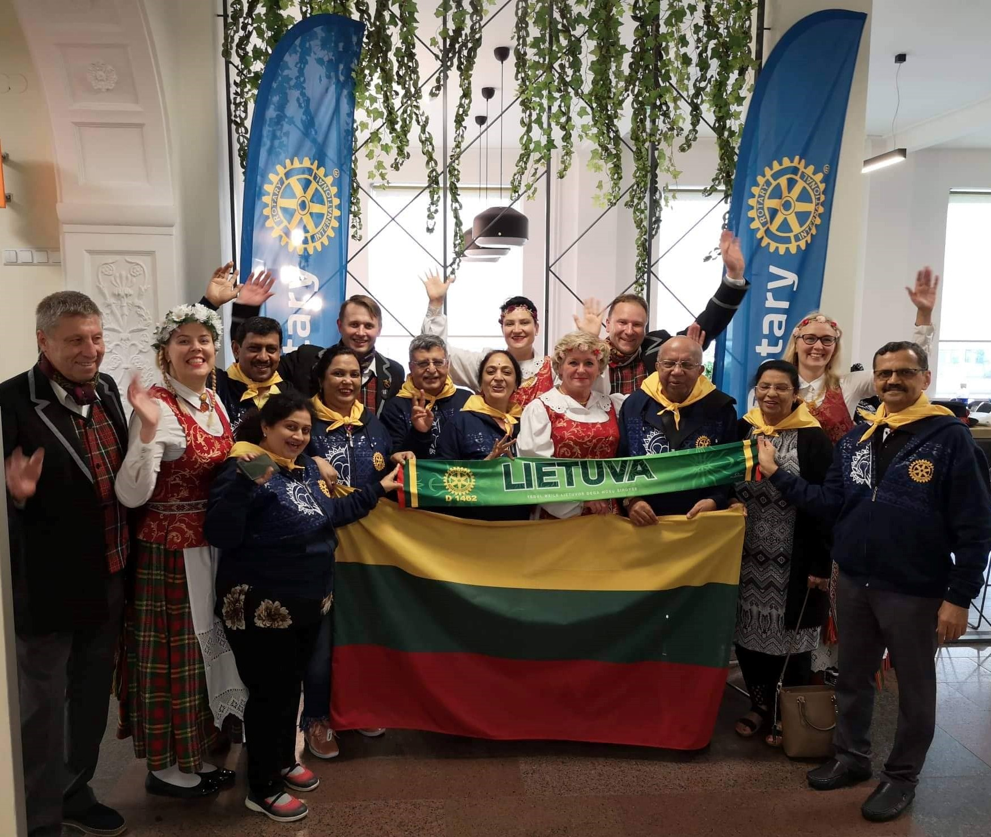
Culture-oriented Exchanges
Rotarians from India visit Lithuania and immerse themselves in the culture.

Slide 12
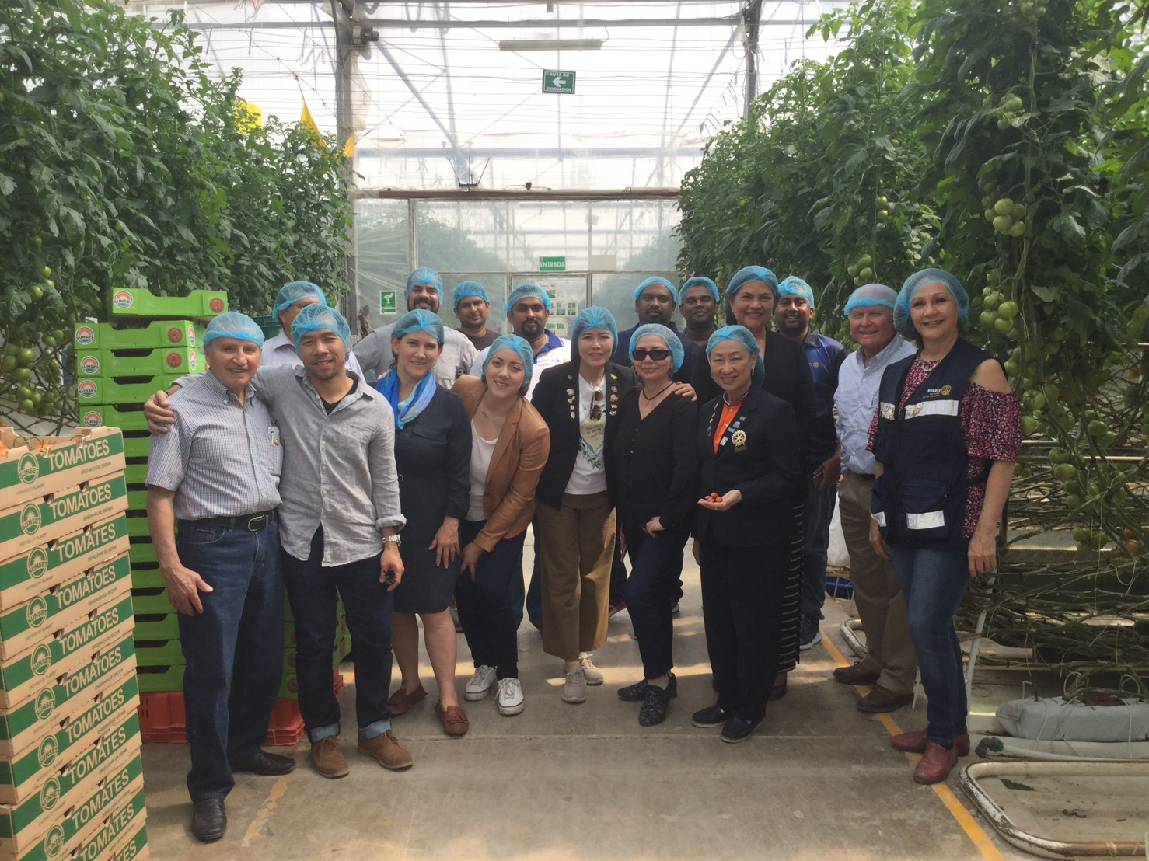
Vocation-oriented Exchanges
Rotarians from Thailand (District 3360) visited a greenhouse in Mexico while on an exchange.

Slide 13
District [#] RFE
[insert an example of how your district has previously participated in an exchange here]
or
[include information about how your district hopes to participate in the program over the coming year]

Slide 14
Resources and Support
For general program information, visit www.rotary.org/friendship-exchange
Interested in getting involved? Contact District [Your District #] Rotary Friendship Exchange Chair ____________
Questions? Contact your District’s Friendship Exchange Chair or Rotary International rotary.service@rotary.org

