Slide 1
Welcome !
Positive Peace

Slide 2


Rotary’s commitment
We're committed to treating everyone with dignity and respect, allowing everyone's voice to be heard, and providing equitable opportunities for fellowship, service, and leadership.
Notes:
Diversity is one of Rotary's longstanding core values and greatest strengths..
We hope to our district and clubs will have a greater focus on celebrating every individual's contributions, advancing equity, and creating a more welcoming and inclusive culture.

Slide 3
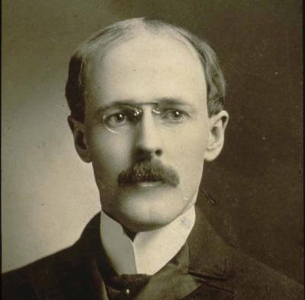
Paul Harris founded Rotary on the premise that Diversity is also about recognizing, respecting and valuing differences based on people of goodwill and diverse backgrounds should come together in the spirit of friendship to foster better understanding. He believed that clubs should represent and embrace the diversity in their communities.
“Our differences make us stronger; let's celebrate diversity.“ Paul Harris

Slide 4
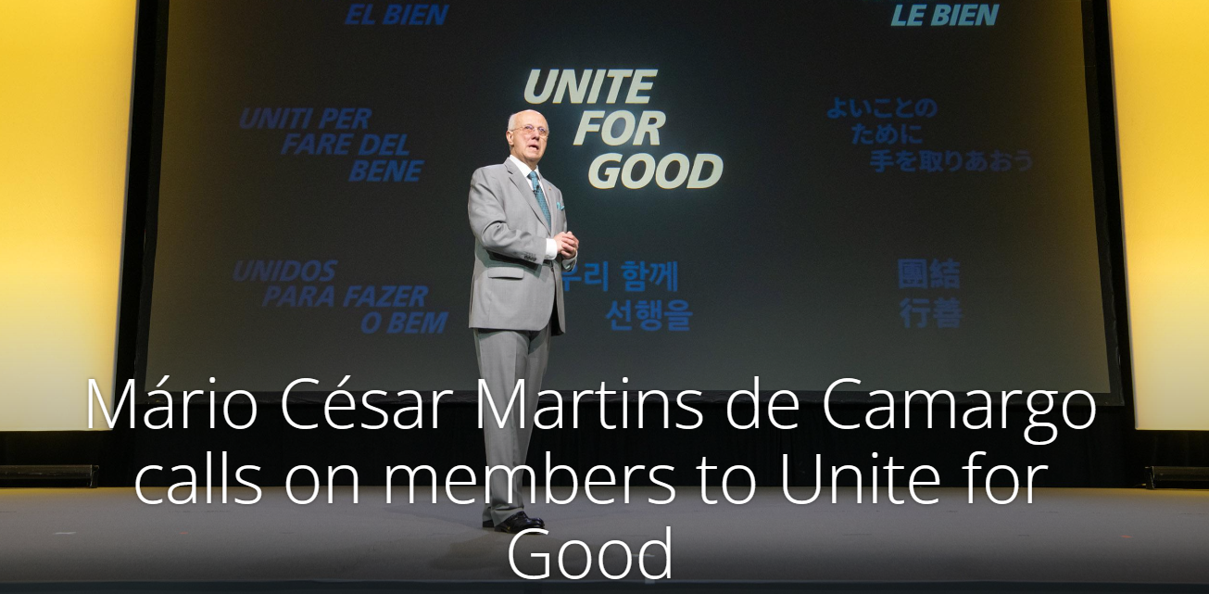
“In a world often divided, Rotary stands as a beacon of unity and hope,” de Camargo said. “Our projects bring together people of all races, religions, genders, ideologies, and economic backgrounds, uniting us in a shared purpose: to do good in the world. ... Let’s build a Rotary that unites for good and ensures a brighter future for all.” Feb 2025

Slide 5
Rotary’s DEI Code of Conduct
Rotary International's Board approved a new
DEI code of conduct that reflects our core values.
The DEI code of conduct asks Rotary members to:
Use respectful language
Be supportive
Foster a welcoming and inclusive environment
Celebrate diversity
Notes:
As you may know, DEI is nothing new to Rotary. Rotary in 1933 adopted a Tolerance of Differences and Paul Harris repeatedly iterated that Rotarians should respect each other’s opinions and be tolerant and friendly at all times. Today’s DEI Code of Conduct looks like this. It incorporates our core values. All club members and other participants including Rotary program participants, Alumni, project partners, and representatives of Rotary are expected to comply with this code of conduct, be considerate and contribute to a collaborative, positive, and healthy environment in which all are respected and valued.

Slide 6

Rotary’s DEI Statement
We value diversity and celebrate the contributions of people of all backgrounds, across age, ethnicity, race, color, disability, learning style, religion, faith, socioeconomic status, culture, marital status, languages spoken, sex, sexual orientation, and gender identity as well as differences in ideas, thoughts, values, and beliefs.
.

Slide 7
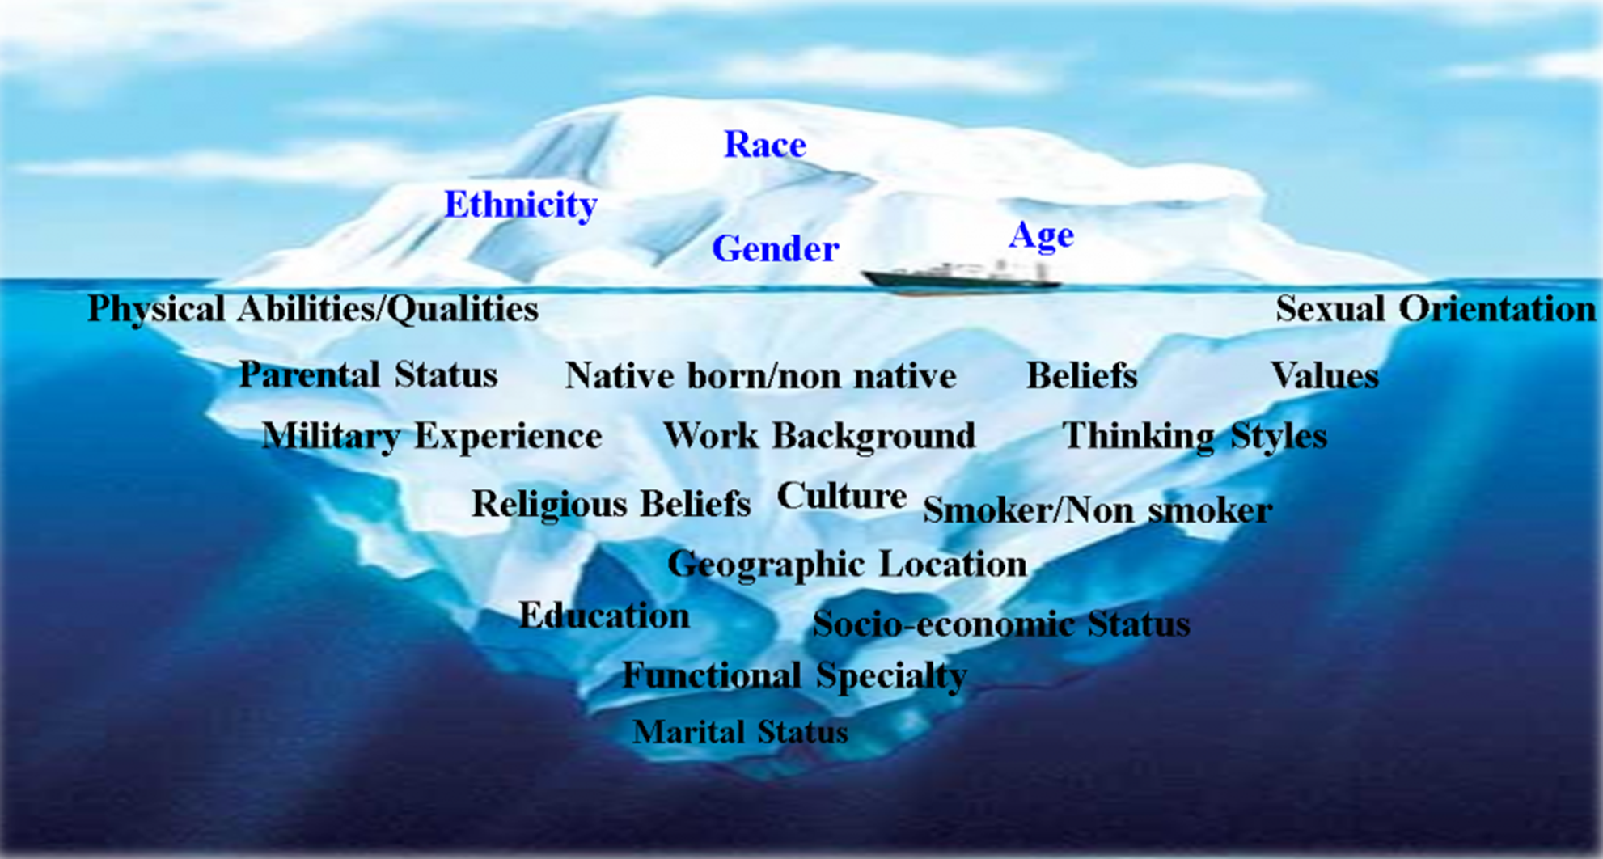

diversity
The strongest and most effective clubs reflect the demographics of the communities they serve.
What is the gender balance of your District?
How many members are under the age of 40?
Is the ethnic makeup of your community represented in your District?
Do your District’s leaders reflect the diversity based on its members?
Are different perspectives welcomed?

Slide 8
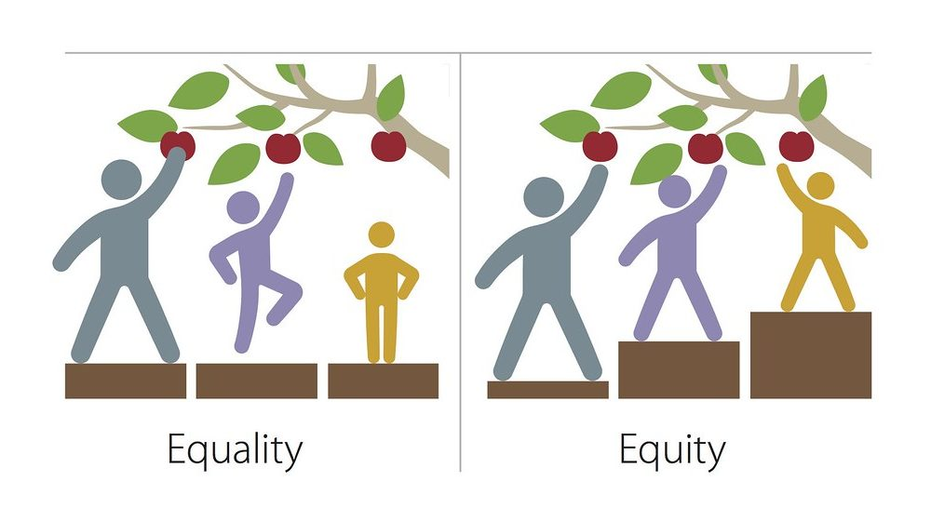

Slide 9
Inclusion – Share the gift of Rotary
How can the Clubs be more inclusive?
  Regular meetings
  Service Projects
  Social Media
  Policies
  Events
  Find opportunities to make your clubs more inclusive
Notes:
And the I is for inclusion. This one might be the hardest to work on.
When you assess your club culture, you may find it complex.
Each member's behavior and actions contribute to it, and it will take time and effort to create a culture of inclusion. Look at various facets of your club to help you find opportunities to make it more inclusive

Slide 10

As a humanitarian organization, peace is a cornerstone of our mission. We believe when people work to create peace in their communities, that change can have a global effect.
Notes:
By carrying out service projects and supporting peace fellowships and scholarships, our members take action to address the underlying causes of conflict, including poverty, discrimination, ethnic tension, lack of access to education, and unequal distribution of resources.
Our commitment to peacebuilding today answers new challenges: how we can make the greatest possible impact and how we can achieve our vision of lasting change. We are approaching the concept of peace with greater cohesion and inclusivity, broadening the scope of what we mean by peacebuilding, and finding more ways for people to get involved.

Slide 11
WHAT IS PEACE
At its most basic, peace is an open and nonviolent way of being. Peace is both a state of mind and a state of society, encompassing a wide range of actions. Martin Luther King Jr. imagined peace as unfolding in a straight line — running from “inner peace,” based in the heart, to family, community, nation, and the world. Peace is associated with a range of values, from kindness and justice to safety, security, and freedom

Slide 12
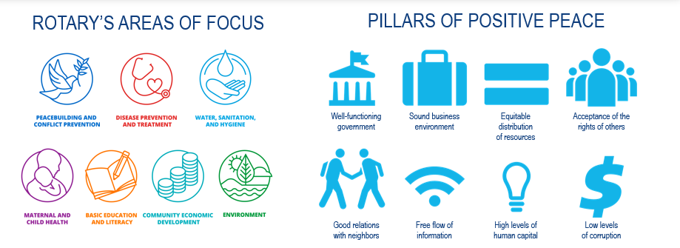
Positive peace

Slide 14
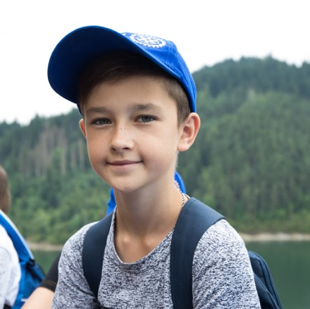
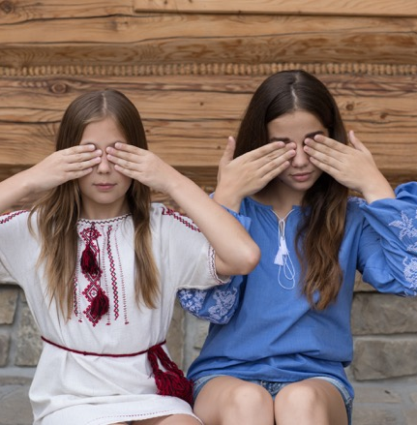
INTERCOUNTRY COMMITTEES
The Poland-Ukraine Intercountry Committee organized a summer camp for children affected by the conflict in Ukraine in 2014.
In addition to activities and field trips, the campers received counseling to help deal with their feelings.
ICC members raised money to pay for the travel and lodging expenses of the children and their caretakers.
Learn how an ICC can help your club.

Slide 15
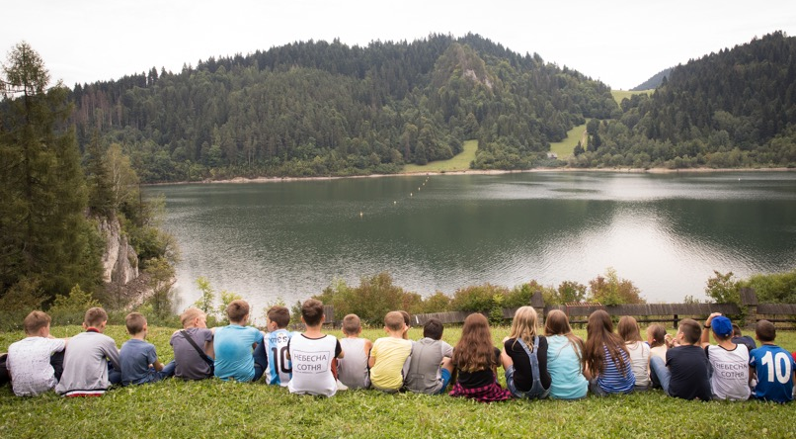
INTERCOUNTRY COMMITTEES
“Sometimes the best peace projects don’t focus on the conflict itself, but rather initiate communication and cooperation between two parties…. Intercountry meetings and projects not only lead to better understanding between Rotary and Rotaract members, but can also act as a catalyst for clubs within a country with a long-standing history of internal conflict.”
~ Toni Polsterer, Rotary Club of Wien-Nordost, Austria

Slide 16
FRIENDSHIP EXCHANGE
Rotary Friendship Exchange allows Rotary members and their friends to explore new cultures and discover diverse perspectives while staying in the homes of international hosts.
Exchanges are reciprocal and can include cultural experiences, vocational activities, and hands-on service projects.
Participants often discover new partners for lasting change through their exchanges. More than 300 Rotary Friendship Exchanges are organized every year.

Slide 17
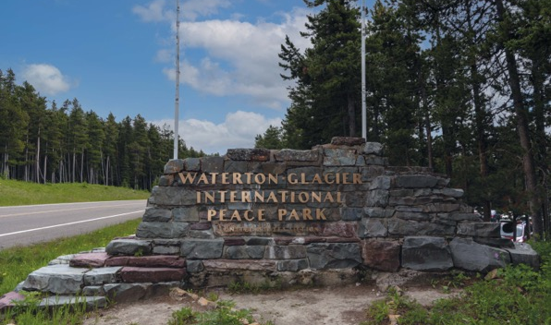
FRIENDSHIP EXCHANGE
The idea for the Indus Peace Park on the border of India and Pakistan came about after a Rotary Friendship Exchange group from Canada visited Pakistan in 2015 and participants learned that because of security considerations, they couldn’t attend a changing of the guard ceremony on the border with India.
Group leader Kees van der Pol, a Rotarian from British Columbia who’s a director of the Waterton-Glacier International Peace Park on the U.S.-Canadian border, suggested creating a new park.
Once the park is finished, the goal is for the park to be a place where Indians and Pakistanis can celebrate and share their cultures through dialogue, literature, religion, dance, music, history, and art.
Learn more about Rotary Friendship Exchange.

Slide 18
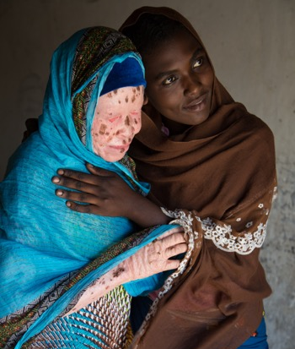
ROTARY FELLOWSHIPS
Rotary Fellowships are international, independently organized groups that form around a common interest, vocation, or recreational activity.
They also foster international connections, friendships, and understanding across cultures and geographies.
These groups, such as the International Fellowship of Healthcare Professionals, the LGBT+ Fellowship, or the Fellowship for Global Development, give people a chance to explore issues they’re committed to, making connections around the world, while also creating more peaceful societies.
Learn more about Rotary Fellowships.

Slide 19
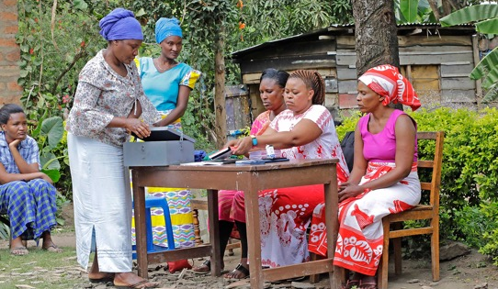
ROTARY FELLOWSHIPS
INTERNATIONAL ROTARY FELLOWSHIP OF HEALTHCARE PROFESSIONALS
The International Rotary Fellowship of Healthcare Professionals uses their professional skills and the global network of medical workers in Rotary to help people with albinism in Tanzania who are marginalized and discriminated against.
ROTARY FELLOWSHIP FOR GLOBAL DEVELOPMENT
Through learning and networking opportunities, the Rotary Fellowship for Global Development encourages Rotarians and other individuals to support global development in the context of the Sustainable Development Goals.
The fellowship organizes seminars and learning events, maintains a newsletter/blog related to various aspects of global development, and organizes networking opportunities for its members.

Slide 20
ROTARY FELLOWSHIPS
To have a fellowship where I can meet and visit — virtually now — with other gay Rotarians in a completely “out” environment really affirms that we are now completely included in Rotary.
~ Valleri Crabtree, Rotary Club of Wellston, Ohio

Slide 21
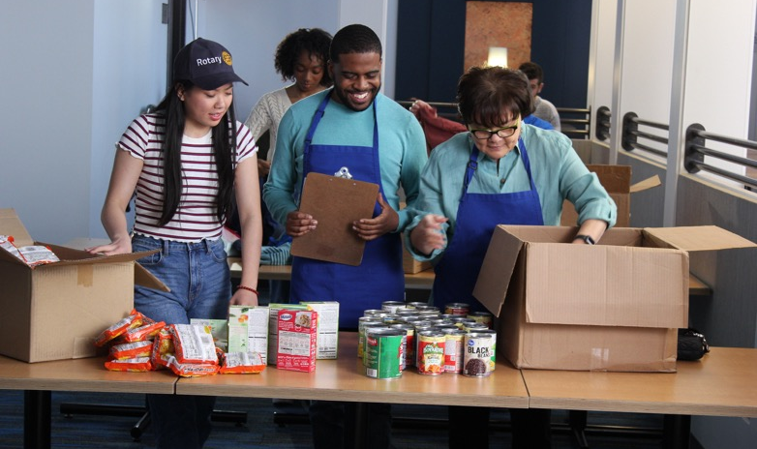
ROTARY YOUTH EXCHANGE
Each year, Rotary Youth Exchange gives thousands of students the opportunity to experience life in another part of the world.
During their exchanges, students develop new skills, build lifelong friendships, and gain a new perspective on themselves and the people around them that fosters an understanding and appreciation of different cultures.
Rotary Youth Exchange inspires young leaders to serve as catalysts for peace and social justice in their local communities and throughout the world, long after their exchanges end.

Slide 22

Peacebuilder Clubs
The Peacebuilder Club program is designed to enhance Rotary International’s mission of, “advancing world understanding, goodwill and peace” through the promotion of programs and projects that align with our organization’s Seven Areas of Focus – in particular, the first: Peace, Conflict Prevention and Conflict Resolution.

Slide 23
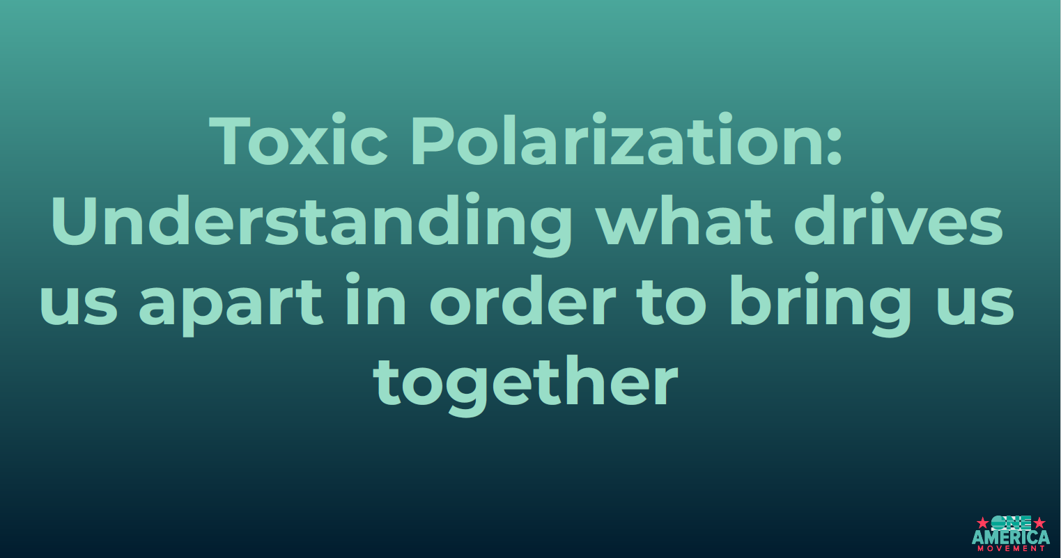

Notes:
There is sentiment that the U.S. is suffering from Toxic Polarization and it is poisoning America. Rotary is one of the largest peacebuilding organizations in the world, united across
the globe in a spirit of friendship and curiosity about our many cultures and lived
experiences. For this reason, Rotary is uniquely positioned as a place to deal with
societal divisions with grace and healing towards each other and our fellow citizens.

Slide 24
In this quote, Paul P Harris highlights the incredible power that lies within unity. He emphasizes the importance of individuals coming together and working collectively towards a common goal – building a better world. Harris acknowledges that solving the complex challenges we face today requires collective effort, which can only be achieved through unity. By setting aside personal differences, embracing diversity, and pooling our strengths, we can create a harmonious and prosperous global community. In a world plagued by division and conflict, Harris's words serve as a call to action for individuals to join forces and work collaboratively to create a brighter future for all.

Slide 25
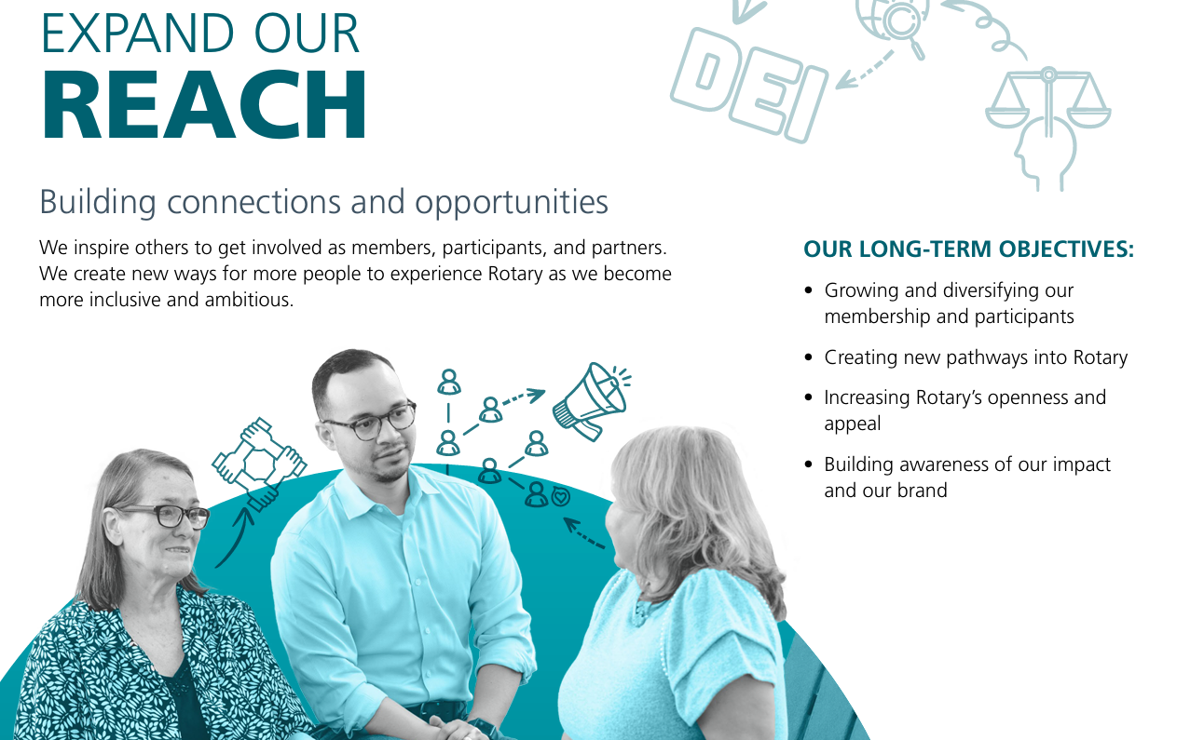
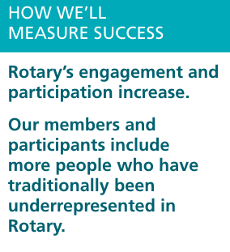
Action Plan – Expand your Reach

Slide 26
Revised Standard Club constition
Article 9 Club Membership Composition:
Section 1 — General Provisions. Each member shall be classified in accordance with the member’s business, profession, occupation, or community service.
Section 2 —Diverse Club Membership. This club’s membership should represent a cross section of the businesses, professions, occupations, and civic organizations in its community, including age, gender, and ethnic diversity.
Article 10 Attendance Section 1 — General Provisions. Each member should attend this club’s regular meetings, or its satellite club’s regular meetings, and engage in this club’s service projects, events, and other activities.
Notes:
Rotary, in June 2022, revised the standard Rotary club constitution. Even though the rules on classification and attendance have been relaxed, it is recommended to look at the composition of the club to keep DEI in mind by reflecting the demographics of the community served

Slide 27


Slide 28
Positive peace

Slide 29
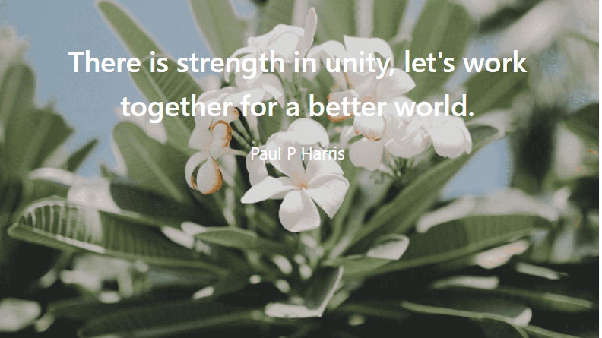

Slide 30


Slide 31
Thank You!

