Slide 1

ROTARY STRUCTURE
CLUBS, ZONE & INTERNATIONAL
Notes:
Did you all have your coffee because we have a lot to cover today. There are a lot of slides, but don’t worry, this powerpoint and recording will be available for you to refer to.

Slide 2
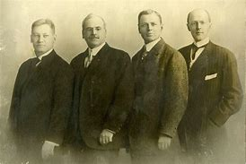

ROTARY WAS STARTED IN 1905
in Chicago by an attorney named Paul Harris.
Founding years focused on building an organization that encouraged friendship and service.
Title Page Option
Notes:
On February 23, 1905, Paul Harris, Gustavus Loehr, Silvester Schiele and Hiram Shorey gathered at Loehr’s office in Room 711 of the Unity Building in downtown Chicago. This was the first Rotary Club meeting. They decided to call the new club “Rotary” after the practice of rotating meeting locations

Slide 3

Rotary International Vision Statement
Notes:
Rotary adopted this vision statement in June of 2017 as a first step in our 2019-2022 strategic plan. The new RI Strategic Plan was approved in 2019 and went into effect as of 1 July 2019.

Slide 4
Our mission
We provide service to others, promote integrity, and advance world understanding, goodwill, and peace through our fellowship of business, professional, and community leaders.
Notes:
This is our mission

Slide 5

Our core values
Notes:
Rotary and Rotarians are grounded in the core values. These are reasons that we are Rotarians. As leaders we see the bigger picture. Why did you want to be Club President, why are you here in the Leadership Academy?

Slide 6
ROTARY’S STRUCTURE
Notes:
When we talk about Rotary’s leadership, let’s first understand the structure of Rotary

Slide 7

Rotary’s Structure in 3 Parts:
The operations of a Club are overseen by its Board. The Club is an “Unincorporated Organization” for DCCA and falls under RI’s 501(c)(4) umbrella with IRS.
The operations of Rotary International, a member organization, are overseen by its Board of Directors. 501(c)(4)
The Rotary Foundation is organized as a public charity operated exclusively for charitable purposes and governed by a Board of Trustees. 501(c)(3)
Notes:
The District is here to support the clubs, so if you want to visualize this, picture the President and club at the top of the pyramid. The district is the support, the foundation for the clubs and it is our responsibility to support the clubs. So let’s start with the structure of clubs.

Slide 8

The Stats – Rotary international
36,664 Rotary Clubs
1,156,520 Rotary Members
9,826 Rotaract Clubs
151,919 Rotaractors
14,900 Interact Clubs
343,000 Interactors
529 Districts
34 Zones
200 Countries
(as of September 19, 2026)

Slide 9
Clubs

Slide 10
Club Structure
Organized in the Club Leadership Plan
  President
  President-Elect
  Secretary
  Treasurer
  Directors/Committees
Notes:
The Legislative Council has suggested that clubs reorganize to align with the RI and District Leadership Plans.
This is not mandatory. Clubs can opt to not reorganize but if they do change to the club leadership plan, the club will have to make sure that the clubs by-laws and other documents are revised too.
The Club Leadership Plan encourages and utilizes the following best practices of Rotary clubs worldwide:
The CLP follows on the success of the District Leadership Plan.
Develop long-range goals that address the elements of an effective club.
Set annual goals that support long-range goals.
Make sure that all club members feel involved and informed.
Keep the lines of communication open, both in the club and with the district.
Ensure continuity in leadership from year to year.
Customize the bylaws to reflect club operations.
Provide regular fellowship opportunities.
Actively involve all club members.
Offer regular and consistent training

Slide 11

Club Committees
Recommended club committees:
Club administration
Membership
Public image
Rotary Foundation
Service projects
And a Club Learning Facilitator (fka as Club Trainer)
Notes:
Committees coordinate their efforts to achieve the club’s annual and long-term goals which should be set at least annually and coordinated across years.
Club administration committee is responsible for:
The role of the club administration committee is to conduct activities associated with the effective operation of the club. It is only through efficient club operations that a Rotary club can provide service to its community, retain members, and develop leaders for the club, district, and Rotary International.
The responsibilities of the club administration committee are:
• Develop committee goals to achieve club’s annual goals.
• Organize weekly and special programs.
• Produce the club bulletin and maintain the club Web site.
• Help the club secretary track club attendance.
• Promote fellowship among club members.
• Conduct any other activities associated with the effective operation of the club.
Membership – retention and attracting new members; facilitating current and future members
Public Image – public relations and marketing – how to get in the news and raise the club’s profile
Foundation – raising $$ for TRF
Service Projects – developing and administering club service projects that may include global or district grants as well as local service provided to the community outside of any RI or TRF projects or programs.

Slide 12
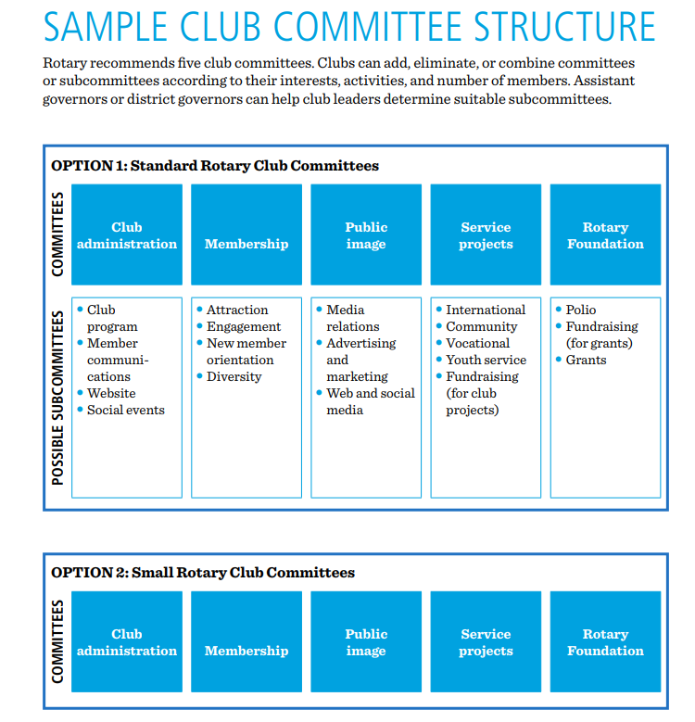

Club Structure

Slide 13

The Four Elements of Effective Clubs
Effective Clubs are able to
Sustain
and
Grow Membership
Implement
Successful
Service
Projects
Support
the
Rotary
Foundation
Develop Club Leaders
to Serve Beyond the Club Level
Efficient Club Administration
Foundation of Fellowship and Service

Slide 14
Zone Structure

Slide 15
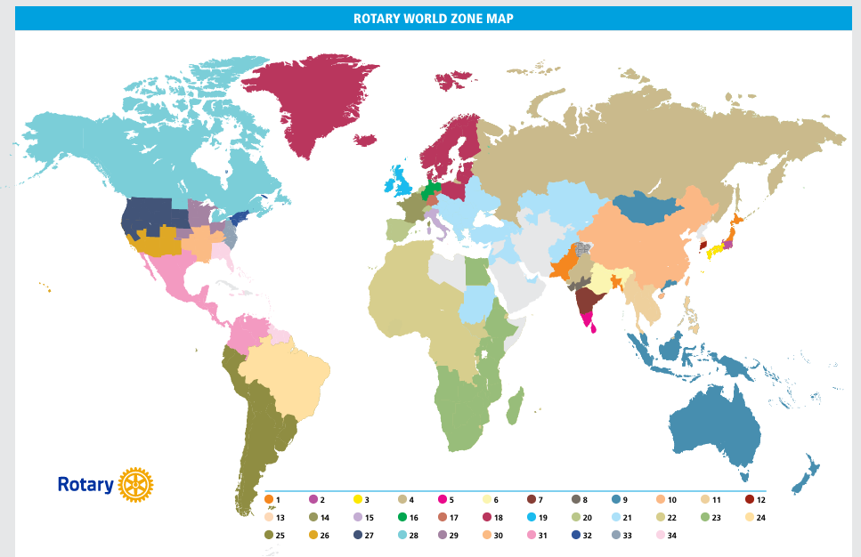
Rotary Zones

Slide 16
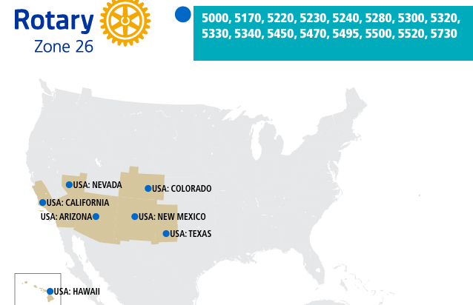
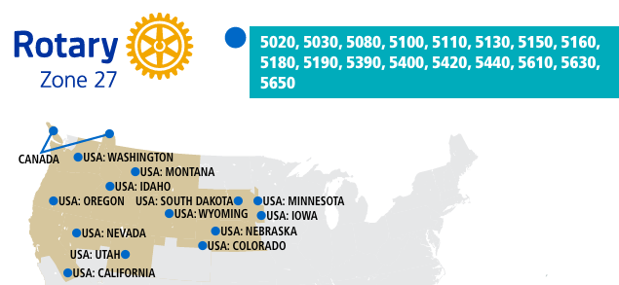
Zones 26 & 27
We are in Zone 26 & 27 with 30 Districts in Canada, along the west coast to Texas, Colorado, Minnesota and Iowa.

Slide 17
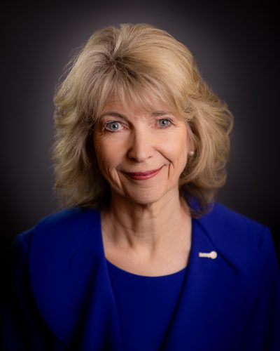
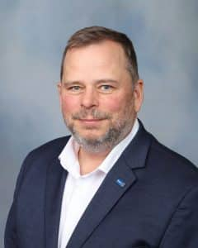
Wyn Spiller
JOHN CHASE
Rotary International Director, 2027-2029 Rotary Club of Boulder City, Nevada
Rotary International Director, 2025-2027
Rotary Club of Grass Valley, California
Notes:
On the Zone level, they support the Districts with information and assistance. We are in Zone 26 and combined with Zone 27, there are 14 states, 30 districts and 1,700 clubs. The Zone training team trains the District Governors Elect and Nominees. They have a Zone Institute each year, which by the way, is going be in-person in Dan Diego this November. Zone Institute is like spring training assembly on steroids and is now open to any Rotarian who like to attend. You meet people who are really deep into Rotary and this year is open to any Rotarian who wants to attend.

Slide 18
RI Director – Nominated by the Zone
Past district governors are eligible to serve on the Board, but at least three years must have elapsed since the end of their term as governor.
Candidates must have attended two Rotary institutes and a Rotary convention in the previous three years.
Each director serves for two years.
Notes:
The District votes every other year to nominate an RI Director and this is done at the District Conference.

Slide 19
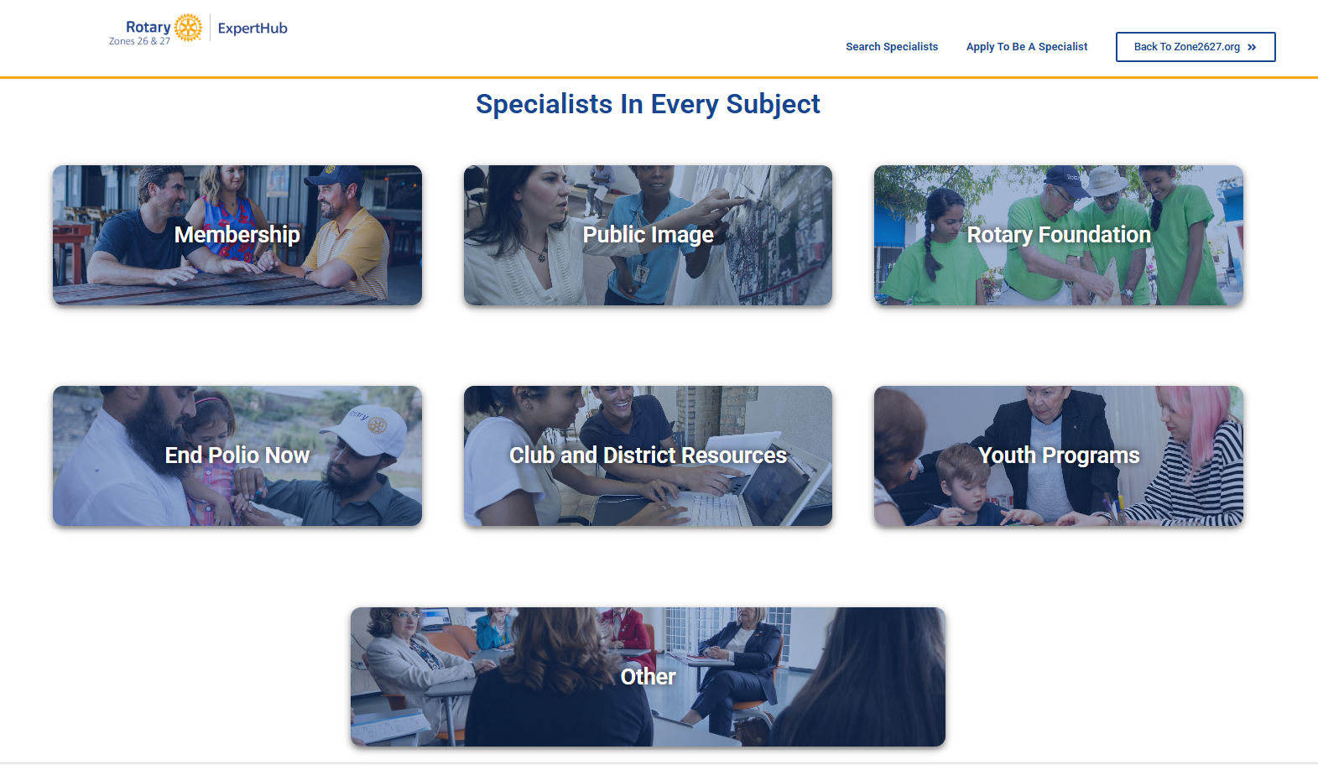
zone2627.org – Zone Resources

Slide 20
Regional Leaders – Subject Matter Experts
Regional leaders are appointed by the RI president or The Rotary Foundation trustee chair and serve a three-year term. The regional leaders are:
Regional Rotary Foundation coordinators (RRFCs) assist clubs and districts in fundraising and can support them through Rotary’s grant system. They also encourage Rotarians to support PolioPlus and the Annual Fund.
Rotary coordinators (RCs) help clubs develop new strategies to attract and engage members. They also support district efforts to establish new clubs.
Rotary public image coordinators (RPICs) provide marketing, media outreach, and social media advice to clubs and districts and help them implement Rotary’s public image campaigns.
Endowment/major gifts advisers (E/MGAs) promote major giving opportunities to Rotarians and other community donors.
Notes:
Rotary’s regional leaders use their skills to support and strengthen clubs, focus and increase Rotary’s humanitarian service, and enhance and heighten Rotary’s public image.

Slide 21

Annual Zone Institute : https://zoneinstitute.org/
November 11-13, 2027
Grand Sierra Resort
Reno, Nevada

Slide 22
Rotary International

Slide 23
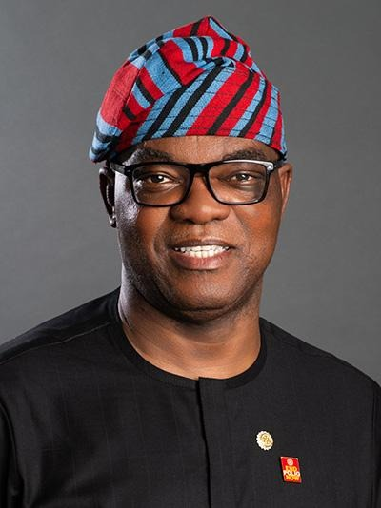
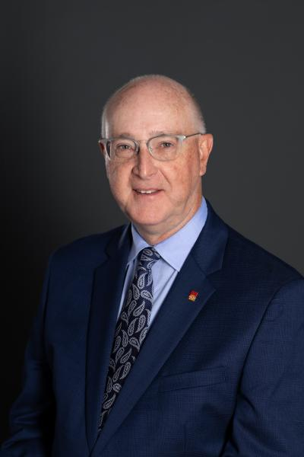
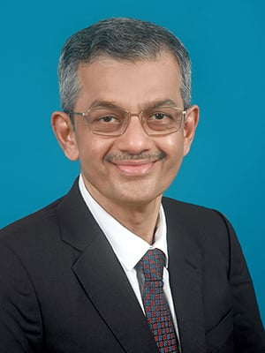
Rotary International president
Olayinka Hakeem Babalola Larry Lunsford Bharat Pandya
2026-2027 2027-2028 2028-2029
Rotary Club of Trans Amadi Rotary Club of Kansas City-Plaza Rotary Club of Borivli, Mumbai
Nigeria USA India

Slide 24

Annual Rotary message
(not theme)
Our 2026-27 message, Create Lasting Impact, encourages all of us, as people of action, to work together to make a meaningful difference in our communities and around the world.

Slide 25
RI President
The official requirements to become president of Rotary International are actually pretty simple:
serve as club president, district governor, and on Rotary’s Board of Directors.
most RI presidents have held additional leadership roles, including serving on committees that offer international experience.

Slide 26
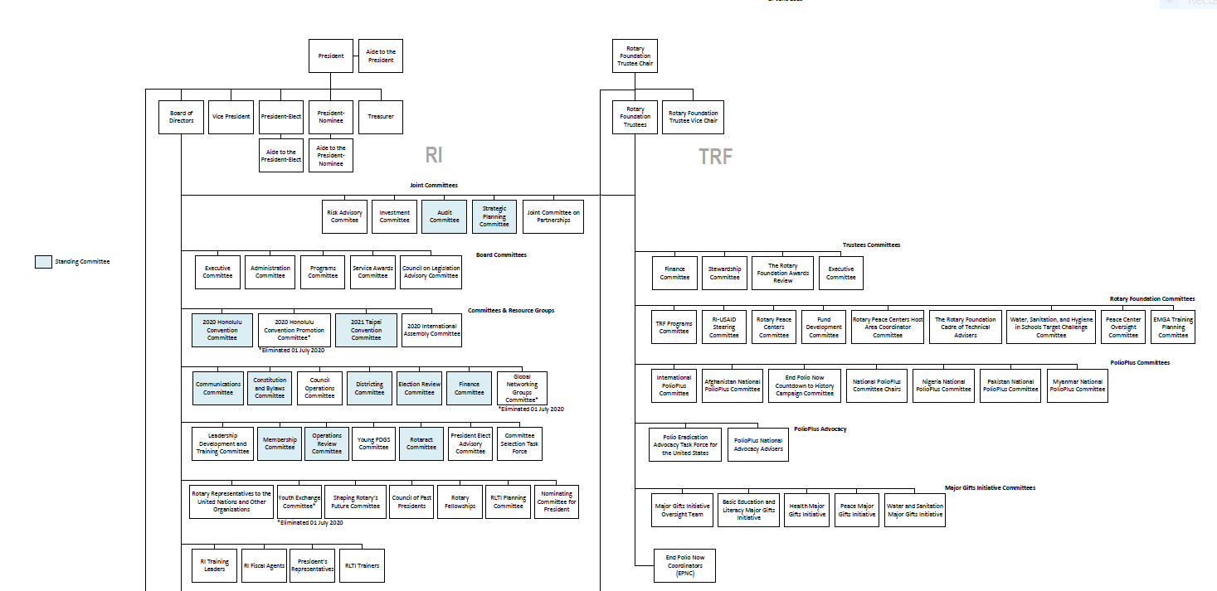
Governance – Committee Structure
Notes:
There are two boards
RI Board of Directors
governs the totality of Rotary International including TRF, RI the federation of clubs, and the general secretary which supports RI & TRF.
The RI President is the highest office in the organization and serves a 1-year term.
President is selected by a worldwide nominating process
There are 19 board members representing the membership geographically and culturally
Each director serves a 2-year term.
The Rotary Foundation Board of Trustees
governs the programs, philanthropy and fundraising requirements of the 501C3 charitable organization.
The Trustee Chair is the highest office in the Foundation and serves a 1 year term.
Trustees are elected by the RI Board from a list of recommendations from the President-elect.
Trustees serve for 4 years; There are 15 trustees
There is no formal geographic or cultural alignment of the Trustees.
TRF is a corporate member of Rotary International and is ultimately governed by the RI Board of Directors.
The boards are made up of lifelong, committed Rotarian Volunteers.
Both boards operate a variety of committees whose work generally align with organizational strategy and Rotary’s business groups.
There are several joint committees including the SPC, Finance (2 committees collaborating jointly) & Partnerships.
Note: There are no plans at this time to consolidate boards as a result of moving the entire organizations to 501c3.
Note that the Rotary President, District Governors and Club presidents all serve one-year terms. However, the governance structure allows for a nominee year, an “elect” year and then the “sitting” year. In essence, the Presidents have 3 years working on their presidential/trustee chair years.

Slide 27

Rotary Conventions convention.rotary.org
RI Conventions:
June 13-17, 2026 | RI Convention in Taipei, Taiwan
June 26-30, 2027 | RI Convention in Barcelona, Spain
May 27-31, 2028 | Minneapolis, Minnesota
June 23-27, 2029 | Dubai, UAE
May 25-29, 2030 | Chicago (Rotary's 125th anniversary)
June 7-11, 2031 | Dublin, Ireland
2032 | RI Convention in Honolulu

Slide 28
Governance Structure

Slide 29
Rotary International – RI-TRF-GS
Rotary International
The Rotary Foundation
General Secretary
RI
Notes:
Rotary International is the umbrella organization.
It has 3 distinct operational areas:
Rotary International, which is the federation of 37,000+ + clubs
501c4 – Non-profit, advocacy organization
Support RI’s clubs and districts in their pursuit of programs and activities that promote “the object of Rotary.”
Encourage, promote, extend and supervise Rotary throughout the world to help clubs grow, prosper and serve their communities.
Coordinate and generally direct the activities of RI.
The Rotary Foundation is our giving arm. 501 c3
Funds humanitarian activities from local service projects to global initiatives including our flagship project – Polio Eradication
In 2019 the COL approved RI’s move from a 501c4 to a 501c3 organization. How that will be implemented, and the ramifications are still TBD.
The general secretary
operational support system for both RI and TRF
Provides club and program support
facilitates fundraising, receiving contributions in dozens of currencies,
provides language interpretation, translation and communication services in 7 official languages
provides marketing, international finance and investment and
Provides senior leader support.

Slide 30
Rotary International Leaders with a staff of 650
President (1 year term)
TRF Trustee Chair (1 year)
General Secretary and CEO John Hewko
Executive Staff
Directors (2 years)
Trustees (4 years)
Regional Leaders (3 years, annual review)

Slide 31
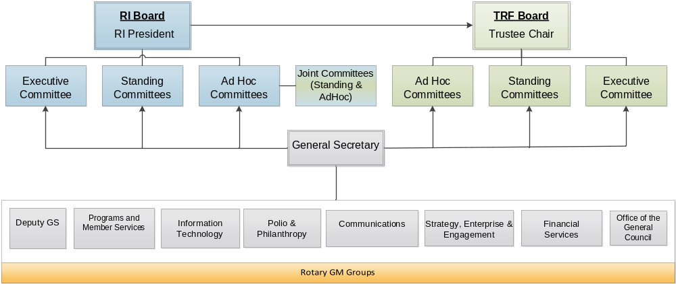
RI’s Organizational Chart
Notes:
Here is the org chart to see how the positions entertwine.
The General Secretary is the operational arm of the two boards and is responsible for carrying out board decisions. The general secretary’s office is organized around 8 business units whose general managers all report to the General Secretary, John Hewko. There are 819 Rotary staff members, have 6 international offices (Europe & Africa; Japan, Korea, Australia, India, Brazil) and 49 languages are spoken.

Slide 32
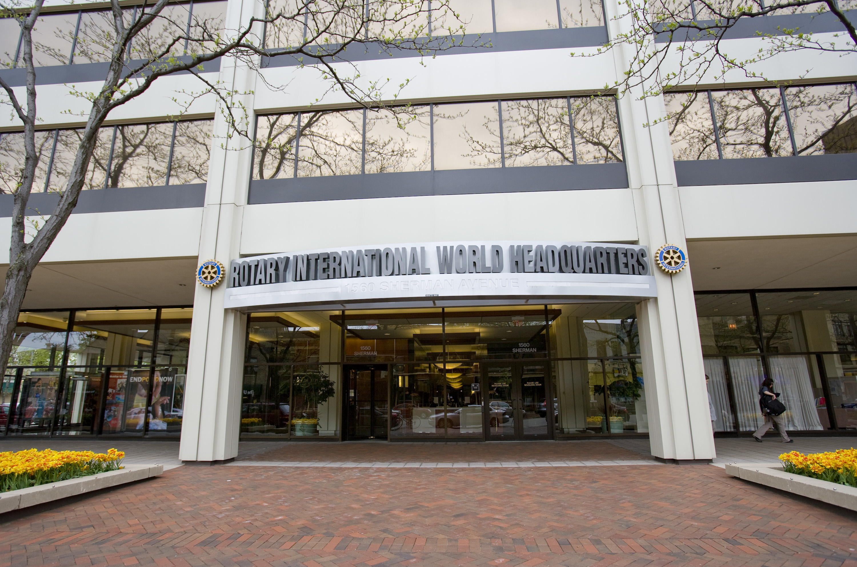
The Secretariat
650 staff
7 international offices
49 Languages spoken
Notes:
806 Employees –568 in Evanston, 251 in the IOs
IOs: Geneva – Europe & Africa; Japan, Korea, Australia, India, Brazil

Slide 33
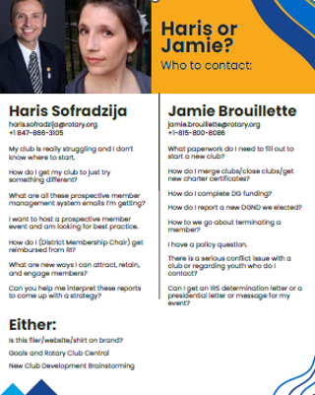
ubhead

Slide 34
Rotary Partners
Habitat for Humanity International
ShelterBox
Toastmasters
UN Environment Programme(Freshwater Systems)

Slide 36
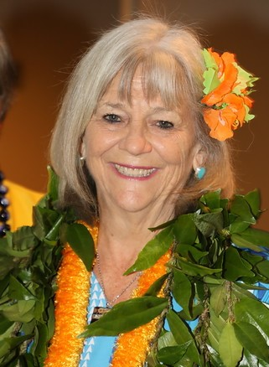
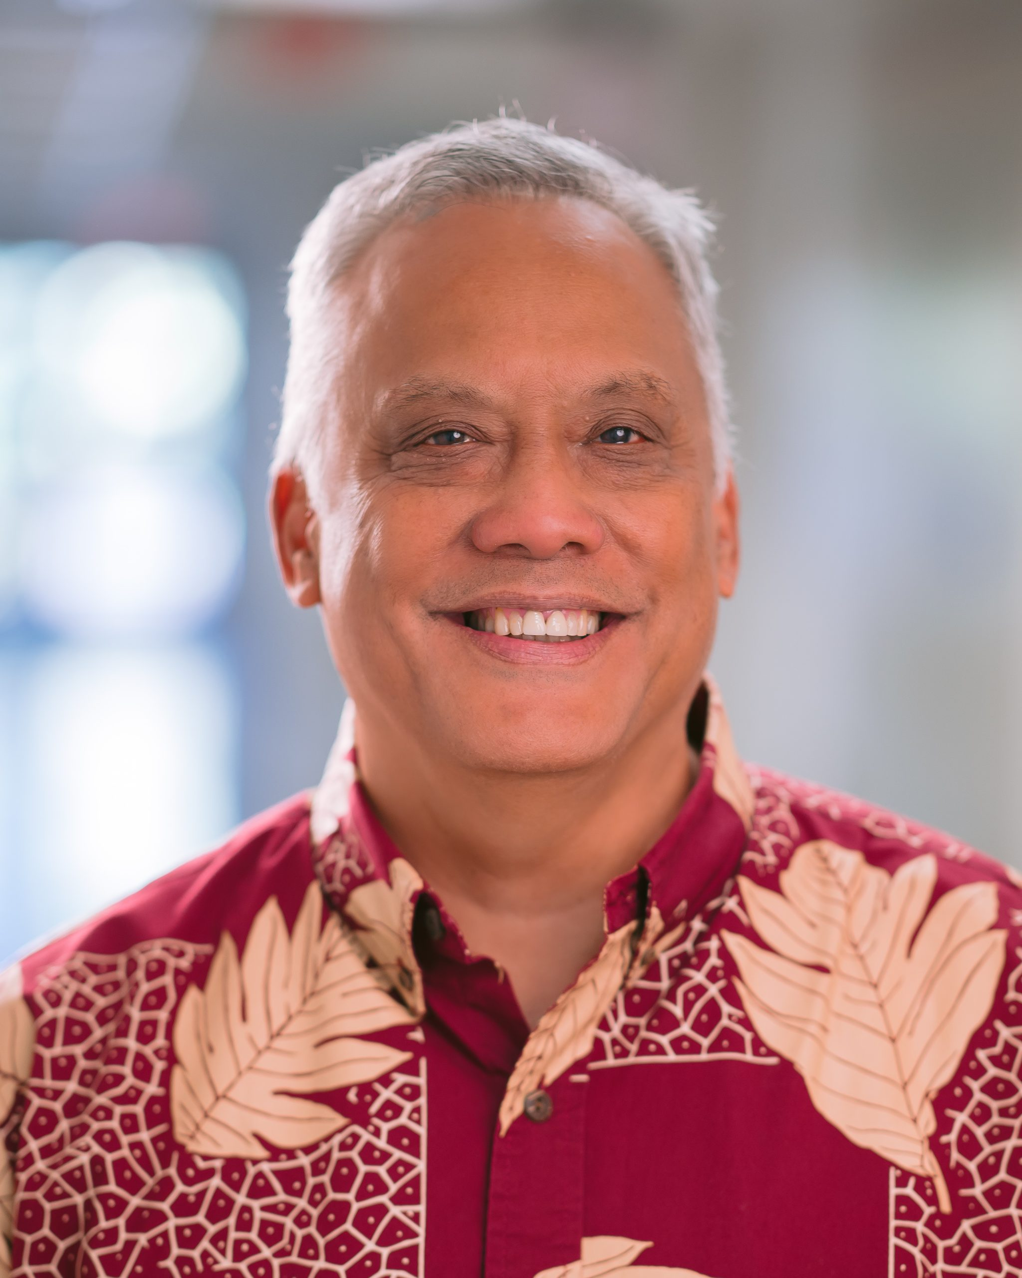
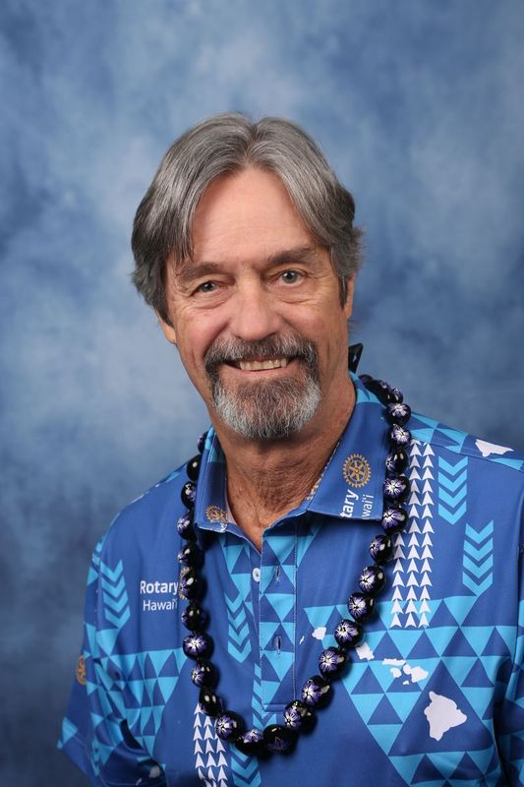
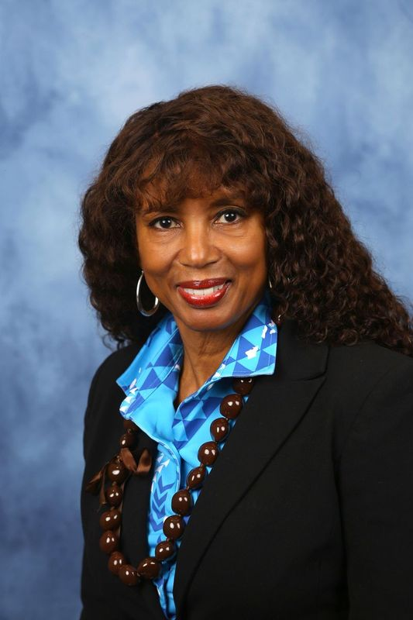
District 5000 Leadership
Nancy Cabral Benson Medina Rich Proctor Beverly Heikes
IPDG & Vice DG District Governor District Governor Elect District Governor Nominee
Rotary Club of Hilo Rotary Club of South Hilo Rotary Club of Honolulu Rotary Club of Hilo

Slide 37

District 5000 – Hawaii stats
1,391 Rotary Members, including 40 Rotaractors
49 Clubs, including 2 E-clubs (online)
3 Rotaract Clubs (from age 18)
39 Interact Clubs (12-18 years old)
3 Community Corps

Slide 38
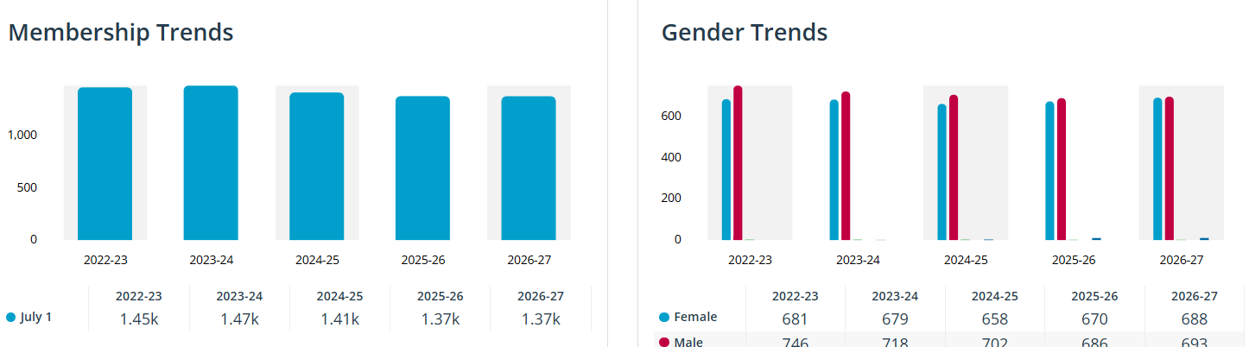
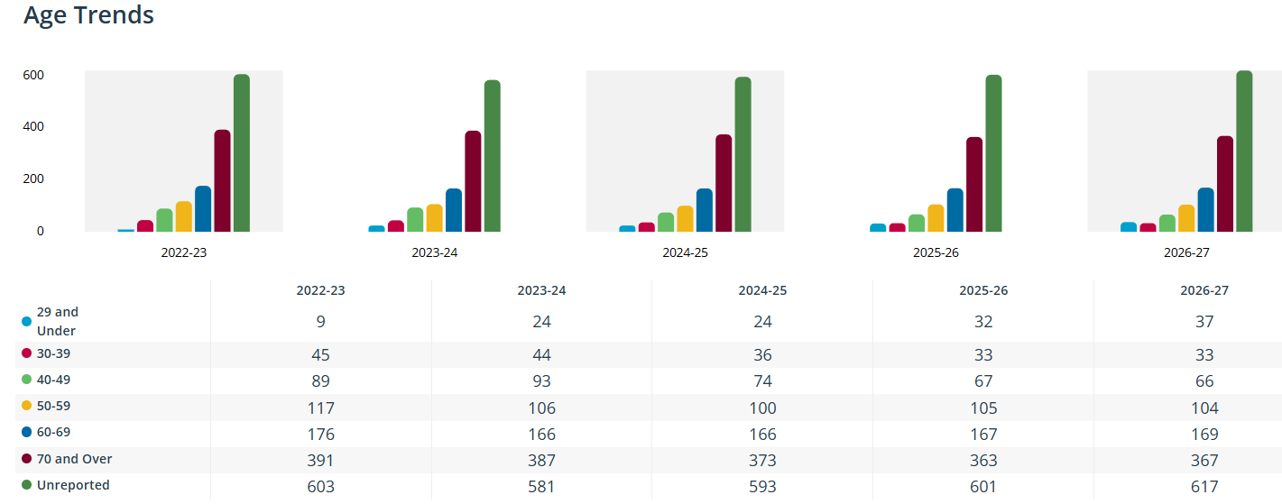
District Trends
1.53k 1.48k

Slide 39

District 5000 Policy Manual
Under “Club Resources”: https://rotaryd5000.org/sitepage/district-information/district-policies-and-forms
Notes:
You can find the policy manual on the district website under “Our District”. Revisions are voted on at the District Conference

Slide 40
District Leadership Team (DLT)
The District Governor and the District Leadership Team ("DLT"), the Governing Body of the District, shall appoint additional District committees only when they serve a specific function as identified.
The DLT shall meet at least quarterly, and more frequently as determined by the District Governor

Slide 41
District Leadership Team (DLT)
Governor Line (DG, DGE, DGN, DGND)
Chief of Staff, if applicable
Vice Governor
District Secretary
District Treasurer
District Learning Facilitator
District Committee Chairpersons (Foundation, Membership, Public Image and Finance)
Notes:
The District positions, committees and duties may change from year-to-year, depending on the needs of the clubs, the DG’s discretion and the skills the chairs.

Slide 42
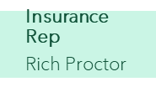
Rotary International District 5000
Vice Governor
Nancy Cabral
DGE
Rich Proctor
DGN
Bev Heikes
District Governor
Benson Medina
Organization chart 2026-2027
DGND
PDG Council
Nancy Cabral
Chief of Staff
Doug Adam
Chief Op Officer
Foundation Chair (3)
Dave Mozdren
Membership Chair (3)
Nancy Cabral
Assistant Governors
District Treasurer
Len Miyazono
District Secretary
Nancy Youngren
International Svc
James Ham
Youth Service
Jen Tanouye
Public Image
Janet Kelley
Community Svc
Finance Committee (3)
Naomi Masuno
District Learning
Benson Medina
Paul Harris Society
Interact - HS
Vocational Svc
Member Attraction
Connie Ichinose
New Club Advisor (3)
Annual Fund
Webmaster
Ombudsman
Paul Saito
White Hat Society
Interact-MS
Awards
Member Engagement
Doug Adams
District Grants
Legal Advisor
Del Green
Social Media
Hawaii West- Scott Unger
Hawaii East-Connie Ichinose
Maui Valley-Jennifer Barr
Maui Coast-Ann Neizman
Oahu West-Pala Walpola
Oahu Central-Dennis Drake
Oahu East-Murray Missar
Oahu Waikiki-Dave Livingston
Oahu Downtown-Nathan Kam
Kauai- Margaret Kagawa
Alumni
Other Committees
Positions
RYLA
Travel Coordinator
Laurie Yoshida
Global Grants
Peace Fellowship
New Club Development
Ayman El-Dakhakhni
Newsletter
District Conference
Youth Protection
Peter Evans
District Resolution/ Legislation
DGE
Endowment/MG
Rotary Scholarships
Youth Exchange
Tom Gross
RI Convention Promotion
DGN
Stewardship
District Leadership Team
July 1, 2026
Audit
Council on Leg
Roz Cooper (3)
Vocational Training Team
Service Exchange

Slide 43
District Governor

Slide 44
Qualifications
At the time of selection, the nominee will be called governor-nominee-designate and will assume the title of governor-nominee on July 1, two years before serving as governor. The governor-nominee must:
Be a member in good standing of a functioning club in the district. (RIB 16.070.1.)
Have full qualifications for membership in the strict application of the club membership provisions and have a classification whose integrity is without question. (RIB 16.070.2.)
Have served as president of a club for a full term or be a charter president of a club having served the full term from the date of the charter to 30 June, provided that this period is at least six months. (RIB 16.070.3.)
Demonstrate willingness, commitment, and ability, physically and otherwise to fulfill the duties and responsibilities of the office of governor as provided in section 16.090.
Demonstrate knowledge of the qualifications, duties and responsibilities of governor as prescribed in the bylaws and submit to RI, through its general secretary, a signed statement that the Rotarian understands clearly such qualifications, duties and responsibilities. Such statement shall also confirm that the Rotarian is qualified for the office of governor and willing and able to assume the duties and responsibilities of that office and to perform them faithfully. (RIB 16.070.5.)

Slide 45
District Governor
District Governor should have proven strong leadership skills and decision making. As DG, clubs will look to the DG for leadership, support, and motivation as they carry out service projects and participate in Rotary programs. What DGs do:
Strengthen clubs, organize new clubs, and grow membership
Encourage contributions and other support for The Rotary Foundation
Promote positive public image and serve as spokesperson for district
Develop a safe environment for youth participants
Conduct district conference and other meetings
Supervise district nominations and elections
Prepare budget, provide annual report, and help administer District Designated Funds
Complete online district qualification
Work with governor-elect and other district leaders

Slide 46
Role of the District Governor
The District Governor shall be the chief executive officer of the District and shall supervise its activities in accordance with this Policy Manual and the most recent edition of RI’s Manual of Procedure. The District Governor shall preside at the District Conference and at such other meetings of the District where another leader is not specified herein. The District Governor shall be an ex-officio member of all District committees. Governors are elected by the district two to three years before taking office.
As governor-elect:
Attend the governors-nominee and elect learning seminar and International Assembly (1 week each)
Conduct seminars for incoming district leaders and club leaders (Club Leadership Learning Seminar)
Plan the district conference
Qualify district for Rotary grants and conduct grant management training
Appoint assistant governors and committee chairs
Work with the governor and district leaders to create a district plan
Learn about the district (as nominee)

Slide 47
And More
Conducting, implementing, or reviewing district strategic planning with the DGE and DGN
Promoting membership growth and engagement by working with district leaders and club presidents to set realistic membership goals for each club
Managing online membership prospect leads with your district membership committee chair, including promptly reviewing and assigning leads to clubs
Serving as a spokesperson for your district and Rotary when appropriate
Helping the governor-elect plan and prepare for incoming officer training meetings
Conducting district events, including the district conference and a Vibrant Club workshop
Supervising the district leadership team
Officially visiting each club (through meetings with one or more clubs), to raise awareness of important Rotary issues, support struggling clubs, motivate club members to participate in service, and recognize members’ contributions
Communicating at least monthly with each club president and secretary
Fostering continuity by working with past, current, and incoming district leaders

Slide 48
Meetings – above the district level
International Assembly - Mandatory
RI Convention
Zone Meetings
Institutes
Governor-elect (GELS), Governor-nominee (GNLS)
Regional leaders and EMGA training
Regional learning seminars conducted by coordinators
Notes:
International Assembly – IA
Motivates and inspires Governors-elect
Provide Rotary education, instruction in administrative duties
President-elect announces his theme for the coming year
Gives the governors the opportunity to plan implementation of Rotary’s programs in the following year
President, President-elect & President-nominee, both boards, Council of past presidents, Governors-elect, other senior leaders as directed by the board
Convention
Annual – somewhere in the world
Open to all Rotarians
Purpose to formally elevate the president elect to president
Council on Legislation
Held every 3 years in Chicago
Purpose is to consider and adopt changes to Rotary’s bylaws and constitution
Delegates from all districts
Legislation is prepared in a detailed process where changes are suggested, vetted for strategic and financial impact and other considerations before being approved for council consideration

Slide 49
Assistant Governors
One year term, renewable up to 3 years at the discretion of the DG
Assistant Governors are the connection between clubs and the District. The relationships built with club leaders make Rotary stronger.

Slide 50
Qualifications
Minimum criteria in selecting Assistant Governors should include the following:
Active Membership, in good standing in a club in the District for at least three (3) years;
Service as President of a club for a full term;
Willingness and ability to accept the responsibilities of Assistant Governor;
Demonstrated outstanding performance at the district level; and
Potential for future leadership in the District.
Assistant Governors are district appointees. Assistant Governors are not officers of Rotary International. Assistant Governors are to be appointed on an annual basis, with no Assistant Governor serving more than three (3) consecutive one-year terms to provide continuity in the District leadership. It is recommended that no Past District Governor serve as an Assistant Governor. The District Governor may make exceptions as deemed necessary or appropriate.
Notes:
In order to fully meet these responsibilities, all Assistant Governors are expected to:
Attend the District team-training seminar;
Attend the Pre-PETS and Presidents-elect Training Seminar (PETS) and the district training assembly;
Advise the incoming District Governor on district committee selections;
Attend and actively promote attendance at the District Conference and other District meetings; participate in Rotary Foundation programs, annual and special giving events, and other special assignments as necessary

Slide 51
Responsibilities
Meet with and assist the incoming club Presidents before the beginning of the Rotary year to discuss the clubs’ goals and to review the Planning Guide for Effective Clubs and section 2.010.1 of the Rotary Code of Policies (Failure to Function);
Attend each club assembly associated with the District Governor’s official visit;
Visit each club regularly, preferably monthly with a minimum of one visit each quarter of the Rotary year, and meet with the club President and other club leadership to discuss the business of the club and resources available to them;
Assist club leaders in scheduling and planning for the District Governor’s official visit;
Keep the District Governor posted on progress of the clubs and suggest ways to enhance Rotary development and address problems;
Encourage clubs to follow through on requests and recommendations of the District Governor;
Monitor each club’s performance with respect to service projects;
Identify and encourage the development of future district leaders.

Slide 52
District Committees

Slide 53
District Committee Appointments
Rotary International requires the following district chairs serve a three-year term:
District Rotary Foundation
District International Service Chair
District Membership Chair
District New Club Advisor
Each district governor that serves during the three-year term of these district chairs agrees to the selection of that chair and have provided their written confirmation.
Any removal for cause of these committee chairs must have the prior written approval of all the district governors for each of the remaining years of the three-year term.
Written approval to name a new chair or to remove a chair for cause must remain on file at the district and be available upon request from Rotary.
Notes:
There are 3 District Committee Chair positions that have 3 year terms. Rotary International requires these 3 positions to be confirmed by the 3 DGs that serve during that 3 year term. I have a lot of slide with the description for the position or committee, which you can refer to later, so I will be flying through the slides so we have time for Randy to speak at the end. This powerpoint will be posted on the page with the webinar recordings.

Slide 54
Standing Commttees (Section 2.5 of Policy Manual)
(1) District Rotary Foundation Committee *
(2) District Membership Development Committee *
(3) Past District Governor Advisory Council
(2) District Learning Committee *
(3) District Public Image & Awareness Committee *
(4) District Conference Committee
(5) District Finance Committee *
(6) District Nominating Committee
(8) RI Convention Promotion Committee
(9) District Youth Services Committee
(10) (11) District Resolutions/Legislation Committee
* RI Required Committees
Notes:
There are the

Slide 55
Optional Committees per RI
Alumni
Awards & Recognitions
District Conference
Nominating
Rotary Convention Promotion
Rotary Friendship Exchange
Community Service
International Service
Vocational Service
Interact
Rotaract
Rotary Youth Leadership Awards (RYLA)
Youth Exchange
Notes:
As you saw from the Learning Center assignment, there are these other committees

Slide 56
Committee Chair Qualifications
Active Member, in good standing in a club in the District.
Past District Governor, a past Assistant Governor, a past club President, or an effective past District committee member that has had previous experience as a member of the District committee.
Attends District training seminars/assemblies

Slide 57
DG Nominating Committee Composition
The District Nominating Committee shall consist of five (5) Past District Governors plus (4) Past Presidents (one from a club in the County of Kauai, one from a club in the County of Maui, one from a club in the County of Hawaii and one from a club in the City and County of Honolulu).
It is recommended, but not required, that the District Governor budget for transportation expenses for individuals who do not reside on the same island where in-person candidate interviews are to be conducted.
Notes:
Each year, the District Nominating Committee shall select (i) a District Governor Nominee Designate, and (ii) a Vice-Governor for the following Rotary year.
Your committee nominates the most qualified Rotarian to serve as district governor. Together you:
Conduct a fair and open selection process.
Find and nominate the most qualified person.
Interview all candidates for governor, who can be suggested by clubs or by the committee.
The past President committee members shall be immediate past Presidents who have successfully completed their year as club president in District 5000, who have expressed a willingness and ability to serve on the District Nominating Committee and whose club meaningfully participated in a District club recognition program (e.g., Club of the Year, Club of Excellence, etc.) during their year as club president. Each representative, plus one alternate in the event such representative later becomes unwilling or unable to serve, shall be selected by a random selection process to be overseen by the Assistant Governor(s) from the same county, and conducted at a District Meeting designated by the District Governor.

Slide 58
Past District Governor Advisory Council
The purpose of the PDG Advisory Council is to advise the District Governor on policy matters affecting the District and to assist the District Governor when called upon to do so.
The PDG Advisory Council shall be composed of all Past District Governors who reside in the District, who indicate a desire and willingness to actively serve on this committee and shall be chaired by the Immediate Past District Governor.
The PDG Advisory Council should hold at least two (2) meetings for each Rotary year, as necessary

Slide 59
Councils
The Councils give us a voice in how our organization is governed.
Council on Resolutions
Council on Resolutions meets online every year to vote on proposed resolutions and urgent enactments. Resolutions are requests to the Board or the Trustees to take an action that is outside the purview of the constitutional documents.
Council on Legislation
Every three years, Rotarians meet to review and vote on proposed changes to the legislation that governs Rotary. They consider enactments, which change Rotary’s governing documents, and position statements by the RI Board.

Slide 60
District Meetings
Tues & Thurs-AG Groups with DG bi-monthly
First Tues, 6:30pm- Briefing for Alaka’I, COS
Second Monday, 6:30pm-President Elect Forum
Third Monday, 6:30pm- Membership
Third Wednesday, 5:30pm - Foundation
Fourth Monday, 5:30pm - Youth Service
Last Thursdays , 4:30pm- International Service
Last Friday, 5pm- Mental Health Action Group

Slide 61
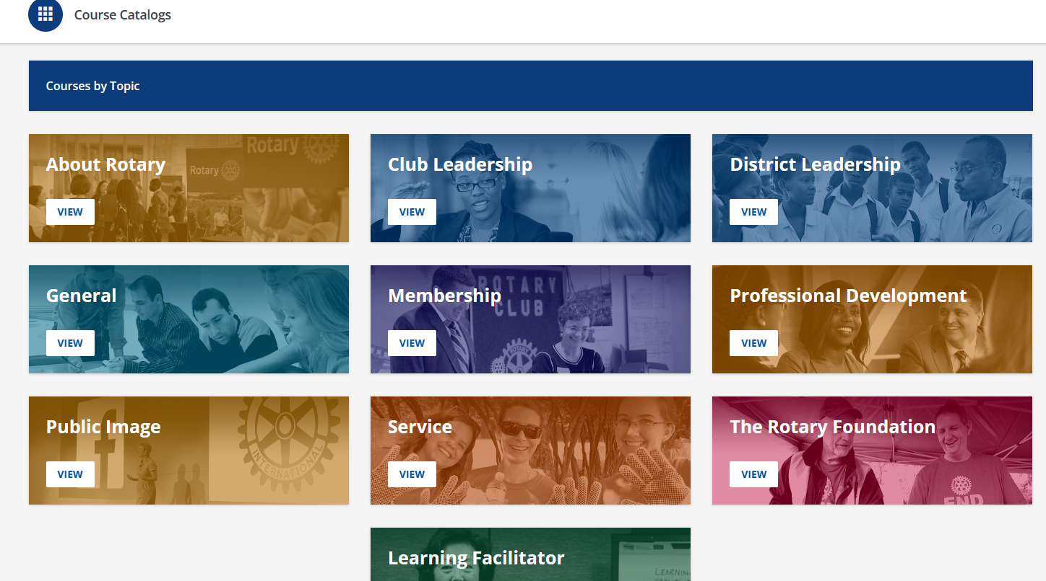
subhead
Learning Center
Take advantage of a wealth of training materials designed to help you learn new skills and become more successful in what you do.
Notes:
The RI Learning & Development team have done an excellent job in creating the online Learning Center. Many of the manuals you may be familiar with have been transformed into online, interactive courses. Take them at your own speed and keep track of your achievements. With more courses being added and updated, there’s something for everyone! If you know of someone who would be good on a committee or in a leadership role, encourage them to sign up for DLA and take courses in the Learning Center.

Slide 62


