Slide 1

Serving humanity, empowering a positive change globally

Slide 2
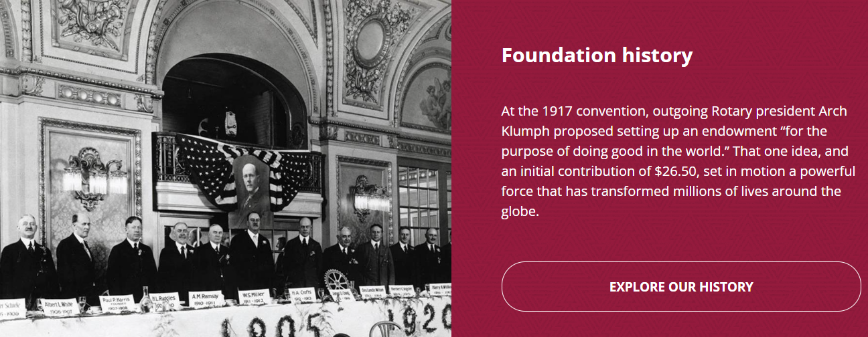

Slide 3
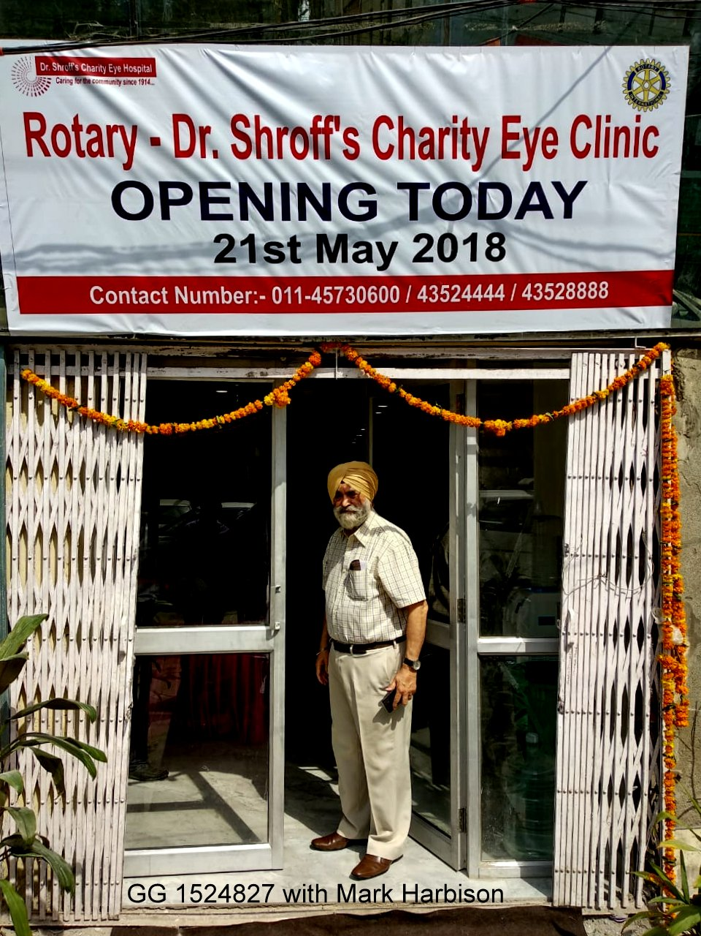
Your Rotary Foundation
The Rotary Foundation has been Doing Good in the World for over 100 years with over $4 billion in contributions.
The Rotary Foundation transforms your gifts into service projects that change lives both close to home and around the world.

Slide 4
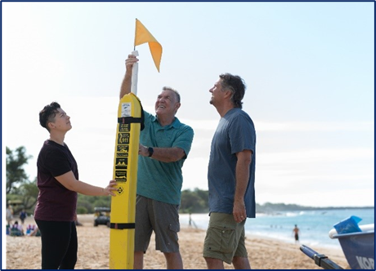

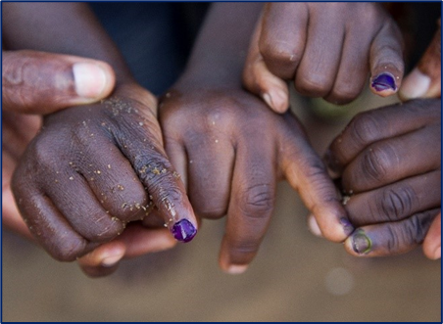
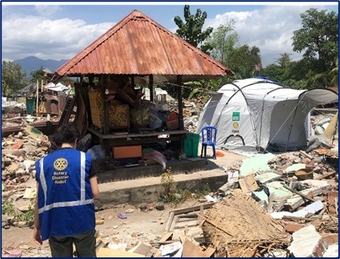

SUPPORTING THE ROTARY FOUNDATION
Annual Fund
For support today
Endowment Fund
To secure tomorrow
PolioPlus Fund
End Polio Now
Donating to The Rotary Foundation earns the donor Paul Harris recognition points
Notes:
Rotarians support our Foundation through these funds:
PolioPlus Fund, dedicated to global polio eradication
Annual Fund, the primary source of funding for Foundation grants and activities
Endowment Fund, which supports the Foundation in perpetuity

Slide 5
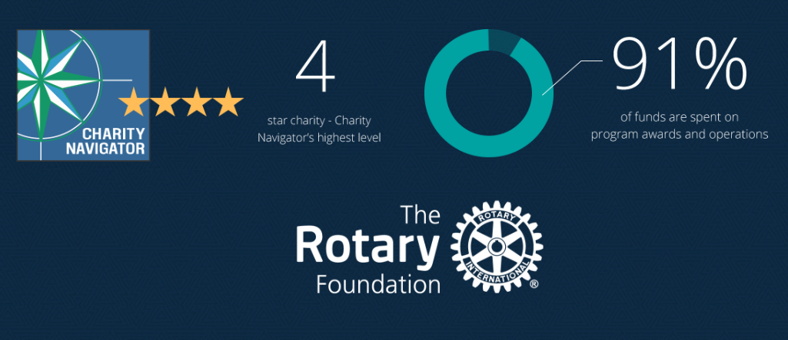
The Rotary Foundation of Rotary International has received 15 consecutive 4-star ratings from Charity Navigator.
The rating reflects Charity Navigator's assessment of how the Foundation uses donations, sustains its programs and services, and practices good governance and openness. (aka Stewardship)
Notes:
The Foundation earned the recognition for adhering to sector best practices and executing its mission in a financially efficient way, demonstrating both strong financial health and commitment to accountability and transparency. Only one percent of the organizations Charity Navigator evaluates have received 15 consecutive 4-star evaluations. The rating reflects Charity Navigator's assessment of how the Foundation uses donations, sustains its programs and services, and practices good governance and openness. This is also known as Stewardship. The District signs an MOU and must oversee the process and adhere to Rotary’s rules.

Slide 6
What is Stewardship?
Stewardship is the responsible management and oversight of grant funds, which ensures that funds are used properly and truly benefit the populations in need:
Supervise projects—MOU Guidelines
Implement projects as approved
Report irregularities
Submit reports
Retain documents- 5 years of soft (electronic) and hard copy

Slide 7
Foundation Finances in 2023-2024
The Rotary Foundation Expenditures $344 million: (Program awards=88%)
$157 PolioPlus
$ 55 Global grants
$ 26 District grants
$ 15 Disaster Response grants
$ 20 Other grants
$ 5 Peace Centers
$ 2 Programs of Scale
$ 22 Program operations
$ 25 Fund development
$ 17 General administration

Slide 8
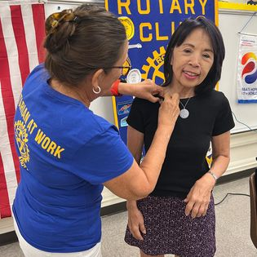
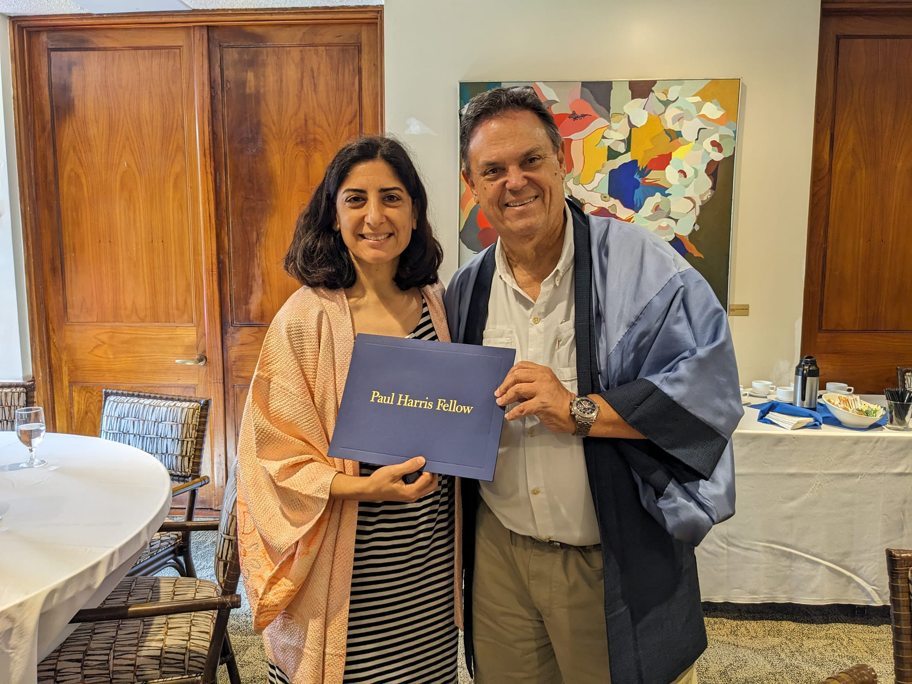
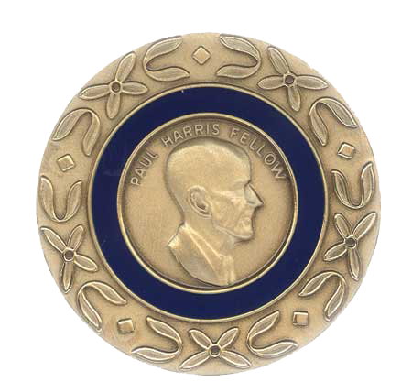
DONOR RECOGNITION INSPIRES
OTHERS TO GIVE
Rotary Foundation Sustaining Member
Benefactor
Paul Harris Fellow
Multiple Paul Harris Fellow
Paul Harris Society
Bequest Society
Major Donor
Arch Klumph Society
Triple Crown
White Hat
Legacy Society

Slide 9

Major Gifts to
The Rotary Foundation
Major Donor - Single or cumulative donation of $10,000 by an individual or couple
  Level 1: $10,000 to $24,999
  Level 2: $25,000 to $49,999
  Level 3: $50,000 to $99,999
  Level 4: $100,000 to $249,999
Arch Klumph Society
  Trustees Circle: $250,000 to $499,999
  Chair’s Circle: $500,000 to $999,999
  Foundation Circle: $1,000,000 to $2,499,999
  Platinum Trustees Circle: $2,500,000 to $4,999,999
  Platinum Chair’s Circle: $5,000,000 to $9,999,999
  Platinum Foundation Circle: $10,000,000 and above

Slide 10
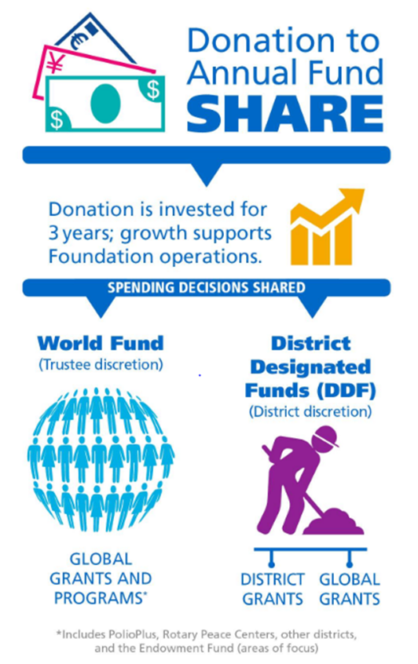
SHARE PROGRAM
When you select Annual Fund – SHARE, the contribution enters the SHARE system for the next 3 years
Under the SHARE system, contributions are divided between the World Fund and District Designated Funds (DDF), after operating expenses of 5% are deducted

Slide 11
Grant Funds to Rotary Projects
2021-2022 donations of SHARE $263,969 from District 5000
5% Admin Fee $ 13,198 to Rotary International
47.5% to World Fund $125,385 to The Rotary Foundation
47.5% to District Designated Fund (DDF) $125,385 to District 5000
Funds returned in 3 years to the District as grants. Available this year for projects:
$ 24,324 No match (20% of DDF)
$ 36,487 Match (30% of DDF)
$ 62,692 Match for Global Grants (50% of DDF)
$123,503 From District Designated Funds (DDF), net of Admin fee
$ 36,487 Matching Club Cash for matching District Grants
$ 62,692 Matching Club Cash for Global Grants
$ 50,153 From World Fund to match Global Grants
$272,835 Total for Global and local projects
.
Notes:
This year, we have $125k in DDF –District Designated Funds for District and Global Grants. With the club matching cash and the World Fund for Global grants, there is potentially $273k for projects and this is because of the donations to The Rotary Foundation and club funds. The District’s process is to take 20% of the DDF for no matched funds. Meaning the club does not need to match this amount with club cash. Then 30% is to be matched with cash from the club. 50% of the DDF is for global grants and the club needs to match this amount and is able to pledge the total to a global grant.

Slide 12
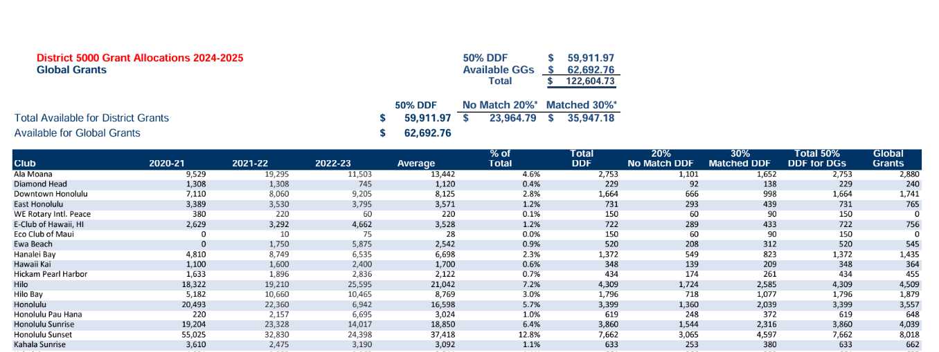

Slide 13
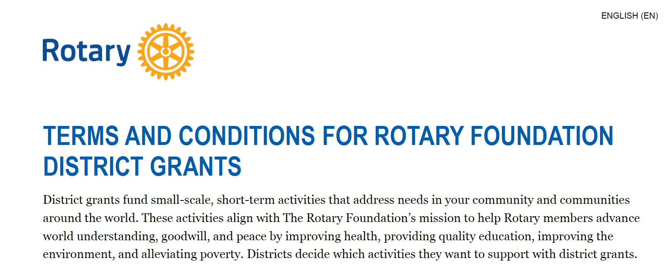

Slide 14
Grants cannot fund:
Unrestricted cash donations to a beneficiary or cooperating organization
Continuous or excessive support of any one beneficiary, entity, or community
The purchase of land or buildings
Fundraising activities
Expenses related to Rotary events such as district conferences, conventions, institutes, anniversary celebrations, entertainment activities, or project ceremonies
Public relations initiatives, unless they are essential to carrying out the project
Project signs that cost more than $1,000
The operating, administrative, or indirect program expenses of another organization
Activities for which the cost has already been incurred

Slide 15
Grant Timeline
For 2024-2025 Grants:
Fall 2023 – 2 members attend grant management training
Jan 31, 2024- submit 3 documents (MOU, Addendum, Financial Plan) and the filing confirmation of fed tax return and GET for year ended 6/30/23. The president for 2023-2024 and 2024-2025 sign the documents. If no President Nominee (PN), the current president can sign.
May 31, 2024-Final grant report submitted by this year’s team.
June 15, 2024-Grant application for Rotary year 2024-2025 submitted
July 15, 2024 – Submit District grant to RI for approval
August - distribute grant funds to clubs
All documents are emailed to grants@rotaryd5000.org
Forms can be found on the District website at: https://rotaryd5000.org/sitepage/district-grant-info-documents

Slide 16

Rotary GRANTS
District Leadership Academy

Slide 17

AREAS OF FOCUS
Peacebuilding and conflict prevention
Disease prevention and treatment
Water, sanitation, and hygiene
Maternal and child health
Basic education and literacy
Community economic development
Environment

Slide 18

GRANT STATISTICS

Slide 19

2023-24 GRANT STATISTICS
District grants
485 grants
$30 million
Global grants
1,285 grants
$ 82 million
Disaster response grants
105 grants
$ 4 million
Programs of scale grants
$ 2 million

Slide 20
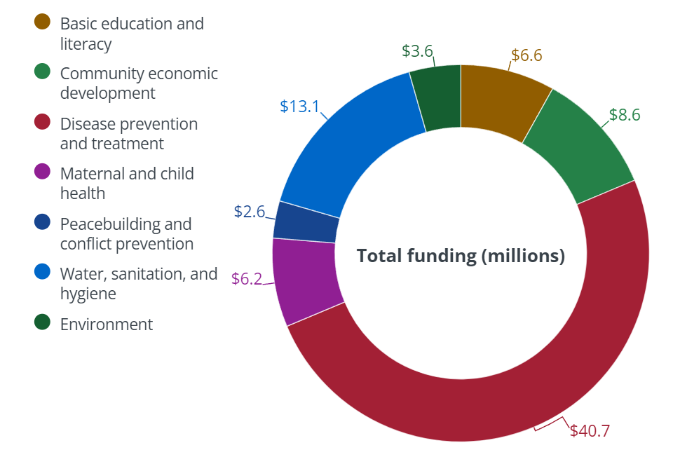
2023-2024 Global grants by Areas of focus

Slide 21
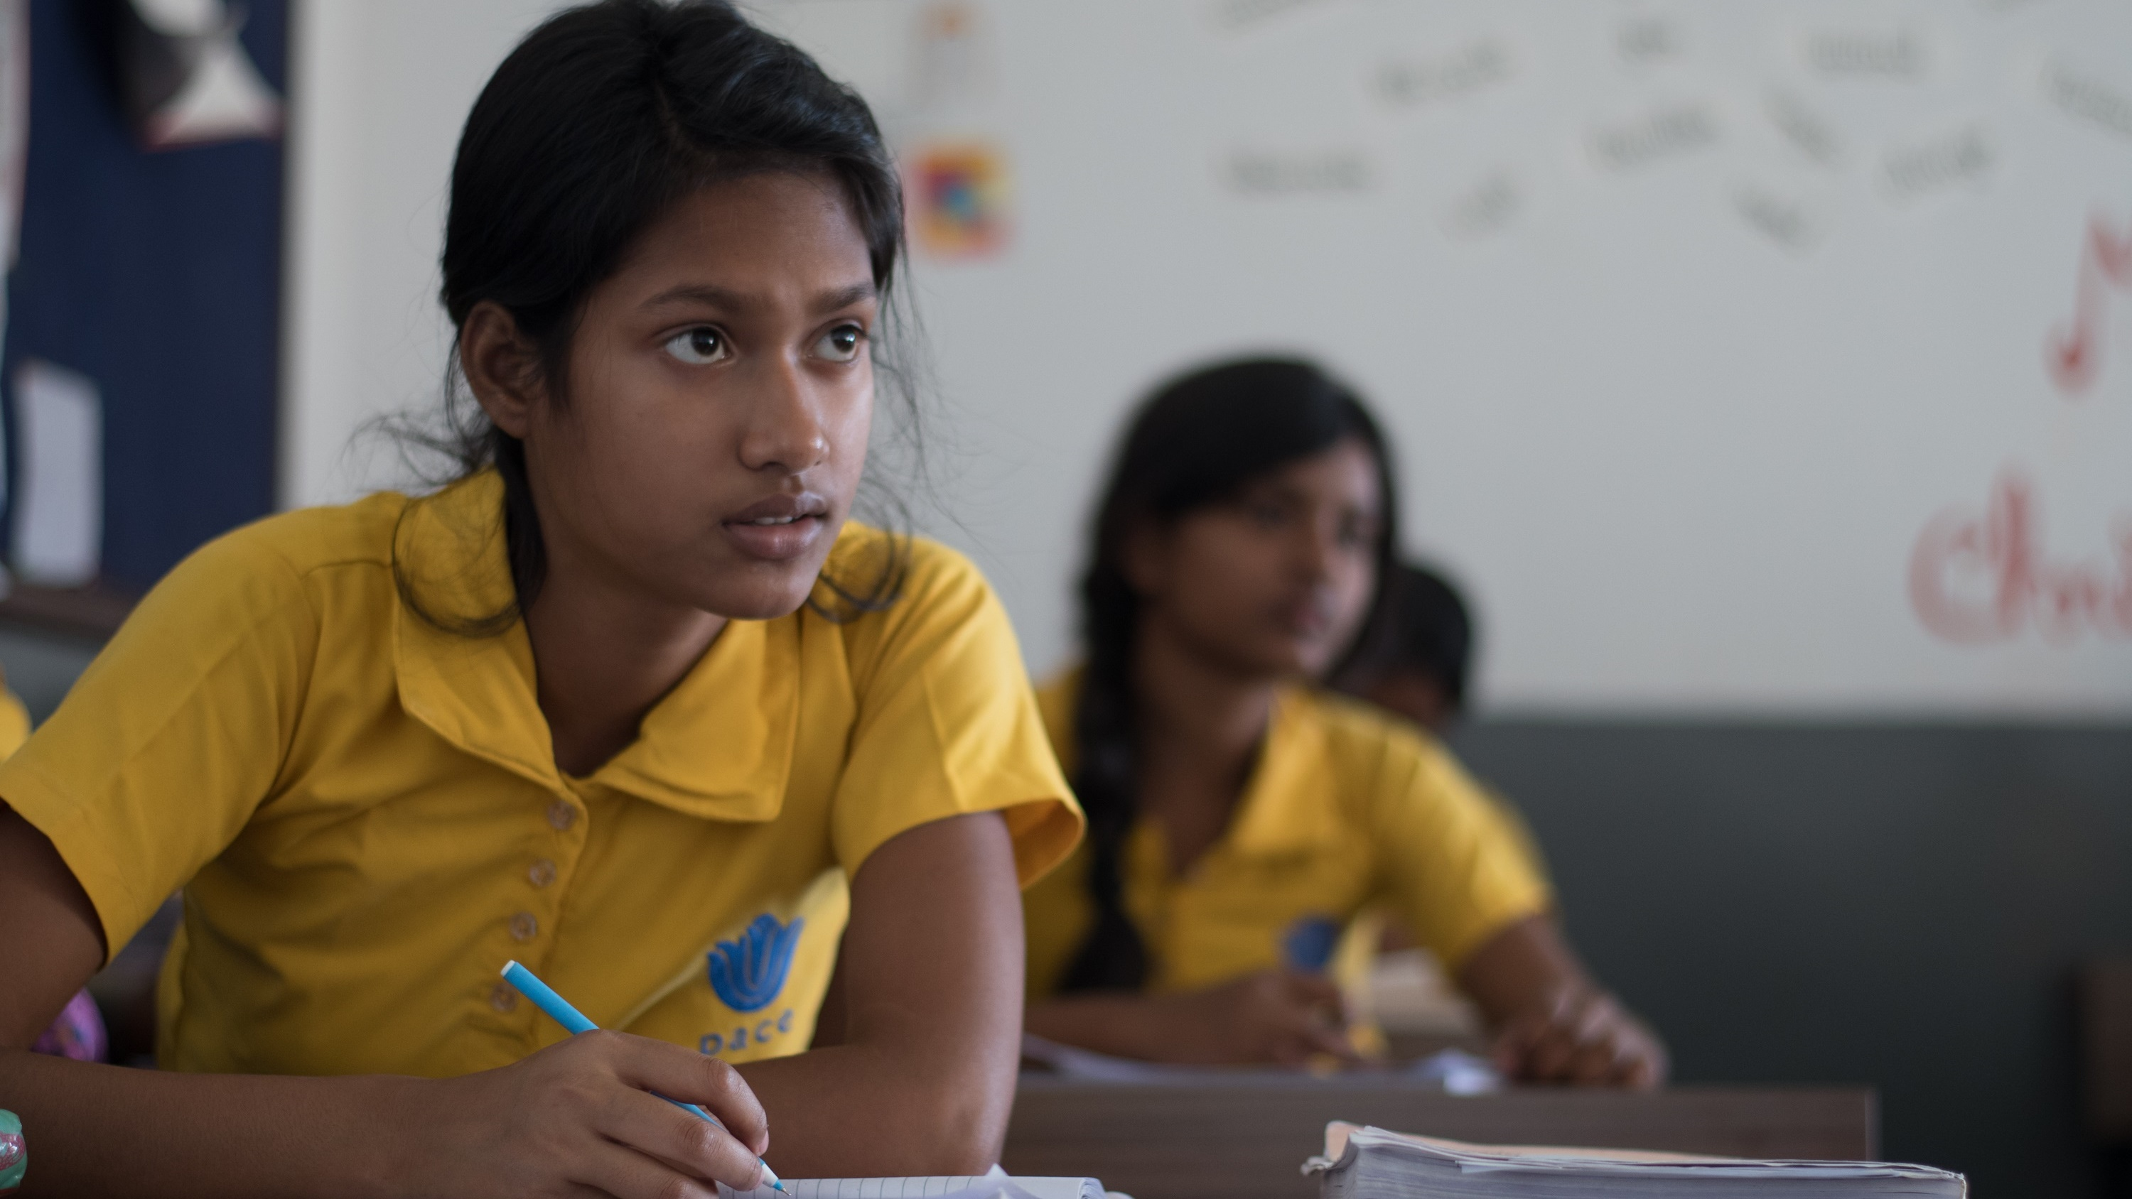
subhead
Grant types
District grants
Global grants
Disaster response grants
Programs of scale grants
Notes:
The Rotary Foundation offers grants that support a wide variety of humanitarian projects, scholarships, and vocational training that Rotarians are doing around the world. We have four types of grants: global grants, district grants, disaster response grants, and programs of scale grants.

Slide 22
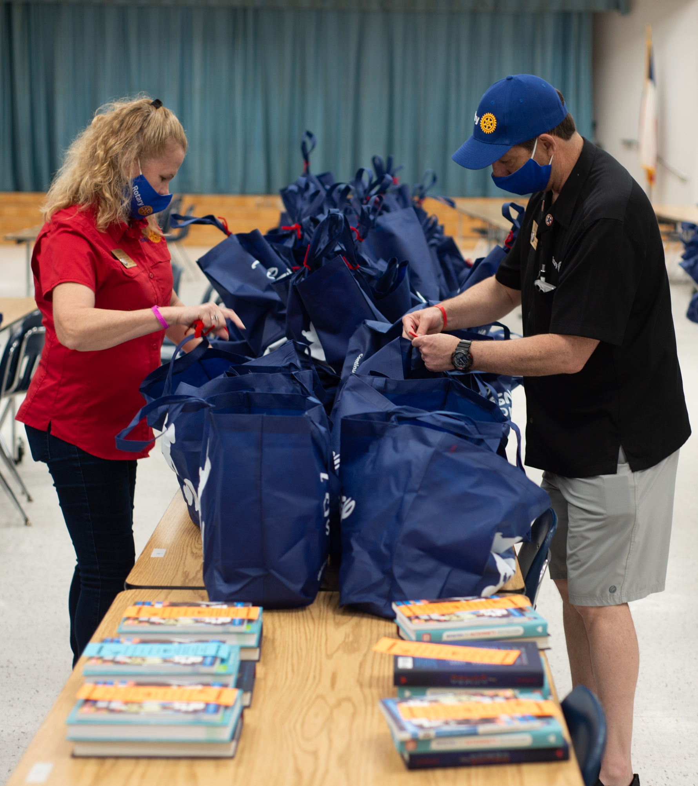
subhead
DISTRICT GRANTS
Small-scale, short-term
Local or international activities
Aligned with the Foundation’s mission
Single grant awarded annually
Notes:
District grants fund small-scale, short-term activities that address needs in your community and communities abroad. You can use district grants to fund a variety of district and club projects and activities, such as local service projects, international humanitarian projects, scholarships and vocational exchanges. District grants can support scholarships at any level of study and for any study area.
You have a lot of freedom to customize your service projects. There aren’t many restrictions, as long as your district grant supports the mission of The Rotary Foundation

Slide 23
Rotary District 5000 Grants
The Rotary Foundation awarded $78,209 in funding to 114 district grants for fiscal
year 2023-2024. Here is a breakdown of causes the grants supported:
$ 14,756 Community Development
2,143 Economic Development
30,854 Education
4,290 Environment
6,288 Health
14,436 Peace (includes RYLA)
2,233 Water
For 2024-2025, we received $69,857
Notes:
Patti (2min)

Slide 24

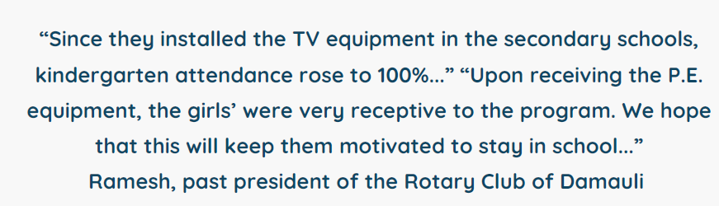
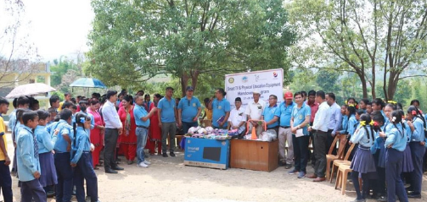
Nepal Project -District grant
RC of Kapolei
Bought 3 TVs and P.E. Equipment for $1,720

Slide 25
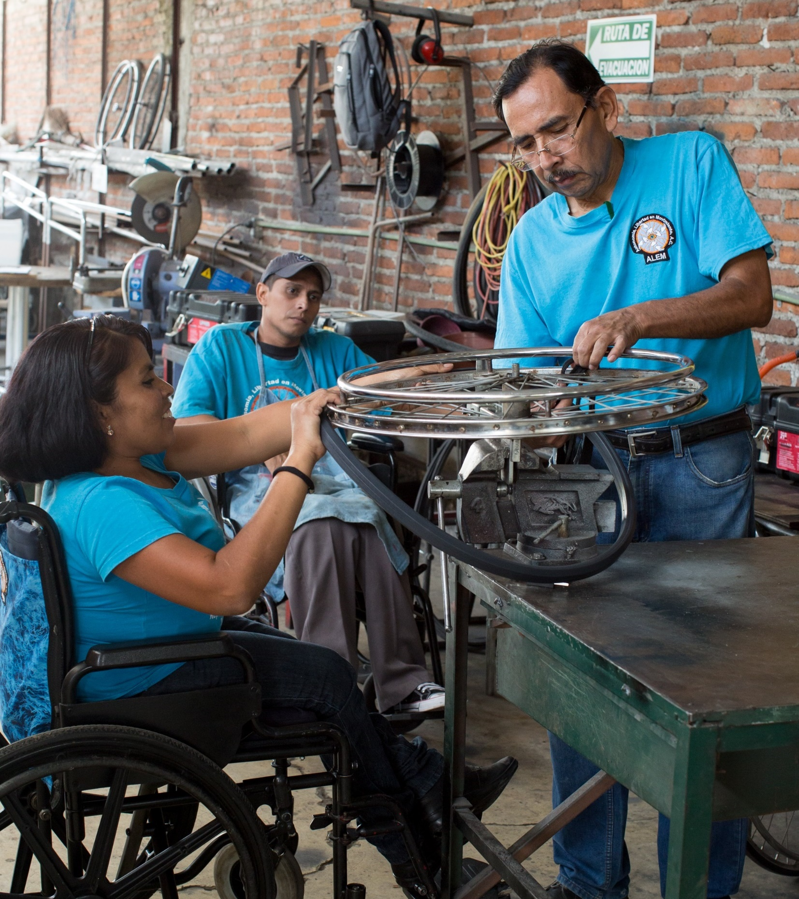
subhead
GLOBAL GRANTS
Large, long-term projects
Sustainable, measurable outcomes
Alignment with areas of focus
International partnership
$30,000 minimum budget
New World Fund match for DDF
Notes:
Global grants support large international activities with sustainable, measurable outcomes in Rotary’s areas of focus. A key feature of global grants is partnership, between the club or district where the activity is carried out and a club or district in another country.
Global grants can support humanitarian projects, scholarships, and vocational training teams. Global grant scholarships support international graduate and post-graduate study for a period of 1-4 years. Global grant vocational training teams support groups of professionals to travel abroad to provide or receive training.
Global grants have a minimum budget of $30,000. Grant sponsors can use a combination of District Designated Funds (DDF), cash, and/or directed gifts and endowment earnings to fund a global grant.

Slide 26
Global grants
$74.897 allocated for global grants in 2023-2024
$62,692 allocated for global grants in 2024-2025
Notes:
Jmes and Arjun (3min)

Slide 27
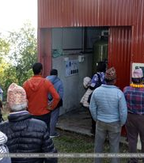
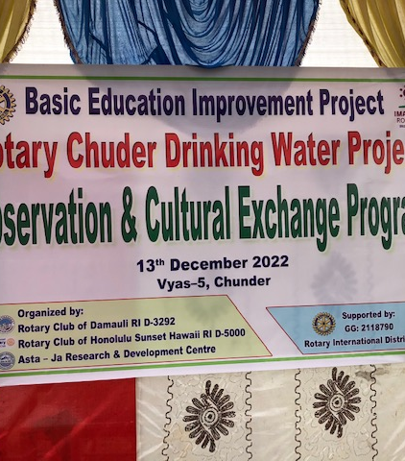
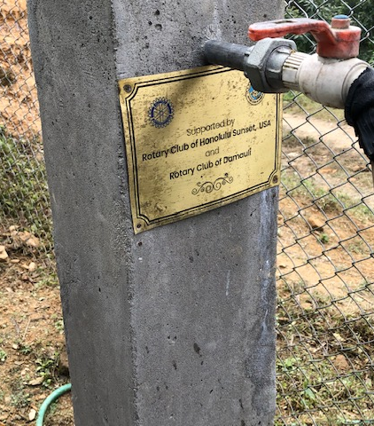
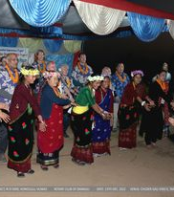
Chuder Drinking Water Project
Spearheaded by Dr. Arjun Aryal and Dr. James Ham, this water project completed in 2021 for $72,755, brought clean water to a village of about 500 people in 120 families.
Previously, they hiked up to 1-4 hours (round trip) to get water.

Slide 28
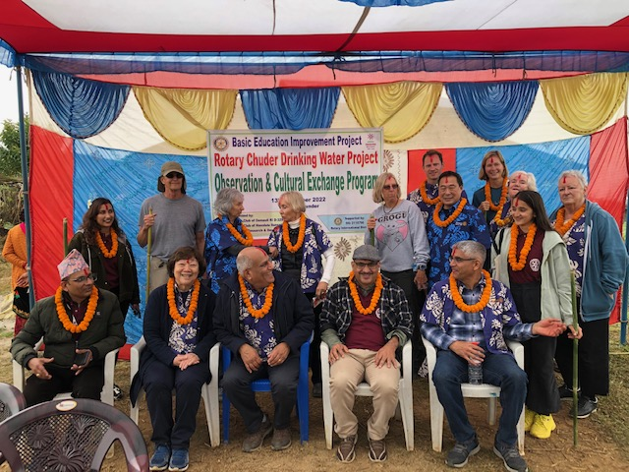
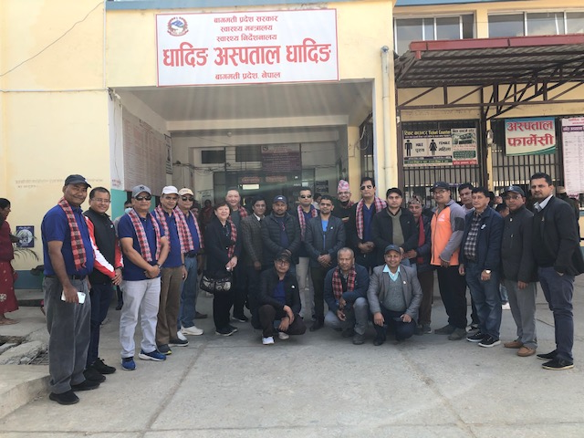
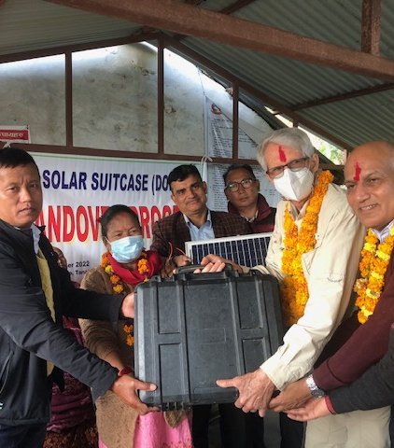
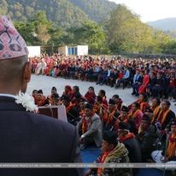
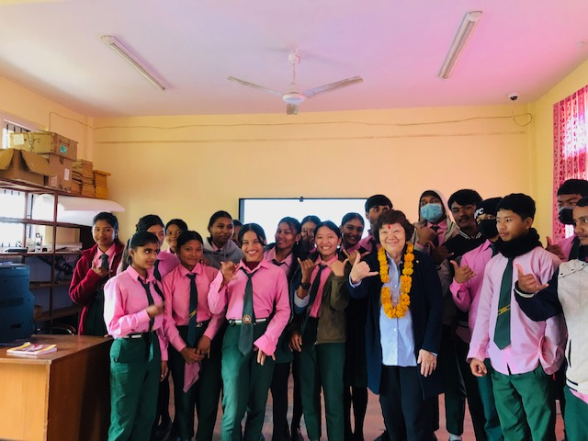
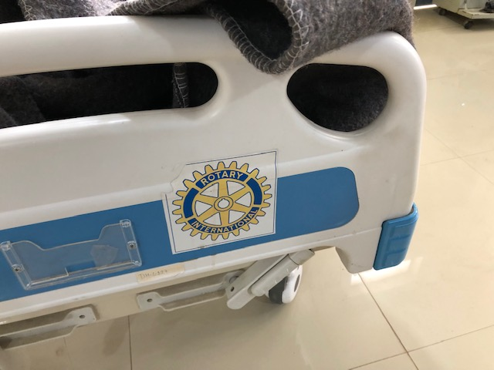
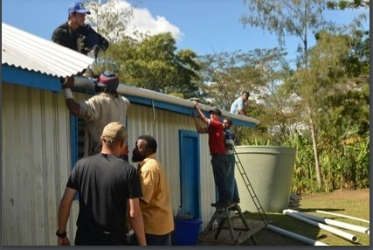
International service projects

Slide 29
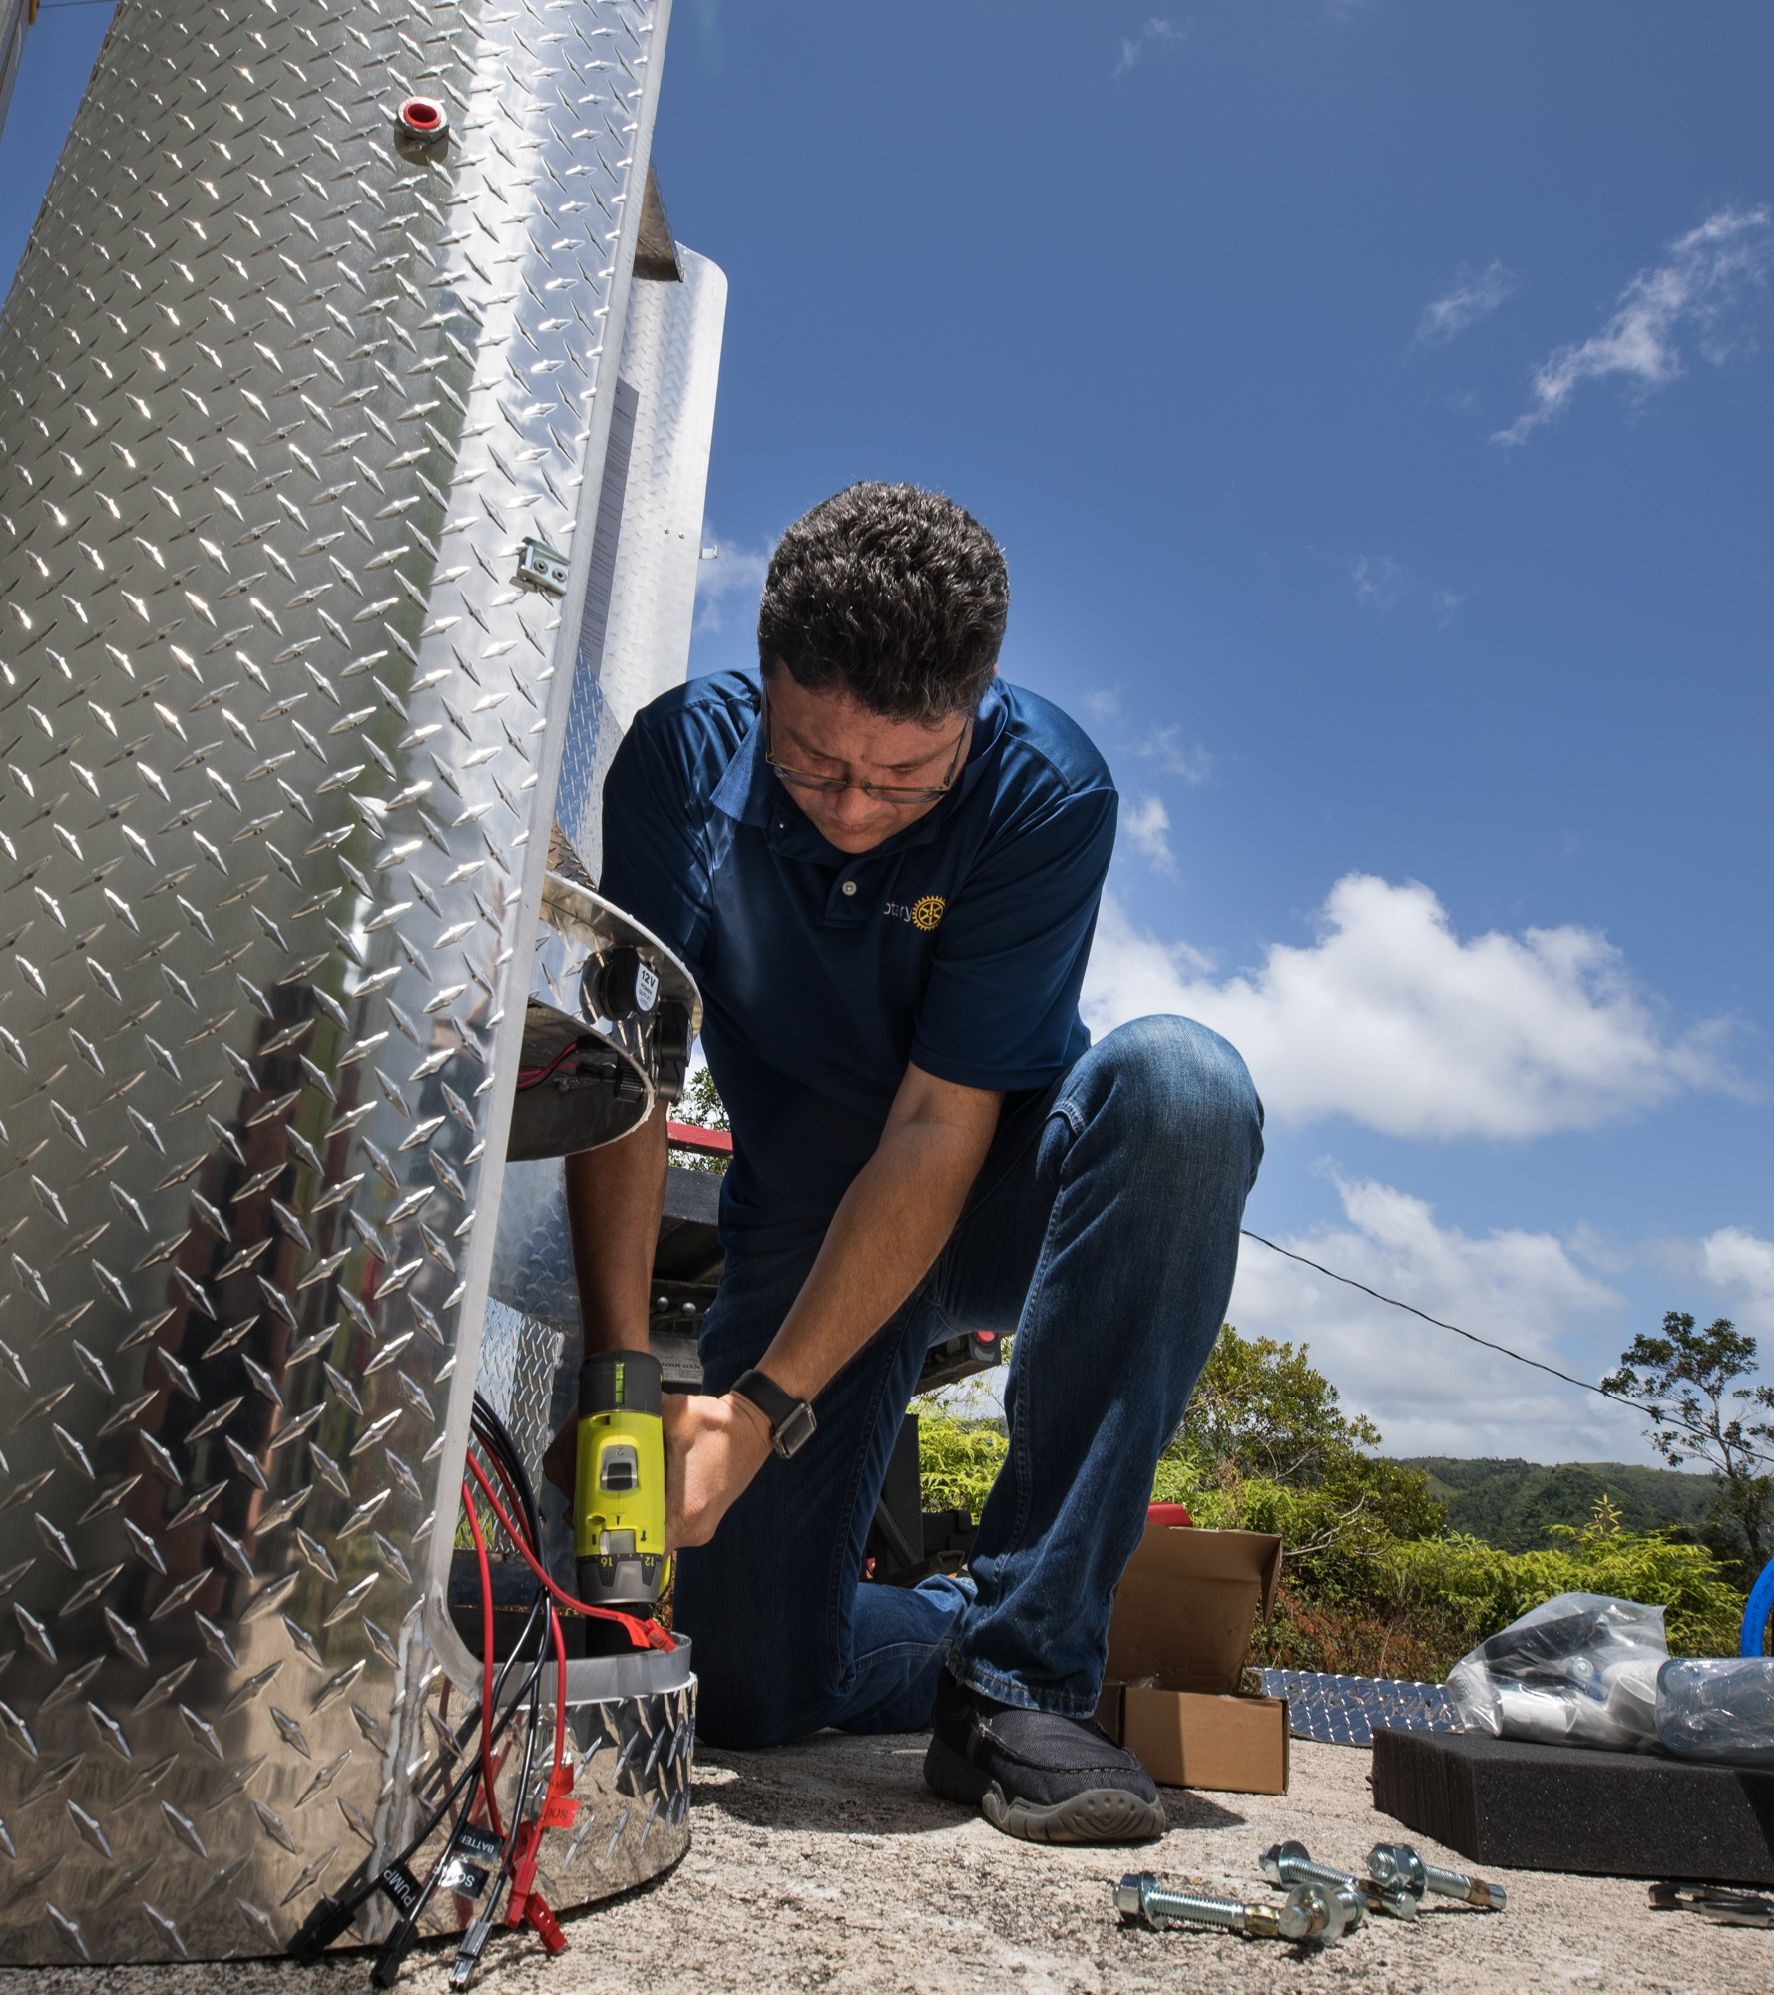
subhead
Disaster response GRANTS
Support relief and recovery efforts in areas affected by natural disaster
Funded by contributions to the Rotary Disaster Response Fund
Notes:
Disaster response grants support relief and recovery efforts in areas affected by natural disaster. Districts in affected areas may apply for grants of up to $25,000, based on the availability of funds. Grant funds can be used to provide basic items such as water, food, medicine, and clothing. These grants are funded by contributions to the Rotary Disaster Response Fund.

Slide 30
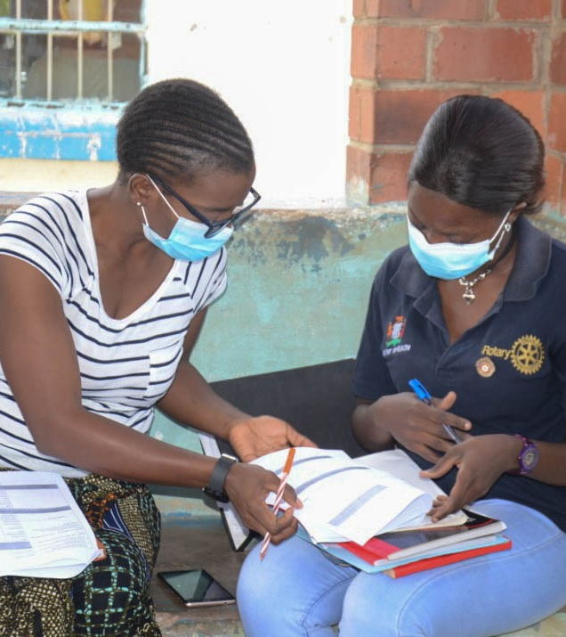
subhead
Programs of scale
Long-term activities that benefit large number of people
Alignment with areas of focus
World Fund award of $2 million; no additional Rotarian funding required
Implemented with partner organization(s)
Competitive two-step application process
Notes:
Programs of Scale is a new grant that enhances the scope, impact, and sustainability of successful Rotary member-led service projects in our areas of focus, by providing longer-term resources. It empowers Rotary members to implement large-scale, high-impact programs with experienced partners that benefit a large number of people in need across a significant geographic area.
The Rotary Foundation will award one $2 million grant each year to a program sponsored by a Rotary club or district working in strong collaboration with partners. It is a competitive process that requires a concept note and full proposal. Applicants should be prepared to include a fully developed program design that is based on clear evidence and involves all of the key stakeholders for successful implementation and sustainability. Each grant will help these programs scale up over a three- to five-year period.
More information is available at rotary.org/programsofscale.

Slide 31
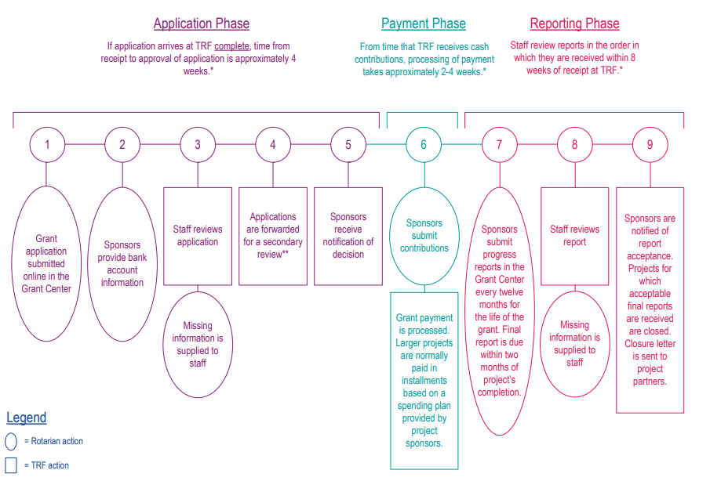
Global grant lifecycle

Slide 32
Best Practices for Submitting Global Grant Applications
Request a preliminary review prior to submission
Conduct a community assessment and include the results in the grant application
Submit a signed MOU if partnering with a cooperating organization
Submit a sustainability component, usually a robust training plan that aligns with the proposed Area of Focus
Include bank account information before submitting the application
Utilize our resources on the website

Slide 33

RESOURCES

Slide 34

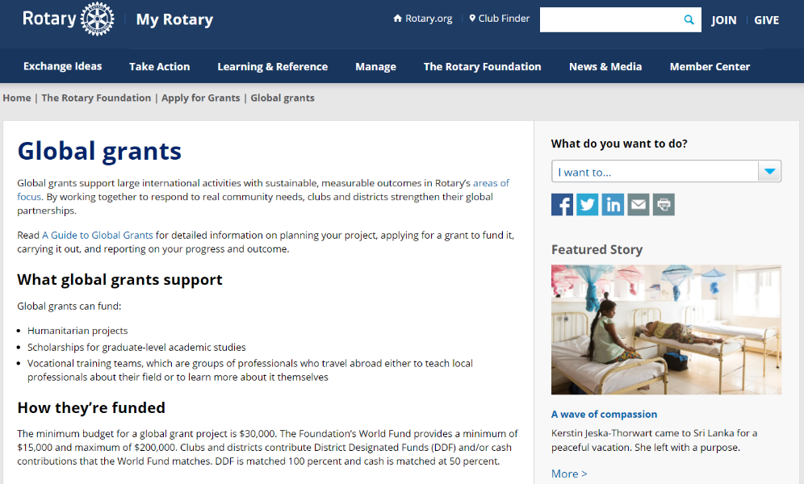
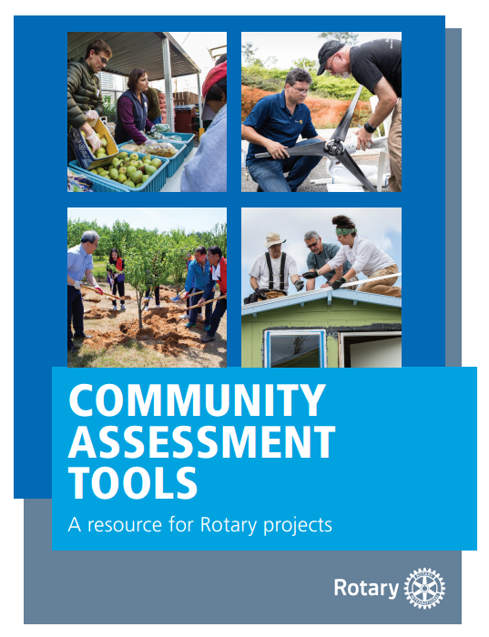
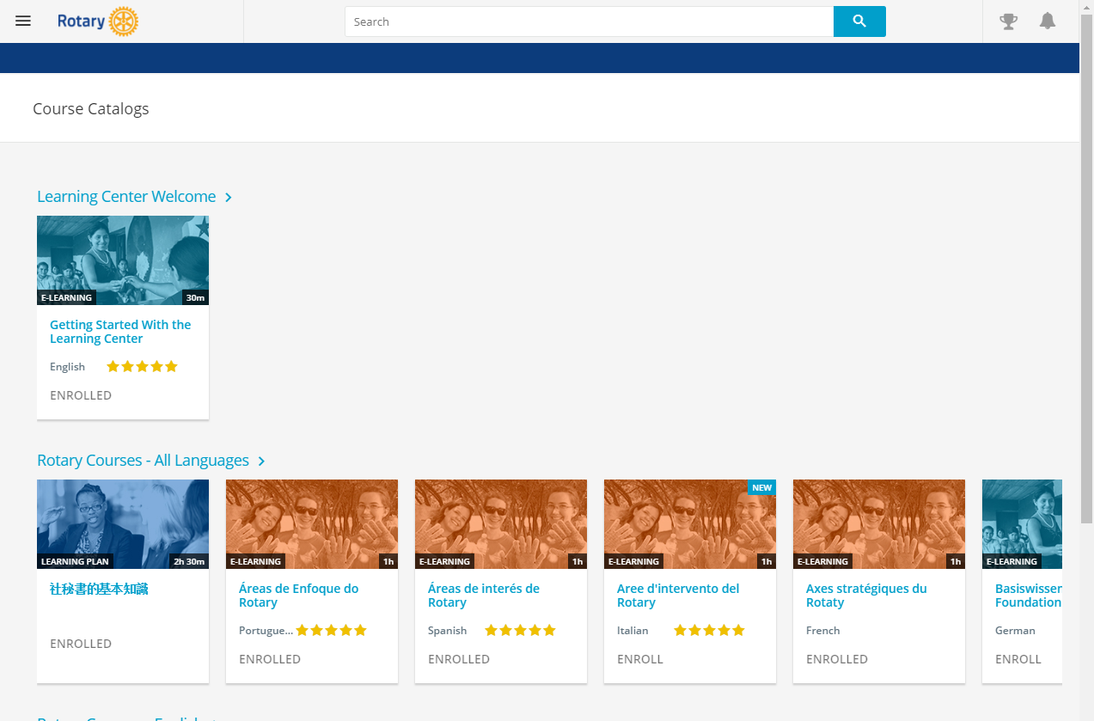
RESOURCES
Notes:
We have a number of resources available to help you take full advantage of grant opportunities.
First and foremost, I encourage you to read A Guide to Global Grants, as it was recently updated back in July. This helpful manual includes everything you need to know to get started and goes through the global grant lifecycle in great detail.
Rotary’s website has a wealth of general and detailed information about each of our grant types. If you navigate to the global grants informational page in My Rotary, there are a ton of resources listed, such as the Terms and Conditions, the Area of Focus Policy Statements, various guides, and other super helpful documents.
The recently refreshed learning center offers training resources on a wide variety of topics, including information to help you apply for Foundation grants. I would encourage anyone interested in applying for grants to take the grant management seminar courses in the Learning Center if you haven’t already.
And last, the guide you see on the right there, Community Assessment Tools, is an invaluable resource for clubs and districts who are conducting a community assessment.

Slide 35
Rotary alumni – any in your club?
Alumni committee Chair-Steve dyer
You are an alum if you participated in any of the following programs:
Interact or Rotaract
Rotary Youth Exchange
New Generations Service Exchange
Rotary Youth Leadership Awards (RYLA)
Rotary Peace Fellowships
Rotary Scholarships (funded by global grants or district grants)
vocational training teams (members and leaders),
Ambassadorial Scholarships
Grants for University Teachers
Group Study Exchange (members and leaders)
Rotary Volunteers (formal program, discontinued)

Slide 36
QUESTIONS

