Slide 1

Serving humanity, empowering a positive change globally

Slide 2
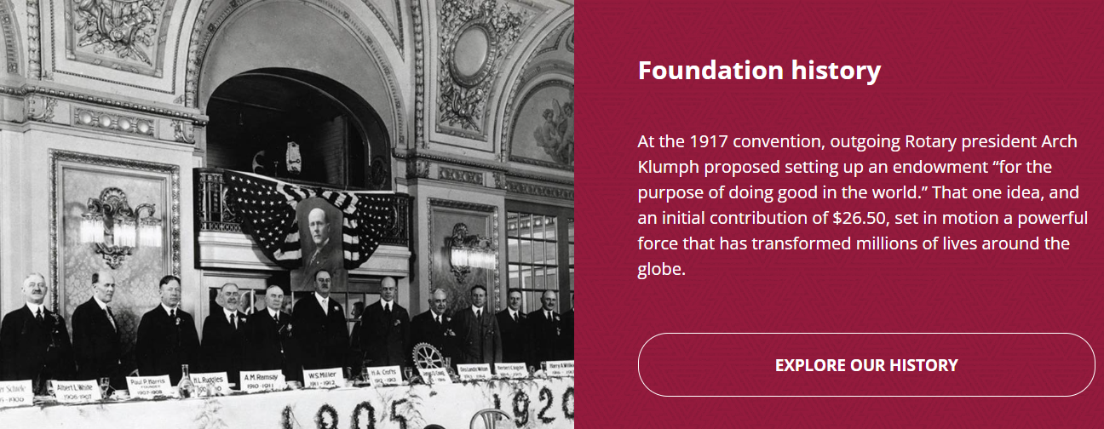

Slide 3
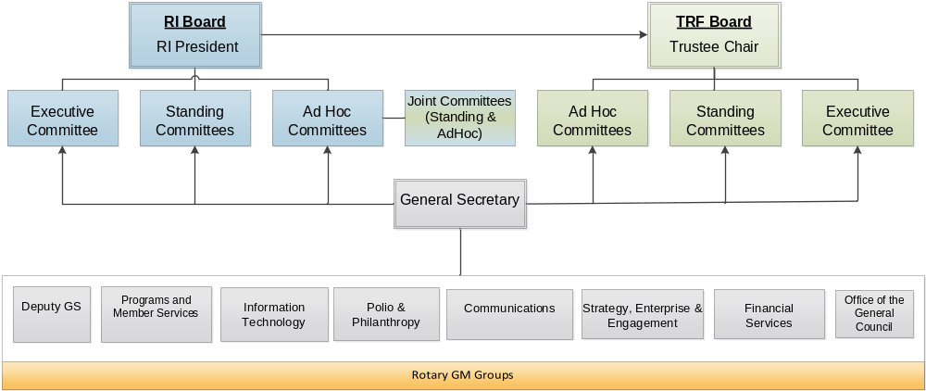
RI’s Organizational Chart
Notes:
Here is the org chart to see how the positions entertwine.
The General Secretary is the operational arm of the two boards and is responsible for carrying out board decisions. The general secretary’s office is organized around 8 business units whose general managers all report to the General Secretary, John Hewko. There are 819 Rotary staff members, have 6 international offices (Europe & Africa; Japan, Korea, Australia, India, Brazil) and 49 languages are spoken.

Slide 4
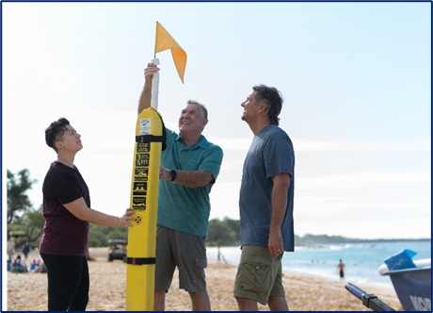

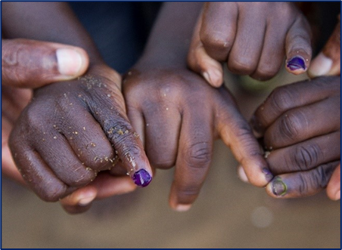
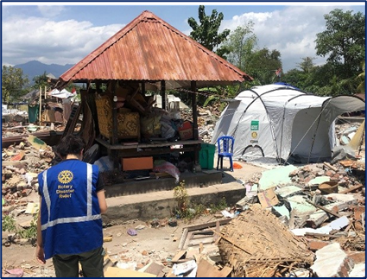
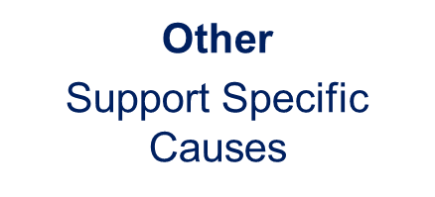





SUPPORTING THE ROTARY FOUNDATION
Annual Fund
For support today
Endowment Fund
To secure tomorrow
PolioPlus Fund
End Polio Now
Donating to The Rotary Foundation earns the donor Paul Harris recognition points
Notes:
Rotarians support our Foundation through these funds:
PolioPlus Fund, dedicated to global polio eradication
Annual Fund, the primary source of funding for Foundation grants and activities
Endowment Fund, which supports the Foundation in perpetuity

Slide 5
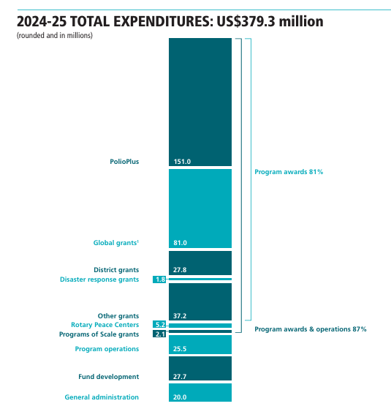
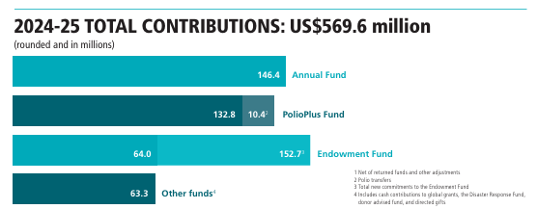








Slide 6
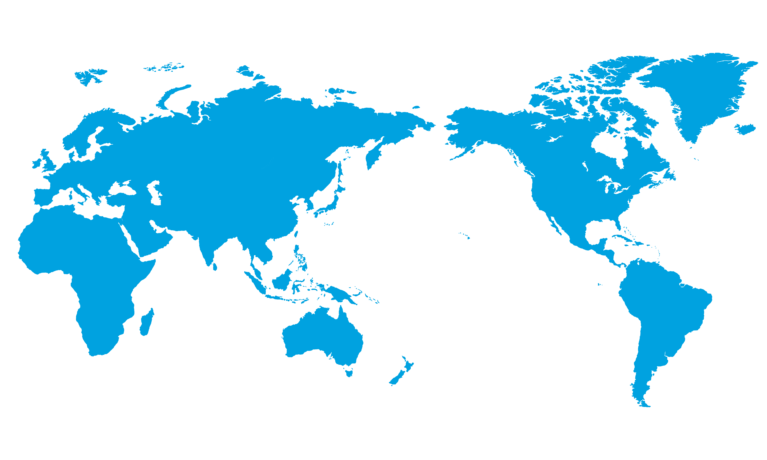
2024-25 GRANT STATISTICS
District grants
468 grants
US$29 million
Global grants
1,423 grants
US$88.2 million
Disaster response grants
74 grants
US$1.9 million
Programs of Scale grant
1 grant
US$2 million
Notes:
In 2024-25, Rotary awarded:
468 district grants with total funding of US$29 million
1,423 global grants with total funding of US$88.2 million
74 disaster response grants with total funding of US$1.9 million
1 Programs of Scale grant with total funding of US$2 million

Slide 7
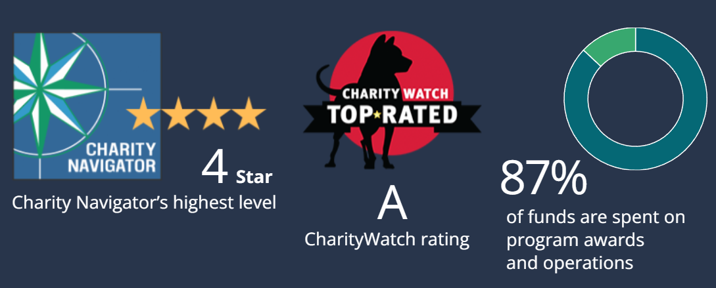

The Rotary Foundation of Rotary International has received 17 consecutive 4-star ratings from Charity Navigator.
The rating reflects Charity Navigator's assessment of how the Foundation uses donations, sustains its programs and services, and practices good governance and openness. (aka Stewardship)
Notes:
The Foundation earned the recognition for adhering to sector best practices and executing its mission in a financially efficient way, demonstrating both strong financial health and commitment to accountability and transparency. Only one percent of the organizations Charity Navigator evaluates have received 17 consecutive 4-star evaluations. The rating reflects Charity Navigator's assessment of how the Foundation uses donations, sustains its programs and services, and practices good governance and openness. This is also known as Stewardship. The District signs an MOU and must oversee the process and adhere to Rotary’s rules.

Slide 8
What is Stewardship?
Stewardship is the responsible management and oversight of grant funds, which ensures that funds are used properly and truly benefit the populations in need:
Supervise projects—MOU Guidelines
Implement projects as approved
Report irregularities
Submit reports
Retain documents- 5 years of soft (electronic) and hard copy

Slide 9
Who is responsible for grant funds?
The governor, governor-elect, and district Rotary Foundation chair have the primary responsibility for club and district qualification. They also oversee the proper implementation of Foundation grants.
DGE and DGN sign District MOU by July 31 in the Grant Center
Districts are responsible for qualifying their clubs. They develop and manage the process using resources such as the Grant Management Seminar Leader’s Guide and the online Grant Management Seminar in the Learning Center. To become qualified, a club must agree to the club MOU and have at least one club member participate in the district’s grant management seminar. Clubs must qualify each year to apply for global grants.

Slide 10
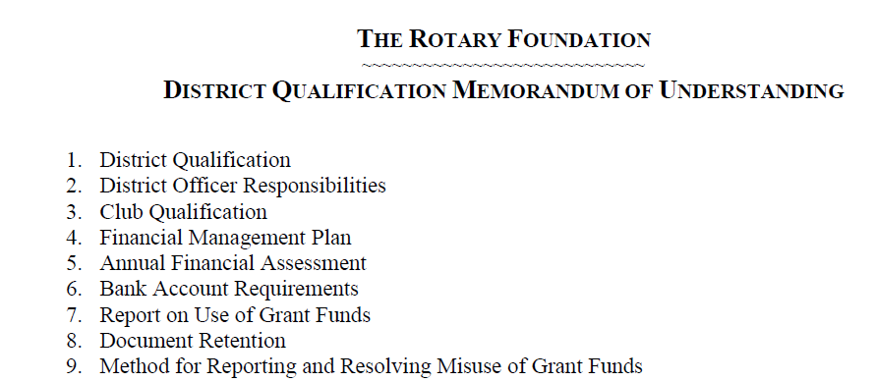
District Qualification MOU

Slide 11
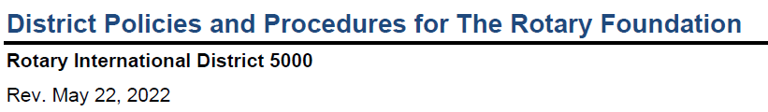
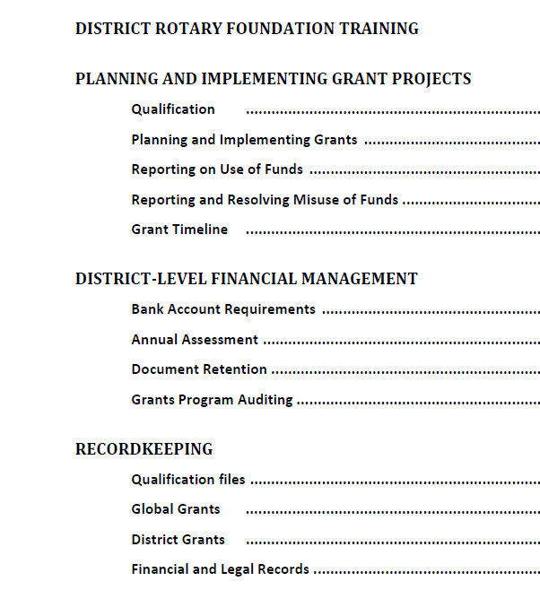

Slide 12
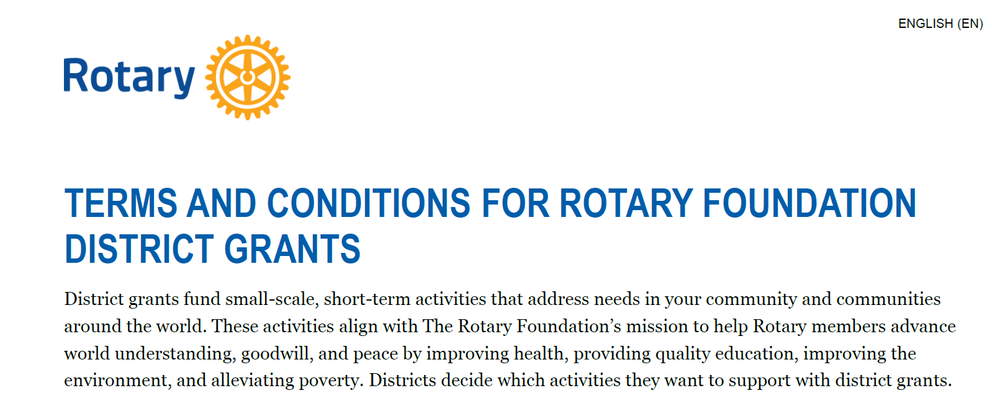

Slide 13
Grants cannot fund:
Unrestricted cash donations to a beneficiary or cooperating organization
Continuous or excessive support of any one beneficiary, entity, or community
The purchase of land or buildings
Fundraising activities
Expenses related to Rotary events such as district conferences, conventions, institutes, anniversary celebrations, entertainment activities, or project ceremonies
Public relations initiatives, unless they are essential to carrying out the project
Project signs that cost more than $1,000
The operating, administrative, or indirect program expenses of another organization
Activities for which the cost has already been incurred

Slide 14
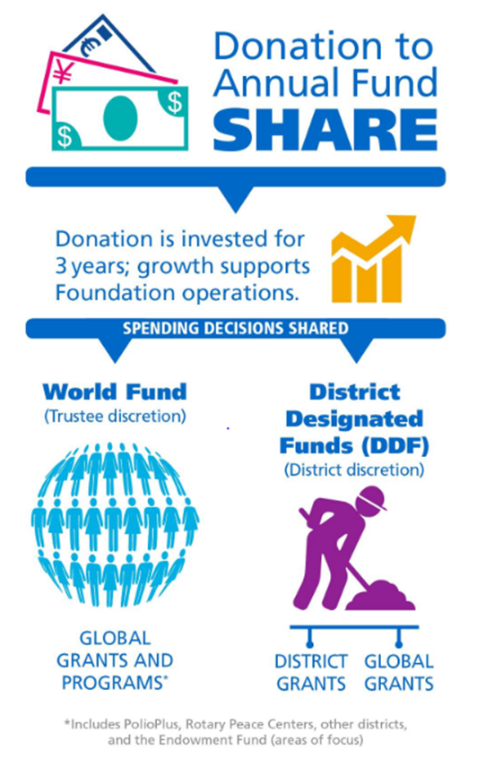
SHARE PROGRAM
When you select Annual Fund – SHARE, the contribution enters the SHARE system for the next 3 years
Under the SHARE system, contributions are divided between the World Fund and District Designated Funds (DDF), after operating expenses of 5% are deducted

Slide 15
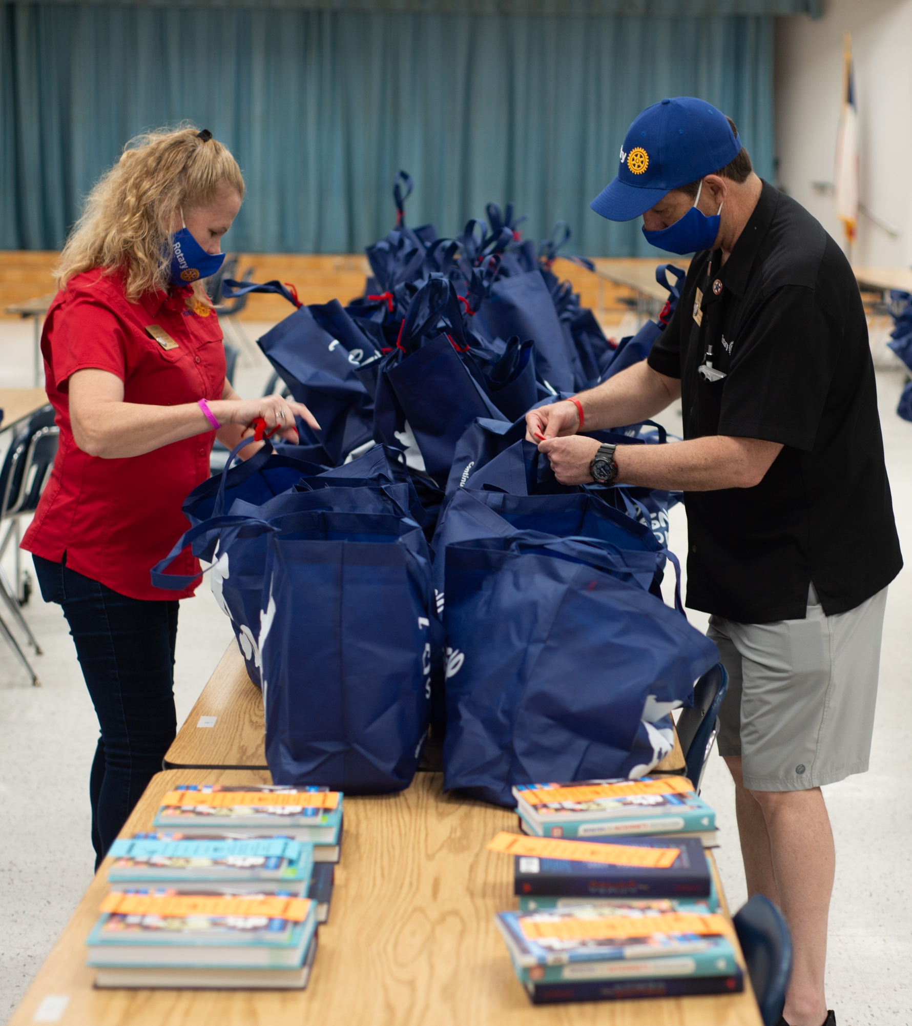
subhead
DISTRICT GRANTS
Small-scale, short-term
Local or international activities
Aligned with the Foundation’s mission
Single grant awarded annually
Notes:
District grants fund small-scale, short-term activities that address needs in your community and communities abroad. You can use district grants to fund a variety of district and club projects and activities, such as local service projects, international humanitarian projects, scholarships and vocational exchanges. District grants can support scholarships at any level of study and for any study area.
You have a lot of freedom to customize your service projects. There aren’t many restrictions, as long as your district grant supports the mission of The Rotary Foundation

Slide 16

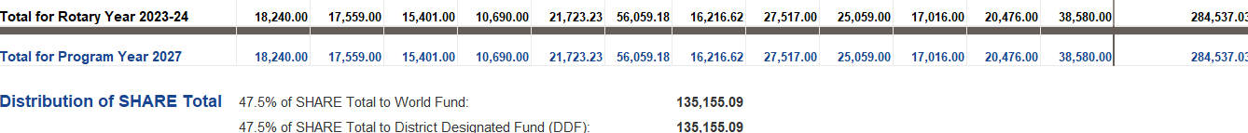



Slide 17

Grant Funds to Rotary Projects
2023-2024 donations of SHARE $284,537 from District 5000
5% Admin Fee $ 14,226 to Rotary International
47.5% to World Fund $135,155 to The Rotary Foundation
47.5% to District Designated Fund (DDF) $135,155 to District 5000
Funds returned in 3 years to the District as grants. Available this year (2026-2027) for projects:
$ 33,789 No match (50% of District Grant DDF)
$ 33,789 Match (50% of District Grant DDF)
$ 67,577 Global Grants (50% of DDF)
$123,503 From District Designated Funds (DDF), net of Admin fee
$ 33,789 Matching Club Cash for matching District Grants
$ 33,789 Matching Club Cash for Global Grants (50% match)
$ 81,093 From World Fund to match Global Grants (80%)
$272,174 Total for Global and local projects
.
Notes:
This year, we have $135k in DDF –District Designated Funds for District and Global Grants. With the club matching cash and the World Fund for Global grants, there is potentially $272k for projects and this is because of the donations to The Rotary Foundation and club funds. The District’s process is to take 50% of the DDF for no matched funds. Meaning the club does not need to match this amount with club cash. Then 50% is to be matched with cash from the club. 50% of the DDF is for global grants and the club needs to match this amount and is able to pledge the total to a global grant.

Slide 18
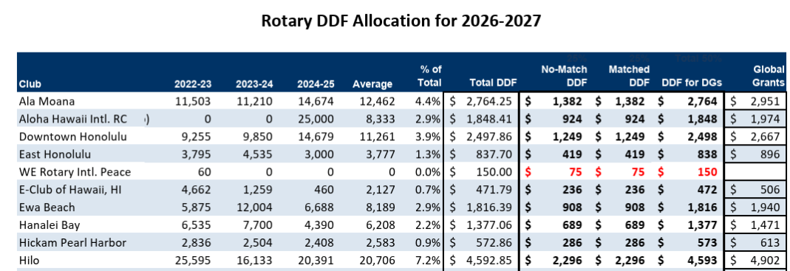

Slide 19
Grant Timeline
For 2026-2027 Grants:
Fall 2025 – 2 members attend grant management training
Jan 31, 2026- submit 3 documents (MOU, Addendum, Financial Plan) and the filing confirmation of fed tax return and GET for year ended 6/30/25. The president for 2026-2027 and 2027-2028 sign the documents. If no President Nominee (PN), the current president can sign.
May 31, 2026-Final grant report submitted by last year’s team.
June 15, 2026-Grant application for Rotary year 2026-2027 submitted
July 2026 – Submit District grant to RI for approval
August - distribute grant funds to clubs
All documents are emailed to grants@rotaryd5000.org
Forms can be found on the District website at: https://rotaryd5000.org/sitepage/district-grant-info-documents

Slide 20
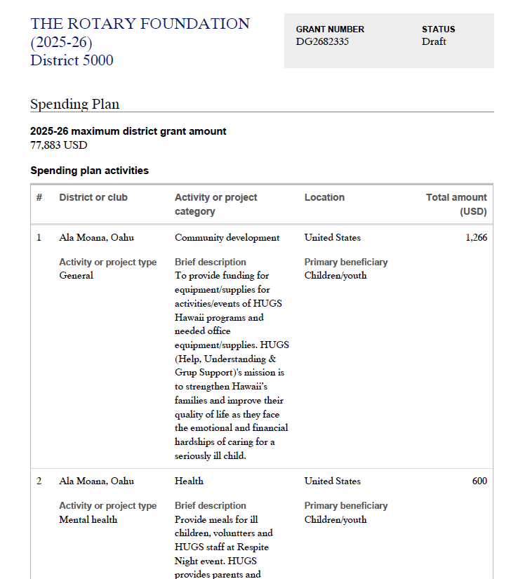

Slide 21

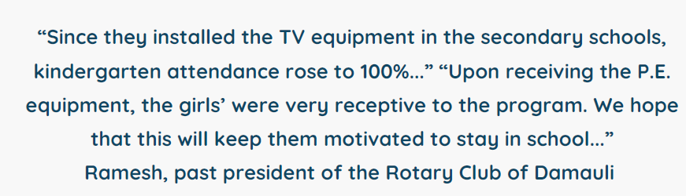
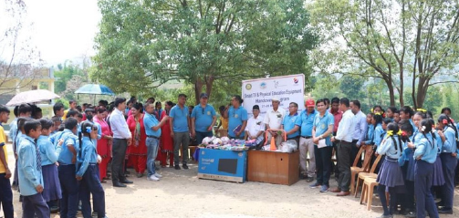
Nepal Project -District grant
RC of Kapolei
Bought 3 TVs and P.E. Equipment for $1,720

Slide 22
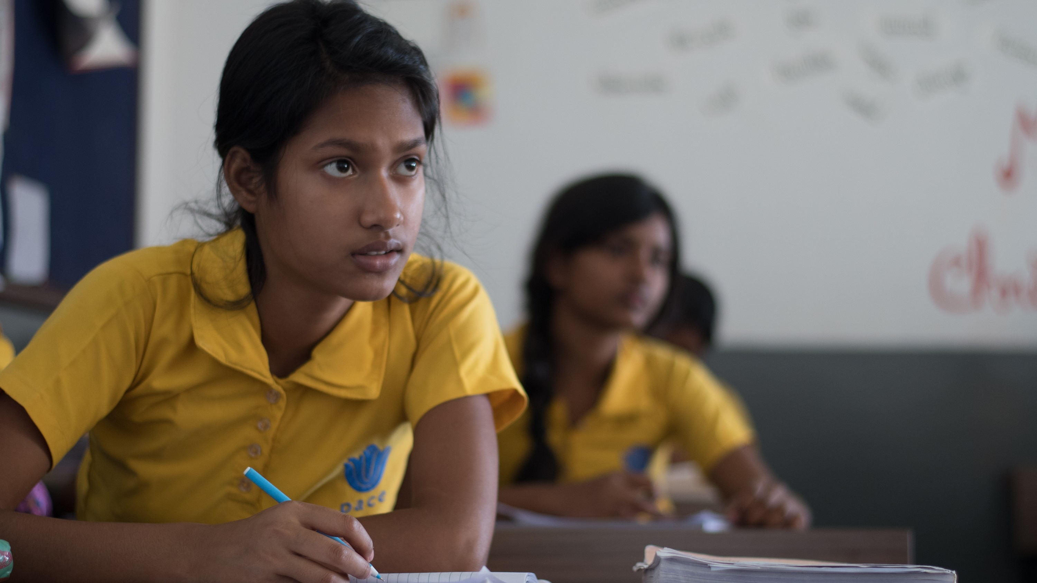
subhead
Grant types
District grants
Global grants
Disaster response grants
Programs of scale grants
Notes:
The Rotary Foundation offers grants that support a wide variety of humanitarian projects, scholarships, and vocational training that Rotarians are doing around the world. We have four types of grants: global grants, district grants, disaster response grants, and programs of scale grants.

Slide 23
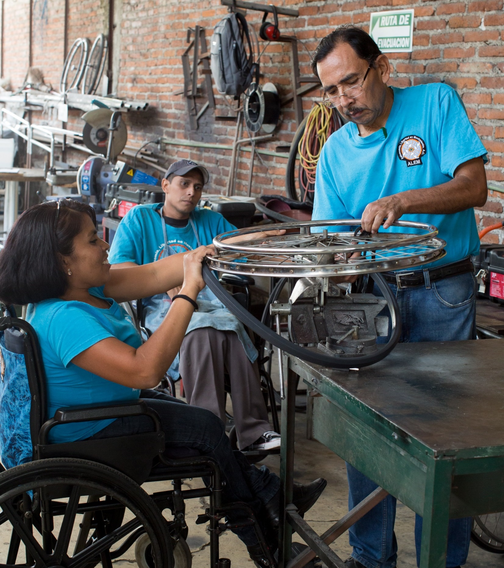
subhead
GLOBAL GRANTS
Large, long-term projects
Sustainable, measurable outcomes
Alignment with areas of focus
International partnership
$30,000 minimum budget
New World Fund match for DDF
Notes:
Global grants support large international activities with sustainable, measurable outcomes in Rotary’s areas of focus. A key feature of global grants is partnership, between the club or district where the activity is carried out and a club or district in another country.
Global grants can support humanitarian projects, scholarships, and vocational training teams. Global grant scholarships support international graduate and post-graduate study for a period of 1-4 years. Global grant vocational training teams support groups of professionals to travel abroad to provide or receive training.
Global grants have a minimum budget of $30,000. Grant sponsors can use a combination of District Designated Funds (DDF), cash, and/or directed gifts and endowment earnings to fund a global grant.

Slide 24
Global grants for D5000
$74.897 allocated for 2023-2024
$62,692 allocated for 2024-2025
$70,195 allocated for 2025-2026
$67,577 allocated for 2026-2027
Notes:
Jmes and Arjun (3min)

Slide 25
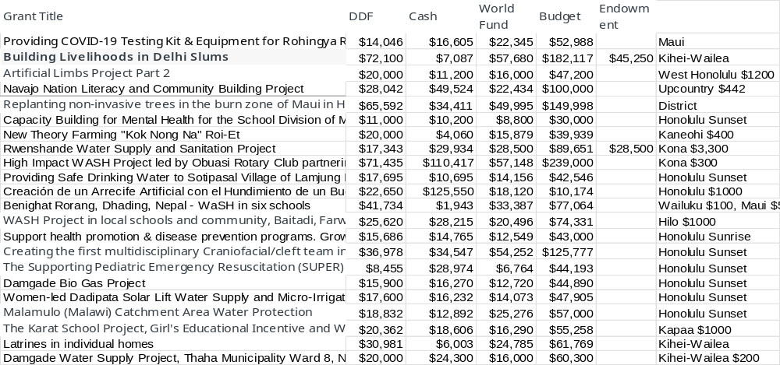
Global grants approved

Slide 26
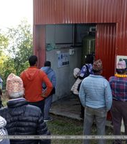
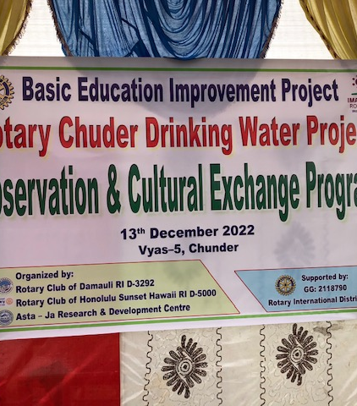
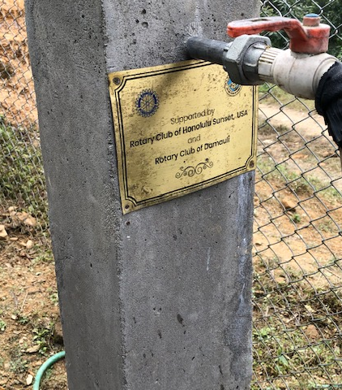
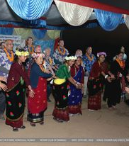
Chuder Drinking Water Project
Spearheaded by Dr. Arjun Aryal and Dr. James Ham, this water project completed in 2021 for $72,755, brought clean water to a village of about 500 people in 120 families.
Previously, they hiked up to 1-4 hours (round trip) to get water.

Slide 27
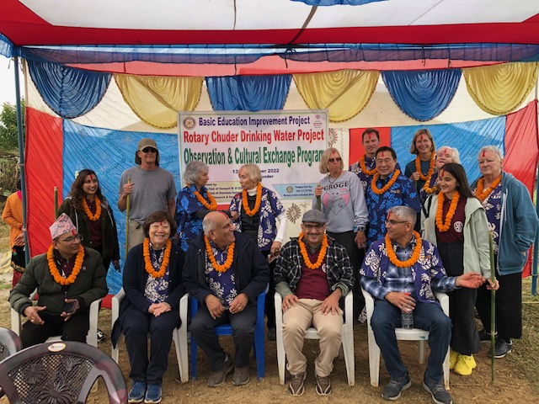
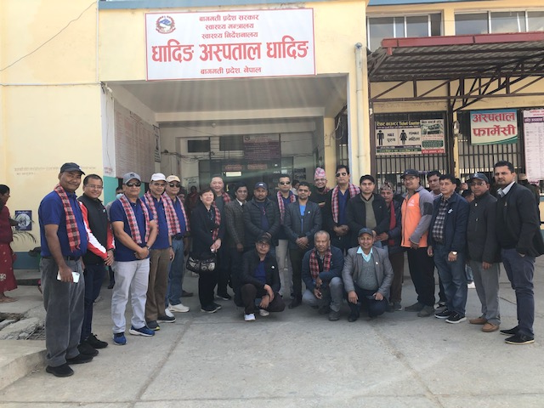
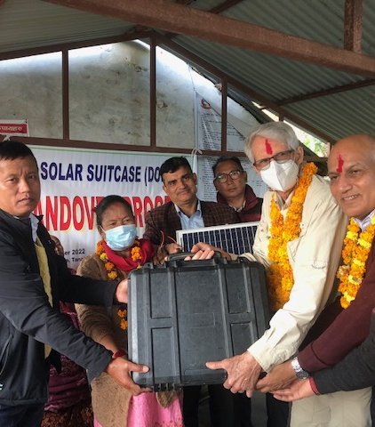
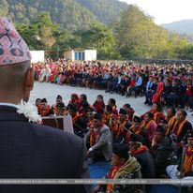
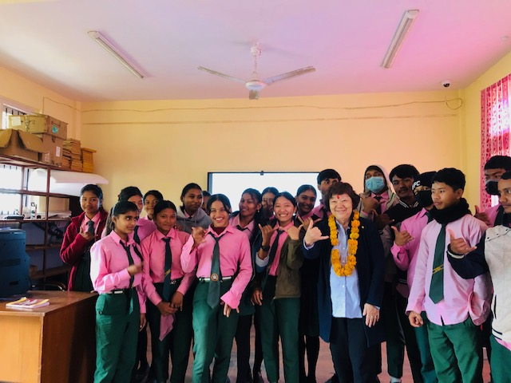
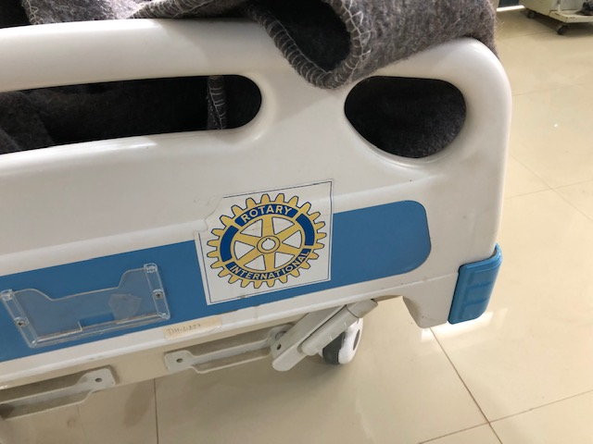
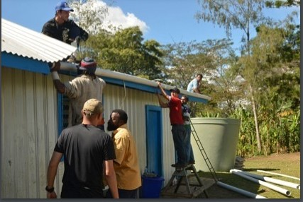
International service projects

Slide 28
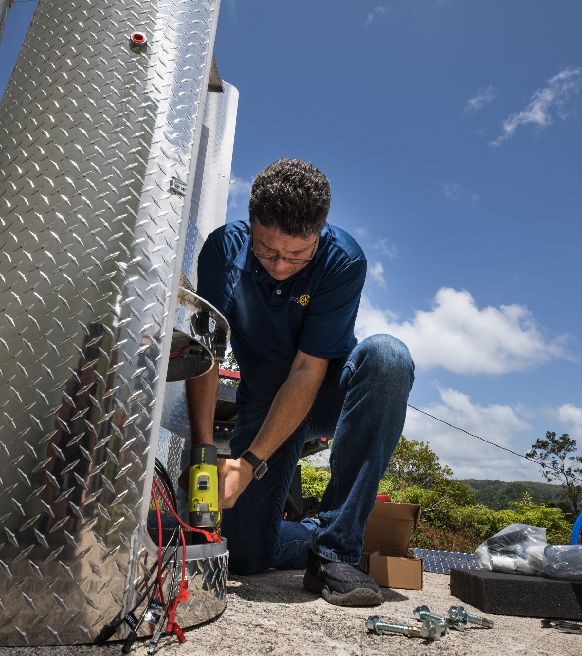
subhead
Disaster response GRANTS
Support relief and recovery efforts in areas affected by natural disaster
Funded by contributions to the Rotary Disaster Response Fund
Notes:
Disaster response grants support relief and recovery efforts in areas affected by natural disaster. Districts in affected areas may apply for grants of up to $25,000, based on the availability of funds. Grant funds can be used to provide basic items such as water, food, medicine, and clothing. These grants are funded by contributions to the Rotary Disaster Response Fund.

Slide 29
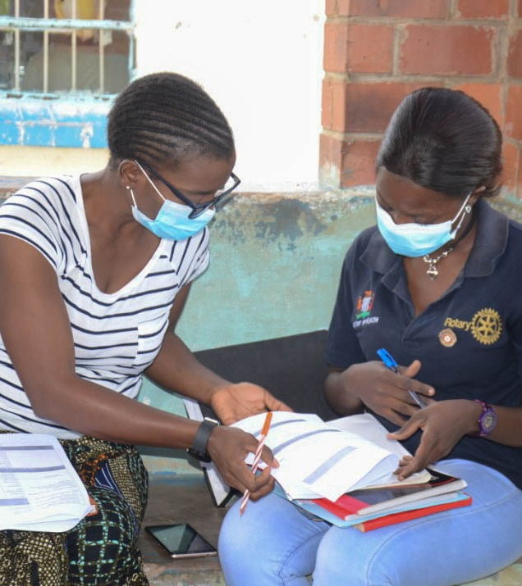
subhead
Programs of scale
Long-term activities that benefit large number of people
Alignment with areas of focus
World Fund award of $2 million; no additional Rotarian funding required
Implemented with partner organization(s)
Competitive two-step application process
Notes:
Programs of Scale is a new grant that enhances the scope, impact, and sustainability of successful Rotary member-led service projects in our areas of focus, by providing longer-term resources. It empowers Rotary members to implement large-scale, high-impact programs with experienced partners that benefit a large number of people in need across a significant geographic area.
The Rotary Foundation will award one $2 million grant each year to a program sponsored by a Rotary club or district working in strong collaboration with partners. It is a competitive process that requires a concept note and full proposal. Applicants should be prepared to include a fully developed program design that is based on clear evidence and involves all of the key stakeholders for successful implementation and sustainability. Each grant will help these programs scale up over a three- to five-year period.
More information is available at rotary.org/programsofscale.

Slide 30
Program of Scale
2021 – Partners for a Malaria-Free Zambia. Reaching 1.2 million people
2022 – Together for Healthy Families in Nigeria working to reduce maternal and neo-natal mortality rate.
2023 – United to End Cervical Cancer in Egypt, a four-year campaign to increase awareness about cervical cancer and how to prevent it.
2024 – Partners for Water Access and Better Harvests in India, a five-year evidence-based program to improve livelihoods of over 60,000 rural farmers across four states in India
2025 – Pathways to Peace an Prosperity in Colombia to establish Positive Peace hubs in four urban and rural communities to strengthen their capacity to resolve conflicts
2026 – Collaboration for Sustainable Water and Sanitation Systems in Haiti to improve living conditions and reduce the incidence of waterborne disease by 25% in three local government areas

Slide 31

GLOBAL GRANT SCHOLARSHIPS
Graduate level
Study periods of 1-4 years
Selected area of focus strongly relates to:
  Previous work, volunteer, and study experience
  Academic program
  Future career plans (immediate and long-range)
Host and international sponsors
$30,000 minimum budget
Notes:
Global grants can fund scholarships for career-minded professionals for one to four years of graduate-level study in Rotary’s areas of focus.
The scholars’ previous work, volunteer, and study experience must strongly relate to the selected area of focus; the scholars’ academic program must strongly relate to the selected area of focus; and the scholars’ future career plans, both immediately after the scholarship period and in the long-term, must strongly relate to the selected area of focus.
A host sponsor and international sponsor work together to identify the scholar and submit the application.
The minimum budget for global grants is $30,000.
Global grant scholarship applications undergo an intense review. Not all applications are approved because, often, applications do not align with an area of focus.

Slide 32
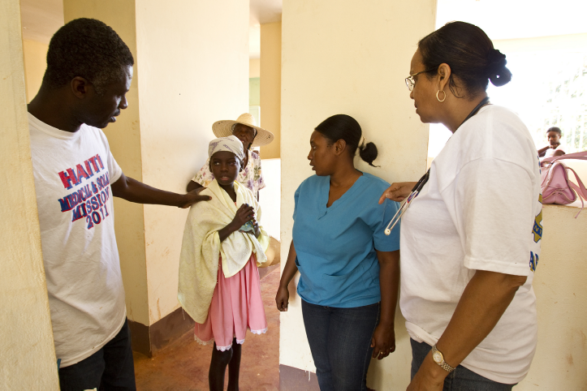


VOCATIONAL TRAINING TEAMS
Traveling groups of professionals:
  Learn about their vocation
  Teach professionals
  about a particular field
  Strengthen knowledge and skills
Notes:
Vocational training teams are groups of professionals who travel, either to learn more about their vocation or to teach local professionals about a particular field. These teams can expand the knowledge and skills of individuals and communities.
The vocational training team concept was inspired by the successes of past grant programs, including Group Study Exchange and Volunteer Service Grants.
Rotary clubs and districts can support vocational training teams through district grants or global grants.

Slide 33
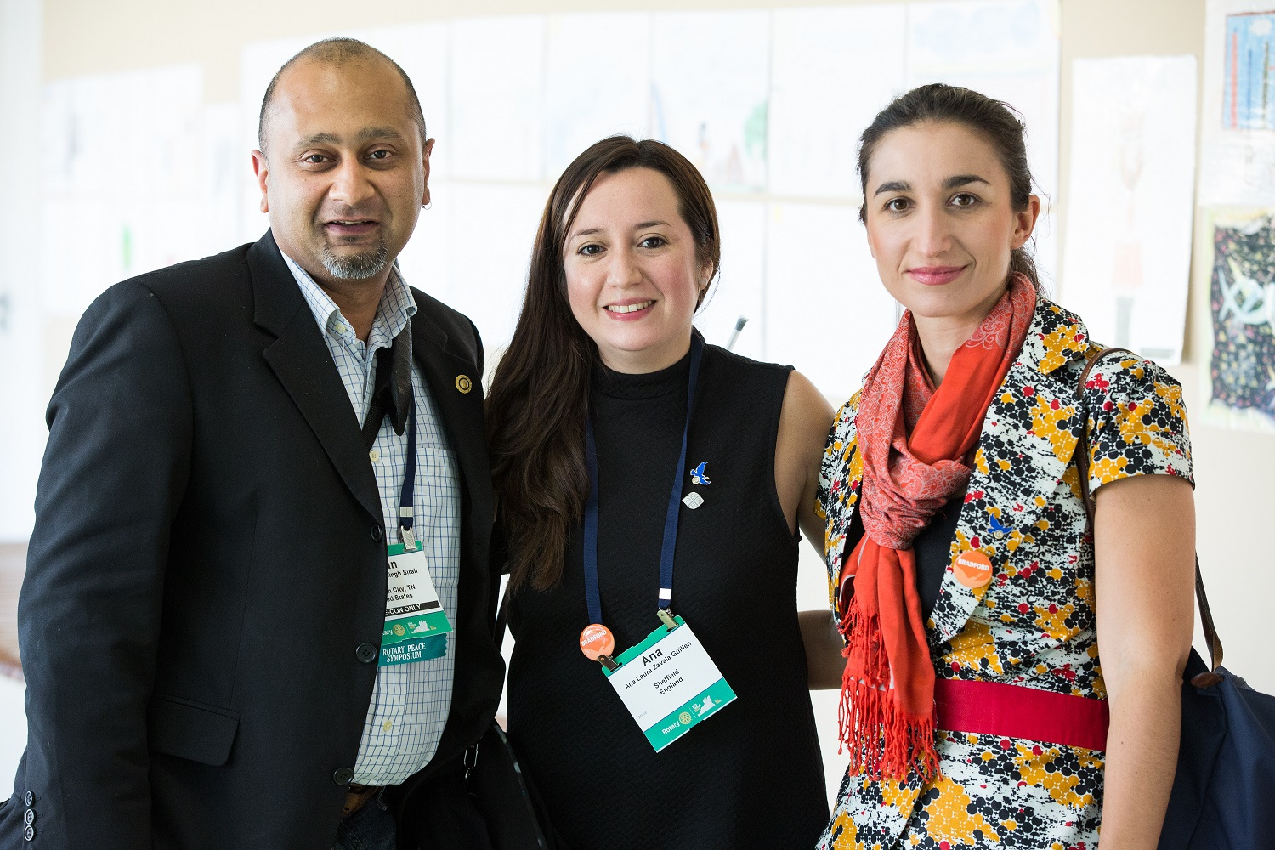
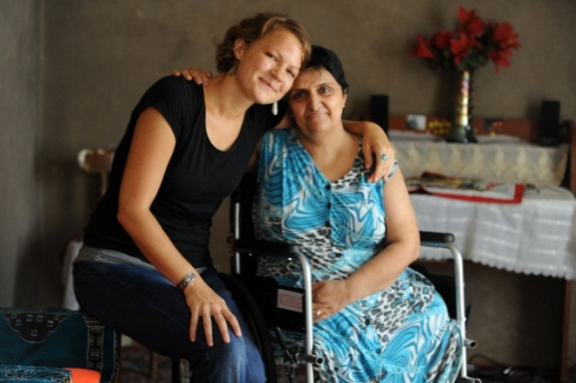

SUPPORT ROTARY PEACE CENTERS
Nominate qualified candidates
Promote the fellowships
Identify Major Donors
Become a Peacebuilder District
Involve peace fellow alumni
Notes:
Rotarians can support Rotary Peace Centers by:
Seeking and endorsing qualified candidates to compete for fellowships. All districts are invited to nominate candidates each year. The due date to submit applications to The Rotary Foundation is 1 July.
Sharing information about the program within your network
Identifying Major Donors in your region to endow an annual fellowship with a gift of $25,000 or more
Supporting the program — encourage your district to become a Peacebuilder District
Asking Rotary Peace Centers alumni to speak at club meetings and involving them in club activities

Slide 34
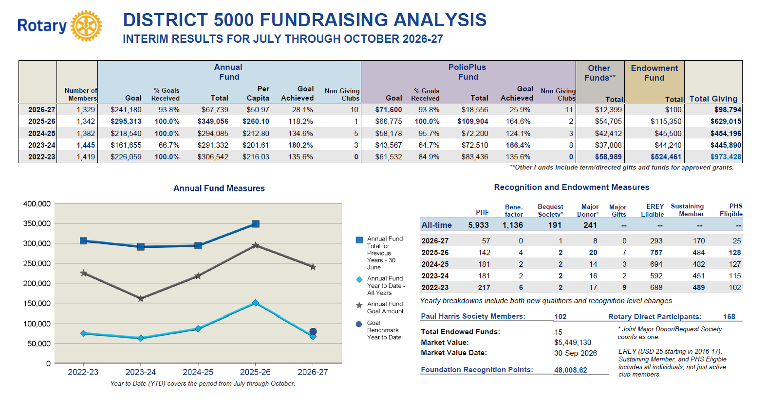

Slide 35

RESOURCES

Slide 36

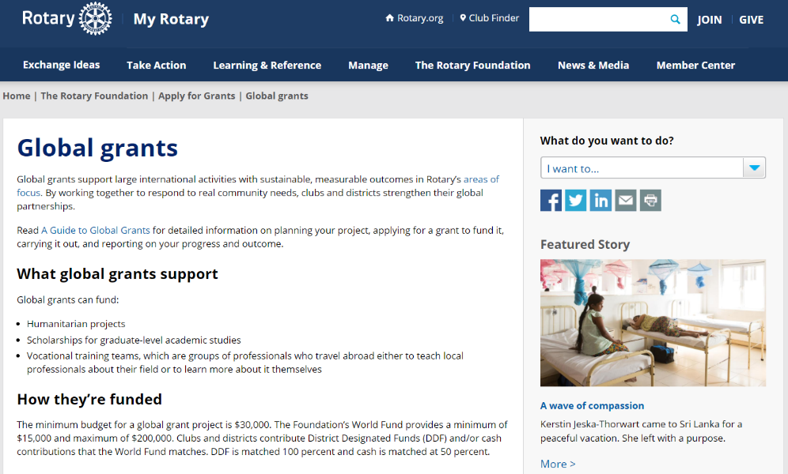
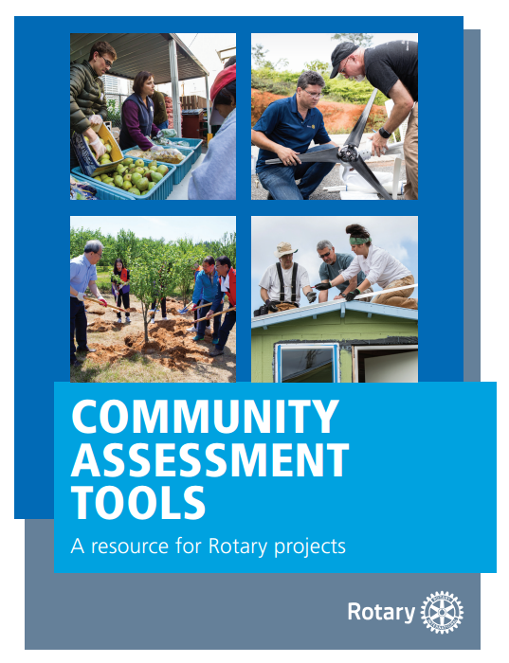
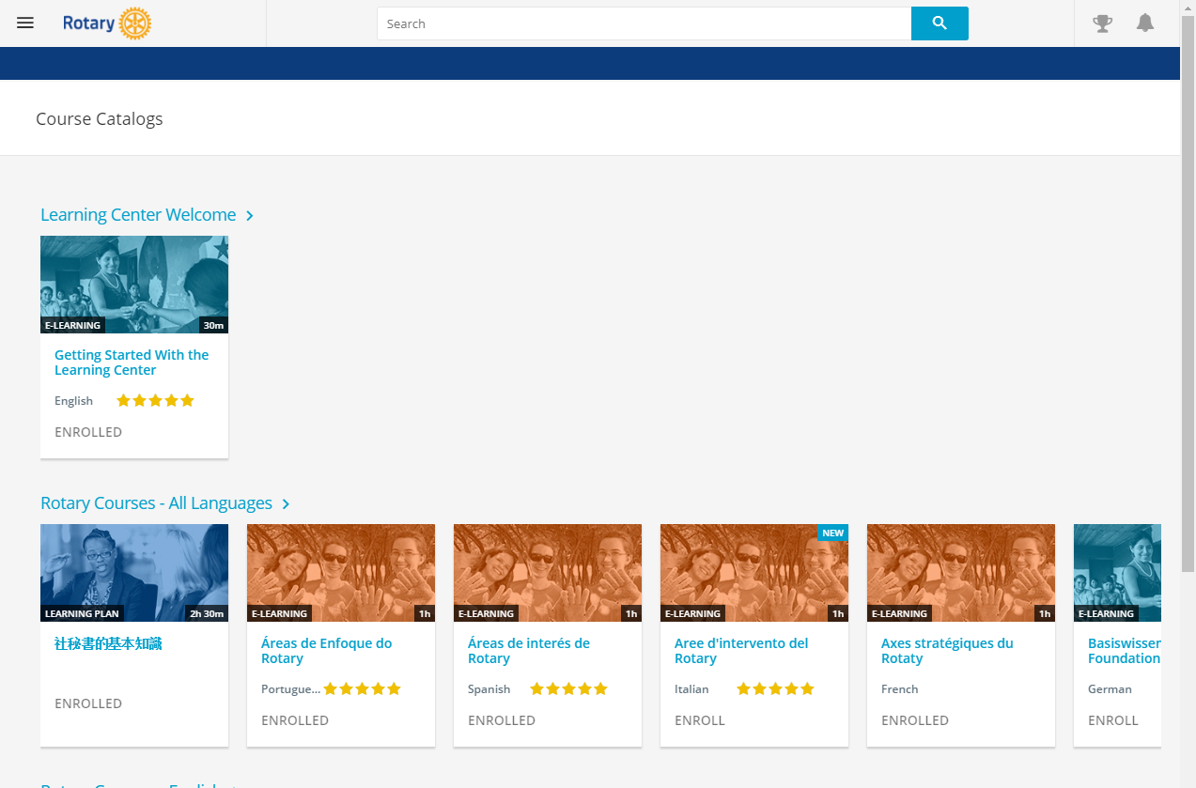
RESOURCES
Notes:
We have a number of resources available to help you take full advantage of grant opportunities.
First and foremost, I encourage you to read A Guide to Global Grants, as it was recently updated back in July. This helpful manual includes everything you need to know to get started and goes through the global grant lifecycle in great detail.
Rotary’s website has a wealth of general and detailed information about each of our grant types. If you navigate to the global grants informational page in My Rotary, there are a ton of resources listed, such as the Terms and Conditions, the Area of Focus Policy Statements, various guides, and other super helpful documents.
The recently refreshed learning center offers training resources on a wide variety of topics, including information to help you apply for Foundation grants. I would encourage anyone interested in applying for grants to take the grant management seminar courses in the Learning Center if you haven’t already.
And last, the guide you see on the right there, Community Assessment Tools, is an invaluable resource for clubs and districts who are conducting a community assessment.

Slide 37
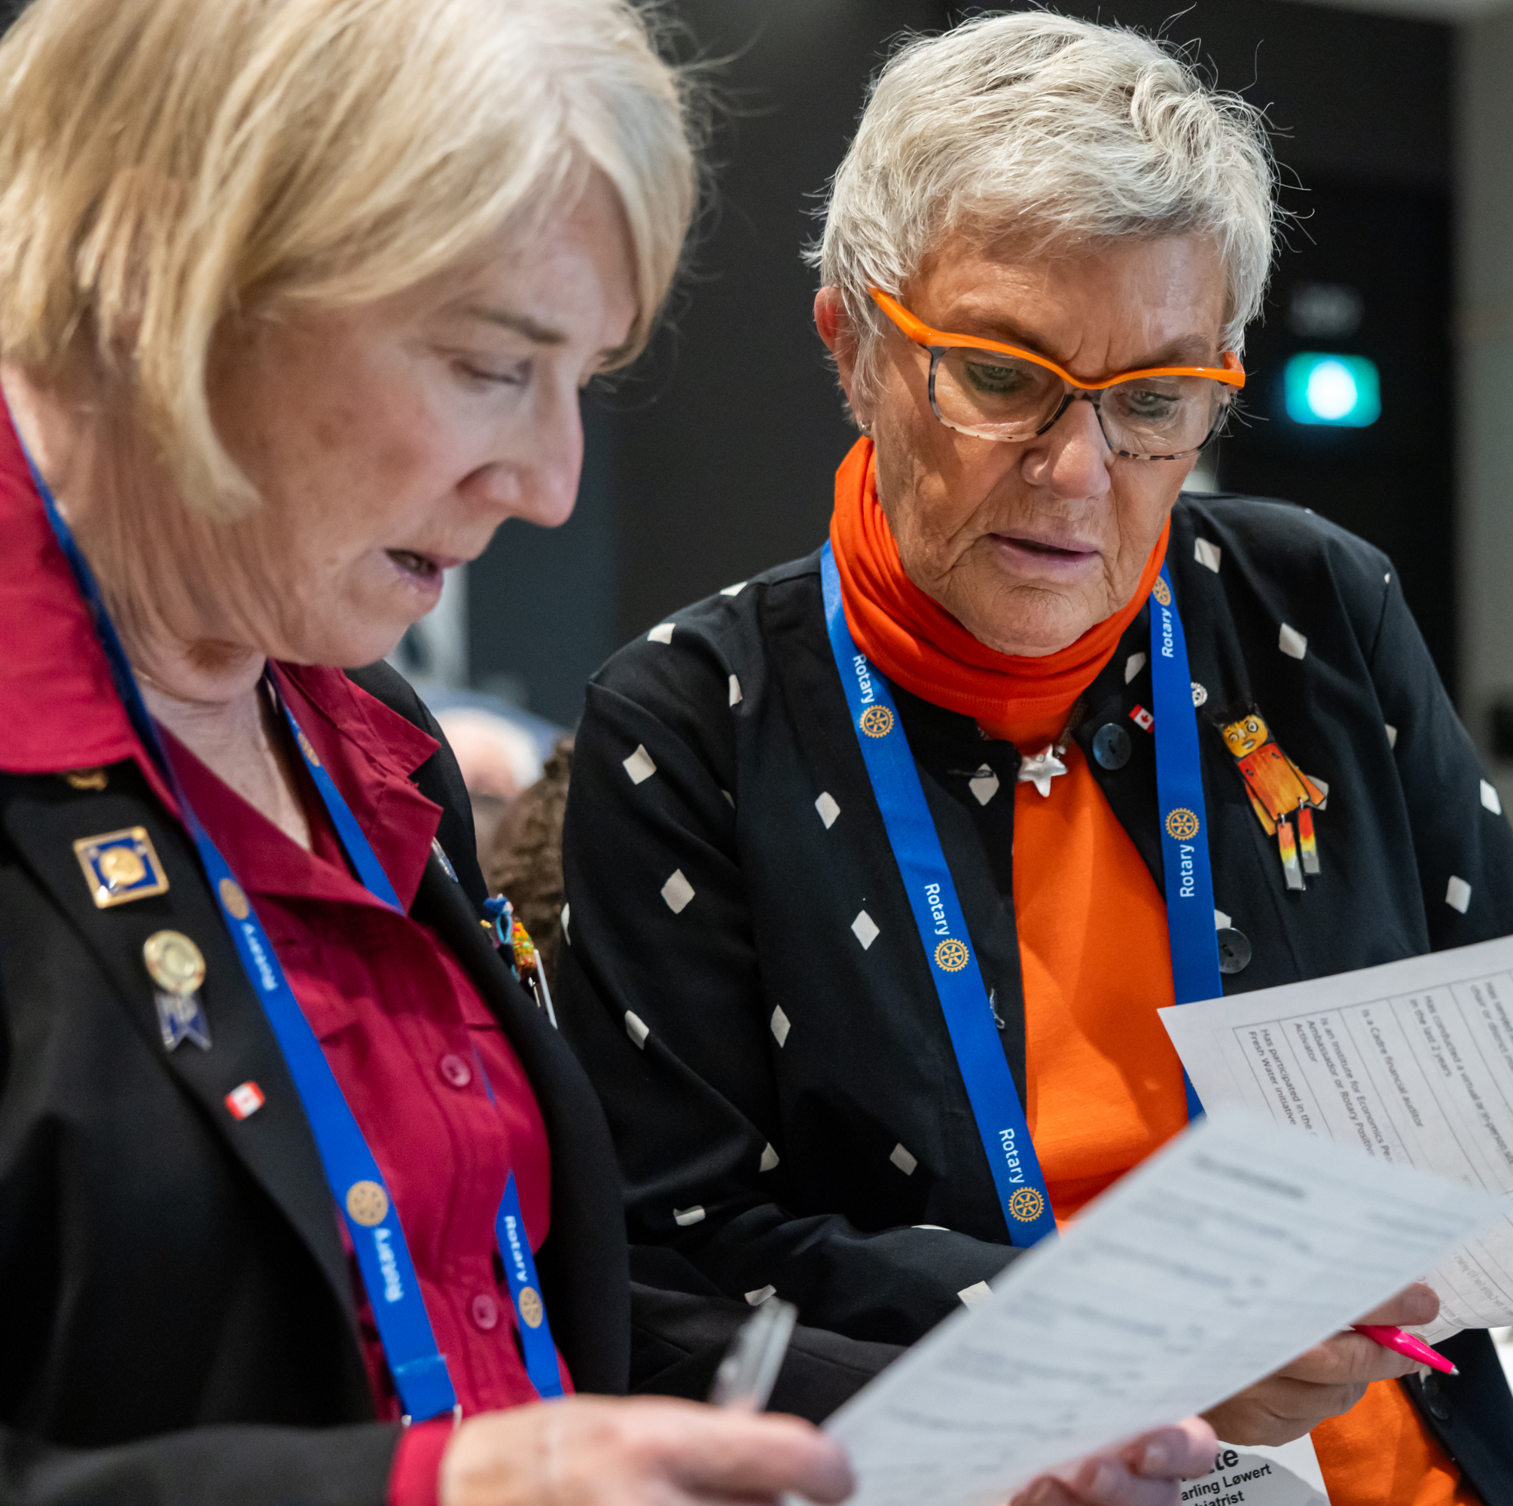
The Cadre of Technical Advisers and rotary action groups
The Cadre consists of Rotary members with professional expertise in our areas of focus and in financial auditing.
Rotary Action Groups include members around the world with expertise in a specific topic. They can help you:
  Understand Rotary’s areas of focus
  Plan community assessments
  Design and implement your project
  Incorporate elements of sustainability
  Establish monitoring and evaluation plans
Notes:
Members of The Rotary Foundation Cadre of Technical Advisers are Rotary members who have professional expertise in our areas of focus and in financial auditing. Cadre members help the Foundation evaluate grant projects and help Rotary members plan and implement projects. They offer their technical and regional expertise, advice about planning and implementing projects, and assistance navigating the grant application process.
Rotary Action Groups are international, RI-recognized organizations whose members have expertise in a specific topic such as economic development, family health, the environment, or water. They use this technical knowledge and their global networks to help clubs and districts plan and carry out meaningful service projects. They also can help clubs find partners, funding, and other resources.
To find a Cadre member who can help you, write to cadre@rotary.org.
To learn more about Rotary Action Groups, visit rotary.org/actiongroups.

