Slide 1
An Overview of Grief: Navigating the Journey
What is Grief?
Intense sorrow and emotional response experienced after losing someone important to us.
It is a normal, healthy human process, not a sign of weakness
It is a unique journey, there is no “right” or “wrong” way to grieve

Slide 2
Common symptoms of Grief
Emotional: Sadness, anger, guilt, anxiety, loneliness, yearning
Physical: Fatigue, nausea, changes in weight and/or sleeping, headaches, chest pain
Behavioral/Cognitive: Forgetfulness, difficulty concentrating, social withdrawl, crying spells

Slide 3
Stages of Grief (Kubler-Ross Model)
Denial: “This can’t be happening?”
Anger: “This is not fair?”
Bargaining: “If I promise to be a better person, work harder, etc. will you bring them back?”
Depression: “I miss them so much, its hard to go on”
Acceptance: “It’s going to be okay; I can live with this”

Slide 4
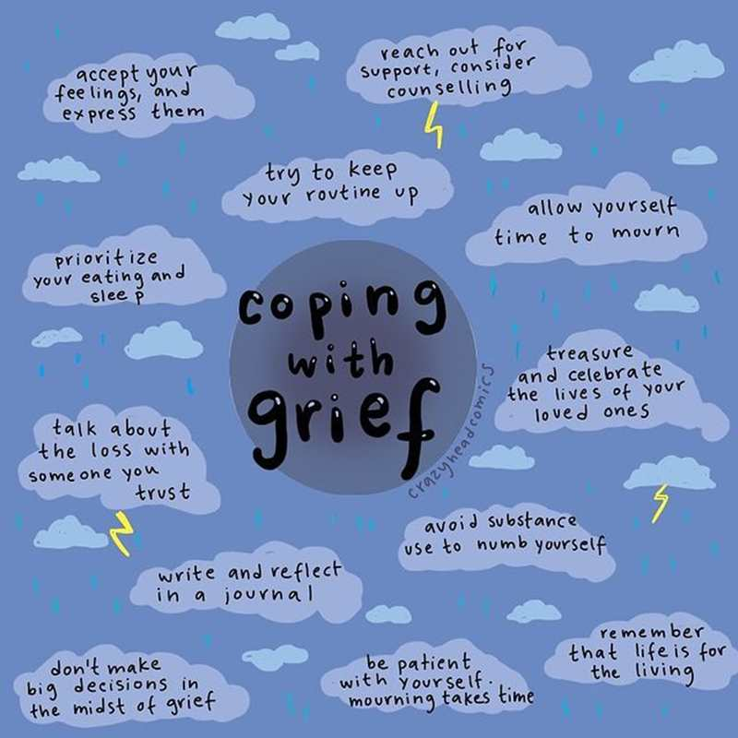
Tips for the journey…

Slide 5
Self care during grief
What and who is my support?
Managing my schedule: personal and work - boundaries
Water & exercise
Rest periods
Taking time to breathe
Seeking additional support, maybe a professional? A support group?

