Slide 1
LEADERSHIP: It’s all about perspective
Kimberly B. Moore, PHD
Rotary d5000
Pre-pets training
21 February 2015

Slide 2
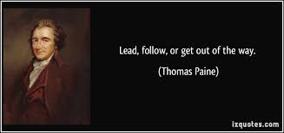
Agenda
Thoughts on Leadership
Leading Volunteers
Thoughts on Time
Common Fears
Five Keys to Success
Reflection
Lead, Follow, or Get Out of the Way

Slide 3
Thoughts on leadership
“Leadership is not about position, it’s about influence.”
- John C Maxwell
“Leadership is the art of balancing shortfalls.”
- General Stephen R. Lorenz
“Leadership is a function of knowing yourself, having a vision that is well communicated, building trust among colleagues, and taking effective action to realize your own leadership potential.”
- Warren Bennis

Slide 4
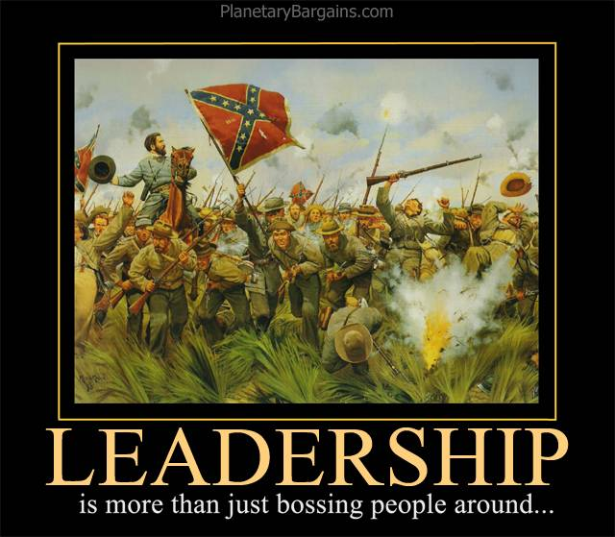

Slide 5
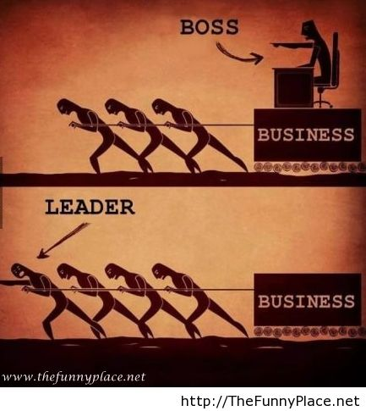
Leading Volunteers
If every American donated
5 hours each week it would
equal the labor of 20 million
full-time volunteers.
~Whoopi Goldberg

Slide 6
Thoughts on Time
“Your time is limited, so don't waste it living someone else's life. Don't be trapped by dogma - which is living with the results of other people's thinking. Don't let the noise of others' opinions drown out your own inner voice. And most important, have the courage to follow your heart and intuition.”
”My favorite things in life don't cost any money. It's really clear that the most precious resource we all have is time.”

Slide 7
Common FEARS
► I don’t know how …
► Am I all alone?
► Will I succeed or fail?
► Will they like me?
► Can I handle success?
“Sometimes when you innovate, you make mistakes. It is best to admit them quickly, and get on with improving your other innovations” ~Steve Jobs

Slide 8
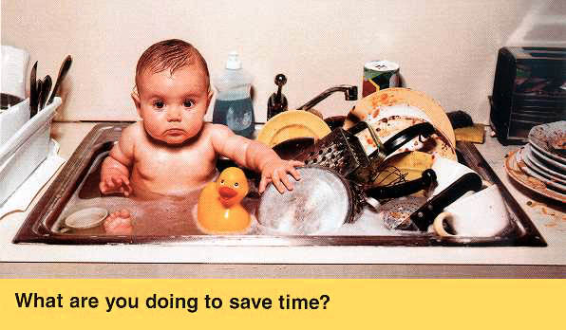
five Keys to success
Respect others
Build the reputation
Trust your instincts
Be accountable
Embrace change

Slide 9
http://www.brainyquote.com/photos/o/ogmandino164003.jpg

Slide 10
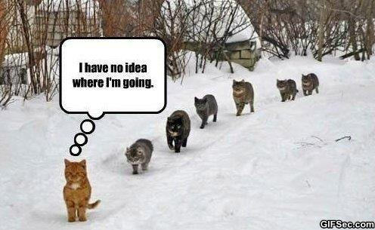
Reflections ……
On your own paper – answer each of these questions.
1. My year as president will be successful if I ________________________
During my year as President, I will need the most help with _____________________________________________________________
My best club level resource is ___________________________________
My best D5000 resource is _____________________________________
My most positive leadership attributes are_________________________

Slide 11
Lead, follow, or get out of the way…
“Technology is nothing. What's important is that you have a faith in people, that they're basically good and smart, and if you give them tools, they'll do wonderful things with them.:”
Steve Jobs

Slide 12
