Slide 1
Club and District Training 2018-2019
Innovate & Improve
Club and Vocational Service
Bob Peterson
D5000 Vocational Service Chair
Rotary Club of Metropolitan Honolulu (Metro)
Sandy Matsui (
D5000 Club Service Chair
Rotary Club of Kaneohe

Slide 2
BE A VIBRANT CLUB YOUR CLUB LEADERSHIP PLAN
Does your clubʻs values statement unify your members, inspire prospective members & and generate interest in community work? (donʻt know if your club has a value statement.., thatʻs ok, thatʻs why youʻre here)
Introduced creative meeting formats?
Traditional 1905 Meetings
Speed networking
Service 1st Thursdays
Socials
Relaxed Attendance Guidelines?

Slide 3
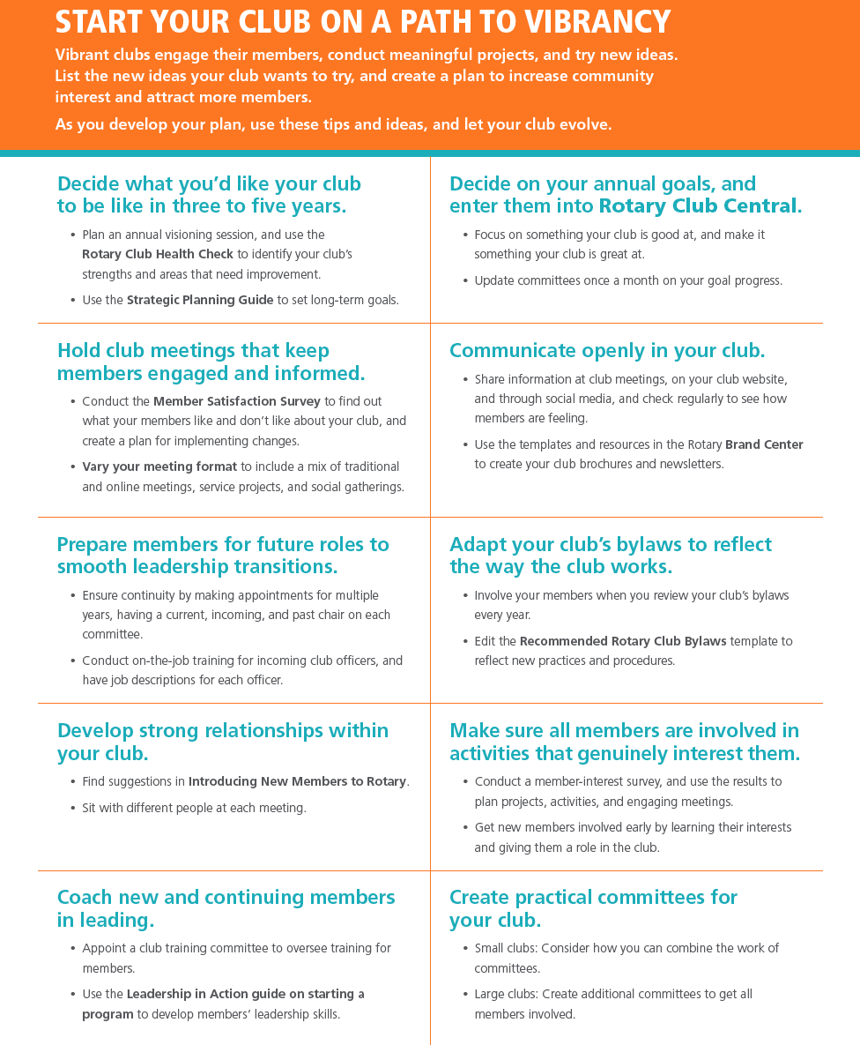
TIPS TO START YOUR CLUB ON A PATH TO VIBRANCY
Decide what you’d like your club to be like in three to five years.
Decide on your annual goals, and enter them into Rotary Club Central.
Hold club meetings that keep members engaged and informed.
Communicate openly in your club.
Prepare members for future roles to smooth leadership transitions.

Slide 4
TIPS TO START YOUR CLUB ON A PATH TO VIBRANCY
Adapt your club’s bylaws to reflect the way the club works.
Develop strong relationships within your club.
Make sure all members are involved in activities that genuinely interest them.
Coach new and continuing members in leading.
Create practical committees for your club.

Slide 5
The Role OF CLUb SERVICE OR CLUB ADMINISTRATION COMMITTEE
To perform the logistical tasks that help your club run smoothly and make your club meetings successful.
The club meeting shapes members’ Rotary experience. Meetings should be fun and interactive.
Clubs need active, engaged members in order to provide service to their communities and attract new members.

Slide 6
DUTIES OF THE CLUB SERVICE COMMITTEE
May include:
arranging speakers
setting meeting agendas
maintaining websites and social media
coordinating communication
planning assemblies, socials and other events.
Notes:
Handout

Slide 7
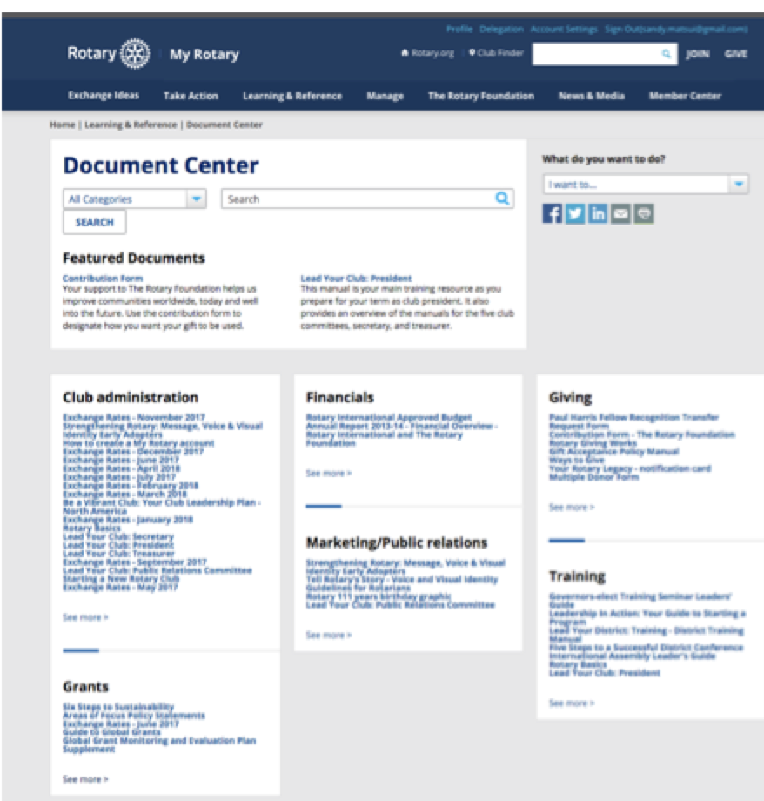
Resources for CLUB SERVICE & Administration
The role of the Club Service Committee is to perform the logistical tasks that help your club run smoothly and make your club meetings successful.
If you find yourself wishing you had more information on how to do this, the good news is that it has probably already been created for you. The Rotary International Website is filled with log-in to MY Rotary, forms, documents, videos, webinars… and more (see handout)
My Rotary https://my.rotary.org/en/learning-reference/document-center

Slide 8
Vocational service

Slide 9
Early Growth of Rotary

Slide 10
Vocational Service Is …
“It was in this atmosphere that Paul Harris began to wonder if one person from each business and profession could actually work together, in a non-competitive atmosphere, to help each other improve their business and income. If they were not rivals or competitors, they could be friends and help each other achieve success. Thus, the idea of friendship and business was combined — and the idea of a Rotary Club evolved.” ~ Cliff Dochterman, Past RI President 1992-93

Slide 11
Vocational Service
Vocational Service is one of Rotary’s Avenues of Service. Vocational Service calls every Rotarian to:
Aspire to high ethical standards in their occupation;
Recognize the worthiness of all useful occupations, and;
Contribute their vocational talents to the problems and needs of society.

Slide 12
E-20. Vocational Service Committee: R.I. Messages on Vocational Service
Create a stronger emphasis on business networking with integrity in Rotary at the club and district level.
Focus more attention on business networking with integrity as a means of attracting and mentoring the new generation.

Slide 13
E-20. Vocational Service Committee: R.I. Messages on Vocational Service
Emphasize the connection between the Four Way Test and the Rotary Code of Conduct (Declaration of Rotarians in Businesses and Professions) and their importance to the values of Rotary.

Slide 14
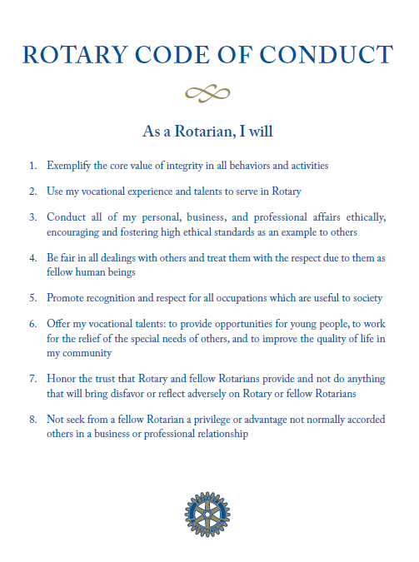
Ethics
One of the central goals of Vocational Service is to promote and advance Rotary’s high ethical standards. Two useful tools Rotarians have to assess these standards are The Four-Way Test and The Rotary Code of Conduct.

Slide 15
What was E-20 addressing …
"He profits most who serves best" ~ Arthur Sheldon, 1909 adopted by R. I. (secondary motto)
“Givers Gain®” ~ Dr. Ivan Misner, PhD – Founder/CEO of Business Network International / Father of Modern Business Networking / Former Rotarian / Paul Harris Fellow, 1985
“They profit most who serve best” ~ 2004, R. I. the Council on Legislation (secondary motto)

Slide 16
Vocational Networking & Vocational MentorInG
Hold monthly Biz Networking events for the benefit of members
Revision of District Membership Directory (LinkedIn)
Establish club mentors by vocations (SCORE)
Younger Rotarians are paired up with seasoned mentors for professional development

Slide 17
Project Ideas
Classification talks at club meetings
Tours of members’ businesses
Community career fairs, job listings, and workshops
Mentor (vocational / career / profession) young people
Promote ethical behavior in business / Community Partner
Volunteer your vocation
Create a vocational award program

Slide 18
Vocational Service is NOT…
Interact
Rotaract
RYLA (Rotary Youth Leadership Awards)
LEAD (Leadership, Ethics, And Determination)
Long Term Youth Exchange
Short Term Youth Exchange /MusiCamp /Summer Camp Short Term Youth Exchange
Model UN
Four-Way-Test Speech Contest
Scouting
Service Above Self Video Contest

Slide 19
Vocational Service Month
Every October, Rotarians are encouraged to focus their attention on vocational service. Vocational Service Month is an opportunity to begin year-long vocational service activities, ranging from Rotary discussions to awards to community projects.

Slide 20
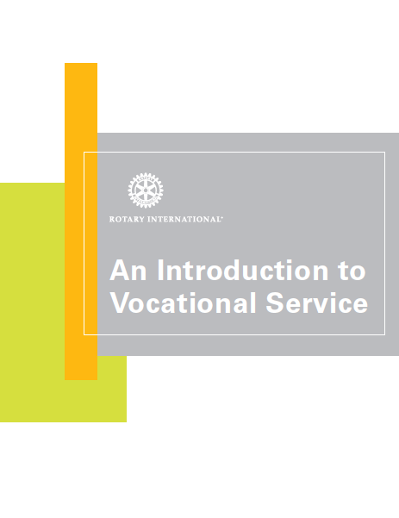
An Introduction to Vocational Service
An Introduction to Vocational Service (255) provides information, resources, and project ideas related to vocational service. You can either download or purchase a copy from www.rotary.org.

Slide 21
Sharing IDEas on how to start your clubʻs plan on a path to vibrancy
Divide into small groups of 2-3
Using the handout, Start Your Club on a Path to Vibrancy, each group will be assigned to 2 of the tips and brainstorm new ideas to try. Great opportunity to share best practices from your own club. (approx10 min)
Each group will identify 1 person(more more) to share their ideas with the whole group
List the ideas each club can take back to their clubs to increase community interest, attract and retain members and most of alll become a FUN & VIBRANT CLUB.

Slide 22
MAHALO ATTENDING INNOVATE & IMPROVE CLUB & VOCATIONAL SERVICE
Bob Peterson
D5000 Vocational Service Chair
Rotary Club of Metropolitan Honolulu (Metro)
bobpeterson@gproadwaysolutions.com
Sandy Matsui (
D5000 Club Service Chair
Rotary Club of Kaneohe
sandy.matsui@gmail.com

