Slide 1
CLUB TRAINER
D5000 2017-2018 Trainers:
Kathleen Merriam K.merriam@live.com
Liz Kane Lizkaned5000@gmail.com
DG Nalani Flinn

Slide 2
What does a club trainer do?
New member orientation
Work with club membership chair
Set up program for initiation of new members
Give information about Rotary to new members
Keep Rotarians up to date with Rotary information
Work with President and Program Chair
Newsletter articles on Rotary topics
Rotary Moments
“Fireside Chats”

Slide 3
New Member Orientation
Work with club membership chair
Give information about Rotary to new members
Orientation packet for new members
PowerPoint or similar presentation
Set up program for initiation of new members
“Red Badge” or similar program
Checklist for new member activities
Mentor program for new members

Slide 4
New Member Kits available to purchase
Russell Hampton’s includes:
Service Above Self Presentation Folder
8-1/2 x 11” Four Way Test Card
8-1/2 x 11” Object of Rotary Card
Four Way Test/Object of Rotary Wallet Card
½” Gold Plated Member Lapel Pin
Reflectorized 5-1/2 x 2-1/4” Auto Decal
Certificate of Membership
New Member Ribbon for Name Badge
Notes:
$7.95

Slide 5
New Member Orientation Kit

Slide 6
General Rotary Materials
Rotary Basics (Connect for Good) – #595
ABCs of Rotary – #363
RI (Presidential) Theme Brochure – #900
Most recent copy of The Rotarian
Welcome to Rotary Folder – #265-MU
Notes:
Suggestions from Rotary International. These are the publication numbers. These materials are each sold separately.
New Member kits are also available from RI for $4.95.

Slide 7
Rotary Foundation Materials
Rotary Foundation Facts – #159
The Rotary Foundation Quick Reference Guide – #219
Every Rotarian Every Year Brochure – #957
Two Needs, Two Ways of Giving – #173

Slide 8
New Member Orientation PowerPoint
To show to new members
Rotary 101 PowerPoint is one example
A few slides from a generic orientation PPT

Slide 9
WELCOME TO ROTARY

Slide 10
What next?
This presentation will help new members begin the process of learning what Rotary is about.
First, you will see Rotary’s Guiding Principles.
Then this presentation will show some of the service opportunities within Rotary.

Slide 11
Rotary’s Guiding Principles

Slide 12
Four basic principles guide Rotarians in achieving the ideal of service and high ethical standards:
Object of Rotary
Classification Principle
Avenues of Service
Four-Way Test

Slide 13
Object of Rotary
First formulated in 1910, the Object of Rotary is to encourage and foster the ideal of service as a basis of worthy enterprise and in particular, to encourage and foster:
FIRST. The development of acquaintance as an opportunity for service;
SECOND. High ethical standards in business and professions; the recognition of the worthiness of all useful occupations; and the dignifying of each Rotarian’s occupation as an opportunity to serve society;
THIRD. The application of the ideal of service in each Rotarian’s personal, business and community life;
FOURTH. The advancement of international understanding, goodwill, and peace through a world fellowship of business and professional persons united in the ideal of service.

Slide 14
Why a Classification System?
Rotary uses a classification system to:
Establish and maintain a vibrant cross-section or representation of the community's business, vocational, and professional interests among members
Develop a pool of resources and expertise to successfully implement service projects

Slide 15
What are the Avenues of Service?
There are five Avenues of Service:
Club Service
Community Service
Vocational Service
Youth Service
International Service

Slide 16
What is The 4-way Test?
Of the things we think, say or do
Is it the TRUTH?
Is it FAIR to all concerned?
Will it build GOODWILL and BETTER FRIENDSHIPS?
Will it be BENEFICIAL to all concerned?

Slide 17
Red Badge Program
Overview
New members are given temporary Red Badges (available from authorized Rotary suppliers) and are given a list of items they must accomplish in order to receive a permanent blue badge. A brief ceremony is held when the new member receives their blue badge.
How the Practice Works:
The club adopts a policy that all new members are given red badges and a list of items they must accomplish in order to receive a permanent blue badge. The items should be posted on the club’s website for easy access, and given to the member in their “New Member Kit” as a checklist.
The program works best when coupled with a mentoring program, so the new member has someone they can turn to for assistance in knowing how to accomplish their tasks.

Slide 19
Common Tasks on Red Badge Checklist
Attend a board meeting
Attend a District event
Be a greeter twice
Give an invocation twice
Make up at another Rotary club
Attend a club fellowship event
Attend a club service project
Take part in a club fundraiser
Be on a club committee
Attend a new member information meeting
Give a new member talk

Slide 20
Sample checklist
The Rotary Club of _________________ New Member Checklist
Name Date of induction
In order to enhance your Rotary experience, we are asking each new member to complete the following checklist within the next six months. Please work with your sponsor to complete the tasks.
__________ Read the ABC’s of Rotary or Rotary Basics
__________ Watch the District 5000 New Member Orientation PowerPoint
__________ Register for online member access at www.rotary.org
__________ Meet the chairs of each of the committees on the Board of Directors and talk with them about their plans
______ Club Administration
______ Community Service
______ Vocational Service
______ International Service
______ New Generations
_______ Membership
______ The Rotary Foundation
_______ Public Relations
_______ Attend a Board meeting
________ Attend a Fireside Chat
________ Participate in a service project

Slide 21
Checklist continued
Complete at least 3 of the following club meeting activities
______ Greeter
______ Lead Pledge of Allegiance
______ Lead the 4-Way Test
______ Assist the Sergeant at Arms
______ Assist with collecting money for meals
______ Give a short vocational talk
_______ Have your picture taken for the club directory
_______ Provide a short biography for the club newsletter
_______ Attend a make-up meeting
Your sponsor is:_____________________ Date completed: __________

Slide 22
Mentor Program
Mentoring is an effective way to engage a new member with other club members and with club service.
The Membership Committee will invite club members to serve as mentors who are willing to volunteer for this service.
The important consideration is to have a pool of mentors who are knowledgeable about club activities and who will be committed to serve as an ongoing resource and source of support for our new members.
The Membership Committee will assign a mentor immediately after the induction ceremony.
A new member will have a mentor for 12 months.
Notes:
This is a description of the mentoring program from the Rotary Club of New Brunswick, CT

Slide 23
Examples of Typical Responsibilities of Mentors
Identify various resources dealing with Rotary and club history, accomplishments and structure such as RI and District websites, club website, bylaws and membership bulletin.
Meet periodically to monitor the new member’s involvement in club activities and attendance at club meetings.
Introduce the new member to every club member. On occasion, serve together as greeters at luncheon meetings.
Notes:
From the New Brunswick Rotary description of its program

Slide 24
More Typical Responsibilities of Mentors
Ensure that the new member understands all club rules, including the attendance requirement and options, and financial obligations. Be readily available to answer questions and provide advice or guidance if asked.
Identify the various opportunities for service and participation in club projects and activities. This responsibility should be introduced early in the mentorship process.
Notes:
From the New Brunswick Rotary description of its program

Slide 25
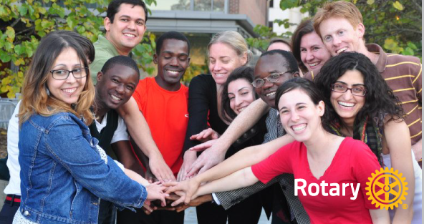
More Typical Responsibilities of Mentors
Describe the responsibilities of club committees and suggest a committee assignment that is suited to the new member’s interests, if possible.
Inform the new member about opportunities to serve the club administration, such as the newsletter, club website, fellowship, public relations, fund raising, and Rotaract.
Encourage the new member and the member’s family to attend club social events held during the year. Suggest how the new member can participate in planning these special events.
Notes:
From the New Brunswick Rotary description of its program

Slide 26
Keep Rotarians up to date with Rotary information
Work with President and Program Chair
Rotary Moments
Brief, informational snippets of Rotary information, at meetings
Newsletter articles on Rotary topics
Periodic updates from The Rotarian or the Rotary website
“Fireside Chats”
Formal programs outside of regular meetings, to provide information and updates to members

Slide 27
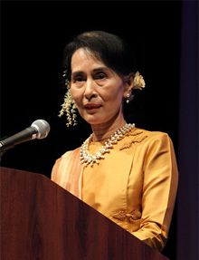
Ongoing education for members
Rotary Moments
Brief information about Rotary, presented during meetings
Articles in club newsletter or website
Materials can come from the D5000 website
From the RI website
From The Rotarian
From Rotary informational newsletters

Slide 28
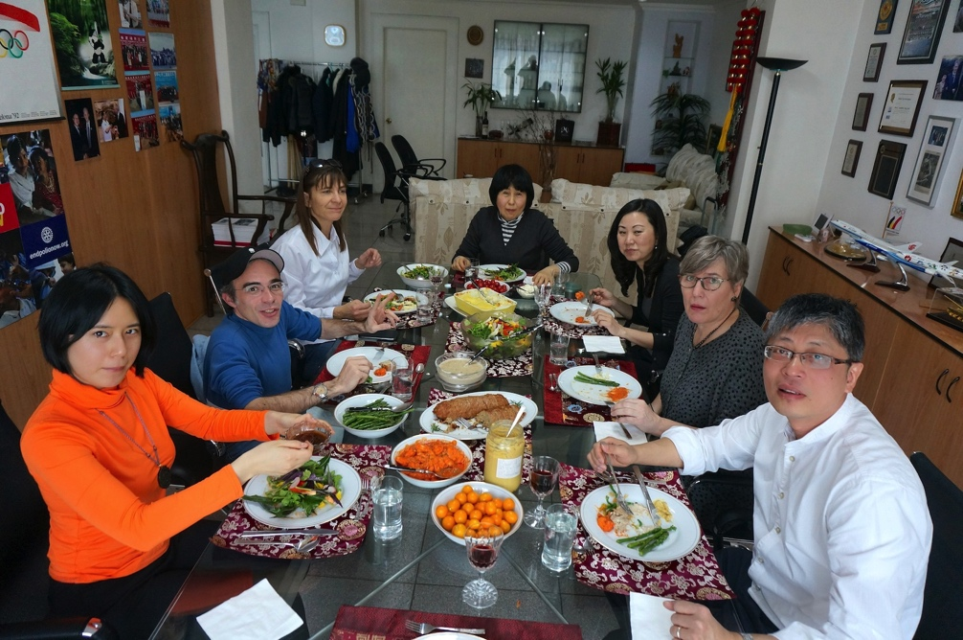
Fireside Chats
Organized presentations of Rotary information
Usually apart from meetings
Sometimes combined with Club Assemblies

Slide 29
Sample Agenda for Fireside Chat
Welcome and purpose
Opportunities for service
Current club and district projects
Club Structure
Communications
Club Meetings
Rotary History
Rotary Programs
The Rotary Foundation
Have fun in Rotary

Slide 30
URLS for some examples of orientation PowerPoints
assets.ngin.com/attachments/document/0002/9222/Rotary_Orientation.ppt
https://clubrunner.blob.core.windows.net/.../new-member-orientations/NewMembers....

Slide 31
Rotary New Member kits
https://shop.rotary.org/new-member-welcome-kit-426
http://www.docs.rotary5020.org/Membership%20Development%20Kits.pdf
http://www.bestclubsupplies.com/Rotary-New-Member-Presentation-Kit/productinfo/R89485/
Notes:
The URLs for new member kits from RI and from Russell Hampton

Slide 32
URLs for RI orientation information
https://my.rotary.org/en/document/introducing-new-members-rotary-orientation-guide
https://my.rotary.org/en/learning-reference/learn-topic/membership

Slide 33
URLS for Mentor program information
http://www.newbrunswickrotary.org/Page/mentor-program
https://www.rotary.org/en/clubs-mentor-new-members
Notes:
This is the URL for the New Brunswick mentor, and for an article in the Rotarian about mentor programs.

Slide 34
URL for Red Badge Program information
http://www.district5110.org/wp-content/uploads/2015/06/BP-Red-Badge-Program.pdf
Notes:
This is the URL to get the description of the program from District 5110

