Slide 1
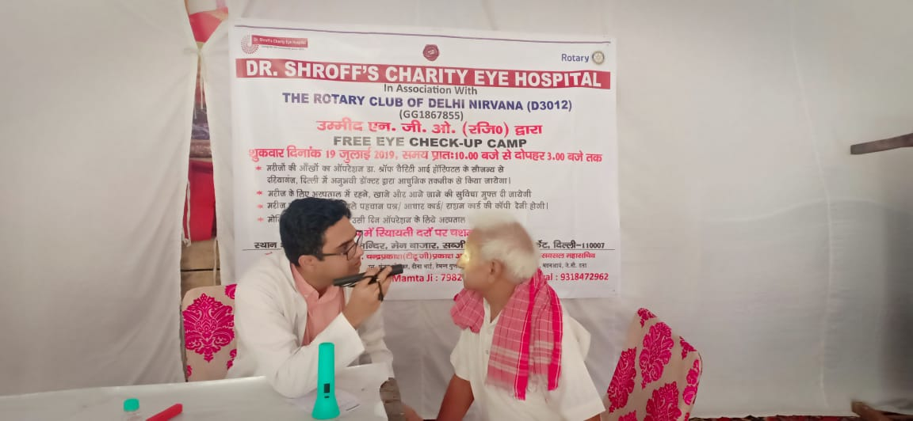
District 5000 2019-2020 International Service—Global Grants Webinar
Mark Harbison, District Rotary Foundation Committee Vice Chair—Grants Subcommittee Chair

Slide 2
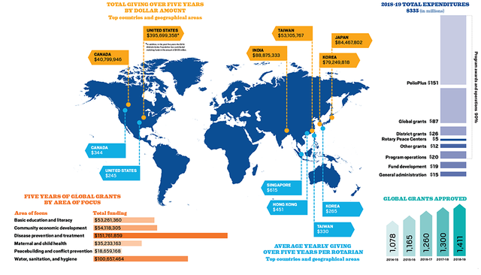
District 5000 2019-2020 Global Grants Webinar

Slide 3
District 5000 2019-2020 Global Grants Webinar

Slide 4
2018-19 GRANT STATISTICS
District grants
494 grants
$27.7 million
Global grants
1,403 grants
$97.9 million
Disaster response grants
7 grants
$134,178 (Covid-19 Response in 2020—SO FAR, 50 grants $1,000,000)
Notes:
Here are some statistics from the 2018-19 Rotary year. We awarded:
494 district grants with total funding of $27.7 million
1,403 global grants with total funding of $97.9 million
7 disaster response grants with total funding of $134,178
We look forward to awarding our first programs of scale grant in October 2020.

Slide 5
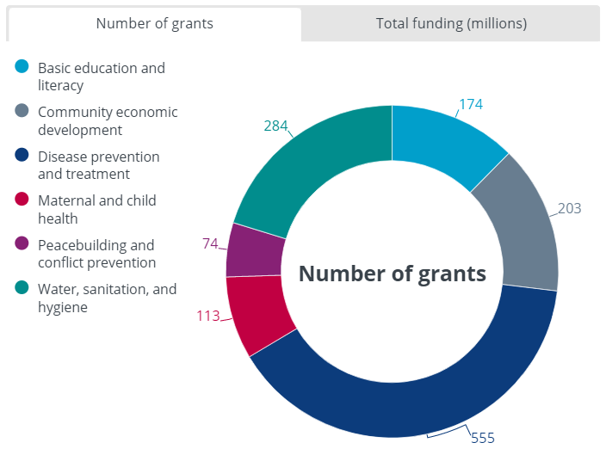
Global grants BY area of focus
Notes:
These two graphs show the number of global grants and the total funding for global grants broken down by area of focus. Disease prevention and treatment continues to be the most popular area of focus, followed by water, sanitation, and hygiene.

Slide 6
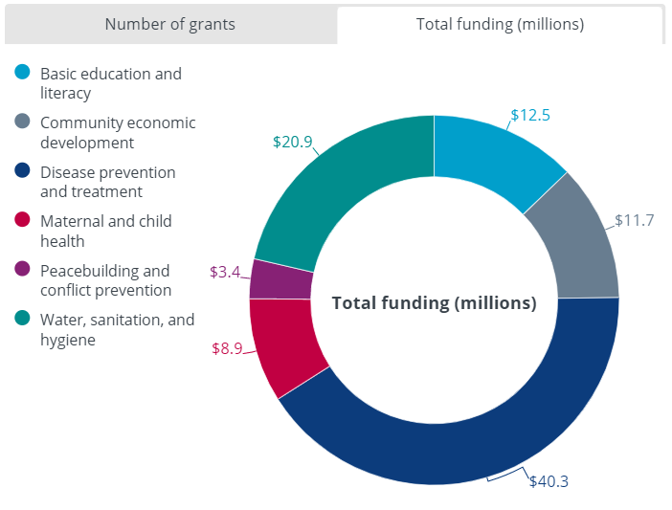
Global grants BY area of focus
Notes:
These two graphs show the number of global grants and the total funding for global grants broken down by area of focus. Disease prevention and treatment continues to be the most popular area of focus, followed by water, sanitation, and hygiene.

Slide 7
District 5000 2019-2020 Global Grants Webinar: Rotary Areas of Focus and the Sustainable Development Goals

Slide 8
District 5000 2019-2020 Global Grants Webinar: Rotary Areas of Focus and the Sustainable Development Goals

Slide 9
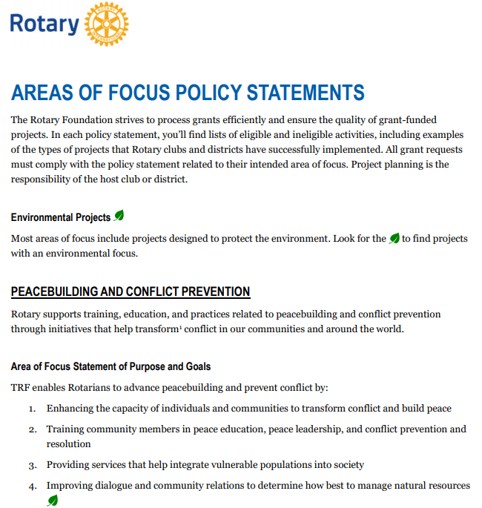

Slide 10
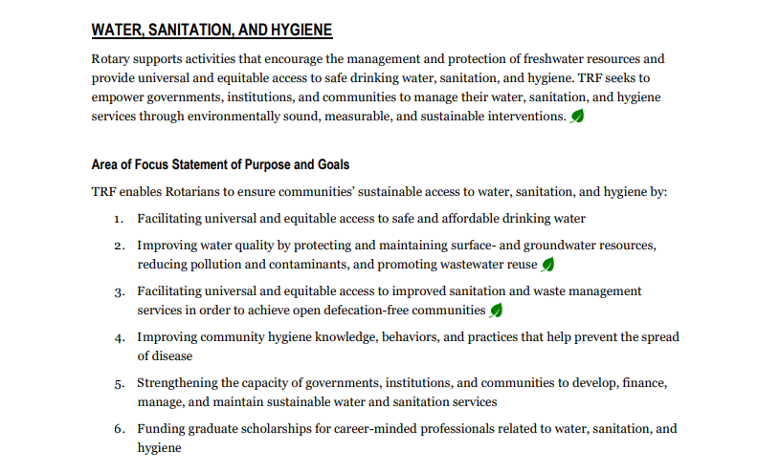

Slide 12
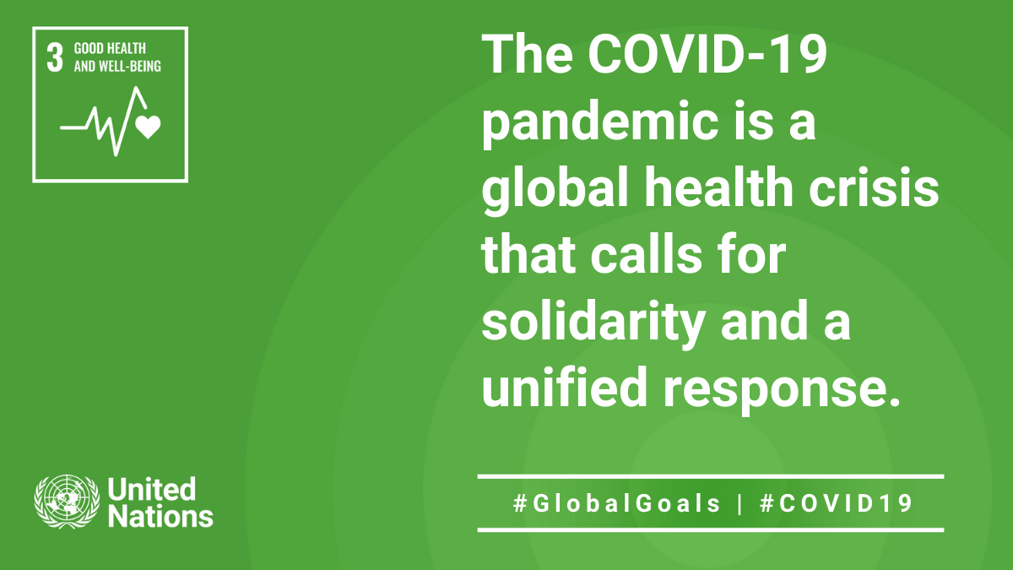
District 5000 2019-2020 Global Grants Webinar
.

Slide 13
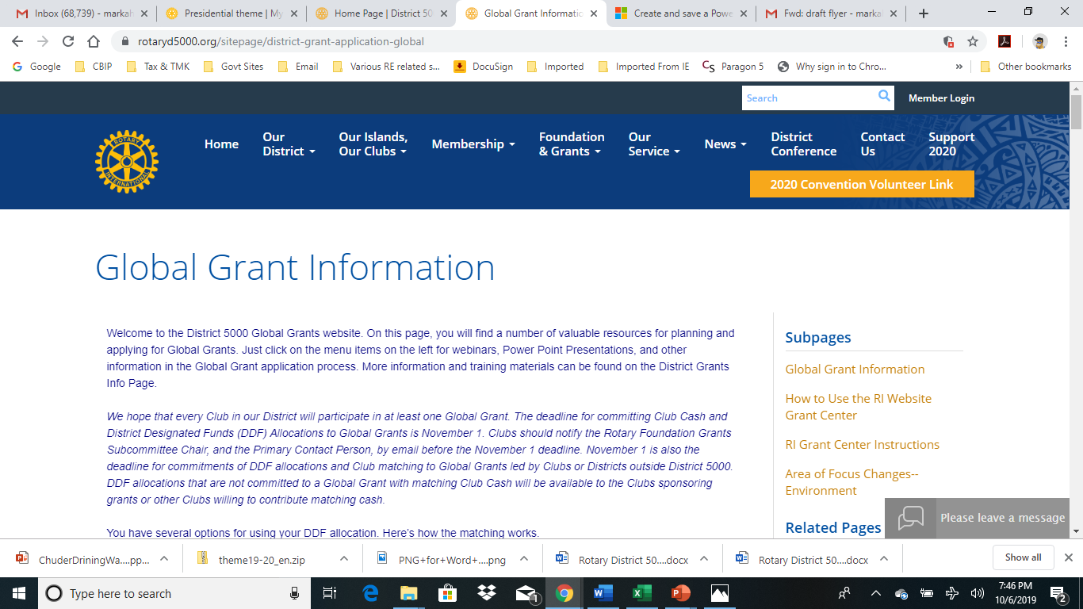
District 5000 2019-2020 Global Grants Webinar

Slide 14
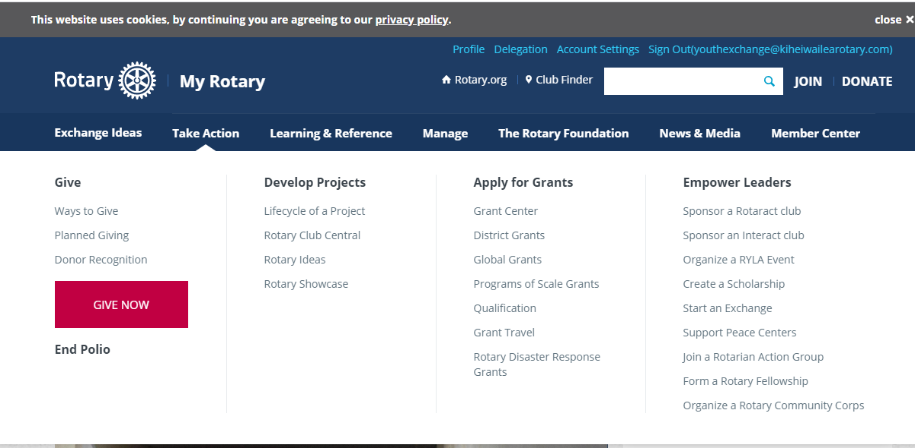
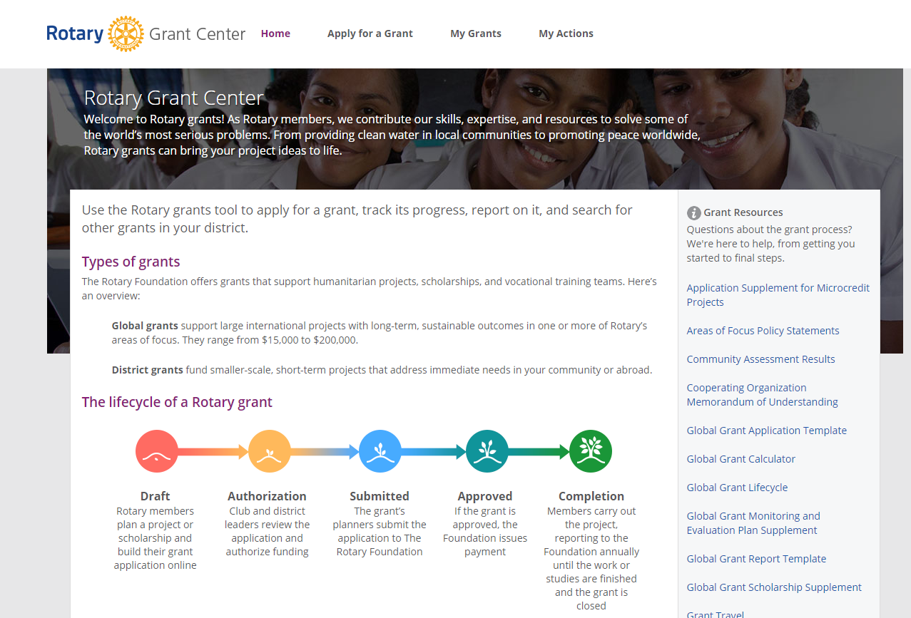

Slide 16
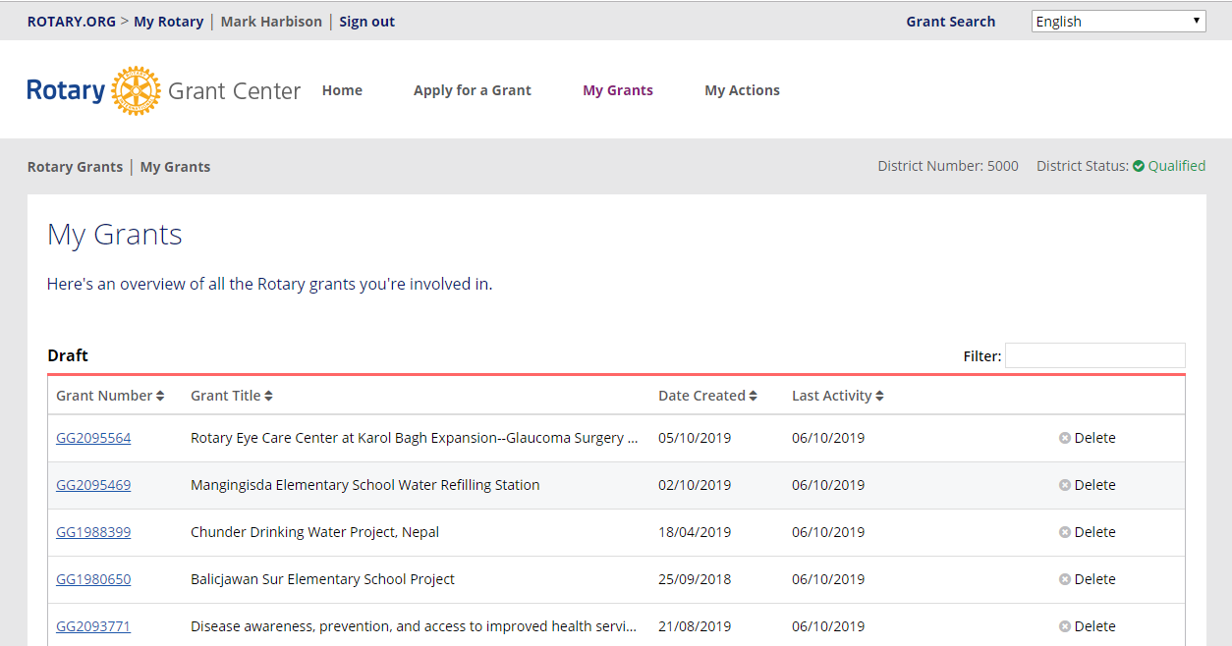
District 5000 2019-2020 Global Grants Webinar

Slide 17
District 5000 2019-2020 Global Grants Webinar
The True Meaning of PolioPlus
Polio Eradication in the context of the COVID-19 pandemic Summary of urgent recommendations from the Polio Oversight Board meeting of March 24, 2020
The COVID-19 pandemic response requires worldwide solidarity and an urgent global effort. The GlobalPolio Eradication Initiative (GPEI), with thousands of polio workers, and an extensive laboratory and surveillance network, is positioned and ready to ensure that our resources are used by countries in their preparedness and response.

Slide 18
From polioeradication.org
District 5000 2019-2020 Global Grants Webinar
While halting important polio eradication activities is necessary, it will result in increased spread of disease and number of children paralyzed by wild and circulating vaccine-derived polioviruses. This will require a scale up of polio eradication efforts once the COVID-19 situation has stabilized.
.

Slide 19
District 5000 2019-2020 Global Grants Webinar
Questions?
Comments?

Slide 20
GG1988382 Pediatric Orthopedics Vocational Training Team to Establish a Uganda Center of Training Excellence
Rotary Clubs of Kihei-Wailea and Kajjansi (District 9211) with Nara East and District 2650
Fully Funded $83,648.00
Area of Focus: Disease Prevention and Treatment
VTT: Team of 11 Doctors will spend one month each in Uganda teaching pediatric orthopedics specialist trainees in preparation for certification in advanced surgical techniques. Second VTT project in Africa—the first was GG1864829 Pediatric Orthopedics Vocational Training Team for Tanzania Center of Training Excellence. The current grant was our first project in partnership with District 2650 (centered on Kyoto), which provided $32,000 (with $32,000 in TRF matching). Contact Mark Harbison markaharbison@gmail.com 808-283-3785

Slide 21
GG2093771 Dialysis Equipment in Rural Thailand: Disease awareness, prevention, and access to improved health services
Rotary Clubs of Honolulu Sunrise and Silom Thailand (District 3350)
Area of Focus: Disease Prevention and Treatment
Another Dialysis Equipment and community outreach grant in rural Thailand from Kasemchai Nitiwanakun of the RC of Silom in District 3350 and David Mozdren and Eberhard Mann of the RC of Honolulu Sunrise. The grant leaders have not yet set a budget, but many of you are familiar with these life saving projects in Thailand. The budget is set at $109,839. These are great global grants and our district and usually receive wide support from Sister Clubs in Thailand, Korea, and Japan, as well as District 5000. Contact Dave Mozdren David.Mozdren@hawaiiantel.com 808-294-3283

Slide 22
GG2095564 Rotary Eye Care Center at Karol Bagh Expansion--Glaucoma Surgery Equipment and Training
Rotary Clubs of Kihei-Wailea and Delhi South Metropolitan (District 3011) partnering with the International Agency for Prevention of Blindness and the Rotarian Action Group for Blindness Prevention
Area of Focus: Disease Prevention and Treatment
Another global grant for the Karol Bagh Eye Care Center. The first collaboration between the IAPB and the International Eye Foundation and Rotary was Global Grant 1524827, and $200,000 grant from TRF matched by $200,000 from the IEF. This project paid for the equipment and renovations of the eye care center building, and was the pilot project in establishing the Strategic Partnership between Rotary and the IAPB. The first follow-up grant was GG1867855 Project Vision—Eye Surgeries and Checkup Camps, which funded large eye care camps sponsored by the Karol Bagh Eye Care Center, with a full range of basic medical and specialized eye examinations, with referrals to the Center for cataract and other surgeries. Many of you are familiar with these grants and participated with contributions of cash and DDF. The current grant will expand the capacity of the Center by funding equipment for glaucoma surgeries and training for surgeons at the Center. The equipment will be partly funded by IAPB member Shroff’s Charity Eye Hospital, which will also provide training and public outreach. These grants are also supported by California,
Taiwanese, and Korean Districts. Two surgical machines will cost $92,000 Globally, at least 2.2 billion people have a vision impairment or blindness, of whom at least 1 billion have a vision impairment that could have been prevented.
Contact Mark Harbison markaharbison@gmail.com 808-283-3785

Slide 23
GG1988399 Chunder Drinking Water Project, Nepal
Rotary Clubs of Honolulu Sunset and Damauli Nepal (District 3292)
Area of Focus: WASH
A great WASH project spearheaded by Arjun Aryal and Dr James Ham of the RC of Honolulu Sunset and Girija Subedi of the RC of Damauli. This project aims to develop and supply drinking water at Chuder village in Nepal. The project will directly serve about 500 people (120 household) and a school will directly benefit from the project. Situated only about 40 miles from the 2015 M7.9 earthquake, this indigenous ethnic community was hit very badly and also impacted its water resources. People in Chuder have to hike slippery trails 30 min to 2 hours (one-way) to fetch drinking water. Due to lack of drinking water, people in the hillside are forced to migrate down to the foothill. On Feb 16, 2019, three engineer/experts from Lucent Drop Nepal who have done several Rotary projects, three Astaja volunteers (a charity which arranged the trip), 10 Rotarians from RC of Damauli and RC of New Road Kathmandu, Vyas Municipality mayor and two WASH team volunteers from Water Hands Hope, Honolulu visited the site and also prepared the assessment report. The budget is set at $72,755. Many of you contributed to James’s previous WASH project in Nepal GG1862877 Improving Access to Safe Water and WASH Education in Lahan and Siraha District, another project in areas impacted by the earthquake.
James Ham james.ham@gmail.com 1-360-480-7194

Slide 24
GG1980650 Balicjawan Sur Elementary School WASH Project
Rotary Clubs of Kapolei and Iloilo the Philippines (District 3850)
Area of Focus: WASH
Marienne Vergara of the RC of Kapolei is in the Philippines now completing the Community Assessment for this grant. Marienne and Virgil (Vergara) have been working on this project for two years, consulting with school officials, local community leaders, and water and sanitation engineers and contractors to develop a comprehensive plan to provide a direct water system to the school and the island community as well as separate sanitation facilities for girls and boys. The budget is set at $59,000. Kapolei has Global Grant DDF of $8,766, so they are able to fund $30,681. They are asking for additional Cash and DDF. Contact Marienne Vergara marienne@alexvergaraphotography.com 1-808-542-6077

Slide 25
GG2095469 Mangingisda Elementary School Water Refilling Station
Rotary Clubs of Lahaina and Paco in the Philippines (District 3850)
Area of Focus: WASH
The Mangingisda Elementary School Water Refilling Station is intended to provide clean drinking water to the community of Barangay Mangingisda, Puerto Princesa, Palawan. Through this project we want to encourage the parents of school children to continue sending their kids to school by allowing them to get free drinking water in exchange for continued attendance to the elementary school. The Rotary Club of Lahaina has been very active in the Philippines with annual hands-on projects and new Sister Clubs. This is their first Global Grant, and will also offer opportunities for service trips to the project and associated ongoing projects with Lahaina. Budget $48,077
Contact Darryl Ng ngdarryl@hotmail.com 323-388-9367

