Slide 1
ROTARY 101
District 5000
Spring Training Assembly Webinar
Saturday, May 2, 2020
(No pastries or coffee provided)

Slide 2
What’s Rotary?
Rotary is an international membership organization made up of people
who share a passion for and commitment to enhancing communities
and improving lives across the world.
Making an Impact on local lives
Connecting globally for internationally projects
Sowing the seeds of peace, health, literacy, prosperity,
and individual potential
www.rotary.org

Slide 3
https://www.youtube.com/watch?v=wH6ZzsYgR1Q

Slide 4
Webinar Outline
Stats
Action Plan/Vision
Organization
History
Programs
Pop Quiz
Surprise

Slide 5
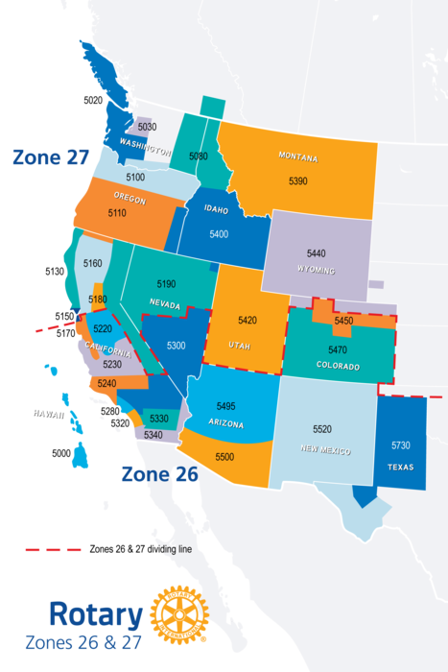
Stats
Rotary International
1.2.million Rotarians
35,000 clubs
530 districts (34 zones)
220 countries/geo areas
$1.8 billion given since 1947
District 5000
State of Hawaii
1648 active members
109 honorary members
53 clubs (2 e-clubs)
11 areas
Zones 26/27 (Big West)

Slide 6
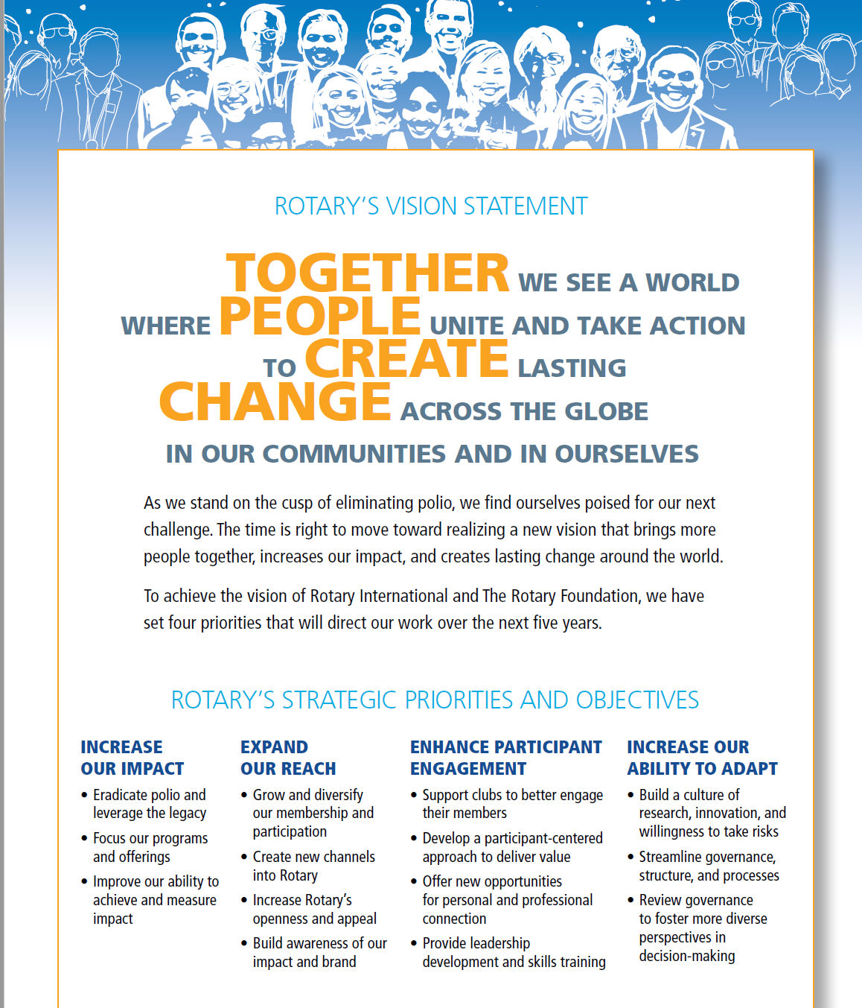
ACTION PLAN
&
Vision
Rotary.org/actionplan

Slide 7
CORE
VALUES

Slide 8
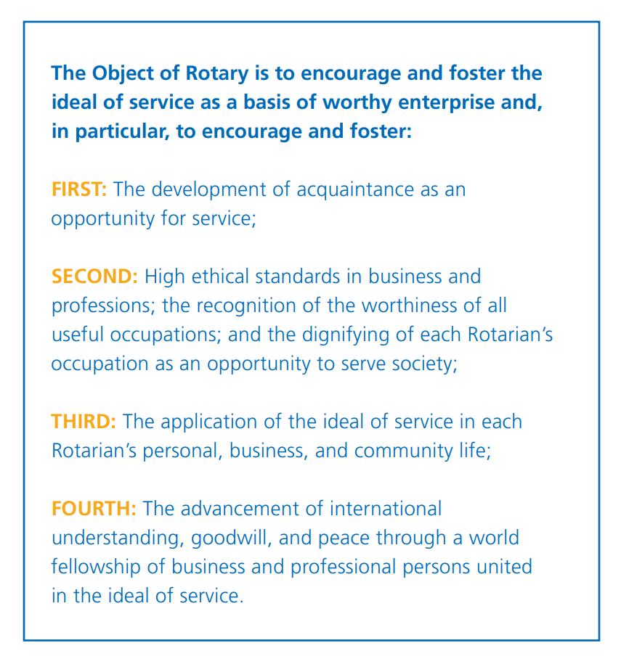
Object
Of
Rotary

Slide 9
Four-Way Test
Of the things we think, say or do:
Is it the Truth?
Is it Fair to all concerned?
Will it build Goodwill and Better Friendships?
Will it be Beneficial to all concerned?
Motto: Service Above Self
Areas of Focus
Peace & conflict prevention/resolution
Disease prevention & treatment
Water & sanitation
Maternal & child health
Basic education and literacy
Economic & community development
--Avenues of Service--
Club, Vocational, Community, International, & New Generations

Slide 10
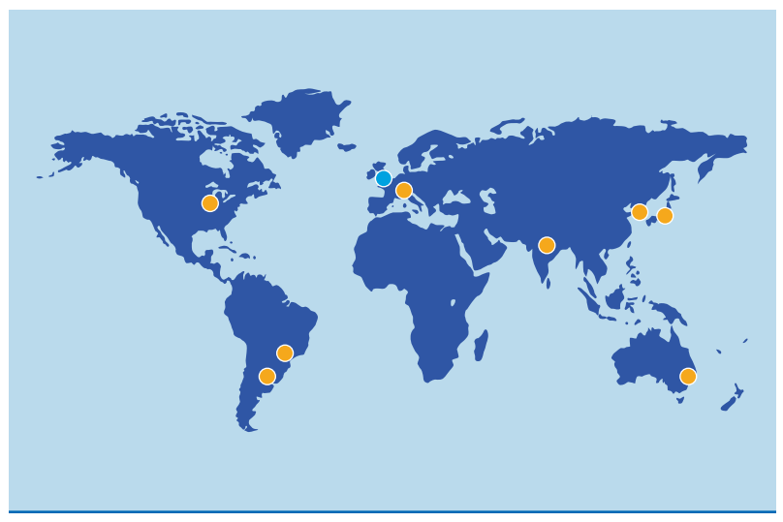
Rotary Structure
Club Constitution/ByLaws: President, President-elect, Immediate Past President,
Secretary, Treasurer, Directors (Club Administration, Foundation, Membership,
Public Relations, Service Projects), Service Committee Chairs
(Next
Slide)
Zone 26/27: 1 Director
Serves on RI Board
Rotary International:
RIP
RIPE
Board of Directors
Council of Legislation
General Secretary
(Rotary Foundation:
Board of Trustees)

Slide 11
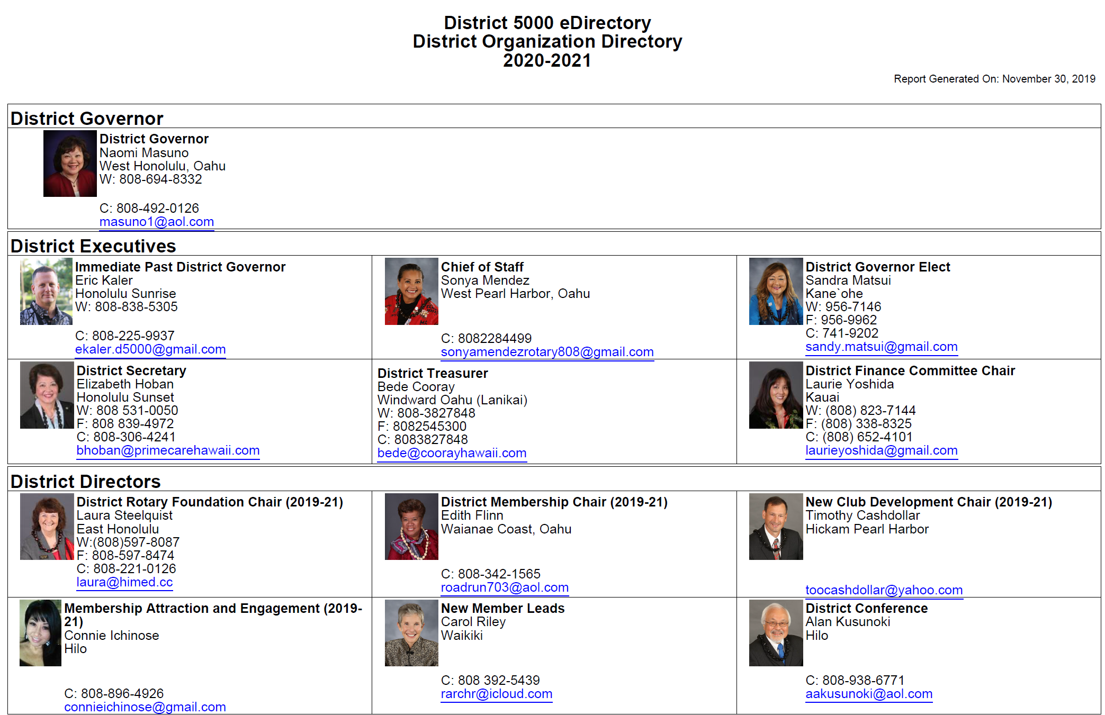
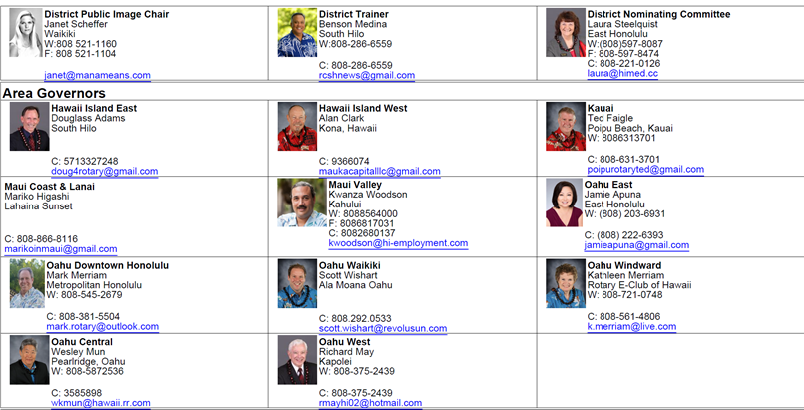
DISTRICT 5000
www.rotaryd5000.org

Slide 12
History of Rotary

Slide 13
Rotary Programs
The Rotary Foundation (TRF)
PolioPlus
Rotary Youth Exchange
Rotary Peace Centers/Fellowships
Rotary Friendship Exchange
Grants
New Generations Service Exchange
Interact/Rotaract
Rotary Youth Leadership Awards
Rotary Fellowships/Rotarian Action Groups
Rotary Community Corps

Slide 14
https://www.youtube.com/watch?v=skD0NAoK9OM&feature=youtu.be

Slide 15
Rotary Quiz
(also known as: “I thought I was going to get out of here without having to talk!”
What are the two youth organizations that Rotary clubs sponsor?
How do members gather to address club programs and activities?
How often and where do Rotarians gather in Rotary’s international meeting?
What Rotary Foundation program focuses on Rotary’s top priority?
How is Rotary International organized at the headquarters level?
What is the name of Rotary’s youth leadership training and where is it held in District 5000?
What are Rotarian Action Groups?
What is the title of the senior official in the district?
What is the most important component in the Rotary organization?

Slide 16
https://www.facebook.com/rotary/videos/2625918450998973/?t=4744

Slide 18
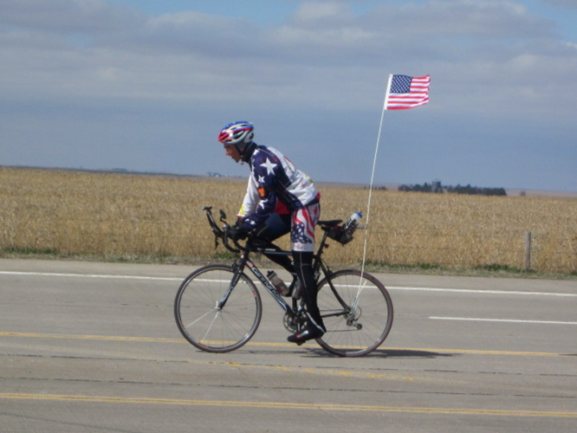
MAHALO!

