Slide 1

CLUB TREASURER BASICS
District Spring Training Assembly
2020

Slide 2
DUTIES
Manage club funds:
1. Control of club funds
2. Collect dues and fees
3. Keep Board informed of the finances
4. Remit payments, may include Rotary Foundation & HRYF donations
Maintain Records:
1. Bank statements and reconciliations
2. Grant finances
Reporting:
1. Taxes: Federal, State, General Excise
2. Keep Board informed of the finances and budget comparisons

Slide 3
Financial Controls
Financial controls are highly suggested to help ensure that funds are managed properly and preclude misuse.
Require more than 1 signature on checks or have a disbursement authorization form approved by an officer for payment
Review bank statements before giving them to the treasurer
Reconcile bank statements monthly
Update signature cards at the bank for new officers
Close accounting records in a timely fashion
Submit tax forms in a timely fashion

Slide 4
Annual Requirements
Budget – approved by Board (ideally before 7/1)
IRS 990 – due by 11/15
All Clubs with gross receipts of $50,000 or less are required to file Form 990-N (electronic postcard)
Due 15th day of the 5th month after June 30
Send a copy to Grants Chair at Email: grants@rotaryd5000.org for grant qualification purposes
General Excise Tax (GET) filings as required by State Tax Department

Slide 5
General Excise Tax Requirements (Disclaimer: Please consult your tax advisor for guidance.)
-Proceeds from fundraisers are subject to GET
-Collections for meals is not subject to GET, IF the club obtains an exemption from the State Tax office.
Response from Tax Office, Technical Section: “A nonprofit organization that has obtained an exemption from the general excise tax (GET) is exempt from paying the GET on income that is (1) derived from its activities that fulfill its exempt function, and (2) that do not have as a primary purpose the production of income.
If the nonprofit organization obtained an exemption from the GET, and the meetings fulfill the organization's exempt function, the meal collections for the three situations would be exempt from the GET. “ Examples of meal collections:
1) Meal collections at a meeting and subsequently paid to the restaurant
2) Meal collections included in the annual dues and subsequently paid to restaurants as the meetings occur
3) Meal collections that are higher than the restaurants cost, because it includes meeting expenses (ie speaker’s meal)
Apply for a General Excise Tax license at: https://hbe.ehawaii.gov/BizEx/home.eb

Slide 6
Budget Templates
Budget template below available on rotary.org in the Treasurer’s Manual. QuickBooks for club accounting is easy to use and has a budget feature.
 | Budgeted income last year | Actual income last year | Amount under/over last year | Estimated income this year
OPERATIONS
Membership dues
Admission fees
Income from visitors
Other income
SUBTOTAL | 0 | 0 | 0 | 0
CHARITABLE
Donations to club for projects
Club fundraisers
Other income
SUBTOTAL | 0 | 0 | 0 | 0
TOTAL INCOME | 0 | 0 | 0 | 0
EXPENSES | Budgeted income last year | Actual income last year | Amount under/over last year | Estimated income this year
OPERATIONS
Secretary's Office
Badges/engraving
Postage and post box

Slide 7
Budget Items 2020-2021
RI Invoice - $84.33
District Dues – $60.00
HRYF Club Dues - $200
District Assemblies (about $20-$45)
Pre-PETS (2021 Oahu) – (about $50) - airfare
PETS (San Jose airfare, reg, extra nights) - $1,500 approx
PETS Hospitality Room (about $100)
District Workshops (Foundation, Membership Seminars)
RYLA
District Conference

Slide 8
Rotary Dues
RI Invoice: $84.57 annually for 2020-21, with COL, Insurance and $12 for magazine. Due July 31 ($44.57) and Jan 31 ($40.00) to RI. New members prorated. Honorary magazine $12.
District Dues: $60.00 per active member annually) due July 1 ($30.00) and Jan 31($30.00) to District Treasurer, PO Box 3325, Honolulu, HI 96801.
Suggest that you send out the club invoice by June 1 and Dec 1 and have a due date of July 1 and January 1. You may want to include an “Optional” line for Rotary Foundation giving and HRYF ($40).

Slide 9
Rotary International Dues
RI dues are based on the members count as of 7/1 and 1/1 and cannot be adjusted. Very important to have the correct roster before those dates.
RI invoices are emailed to Club President, Secretary and Treasurer. Please ensure that the email addresses are correct. The invoice can also be found on the rotary.org/myrotary website in the Club Administration section. A detailed listing of members is available. Payments can be made online with a credit card.

Slide 10
RI Dues – Where Does It Go?
Annual RI dues $68 (no increase) for:
HR, Legal, Audit
Finance
Governance and Executive
International Operations
Messaging and Communications
IT, Operations, Administration
Programs and Member Services
$1.00 per member annually for Council on Legislation *
$0.43 per member annually for D&O/EPL insurance *
$3.14 per member annually for General Liability insurance *
$12 annually for the Rotarian magazine
* Annual payments on only the July 1 invoice

Slide 11
District Website: rotaryd5000.org
What you can find on the district website:
Membership rosters
District dues invoice
District Chairs and Org Chart
Information on the Avenues of Service
Club Presidents and Meeting Locations
Events in the Calendar
Register for Events
Look for Rotarians in the Yellow Pages

Slide 12

District Dues Invoice– Input number of members
 |  | Rotary International District 5000
 |  | District Dues Invoice
 | Rotary Club of | ________________________________________________________
 | Contact Name | ________________________________________________________
 | Phone/Email: | ________________________________________________________
 | DESCRIPTION |  | AMOUNT
 | 7/1/2017 | Semi-Annual Dues (7/1/2017-12/31/2017) Per Active Member: | $28.75
 |  | Enter Number of Active members as of 7/1/17 -> | 0
 |  | Total District Dues: | $0.00
 | Please make check payable to Rotary International District 5000 for the total.

Slide 13
Foundation Grant Financial Requirements
Disbursement Requirements:
  Do not disburse funds until your grant application is approved
  Maintain separate grant bank accounts
  Two (2) signatures required for disbursements.
  Invoices and proof of payment required for all disbursements.
Proof of Expenditures:
  Promptly deliver receipts for all expenditures to the Club Treasurer.
  If there is a difference between the receipt and invoice amounts, prove documentation to the Treasurer
  Retain account records in physical form and electronic form for five (5) years from the date of Approval of the Final Report.
Monthly Reconciliation:
  The District Grant Account and each Global Grant Account will be reconciled on a monthly basis by the Club Treasurer and a report of this shall be made to the Club President and President-elect

Slide 14
District Audit of Grant Records
If your club is selected to be audited, the following documents will be requested for the review by a member of the audit committee:
1. The grant report showing the revenues and disbursements for the project
2. Bank statements
3. Cancelled checks
4. Bank signature cards
5. Check registers
6. Invoices and receipts to support disbursements
7. Bank reconciliations
8. List of physical assets acquired for the grant projects, if any
9. Report to district of misuse of funds, if any
The review is limited only to the transactions regarding the grant, and does not include the other operations and bank accounts of the club.

Slide 15
RI Website: rotary.org/myrotary

Slide 16
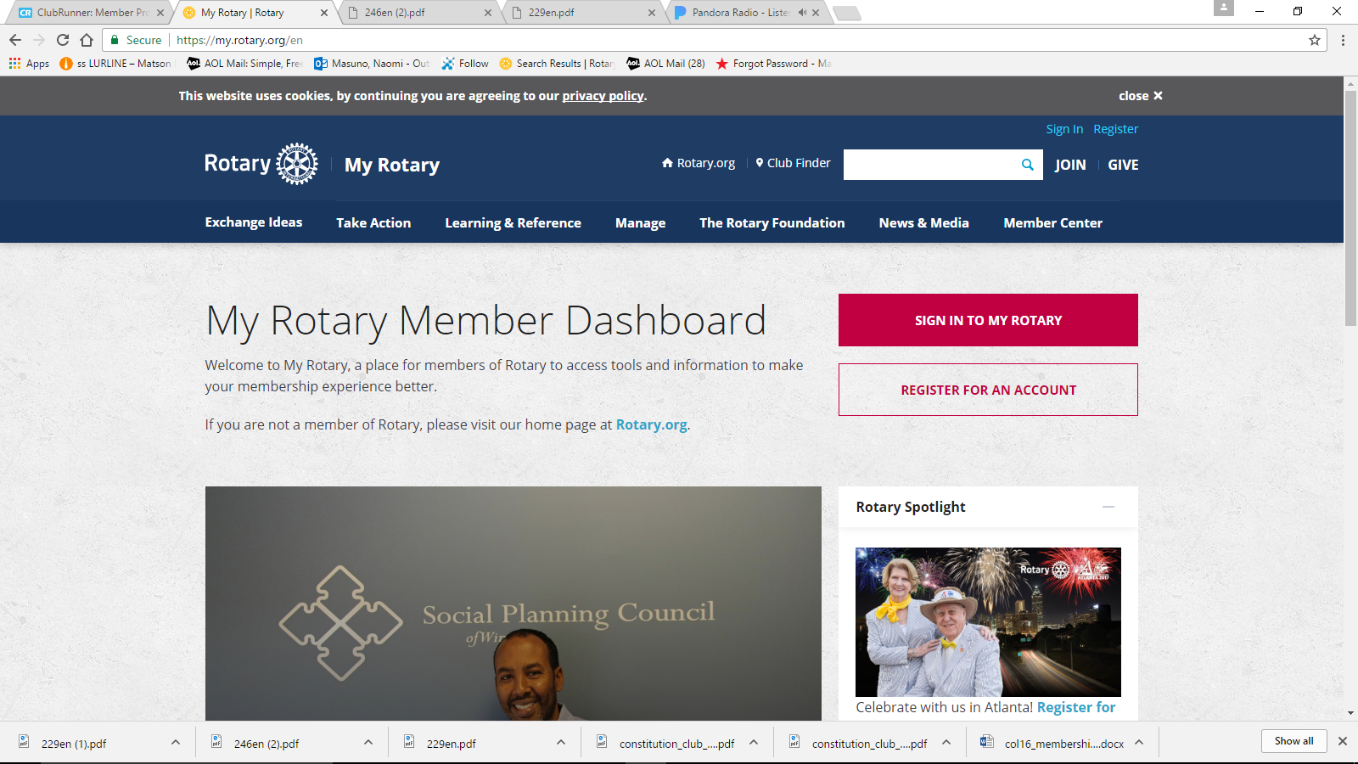
rotary.org - Sign In
Sign in with your email address and password. “Register for an Account”, if you have never signed in or if you have entered the wrong sign-in info too many times. The User Name or Login password may be different from District’s website password. Email address is from the District’s website, unless you change it for RI. If your email address changes, RI’s website needs to be updated separately.

Slide 17
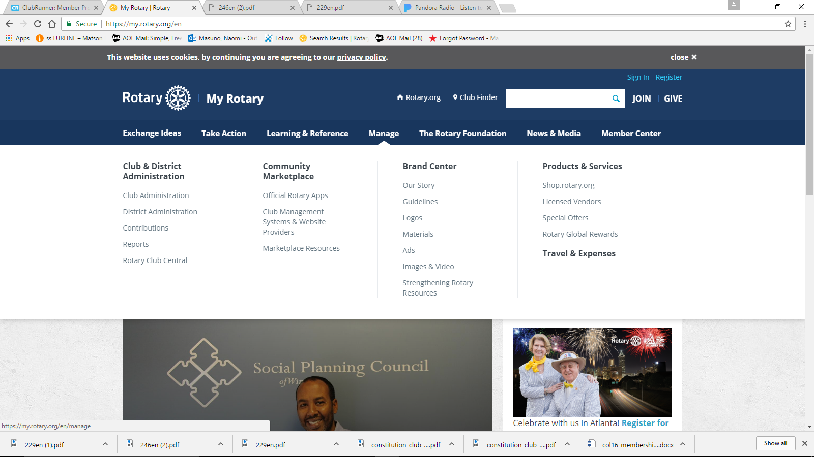
Click on “Manage”
Go to “Club Administration” for Dues Invoice or Member Data.

Slide 18
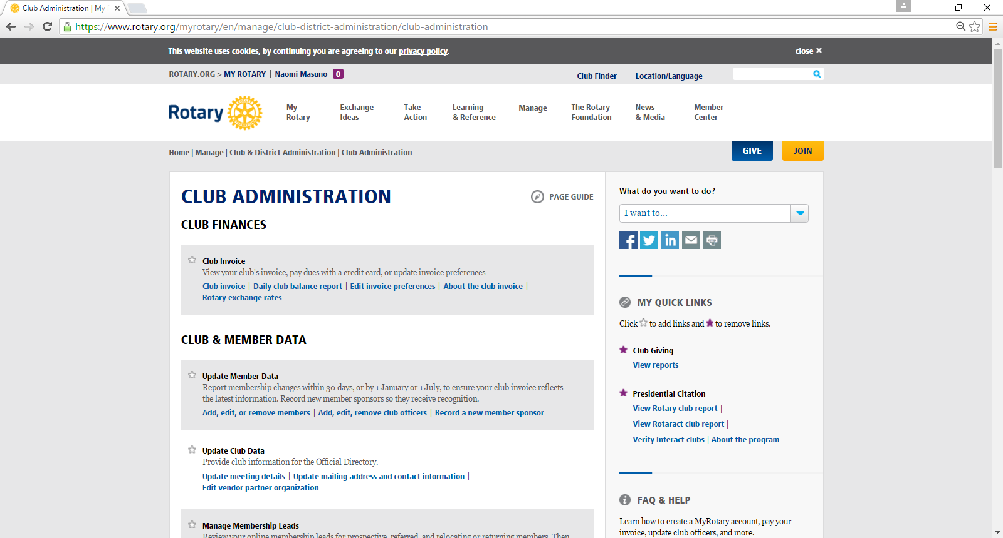
RI Club Invoice in the “Club Administration” site page

Slide 19
Rotary Foundation Contributions
Forms and Foundation Reports can be found on the rotary.org website, under “The Rotary Foundation” tab. For forms, go to “Ways to Give”. Forms are on the bottom of the site page.
Individual contributions are submitted using The Rotary Foundation Contribution Form. Members can donate online.
If you send multiple donations together, complete a Multiple Donor Form.
Indicate gift designations (such as Polio Plus or Annual Fund- SHARE) and include all contributors’ names and membership numbers so that each receives proper acknowledgment, recognition, and a tax receipt, where appropriate.
In addition to monetary gifts, contributions can include stock, appreciated securities, life insurance policies, property, and bequests. Contact Planned Giving staff at Rotary headquarters or your international office for assistance in sending these types of contributions. Se e the Foundation’s Gift Acceptance Policy for more information.

Slide 20
rotary.org - Resources
Rotary Club Central Goals
Sign up for Newsletters
Get Membership and Foundation Reports
Find Projects and Ideas
Download Manuals, Documents
Find Global Rewards (Discounts for Rotarians)

Slide 21

Mahalo!

