Slide 1
2025-2026 Presidents!
Title Page Option

Slide 2
Introductions
Name
Club
Vocation

Slide 3
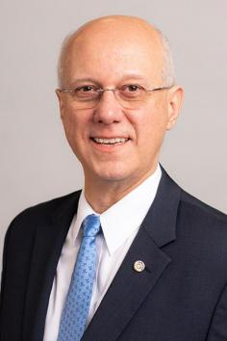
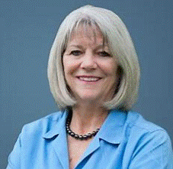
Leadership 2025-2026
Mário César Martins de Camargo Nancy Cabral
Rotary International President District Governor
Rotary Club de Santo André Rotary Club of Hilo
São Paulo, Brazil

Slide 4
Schedule
Monthly meeting on 2nd Tuesday, 5:30pm-6:30pm
Pre-PETS January 25, Saturday, 9am-Noon
PETS in Los Angeles, February 21-23, 2025

Slide 5

President-Elect Training (PETS)
February 21-23, 2025
Los Angeles Marriott
Starts Friday 9am, end Sunday 1pm
Registration opening October (club pay)
    Full package, includes Fri and Sat rooms $799
    Extra room night for Thurs $270
    Partners welcome, shared room $375

Slide 6
Hawaiian Air Discount Program
Click on “Hawaiian Air Discount” under Rotary Benefits in the right margin of the home page of rotaryd5000.org
You get the lowest available HawaiianAirlines.com web fare.
You use the convenient online access with a variety of fare and itinerary options.
Rotary District 5000 will earn 1 HawaiianMile for every $1 spent via this special link.
You will earn flight credit in your individual HawaiianMiles account too.
And for a limited time, HAL is offering District 5000 Rotarians a 5% discount on transpacific web fares! 5% Off applies to flights between SEA, PDX, SMF, OAK, SFO, SJC, LAX, SAN, PHX, LAS, JFK and Hawaii.

Slide 7
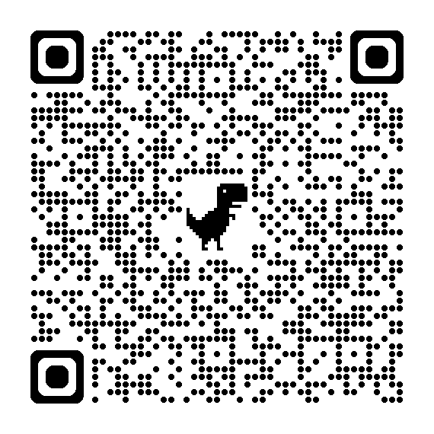
Pre-orders
Lapel pins $.50 by Oct 15
District shirts $50 by Oct 15
Hospitality Room $100 by Feb 1

Slide 8
Preparation
Pre-work starts September
District Zoom learning
District Training Assemblies March 29, April 5 and 12

Slide 9
QUESTIONS

Slide 10
QUESTIONS

Slide 11
QUESTIONS

