Slide 1


2025 Grant Qualification Webinar
Notes:
The slide will be on the screen when PEs enter the room.
Introduce yourself. Put forth that we’ve attempted to change the Foundation presentation to hopefully give a better understanding of how TRF is different and why Rotarians should choose to give to the Foundation first over other charitable organizations

Slide 2
Agenda – Learning Plan
Overview of grant program
Grant funding (where does the money come from)
How to qualify for grant funds
Grant agreements
  Memorandum of Understanding (MOU)
  Addendum to MOU
  Financial Management Plan
Resources
Notes:
Benson

Slide 3
Key takeaways
Use of grant funds
  Used for the purpose described on the application that was approved
  Do not spend project funds until after the grant funds are in the account
  Use funds by May 31, return funds to D5000 asap if not used
  Disbursements authorized by 2 people via the voucher or on the grant check
  Grant funds cannot be carried over to another year
Complete qualification checklist by January 31
Maintain separate club grant account – all disbursements from this account
Keep documents for 5 years
Notes:
Benson

Slide 4
Types of grants
The Rotary Foundation offers grants that support humanitarian projects, scholarships, and vocational training teams. Here’s an overview:
Global grants support large international projects with long-term, sustainable outcomes in one or more of Rotary’s areas of focus. They range from $30,000 to $400,000.
District grants fund smaller-scale, short-term projects that address immediate needs in your community or abroad. 50% of DDF
Disaster response grants support disaster relief and recovery efforts through grants from the Rotary Disaster Response Fund. Max Is $25k
Programs of scale grants support Rotary member-led, evidence-based, programs that have already demonstrated success. $2million over 3-5 years
Notes:
Benson

Slide 5
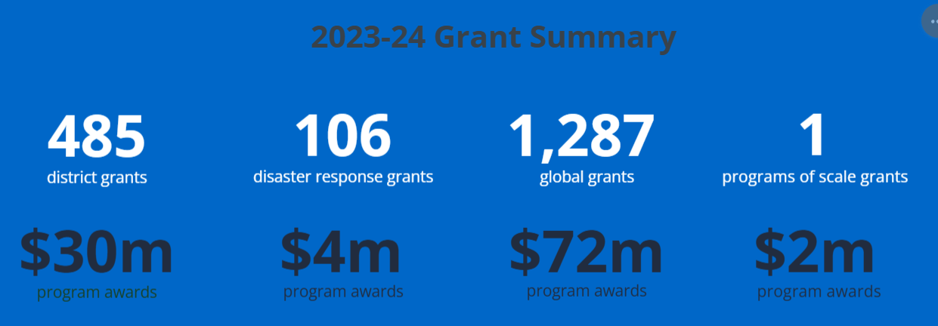

District grants
485 grants
$30 million
Global grants
1,285 grants
$ 82 million
Disaster response grants
105 grants
$ 4 million
Programs of scale grants
$ 2 million
Notes:
Benson

Slide 6
Grant Timeline
For 2026-2027 Grants:
Fall 2025 – 2 members attend grant management training
Jan 31, 2026- Due: 3 documents (MOU, Addendum, Financial Plan) and the IRS filing confirmation of tax return and GET for year ended 6/30/25. The president for 2026-2027 and 2027-2028 sign the documents. If no President Nominee (PN), the current president can sign.
May 31, 2026-Final grant report submitted by this year’s team.
June 15, 2026-Grant application for Rotary year 2026-2027 submitted
July 15, 2026 – Submit District grant to RI for approval
August - distribute grant funds to clubs
All documents are emailed to grants@rotaryd5000.org
Forms on the District website at: https://rotaryd5000.org/sitepage/district-grant-info-documents
Notes:
Benson

Slide 7
The Process
Qualification
By Jan 31
Application
By June 15
Funding
Club cash in grant account in July
3 Documents
Tax Filings
Club agreement on projects
Application submitted by June 15
Rotary approves
Grant funds deposited
All disbursements from grant account
Disbursements authorized by 2, use voucher form
Final Report
Allocation
Training
Documents
D5000 Grant Subcommittee: Joni Henderson, Naomi Masuno,
Stewardship: Paul Saito, Laura Steelquist
Final 2025 report due May 31
Funds used as approved
All receipts sent with report
Keep 5 years

Slide 8
Qualification checklist
By January 31:
1) Review, Sign and Submit
Memorandum Of Understanding (MOU)
District 5000 Addendum to the MOU
Financial Management Plan
2) Evidence of tax filing (tax return copy or 990N confirmation, proof of GE return)
3) Evidence of grant bank account (bank statement or check copy)
4) Attended District Grants training by 2 members, preferably the PE and person handling grant funds
By May 31: Final grant report for the current year
Notes:
Laura: So, how does the club qualify?

Slide 9
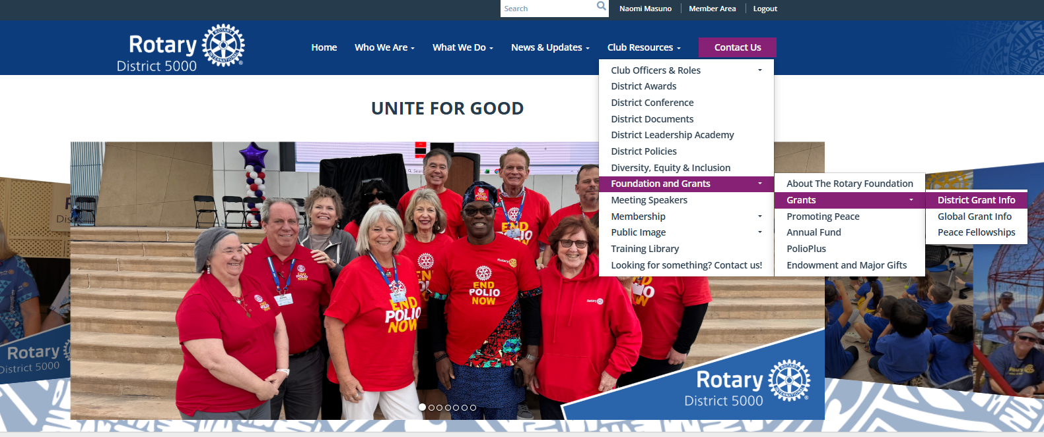
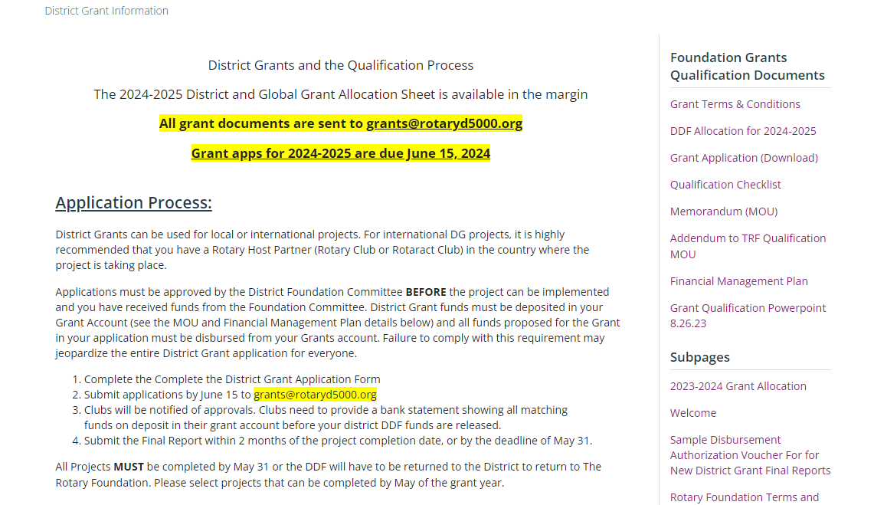
District Sitepage
https://rotaryd5000.org/sitepage/district-grant-info-documents
Notes:
Naomi

Slide 10
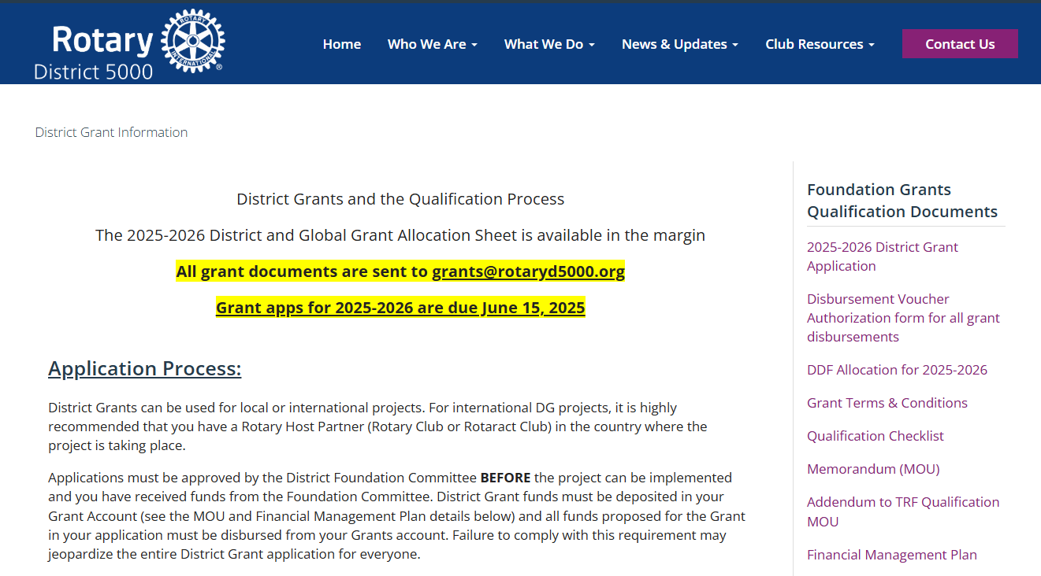

Slide 11
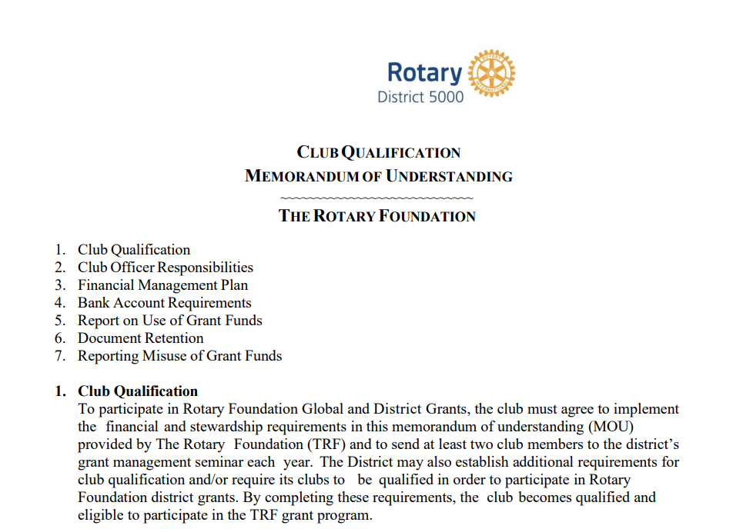
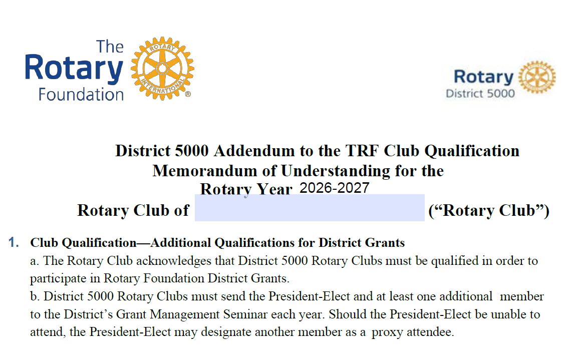
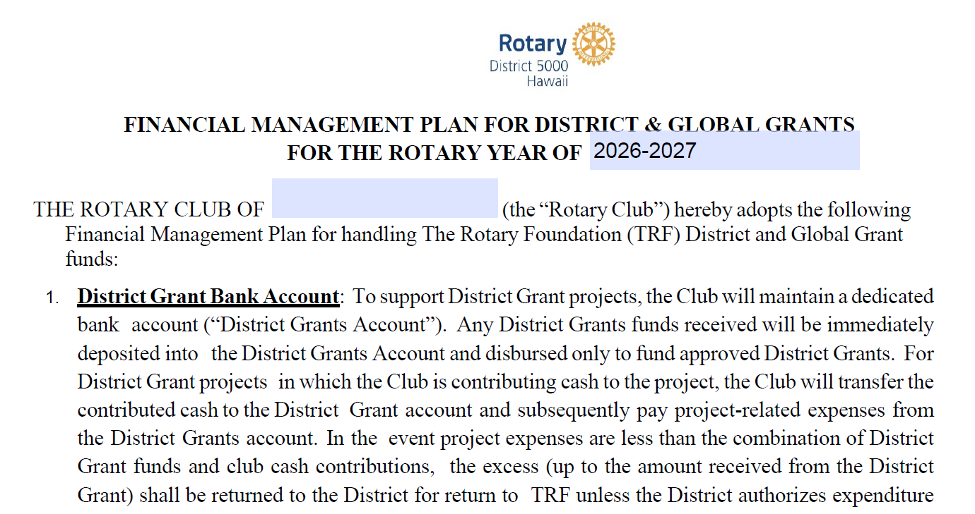
Three forms signed by PE and PN
Notes:
Laura

Slide 12
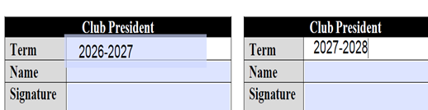
MEMORANDUM OF UNDERSTANDING
1. Club Qualification
2. Club Officer Responsibilities (adhere to stewardship measures)
3. Financial Management Plan (handling funds)
4. Bank Account Requirements (2 authorizing disbursements)
5. Report on Use of Grant Funds (how funds were spent)
6. Document Retention (5 years)
7. Reporting Misuse of Grant Funds (no tolerance)
Notes:
Laura

Slide 13
District 5000 Addendum to the
TRF Club Qualification
Section 4 “Bank Account Requirements” Item C requires that a “separate account should be opened for each club-sponsored grant, and the name of the account should clearly identify its use for grant funds.” This requirement applies to Global Grants, include Vocational Training Team and Global Scholar Global Grants.
Notes:
Laura

Slide 14
FINANCIAL MANAGEMENT PLAN FOR
DISTRICT & GLOBAL GRANTS
Maintain a dedicated bank account.
  Grant funds deposited and disbursed to fund approved District Grants.
  Club cash is transferred to the District Grant account and subsequently pay project-related expenses from the District Grants account
Title of the account: Rotary Club of xxxx TRF District Grants Account
Disbursements require two (2) signatures on a Disbursement authorization form or checks written from the Club District Grants Account or Global Grants Accounts. Authorized signatories may be: The Club President, the Immediate Past President, the Club Treasurer, or the Rotary Foundation Chair. An invoice or receipt, retained by the Club Treasurer, shall be required for all disbursements.
The Club will retain receipts and other documentation of disbursement of Funds in physical form and electronic form for five (5) years from the date of Approval of the Final Report
Notes:
Laura

Slide 15
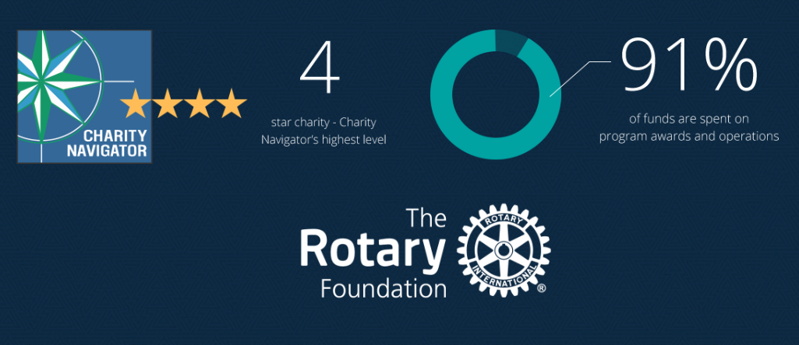
The Rotary Foundation of Rotary International has received 17 consecutive 4-star ratings from Charity Navigator.
The rating reflects Charity Navigator's assessment of how the Foundation uses donations, sustains its programs and services, and practices good governance and openness. (aka Stewardship)
Notes:
Laura: The Foundation earned the recognition for adhering to sector best practices and executing its mission in a financially efficient way, demonstrating both strong financial health and commitment to accountability and transparency. Only one percent of the organizations Charity Navigator evaluates have received 17 consecutive 4-star evaluations. The rating reflects Charity Navigator's assessment of how the Foundation uses donations, sustains its programs and services, and practices good governance and openness. This is also known as Stewardship. The District signs an MOU and must oversee the process and adhere to Rotary’s rules.

Slide 16
What is Stewardship?
Stewardship is the responsible management and oversight of grant funds, which ensures that funds are used properly and truly benefit the populations in need:
Supervise projects—MOU Guidelines
Implement projects as approved
Report irregularities
Submit reports
Retain documents- 5 years of soft (electronic) and hard copy
Notes:
Laura

Slide 17
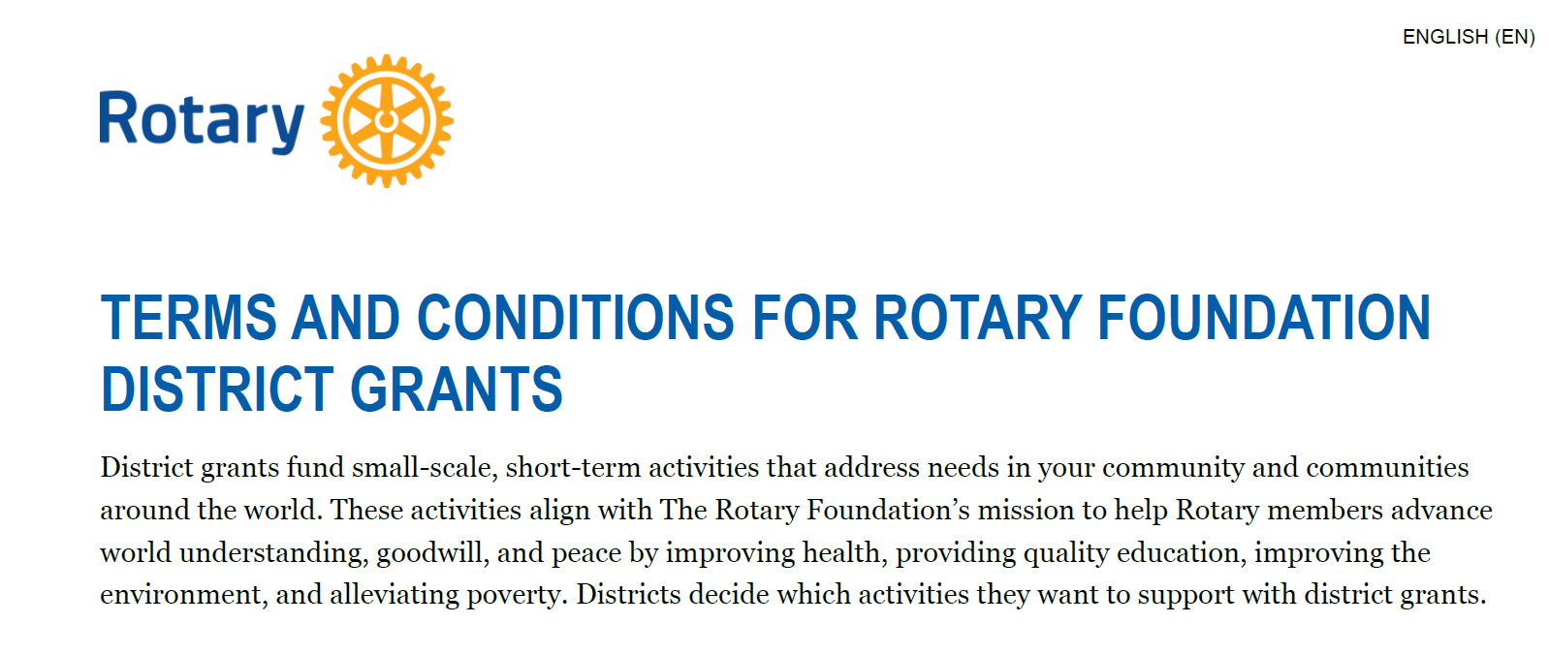
Notes:
Laura

Slide 18
Grant eligibility guidelines
Relate to the Foundation’s mission
Can’t use grants to reimburse clubs or districts for activities and expenses that are in progress or already completed.
If you want to alter a project after a grant is approved, the Foundation also needs to approve those changes before they are carried out.
Comply with the Conflict of Interest Policy for Program Participant
Follow Rotary’s Privacy Statement (personal data, images, etc)
Include signs on/near projects that identify Rotary Foundation
Notes:
Laura

Slide 19
Grants cannot fund:
Unrestricted cash donations to a beneficiary or cooperating organization
Continuous or excessive support of any one beneficiary, entity, or community
The purchase of land or buildings
A Rotary Club cannot own assets purchased with grant funds
Fundraising activities
Expenses related to Rotary events such as district conferences, conventions, institutes, anniversary celebrations, entertainment activities, or project ceremonies
Public relations initiatives, unless they are essential to carrying out the project
Project signs that cost more than $1,000
The operating, administrative, or indirect program expenses of another organization
Activities for which the cost has already been incurred
Notes:
Laura

Slide 20
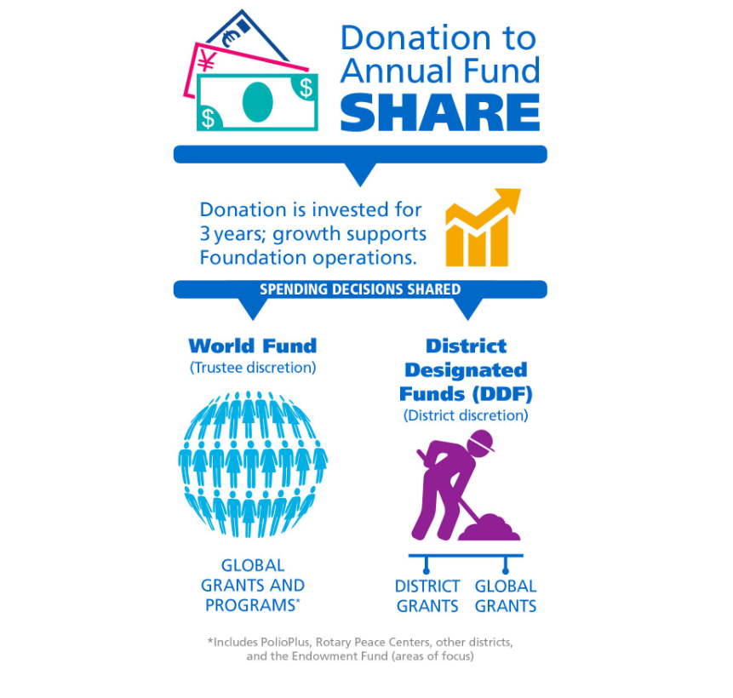
Notes:
Patti: Annual Fund contributions are transformed into grants and programs that support Rotary's humanitarian service using the SHARE system.
SHARE uses a three-year funding cycle. It allows the Foundation to invest donations and use the earnings for administrative and fund development costs.
After the investment period, the donation is divided. Annual Fund-SHARE contributions now have the first 5% of the total directed to operating expenses, with the remainder split equally between the World Fund and District Designated Funds.
The Foundation uses the portion credited to the World Fund to pay for grants and programs that are available to all Rotarians. Your district can use the portion that becomes DDF to participate in grants and the programs you choose.

Slide 21
Grant Funds to 2025-2026 Rotary Projects
2022-2023 donations of SHARE $295,557 from District 5000
5% Admin Fee $ 14,777 to Rotary International
47.5% to World Fund $140,390 to The Rotary Foundation
47.5% to District Designated Fund (DDF) $140,390 to District 5000
Funds returned in 3 years to the District as grants. Available this year for projects:
$ 33,894 No match (25% of DDF)
$ 33,894 Match (25% of DDF)
$ 70,195 Match for Global Grants (50% of DDF)
$137,983 From District Designated Funds (DDF), net of Admin fee
$ 33,894 Matching Club Cash for matching District Grants
$ 35,097 Matching Club Cash for Global Grants
$ 60,367 From World Fund to match Global Grants
$ 267,341 Total for Global and local projects
.

Slide 22
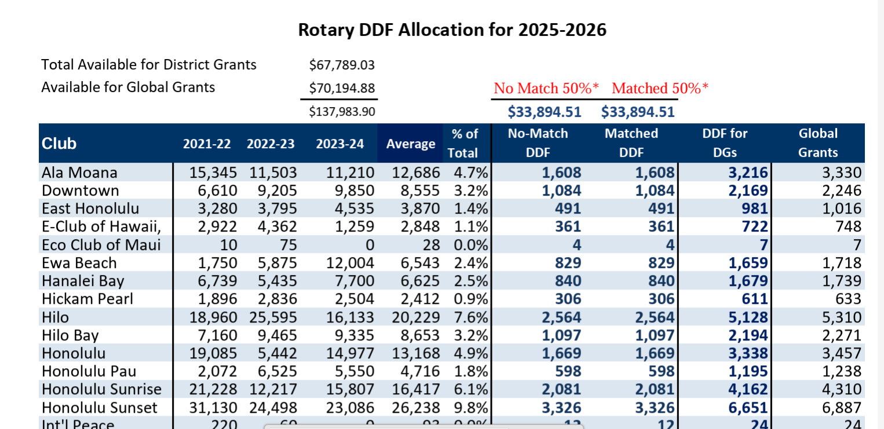
Grant allocation
Notes:
This year, the no match and match is the same to reduce the amount of cash the club has to put up

Slide 23
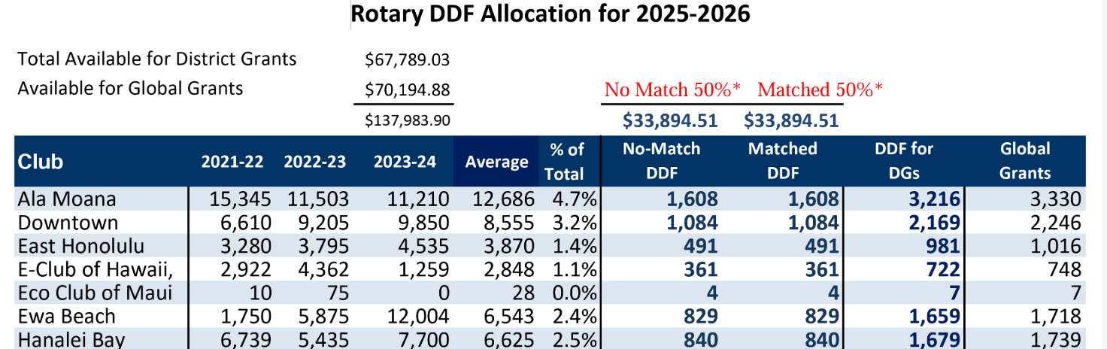
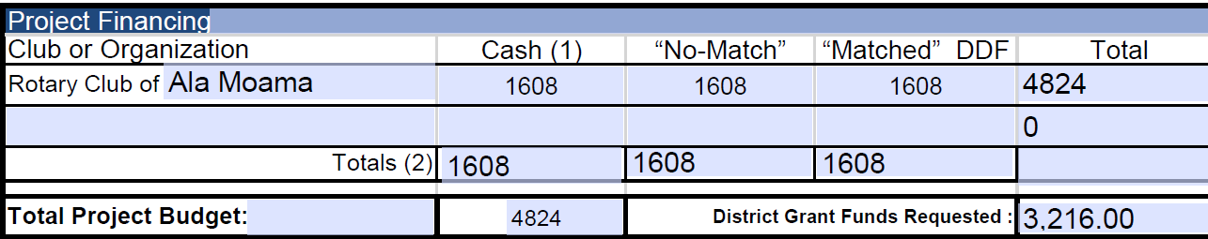

DDF Allocated to the Clubs for district grants and global grants 2025-26 https://rotaryd5000.org/sitepage/district-grant-info-documents
Notes:
Patti

Slide 24
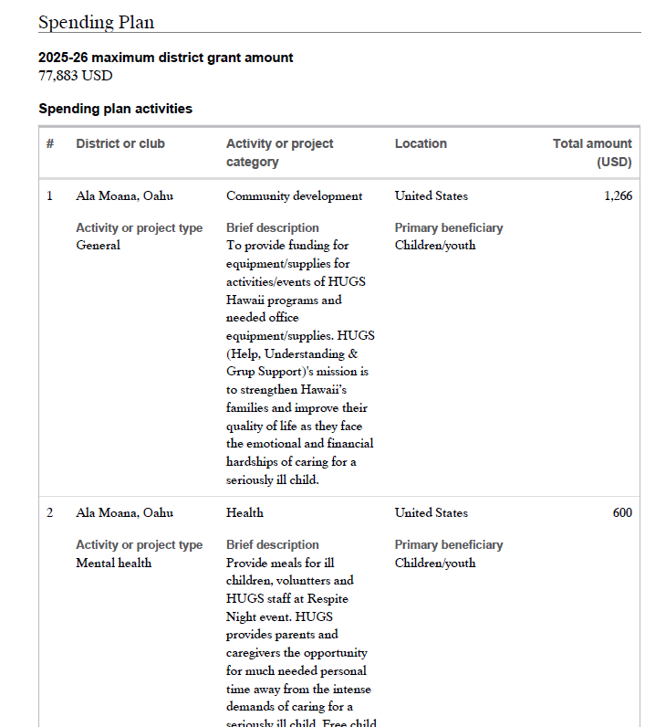

Slide 25
FINANCIAL MANAGEMENT OF DISTRICT GRANTS (DG)
Important
Any DDF received will be immediately deposited in the District Grants Account and disbursed only to fund approved District Grants.
For DG projects in which the Club is contributing cash to the project, the Club will transfer the contributed cash to the District Grant Account
Pay project-related expenses only from the District Grants Account.
Do not disburse any funds until your application is approved and all DDF from District 5000 and Club contributions for matching are deposited in the District Grant Account.
Notes:
Laura

Slide 26
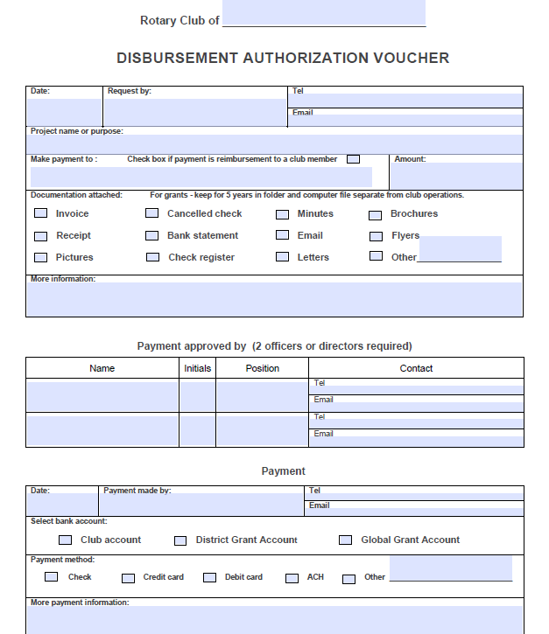
Disbursement Authorization Voucher
Notes:
Patti

Slide 27
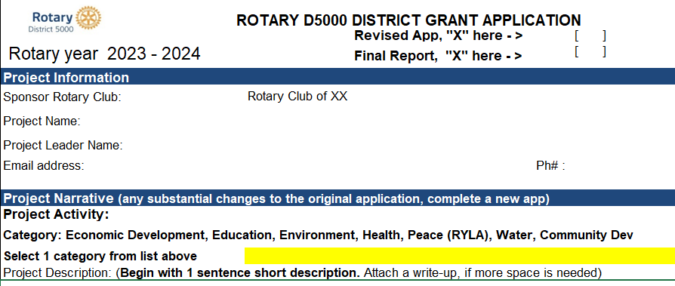

Final Reports
Final Reports are due 2 months after the completion of the project, but no later than May 31. Send the receipts along with the report to grants@rotaryd5000.org
Notes:
Naomi

Slide 28
FINANCIAL MANAGEMENT OF DISTRICT GRANTS— the Audit
About 15-20% of District Grants audited each Rotary Year
Documents you will need:
The DG Application and Final Report with explanation of any changes
Current Bank Signature Cards
Bank Statements showing incoming funds (Club cash and DDF) and disbursements
Cancelled checks
Paid invoices or receipts
D5000 Disbursement Authorization/Payment Vouchers
Notes:
Laura

Slide 29
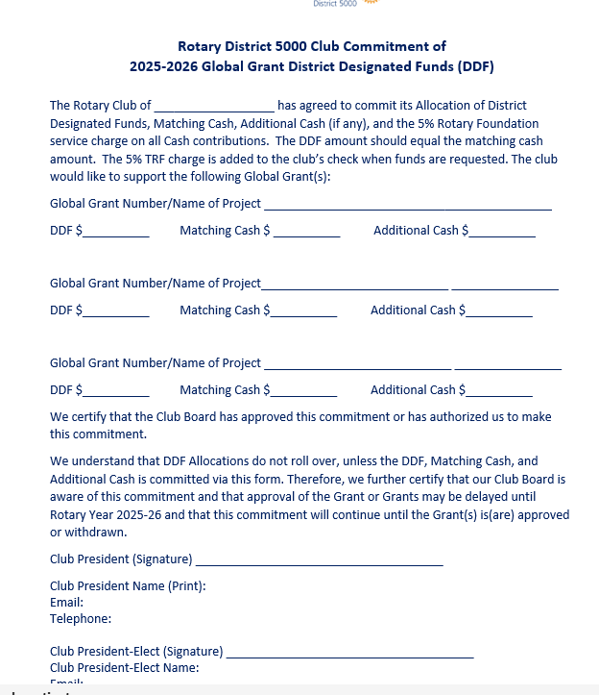
Global Grant Pledge Global Grants – Pledge form
Important
Retain copies of Global Grants Commitment Letter
Make sure PE and incoming Board have copies and understand commitment
COMMITMENT EXISTS UNTIL GRANT IS APPROVED/FUNDED OR CANCELLED
Notes:
Naomi

Slide 30
District Grants vs Global Grants
Global Grant District Grant
Cost - $30,000 minimum No maximum
Funding - World Fund, DDF, Cash DDF and Mandatory Club Match
Application -Online District Application
Area of Focus No area of Focus requirement One of seven areas of Focus
Partnerships – Host Club required No partnership required
Sustainability - Required Not Required
Measurability - Required Required
Scholarships Sponsor Club Determines Graduate- Post Graduate
Notes:
Naomi: What’s the difference between a District Grant and a Global Grant?

Slide 31
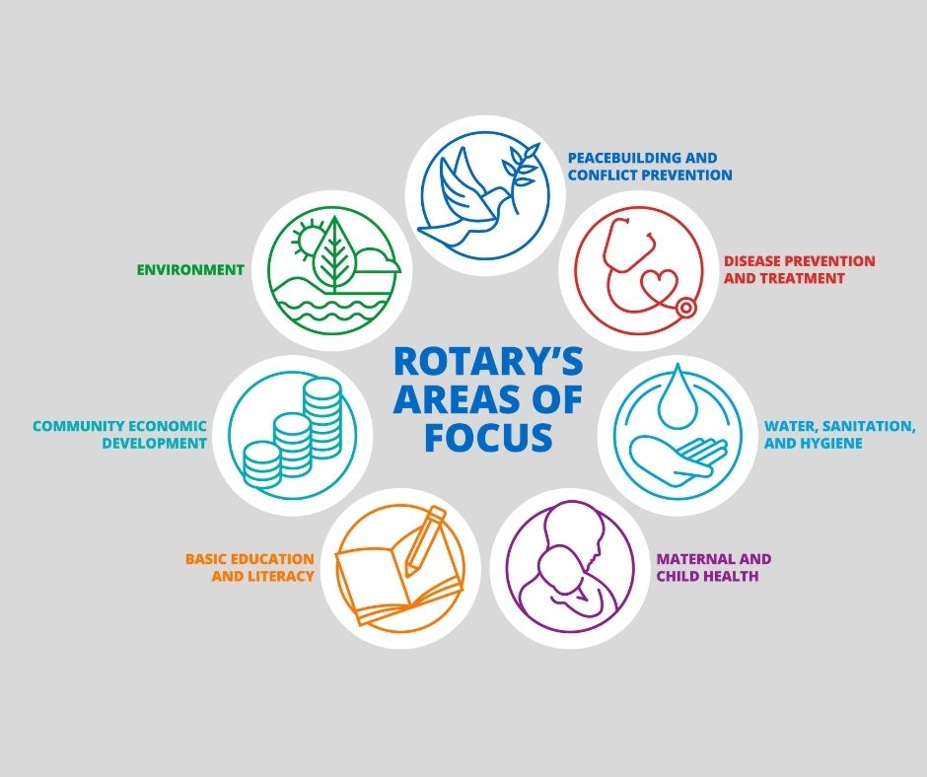
Notes:
Naomi

Slide 32
requirements for Global grants
Districts must be qualified in order to receive grant funding from The Rotary Foundation. Clubs that want to apply for global grants must also be qualified.
The qualification process helps ensure that your district or club understands your financial responsibilities, including stewardship, and is prepared to take them on. Qualification must be completed each year.
Club qualifies for global grants by someone taking the Grant Management Seminar in the Rotary Learning Center. New requirement started last year.
Notes:
Naomi

Slide 33

SUSTAINABILITY STEP No. 1
Notes:
Designing a sustainable project starts by working with the community.
The club in the location where the project will take place, known as the host sponsor, should collaborate with local residents to identify a need and develop a solution that builds on the community’s strengths and aligns with its values and culture. You can use the Conducting Community Assessments handbook, available in My Rotary, to help with this.
A club or district that wants to apply for a global grant to support a humanitarian project or a vocational training team needs to conduct a community assessment first and use the results to design their project. Those assessment results need to be part of their grant applications.

Slide 34
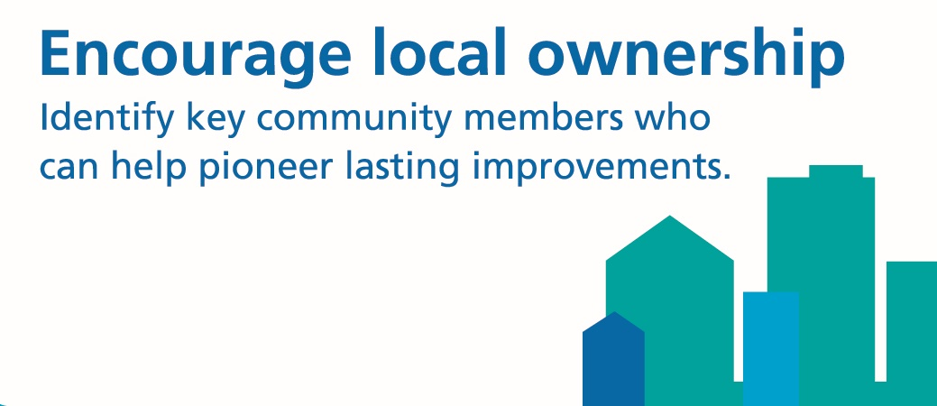
SUSTAINABILITY STEP No. 2
Notes:
The next step is to encourage local involvement.
One indicator of a project’s success is when community members embrace it and are committed to maintaining it. Empowering people to assess their own needs and plan how to address them will lead to the most effective projects and the most sustainable outcomes. It’s important to identify community members who can help initiate and promote lasting improvements.

Slide 35



SUSTAINABILITY STEP No. 3
Notes:
The third step is to include learning opportunities in your plans.
A project’s long-term success depends on the people who become involved in it. By making sure that your plans include community outreach, education, and training, you improve people’s ability to maintain the project’s success.
You should also include a plan to transfer that knowledge to new participants in the project. A good strategy is to collaborate with local organizations to offer learning opportunities.

Slide 36
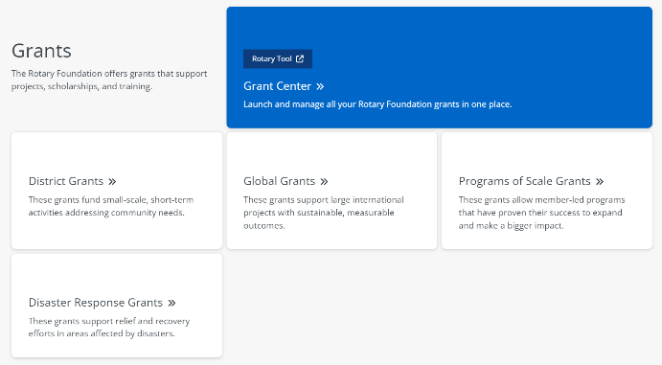
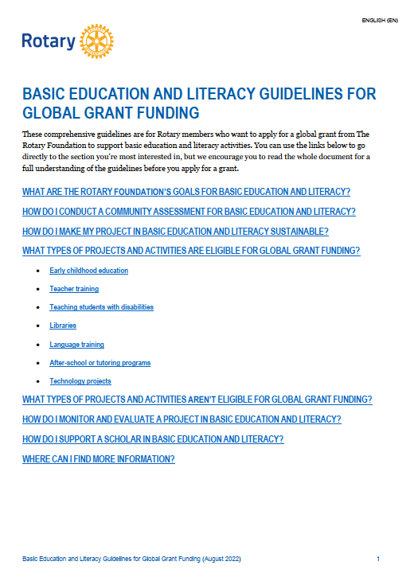

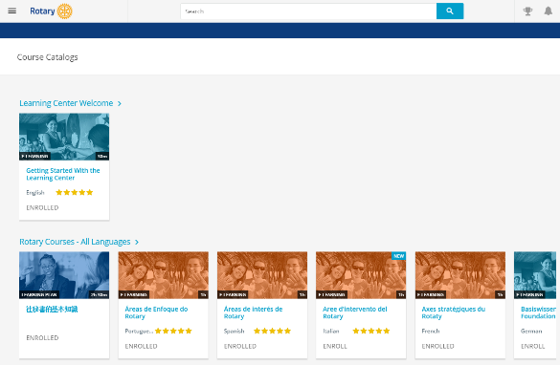
GRANT RESOURCES
My Rotary
A Guide to Global Grants
The Learning Center
Area of focus guidelines
District Rotary Foundation committee
Rotary grants staff
Notes:
Many resources can help you take full advantage of Rotary’s grant opportunities.
My Rotary has pages dedicated to each of our grant types.
If you’re interested in applying for a global grant, I encourage you to read A Guide to Global Grants. This manual includes everything you need to know to get started with global grants.
Rotary’s Learning Center offers resources on many grant-related topics. I encourage anyone interested in applying for a global grant to take the grant management seminar courses.
Another set of resources that will be helpful to you if you decide to apply for a global grant are the area of focus guidelines, one for each area of focus. You can find them in My Rotary.
Another resource is your district’s Rotary Foundation committee. This committee educates clubs about Foundation grant and fundraising activities, inspires them to participate in grants, helps clubs with the grant process, and can advise about whether certain activities are eligible for grant funding. This committee also oversees the distribution of DDF.
You also can talk to members of the Rotary grants staff throughout the process. They can answer questions about grant eligibility and project design. If you have a general idea about a project you’d like to fund with a global grant, you can ask your regional grants officer to conduct a preliminary review of your application. They’ll let you know if there are issues that need to be addressed before you formally submit your application in the Grant Center.

Slide 37
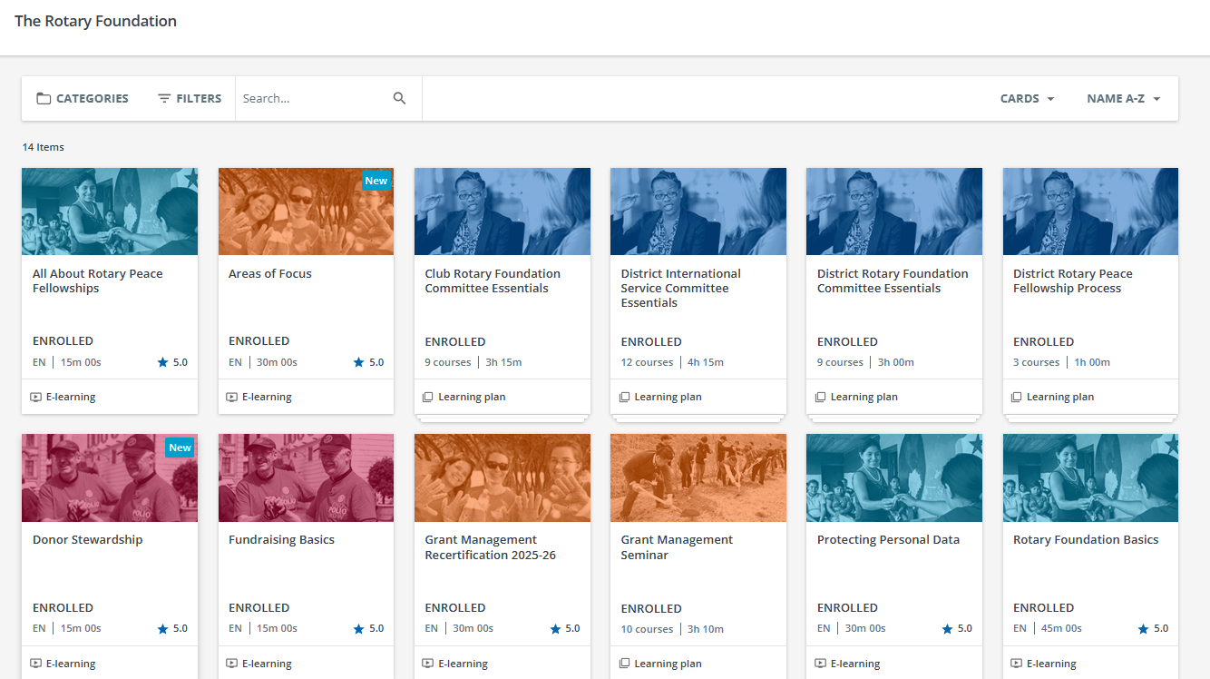

Learn.rotary.org
Notes:
Naomi

Slide 38
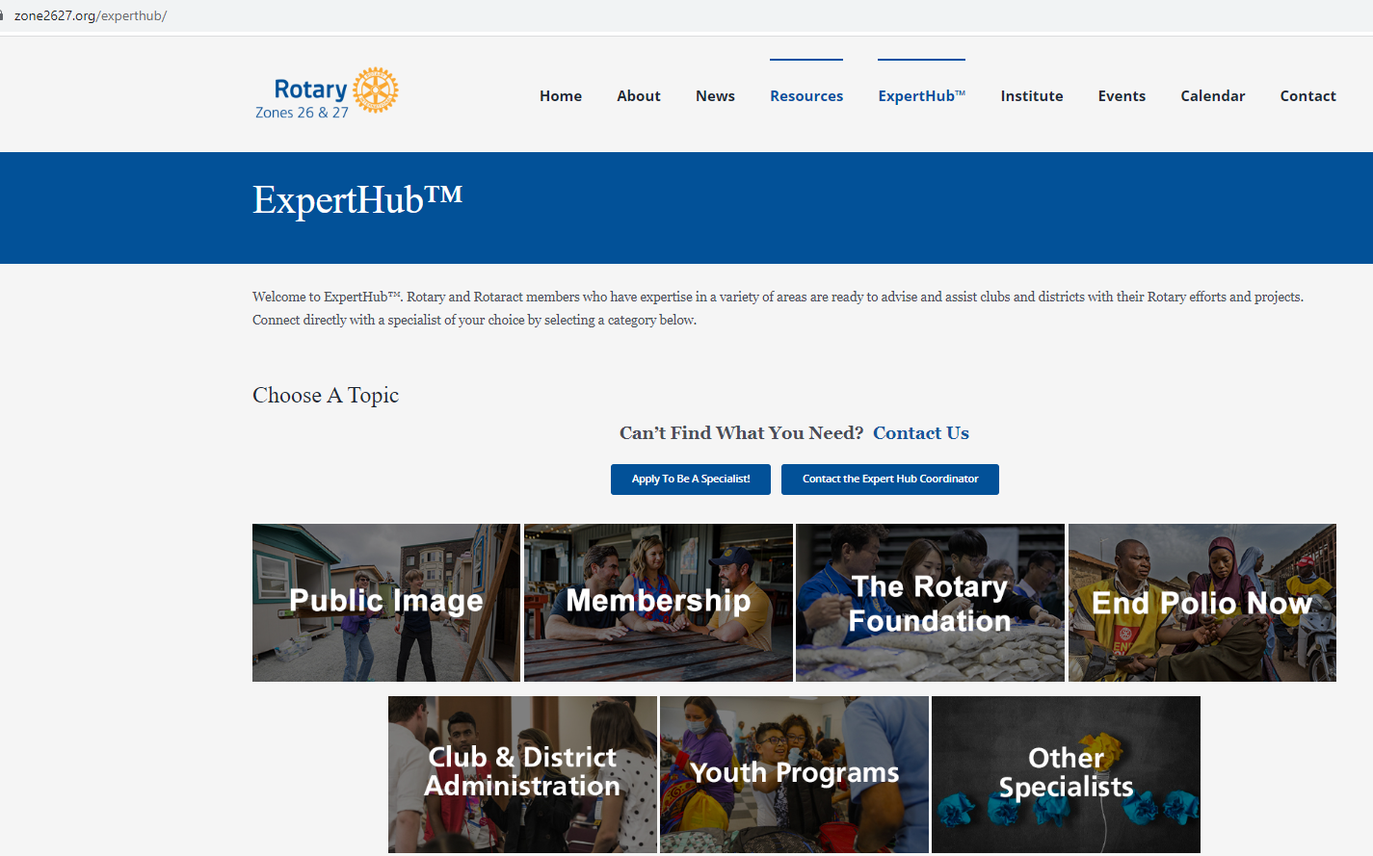
Notes:
Naomi

Slide 39
Key takeaways
Use of grant funds
  Used for the purpose described on the application that was approved
  Do not spend project funds until after the grant funds are in the account
  Use funds by May 31, return funds to D5000 asap if not used
  Disbursements authorized by 2 people via the voucher or on the grant check
  Grant funds cannot be carried over to another year
Complete qualification checklist by January 31
Maintain separate club grant account – all disbursements from this account
Keep documents for 5 years
Notes:
Naomi

Slide 40
QUESTIONS

Slide 41


