Slide 1


Slide 2
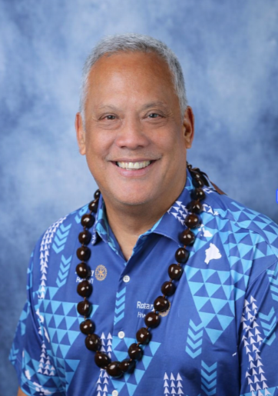


Benson Medina
Rotary Club of South Hilo
District Governor 2026-2027
benson.rotary5000@gmail.com
808-286-6559
Notes:
Introduce yourself

Slide 3

Make decisions grounded in evidence.
Be inclusive, engaging, compassionate, and ambitious on behalf of the world.
Create meaningful relationships across decades and continents.
Seek new perspectives and new ideas that can strengthen Rotary and create lasting change.
Notes:
The action plan isn't just something Rotary International created that doesn't pertain to you. Our goal is that by the end of this session you'll see how everything you do to improve your club has it's roots in the action plan.
So lets take a look at the 4 parts to the action plan:
First we have:
Increase our Impact:
We want to build practices and infrastructure to define, measure, track, and analyze data from our service projects.
Next, we have
Expand our Reach:
We want to share our values with new audiences and creating new ways to bring people together to experience the power of Rotary.
Third, we have:
Enhance Participant Engagement:
We want to use every encounter as an opportunity to show people what Rotary can do for them as individuals and as members of our communities.
Last but not least, and possibly the hardest depending on your club, we have:
Increase our Ability to Adapt:
We need to work to create a culture of research, innovation, and willingness to take risks in your club to better serve your community.

Slide 4
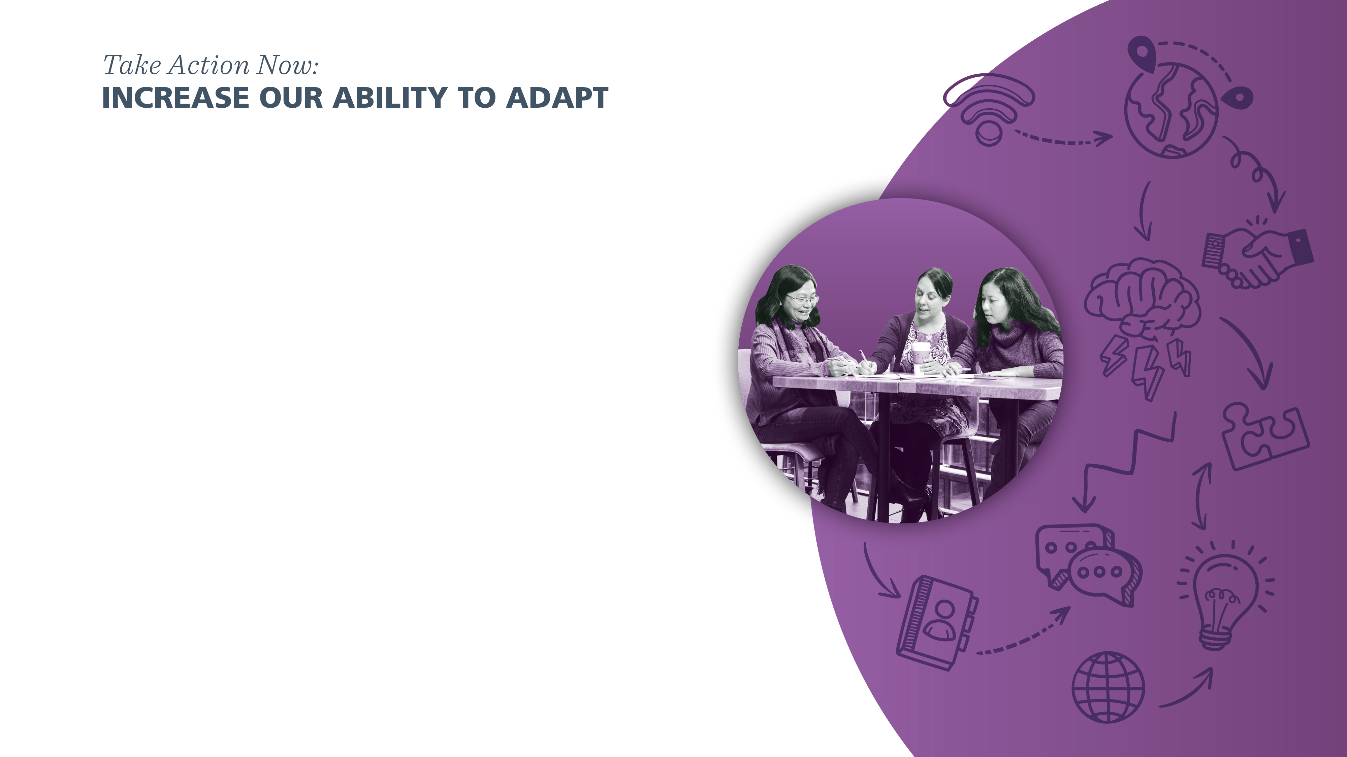
Consider small changes you can make to improve how your club operates.
Improving operations to become more agile and more responsive
Seek new perspectives and new ideas
Create a culture of research, innovation and willingness to take risks to better serve your community.

Slide 5

Increase Impact
How can your club increase the impact in your community and how are you measuring the impact?
Notes:
All of your clubs are doing amazing things in your respective communities – Working at your round table, share with one another what your club is doing for or with your community and how you are measuring the impact.

Slide 6


Embracing and exemplifying diversity, equity, and inclusion (DEI) in everything we do at Rotary
Exploring new products and participant models so that people can join us and take action, no matter where they live
Notes:
We’re committed to embracing and exemplifying diversity, equity, and inclusion (DEI) in everything we do at Rotary. We have revised our DEI statement, which now reflects our stronger-than-ever commitment to being an organization that values, respects, and welcomes everyone who interacts with us. Now we’re developing a comprehensive plan of action with achievable, measurable, and meaningful DEI outcomes for Rotary. Let’s share our values with new audiences, create new ways to bring people together to experience the power of Rotary, and prove we are an organization that’s inclusive, engaging, compassionate, and ambitious on behalf of the world.
I strongly encourage you to read and follow Rotary’s new DEI Code of Conduct, which points the way to creating more just, open, and welcoming communities or all people.
We’re piloting and evaluating new products and participant models so that people can join us and take action, no matter where they live. We also see great potential in existing programs, including Rotary Action Groups, Rotary Community Corps, Rotary Fellowships, and others.

Slide 7

Visit RI’s DEI page at rotary.org/dei to learn more about how to make your club more inclusive.
How are you engaging people beyond traditional membership?
Notes:
You should visit our DEI page at rotary.org/dei to learn more about how to make their club more inclusive.
We’re eager to hear about the ways you’re engaging people beyond traditional membership. I invite you to share those ideas through the My Rotary Action Plan page.

Slide 8

Expand Our Reach
What is your club doing to reach new audiences?
Notes:
We want to share our values with new audiences and creating new ways to bring people together to experience the power of Rotary.
Again, with the people at your table, let’s take 10 minutes to answer this question: What is your club doing to reach new audiences?

Slide 9

Members feel Welcome
Members are involved
Meetings are worthwhile
Build personal connections
Club Experience matters most

Slide 10
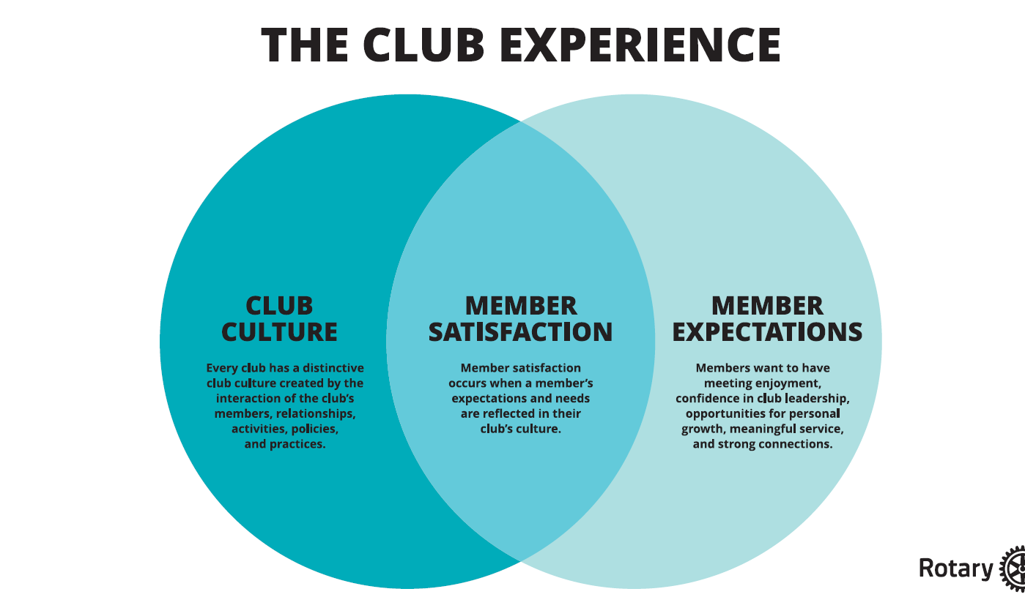




Slide 11
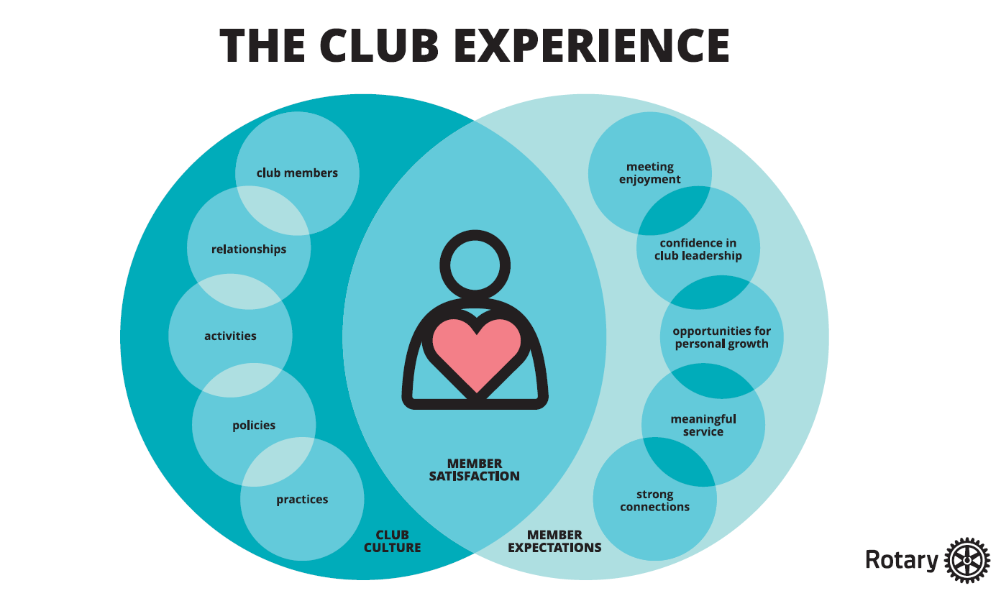

Slide 12
Membership
Attracting
Grow
Enhance
Retaining

Slide 13
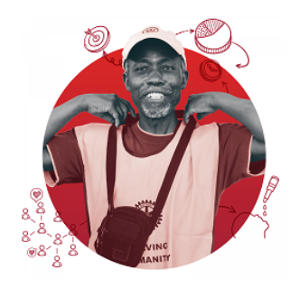
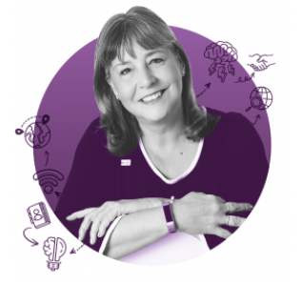
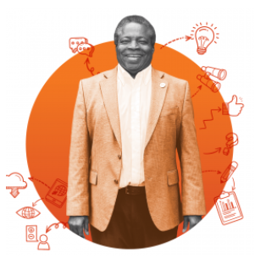

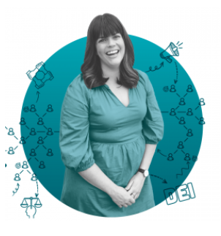
Increase Impact
Enhance Participant Engagement
Increase Our Ability to Adapt
Expand Our Reach
Notes:
These are all great ideas! Now, let’s bring it back to the action plan right now. (4 minutes)
- Who can tell me how expanding our reach will increase our ability to adapt? (let someone answer)
- Who can tell me how expanding our reach will increase impact? (let someone answer)
- Who can tell me how expanding our reach will Enhance Participant Engagement? (let someone answer)
Here are examples you can use just in case there are blank stares:
- We can increase our ability to adapt when we have new perspectives.
- We can increase our impact because we’ll have more people!
- We can enhance participant engagement because bigger impact inspires action which is something we learned earlier. Also, how many people have members in their clubs who are burnt out? Do you think that some people might re-engage in committees and projects if they knew they wouldn’t always be responsible for leading it?

Slide 14
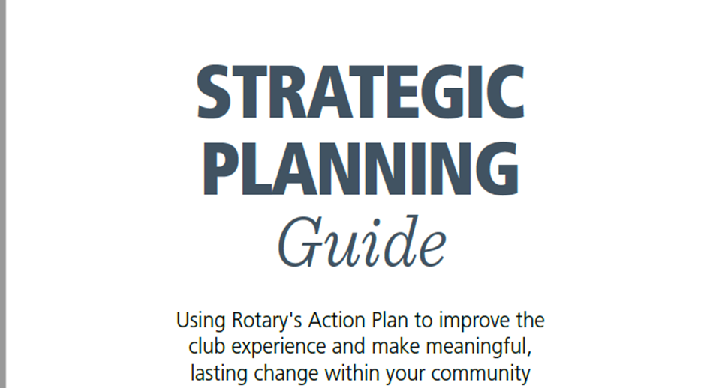

Slide 15
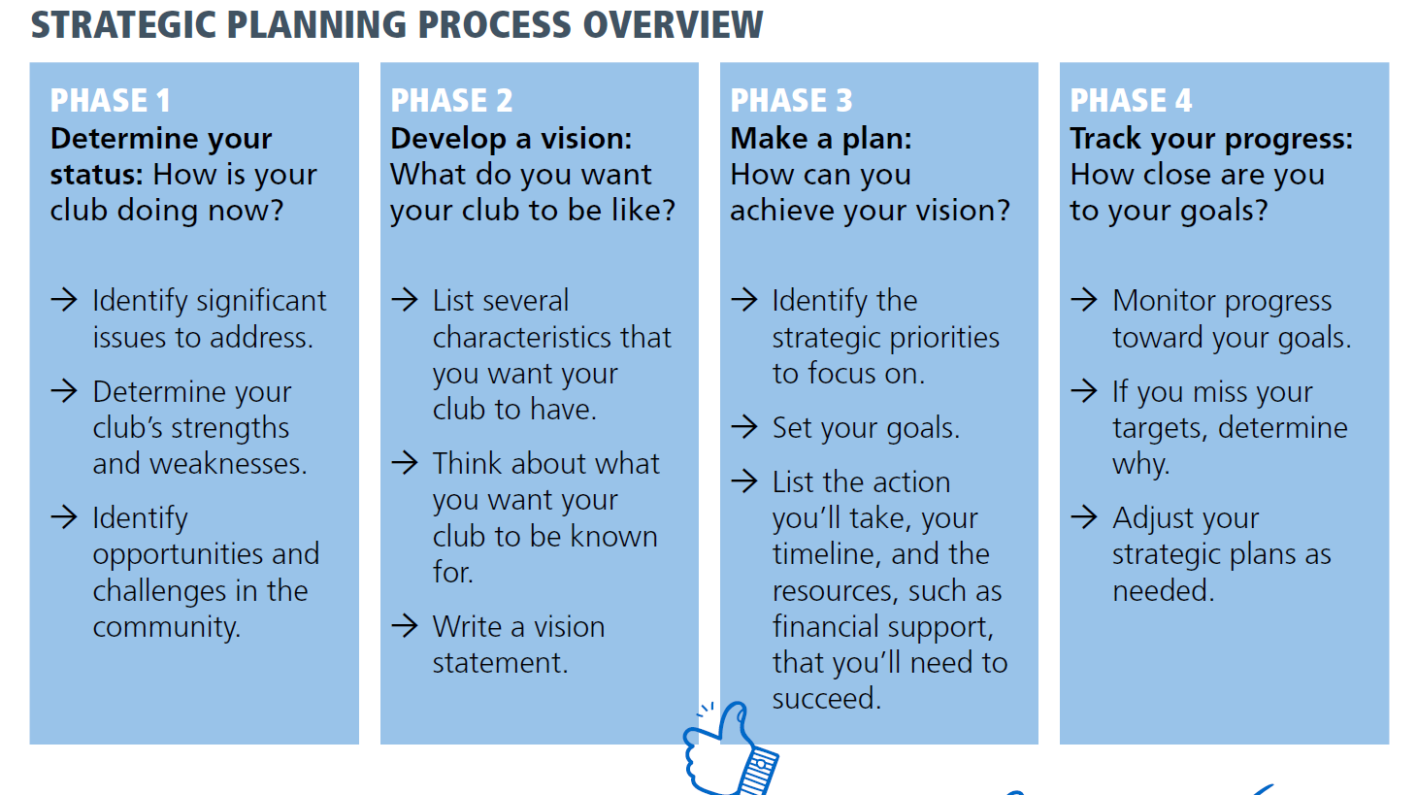

Slide 16
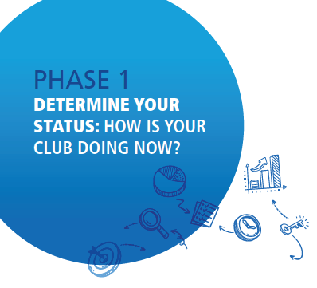
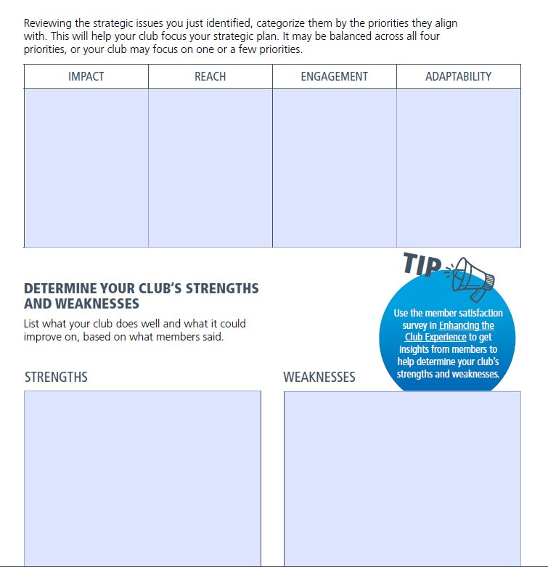
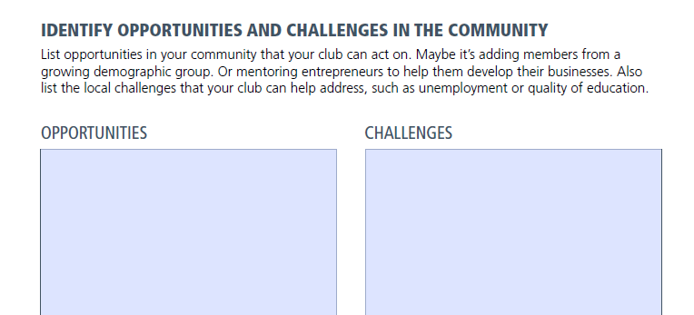

Slide 17
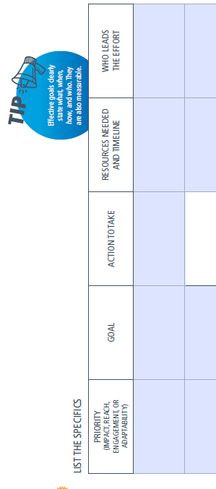
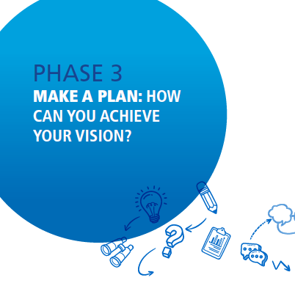

Slide 18
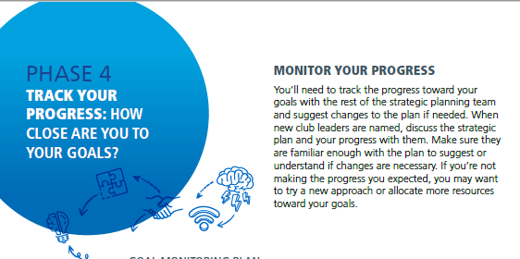
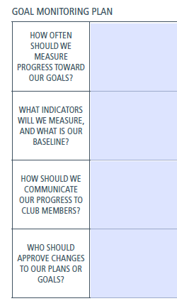

Slide 19

3-year rolling goals – 6 priority Goals

Slide 20
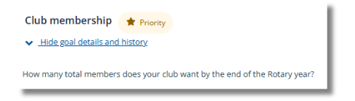
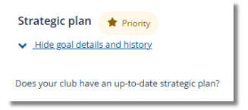
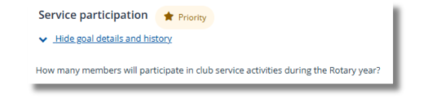

Slide 21
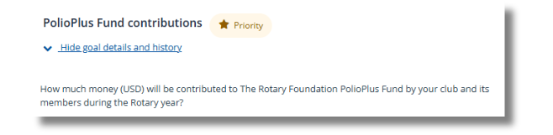
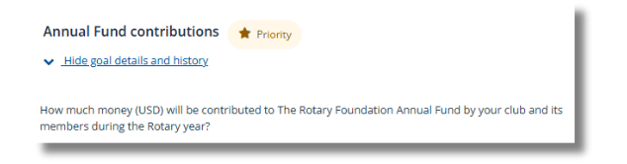
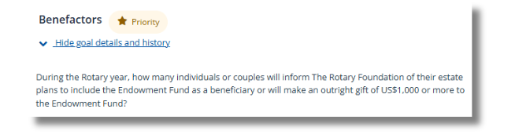

Slide 22
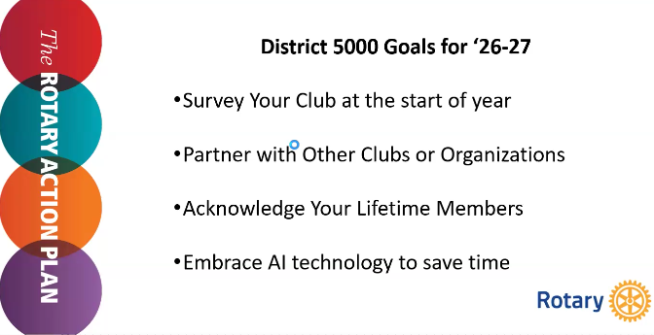

Slide 23
Resources
Notes:
Before we leave today, I want to make sure you know that there are so many resources available to you. On the Southwest PETS Website, links are up to some of our favorites.

Slide 24


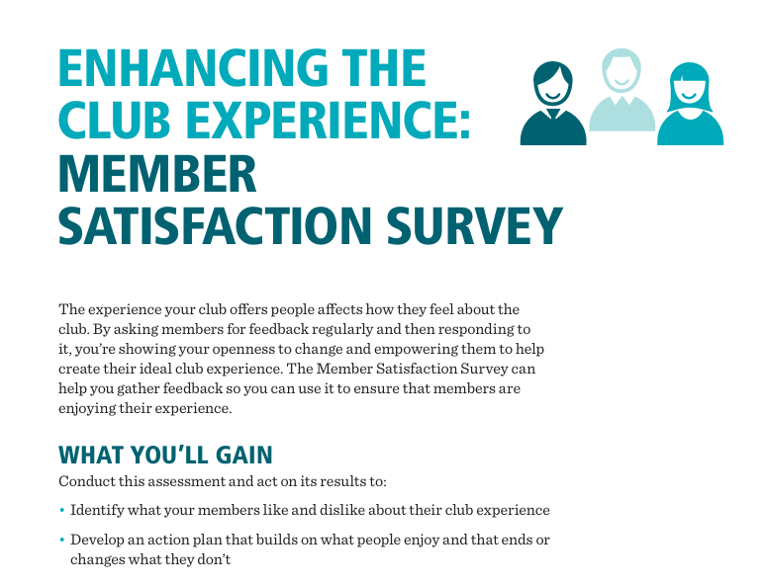

Slide 25

