Slide 1
Rotary Club Board Forum
May 16, 2026
Title Page Option

Slide 2
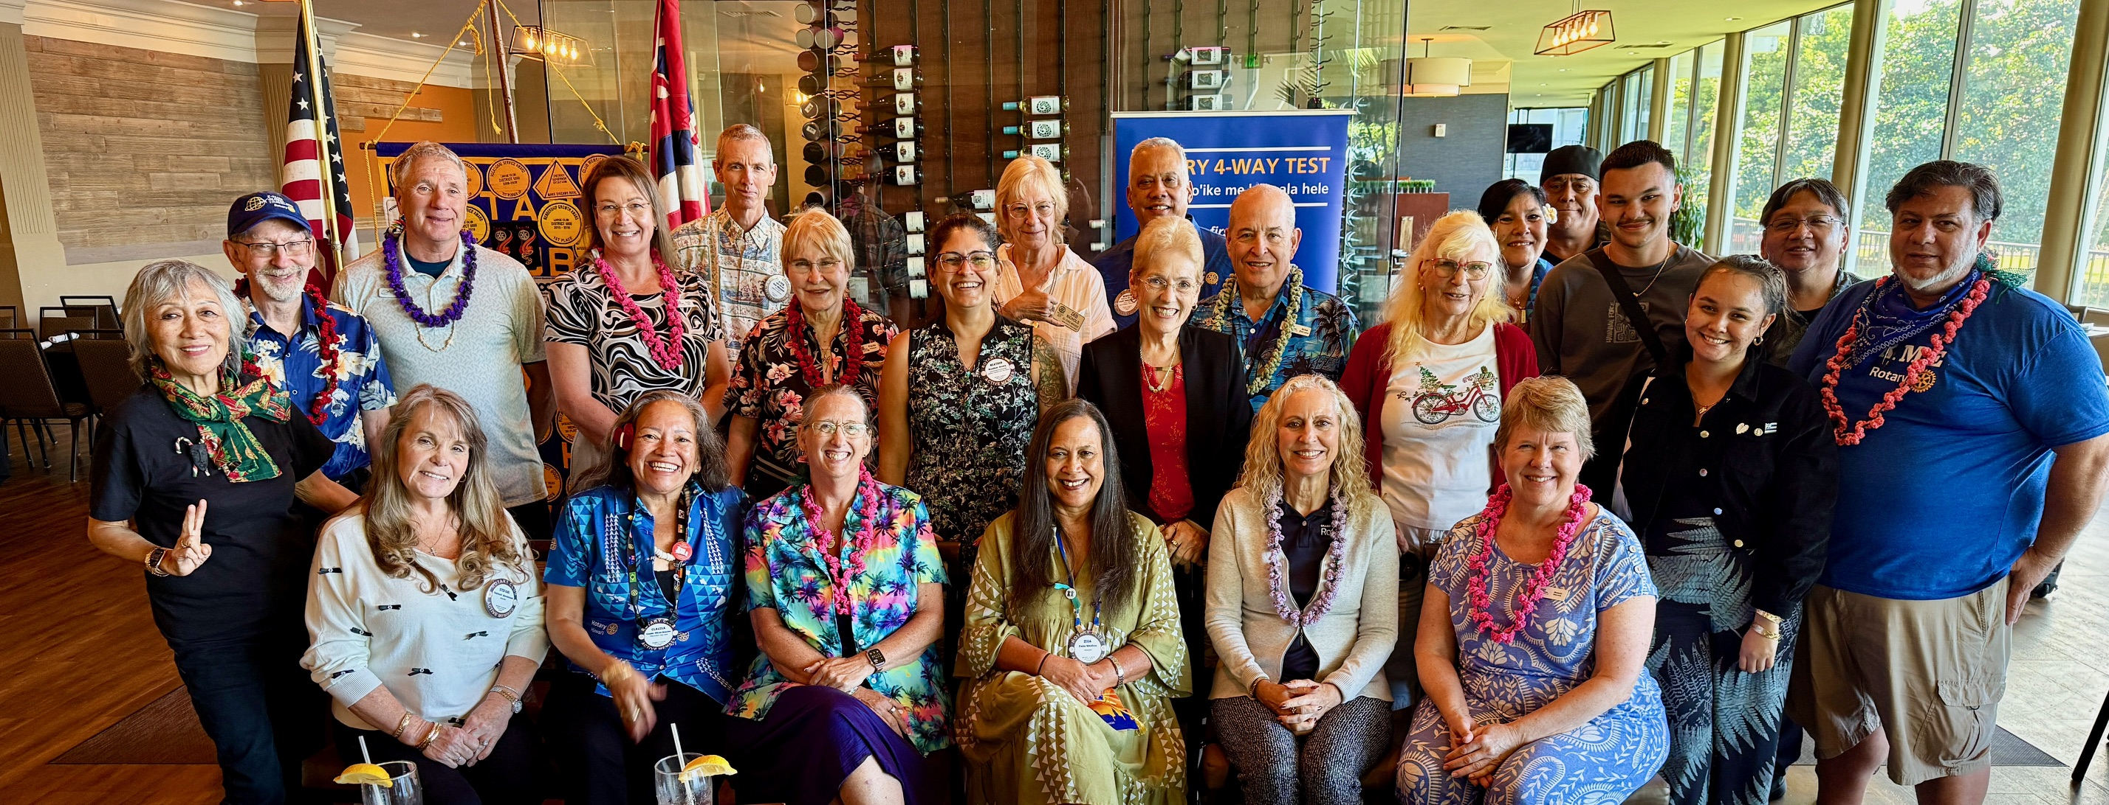
CRITICAL CLUB INFRASTRUCTURE
THE IMPORTANT ROLE OF THE CLUB BOARD
Title Page Option

Slide 3
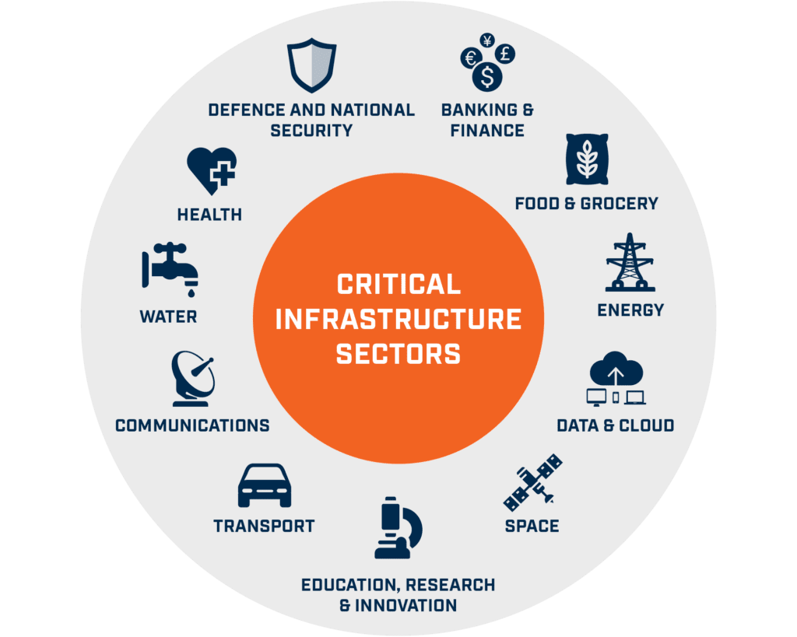
subhead
INFRASTRUCTURE DETERMINES QUALITY OF LIFE

Slide 4
DEVELOPING CLUB INFRASTRUCTURE
A Current Action Plan
Engaged and Active Board
An Enclusive Core Group
Leadership Mentors
Active and Consistent Communication
Active and Predictable Calendar
Systems and Processes for Engagement and Learning
Leadership Line Development
Focus on Positive Member Experience
Members are committed to the long term growth and survival of the club.

Slide 5
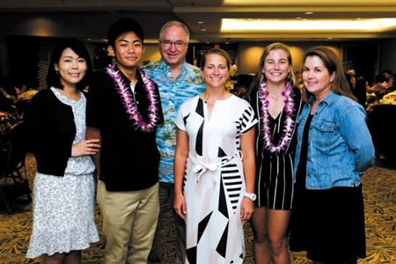

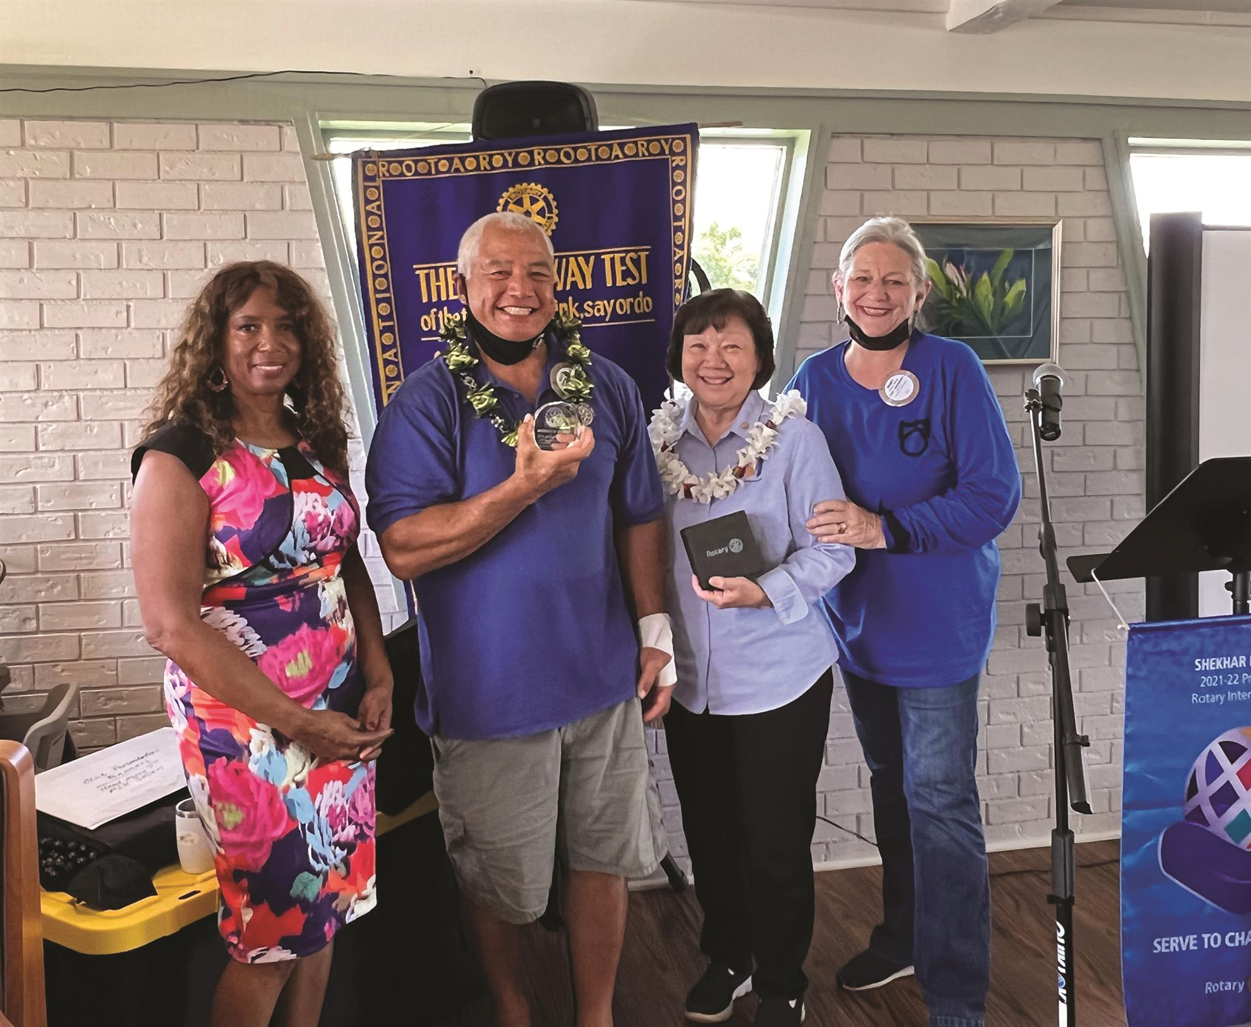


ROTARY CLUBS NEED SUSTAINABLE INFRASTRUCTURE
Title Page Option

Slide 6


1. Current action plan
WHAT ARE WE GOING TO DO?
HOW ARE WE GOING TO DO IT?
WHO IS GOING TO DO IT?
WHEN ARE WE GOING TO DO IT?
USE AI TECHNOLOGY TO HELP

Slide 7

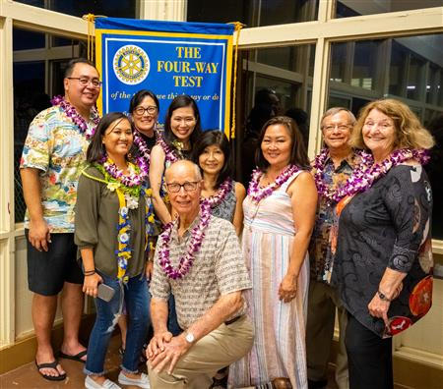

2. An engaged board
REPRESENT YOUR CLUB MEMBERS
FOLLOW THE CLUB BY-LAWS AND ROTARY CONSTITUTION
BE ACCOUNTABLE FOR THE STRATEGIC/ACTION PLAN
CREATE A SAFE SPACE FOR YOUR MEMBERS TO GROWN AND LEARN

Slide 8

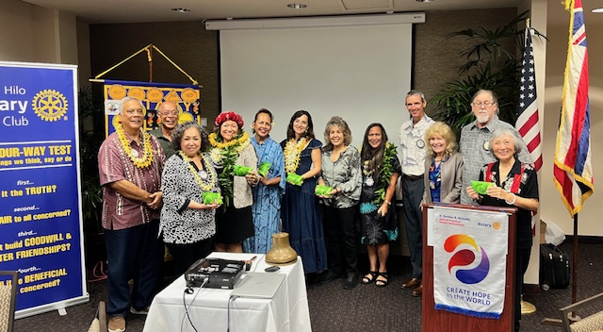
3. inclusive core group
An inclusive core group of members will determine the “Club Culture”, this group is often the members who have made a commitment to Rotary for Life.

Slide 9
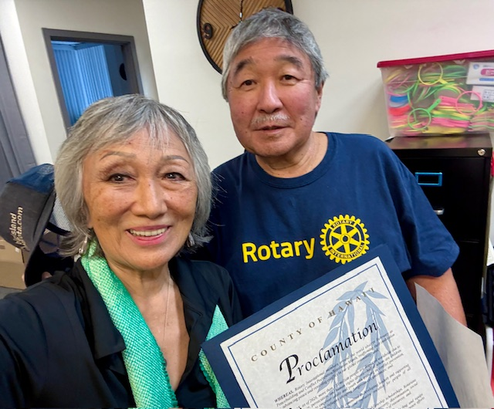
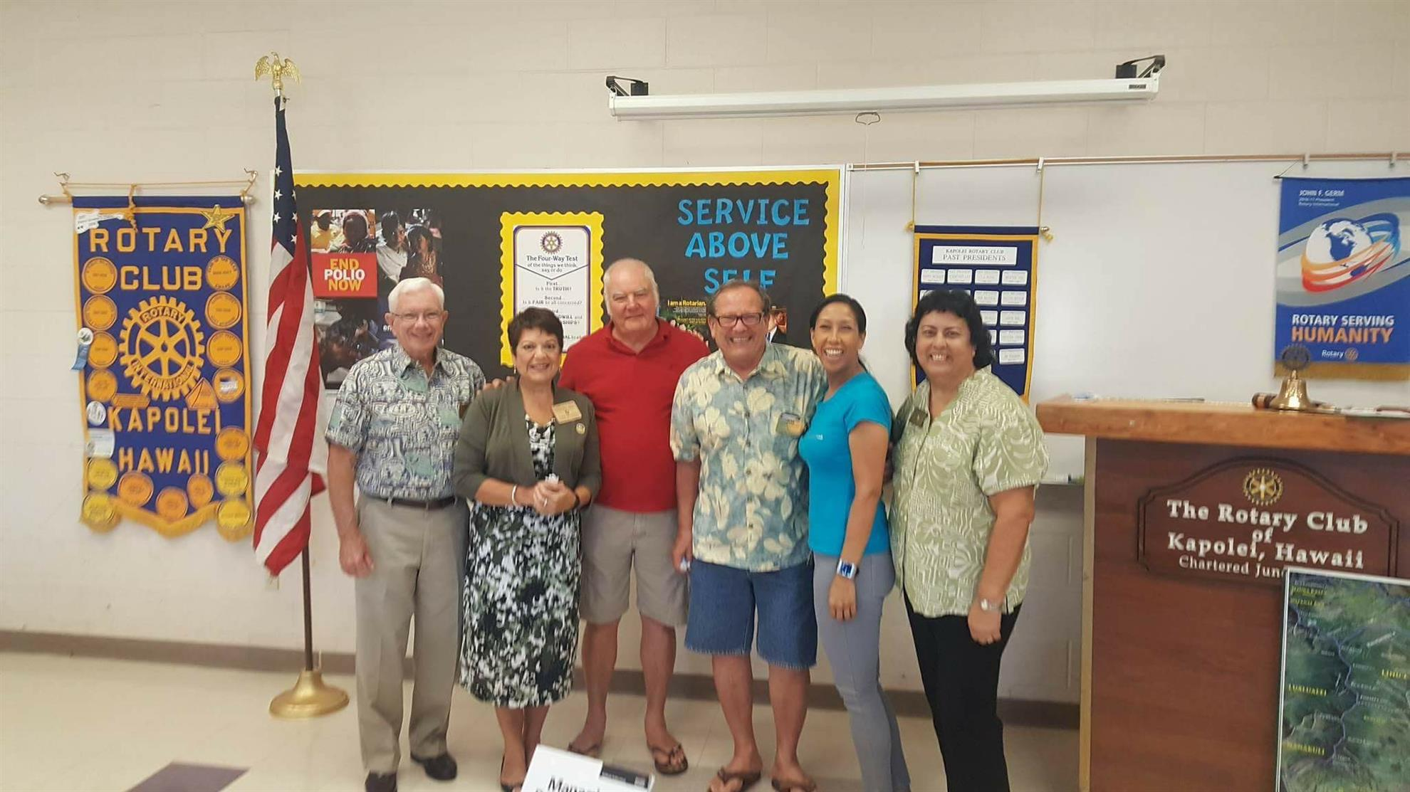
4. Leadership mentors
NEW POSITION THIS YEAR: CHIEF OF STAFF

Slide 10

5. Active and CONSISTENT communication
A RELIABLE WAY TO COMMUNICATE REGULARLY WITH CLUB MEMBERS INCLUDING CURRENT WEBSITE AND SOCIAL MEDIA

Slide 11
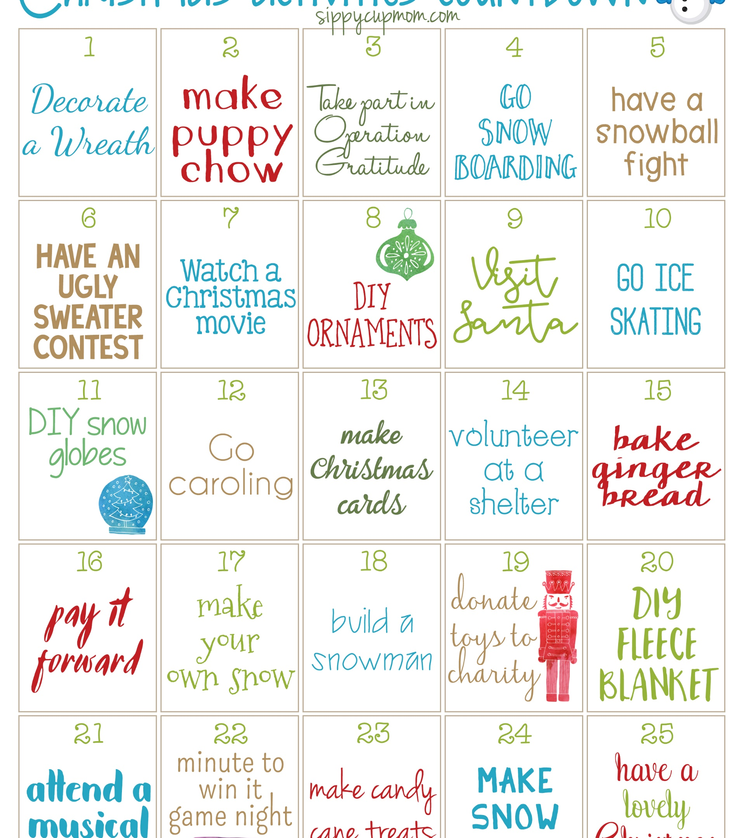
6. Active AND PREDICTABLE calendar
An active calendar drives activity in a club and helps to members to plan engagement

Slide 12




7. Systems and processes for engagement and learning
Systems and processes to help new and existing members to learn and engage quickly in club activities.

Slide 13
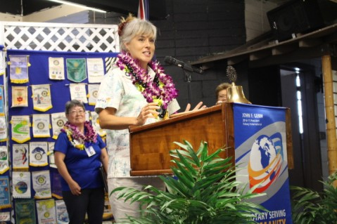
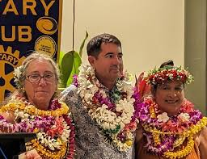

8. Leadership line development
CREATE INFRASTRUCTURE AND SUPPORT FOR PRESENT AND FUTURE CLUB LEADERSHIP

Slide 14
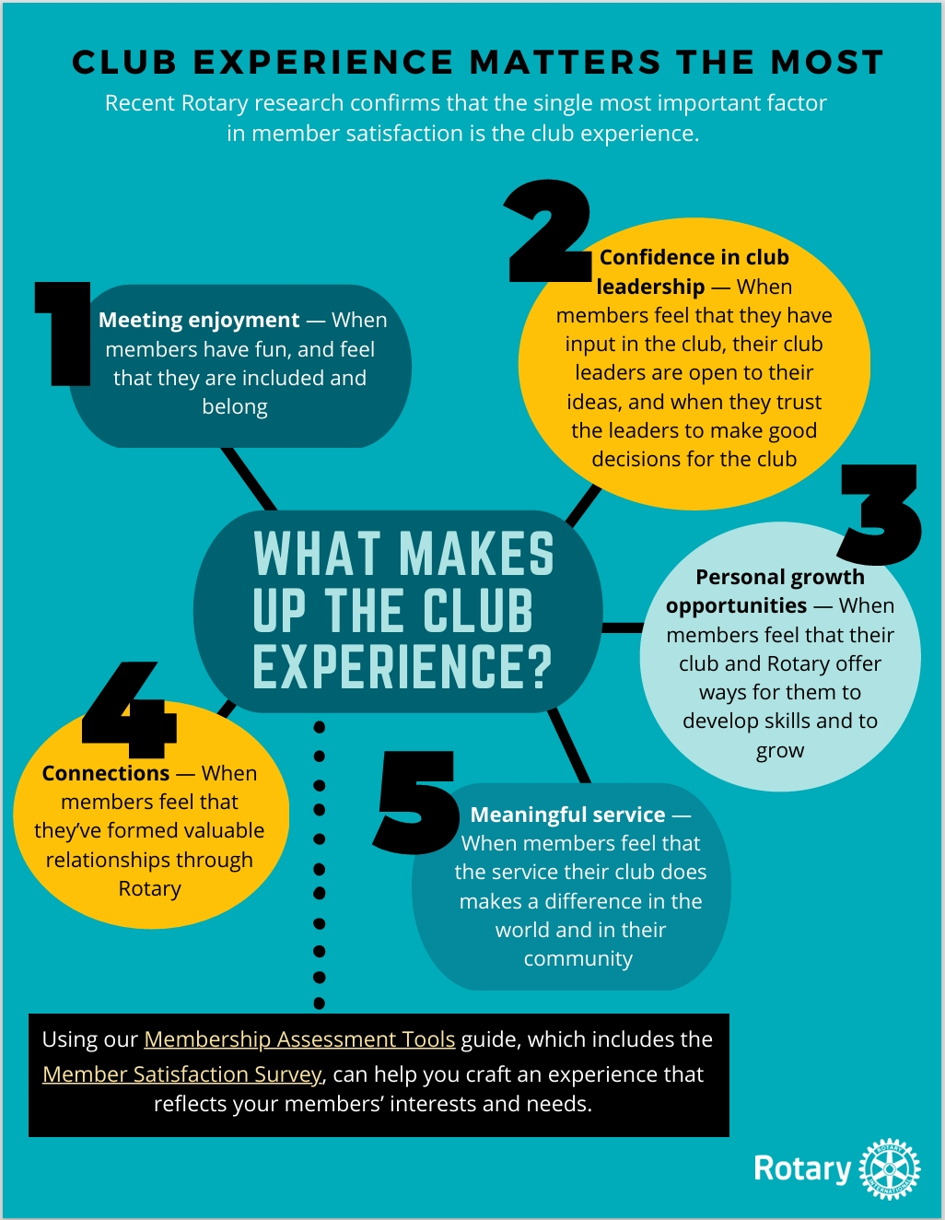
9. FOCUS ON POSITIVE MEMBER EXPERIENCE
Title Page Option

Slide 15
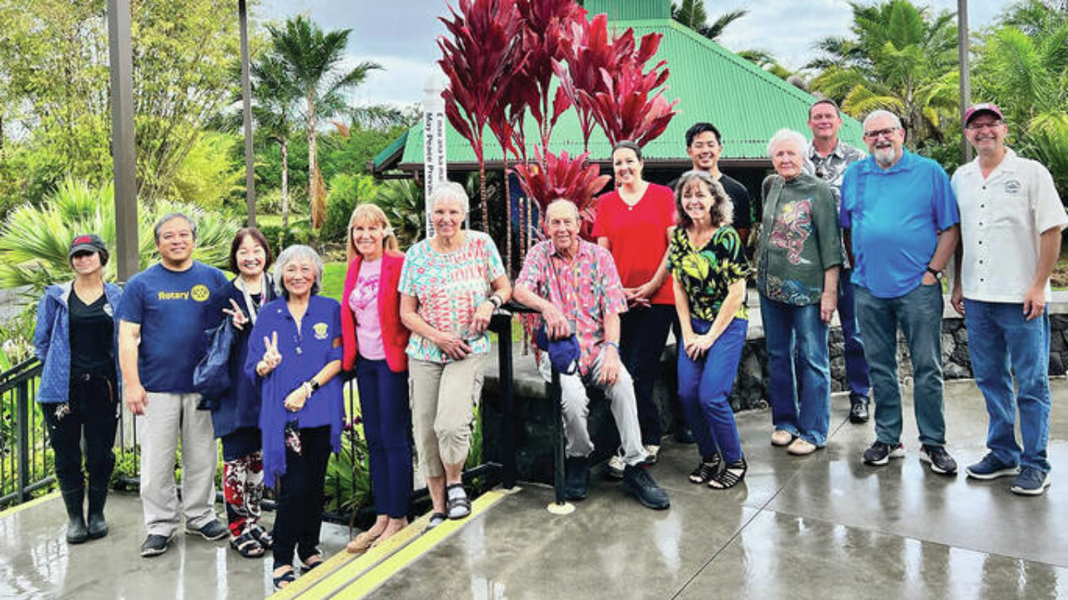

10. Members committed to the clubʻs future
ACKNOWLEDGE YOUR LIFE TIME MEMBERS

Slide 16
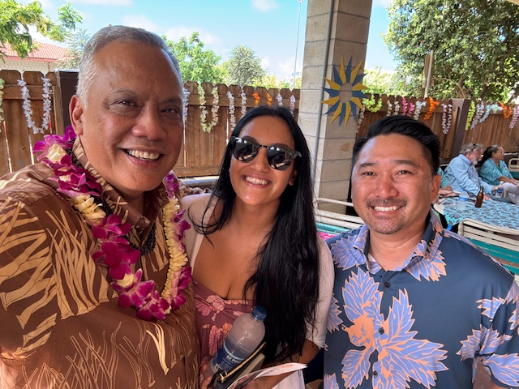
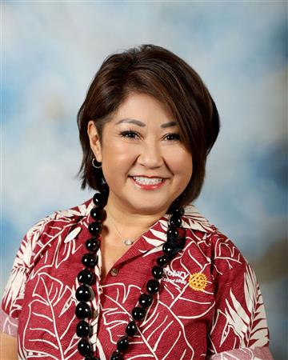
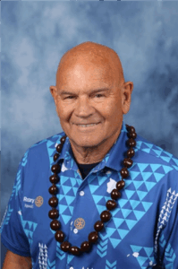
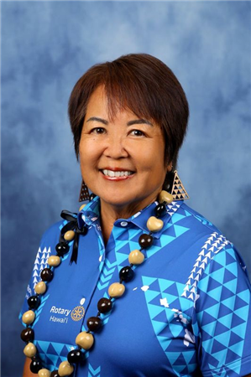
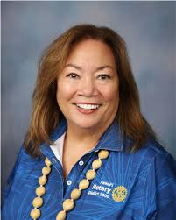
ASSISTANT GOVERNOR “WORKING GROUPS” WILL HELP CLUBS DEVELOP AND SUSTAIN
Title Page Option

Slide 17
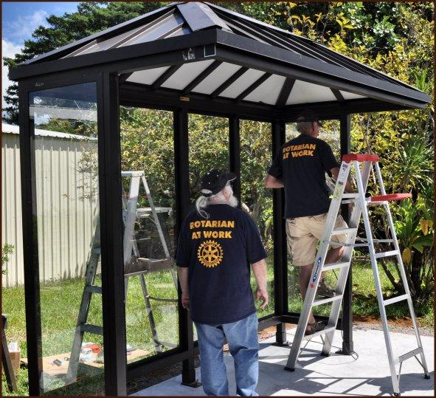

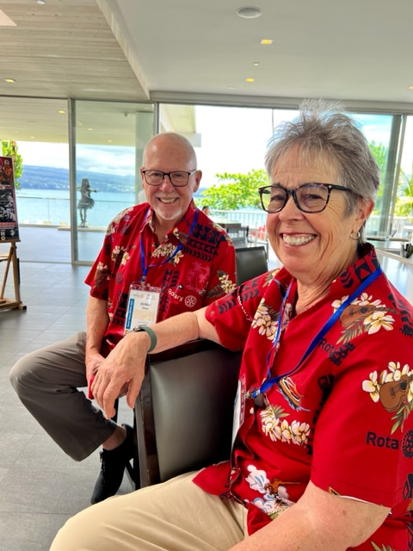

THE CLUB BOARD BUILDS INFRASTRUCTURE
INFRASTRUCTURE AND LEADERSHIP
Title Page Option

Slide 18
QUESTIONS

Slide 19
Rotary Club Board Forum
May 16, 2026
Title Page Option

Slide 20
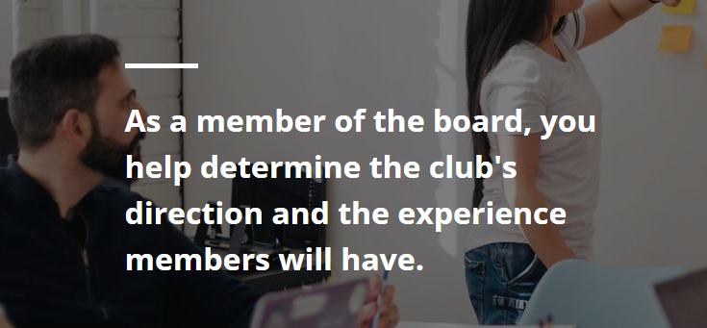

Slide 21
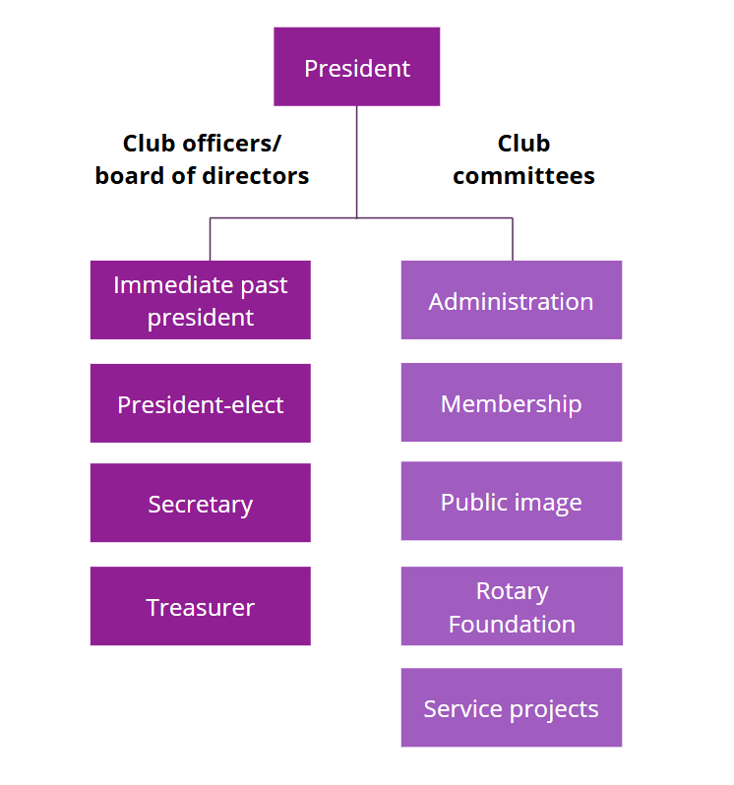

Slide 22

The Four Elements of Effective Clubs
Effective Clubs are able to
Sustain
and
Grow Membership
Implement
Successful
Service
Projects
Support
the
Rotary
Foundation
Develop Club Leaders
to Serve
Efficient Board and Club Administration
Foundation of Fellowship and Service
Notes:
By having an effective board, the club will be able to grow membership, execute successful projects, support the Foundation and develop leaders. By developing leaders, you have more hands to do Rotary business, but also have a succession plan to sustain the club.

Slide 23

Effective board performance
Composition – got the right people
Strategic plan – where are you going
The road map – does everyone know where you’re going
Effectiveness – everyone doing their job
Shared vision – work together
Notes:
What skills do you need on the board? An effective board is one that aligns strategy, governance, and oversight to drive long-term organizational value while fostering accountability, collaboration, and continuous improvement.

Slide 24





How is the board working?

Slide 25
Fiduciary Responsibility
Financial Controls
  Separation of duties
  Filing tax reports on time (IRS and State General Excise Tax)
  Pay bills on time
Youth Protection
Diversity, Equity and Inclusion
Harassment Policy
Stewardship of Grant Funds
Governing documents are your guides
Notes:
Contingency plan

Slide 26
Purpose of governing documents
It is the “law” of the club
Explains the purpose and structure of the club
Contains fundamental principals
Provides consistency
Recommended Constitution and By-Laws can be found at: https://my.rotary.org/en/learning-reference/about-rotary/governance-documents

Slide 27
Club Constitution
Article 11 Directors and Officers and Committees
Section 1 — Governing Body. The governing body of this club is the board, as provided in the bylaws.
Section 2 — Authority. The board has general control over all officers and committees and, for good cause, may declare any office vacant
Section 3 — Board Action Final. In all club matters, the decision of the board is final, subject only to an appeal to the club

Slide 28
Constitution highlights
Meetings- hold regular meetings, at least twice monthly
The board may cancel up to four regular meetings a year for causes not listed (holiday, member death, epidemic, disaster, armed conflict) but may not cancel more than three consecutive meetings.
Annual meeting to elect officer before December 31
Board written minutes available within 60 days
Section 2 —Diverse Club Membership. This club’s membership should represent a cross section of the businesses, professions, occupations, and civic organizations in its community, including age, gender, and ethnic diversity.

Slide 29
Board Meetings

Slide 30
Tips for Good Board Meetings
Have an agenda
Start and end the meeting on time
Keep the discussion on track
Encourage everyone to participate
Accomplish the meeting’s purpose
Notes:
Important to run meetings effectively, with no time waster. The chair is responsible for facilitating the meeting.
Don’t delay the start of meetings. Don’t let someone dominate the discussion or have it wander off the subject.
A good practice is to have time limits on the agenda and the presenter knows how much time they have. Can have reports sent ahead of time, which will help the secretary too. Table any discussions that may take more time to discuss or send to a committee to iron it out.

Slide 31
Time Management
What do you need to do? Goals and priorities
What method works best? Write it down
How much time do you have? Minute by minute?
Schedule, delegate, don’t procrastinate, avoid distractions
Stay healthy – mentally and physically!
Notes:
When you have a club, you have members, their families and work schedules. To reduce stress and achieve goals, When everyone

Slide 32
Robert’s Rules of Order
 | ROBERT'S RULES CHART OF MOTIONS
TO | You say | Interrupt | Second | Debatable | Amendable | Vote
 |  | Speaker | Needed |  |  | Needed
Introduce business (a main motion) | "I move that . . ." | no | yes | yes | yes | majority
Amend a motion | "I move to amend this motion. .." | no | yes | yes | yes | majority
Request information | “Point of information" | yes | no | no | no | none
Adjourn | "I move that we adjourn" | no | yes | no | no | majority
Recess | "I move that we recess until . . " | no | yes | no | yes | majority
Complain about noise, room temp | "Point of privilege" | yes | no | no | no | Chair
 |  |  |  |  |  | decides
Suspend further consideration of | "I move that we table it" | no | yes | no | no | majority
End debate | "I move the previous question" | no | yes | no | no | 2/3
Postpone consideration of | "I move that we postpone this matter until… | no | yes | yes | yes | majority
Notes:
Same as parliamentary procedures. Basically, someone makes a motion, another seconds it and then there is discussion before the vote. Remember that a motion needs a 2nd. If no 2nd, motion dies. And remember to call for the vote.

Slide 33
Rules of Procedure
Majority rules
Minority has the right to be heard
Helps to guide the discussion
Notes:
Chairman is not a dictator. They are there to guide the discussion and help the group accomplish its purpose

Slide 34
Club Assemblies
3 times a year to:
  have open discussion about concerns
  Plan/update club activities
  open forum for members to bring up issues
Last one of the year is for the incoming board:
  to plan events, projects, activities
  develop of update the strategic plan
Notes:
Many of you are having strategic planning meeting or retreats to talk about club operations and plans for the upcoming year. You may want to dedicate a chunk of time to do this, not just 1 hour at a club meeting. Exchange ideas, improve communication

Slide 35
Meaningful club assemblies
Communication : Talk about project ideas or updates about current projects
Feedback: What members like about the club and what needs to change
Inclusive: Ask for input on the club's goals and strategic plan, and try to build consensus
Engagement: Encourage participation in Rotary and Rotary Foundation programs
Recognition: Celebrate the club's and its members' achievements

Slide 36
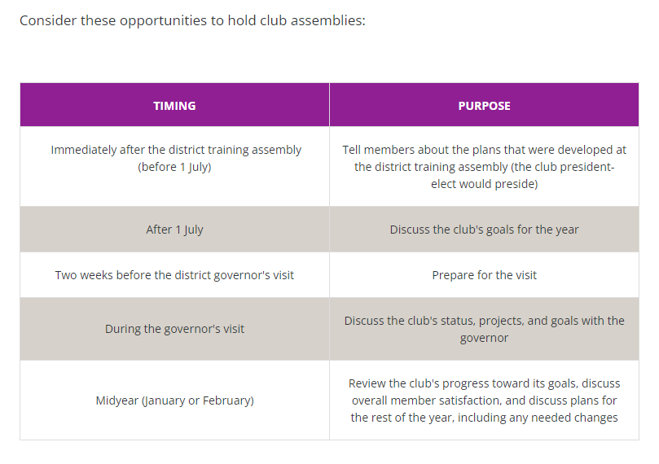
Title Page Option
Notes:
A club assembly should inspire and engage all members. Most clubs have four to six assemblies each year, though some clubs hold them every month.
Work together to plan assemblies that are meaningful to members as well as to club leaders, and encourage all members to attend. You might use the assemblies to:
Talk about project ideas or update members about current projects. Discuss what members like about the club and what they want to change. Ask for input on the club's goals and strategic plan, and try to build consensus. Update people about committee activities and initiatives.

Slide 37
QUESTIONS

Slide 38

Mahalo!

