Slide 1
Rotary Club Directors
Legal Duties

Slide 2
Legal Status of Rotary Clubs
Rotary International designates Clubs in the United States to be non-profit entities, IRS 501(c)(4) Social Welfare Organizations
Rotary Clubs in Hawaii are nonprofit organizations governed by Hawaii’s Non-Corporation Act, HRS §414D
HRS Chapter 414D establishes legal guidelines for non-profit Corporations, but club Articles and Bylaws can customize the law for each club

Slide 3
Hawaii’s Non-Profit Corporations Act
§414D-149 General standards for directors. (a) A director shall discharge the director's duties as a director, including the director's duties as a member of a committee:
(1) In good faith;
(2) In a manner that is consistent with the director's duty of loyalty to the corporation;
(3) With the care an ordinarily prudent person in a like position would exercise under similar circumstances; and
(4) In a manner the director reasonably believes to be in the best interests of the corporation.

Slide 4
Fiduciary Duties
Nonprofit boards, members are responsible for managing the organization’s interests.
They are bound to legal and ethical obligations, thus protecting the nonprofit from abuses of power or conflicts of interest.
  Duty of Care
  Duty of Loyalty

Slide 5
Duty of Care
Duty of care means that board directors must give the same care and concern to their board responsibilities as any prudent and ordinary person would manage their personal matters.
At a minimum, the following fiduciary responsibilities fall under this duty:
Participating actively in board meetings
Serving on at least one committee
Working to advance the nonprofit’s mission and goals
Practicing oversight of programs and activities
Choosing a qualified executive director
Monitoring the budget and financial reports
Questioning expenditures
Engaging in strategic planning and goal setting

Slide 6
Duty of Loyalty
Duty of loyalty means that board directors must place the interests of the organization ahead of their own interests at all times. Board members are required to publicly disclose any conflicts of interest and not use board service as a means for personal or commercial gain.

Slide 7
Thank you!

Slide 8
Rotary club boards
November 23, 2024

Slide 9





How is the board working?
Notes:
How’s it going? Last time we met in July, we talked about effective boards, roles and responsibilities and running board meetings. Did that training help? If not, what can re revisit? Now that we are in the second quarter, do you need a course correction or the plan is still good to charge ahead?

Slide 10
Purpose of the board
Provide guidance for the club to thrive
Connect people to each other, to the community and to Rotary International
Is responsible for overseeing the general direction of the club
Represents the interests of the members
Notes:
We talked last meeting about the purpose of the board and different structures and that the board was the governing body of the club. As the board starts working together, remember to start with the meeting of the minds to have that shared vision for the good of the club.

Slide 11
Annual club meeting
Constitution Section 2 — Annual Meeting.
    An annual meeting to elect officers
    Present a mid-year report
    Current year income and expenses
    Financial report on the previous year
    Shall be held before 31 December, as provided in the bylaws
Notes:
You want to make sure the finances are in order and you are following the budget. The financial statement should be reviewed at board meetings and kept up to date.

Slide 12
Election of officers
Section 5 — Election of Officers.
(a) Terms of Officers other than President. Each officer shall be elected as provided in the bylaws. Except for the president, each officer takes office on 1 July immediately following election and serves for the term of office or until a successor is elected and qualified.
(b) Term of President.
  A president shall be elected at least 18 months but not more than two years before the day of taking office as president. The nominee becomes president-elect on 1 July in the year before taking office as president. The president takes office on 1 July and serves a period of one year. When a successor is not elected, the current president’s term is extended for up to one year.
Notes:
Check your by-laws, but for Rotary’s recommendation, is this
This December, you would be electing the President for 2025-2026. How do you elect officers?

Slide 13
Section 4 — Officers.
The club officers shall be:
a president
the immediate past president
a president-elect
a secretary
a treasurer
may also include one or more vice-presidents, all of whom shall be members of the board
may also include a sergeant-at-arms, who may be a member of the board, if the bylaws provide.
Each officer and director shall be a member in good standing of this club.
Notes:
Should include the Club Learning Facilitator on the board to help with the training and operations

Slide 14
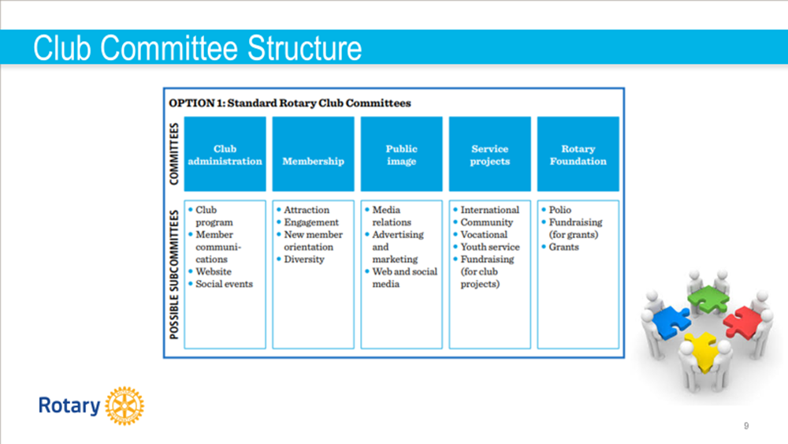

Slide 15
Succession planning
What’s the vision? Where do you want to be?
What skills are needed to lead the next generation?
What do you need to do to get to the next level?
What training, mentoring can you provide?
Notes:
Skills: collaborating, bring people together, agile, innovative, forward thinking, growth mindset, accountable, optimistic.

Slide 16



Ways you are finding, attracting, growing and retaining
future leaders
In your Club?
Title Page Option

Slide 17

Develop and Take Action
Title Page Option

Slide 18
QUESTIONS

