Slide 1
Rotary club boards
May 2023

Slide 2

Rotary International Vision Statement
Notes:
Rotary adopted this vision statement in June of 2017 as a first step in our 2019-2022 strategic plan. The new RI Strategic Plan was approved in 2019 and went into effect as of 1 July 2019.

Slide 3
What is the vision for your club?
Vibrant?
Growing?
Fellowship?
Good projects?
People of Action?
Notes:
What do you want your club to be? How do you get there if it isn’t there yet? Do you have a strategic plan?

Slide 4
Purpose of the board
Provide guidance for the club to thrive
Connect people to each other, to the community and to Rotary International
Is responsible for overseeing the general direction of the club
Represents the interests of the members

Slide 5
Fiduciary Responsibility
Financial Controls
  Separation of duties
  Filing tax reports on time (IRS and State General Excise Tax)
  Pay bills on time
Youth Protection
Diversity, Equity and Inclusion
Harassment Policy
Stewardship of Grant Funds
Governing documents are your guides

Slide 6
Purpose of governing documents
It is the “law” of the club
Explains the purpose and structure of the club
Contains fundamental principals
Provides consistency
Recommended Constitution and By-Laws can be found at: https://my.rotary.org/en/learning-reference/about-rotary/governance-documents

Slide 7
Club Constitution
Article 11 Directors and Officers and Committees
Section 1 — Governing Body. The governing body of this club is the board, as provided in the bylaws.
Section 2 — Authority. The board has general control over all officers and committees and, for good cause, may declare any office vacant
Section 3 — Board Action Final. In all club matters, the decision of the board is final, subject only to an appeal to the club

Slide 8
Constitution highlights
Meetings- hold regular meetings, at least twice monthly
The board may cancel up to four regular meetings a year for causes not listed (holiday, member death, epidemic, disaster, armed conflict) but may not cancel more than three consecutive meetings.
Annual meeting to elect officer before December 31
Board written minutes available within 60 days
Section 2 —Diverse Club Membership. This club’s membership should represent a cross section of the businesses, professions, occupations, and civic organizations in its community, including age, gender, and ethnic diversity.

Slide 9
By-Laws Highlights
Article 10 Method of Electing Members
Section 1 — A member proposes a candidate for membership to the board and/or the membership committee, or another club proposes one of its transferring or former members.
Section 2 — The board approves or rejects the candidate’s membership within 30 days and notifies the proposing member of its decision.
Section 3 — If the board approves the candidate’s membership, the prospective member is invited to join the club.
Notes:
The recommended By-Laws does not have the 7 day challenge period from the club members. The club can opt to keep the method of admitting members, but you should be consistent. Anyone have someone who wanted to join, but there were members who did not feel that person didn’t fit? What did you do?

Slide 10

The Four Elements of Effective Clubs
Effective Clubs are able to
Sustain
and
Grow Membership
Implement
Successful
Service
Projects
Support
the
Rotary
Foundation
Develop Club Leaders
to Serve
Efficient Board and Club Administration
Foundation of Fellowship and Service
Notes:
By having an effective board, the club will be able to grow membership, execute successful projects, support the Foundation and develop leaders. By developing leaders, you have more hands to do Rotary business, but also have a succession plan to sustain the club.

Slide 11

Improve board performance
Composition – got the right people
Strategic plan – where are you going
The road map – does everyone know where you’re going
Effectiveness – everyone doing their job
Shared vision – work together
Notes:
What skills do you need on the board?

Slide 12
Club Structure
Organized in the Club Leadership Plan
  President
  President-Elect
  Secretary
  Treasurer
  Directors/Committees
Notes:
The Legislative Council has suggested that clubs reorganize to align with the RI and District Leadership Plans.
This is not mandatory. Clubs can opt to not reorganize but if they do change to the club leadership plan, the club will have to make sure that the clubs by-laws and other documents are revised too.
The Club Leadership Plan encourages and utilizes the following best practices of Rotary clubs worldwide:
The CLP follows on the success of the District Leadership Plan.
Develop long-range goals that address the elements of an effective club.
Set annual goals that support long-range goals.
Make sure that all club members feel involved and informed.
Keep the lines of communication open, both in the club and with the district.
Ensure continuity in leadership from year to year.
Customize the bylaws to reflect club operations.
Provide regular fellowship opportunities.
Actively involve all club members.
Offer regular and consistent training

Slide 13
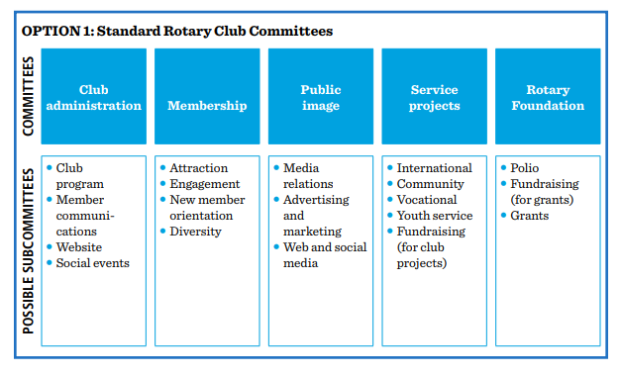

Club Committee Structure

Slide 14
Tips for Good Board Meetings
Have an agenda
Start and end the meeting on time
Keep the discussion on track
Encourage everyone to participate
Accomplish the meeting’s purpose
Notes:
Important to run meetings effectively, with no time waster. The chair is responsible for facilitating the meeting.
Don’t delay the start of meetings. Don’t let someone dominate the discussion or have it wander off the subject.
A good practice is to have time limits on the agenda and the presenter knows how much time they have. Can have reports sent ahead of time, which will help the secretary too. Table any discussions that may take more time to discuss or send to a committee to iron it out.

Slide 15
Rules of Procedure
Majority rules
Minority has the right to be heard
Notes:
Chairman is not a dictator. They are there to guide the discussion and help the group accomplish its purpose

Slide 16
Prepare for the upcoming year
Budget
Calendar
  Board Meetings
  Projects
  Events
Transition
  Bank accounts
  Access to accounts, websites, etc

Slide 17
Club Assemblies
3 times a year to:
  have open discussion about concerns
  Plan/update club activities
  open forum for members to bring up issues
Last one of the year is for the incoming board:
  to plan events, projects, activities
  develop of update the strategic plan
Notes:
Many of you are having strategic planning meeting or retreats to talk about club operations and plans for the upcoming year. You may want to dedicate a chunk of time to do this, not just 1 hour at a club meeting. Exchange ideas, improve communication

Slide 18
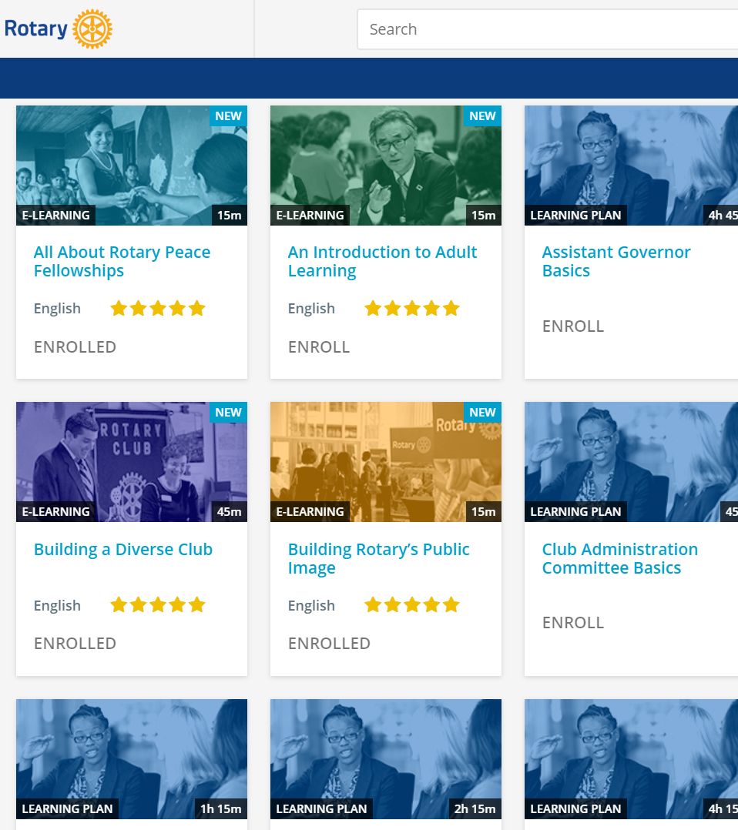
subhead
Learning Center
Take advantage of a wealth of training materials designed to help you learn new skills and become more successful in what you do.
Notes:
The RI Learning & Development team have done an excellent job in creating the online Learning Center. Many of the manuals you may be familiar with have been transformed into online, interactive courses. Take them at your own speed and keep track of your achievements. With more courses being added and updated, there’s something for everyone! If you know of someone who would be good on a committee or in a leadership role, encourage them to sign up for DLA and take courses in the Learning Center.

Slide 19
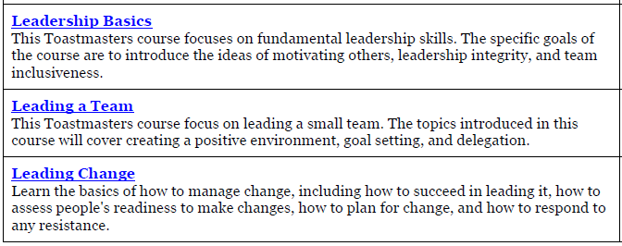
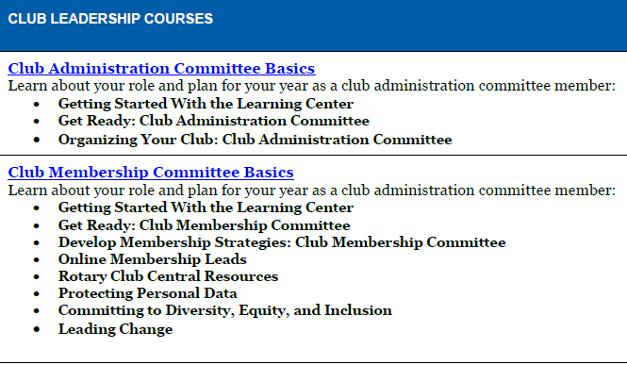
Rotary Learning Center

Slide 20
QUESTIONS

