Slide 1

2023-2024 Rotary Theme
Title Page Option

Slide 2
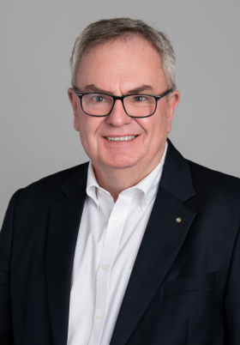
  Classification : Dental Surgery
  Gordon says he looks forward to working with members to build new Rotary clubs and groups. “My vision is that Rotary should exist everywhere in a style to suit everyone who has the desire to be part of us and to help us do good in the world,” he says.
  Gordon describes The Rotary Foundation as “the fuel that provides the energy to do Rotary service.”
  Presidential Initiatives:
    Prioritizing Mental Health
    Building Peace Through Virtual Exchanges
    Empowering Girls
2023-2024 RI President
Gordon McInally
RC of South Queensferry, Scotland

Slide 3
Agenda
Effective Boards – DGND Nancy Cabral, RC of Hilo
Roles and Responsibilities – Lorraine Davis, RC of Hilo Bay
Efficient Board Meetings – Toastmaster Sherry Imamura-Ryan
Strategic Plans- Naomi Masuno, RC of West Honolulu
Breakout rooms – Effective boars
Fiduciary Responsibility – Paul Saito, RC of Honolulu
Next board forum:
  Oct 18 Election, succession planning
  Feb 24 – Conflict resolution, path correction
  June 8 – Transition, lessons learned
  District Learning/Training Assemblies – April 6 and 13

Slide 4
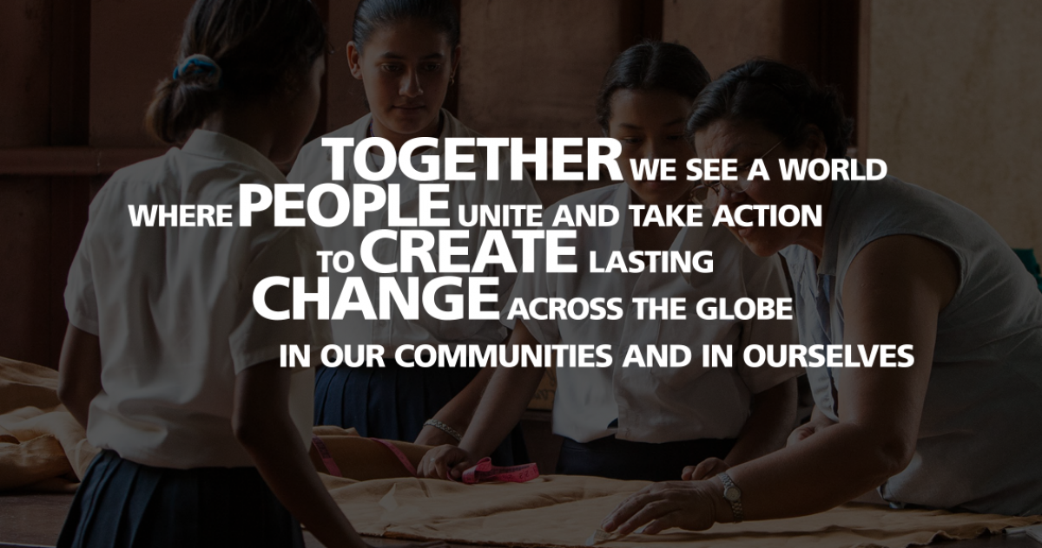
Rotary International Vision Statement
Notes:
Rotary adopted this vision statement in June of 2017 as a first step in our 2019-2022 strategic plan. What is the vision for your club? What do you want the club to be like in 3-5 years? More diverse membership, more meaningful projects? What do you want to accomplish?

Slide 5

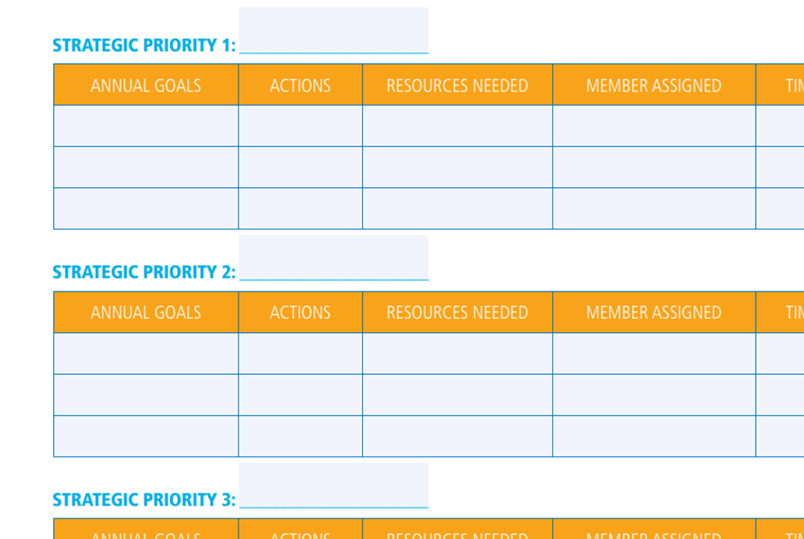
Notes:
Does the club have a strategic plan, with strengths and weaknesses identified and you have shared goals? As a board, you are the keeper of the strategic plan

Slide 6
Purpose of the board
(The Governing Body)
Provide guidance for the club to thrive
Connect people to each other, to the community and to Rotary International
Is responsible for overseeing the general direction of the club
Represents the interests of the members

Slide 7
Governing body (constitution)
Article 11 Directors and Officers and Committees Section 1 — Governing Body. The governing body of this club is the board, as provided in the bylaws.
Section 2 — Authority. The board has general control over all officers and committees and, for good cause, may declare any office vacant.
Section 3 — Board Action Final. In all club matters, the decision of the board is final, subject only to an appeal to the club.

Slide 8
Rotary Happens at the Club!
Recent surveys of our Rotary members reveal a strong conclusion: The Club Experience matters more than anything else. The most important factors for overall Rotary member satisfaction are:
Enjoying club meetings
Confidence in club leadership
Satisfaction with club service
Satisfaction in finding friends
Club’s positive impact in the community
Disengagement is the biggest threat. Disengaged members have not found either friends or business connections through Rotary. Other reasons members leave? "The club doesn’t represent my values” and “lack of community impact” are the top stated reasons.
Notes:
The goal of the board is to have a vibrant club and how do you do that?

Slide 9
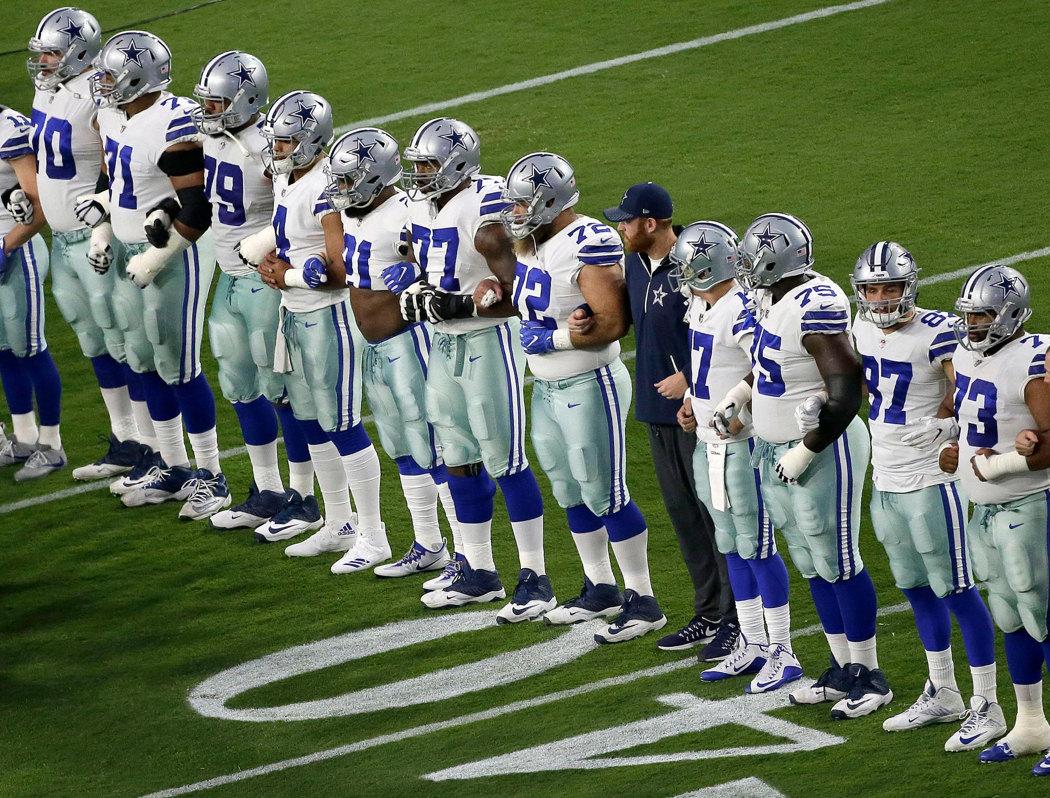
Notes:
As with a football team, there is loyalty through good times and bad, but they stick together for the common goal. The team works together, each player has a specific role, they all protect the quarterback who makes the touchdown for the team. As with a team, there are scouts that look out for potential talent and that’s where developing future leaders come into play.

Slide 10
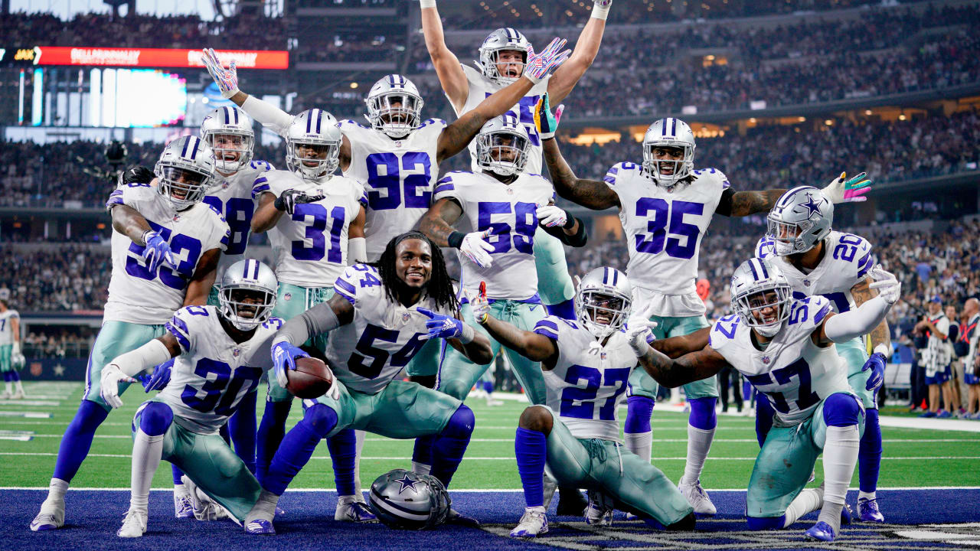
Notes:
Working together, you celebrate the successes as a team. So how do you develop future team players?

Slide 11
Succession planning
Take a human inventory of members. What skills do they have or potentially could have?
Assess the Boards strengths and weaknesses. What do you need?
Assess the Opportunities and Threats: changing demographics, unstable location, funding sources
What is the strategy and action plan to maintain or improve the board to be effective?

Slide 12
Developing future leaders
This is a process that happens over time. Identify potential leaders and help them through their leadership journey
Get members involved in a committee as soon as they join
Raise their Rotary I. Q.: What is Rotary? How does Rotary International and the Club work?
Develop their communication skills: give vocational talks, do presentations and training
Vision: Share Rotary’s and the Club’s vision. What are the long-term goals
Build relationships: by collaboration on projects and committees
Innovation: Ask for new ideas. Adapt and be flexible
Training and Education: Leadership 101, Webinars, Spring Training Assembly, Rotary Learning Center
Read the Rotary Magazine, subscribe to Rotary Newsletters

Slide 13
Breakout session
Discussion in your group:
Is your board effective and if not, what can you do to strengthen the club board and develop leaders?

Slide 14
Checklist
Club Constitution
Club By-Laws
Roles & Responsibilities (Rotary Learning Center)
Budget
Calendar
Communication plan

Slide 15
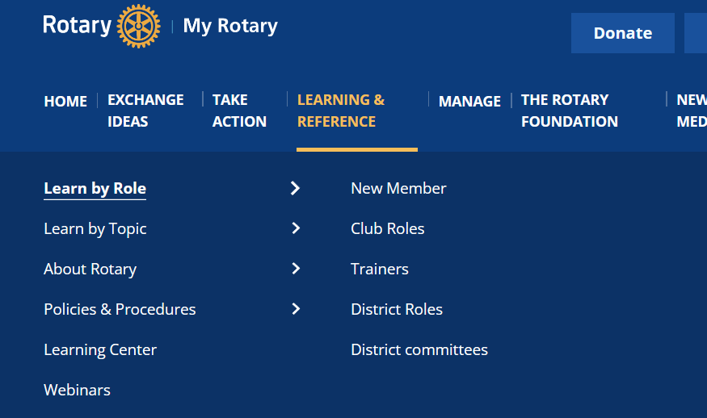
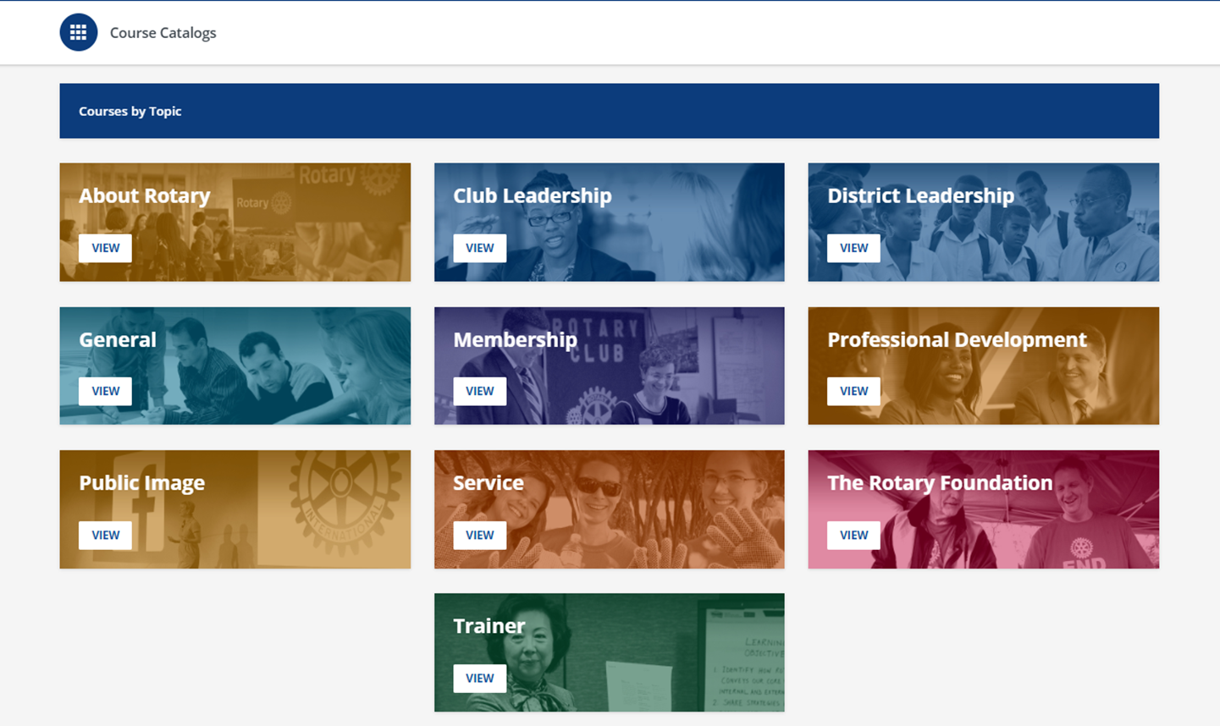
Rotary Learning Center

Slide 16
RESOURCES
Sign in to My Rotary to find resources that can help us make our club more vibrant:
Rotary Club Health Check
Strategic Planning Guide
Rotary Club Central
Member Satisfaction Survey
Online membership courses in the Learning Center
The Brand Center
Introducing New Members to Rotary
Leadership in Action: Your Guide to Starting a Program

Slide 17
QUESTIONS

